Slide 1
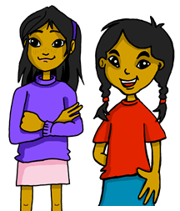
Describing me and others
today
vs.
in general
¿Cómo somos?
¿Cómo estamos?
azul
- To be [state and trait]:
somos vs. estamos
- SSC: consonant-vowel syllables
Notes:
Artwork by Steve Clarke. All additional pictures selected are available under a Creative Commons license, no attribution required.
The frequency rankings for words that occur in this PowerPoint which have been previously introduced in the resources are given in the SOW (excel document) and in the resources that first introduced and formally re-visited those words.
For any other words that occur incidentally in this PowerPoint, frequency rankings will be provided in the notes field wherever possible.
Phonics:
Revisit SSC: casa [106] dos [64] universo [1603] elefante (5000) idea (247) Introduce syllabification: cho-co-la-te (3408) in-te-re-san-te (616)
Vocabulary (new words in bold): somos [ser, 7] estamos [estar, 21] activo [1278] cansado [1818] contento [1949] diferente [293] importante [171] independiente [1177] inteligente [2167] pero [30]
Revisit 1: N/A Revisit 2: grupo [200] favorito [2630] mi [37] tu [53] muy [43] también [49] y [4]
Frequency of unknown words:
clasifica [2729]
Source: Davies, M. and Davies, K. (2018). A frequency dictionary of Spanish: Core vocabulary for learners (2nd ed.). Routledge: London
Source: Davies, M. & Davies, K. (2018). A frequency dictionary of Spanish: Core vocabulary for learners (2nd ed.). Routledge: London

Slide 2
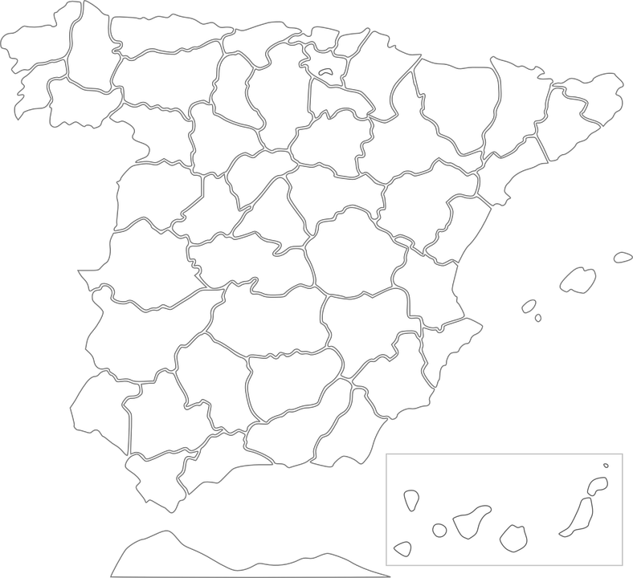
Follow up 1:
Escucha. ¿Cuántas sílabas tiene?
E
Burgos
escuchar
2
E
4
Girona
Pontevedra
4
5
1
1
Salamanca
4
3
2
Madrid
3
2
6
4
Alicante
4
5
3
6
4
2
Tenerife
Notes:
Timing: 5 minutes
Aim: to practise aural syllabification and then transcription of cities in Spain.
Procedure:
Do the example with them (E – ejemplo).
pupils listen to the single word Burgos and write down the number of syllables in it.
Repeat with items 1 – 6.
Click to reveal number answers.
Play the audio again – this time pupils write the names of the cities.
Click to reveal written answers.
Transcript:
E.Burgos
1. Salamanca
2. Tenerife
3. Madrid
4. Pontevedra
5. Girona
6. Alicante

Slide 3
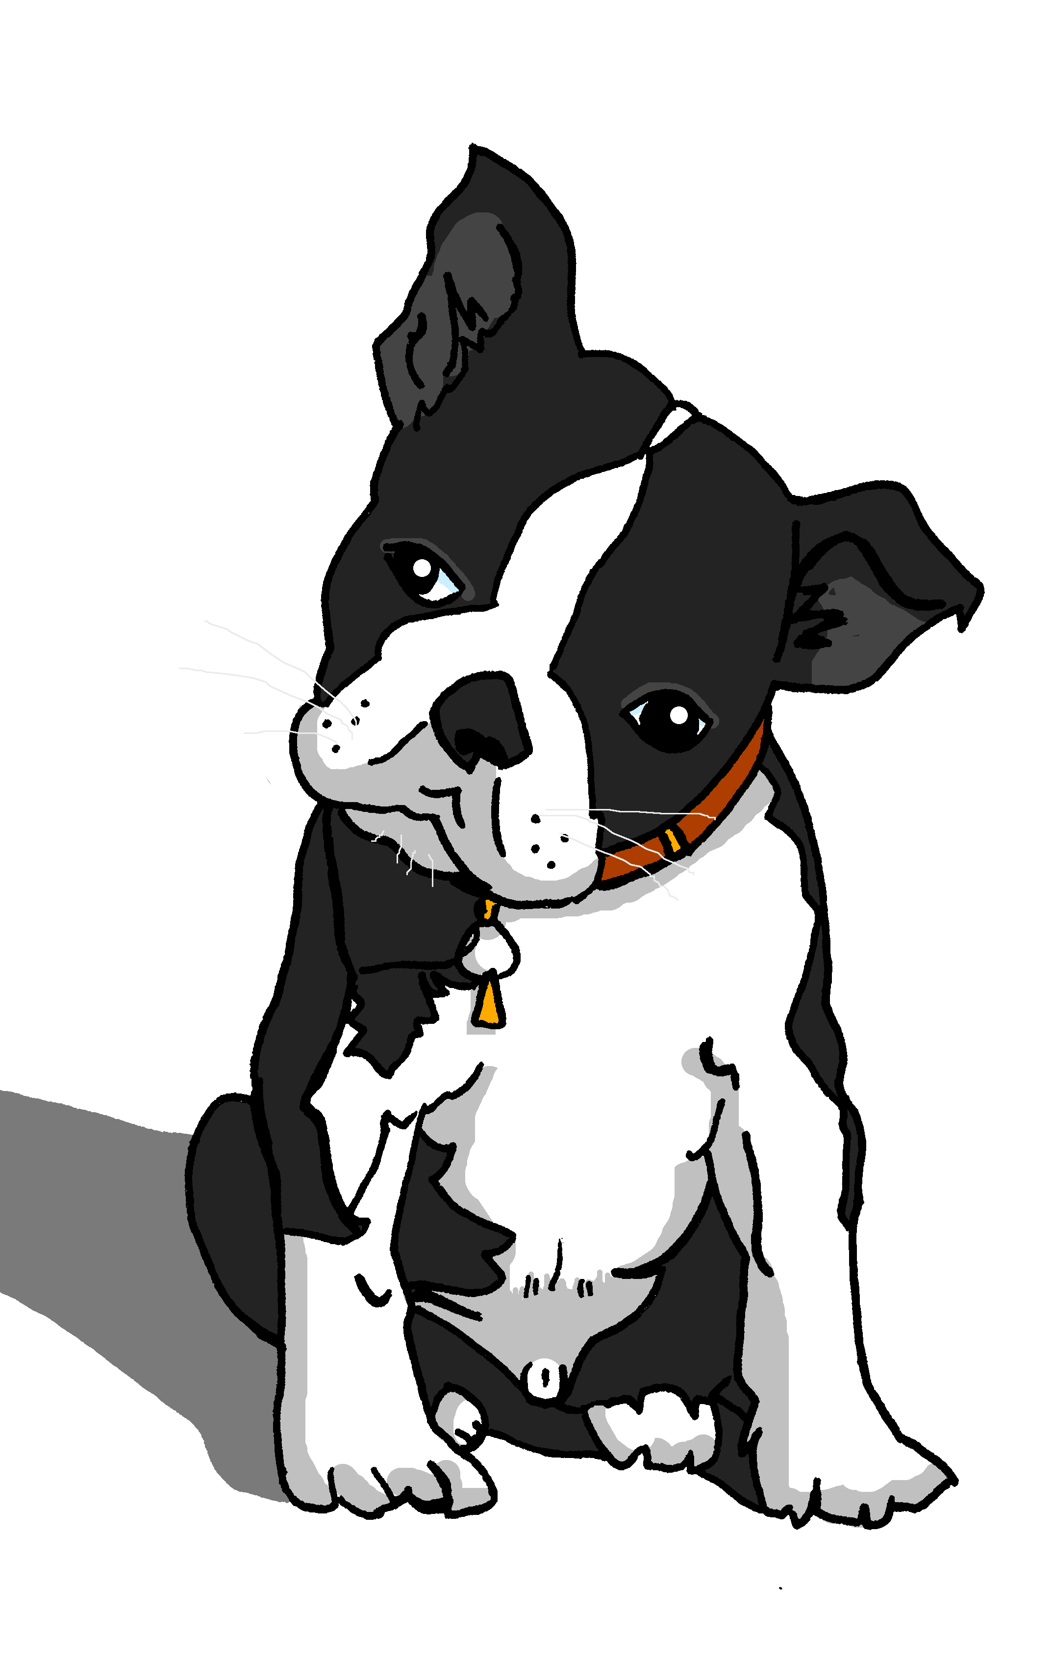
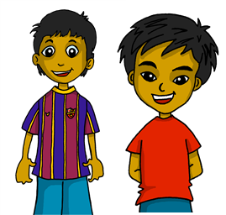
Follow up 2: Gender & number agreement on adjectives
In Spanish we know that adjectives which end in ‘o’ change to end in ‘a’ when the noun described is feminine.
💡 Names are called proper nouns.
Santi está activo.
Manchita está activa.
When we describe more than one masculine noun, the adjective ends in –os.
When we describe more than one feminine noun, the adjective ends in –as.
Estamos contentos.
Estamos contentas.
💡 We is a pronoun, like I, you, s/he, it.
We are (feeling) happy.
We are (feeling) happy.
Notes:
Timing: 10 minutes (three slides) Note: this slide is a quick reminder and is repeated from this week’s lesson.
Aim: to revisit regular adjectival agreement (gender and number) in order use the masculine and feminine plural form of regular adjectives ending in –o, when describing people and animals.
Procedure:
Read the grammar explanation on – Gender and number agreement on adjectives
Elicit English translation for the Spanish examples provided.

Slide 4
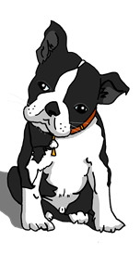
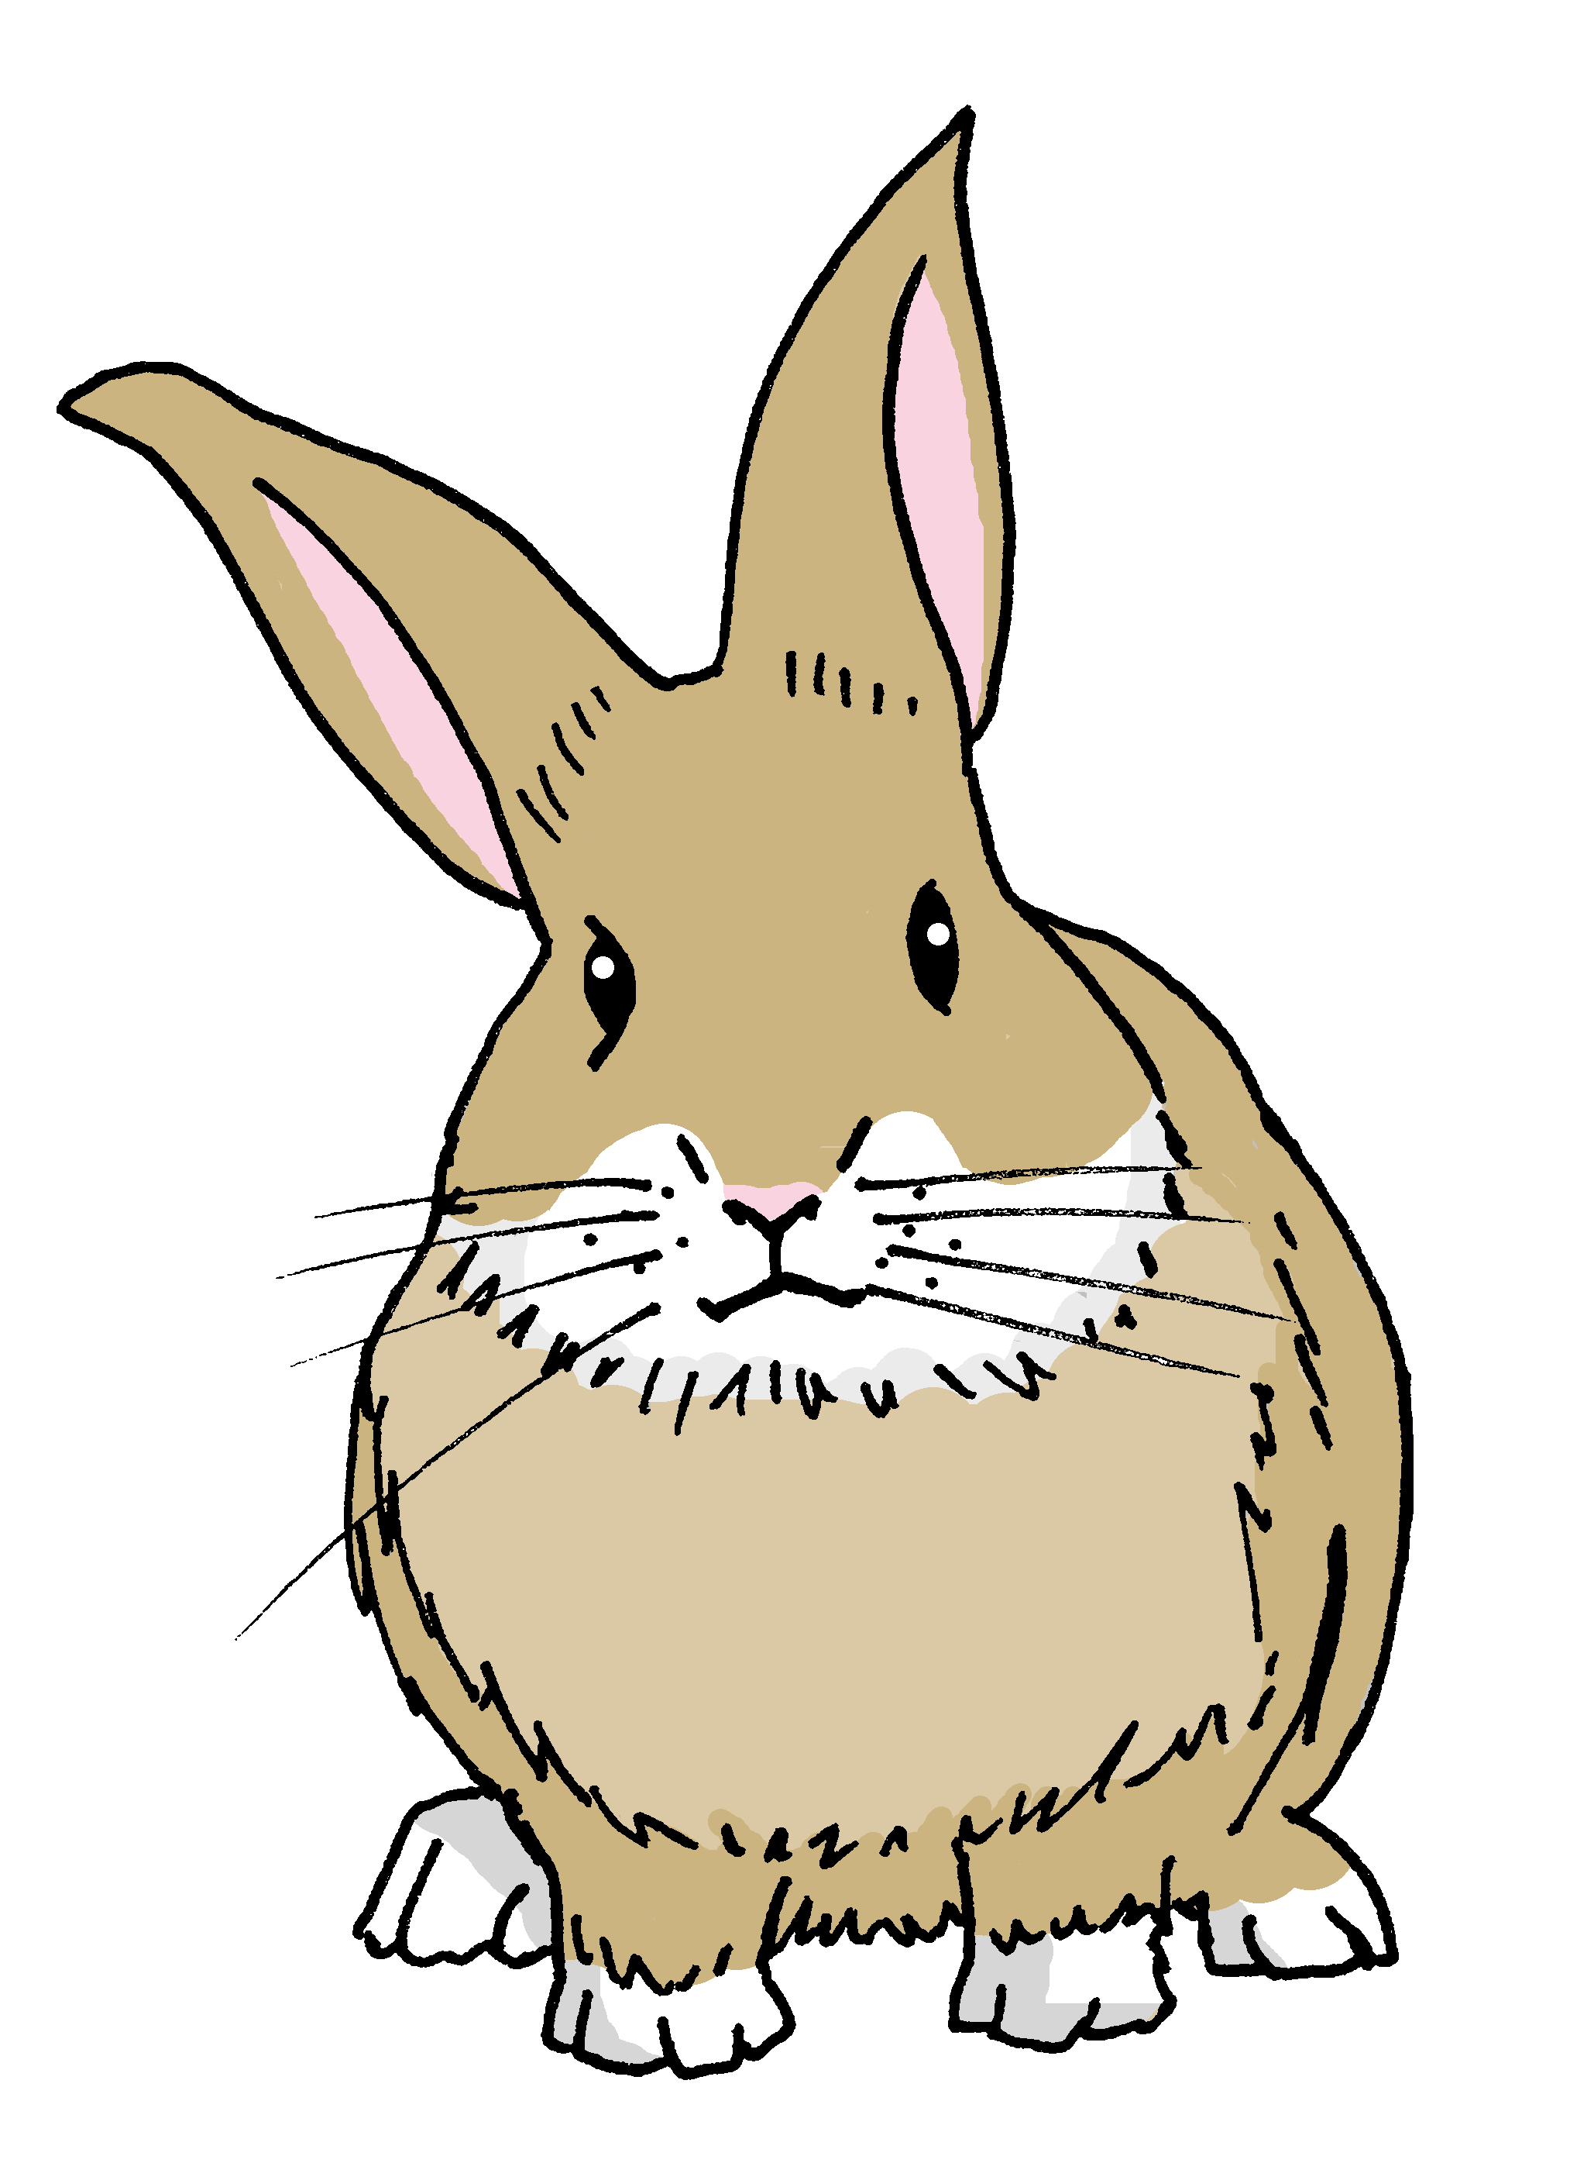
Gender & number agreement on adjectives
When an adjective ends in –e, it can describe a masculine or feminine noun.
Santi es inteligente.
Manchita es inteligente.
Santi is intelligent.
Manchita is intelligent.
To describe more than one noun with adjectives that end in -e, just add –s.
Somos importantes.
Somos importantes.
Pancho
Santi
Manchita
Irene
We are important.
We are important.
Notes:
Aim: to introduce the plural adjective agreement for number for adjectives ending in –e.
Procedure:
Click through the animations to present the information.
Elicit English translation for the Spanish examples provided.
Point out that with plural adjectives ending in –es, as with the singular form -e, you cannot tell from the adjective whether it refers to a masculine or feminine noun.

Slide 5
Follow up 2:
escuchar
Escucha. ¿Quién habla?
escuchar
Marca .
How do they describe themselves?
 |  | los dos
in general | today
Sofía y
Ángela
Rubén y
Quique
descripción en inglés
E
positive
1
nervous
2
calm
3
intelligent
4
tired
5
annoying
6
different
Notes:
Aim: to practise noticing the gender and number of the person (people) described and process the meaning of the adjectives.
Procedure:
1. Ask pupils to write 1-6 in their books.
2. Read the instruction in Spanish from the board.
3. Tell them that they will hear Sofía and Ángela, Rubén and Quique talking about themselves. They need to pay attention to the ending of the adjective and decide if this could apply to Sofía and Ángela, Rubén and Quique or both. Remind them about –os /-as / -es.
4. Do the example with them.
5. The first time they listen, they tick the correct group (Sofía and Ángela, Rubén and Quique or both). 6. Click to reveal answer tick.
7. The second time they listen, pupils need to identify the correct meaning of “we are” (estamos or somos), and the adjective in English. 8. click to reveal answers.
9. Complete 1-6. Challenge pupils to also write down the description (the adjective) in English. 10. Click to provide answers.
Note: there are no adverbs in this activity to compel pupils to focus attention on estamos | somos to identify the meaning of the verb.
Transcript:
E. Somos positivas.
1. Estamos nerviosos.
2. Estamos tranquilos.
3. Somos inteligentes.
4. Estamos cansadas.
5. Somos muy pesadas.
6. Somos diferentes.

Slide 6
Follow up 3:
Clasifica* los adjetivos.
perdido
importante
preparado
tranquilo
elegante
leer
cansado
increíble
lento
rápido
inteligente
diferente
pesado
-o
-a
- es
perdido
preparado
tranquilo
importante
inteligente
cansado
elegante
diferente
lento
increíble
rápido
-os
pesado
-as
clasifica = classify
Notes:
Timing: 5 minutes
Aim: to recap adjective agreements.
Procedure:
Teachers ask pupils to write the adjectives down in two columns depending on whether the ending will change ‘o/a/os/as’ or ‘es’.
NB. As an alternative, this exercise could be done orally, and teachers can elicit the English translation during the feedback.
Notes:
The shapes offer a visual representation of the possible endings. Elicit the responses from the pupils as to when to use the different endings and therefore which type of adjective will go in each box.
Frequency of unknown words:
clasifica [2729]
Source: Davies, M. and Davies, K. (2018). A frequency dictionary of Spanish: Core vocabulary for learners (2nd ed.). Routledge: London

Slide 7
Follow up 4:
a b ñ
vocabulario
Say each word in Spanish when you see the English.
contentas
inteligentes
inteligente
las
estamos
pero
we are (trait)
pleased (f, pl.)
the (f, pl.)
we are (state)
the (m,pl.)
intelligent (m/f, pl.)
intelligent (m/f)
independent (m/f, pl.)
pleased (m, pl.)
¡Excelente!
to love
to hate
but
somos
odiar
contentos
los
independientes
amar
Notes:
Timing: 10 minutes (two slides)
Aim: to practise written comprehension and spoken pronunciation of vocabulary for this week and the revisited weeks.
Procedure:
1. Click for English prompt. Pupils need to locate the correct Spanish word and pronounce it, chorally.
2. Click for target word to be highlighted. 3. Repeat for all 12 items.

Slide 8
Follow up 4:
Escribe en inglés 📝.
a b ñ
vocabulario
Can you get at least15 points?
 | (el) grupo | también | y
 | favorito | mi | tu
 | (la) guitarra | enseñar | (el) niño
 | participar | practicar | (el) trabajo
 | pero | estamos | somos
 | inteligentes | activos | independiente
 | diferentes | cansadas | contentos
vocabulario
vocabulario
vocabulario
vocabulario
group
also, too
and
x3
favoruite
my
your
guitar
to each, teaching
child, kid (m)
x2
to participate
to practise, practising
work, job
but
we are (state)
we are (trait)
intelligent (m/f, pl.)
active (m, pl.)
independent (m/f)
x1
different (m/f, pl.)
tired (f, pl.)
pleased (m, pl.)
Notes:
Timing: 5 minutes
Aim: to practise written comprehension of vocabulary for this week and revisited weeks.
Procedure:
Pupils need to write the English for as many words as possible, aiming to get at least 15 points (but more if possible).
Remind pupils to pay attention to the forms of the words and be precise in their English meanings. Do the first one as an example.
2. Click for English answers.

Slide 9
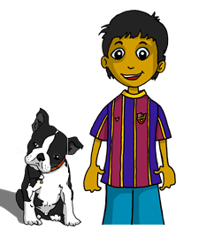
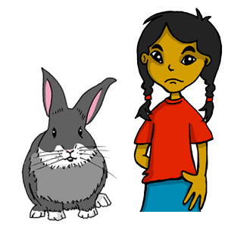
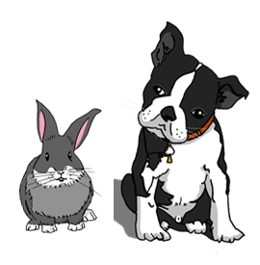
Follow up 5:
Escribe en español 📝.
escribir
1. We are (feeling) happy today.
2. We are always independent.
3. We are family.
4. We are (feeling) ill.
5. We are important.
💡 Spanish adverbs for now, always, today can usually go at the start, end or after the verb.
Estamos contentos hoy.
Siempre somos independientes.
always =
s_ _mpr_
today = h_ y
family = f_m_l_a
Somos familia.
Estamos enfermas.
Somos importantes.
Notes:
Timing: 10 minutes (two slides)
Aim: to produce full sentences using ‘somos’ and ‘estamos’, using the correct form of the adjective too.
Read the instructions in Spanish.
Ask pupils to complete translate the sentences into Spanish, using the correct verb (somos or estamos) and form of the adjective.
Always/ today and family are not new words; however, prompts are provided to support pupils.

Slide 10
Follow up 5
Escribe en español 📝.
a b ñ
vocabulario
Can you get at least15 points?
 | my | your | favourite (m)
 | also, too | group | and
 | to practise | to participate | guitar
 | to teach, teaching | job, work | child, kid (f).
 | different (pl.) | but | intelligent (pl.)
 | we are (trait) | independent (m/f) | pleased (f., pl.)
 | tired (m., pl.) | we are (state) | active (f., pl.)
vocabulario
vocabulario
vocabulario
mi
tu
favorito
x3
también
el grupo
y
practicar
participar
la guitarra
x2
enseñar
el trabajo
la niña
diferentes
pero
inteligentes
somos
independiente
contentas
x1
cansados
estamos
activas
Notes:
Aim: to practise written production of vocabulary for this week and previous weeks.
Procedure:
Pupils need to write the Spanish for as many words as possible, aiming to get at least 15 points (but more if possible).
Tell pupils to write the correct word for ‘the’ with all the nouns.
3. Click for Spanish answers.

