Slide 1
español, con Sofía

Slide 2
Describing me and others
today
vs.
in general
¿Cómo es?
¿Cómo está?
azul
- To be [state and trait]: estoy vs. soy; está vs. es
- SSC [e] [i]
Notes:
Artwork by Steve Clarke. All additional pictures selected are available under a Creative Commons license, no attribution required.
The frequency rankings for words that occur in this PowerPoint which have been previously introduced in the resources are given in the SOW (excel document) and in the resources that first introduced and formally re-visited those words.
For any other words that occur incidentally in this PowerPoint, frequency rankings will be provided in the notes field wherever possible.
Phonics:
Revisit SSC: [e] elefante [>5000] [i] idea [247]
Vocabulary (new words in bold): es [ser, 7] está [estar 21] amigo [210] profesor [510] divertido [2465] lento [1569] rápido [870] serio [856] tranquilo [1093] pesado [2166] también [49] hoy [167] siempre [96] y [4]
Revisit 1: revisit buscar [179] cantar [717] escuchar [281] hablar [90] necesitar [276] frase [1037] presentar [235] pronunciar [1990] Revisit 2: él [9] ella [72] tú [184] yo [28] pero [30]
For any other words that occur incidentally in this PowerPoint, frequency rankings will be provided in the notes field wherever possible.
Frequency of unknown words:
describir [1272] deportista [>5000]
Source: Davies, M. and Davies, K. (2018). A frequency dictionary of Spanish: Core vocabulary for learners (2nd ed.). Routledge: London

Slide 3
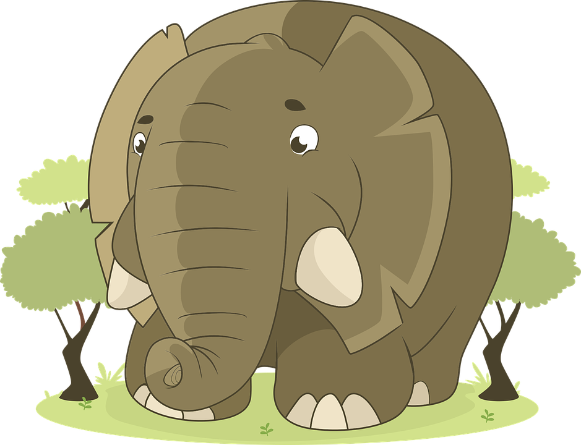
[e]
elefante
pronunciar
Notes:
Timing: 1 minute
Aim: to revisit SSC [e]
Procedure:
Click to present and elicit the pronunciation of the individual SSC [e] and then the source word ‘elefante’ (with gesture, if using).
Click to bring up the picture and get pupils to repeat (with gesture, if using).
Pupils to practise (for a few seconds) in pairs.
Gesture: the suggested gesture for ‘elefante’ is to raise the right arm as though an elephant is raising its trunk.

Slide 4
[i]
idea
pronunciar
Notes:
Timing: 1 minute
Aim: to revisit SSC [i]
Procedure:
Click to present and elicit the pronunciation of the individual SSC [i] and then the source word ‘idea’ (with gesture, if using).
Click to bring up the picture and get pupils to repeat (with gesture, if using).
Pupils to practise (for a few seconds) in pairs.
Gesture: the suggested gesture for ‘idea’ is to raise the index finger of the right hand in the air quickly as an exaggerated mime of someone having an idea.

Slide 5
pronunciar
[i]
idea
[e]
elefante
Notes:
Timing: 2 minutes
Aim: To practise SSC [e] [i]
Procedure:
Click to bring up SSC and elicit pronunciation of the SSC and the source word from pupils.
Click one more time to bring up the written form of the source word.
Next two clicks bring up picture of source words – elicit words again from pupils.
For further practice, pupils work in pairs. One pupils use a gesture, the partners elicits the source word.

Slide 6
pronunciar
Lee y escribe 📝.
Persona A lee. Persona B escucha y escribe las frases.
pronunciar
Persona B 💬 ahora.
Persona A 💬 ahora.
1
1. Mi idea es importante y diferente.
1
1. El inglés es fácil y hablo rápido.
My idea is important and different.
English is easy and I speak fast/quickly.
2
2
2. Mi amigo pronuncia una frase difícil.
2. Mi amiga necesita hablar español también.
My friend (m) pronounces a difficult phrase/sentence.
My friend (f) needs to speak Spanish, too.
Notes:
Timing: 6 minutes
Aim: to practise SSC [e] [i] in a paired dictation task; to practise written comprehension of revisited vocabulary.
Note: i) see final slide for a handout for this task. ii) for a higher level of challenge, pupils could transcribe the full sentences.
Procedure:
Explain that pupil A will read two sentences out loud, and pupil B will listen and write the missing letters.
B turns away from the board with his/her handout.
Click to bring up the two sentences.
A reads each one clearly and slowly, repeating as necessary.
B writes in the missing letters.
B turns back to check his/her work on the board. Click each number to hear the sentence said by a native speaker.
Swap roles. A turns away. Repeat steps 3-6.
When all four sentences are on the board, elicit the English meanings from pupils. This revisits some of this week’s vocabulary from Y3/4.

Slide 7
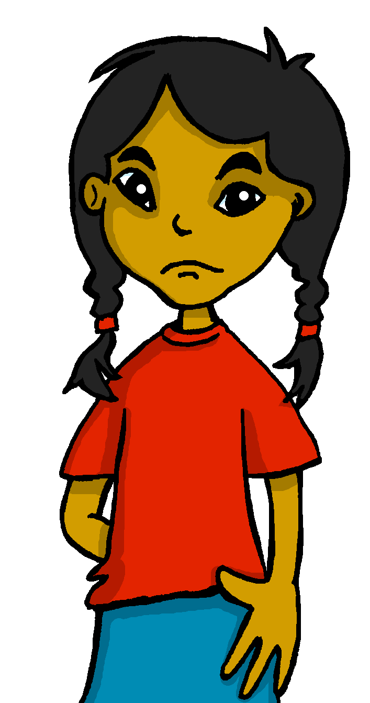
estar and ser: I am vs. s/he is
[to be, being]
To say where something or someone is and describe a temporary state use _______.
estar
To talk about permanent traits use_______.
ser
I am
s/he is
Estoy tranquilo.
Sofía está negativa.
I am (feeling) calm.
Sofía is (feeling) negative.
💡 I am a positive person in general.
Soy positivo.
Sofía es divertida.
💡 Sofía is a funny person.
I am positive.
Sofía is funny.
Notes:
Timing: 2 minutes
Aim: to revisit the two meanings of ‘to be’ (temporary states, permanent traits) in 1st and 3rd person singular
Procedure:
Use the animations to present the information about “estar” and “ser”.
Elicit English translations for the Spanish examples provided.
Note: we haven’t revisited [qui] yet so pupils might need help pronouncing this sound (use ‘key’ gesture).

Slide 8
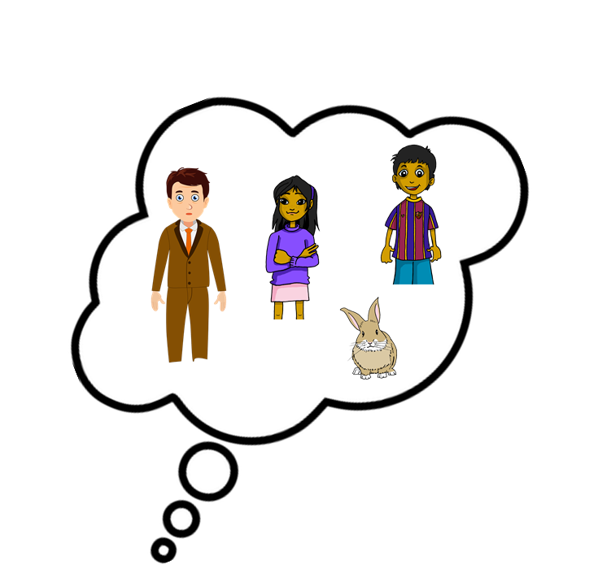
escuchar
Escucha a Sofía. ¿A quién describe?
Escribe el verbo y marca .
escuchar
Today OR
location or in general?
verbo
Sofía [I] | Someone else [s/he]
today / location | in general
E
soy
1
está
2
es
3
estoy
4
está
5
es
6
soy
describe = does she describe
Notes:
Timing: 8 minutes
Aim: to practise listening out for the verbs ‘estoy’, ‘soy’, ‘está’, ‘es’ and connect the verb forms to the person they refer to. To then practise processing the meaning of the two verbs.
Procedure:
1. Ask pupils to write 1-6 in their books.
2. Read the instruction in Spanish from the board.
3. Tell them that they will hear Sofía talking about herself or one of her friends (or her teacher). Tell them they need to pay attention to whether they hear “está”, “es”, “soy” or “estoy”. Encourage pupils to write the verb down for support, too.
4. Do the example with them.
5. Do 1-6. The first time they listen, they should identify the person to whom Sofía refers (herself – one of her friends) and tick the correct box.
Part 2
6. The second time they listen, if they haven’t already written the verb, they should do so now, then tick to identify the correct use of ser / estar.
7. Do the example with them.
8. Do 1-6.
Note: we omit adverbs here (e.g. hoy, siempre) to avoid giving additional clues about the meaning of the verb. Pupils are therefore compelled to connect soy/es and estoy/está with their meanings.
Transcript:
E. Soy positiva.
1. Está nervioso cuando está en el parque.
2. Es rápido y también tranquilo.
3. Estoy un poco pesada.
4. Está en clase de español.
5. Es lento y serio.
6. Soy muy divertida.
Frequency of unknown words:
describir [1272]
Source: Davies, M. and Davies, K. (2018). A frequency dictionary of Spanish: Core vocabulary for learners (2nd ed.). Routledge: London

Slide 9
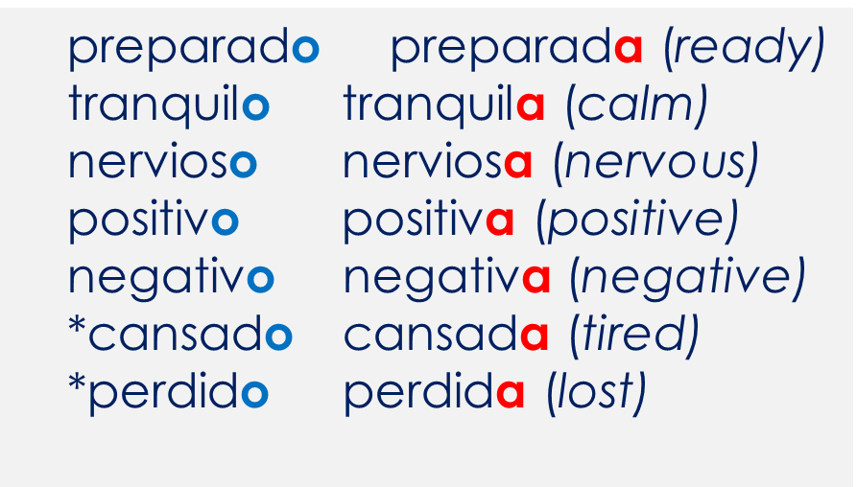
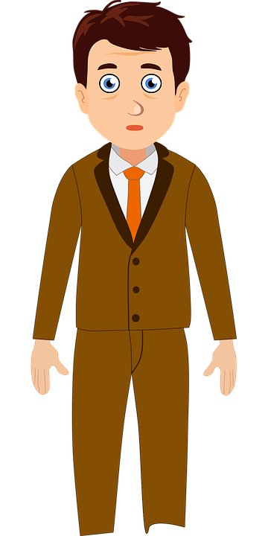
gender agreement
In Spanish, we already know that adjectives that end in ‘o’ change to end in ‘a’ when the noun being described is feminine.
*
💡 *cansado, perdido and preparado can only be used with estar as they are temporary states.
perdido
El señor Valero está ___________.
(lost)
tranquila
Ángela está ___________.
(calm)
Notes:
Timing: 2 minutes
Aim: to revisit singular regular masculine and feminine adjectival agreement for nouns ending in –o.
Read the grammar explanation on agreeing adjectives with feminine / masculine nouns.
Elicit correct form of the adjective for “Ángela” and “Señor Valero” from pupils, using the grey box.

Slide 10
leer
muy
hoy
también
y
very
Lee y escucha: ¿Quién es?
today
Rubén
also
3
Ángela
1
and
4
deportista = sporty
El profesor
(señor Valero)
2
Manchita
1
1. Es muy tranquilo y hoy está positivo. Es muy deportista*.
2. Está nerviosa cuando está en el parque. También es muy pequeña. ¡Es una coneja!
3. Es elegante y divertido. Hoy está muy serio. Está en clase de español.
4. Normalmente es muy creativa y tranquila. Es mi amiga. Hoy está muy pesada.
i. __
ii. __
i. __
ii. __
2
3
i. __
ii. __
4
i. __
ii. __
Notes:
Timing: 8 minutes
Aim: to practise written comprehension of es / está + key adjectives for description in a longer context.
Procedure:
1. Read the instructions in Spanish.
2. Tell pupils Sofía is describing her teacher, Ángela, Rubén and Manchitas.
3. First, pupils read sentence 1 and decide which verb (es or está) fills the gap. The clues are provided by the surrounding words (the adverbs and/or the adjectives).
4. Click to play sentence 1 to them to check their verb choices. Click to reveal the two written answers.
5. Next, draw pupils’ attention to the gender of the adjectives (masculine). Ask them if/how they helps them to identify who Sofía is talking about. (i.e. this narrows the options to two (El profesor / Rubén). Then elicit the English meaning of the adjectives (calm, positive and sporty). Point at Rubén’s t-shirt as a clue as to who the sporty person is.
Note: remind them that “deportista” is an irregular adjective that ends in –a but is both masculine and feminine.
6. Repeat steps 3-5 with sentences 2-4.
7. Elicit English translations of all sentences orally.
Note: elegante (smart / elegant), tranquila (quiet, calm), peasado (annoying) and conejo/a (rabbit) are additionally revisited here.
Frequency of unknown words:
deportista [>5000]
Source: Davies, M. and Davies, K. (2018). A frequency dictionary of Spanish: Core vocabulary for learners (2nd ed.). Routledge: London

Slide 11
¡adiós!
azul

Slide 12
Handout
pronunciar
Persona A
Persona B
1. _l _ngl_s _s fác_l y hablo ráp_do.
1. M_ _d_a _s _mportant_ y d_f_r_nt_.
2. M_ am_ga n_c_s_ta hablar _spañol tamb_ _n.
2. M_ am_go pronunc_a una fras_ d_f_c_l.
Notes:
HANDOUT

