Slide 1
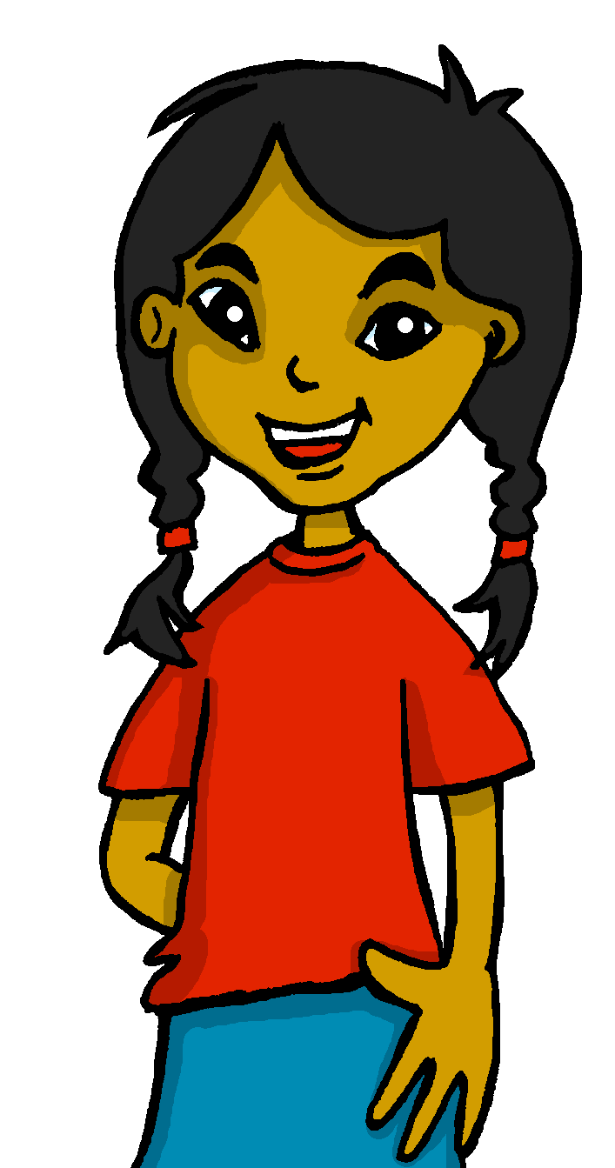
Describing me and others
today
vs.
in general
¿Cómo es?
¿Cómo está?
azul
Follow ups 1-5
Notes:
Artwork by Steve Clarke. All additional pictures selected are available under a Creative Commons license, no attribution required.
The frequency rankings for words that occur in this PowerPoint which have been previously introduced in the resources are given in the SOW (excel document) and in the resources that first introduced and formally re-visited those words.
For any other words that occur incidentally in this PowerPoint, frequency rankings will be provided in the notes field wherever possible.
Phonics:
Revisit SSC: [e] elefante [>5000] [i] idea [247]
Vocabulary (new words in bold): es [ser, 7] está [estar 21] amigo [210] profesor [510] divertido [2465] lento [1569] rápido [870] serio [856] tranquilo [1093] pesado [2166] también [49] hoy [167] siempre [96] y [4]
Revisit 1: revisit buscar [179] cantar [717] escuchar [281] hablar [90] necesitar [276] frase [1037] presentar [235] pronunciar [1990] Revisit 2: él [9] ella [72] tú [184] yo [28] pero [30]
For any other words that occur incidentally in this PowerPoint, frequency rankings will be provided in the notes field wherever possible.
Frequency of unknown words:
muchos [41] nombre [215]
Source: Davies, M. and Davies, K. (2018). A frequency dictionary of Spanish: Core vocabulary for learners (2nd ed.). Routledge: London

Slide 2
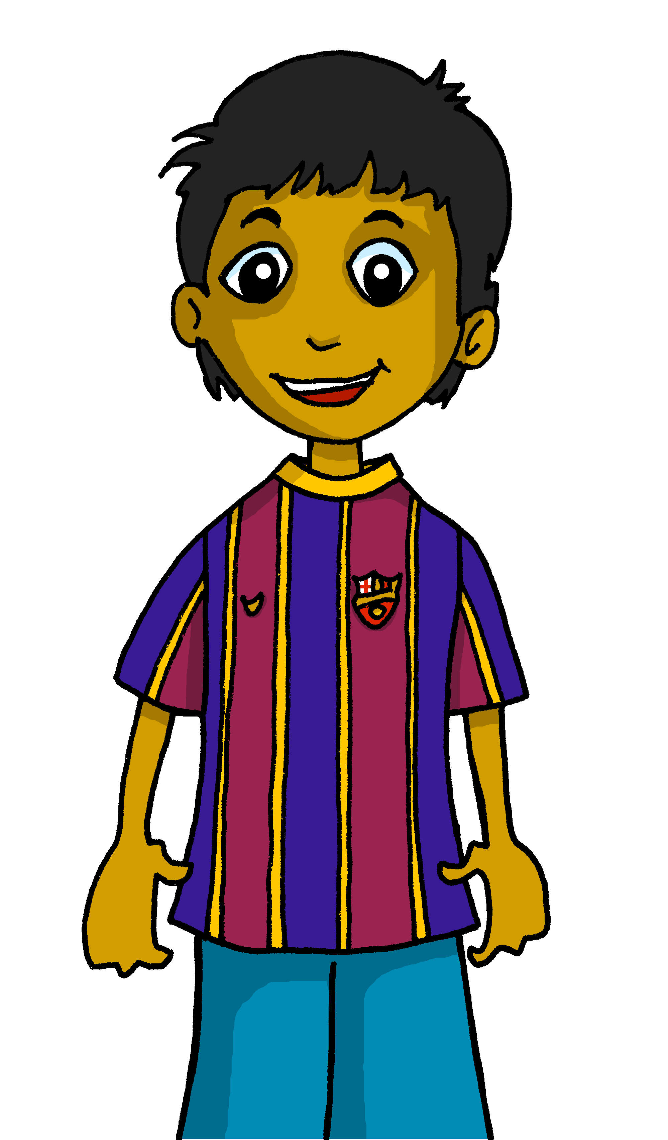
Follow up 1:
[e]
elefante
[i]
idea
Presento a mis amigos.
Rubén tiene muchos* amigos.
pronunciar
¿El nombre tiene‘e’, ‘i’ o los dos?
 |  | [e] | [i]
1 | Tito
2 | Tío
3 | Mateo
4 | Marisol
5 | Graciela
6 | Iliana
7 | Felipe
8 | Alejandra
9 | Valentina
muchos = many
nombre = name
Notes:
Timing: 5 minutes
Aim: to practise aural comprehension of the SSC [e] and [i].
Procedure:
Click to bring up the instructions. Pupils write 1-9, and [e] [i] at the top.
Click on each audio symbol to listen to the names.
Pupils tick if they hear ‘e’ or ‘i’ or both.
Note: for additional challenge pupils can write the full name.
4. Click to bring up the answer ticks and reveal the written names.
Transcript 1. Tito 2. Tío 3. Mateo 4. Marisol 5. Graciela 6. Iliana 7. Felipe 8. Alejandra 9. Valentina
Frequency of unknown words:
muchos [41] nombre [215]
Source: Davies, M. and Davies, K. (2018). A frequency dictionary of Spanish: Core vocabulary for learners (2nd ed.). Routledge: London

Slide 3
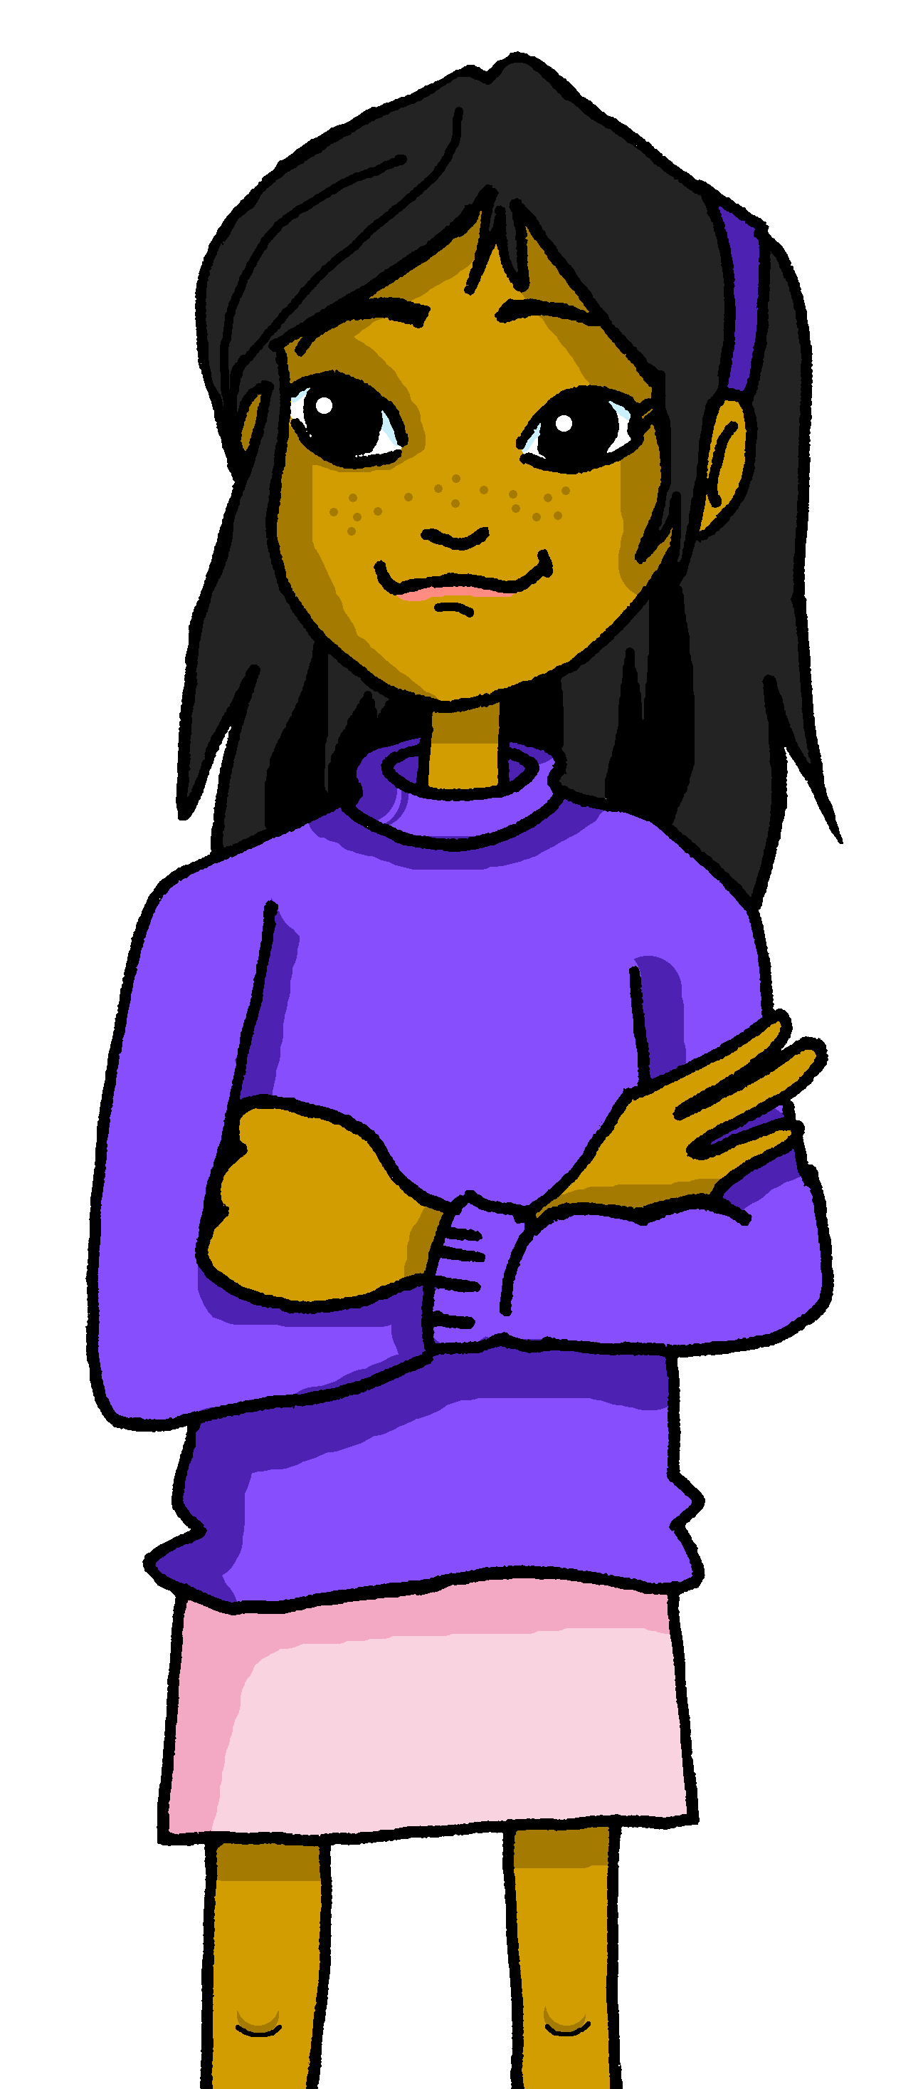
Follow up 2:
Escucha y escribe.
[1/5]
escuchar
Soy
1. _______ divertida y rápida.
3
I
s/he
Ángela
Rubén
2
1
in general
today | location
¡escribe!
Notes:
Timing: 5 minutes
Slide 1/5
Aim: to practise listening out for the verbs ‘estoy’, ‘soy’, ‘está’, ‘es’ and connecting them to person of the verb they refer to. To then practise processing the meaning of the two verbs.
Procedure:
Read the instructions in Spanish. The following instructions apply to the next 5 slides.
Tell pupils this is a delayed dictation activity. They will hear a sentence played twice and they will have to retain that sentence in their working memory (picturing it in their heads!) for 3 seconds.
3. Once the time is up, they need to write the sentence.
4. Click to show the answer to the whole question.
5. Click again to bring up the different forms of the verb in (I, s/he). Elicit answer from pupils.
6. Click to bring up the possible uses of the verb (in general / today | location). Elicit answer from pupils.
Note: Pupils can choose to use the help on the board or write the sentence without looking – encourage pupils to choose their own level of challenge.
Transcript:
Soy divertida y rápida.

Slide 4
Follow up 2:
Escucha y escribe.
[2/5]
escuchar
Está
2. ________ muy positivo.
3
I
s/he
Ángela
Rubén
2
1
in general
today | location
¡escribe!
Notes:
Slide 2/5
Transcript: Está muy positivo.

Slide 5
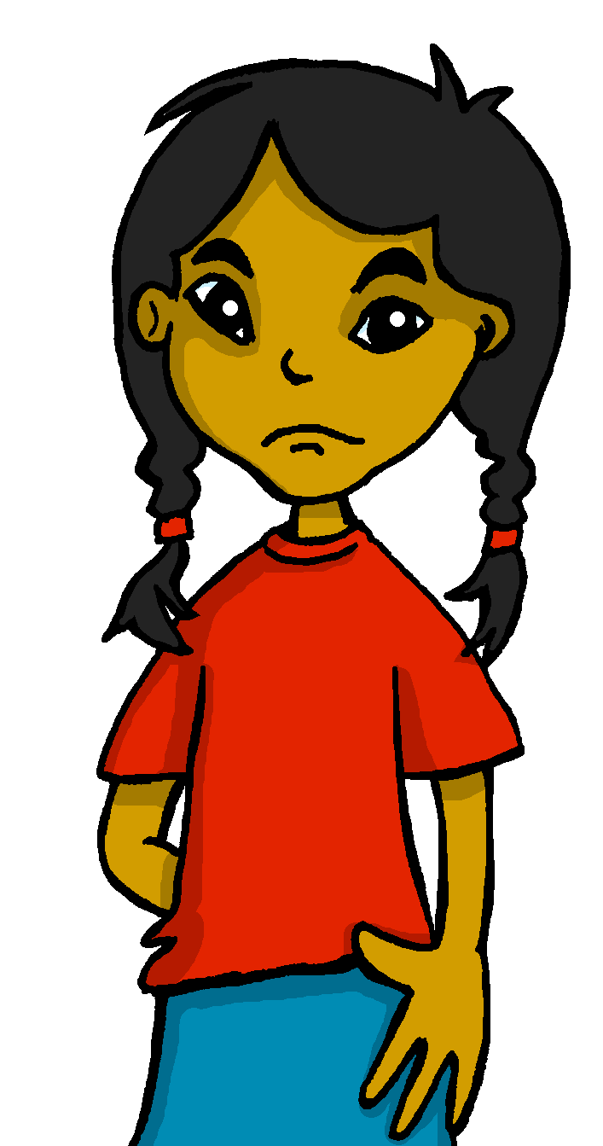
Follow up 2:
Escucha y escribe.
[3/5]
escuchar
Estoy
3. ________ muy cansada hoy.
3
I
s/he
Sofía
el profesor
2
1
in general
today | location
¡escribe!
Notes:
Slide 3/5
Transcript: Estoy muy cansada hoy.

Slide 6
Follow up 2:
Escucha y escribe.
[4/5]
escuchar
Está
4. ______ en clase.
3
I
s/he
Sofía
el profesor
2
1
in general
today | location
¡escribe!
Notes:
Slide 4/5
Transcript: Está en clase.

Slide 7
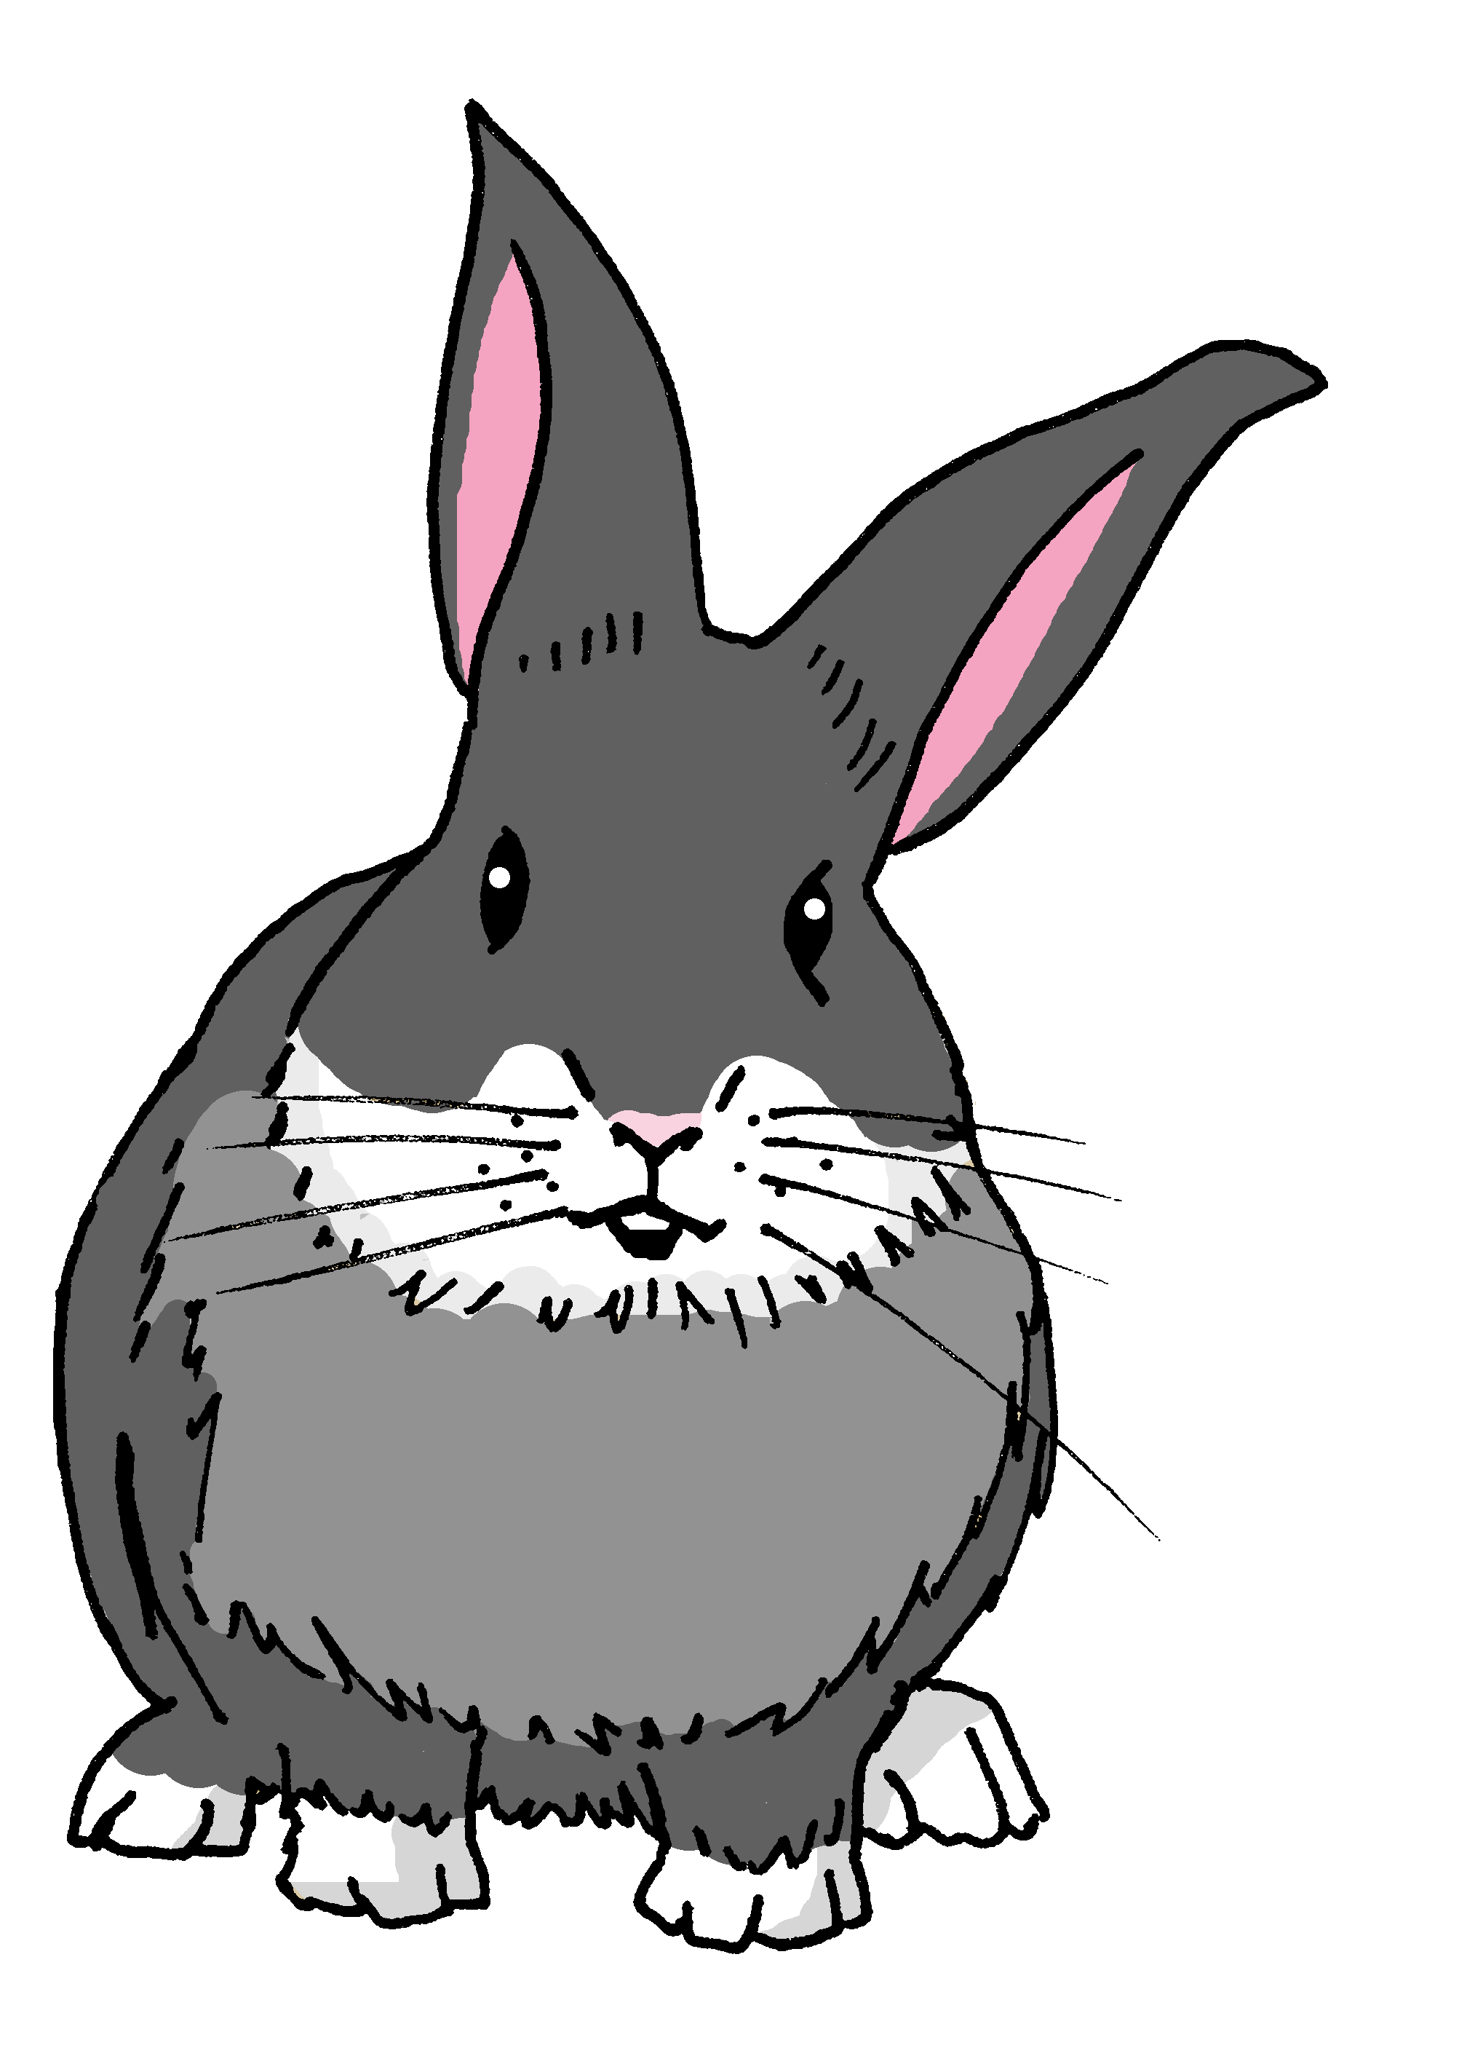
Follow up 2:
Escucha y escribe.
[5/5]
escuchar
Es
5. ___ muy rápida.
3
I
s/he
Manchita
Quique
2
1
in general
today | location
¡escribe!
Notes:
Slide 5/5
Transcript: Es muy rápida.

Slide 8
Follow up 3:
Habla en español.
Normally I am calm and also positive. Today I am feeling very ready.
hablar
muy
tranquilo/a
nervioso/a
positivo/a
negativo/a
divertido/a
rápido/a
lento/a
pesado/a preparado/a
perdido/a
cansado/a
40 segundos
y también
Hoy
Normalmente
Siempre
estoy | soy está | es
Normalmente soy tranquilo y positivo. Hoy estoy muy preparado.
INICIO
Notes:
Timing: 5 minutes (three slides)
Aim: to use ser and estar (I am, s/he is) and adjectival agreement in guided oral production. Note: the layout of the words provides support with word order and prompts thinking about which forms of ser/estar are required, together with the the correct form of the adjective. We avoid separating the adverbs and matching them to ser/estar options as these are the choices we want to compel pupils to make themselves.
Pupils to use the prompts to translate the sentences out loud in pairs within the 40 second time limit.
Draw their attention to the correct from of the adjectives. Make it clear that it is Rubén (a boy) talking.
Click to trigger the timer.
Click to reveal the written answer.

Slide 9
Follow up 3:
Habla en español.
She is always fast and negative. Today she is lost and also slow.
hablar
muy
tranquilo/a
nervioso/a
positivo/a
negativo/a
divertido/a
rápido/a
lento/a
pesado/a preparado/a
perdido/a
cansado/a
40 segundos
y también
Hoy
Normalmente
Siempre
estoy | soy está | es
0
Siempre es muy rápida y negativa. Hoy está perdida y también lenta.
INICIO
Notes:
Slide 2/3

Slide 10
Follow up 3:
Habla en español.
Normally I am… today I am… s/he is always … today s/he is…
hablar
muy
tranquilo/a
nervioso/a
positivo/a
negativo/a
divertido/a
rápido/a
lento/a
pesado/a preparado/a
perdido/a
cansado/a
1 minuto
y también
Hoy
Normalmente
Siempre
estoy | soy está | es
0
INICIO
Notes:
SLIDE 3/3
Aim to practise spoken production of sentences with ser and estar (I am, s/he is) and correct adjectival agreement.
Pupils to work in pairs to describe themselves and someone else. Normally I am… today I am… s/he is always … today s/he is…
Click “inicio” to start timer.
Teachers can ask pupils to feedback to the class on what their partners said.

Slide 11
Follow up 4a:
Escribe en inglés 📝.
a b ñ
Can you get at least15 points?
vocabulario
 | él | ella | tú
 | yo | pero | hablar
 | buscar | cantar | necesitar
 | escuchar | inglés | (la) frase
 | estoy | tranquilo | está
 | divertida | es | ser
 | amigo | también | soy
vocabulario
vocabulario
vocabulario
vocabulario
vocabulario
he
she
you
x3
I
but
to listen, listening
to look for, search
to sing, singing
to need, needing
x2
to listen, listening
English
sentence, phrase
I am (state)
calm (m)
s/he, it is (state)
funny (f)
s/he, it is (trait)
to be, being
x1
teacher (m)
also
I am (trait)
Notes:
Timing: 10 minutes (two slides)
Aim: to practise written comprehension (this slide) and production (next slide) of vocabulary from this week and this week’s revisited sets.
Procedure: 1. Give pupils a blank grid. They fill in the English meanings of any of the words they know, trying to reach 15 points in total.
Note: The most recently learnt and practised words are pink, words from the first revisit are green and those from the second revisit are blue, thus more points are awarded for them, to recognise that memories fade and more effort (heavy lifting!) is needed to retrieve them.

Slide 12
Follow up 4b:
Escribe en español 📝.
a b ñ
Can you get at least15 points?
vocabulario
 | you | he | but
 | to talk, talking | I | she
 | to need, needing | to sing, singing | English
 | to listen, listening | phrase, sentence | to look for, search
 | s/he, it is (state) | also | I am (state)
 | I am (trait) | teacher (f) | fun (m)
 | s/he, it is (trait) | calm (f) | to be being,
vocabulario
vocabulario
vocabulario
vocabulario
vocabulario
tú
él
pero
x3
hablar
yo
ella
necesitar
cantar
inglés
x2
escuchar
la frase
buscar
está
también
estoy
soy
profesora
divertido
x1
es
tranquila
ser
Notes:
Timing: 10 minutes (two slides)
Aim: to practise written comprehension (this slide) and production (next slide) of vocabulary from this week and this week’s revisited sets.
Procedure: 1. Give pupils a blank grid. They fill in the English meanings of any of the words they know, trying to reach 15 points in total.
Note: The most recently learnt and practised words are pink, words from the first revisit are green and those from the second revisit are blue, thus more points are awarded for them, to recognise that memories fade and more effort (heavy lifting!) is needed to retrieve them.

Slide 13
Follow up 5:
Escribe en español 📝.
Completa las frases.
¿’soy’ or ‘estoy’?
¿’es’ or ‘está’?
very
and
also
escribir
Normally I am …
2. Today I am …
3. She always is …
4. Today she is …
funny and calm.
💡 Use these words to make your sentences more interesting.
Normalmente soy divertida y tranquila.
tranquilo/a
nervioso/a
positivo/a
negativo/a
divertido/a
rápido/a
lento/a
pesado/a
preparado/a*
perdido/a*
cansado/a*
Notes:
Aim: to produce full sentences using soy, estoy, es, está and and a range of adjectives to describe personality.
Read the instructions in Spanish.
Ask pupils to complete the sentences in English to describe themselves and someone else, then translate them into Spanish.
Show Sofía’s example.

