Slide 1
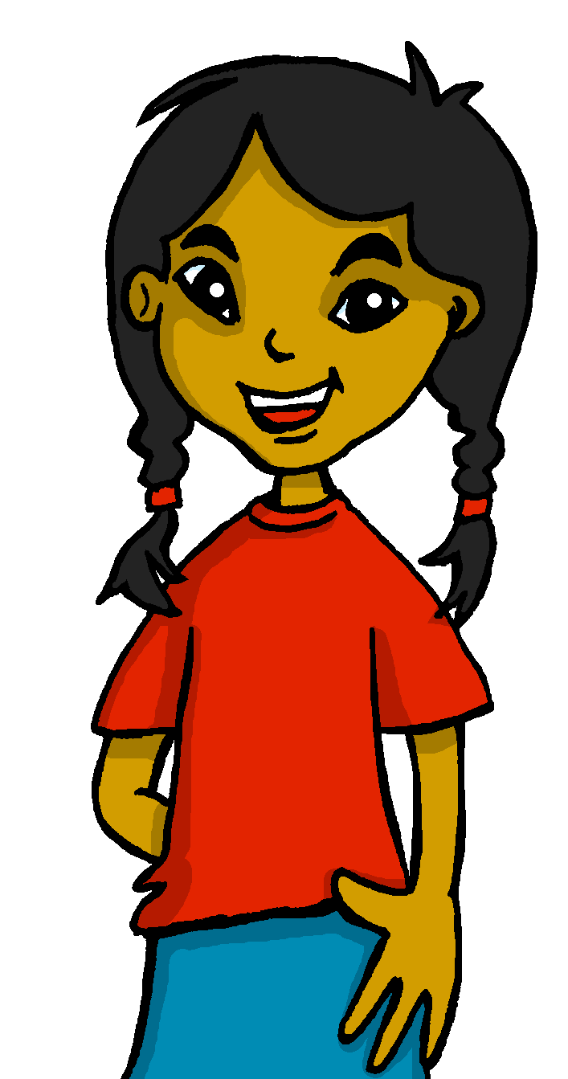
español, con Sofía

Slide 2
Describing me and others
¿Cómo estás?
azul
- To be [state and trait]: estoy vs. soy; estás vs. eres
- SSC [a] [o] [u]
Notes:
Artwork by Steve Clarke. Pronoun pictures from NCELP (ncelp.org). All additional pictures selected are available under a Creative Commons license, no attribution required.
The frequency rankings for words that occur in this PowerPoint which have been previously introduced in the resources are given in the SOW (excel document) and in the resources that first introduced and formally re-visited those words.
For any other words that occur incidentally in this PowerPoint, frequency rankings will be provided in the notes field wherever possible.
Phonics:
Revisit SSC: [a] [o] [u] source: casa [106] dos [64] universo [1603]
Vocabulary (new words in bold): estar [21] estoy [21] estás [21] ser [7] soy [7] eres [7] quién [289] señor [201] señora [509] activo [1279] cansado [1818] creativo [2945] negativo [1804] nervioso [1521] perdido [1899] positivo [1188] preparado [2092] raro [1005] serio [856] tonto [2379] tranquilo [1093] muy [43] ¡Buenos días! [103/65] ¡Buenas tardes! [103/392] hola [1245]
Revisit 1: cuidar [751] enseñar [610] participar [593] practicar [1595] guitarra [2705] niño, niña [173] trabajo [152]
Revisit 2: conejo [4728] tortuga [>5000] amable [2707] diferente [293] divertido [2465] inteligente [2167] demasiado [494]
Frequency of unknown words:
decir [31]
Source: Davies, M. and Davies, K. (2018). A frequency dictionary of Spanish: Core vocabulary for learners (2nd ed.). Routledge: London

Slide 3
[a]
casa
pronunciar
Notes:
Timing: 1 minute
Aim: to revisit SSC [a]
Procedure:
Introduce and elicit the pronunciation of the individual SSC [a] and then the source word ‘casa’ (with gesture, if using).
Click to bring up the picture and get pupils to repeat (with gesture, if using).
Pupils to practise in pairs.
Note: This is a brief introduction to the SSC for this week. Pupils will practise this and other SSC in the follow ups this week. Gesture: form a triangular ‘roof’ above your head, touching your fingertips together.

Slide 4
[o]
dos
pronunciar
Notes:
Timing: 1 minute
Aim: to revisit SSC [o]
Procedure:
Introduce and elicit the pronunciation of the individual SSC [o] and then the source word ‘dos’ (with gesture, if using).
Click to bring up the picture and get pupils to repeat (with gesture, if using).
Pupils to practise in pairs.
Note: This is a brief introduction to the SSC for this week. Pupils will practise this and other SSC in the follow ups this week. Gesture: two fingers (alternatively, thumb and index finger are the typical way for counting two in Spain)

Slide 5
[u]
universo
pronunciar
Notes:
Timing: 1 minute
Aim: To introduce SSC [u]
Procedure:
Introduce and elicit the pronunciation of the individual SSC [u] and then the source word ‘universo’ (with gesture, if using).
Click to bring up the picture and get pupils to repeat (with gesture, if using).
Pupils to practise in pairs.
Note: This is a brief introduction to the SSC for this week. Pupils will practise this and other SSC in the follow ups this week. Gesture: hands start together above head and trace a large oval shape, hands meeting again at the bottom to complete it.

Slide 6
pronunciar
[o]
dos
[a]
casa
[u]
universo
Notes:
Timing: 2 minutes
Aim: to practise SSC [a] [o] [u]
Procedure:
Click to bring up SSC and elicit pronunciation and source word from pupils.
Click one more time to bring up source word.
Repeat with [a] + [u].
For further practice, pupils work in pairs. One pupil uses a gesture, the partner elicits the source word.

Slide 7
pronunciar
La señora Cano dice…
¡B _ _ n _ s
d _ _ s!
u e
o
í a
dice = she says
Notes:
Timing: 1 minute (two slides)
Aim: to reintroduce buenos días / buenas tardes
Procedure:
Elicit Spanish phrase for ‘Good morning’ from pupils.
Bring up answers.
Whole class repeats.
Repeat the steps with the next slide.
Frequency of unknown words:
decir [31]
Source: Davies, M. and Davies, K. (2018). A frequency dictionary of Spanish: Core vocabulary for learners (2nd ed.). Routledge: London

Slide 8
pronunciar
La señora Cano dice*…
¡B _ _ n _ s
t _ r d _ s!
u e
a
a
e
dice = she says
Notes:
Slide 2/2
Frequency of unknown words:
decir [31]
Source: Davies, M. and Davies, K. (2018). A frequency dictionary of Spanish: Core vocabulary for learners (2nd ed.). Routledge: London

Slide 9
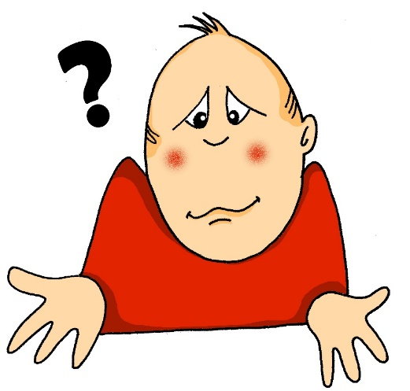
pronunciar
¿cómo?
how?
¿Cómo estás hoy?
[How are you (feeling) today?]
Rachel Hawkes / Emma Marsden
Notes:
Timing: 1 minute
Aim: to revisit question word ¿cómo?
Procedure:
Pupils listen and repeat the key question word (include gesture if possible).
Display the word and get them to repeat one more time.
Elicit English meaning.
Reveal the sentence – ‘estás’ and ‘hoy’ are revisited in this lesson (they are taught both in ‘amarillo’ and ‘rojo’).

Slide 10
estar
[to be | being] (mood and temporary states)
In Spanish the verb estar means ‘to be’ when describing mood or temporary state.
Estoy preparado.
Estás nervioso.
I am ready.
You are nervous.
I am (feeling) ready.
You re (feeling) nervous.
💡 In English, we often use a verb with ‘-ing’ to talk about a temporary state (‘right now’). For example:
I am feeling sick.
You are being silly.
Notes:
Timing: 2 minutes
Aim: to revisit to be (estar) for mood / temporary state
Procedure:
Read the grammar explanation on “estar”, “estoy” and “está”. Make sure pupils are clear about the I / you pictures as these will come up in consecutive lessons.
Elicit English translations for the Spanish examples provided. Pupils were taught these words in Y3/4.

Slide 11
leer
It’s the first Spanish lesson. How is la señora Cano feeling?
and the pupils she talks to?
Lee las frases y marca .
E) Estoy nervioso.
1) Estás seria.
 | I [the teacher] | you
E
1
2
3
4
5
6
2) Estás tranquila.
3) Estoy raro.
4) Estás muy tonta*.
5) Estoy muy preparado.
6) Estás muy serio.
tonto = silly
Notes:
Timing: 5 minutes
Aim: to process the meaning of ‘estoy’ and ‘estás’ by identifying the person they refer to.
Procedure:
Read the example out loud to the class and draw pupils’ attention to “estoy”. Elicit English meaning. Get them to think whether that statement would be said by the teacher about himself/herself or addressing a pupil. Bring up the answers.
Ask pupils to write down the numbers (1-6) and decide who says each sentence.
[NB. They can write I / you on top and tick OR write down I / you next to each number if they don’t work on workbooks].
Note: ‘tonto’ is included in this activity to support the use of ‘estar’ for mood/temporary state. It is a new word for this week, and is not a cognate, so is glossed here.
Frequency of unknown words:
tonto [2379]
Source: Davies, M. and Davies, K. (2018). A frequency dictionary of Spanish: Core vocabulary for learners (2nd ed.). Routledge: London

Slide 12
leer
We know that Spanish adjectives that
end in ‘o’ change to end in ‘a’ when
the person being described is female.
Marca .
 | masculino | femenino
E
1
2
3
4
5
6
Lee las frases otra vez.
¿Es masculino o femenino?
E) Estoy nervioso.
1) Estás seria.
2) Estás tranquila.
3) Estoy raro.
4) Estás muy tonta.
6) Estás muy serio.
5) Estoy muy preparado.
Victoria Hobson
Notes:
Timing: 5 minutes
Aim: to practise written identification of the gender of adjectives; to practise written comprehension of previously taught vocabulary and one new word (tonto).
Procedure:
Read the grammar explanation to remind pupils about adjectives and gender in Spanish.
Do the example with the whole class. Draw their attention to the ending of the adjective. Challenge pupils to think what the feminine form would look like.
Ask pupils to work their way through 1-6.
[NB: They can write masculino / femenino on top and tick OR write down M | F next to each number if they don’t work on workbooks].
To check comprehension, ask pupils the following questions: i) Is the teacher male or female? (male)
ii) Is there one pupil or more than one? How do you know? (more than one as there are both masculine and feminine adjectives used in the estás statements) iii) How is the teacher feeling? (nervous, strange, very prepared)
iv) What does the teacher say the pupils are like? (serious (girl), calm (girl), very silly (girl), serious (boy))

Slide 13
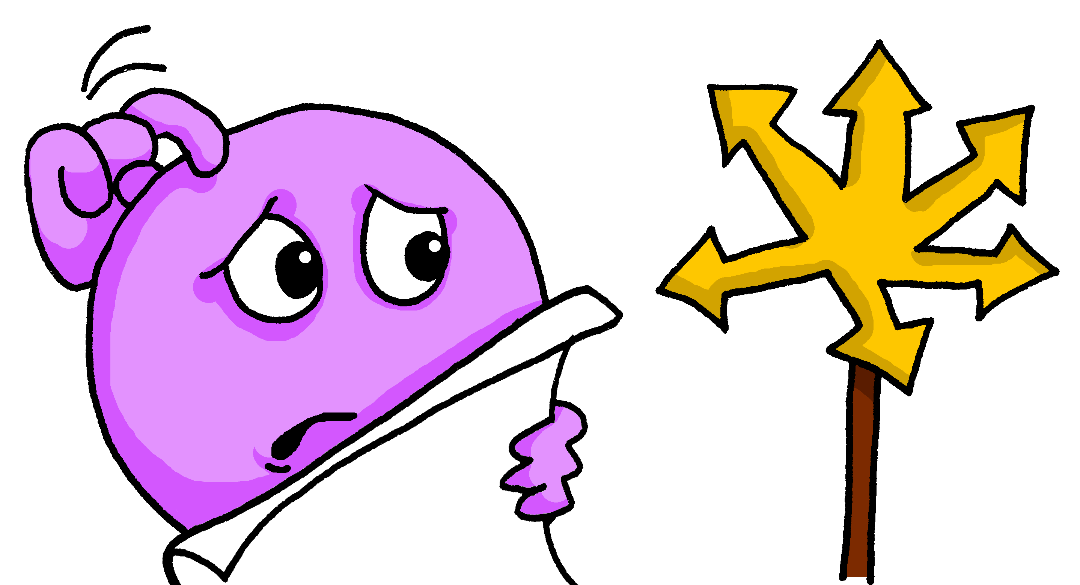
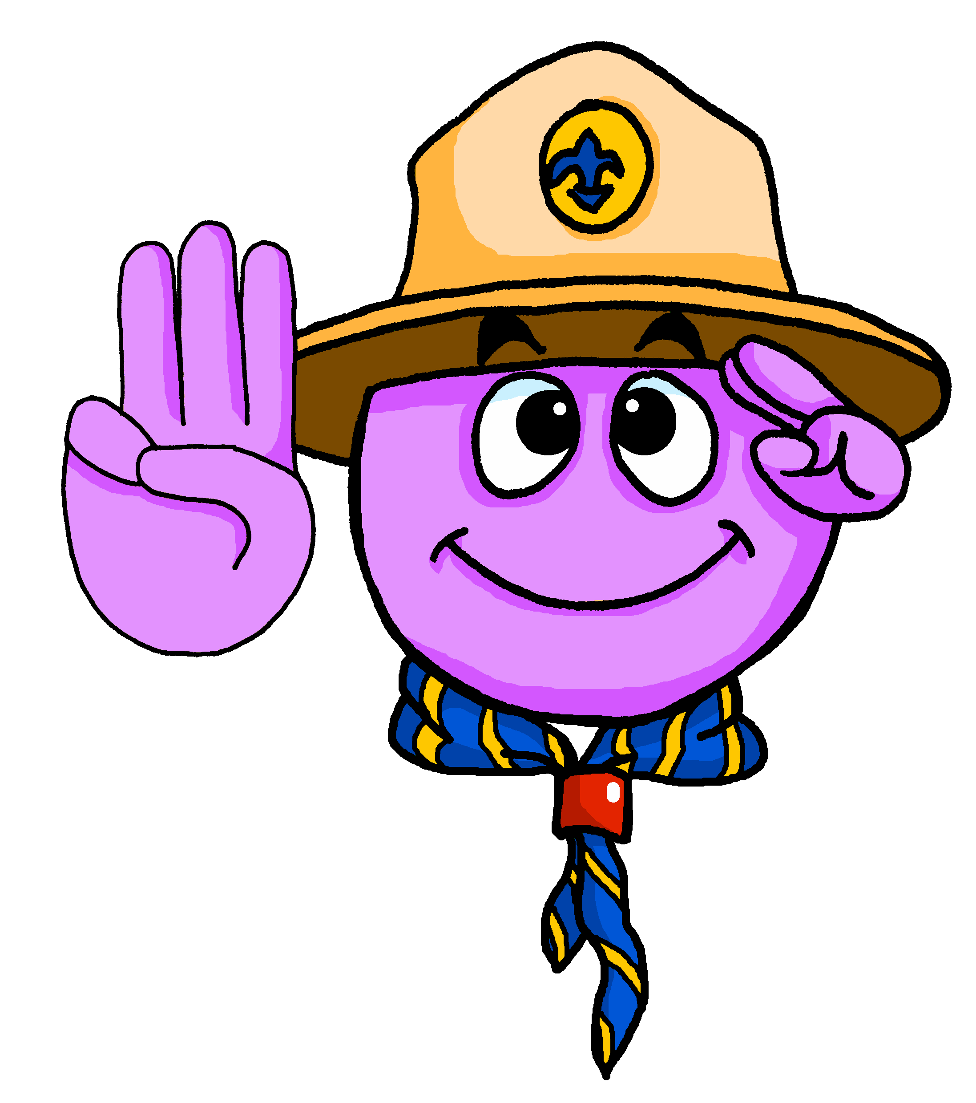
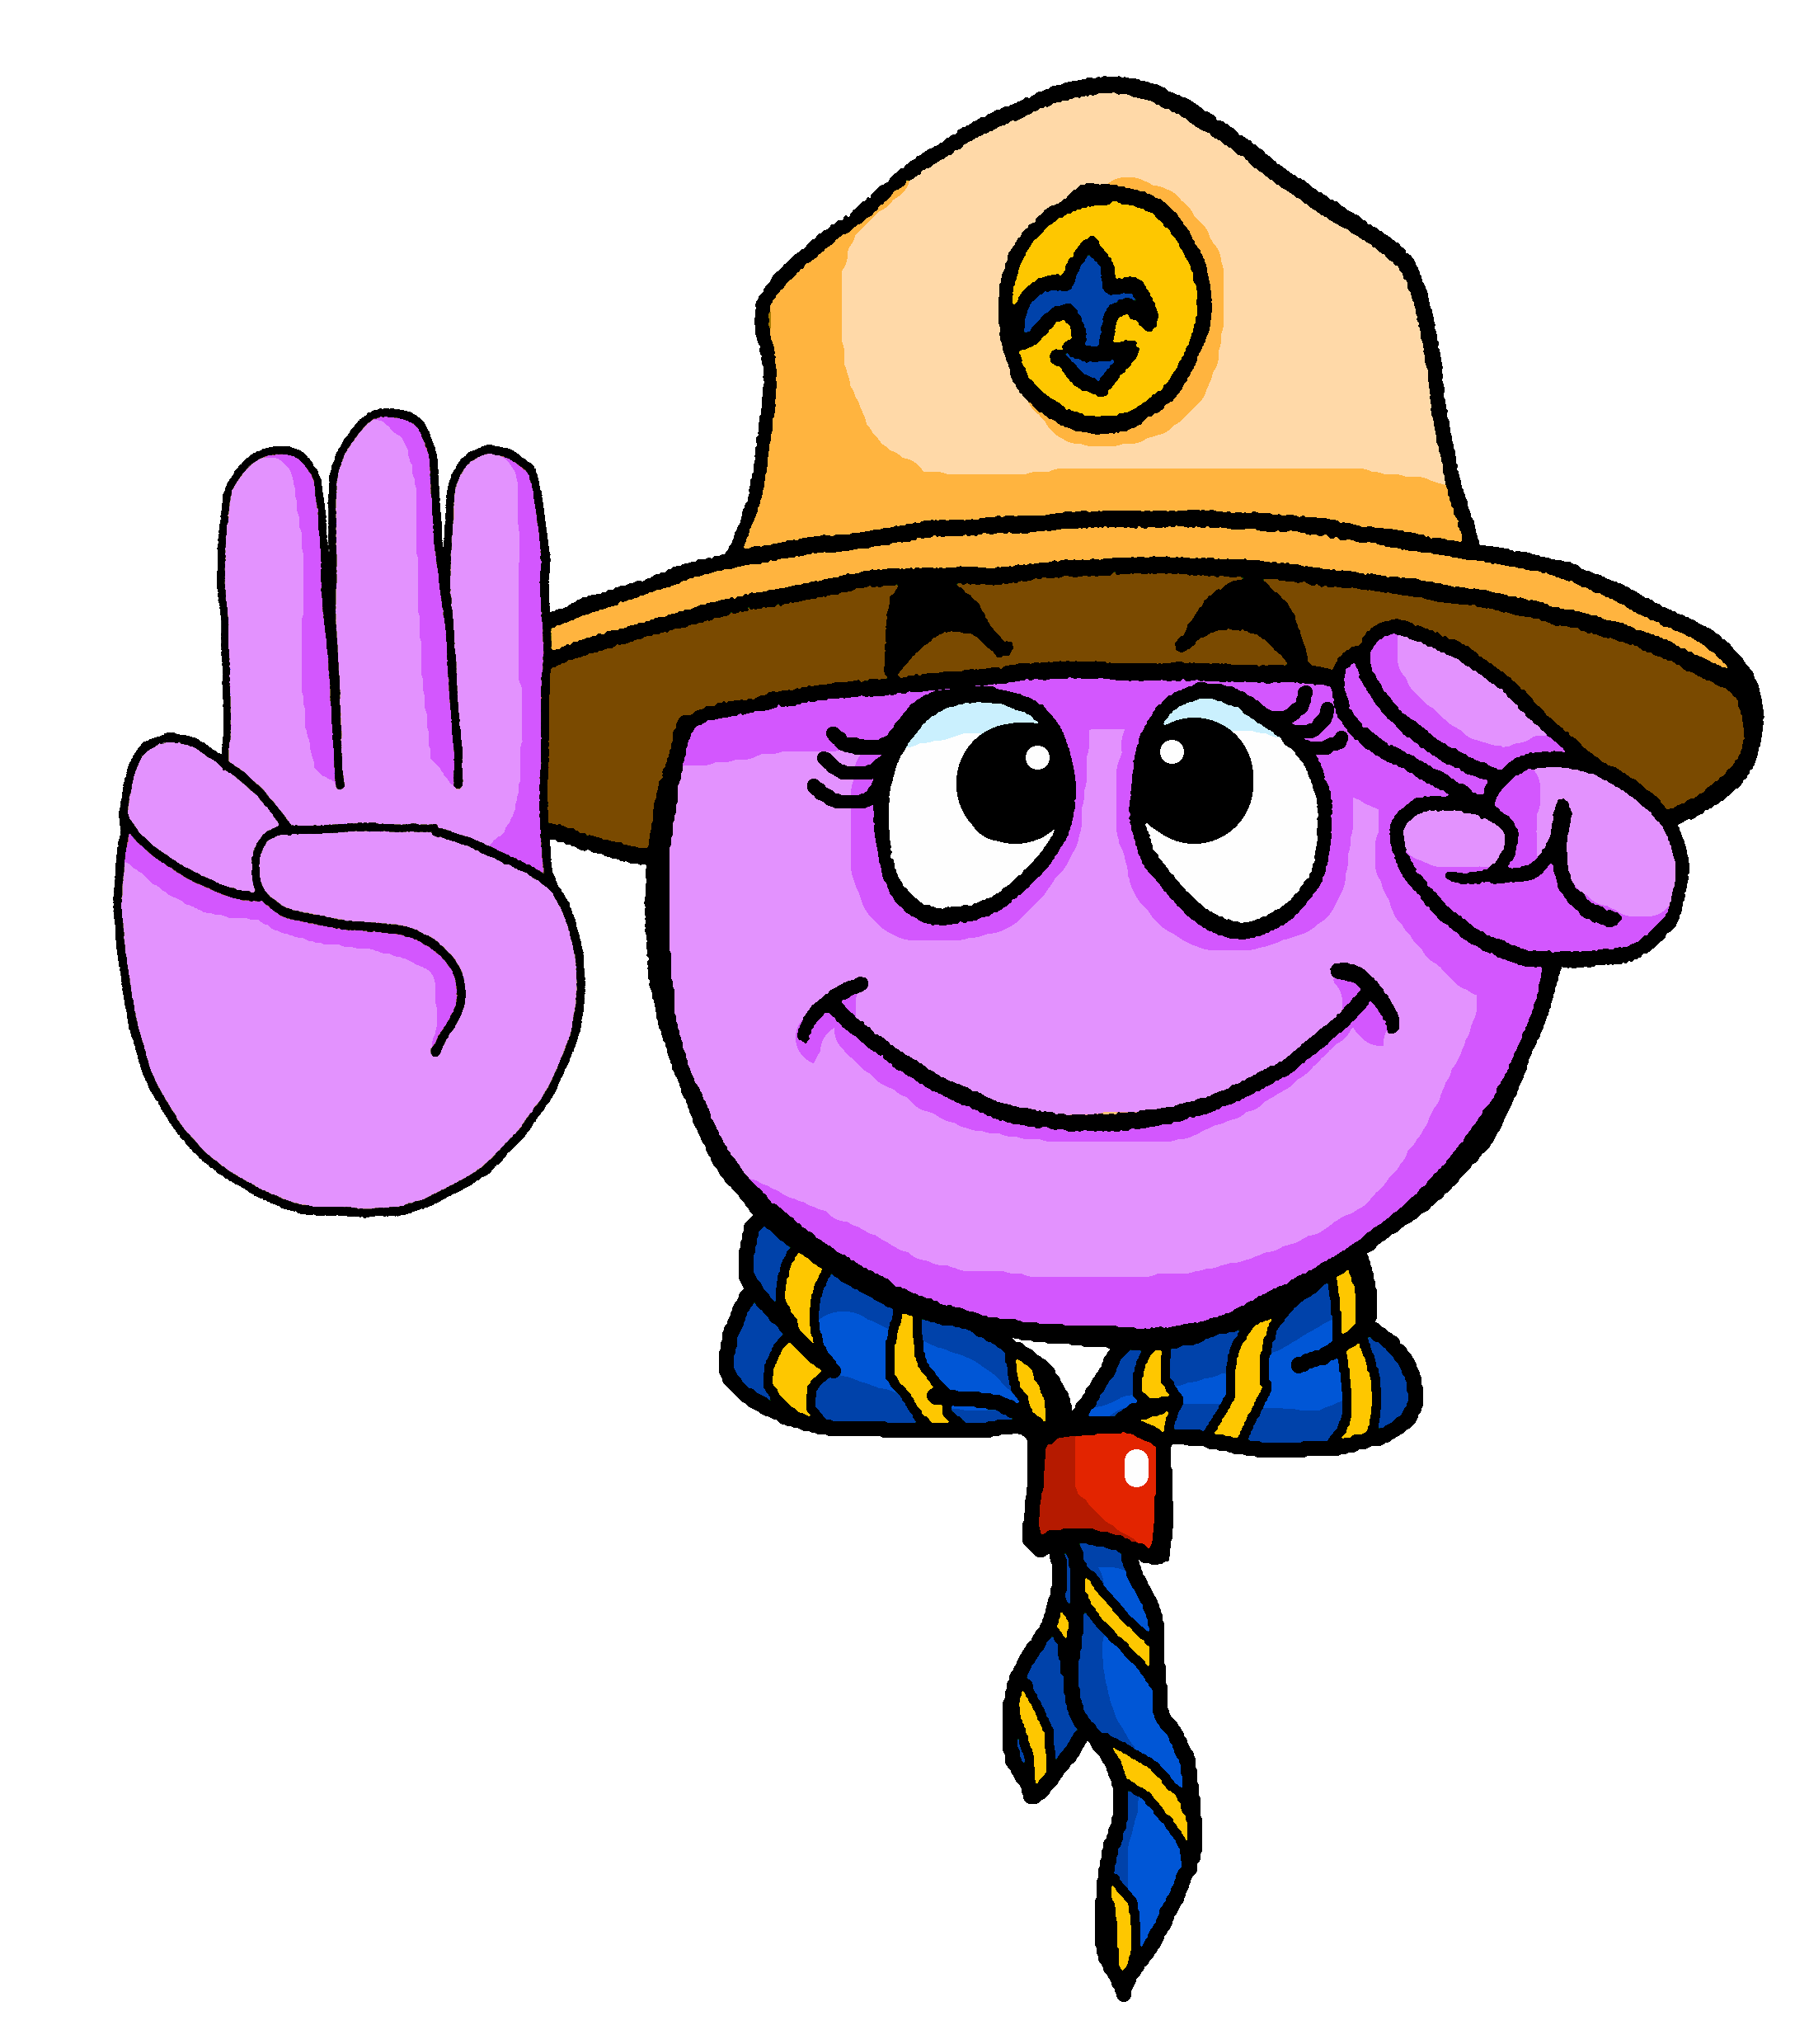
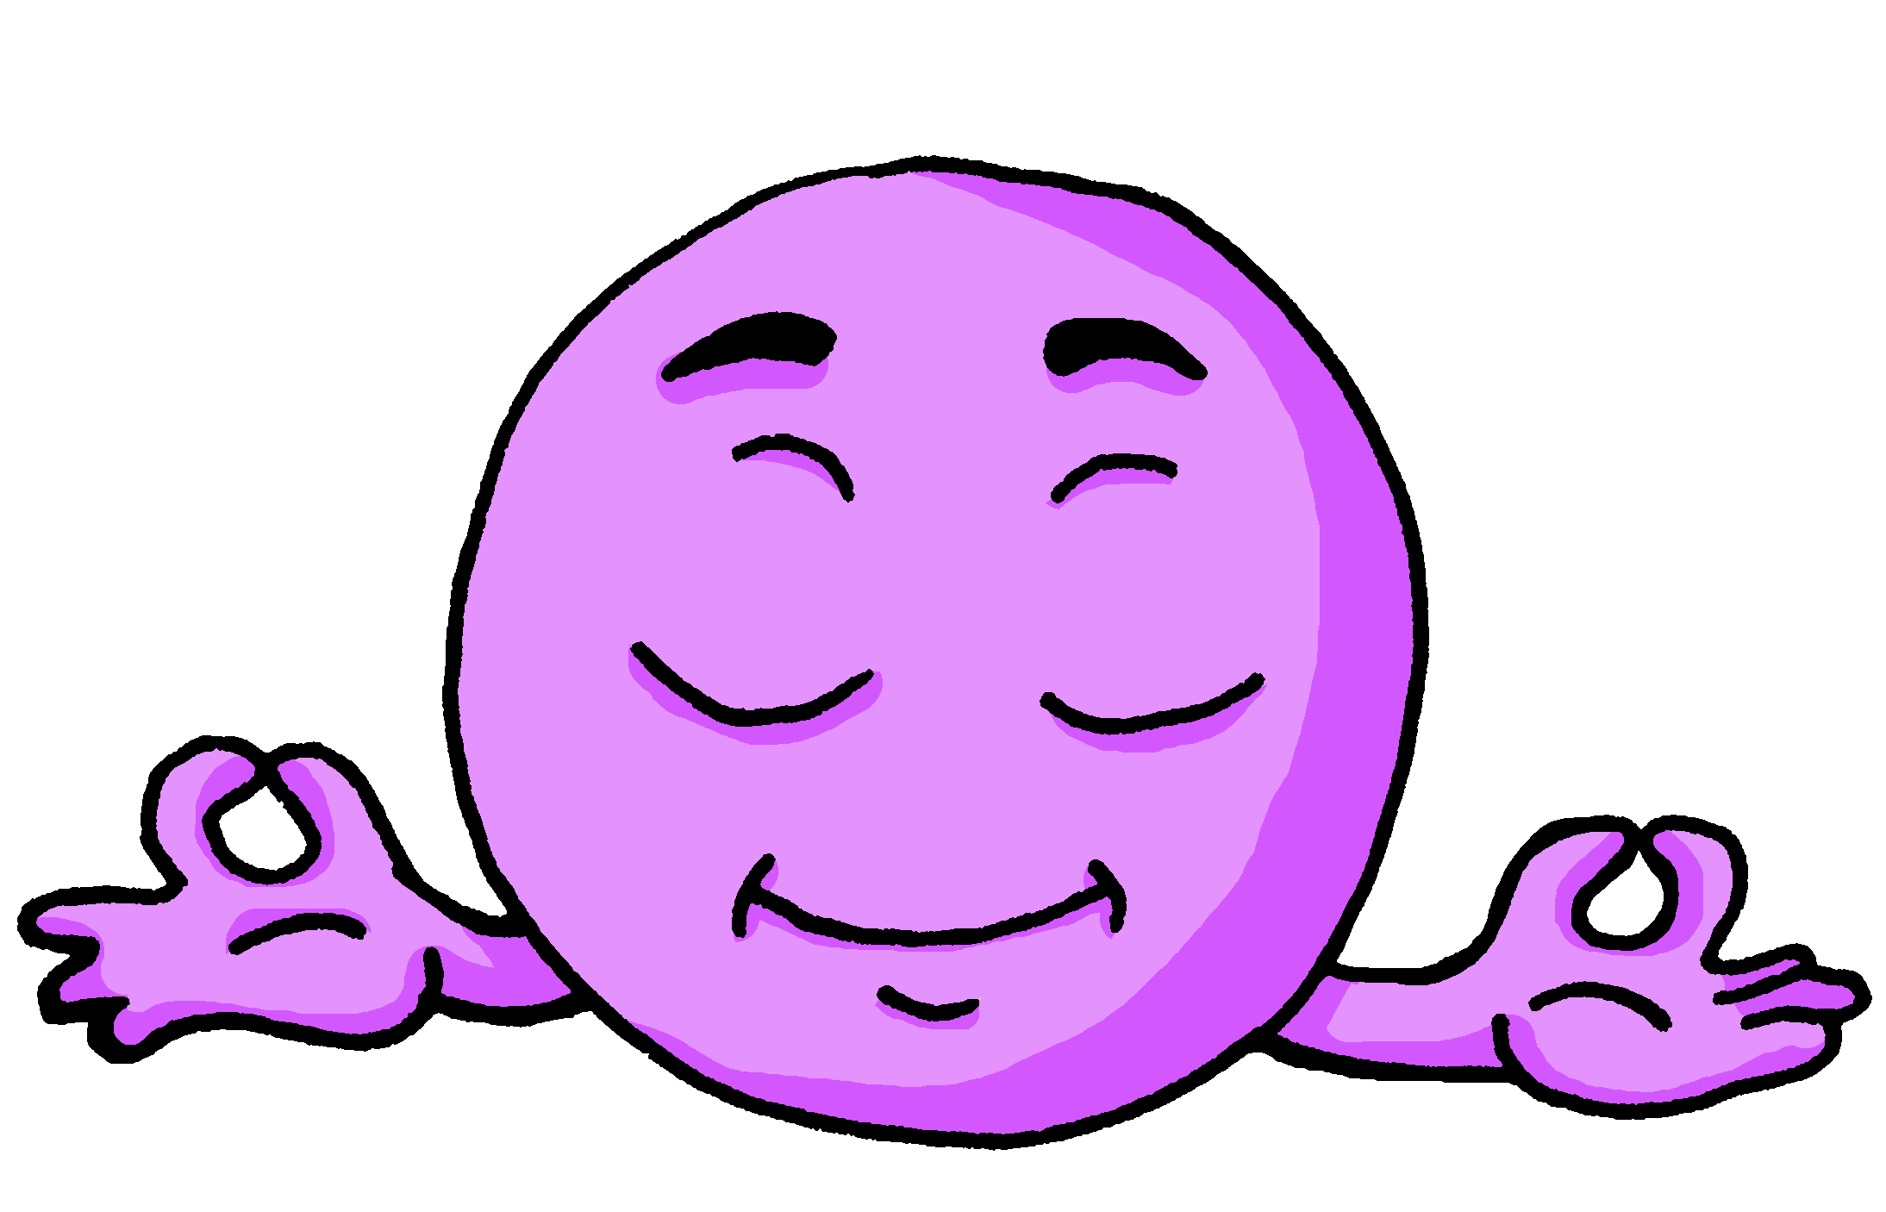
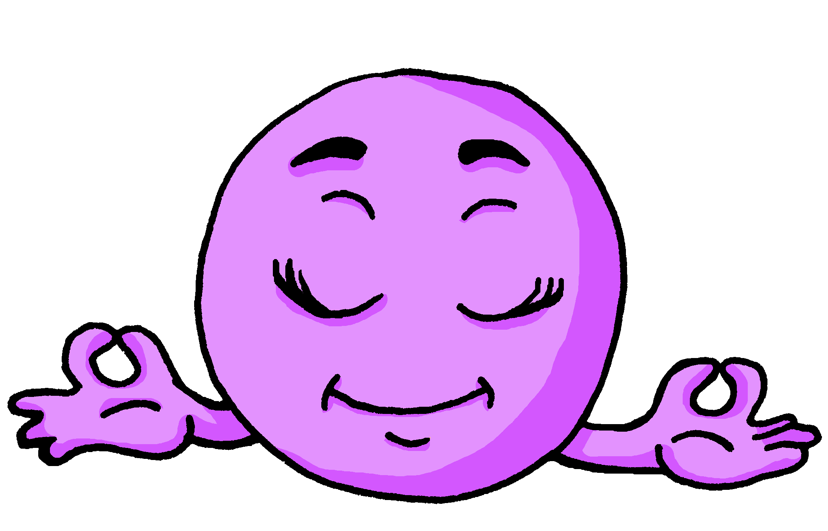
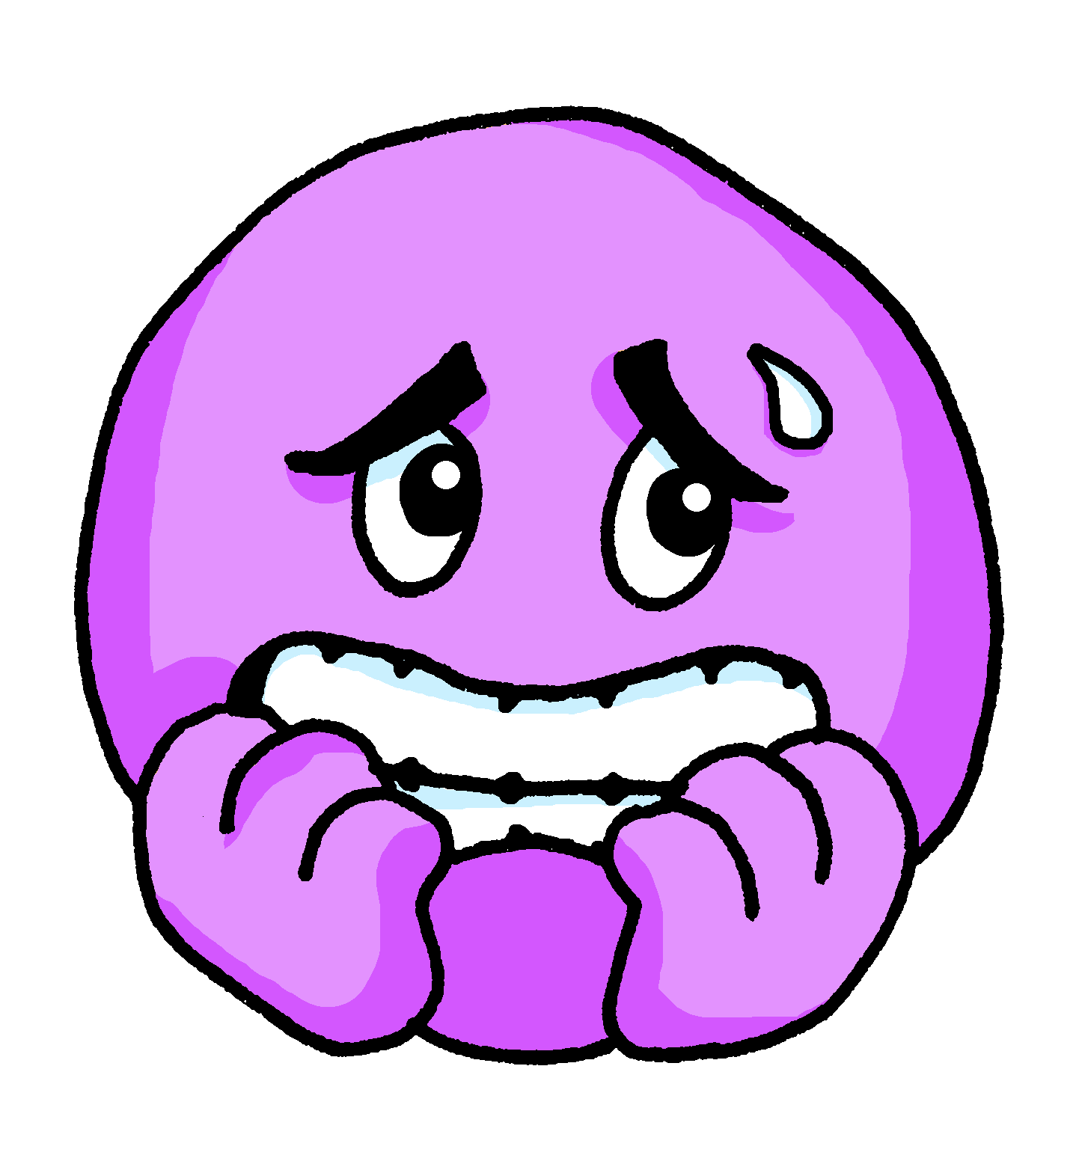
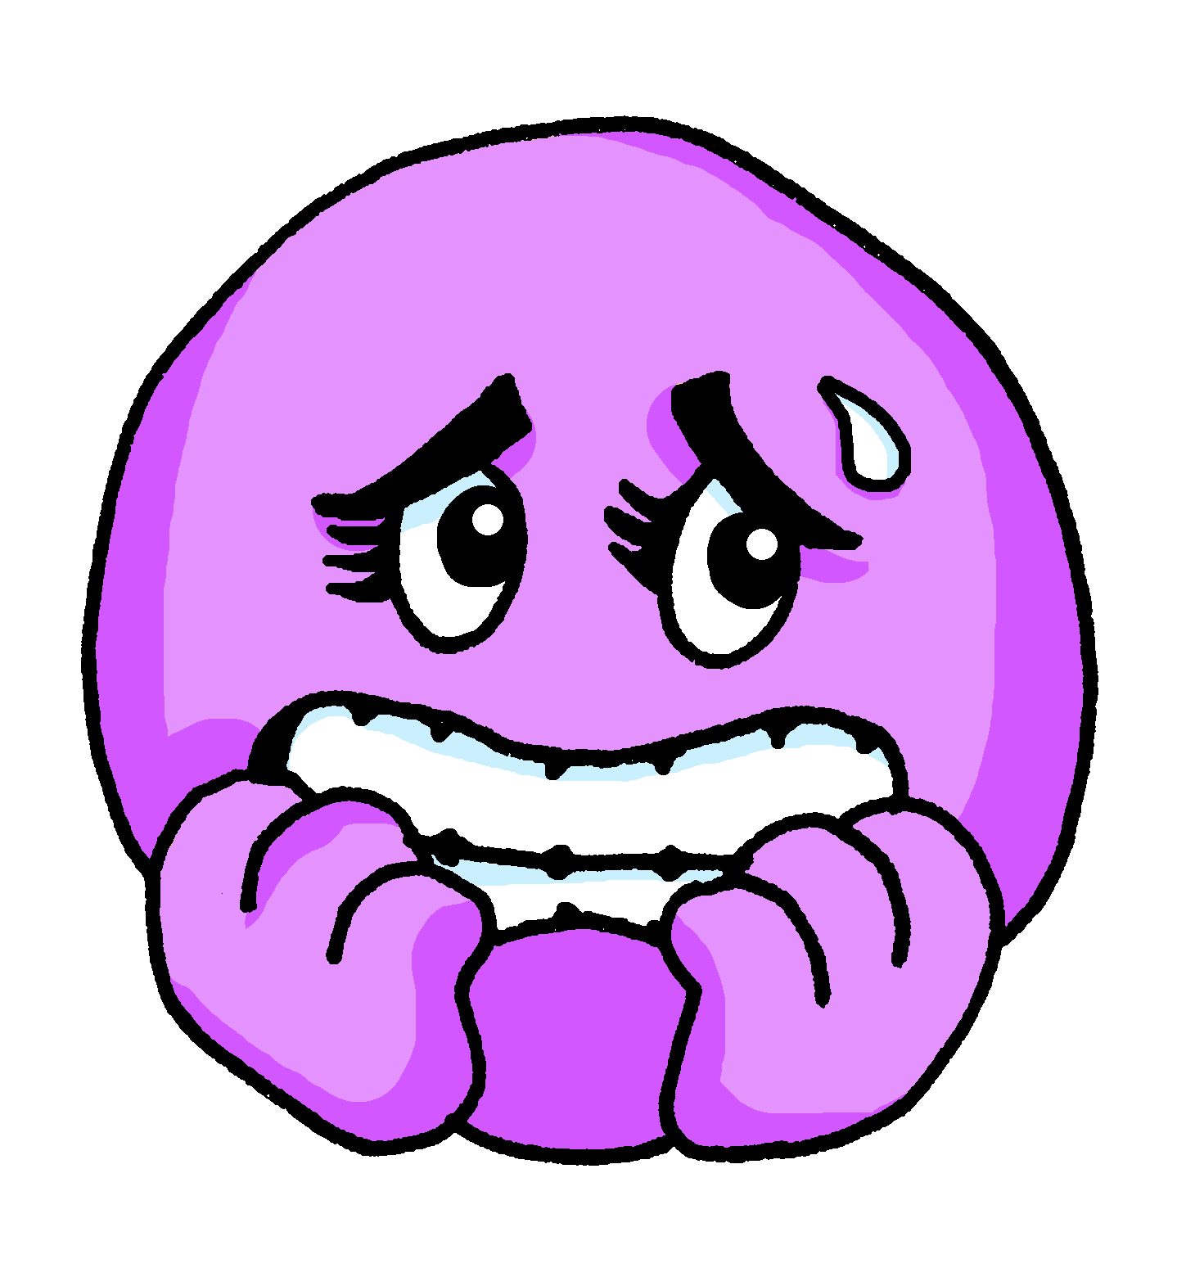
hablar
¿Cómo estás hoy?
¡Buenos días! / ¡Buenas tardes! / ¡Hola!, señor/señora _____
perdido perdida
preparado preparada
tranquilo tranquila
nervioso nerviosa
positivo positiva
negativo negativa
cansado cansada
Hoy estoy
Today I am (feeling)
Notes:
Timing: 5 minutes
Aim: to use ‘estoy’ / ‘estás’ + correct adjectival agreement in guided oral production; revisiting how to respond to the register (using estoy + correct form of the adjective).
Procedure:
Read the question and elicit English meaning. This is their first Spanish lesson (Y5/6) so this is a great opportunity to model how to respond to the register in Spanish and establish a good routine.
Pupils have been taught all of these words previously, except negativo, which is new. There are quite a few cognates – elicit meanings. Then elicit or provide meanings for “perdido” / “tranquilo” / “cansado”, which pupils may have forgotten.
Pupils work in pairs to practise their sentence (1-2 minutes).
Teacher takes (or retakes) the register, giving all pupils the opportunity to practise spoken production. (3 minutes).
Note: pupils can be challenged to respond without referring to the board (e.g. by turning away when responding).

Slide 14
ser
[to be | being] (with permanent traits)
In Spanish the verb ser means ‘to be’ when describing permanent traits.
Soy activo.
Eres tranquilo.
I am active.
You are calm.
We have already seen that the verb estar means ‘to be’ when describing mood or temporary state (“right now”)
Notes:
Timing: 2 minutes
Aim: to revisit to be (ser) for permanent traits.
Procedure:
Read the grammar explanation of “ser”, “soy” and “eres”.
Elicit English translation for the Spanish examples provided.
Draw their attention to “estar” also meaning “to be”.

Slide 15
pronunciar
¿quién?
who?
¿Quién eres?
[Who are you?]
Rachel Hawkes / Emma Marsden
Notes:
Timing: 1 minute
Aim: to introduce the question word ¿quién? (use the key action for the sound ‘qui’) with ‘eres’
Procedure:
Pupils listen and repeat the key question word (include gesture if possible).
Display the word and get them to repeat one more time.
Elicit English meaning.
Reveal the sentence.

Slide 16
pronunciar
¿cómo?
how?
¿Cómo eres?
[How are you? (in general)] What are you like?
Rachel Hawkes / Emma Marsden
Notes:
Timing: 1 minute
Aim: To revisit ‘cómo’ with “eres”
Procedure:
Pupils listen and repeat the key question word (include gesture if possible).
Display the word and get them to repeat one more time.
Elicit English meaning – insist on “in general” and tell pupils that this is usually translated in English as ‘What are you like?’
Reveal the sentence.

Slide 17
escuchar
Escucha a la señora Cano.
She meeting her new class.
¿Quién o cómo?
escuchar
Write the question word in Spanish and the answer in English.
Who? |How? | Respuesta en inglés
E
E
¿Cómo eres?
I (a girl) am creative.
Soy creativa.
1
1
¿Cómo eres?
I (a boy) am active.
2
2
¿Quién eres?
I’m Úrsula.
3
3
¿Quién eres?
I’m Rubén.
4
4
¿Cómo eres?
I (a boy) am very calm.
5
5
¿Quién eres?
I’m Camila.
Notes:
Timing: 5 minutes
Aim: to practise aural comprehension of soy + name versus soy + general trait to indicate the missing question word; to practise written production of two question words.
Note: to remove the written support for ¿Quién? and ¿Cómo? during the task, click on the instruction before listening (or at any time during the task) to make it disappear.
Procedure:
Do the example with pupils.
Pupils write 1-5.
Click to listen. Pupils write the missing question word in Spanish and the answer in English.
Listen twice, as necessary.
Click to reveal answers.
Click to reveal a 2nd set of audio buttons to re-listen to the full questions and answers.
Transcript
E ¿[Cómo] eres? | Soy creativa.
1. ¿[Cómo] eres? | Soy activo.
2. ¿[Quién] eres? | Soy Úrsula.
3. ¿[Quién] eres? | Soy Rubén.
4. ¿[Cómo] eres? | Soy muy tranquilo.
5. ¿[Quién] eres? | Soy Camila.

Slide 18
vocabulario
Escribe en inglés 📝.
Can you get at least15 points?
a b ñ
 | inteligente | demasiado | (la) tortuga
 | amable | divertido | (el) conejo
 | (la) guitarra | enseñar | (el) niño
 | participar | practicar | (el) trabajo
 | señora | señor | ¿quién?
 | estás | creativa | ¿cómo?
 | estoy | negativa | tonto
vocabulario
vocabulario
vocabulario
vocabulario
vocabulario
intelligent
too (much)
tortoise
x3
nice, kind
fun (m)
rabbit
to teach, show
guitar
child, kid (m)
x2
to participate
to practise, practising
Work, job
Mrs, Miss, Ms (teacher)
Mr., Sir –(teacher)
Who?
you are (state)
creative (f)
How?
x1
I am (state)
negative (f)
silly (m)
Notes:
OPTIONAL (TIME PERMITTING)
Timing: 6 minutes
Aim: to practise written comprehension of vocabulary from this week and Y3/4.
Procedure: 1. Give pupils a blank grid (see final slide) 2. They fill in the English meanings of any of the words they know, trying to reach 15 points in total.
Note: The most recently learnt and practised words are pink. As this is the first lesson in Y5/6, words in green / blue are from Y3/4 SOW thus more points are awarded for them, to recognise that memories fade and more effort (heavy lifting!) is needed to retrieve them.

Slide 19
¡adiós!
azul

Slide 20
vocabulario
Escribe en inglés 📝.
Can you get at least15 points?
a b ñ
vocabulario
 | deportista | rosa | muy
 | naranja | después | para mí
 | mi | tu | con
 | cada | amigo | jugar
 | Señora | Señor | ¿Quién?
 | estás | creativa | ¿Cómo?
 | estoy | negativa | tonto
vocabulario
vocabulario
vocabulario
vocabulario
vocabulario
sporty
pink
very
x3
orange
after
for me
my
your
with
x2
each, every
friend (m)
to play, playing
Mrs, (Miss – teacher)
Mr., (Sir – teacher)
Who?
you are (state)
creative (f)
How?
x1
I am (state)
negative (f)
silly (m)
Notes:
BLANK GRID FOR PRINTING

