Slide 1



Describing me and others
¿Cómo estás?
azul
Follow ups 1-5
Notes:
Artwork by Steve Clarke. Pronoun pictures from NCELP (ncelp.org). All additional pictures selected are available under a Creative Commons license, no attribution required.
The frequency rankings for words that occur in this PowerPoint which have been previously introduced in the resources are given in the SOW (excel document) and in the resources that first introduced and formally re-visited those words.
For any other words that occur incidentally in this PowerPoint, frequency rankings will be provided in the notes field wherever possible.
Phonics:
Revisit SSC: [a] [o] [u] source: casa [106] dos [64] universo [1603]
Vocabulary (new words in bold): estar [21] estoy [21] estás [21] ser [7] soy [7] eres [7] quién [289] señor [201] señora [509] activo [1279] cansado [1818] creativo [2945] negativo [1804] nervioso [1521] perdido [1899] positivo [1188] preparado [2092] raro [1005] serio [856] tonto [2379] tranquilo [1093] muy [43] ¡Buenos días! [103/65] ¡Buenas tardes! [103/392] hola [1245]
Revisit 1: cuidar [751] enseñar [610] participar [593] practicar [1595] guitarra [2705] niño, niña [173] trabajo [152]
Revisit 2: conejo [4728] tortuga [>5000] amable [2707] diferente [293] divertido [2465] inteligente [2167]
demasiado [494]
Frequency of unknown words:
diálogo [1466] Orden [421]
Source: Davies, M. and Davies, K. (2018). A frequency dictionary of Spanish: Core vocabulary for learners (2nd ed.). Routledge: London

Slide 2



Follow up 1:
[a]
[o]
[u]
A
B
a
↓
z
Escucha. ¿Qué palabra es?
Lee en orden* alfabético.
pronunciar
1 minuto
Marcos
Alba
Alba
[E]
moro | mora
Alonso
a
↓
z
Luna
[1]
cano | cuna
Malú
Rosa
Malú
[2]
paso | pasa
Sol
Marcos
[3]
rosa | rusa
Paca
Paca
[4]
duda | dudo
Pol
Luna
Rosa
0
Pol
[5]
rima | rimo
INICIO
Sol
Alonso
orden = order
Notes:
Timing: 5 minutes
Aim: to practise aural discrimination of the SSC [a] [o] [u].
Procedure:
Click to bring up the prompts.
Click on each audio symbol to listen to the words.
Click for the number answers. Pictures appear to clarify meaning.
Transcript:
[E] mora
[1] cano
[2] paso
[3] rusa
[4] duda
[5] rimo
Aim: to develop read aloud of words with SSC [a] [o] [u] and practise knowledge of alphabetical order.
Procedure:
Click to bring up the instruction.
Click to bring up the list of names.
Explain that pupils have one minute to pronounce the names, but in alphabetical order.
Start the timer. Pupils work in pairs, saying one each and alternating.
Teacher elicits answers one by one chorally from the class, and clicks to confirm.
Transcript:
Alba
Alonso
Luna
Malú
Marcos
Paca
Pol
Rosa
Sol
Frequency of unknown words:
Orden [421]
Source: Davies, M. and Davies, K. (2018). A frequency dictionary of Spanish: Core vocabulary for learners (2nd ed.). Routledge: London

Slide 3





Follow up 2: estar | ser
estar
ser
[to be | being]
(mood and temporary states)
[to be | being]
(permanent traits)
You know there are two verbs ‘to be’ in Spanish.
Compare:
¿Cómo estás?
¿Cómo eres?
How are you (feeling)?
How are you (in general)?
(What are you like?)
Estoy creativo.
Soy creativo.
I am (feeling) creative.
I am creative (in general).
Notes:
Timing: 7 minutes (two slides)
Aim: to recap knowledge of the two verbs ser and estar.
Procedure:
Use the animations to present and elicit knowledge from pupils.

Slide 4





escuchar
Escucha a la señora Cano.
She meeting her new class.
Is she asking about feelings today (hoy) or characteristics in general (generalmente)?
escuchar
Escribe el verbo (soy|estoy) y marca hoy|generalmente.
verbo | hoy? | general- mente? | adjetivo (en inglés)
Escribe en inglés .
E
estoy
positive (f)
E
1
estoy
negative (m)
1
2
soy
calm (m)
2
3
estoy
silly (m)
3
4
soy
creative (f)
4
5
soy
very active (f)
5
Notes:
Aim: to differentiate aurally between eres and estás, using the information to inform the correct choice of verb (soy | estoy) in the response, and the connection of both with meaning.
Procedure:
Model the task by doing the example. Pupils listen to the question and answer. The verb in the question informs their choice of verb in the answer (the verb is obscured by a beep). Pupils write the verb soy or estoy. They then tick today/now or in general, and write the adjective in English.
Click to play items 1-5. It is likely pupils will need to listen to each one twice.
Click to reveal the answers.
Transcript
E ¿Cómo estás? | [beep] positiva.
1. ¿Cómo estás? | [beep] negativo.
2. ¿Cómo eres? | [beep] tranquilo.
3. ¿Cómo estás? | [beep] tonto.
4. ¿Cómo eres? | [beep] creativa.
5. ¿Cómo eres? | [beep] muy activa.

Slide 5


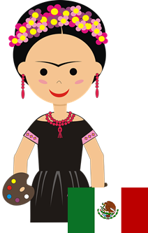
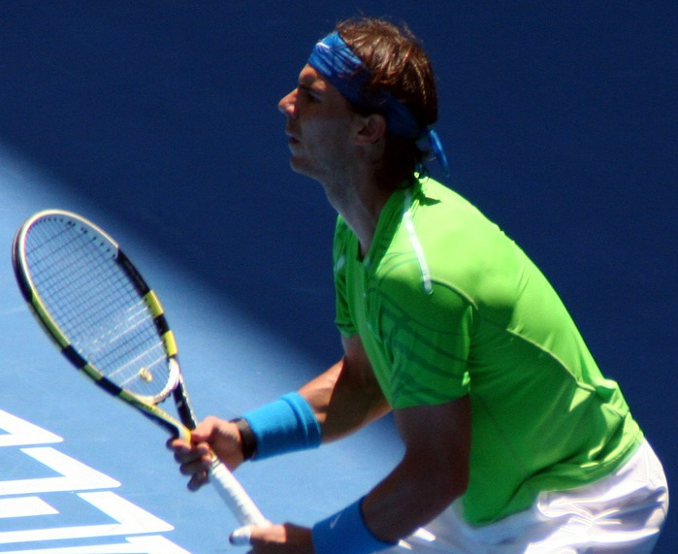
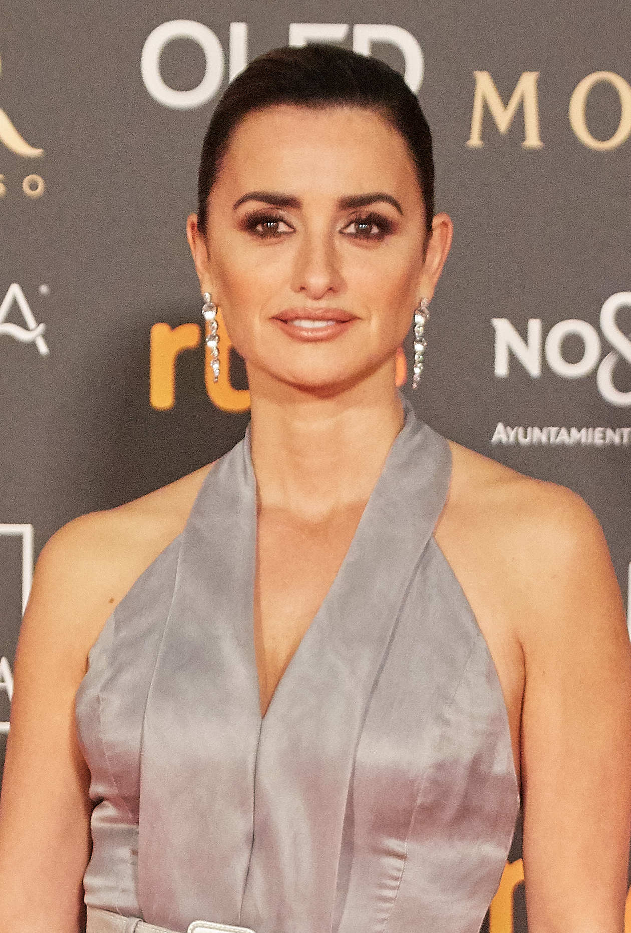
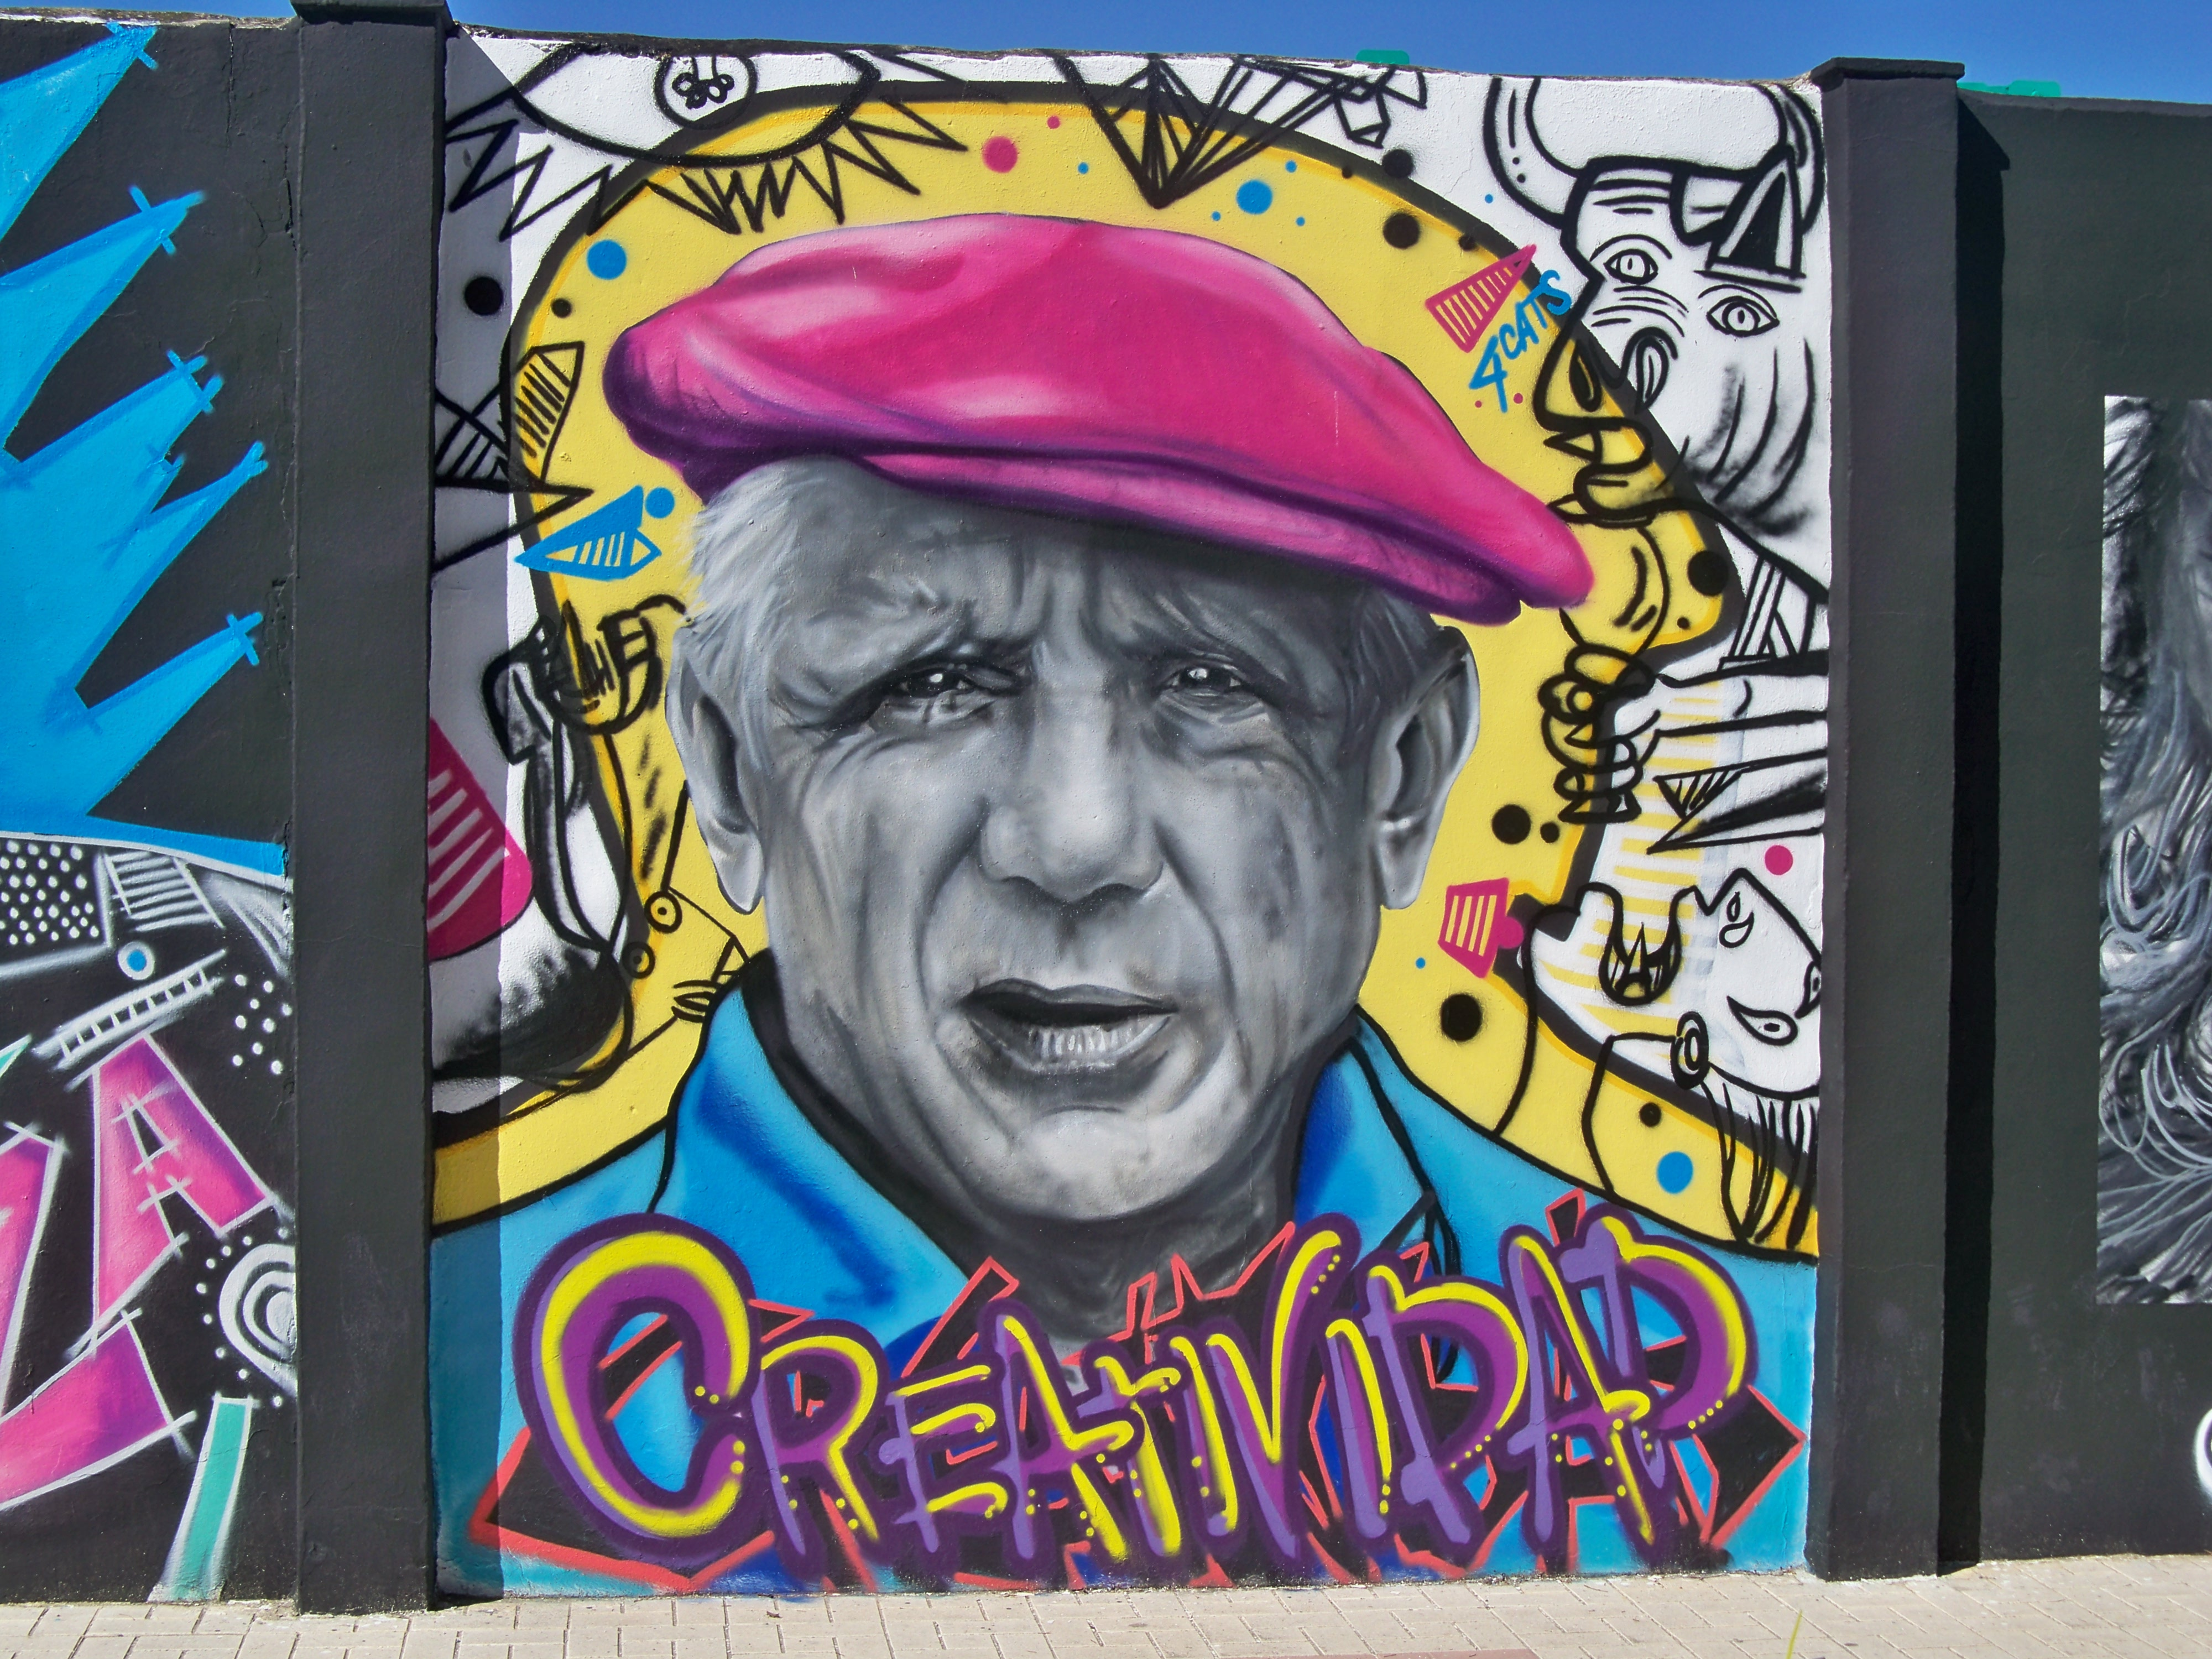
Follow up 3:
Lee y escribe el diálogo*.
1
2
- ¿Quién eres?
- Soy Frida Kahlo.
- ¿Cómo eres ?
- Soy creativa y tranquila.
- ¿Cómo estás?
- Estoy positiva. Ah – soy de México.
- ¡Hola! ¿Cómo estás?
- Estoy nervioso.
- ¿Quién eres?
- Soy Rafa Nadal y soy
muy activo.
- ¿De dónde eres?
- Soy de Mallorca.
leer
escribir
1 ___
1 __?
2 ___
2 ___
3 ___
escuchar
3 ___
4 ___
4 ___?
3
4
- ¿Quién eres?
- Soy Penelope Cruz.
- ¿Cómo estás?
- Estoy preparada.
- ¿Cómo eres?
- Soy positiva y seria. Soy
de España.
- Buenas tardes.
¿Cómo estás?
- Estoy perdido.
- ¿Quién eres?
- Soy Pablo Picasso y soy muy creativo y serio. Soy de España.
1 ___
1 ___
2 ___?
2 ___
3 ___
3 ___?
4 ___
4 ___
diálogo = dialogue
Notes:
Timing: 10 minutes
Aim: to practise written comprehension of the key vocabulary (adjectives and question words quién | cómo) linked to the correct translation of forms of estar | ser; to practise written production of question words and estás / estoy / eres / soy.
Procedure:
Do the example with them. Draw pupils’ attention to the words before and/or after the gap. For number 1 ask them ‘if we use “soy” + name to reply, which question word is missing?’ For number 2, pupils need to look at the words before and after the gap to work out which verb is missing. Guide them through 3 and 4 in a similar way. The click the number to hear the audio and pupils check their answers. Click to reveal the written answers.
Click to bring up text 2.
Give pupils time to complete items 1-4. Then listen and check and reveal the written answers.
Click to bring up texts 3 and 4 and complete, as previously.
Note: the texts are reused for comprehension tasks in follow up 4.
Penelope Cruz attribution: Pedro J Pacheco, CC BY-SA 4.0 <https://creativecommons.org/licenses/by-sa/4.0>, via Wikimedia Commons
Pablo Picasso attibution: Daniel Capilla, CC BY-SA 4.0 <https://creativecommons.org/licenses/by-sa/4.0>, via Wikimedia Commons
Frequency of unknown words:
diálogo [1466]
Source: Davies, M. and Davies, K. (2018). A frequency dictionary of Spanish: Core vocabulary for learners (2nd ed.). Routledge: London

Slide 6
Follow up 4:
Lee las frases.
How do they describe themselves?
leer
 |  | in general | today
1 | Soy Frida Kahlo y soy creativa y tranquila. Estoy positiva. Soy de Méjico.
2 | Estoy nervioso. Soy Rafa Nadal y soy muy activo. Soy de España.
2 | Soy Penélope Cruz. Estoy preparada. Soy positiva y seria. Soy de España.
4 | Estoy perdido. Soy Pablo Picasso y soy muy creativo y serio. Soy de España.
creative
positive
calm
(very) active
nervous
positive
ready
serious
(very)
creative
lost
serious
Notes:
Timing: 5 minutes
Aim: to recognise the key vocabulary (adjectives) linked to the correct meaning of forms of estar | ser (to be / being).
Procedure:
1. Do the example with them. Draw their attention to the underlined adjectives and the verb that accompanies them (soy creativa y tranquila). Ask them if we use “soy” as “I am in general” or “I am (feeling) today”. Repeat with “estoy positiva”.
2. Ask pupils to write 1-4, and write down in general / today on top. pupils to write the English translation under the right category.
3. Click to reveal answers.

Slide 7


Follow up 5:
Practica el diálogo*.
- ¡Buenas tardes!
hablar
¿Cómo estás?
¡Hola! [I am (state)] preparada.
Estoy
- ¿Quién eres?
[I am (trait)] Sofía.
Soy
- ¿Cómo eres?
Soy tranquila y muy [positive].
positiva.
diálogo = dialogue
Notes:
Support slide to model a dialogue, if time allows.
Timing: 2 minutes
Aim: to model the key questions and answers using soy / estoy / eres / estás + correct adjectival agreement.
Procedure:
Click through the animations to present and elicit the key language.

Slide 8
Follow up 5:
Con tu compañero/a, practica.
1
Good morning!
How are you (in general)?
4
hablar
Good afternoon!
I am … (in general)
1 minuto
Hello!
tranquilo tranquila
nervioso nerviosa
positivo positiva
negativo negativa
cansado cansada
perdido perdida
preparado preparada
2
How are you (today)?
(Today) I am …
3
Who are you?
I’m (name).
💡 ‘cansado’, ‘perdido’ and ‘preparado’ can only be used with ‘estar’.
0
INICIO
Notes:
Timing: 5 minutes
Aim: to use the full range of new and revisited language from this week in spoken production.
Procedure:
Explain the format of the task. (teal writing = Pupil A, dark blue = Pupil B)
Pupils practise in pairs. They produce most of the language from memory but have a list of m/f adjectives to support this element of production.
Pupils swap roles so that they have the opportunity to both ask and answer questions.
Teacher circulates to support, as necessary.

Slide 9
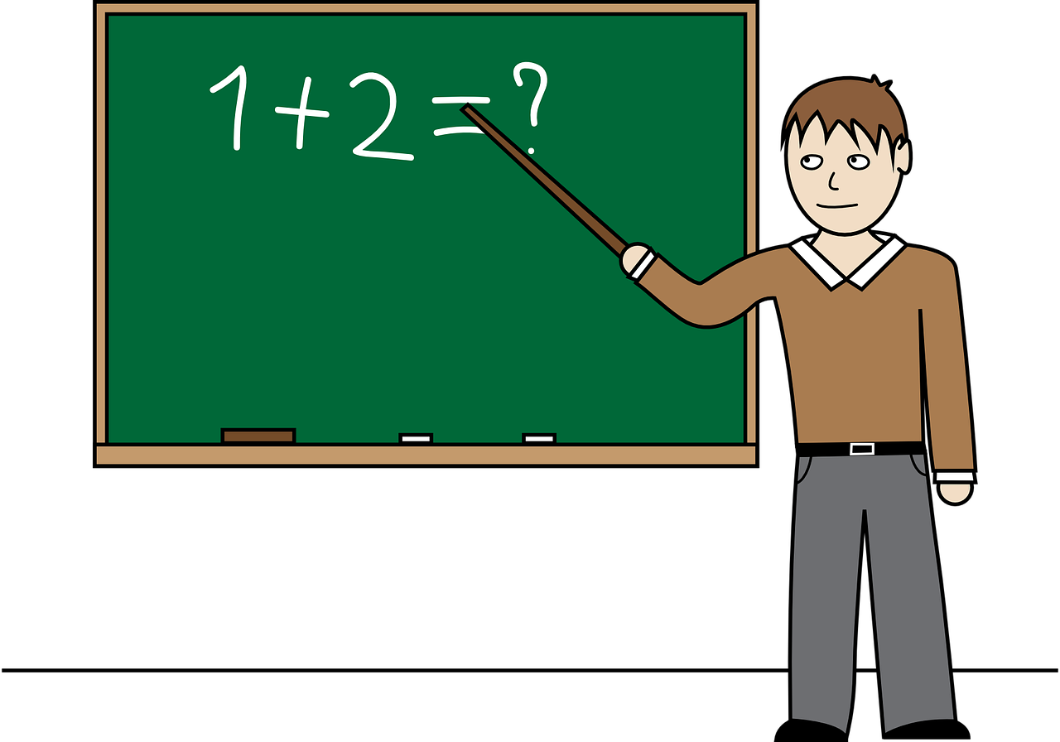
Follow up [extra] :
Escribe en español 📝.
escribir
I am Mr Luján and I am from Spain.
I am very sporty.
I am very negative every day but today
I am (feeling) positive.
Mrs Cano has an orange for me. ☺
Soy el Señor Luján y soy de España.
Soy muy deportista.
Soy muy negativo cada día pero hoy estoy positivo.
La señora Cano tiene una naranja para mí. ☺
Notes:
Additional follow up task
Timing: 10 minutes
Aim: to practise the key grammar features and key new and revisited vocabulary from this week.
Procedure:
1. Present the task.
2. Pupils write the four sentences in Spanish.
3. Click to provide a written answer.
Note: pupils should be encouraged to have a go at writing the words from memory. They should see this a practice task in which mistakes are expected and part of the process. Teachers should ensure that pupils understand the value of writing from memory as memory forming and strengthening – it is this practice itself which constitutes learning. Some of the vocabulary in the text have not been revisited for some considerable time, and pupils are likely to have forgotten some of it. They should just try their best, leaving gaps where they cannot remember, and not see this as a problem. They can add the words they didn’t remember during the feedback stage of the activity (perhaps in a different colour to highlight these words for additional attention later).
Additional task suggestions:
1. If this is too challenging for pupils, it could be provided as a gapped writing.
2. Alternatively, reverse the animations and provide the Spanish text for translation into English as a reading comprehension task.
3. There is a further individual word revision text on the next, which could be used instead.

Slide 10




Follow up 5b:
Escribe en español 📝.
a b ñ
vocabulario
Can you get at least15 points?
 | too (much) | kind, nice | rabbit
 | fun (f) | intelligent | tortoise
 | to practise | to teach, show | job, work
 | child,kid (f) | to participate | guitar
 | Mr., Sir (teacher) | creative (m) | silly (f)
 | How? | I am (state) | negative (f)
 | Who? | you are (state) | Mrs, Miss (teacher)
demasiado
amable
el conejo
x3
divertida
inteligente
la tortuga
practicar
enseñar
el trabajo
x2
la niña
participar
la gutiarra
señor
creativo
tonta
¿Cómo?
estoy
negativa
¿Quién?
estás
señora
Notes:
Timing: 6 minutes
Aim: to practise written comprehension of vocabulary from last week and this week.
Procedure:
1. Pupils need to write the Spanish for as many words as possible, aiming to get at least 15 points (but more if possible).
2. Click for Spanish answers.
Note:
The most recently learnt and practised words are pink, words from the previous week are green and those from two weeks ago are blue, thus more points are awarded for them, to recognise that memories fade and more effort (heavy lifting!) is needed to retrieve them.

Slide 11
Follow up 5b:
Escribe en español 📝.
a b ñ
vocabulario
Can you get at least15 points?
 | too (much) | kind, nice | rabbit
 | fun (f) | intelligent | tortoise
 | to practise | enseñar | job, work
 | niña | to participate | guitar
 | Mr., Sir (teacher) | creative (m) | silly (f)
 | How? | I am (state) | negative (f)
 | Who? | you are (state) | Mrs, Miss (teacher)
x3
x2
Notes:
Timing: 6 minutes
Aim: to practise written comprehension of vocabulary from last week and this week.
Procedure:
1. Pupils need to write the Spanish for as many words as possible, aiming to get at least 15 points (but more if possible).
2. Click for Spanish answers.
Note:
The most recently learnt and practised words are pink, words from the previous week are green and those from two weeks ago are blue, thus more points are awarded for them, to recognise that memories fade and more effort (heavy lifting!) is needed to retrieve them.

