Slide 1
español, con Quique
¡Feliz Navidad!

Slide 2
Saying what I and others have
A Christmas carol
azul
Notes:
Artwork by Steve Clarke. All additional pictures selected are available under a Creative Commons license, no attribution required.
The frequency rankings for words that occur in this PowerPoint which have been previously introduced in the resources are given in the SOW (excel document) and in the resources that first introduced and formally re-visited those words.
vocabulary:
SSC:
For any other words that occur incidentally in this PowerPoint, frequency rankings will be provided in the notes field wherever possible.
Glossed words: el villancico = Christmas carol
Source: Davies, M. & Davies, K. (2018). A frequency dictionary of Spanish: Core vocabulary for learners (2nd ed.). Routledge: London

Slide 3
escuchar
Vocabulary
At home, Nina speaks Aymara, a language spoken by Aymara people of Peru and Bolivia. She is learning Spanish at school, like you. Help Nina by answering the questions in this quiz.
A For each question, put a cross (x) under the English meaning that matches what you hear.
You will hear each Spanish word twice. Choose one correct answer only.
 | A | B | C | D
Ej. | 1 | 11 | 21 | 31
 | ☐ | ☐ | ☐ | ☐
1. | there is/are | to have | to be | s/he, it has
 | ☐ | ☐ | ☐ | ☐
2. | a bit | ugly | too | silly
 | ☐ | ☐ | ☐ | ☐
3. | which | what | when | who
 | ☐ | ☐ | ☐ | ☐
1
2
3
4
Notes:
Timing: 20-25 minutes (all assessment slides)
Aim: to practise aural comprehension of vocabulary taught in weeks 1-12 of the course.
Procedure:
1. Click the audio buttons to play each item. (The words are recorded twice with a pause to allow pupils to process the information).
2. Pupils can either write 1C, etc.. or if they have the assessment on a print out they can put a X in the correct box.
3. After items 1-4, continue to the next slide to complete the remainder of the task.
Transcript:
1. veintiuno
2. tener
3. tonto
4. quién ?
5. leer
6. quince
7. viejo
8. moreno

Slide 4
escuchar
Vocabulary
A For each question, put a cross (x) under the English meaning that matches what you hear.
You will hear each Spanish word twice. Choose one correct answer only.
 | A | B | C | D
4. | to read | to listen | to sing | to prepare
 | ☐ | ☐ | ☐ | ☐
5. | 15 | 14 | 12 | 13
 | ☐ | ☐ | ☐ | ☐
6. | long | short | old | new
 | ☐ | ☐ | ☐ | ☐
 | dark, brown | black | enormous | blond
 | ☐ | ☐ | ☐ | ☐
5
6
7
8
Notes:
Timing: 20-25 minutes (all assessment slides)
Aim: to practise aural comprehension of vocabulary taught in weeks 1-12 of the course.
Procedure:
1. Click the audio buttons to play each item. (The words are recorded twice with a pause to allow pupils to process the information).
2. Pupils can either write 1C, etc.. or if they have the assessment on a print out they can put a X in the correct box.
Transcript:
1. veintiuno
2. tener
3. tonto
4. quién ?
5. leer
6. quince
7. viejo
8. moreno

Slide 5
escuchar
Vocabulary
B For each question, put a cross (x) under the type of word you hear. You will hear each Spanish word twice. Choose one correct answer only.
This word is a good example of …
 | A | B | C | D
 | a place ☐ | a person ☐ | a month ☐ | a greeting ☐
 | a day ☐ | an object ☐ | an animal ☐ | a part of the body ☐
 | a greeting ☐ | a question word ☐ | personality ☐ | a number ☐
 | a number ☐ | position ☐ | a question word ☐ | a part of the body ☐
1
2
3
4
Notes:
Procedure:
1. Click the audio buttons to play each item. (The words are recorded twice with a pause to allow pupils to process the information).
2. Pupils can either write 1C, etc.. or if they have the assessment on a print out they can put a X in the correct box.
3. When complete, continue to the reading.
Transcript:
1. el jardín
2. la mochila
3. treinta
4. detrás
5. rubio
6. junio
7. la oreja
8. cuál

Slide 6
escuchar
Vocabulary
B For each question, put a cross (x) under the type of word you hear. You will hear each Spanish word twice. Choose one correct answer only.
This word is a good example of …
 | A | B | C | D
 | personality description ☐ | a question word ☐ | physical description ☐ | a number ☐
 | a month ☐ | a greeting ☐ | personality ☐ | a day ☐
 | a number ☐ | a part of the body ☐ | a month ☐ | a day ☐
 | a greeting ☐ | position ☐ | a question word ☐ | a colour ☐
5
6
7
8
Notes:
Transcript:
1. el jardín
2. la mochila
3. treinta
4. detrás
5. rubio
6. junio
7. la oreja
8. cuál

Slide 7
leer
A Translate the underlined Spanish word(s) to complete each English sentence.
1. Tiene el pelo negro y corto. He has _____________, ___________ ________.
2. El Señor Valero no es negativo. ____ Valerio ________ negative.
3. Tienes una nariz larga. You have a ___________ ___________ .
4. Hay trece diccionarios ? Are there ________ ___________________?
5. ¡Es demasiado fácil! It’s ____________ ___________!
6. Está debajo de la mesa. It is ____________ __________ ___________ .
7. Tiene un pegamento ? Does he have ________________________?.
8. Sofía solo tiene un poco. Sofía _______ has ______________.
9. No tiene una cara fea. It doesn’t have an ___________ _______________.
10. El médico es nuevo. ___ __________ is ____________ .
Notes:
ANSWERS

Slide 8
escribir
B Translate the underlined English words to complete the Spanish sentence.
1. It is an enormous class. Es una ___________ __________. (write two words)
2. It is a small space. Es un __________ _____________. (write two words)
3. The doctor (f) is creative. ___ __________ es ____________. (write two words)
4. He has a blue rubber. Tiene una __________ _______. (write two words)
5. Mrs Román is curious and nice. _______ Román es curiosa ___ amable. (write two words)
6. Today it’s my birthday. _____ es mi _______________. (write two words)
7. There is a lamp in the office. Hay una ___________ en la _______. (write two words)
8. He has round eyes. . Tiene _____ ojos _____________. (write two words)
9. I need a sandwich now. Necesito ____ _____________ _______. (write three words)
10. Yes, he is calm, too! ____, es tranquilo ____________ ! (write two words)
Notes:
ANSWERS

Slide 9
leer
Grammar
A Put a (X) next to the person the sentence is about.
1 | ☐ I ☐ you _{[singular]} ☐ s/he, it ☐ we ☐ they | Es inteligente. |  | 4 | ☐ I ☐ you _{[singular]} ☐ s/he, it ☐ we ☐ they | Tenemos una amiga.
2 | ☐ I ☐ you _{[singular]} ☐ s/he, it ☐ we ☐ they | Son creativos. |  | 5 | ☐ I ☐ you _{[singular]} ☐ s/he, it ☐ we ☐ they | Están en clase.
3 | ☐ I ☐ you _{[singular]} ☐ s/he, it ☐ we ☐ they | Estás triste. |  | 6 | ☐ I ☐ you _{[singular]} ☐ s/he, it ☐ we ☐ they | Tiene una pregunta.
Notes:
ANSWERS

Slide 10
leer
Grammar
Like English, Aymara doesn’t have grammatical gender and adjectives go before the noun. Verb forms are different, too. Help Nina with her Spanish grammar by answering the questions in this part of the quiz.
B Put a cross (x) next to the correct English meaning.
1. Estoy contento. | ☐ I am pleased. | ☐ I am not pleased.
2. No tienes un gato. | ☐ You have a cat. | ☐ You do not have a cat.
3. Habla español. | ☐ She speaks Spanish. | ☐ She does not speak Spanish.
4. No eres rápido. | ☐ You are fast. | ☐ You are not fast.
C ESTAR or SER? Put a cross (x) next to the correct start of each sentence.
1. | ☐ Está… ☐ Es … | tranquilo hoy.
2. | ☐ Son … ☐ Están … | en Perú.
3. | ☐ Están … ☐ Son … | serios siempre.
Notes:
ANSWERS

Slide 11
leer
Grammar
D Write the words in each box in the correct order to make a question.
1. | hay cuántos cuadernos | Correct order:_________________________________________
2. | la fecha es cuál | Correct order:_________________________________________
E Singular or plural? Put a cross (x) next to the correct start of each sentence.
1. | ☐ Es… ☐ Son … | elegantes.
2. | ☐ Está… ☐ Están … | preparado.
3. | ☐ Son … ☐ Es … | especiales.
4. | ☐ Están … ☐ Está … | nerviosa.
Notes:
ANSWERS

Slide 12
leer
Grammar
F Write the words in each box in the correct order.
1. | profesora estricta una | Correct order:_________________________________________
2. | problemas unos difíciles | Correct order:_________________________________________
escribir
G Write the Spanish for the English given in brackets. Use the clues to help you.
 |  | Clues
1. | ___________ allí. (you are) | to be = estar
2. | ___________ una foto. (I have) | to have = tener
3. | ___________ un libro. (they have) | to have = avoir
4. | _______________ importantes. (we are) | to be = ser
5. | _________ de Inglaterra. (I am) | to be = ser
6. | __________ cansados. (we are) | to be = estar
Notes:
ANSWERS

Slide 13
escribir
H Write the Spanish article ‘a’ or ‘some’. The gender (and number) of the noun is provided.
1. | Es _______ casa. (f)
2. | Hay ________ frases. (fpl)
3. | Son ________ bolígrafos. (mpl)
4. | Hay ________ perro. (m)
I Write the Spanish article ‘the’. The gender (and number) of the noun is provided.
1. | _____ teléfono (m) gris.
2. | _____ gatos (mpl) negros.
3. | _____ pelotas (fpl) redondas.
4. | _____ silla (f) blanca.
Notes:
ANSWERS

Slide 14
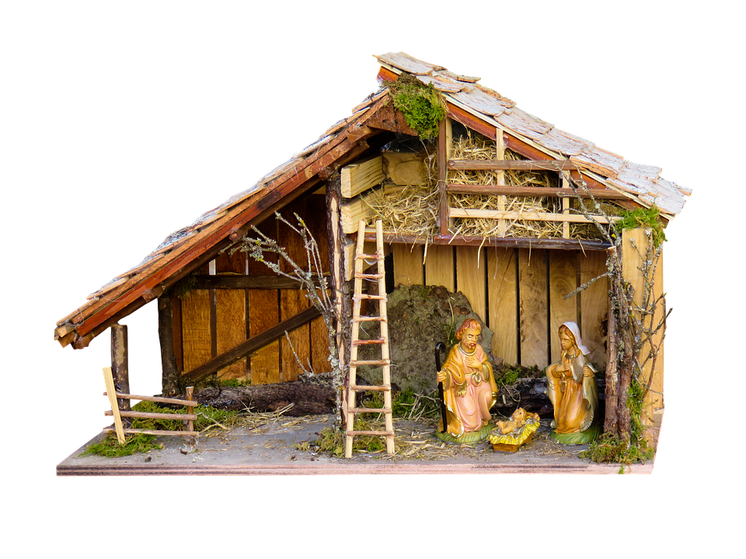
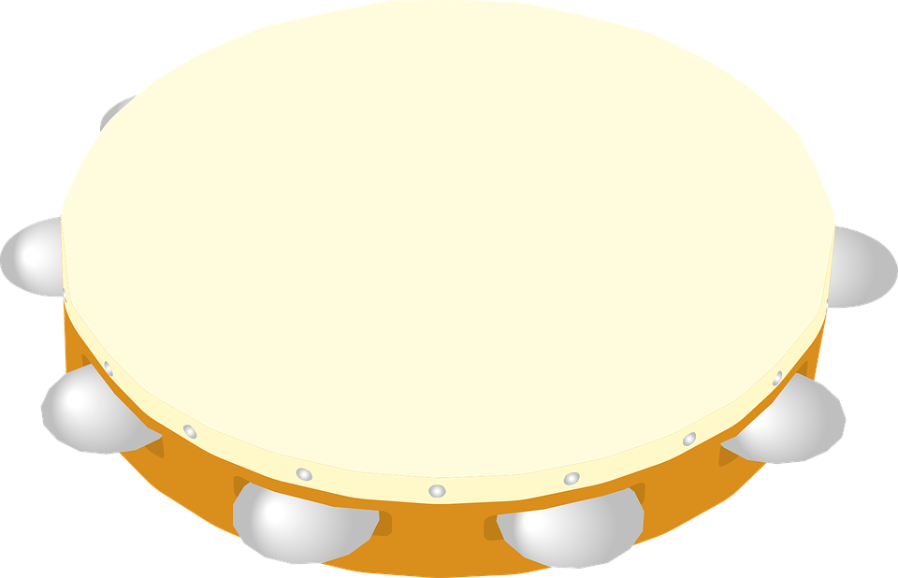
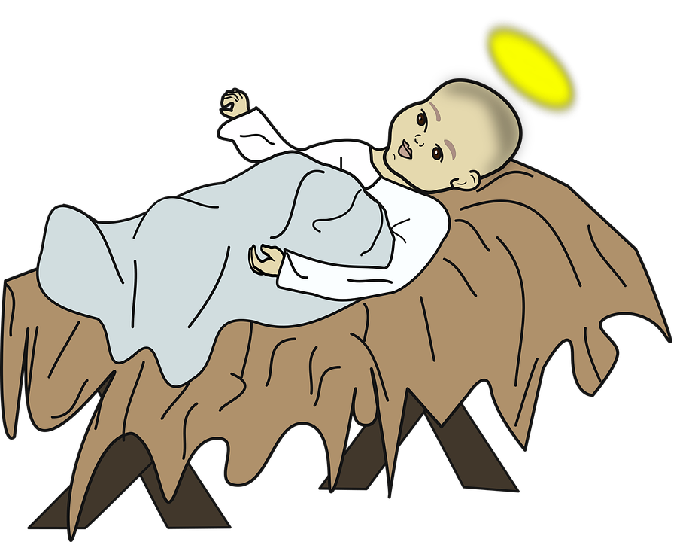
escuchar
Un villancico: ________ de _____________
A Escucha y ordena las frases.
A Escucha y completa el estribillo.
el villancico = Christmas carol
[estribillo] (chorus)
_____________ (1) de _____________ (2) fum, fum, fum.
_____________ (3) de _____________ (4) fum, fum, fum.
Venid, venid, pastorcillos fum, fum, fum venid, venid, pastorcillos fum, fum, fum.
veinticinco
diciembre
veinticinco
diciembre
4
 | que ha aparecido en el suelo
 | y castañuelas al portal
 | fum, fum, fum
 | venid con la pandereta
 | a adorar al rey del cielo
3
 | con su carita de rosa
 | fum, fum, fum (x2)
 | ha nacido en el portal
 | un niñito muy bonito
 | parece una flor hermosa
2
5
5
2
1
1
3
4
[estribillo] (chorus)
[estribillo] (chorus)
Notes:
Tune:
https://www.youtube.com/watch?v=3xymP1HmQgk&ab_channel=DiaKariMoLan
Timing: flexible
Aim: to enjoy a traditional Spanish carol; to practise read aloud and pronunciation, including of some unknown words.
Procedure:
1. Click to listen to the carol, using the youtube link provided. 2. Pupils write in the number 25 in Spanish to fill the gaps. 3. They then listen to the lines of the verses and number them in the correct order. They may need to hear them multiple times to do this. 4. Click to correct.
Transcript: [estribillo] (chorus)
Veinticinco de diciembre fum, fum, fum.
Veinticinco de diciembre fum, fum, fum.
Un niñito muy bonito ha nacido en el portal con su carita de rosa parece una flor hermosa fum, fum, fum (x2)
[estribillo] (chorus)
Venid, venid, pastorcillos fum, fum, fum venid, venid, pastorcillos fum, fum, fum.
venid con la pandereta
y castañuelas al portal a adorar al rey del cielo que ha aparecido en el suelo fum, fum, fum
[estribillo] (chorus)

Slide 15
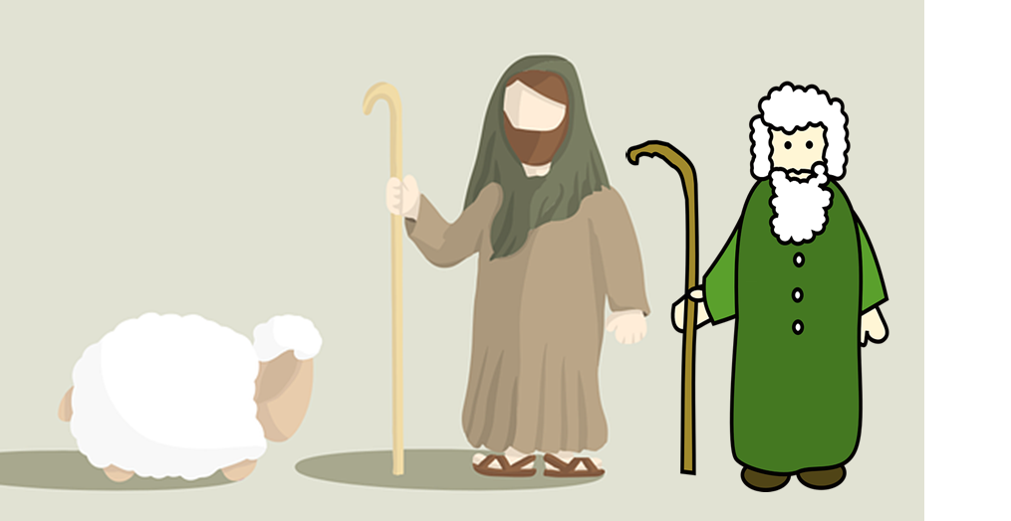
escuchar
Un villancico: ________ de _________
Veinticinco
diciembre
B ¿Cuál es el título del villancico?
Venid, venid, pastorcillos fum, fum, fum venid, venid, pastorcillos fum, fum, fum.
venid con la pandereta
y castañuelas al portal a adorar al rey del cielo que ha aparecido en el suelo fum, fum, fum
[estribillo] (chorus)
C ¡Canta el villancico!
[estribillo] (chorus)
Veinticinco de diciembre fum, fum, fum.
Veinticinco de diciembre fum, fum, fum.
Un niñito muy bonito ha nacido en el portal con su carita de rosa parece una flor hermosa fum, fum, fum (x2)
[estribillo] (chorus)
ha nacido = s/he is born venid = come!
parece = s/he looks like adorar = to worship
ha aparecido = s/he has appeared
Notes:
Tune:
https://www.youtube.com/watch?v=3xymP1HmQgk&ab_channel=DiaKariMoLan
Aim: to enjoy a traditional Spanish carol; to practise read aloud and pronunciation, including of some unknown words.
Procedure: 1. Ask pupils for the title of the carol, in Spanish. 2. Play the song again for pupils to join in with.
Transcript: [estribillo] (chorus)
Veinticinco de diciembre fum, fum, fum.
Veinticinco de diciembre fum, fum, fum.
Un niñito muy bonito ha nacido en el portal con su carita de rosa parece una flor hermosa fum, fum, fum (x2)
[estribillo] (chorus)
Venid, venid, pastorcillos fum, fum, fum venid, venid, pastorcillos fum, fum, fum.
venid con la pandereta
y castañuelas al portal a adorar al rey del cielo que ha aparecido en el suelo fum, fum, fum
[estribillo] (chorus)

Slide 16
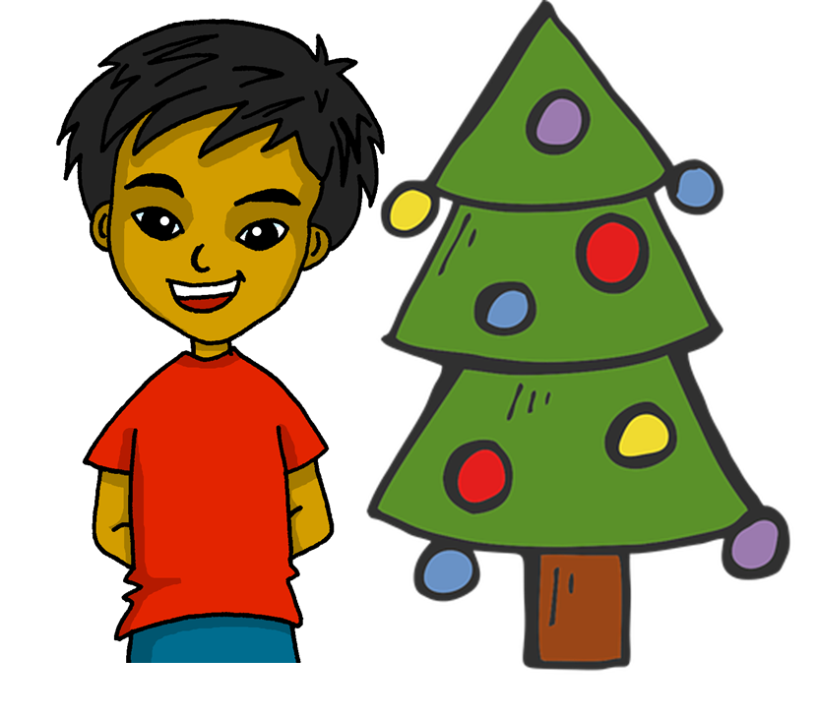
¡Feliz Navidad !
azul

Slide 17
escuchar
Vocabulary
At home, Nina speaks Aymara, a language spoken by Aymara people of Peru and Bolivia. She is learning Spanish at school, like you. Help Nina by answering the questions in this quiz.
A For each question, put a cross (x) under the English meaning that matches what you hear.
You will hear each Spanish word twice. Choose one correct answer only.
 | A | B | C | D
Ej. | 1 | 11 | 21 | 31
 | ☐ | ☐ | ☐ | ☐
1. | there is/are | to have | to be | s/he, it has
 | ☐ | ☐ | ☐ | ☐
2. | a bit | ugly | too | silly
 | ☐ | ☐ | ☐ | ☐
3. | which | what | when | who
 | ☐ | ☐ | ☐ | ☐
1
2
3
4
Notes:
Timing: 20-25 minutes (all assessment slides)
Aim: to practise aural comprehension of vocabulary taught in weeks 1-12 of the course.
Procedure:
1. Click the audio buttons to play each item. (The words are recorded twice with a pause to allow pupils to process the information).
2. Pupils can either write 1C, etc.. or if they have the assessment on a print out they can put a X in the correct box.
3. After items 1-4, continue to the next slide to complete the remainder of the task.
Transcript:
1. veintiuno
2. tener
3. tonto
4. quién ?
5. leer
6. quince
7. viejo
8. moreno

Slide 18
escuchar
Vocabulary
A For each question, put a cross (x) under the English meaning that matches what you hear.
You will hear each Spanish word twice. Choose one correct answer only.
 | A | B | C | D
4. | to read | to listen | to sing | to prepare
 | ☐ | ☐ | ☐ | ☐
5. | 15 | 14 | 12 | 13
 | ☐ | ☐ | ☐ | ☐
6. | long | short | old | new
 | ☐ | ☐ | ☐ | ☐
 | dark, brown | black | enormous | blond
 | ☐ | ☐ | ☐ | ☐
5
6
7
8
Notes:
Timing: 20-25 minutes (all assessment slides)
Aim: to practise aural comprehension of vocabulary taught in weeks 1-12 of the course.
Procedure:
1. Click the audio buttons to play each item. (The words are recorded twice with a pause to allow pupils to process the information).
2. Pupils can either write 1C, etc.. or if they have the assessment on a print out they can put a X in the correct box.
Transcript:
1. veintiuno
2. tener
3. tonto
4. quién ?
5. leer
6. quince
7. viejo
8. moreno

Slide 19
escuchar
Vocabulary
B For each question, put a cross (x) under the type of word you hear. You will hear each Spanish word twice. Choose one correct answer only.
This word is a good example of …
 | A | B | C | D
 | a place ☐ | a person ☐ | a month ☐ | a greeting ☐
 | a day ☐ | an object ☐ | an animal ☐ | a part of the body ☐
 | a greeting ☐ | a question word ☐ | personality ☐ | a number ☐
 | a number ☐ | position ☐ | a question word ☐ | a part of the body ☐
1
2
3
4
Notes:
Procedure:
1. Click the audio buttons to play each item. (The words are recorded twice with a pause to allow pupils to process the information).
2. Pupils can either write 1C, etc.. or if they have the assessment on a print out they can put a X in the correct box.
3. When complete, continue to the reading.
Transcript:
1. el jardín
2. la mochila
3. treinta
4. detrás
5. rubio
6. junio
7. la oreja
8. cuál

Slide 20
escuchar
Vocabulary
B For each question, put a cross (x) under the type of word you hear. You will hear each Spanish word twice. Choose one correct answer only.
This word is a good example of …
 | A | B | C | D
 | personality description ☐ | a question word ☐ | physical description ☐ | a number ☐
 | a month ☐ | a greeting ☐ | personality ☐ | a day ☐
 | a number ☐ | a part of the body ☐ | a month ☐ | a day ☐
 | a greeting ☐ | position ☐ | a question word ☐ | a colour ☐
5
6
7
8
Notes:
Transcript:
1. el jardín
2. la mochila
3. treinta
4. detrás
5. rubio
6. junio
7. la oreja
8. cuál

Slide 21
leer
A Translate the underlined Spanish word(s) to complete each English sentence.
1. Tiene el pelo negro y corto. He has _____________, ___________ ________.
2. El Señor Valero no es negativo. ____ Valerio ________ negative.
3. Tienes una nariz larga. You have a ___________ ___________ .
4. Hay trece diccionarios ? Are there ________ ___________________?
5. ¡Es demasiado fácil! It’s ____________ ___________!
6. Está debajo de la mesa. It is ____________ __________ ___________ .
7. Tiene un pegamento ? Does he have ________________________?.
8. Sofía solo tiene un poco. Sofía _______ has ______________.
9. No tiene una cara fea. It doesn’t have an ___________ _______________.
10. El médico es nuevo. ___ __________ is ____________ .
short
black
hair.
Mr.
is not
long
nose
13
dictionaries
too
easy
under
the table
a glue
only
a bit
ugly
face
The
doctor
new
Notes:
Aim: to practise written recall of previously taught vocabulary.
Procedure:
Ensure that the task is clear.
Pupils could write 1 – 10 and the individual English word meanings (or they could fill in if they have printed assessment sheets).

Slide 22
escribir
B Translate the underlined English words to complete the Spanish sentence.
1. It is an enormous class. Es una ___________ __________. (write two words)
2. It is a small space. Es un __________ _____________. (write two words)
3. The doctor (f) is creative. ___ __________ es ____________. (write two words)
4. He has a blue rubber. Tiene una __________ _______. (write two words)
5. Mrs Román is curious and nice. _______ Román es curiosa ___ amable. (write two words)
6. Today it’s my birthday. _____ es mi _______________. (write two words)
7. There is a lamp in the office. Hay una ___________ en la _______. (write two words)
8. He has round eyes. . Tiene _____ ojos _____________. (write two words)
9. I need a sandwich now. Necesito ____ _____________ _______. (write three words)
10. Yes, he is calm, too! ____, es tranquilo ____________ ! (write two words)
clase
enorme
espacio
pequeño
El
médico
creativo
goma
azul
Señora
y
Hoy
cumpleaños
lámpara
office
los
redondos
un
bocadillo
ahora
Sí
también
Notes:
Aim: to practise written production of previously taught vocabulary.
Procedure:
Ensure that the task is clear.
Pupils could write 1 – 10 and the individual English word meanings (or they could fill in if they have printed assessment sheets).

Slide 23
leer
Grammar
A Put a (X) next to the person the sentence is about.
1 | ☐ I ☐ you _{[singular]} ☐ s/he, it ☐ we ☐ they | Es inteligente. |  | 4 | ☐ I ☐ you _{[singular]} ☐ s/he, it ☐ we ☐ they | Tenemos una amiga.
2 | ☐ I ☐ you _{[singular]} ☐ s/he, it ☐ we ☐ they | Son creativos. |  | 5 | ☐ I ☐ you _{[singular]} ☐ s/he, it ☐ we ☐ they | Están en clase.
3 | ☐ I ☐ you _{[singular]} ☐ s/he, it ☐ we ☐ they | Estás triste. |  | 6 | ☐ I ☐ you _{[singular]} ☐ s/he, it ☐ we ☐ they | Tiene una pregunta.
Notes:
Aim: to practise written recall of previously taught grammar.
Procedure:
Ensure that the task is clear.
Pupils could write the correct English pronouns (or they could fill in if they have printed assessment sheets).

Slide 24
leer
Grammar
Like English, Aymara doesn’t have grammatical gender and adjectives go before the noun. Verb forms are different, too. Help Nina with her Spanish grammar by answering the questions in this part of the quiz.
B Put a cross (x) next to the correct English meaning.
1. Estoy contento. | ☐ I am pleased. | ☐ I am not pleased.
2. No tienes un gato. | ☐ You have a cat. | ☐ You do not have a cat.
3. Habla español. | ☐ She speaks Spanish. | ☐ She does not speak Spanish.
4. No eres rápido. | ☐ You are fast. | ☐ You are not fast.
C ESTAR or SER? Put a cross (x) next to the correct start of each sentence.
1. | ☐ Está… ☐ Es … | tranquilo hoy.
2. | ☐ Son … ☐ Están … | en Perú.
3. | ☐ Están … ☐ Son … | serios siempre.
Notes:
Aim: to practise written recall of previously taught grammar.

Slide 25
leer
Grammar
D Write the words in each box in the correct order to make a question.
1. | hay cuántos cuadernos | Correct order:_________________________________________
2. | la fecha es cuál | Correct order:_________________________________________
¿Cuántos cuadernos hay?
¿Cuál es la fecha?
E Singular or plural? Put a cross (x) next to the correct start of each sentence.
1. | ☐ Es… ☐ Son … | elegantes.
2. | ☐ Está… ☐ Están … | preparado.
3. | ☐ Son … ☐ Es … | especiales.
4. | ☐ Están … ☐ Está … | nerviosa.
Notes:
Aim: to practise written recall of previously taught grammar structures.

Slide 26
leer
Grammar
F Write the words in each box in the correct order.
1. | profesora estricta una | Correct order:_________________________________________
2. | problemas unos difíciles | Correct order:_________________________________________
una profesora estricta
unos problemas difíciles
escribir
G Write the Spanish for the English given in brackets. Use the clues to help you.
 |  | Clues
1. | ___________ allí. (you are) | to be = estar
2. | ___________ una foto. (I have) | to have = tener
3. | ___________ un libro. (they have) | to have = avoir
4. | _______________ importantes. (we are) | to be = ser
5. | _________ de Inglaterra. (I am) | to be = ser
6. | __________ cansados. (we are) | to be = estar
Estás
Tengo
Tienen
Somos
Soy
Estamos
Notes:
Aim: to practise written recall of previously taught structures.

Slide 27
escribir
H Write the Spanish article ‘a’ or ‘some’. The gender (and number) of the noun is provided.
una
1. | Es _______ casa. (f)
2. | Hay ________ frases. (fpl)
3. | Son ________ bolígrafos. (mpl)
4. | Hay ________ perro. (m)
unas
unos
un
I Write the Spanish article ‘the’. The gender (and number) of the noun is provided.
El
1. | _____ teléfono (m) gris.
2. | _____ gatos (mpl) negros.
3. | _____ pelotas (fpl) redondas.
4. | _____ silla (f) blanca.
Los
Las
La
Notes:
Aim: to practise written production of previously taughtstructures.

