Slide 1


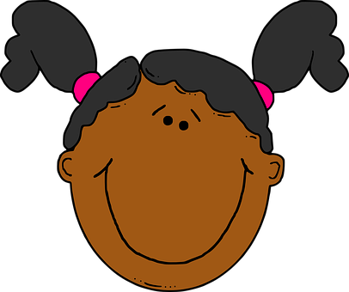





Saying what I and others have
descripciones
azul
Follow ups 1-5
Notes:
Artwork by Steve Clarke. All additional pictures selected are available under a Creative Commons license, no attribution required.
The frequency rankings for words that occur in this PowerPoint which have been previously introduced in the resources are given in the SOW (excel document) and in the resources that first introduced and formally re-visited those words.
Phonics: SSC: [ch] Source: noche[164] Cluster: chocolate [3408] leche[1397] chino [1349]
Vocabulary: tiene [8] cara [337] médico, médica [692] nariz [1570] ojo [169] oreja [2095] pelo [873] profesor / profesora [501] azul [811] corto [1055] grande [66] gris [1751] largo [300] moreno [3304] negro [307] pequeño [202] redondo [2470] rubio [2861] verde [812] los / las [1]
Revisit 1: tiene [tener 19] tienes [tener 19] bocadillo [>5000] botella [1878] casa [106] cuaderno [3301] gato [1728] libro [230] mentira [1673] mochila [>5000] pegamento [>5000] pelota [2270] pregunta [507] verdad [176] nuevo [94] viejo [225] pero [30] también [49] y [4] unos, unas [6]
Revisit 2: cumpleaños [3372] mes [288] enero [1173] febrero [1419] marzo [1231] abril [1064] mayo [909] junio [1035] julio [659] agosto [931] septiembre [1150] octubre [1242] noviembre [1434] diciembre [1165] cuándo [138] de [2] trece [2700] catorce [2411] quince [1215] dieciséis [3373] diecisiete [3400] dieciocho [2730] diecinueve [4232] veinte [819] veintiuno [819/425] veintidós | veintitrés | veinticuatro | veinticinco |veintiseis|veintisiete|veintiocho |veintinueve |treinta [830] treinta y uno [830/4/425]
Frequency of unknown words:
pregutnar [219] pareja [893]
Source: Davies, M. and Davies, K. (2018). A frequency dictionary of Spanish: Core vocabulary for learners (2nd ed.). Routledge: London
For any other words that occur incidentally in this PowerPoint, frequency rankings will be provided in the notes field wherever possible.

Slide 2




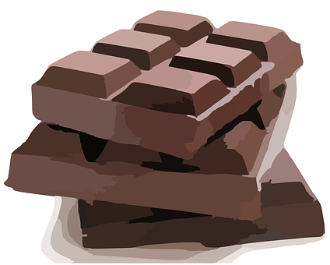
pronunciar
[ch]
noche
leche
chocolate
chino
Notes:
Timing: 1 minute
Aim: to introduce SSC [ch]
Procedure
Introduce and elicit the pronunciation of the individual SSC [ch] and then the source word ‘noche’ (with gesture, if using).
Click to bring the picture & get pupils to repeat (with gesture, if using).
Note: the [ch] sound in Spanish is the same as one of the pronunciations English has for this sound, as in the word ‘chocolate’. However, English also pronounces [ch] differently, mostly in borrowed words such as ‘chef’. In teaching this sound in Spanish, we also bear in mind that many pupils will learn French at some point, and will learn a different pronunciation for these two letters.
Gesture: one suggestion would be to use British sign language for night, which is shown here: https://www.signbsl.com/sign/night
It is best to watch the video clip but here is a description: arms bent at the elbow, palms open and facing the speaker, move quickly in front of the body, crossing over so that right finger tips end up facing left, and left facing right, to emulate the suddenness of nightfall.

Slide 3

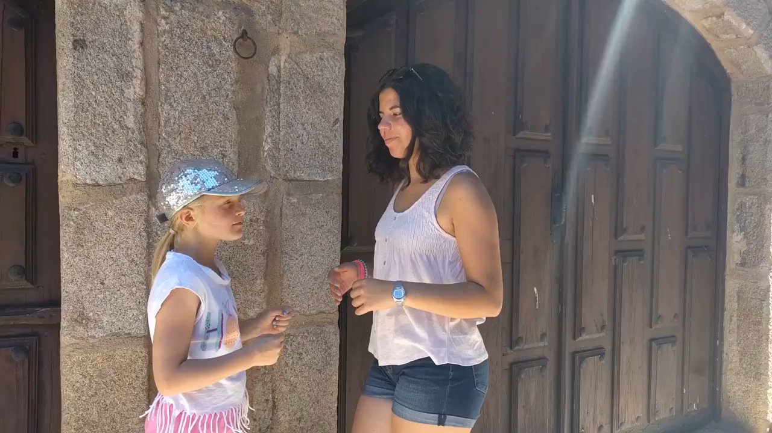
Follow up 1:
Mira el vídeo.
[ch]
Escribe 📝 y canta 🎤.
pronunciar
Cho-co-la-te
Cho-co, Cho-co-la-la
Cho-co, Cho-co-te-te
Cho-co-la, Cho-co-te
Cho-co-la-te
Notes:
Timing: 5 minutes
Aim: to use a well-known Spanish children’s hand-clapping game to practise oral production of the syllables in the Spanish word ‘chocolate’, including the SSC [ch], to develop speed of production and spoken confidence.
Procedure:
Play the video through once. It has three versions which decrease in speed in time. The syllable sequence is shown in writing for support.
Rewind the recording to play the slower version several times. Note: the slowest version starts at around 24 seconds.
Pupils join in with the video saying the syllables.
Pupils may naturally want to pair up and try out the hand actions. Encourage this!
Pupils practise a few times without the video.
Finally, play the video again and encourage pupils to join in. Remind them that the first two versions are faster and reassure them that they will definitely be able to join in with the 3rd time, if not before.
Frequency of unknown words and cognates:
chocolate [3408]
Source: Davies, M. & Davies, K. (2018). A frequency dictionary of Spanish: Core vocabulary for learners (2nd ed.). Routledge: London

Slide 4


Follow up 2:
Quique describe. ¿Cómo son?
leer
 | Ángela tiene los ojos verdes.
 | Pedro tiene el pelo corto.
 | Sofía tiene los ojos redondos.
 | La profe tiene la cara grande.
 | Mi amiga tiene el pelo bonito.
 | El medico tiene las orejas largas.
E
Ángela has green eyes.
1
Pedro has short hair.
2
Sofía has round eyes.
3
💡 Don’t forget:
largo means long, not large.
This is called a false friend because the word tricks you into thinking of the wrong meaning.
The (female) teacher has a big/large face.
4
My (female) friend has pretty hair.
5
The (male) doctor has long ears.
Notes:
Timing: 4 minutes
Aim: to practise written comprehension of this week’s vocabulary in sentences.
Procedure:
Do the example with pupils. They write (or say) the English sentence meaning (they could do this on mini whiteboards).
Complete sentences 1-5 and correct them. The English sentence meanings appear on consecutive mouse clicks.

Slide 5
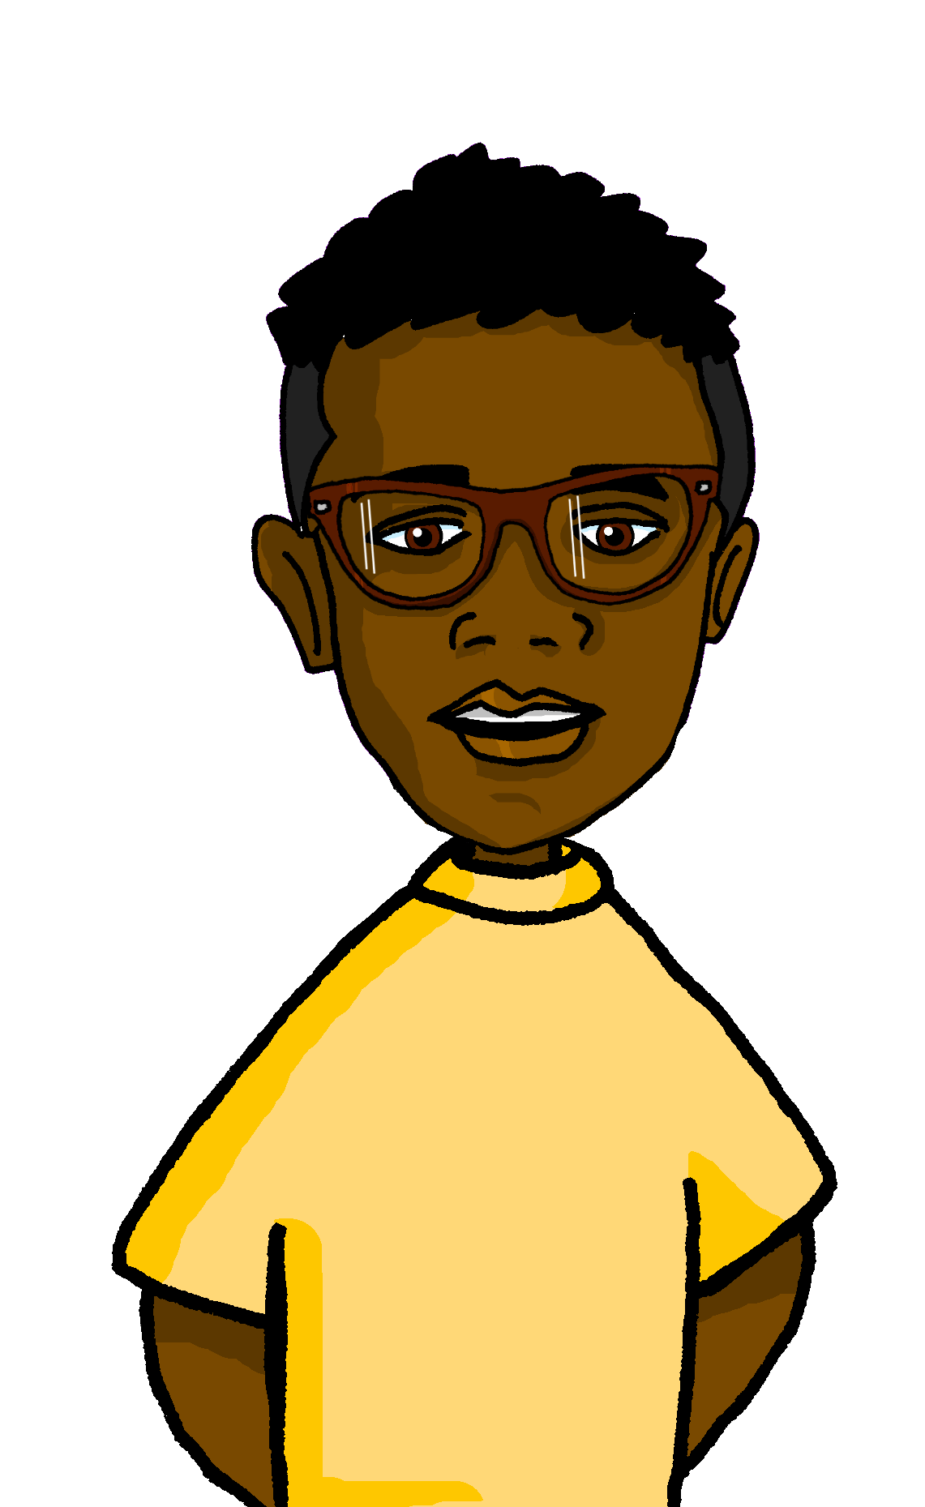



Follow up 3
Quique describe a un amigo.
escuchar
?
Escribe la descripción en inglés .
Today is Monday 24th August.
E
_____________________.
1
____________.
It’s my friend Max’s birthday.
_______
2
_____________________.
Max is from England.
3
He has short, dark/brown hair.
_____________________________.
4
He has black eyes and big ears.
_____________________________.
He has a long face.
5
_____________________________.
6
In his school bag, Max has some exercise books, a glue and two books.
_____________________________________________________________________.
_______________________________________.
7
He also has a bottle and a sandwich.
Notes:
Timing: 7 minutes
Aim: to practise aural comprehension of a wide variety of vocabulary from this and revisited weeks.
Procedure:
Click to listen to the example. Pupils complete the sentence in English.
For items 2 and 3, pupils can either turn away from the board and try to write the whole sentence, or use the written support on the board.
After each item, click to reveal the answers.
For items 4 – 8, pupils listen and translate the full sentence.
Click to reveal the answer each time.
The final click reveals Max.
Transcript:
Ej. Hoy es lunes veinticuatro de agosto.
1. Es el cumpleaños de mi amigo, Max.
2. Max es de Inglaterra.
3. Tiene el pelo corto y moreno.
4. Tiene los ojos negros y las orejas grandes.
5. Tiene la cara larga.
6. En la mochila, Max tiene unos cuadernos, un pegamento y dos libros.
7. También tiene una botella y un bocadillo.

Slide 6
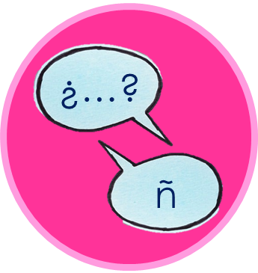



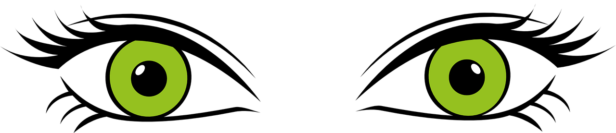

Follow up 4:
En parejas*, pregunta* y responde.
Chalina
Chucho
Costa
Corona
hablar
Carlito
Cheche
Cuevas
Chofa
Catalina
Cuba
Casilda
Carmelo
Chico
Carina
Castel
Chita
pareja = partner
pregunta = ask
black or green eyes? | long or round face? | long or short hair?| big or small ears?
Notes:
Timing: 5 minutes
Aim: to practise oral production of tiene + definite article + noun + adjective.
Before beginning the activity, the teacher may want to clarify the variables: long/round face; long/short hair; black/green eyes; small/big ears.
Click to bring up the aide memoire at the bottom of the slide.
Pupils work in pairs. The aim of the activity is to identify a character chosen by one of the partners.
Pupil B chooses one of the people but doesn’t tell his/her partner which one.
Pupil A asks questions in Spanish to determine which person B has chosen. E.g. ¿Tiene el pelo corto?
Pupil A makes notes and after several questions can ask ¿Eres [XXX]?
When A has correctly identified the person, they swap roles.
Notes:
The names practise the SSC [ch] and other previously taught SSC.
Several of these names are neutral and work equally for boys and girls. These include: Costa, Cuevas, Cheche and Castell.
Frequency of unknown words:
pregutnar [219] pareja [893]
Source: Davies, M. and Davies, K. (2018). A frequency dictionary of Spanish: Core vocabulary for learners (2nd ed.). Routledge: London

Slide 7



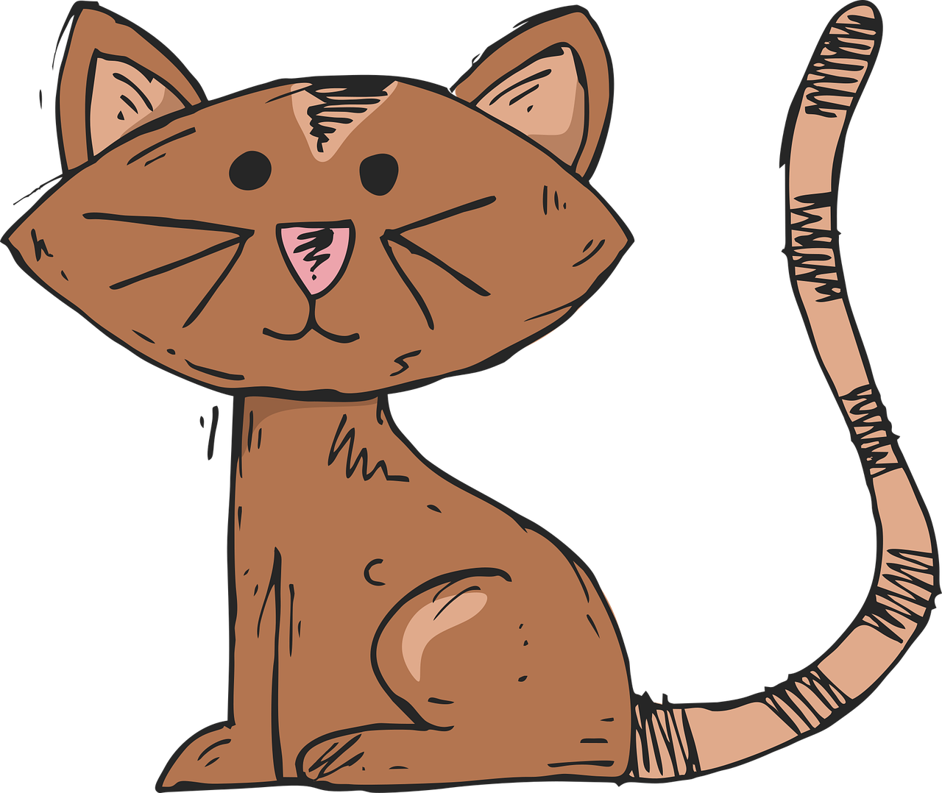


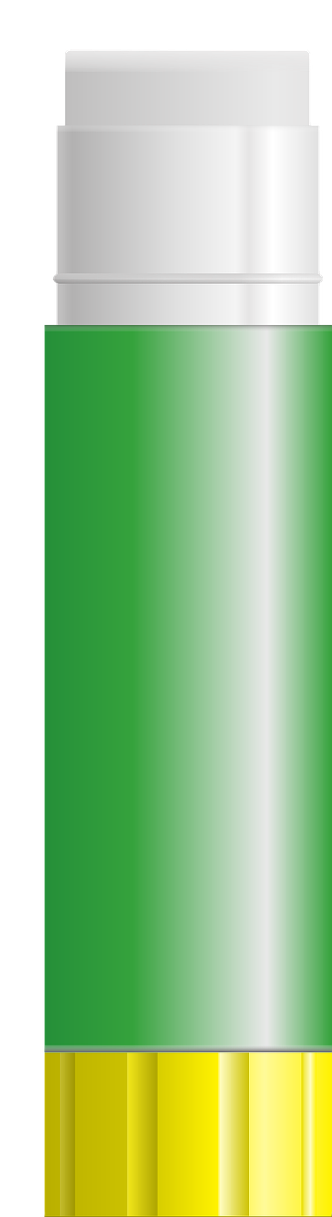
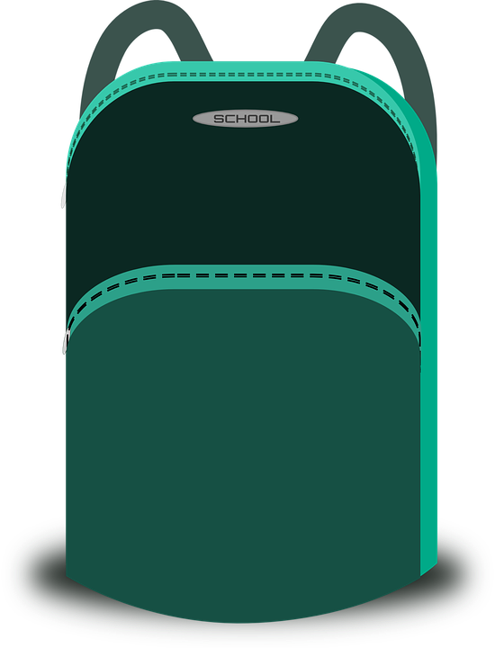
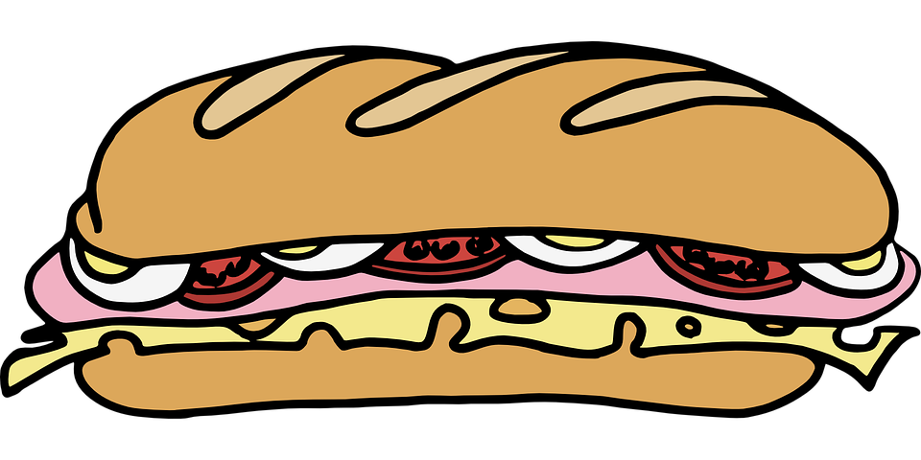
Follow up 5:
¿Qué no hay? Escribe las palabras en español.
6. En casa, Max tiene un gato y unos libros.
escribir
_____
_____
_____
_____
5. ¿ Tienes una pelota nueva? No, tengo una pelota vieja.
______
______
______
____
4. En la mochila tengo unos bocadillos y un pegamento.
___ _________
___ ________________
___ _______________
3. once, trece, quince, diecisiete, diecinueve
______
______
______
2. doce, catorce, dieciseis, dieciocho, veinte
______
______
1. enero, febrero, marzo, abril, mayo, junio, julio, agosto, septiembre, octubre, noviembre, diciembre
______
______
______
______
______
______
Notes:
Timing: 10 minutes
Aim: to practise written production of vocabulary from the revisited weeks.
Procedure:
1. Tell pupils that they need to write the missing words, and to look both sides of the gap to decide which words are missing.
2. Do the first one with them. We are working from the bottom up. The items increase in difficulty to the top.
3. Click to reveal written answers.

Slide 8





Follow up 5b:
Escribe en español 📝.
a b ñ
vocabulario
Can you get at least15 points?
 | When? | month | fourteen
 | August | nineteen | thirty
 | pretty (m) | school | swimming pool
 | there | bridge | park
 | dark, brown (m) | round (f) | blonde (m)
 | ear | hair | short (m)
 | face | doctor (f) | nose
¿Cuándo?
(el) mes
catorce
x3
agosto
diecinueve
treinta
bonito
(la) escuela
(la) piscina
x2
allí
(el) puente
(el) parque
moreno
redonda
rubio
(la) oreja
(el) pelo
corto
x1
(la) cara
(la) médica
(la) nariz
Notes:
Aim: to practise written production of vocabulary for this week and previous weeks.
Procedure:
Pupils need to write the Spanish for as many words as possible, aiming to get at least 15 points (but more if possible).
Tell pupils to write the correct word for ‘the’ with all the nouns.
3. Click for Spanish answers.
Note:
The most recently learnt and practised words are pink, words from the first revisit are green and those from the second revisit are blue, thus more points are awarded for them, to recognise that memories fade and more effort (heavy lifting!) is needed to retrieve them.

