Slide 1
español, con Quique

Slide 2
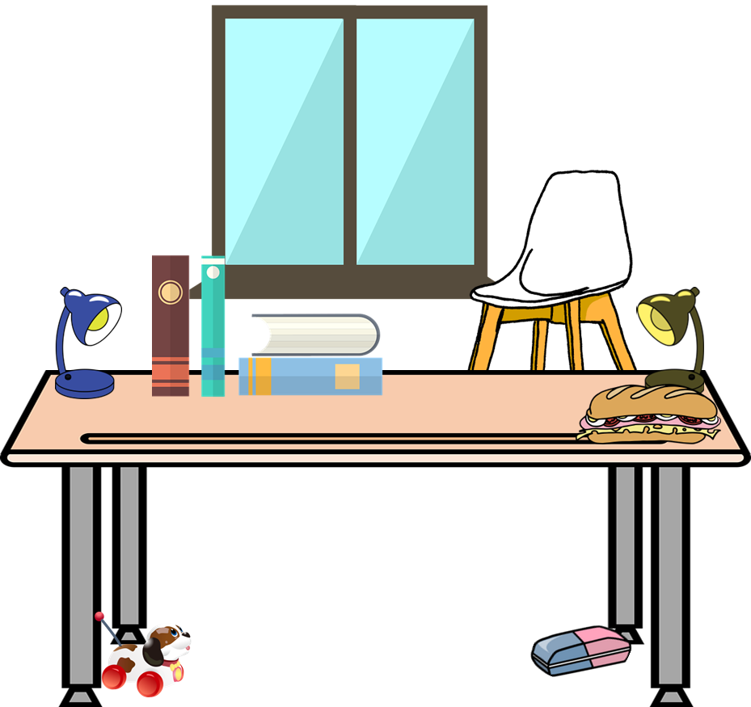
Saying what I and others have
¿Qué tenemos?
azul
Tener: 1st & 3rd person plural
Postnominal adjectives
SSC: [z]
Notes:
Artwork by Steve Clarke. All additional pictures selected are available under a Creative Commons license, no attribution required.
The frequency rankings for words that occur in this PowerPoint which have been previously introduced in the resources are given in the SOW (excel document) and in the resources that first introduced and formally re-visited those words.
Phonics: revisit [z]
Vocabulary (new words in bold): tienen [8] tenemos [8] espacio [451] gato [1728] goma [4437] lámpara [2978] mesa [187] mentira [1673] oficina [1072] perro [888] regla [1380] ventana [725] verdad [176] aquí [130] de12 [2] debajo [1366] detrás [2044] en1 [6]
Revisit 1: tener [19] tengo [tener 19] tiene [tener 19] casa [106] familia [233] habitación [1069] jardín [1195] libro [230] madre [226] padre [162] problema [145] profesor / profesora [501] silla [1271] estricto [3155] feo [2373] terrible [1246] muy [43] un [6] una [6] Re-use adjectives: bonito [891]cómodo [2237] diferente [293] divertido [2465] feliz [908] elegante [2742] grande [66] importante [171] independiente [1177] negativo [1804] normal [1000] pequeño [202] tranquilo [1093]
Revisit 2: somos [ser, 7] estamos [estar, 21] activo [1278] cansado [1818] contento [1949] diferente [293] importante [171] independiente [1177] inteligente [2167] pero [30]
Frequency of unknown words:
espacio [451]
Source: Davies, M. and Davies, K. (2018). A frequency dictionary of Spanish: Core vocabulary for learners (2nd ed.). Routledge: London
For any other words that occur incidentally in this PowerPoint, frequency rankings will be provided in the notes field wherever possible.

Slide 3
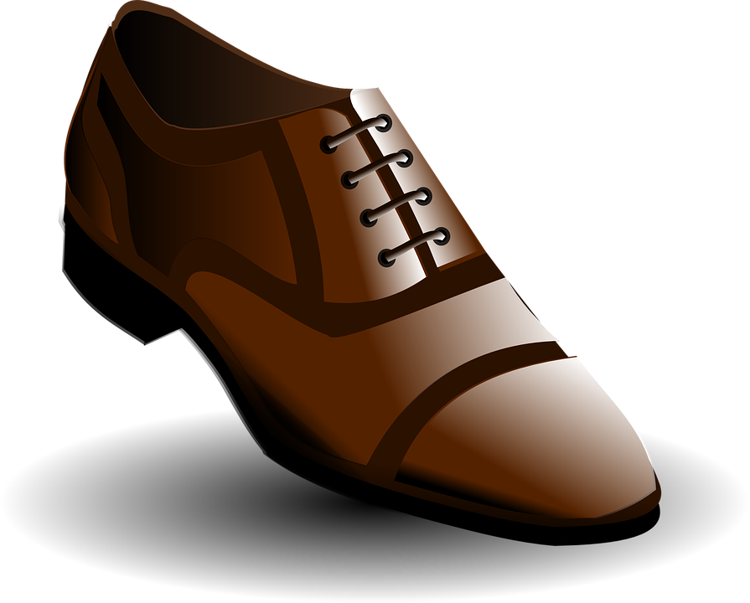
pronunciar
[z]
zapato
[Z] always comes before the sounds [a] [o] [u]
Notes:
Timing: 1 minute
Aim: To introduce SSC [z]
Procedure:
Introduce and elicit the pronunciation of the individual SSC [z] and then the source word ‘zapato’ (with gesture, if using).
Click to bring the picture & get pupils to repeat (with gesture, if using).

Slide 4
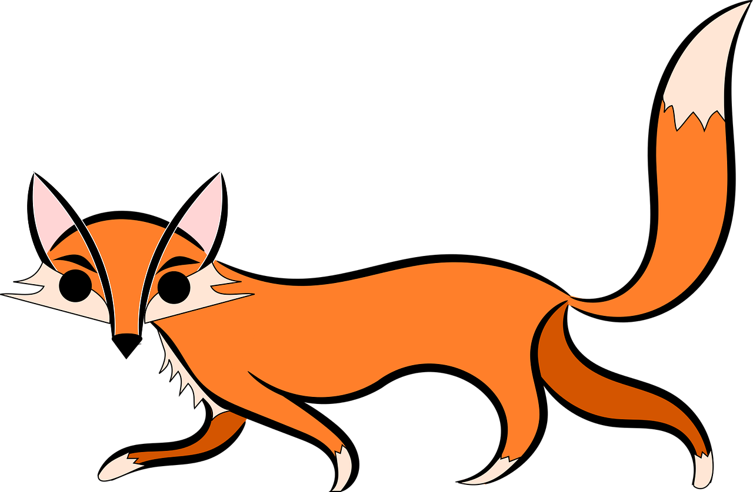
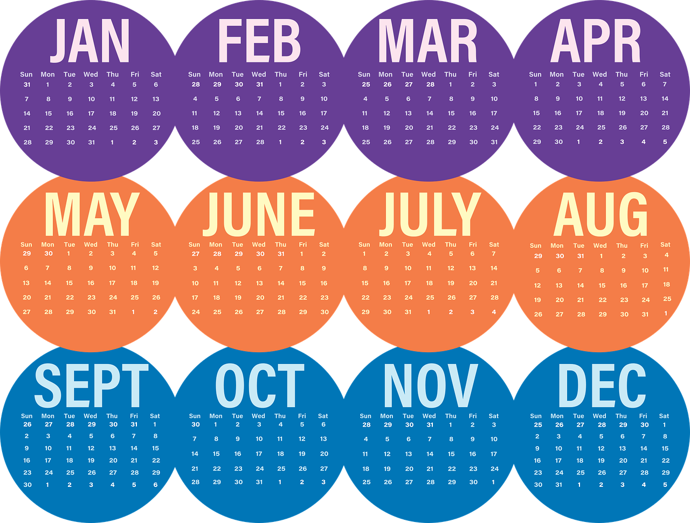
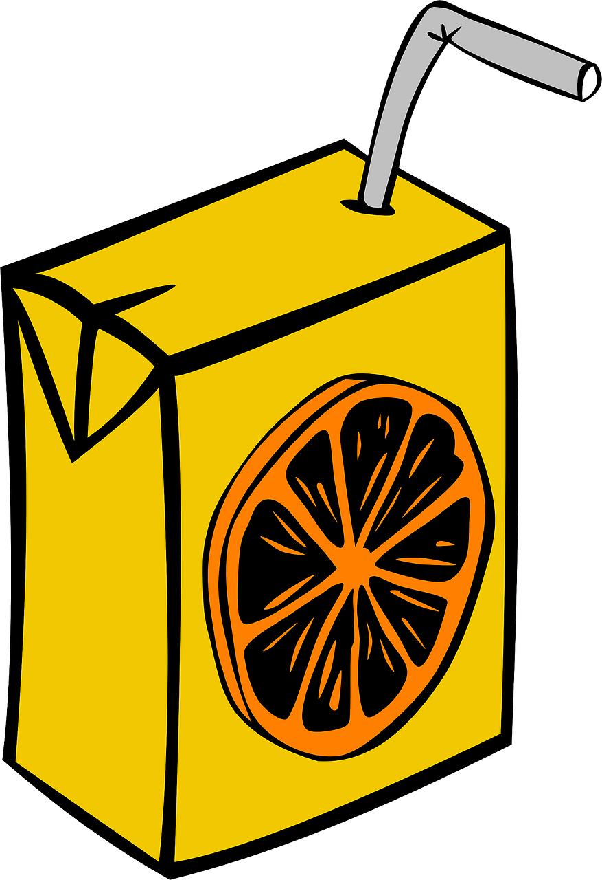
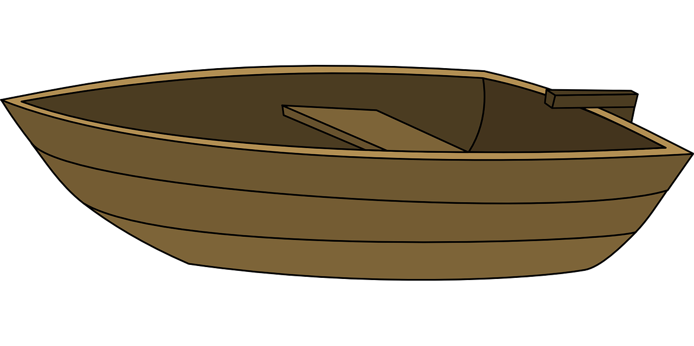
pronunciar
Escucha. ¿Se escribe con [z] o [c]? Luego, pronuncia.
30 minutos
zorro
coro
marzo
marca
cubo
zumo
taza
barco
0
INICIO
Notes:
Timing: 5 minutes
Aim: to apply the spelling rule for SSC [z] (for ‘th’ sound before a, o, u) and [c] (for hard ‘c’ sound before a, o, u).
Procedure:
Click to listen.
Pupils write 1-8 and either ‘z’ or ‘c’.
Click again to reveal the pictures and the answers.
Click inicio for pupils to pronounce all of the words.
Click on each image to hear it, if desired.
Transcript: 1. zorro 2. coro 3. marzo 4. marca 5. cubo 6. zumo 7. taza 8. barco
Frequency of unknown words and cognates: zorro [>5000] coro [2683] marzo [1231] marcar [993] cubo [>5000] zumo [>5000] taza [3065] barco [1384]
Source: Davies, M. & Davies, K. (2018). A frequency dictionary of Spanish: Core vocabulary for learners (2nd ed.). Routledge: London

Slide 5
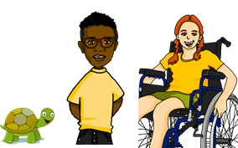
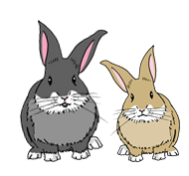
tenemos | tienen
[we have | they have]
In Spanish the verb tener is irregular.
To say ‘they have’ we say ____________.
To say ‘we have’ we say _________.
tienen
tenemos
Tienen una tortuga activa.
Tenemos dos conejos pequeños.
They have an active tortoise.
We have two small rabbits.
Notes:
Timing: 2 minutes
Aim: to revisit ‘tienen’ and introduce ‘tenemos’
Procedure:
Click to present the information.
Elicit English translations for the Spanish examples provided.

Slide 6
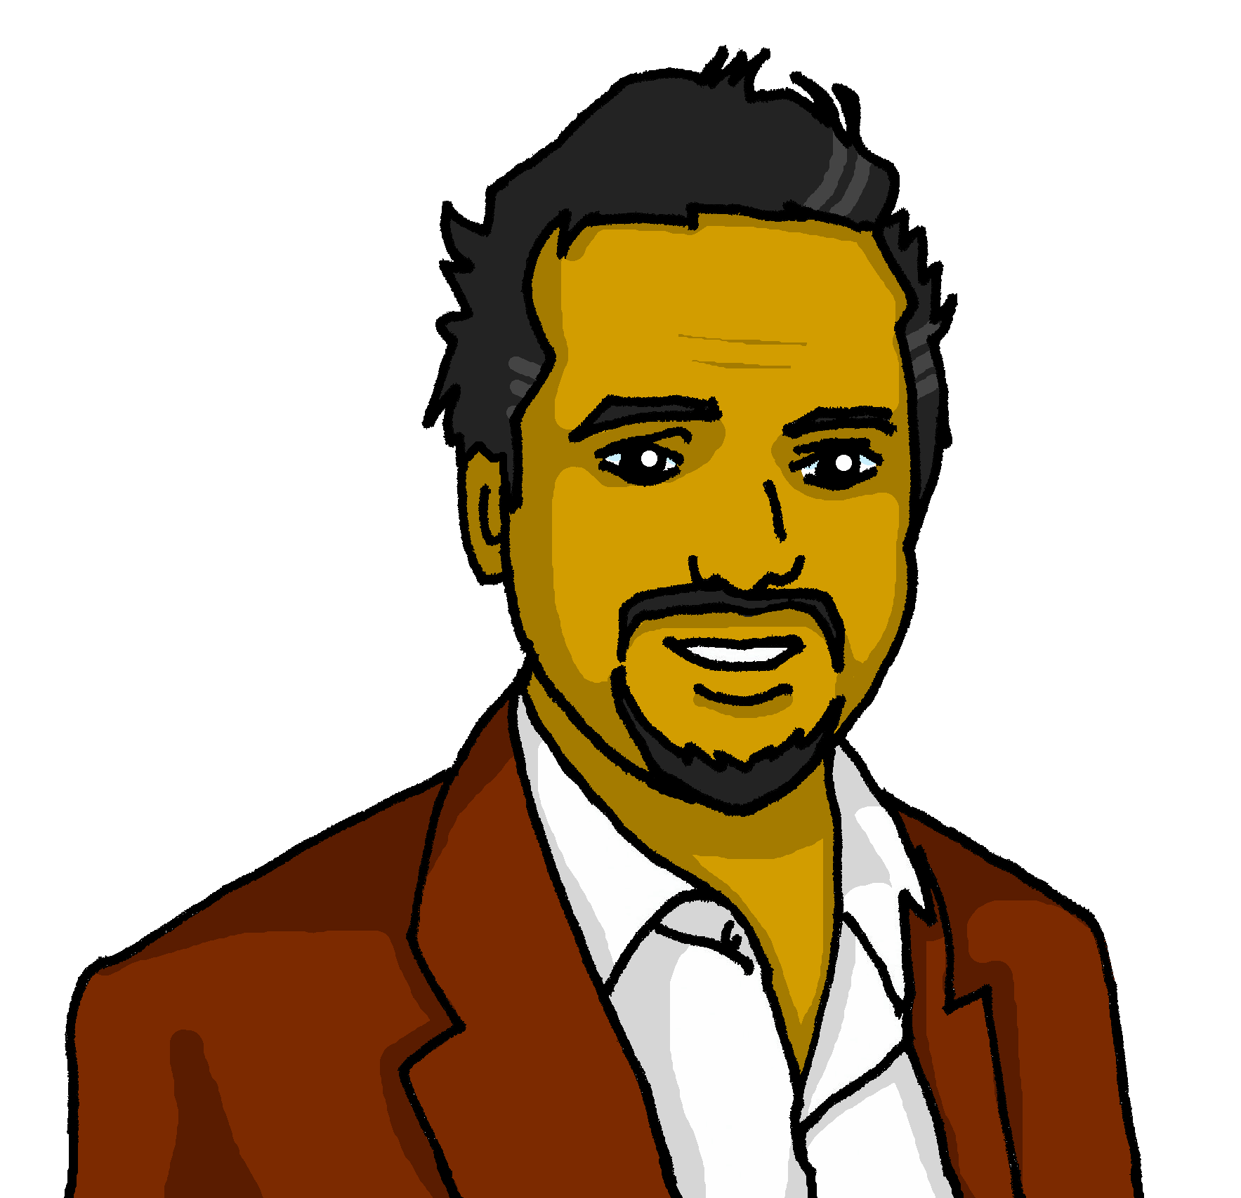
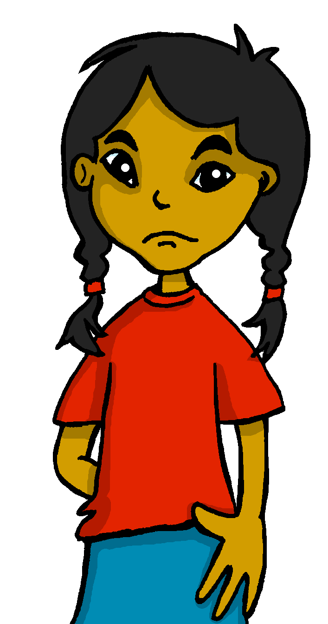
leer
Lee el diario de Sofía. No está contenta. ¿Por qué?
¿Quién tiene qué?
Escribe dos listas en inglés.
☹
Tienen un espacio* grande.
Tenemos una mesa pequeña.
we have | they have
a small table | a big space
only one chair | some comfortable chairs
some old sandwiches | some old books
a small space | an enormous office
Tenemos solo una silla.
Tienen unas sillas cómodas.
Tienen unos libros viejos.
¡Tenemos unos bocadillos viejos en la mesa!
Tenemos un espacio pequeño.
Tienen una oficina enorme.
espacio = space
Notes:
Timing: 5 minutes
Aim: to practise written comprehension of tenemos, tienen and some new and revisited vocabulary.
Procedure:
1. Ensure that pupils understand the task. They need to identify and list in English the items that Sofía says her parents have (they) and she and Quique have (we).
2. Pupils write the words in English.
3. Click to reveal answers.
Frequency of unknown words:
espacio [451]
Source: Davies, M. and Davies, K. (2018). A frequency dictionary of Spanish: Core vocabulary for learners (2nd ed.). Routledge: London

Slide 7
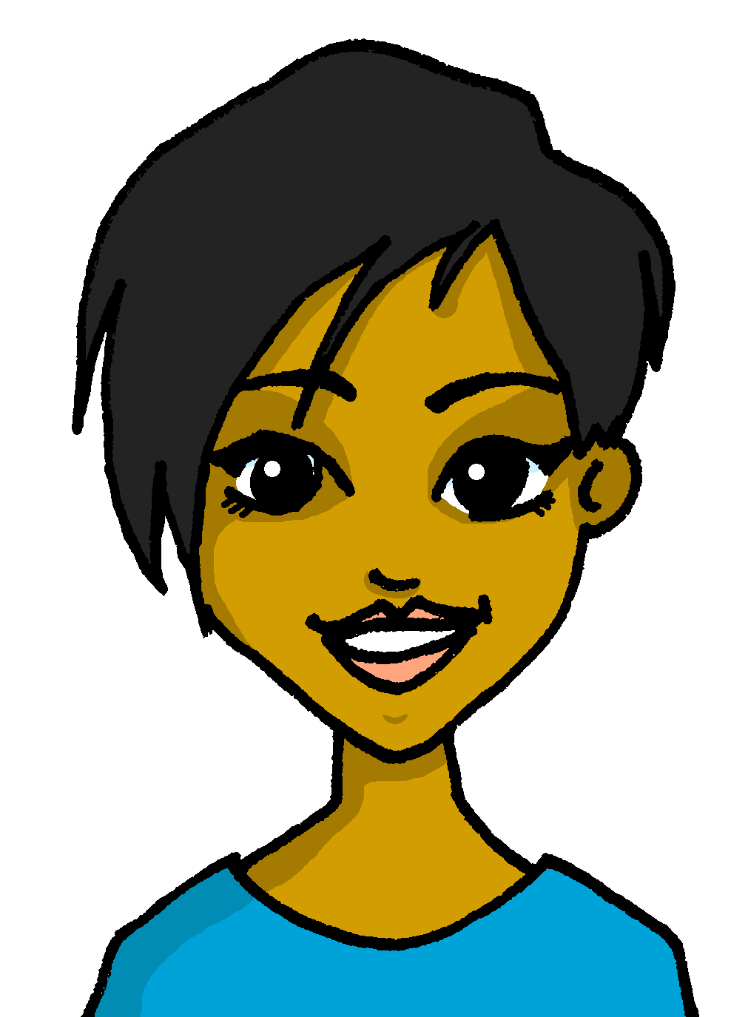
escuchar
Sofía habla sobre Luis y Ceci.
Remember: We use un or una with singular nouns and unos or unas with plural nouns.
Escucha. ¿Quién es? Marca .
escuchar
Q&S (we) | L&C (they)
Ahora escucha y escribe la palabra y el artículo en español.
¿Cómo es?
Escribe en inglés .
lámpara
Tenemos una _____________ fea.
Tenemos unas ____________ pesadas.
Tienen unos ____________ divertidos.
Tienen unas ___________ nuevas.
Tienen un _____________ bonito.
Tenemos unos ____________ viejos.
E
ugly
E
mochilas
heavy
1
1
libros
2
fun
2
3
reglas
new
3
4
gato
pretty
4
5
bocadillos
old
5
Notes:
Timing: 7 minutes
Aim: to practise aural comprehension of ‘tenemos’ & ‘tienen’; to practise written transcription of known and new vocabulary; to practise connecting nouns and their adjectives with the correct indefinite article (un, una, unos, unas).
Procedure:
Read the title / context & instruction.
Click to bring up further instruction & clarify Q&S is for Quique and Sofía, and L&C is for Luis and Ceci, their cousin and aunt in Perú.
Explain to pupils Quique and Sofíá will be describing either what they have on their table (so they will be using the form “we”), or what Luis and Ceci have on their table (and therefore they will be using the form “they”).
Click to listen to the example.
Ask pupils to write 1-6 in their books.
Complete the task with items 1-5, listening out once for the correct verb form.
Click to reveal answers.
Click to bring up further instructions.
Listen again to transcribe the words. Here the article is ‘beeped out’ so that pupils have to consider the correct form according to the noun.
Click to reveal answers to the transcriptions, elicit correct article and translation of the adjective.
Click to listen again to the full sentences and elicit oral translations in English.
Transcript:
Ej. Tenemos [una] lámpara fea. 1. Tenemos [unas] mochilas pesadas.
2. Tienen [unos] libros divertidos.
3. Tienen [unas] reglas nuevas.
4. Tienen [un] gato bonito.
5. Tenemos [unos] bocadillos viejos.
Transcript 2:
Ej. Tenemos una lámpara fea. 1. Tenemos unas mochilas pesadas.
2. Tienen unos libros divertidos.
3. Tienen unas reglas nuevas.
4. Tienen un gato bonito.
5. Tenemos unos bocadillos viejos.

Slide 8
pronunciar
¿qué?
what?
¿Qué tienen?
[What do they have?]
Rachel Hawkes / Emma Marsden
Notes:
Timing: 1 minute
Aim: to revisit question word ¿qué?
Procedure:
Pupils listen and repeat the key question word (include gesture if possible).
Display the word and ask them to repeat one more time.
Elicit English meaning.
Reveal the sentence.

Slide 9
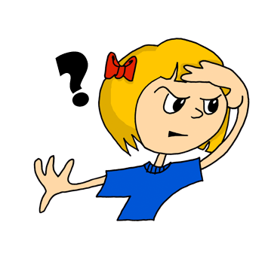
¿dónde?
pronunciar
where?
¿Dónde tienen un perro?
[Where do they have a dog?]
Rachel Hawkes / Emma Marsden
Notes:
Timing: 1 minute
Aim: to revisit question word ¿dónde?
Procedure:
Pupils listen and repeat the key question word (include gesture if possible).
Display the word and get them to repeat one more time.
Elicit English meaning.
Reveal the sentence.

Slide 10
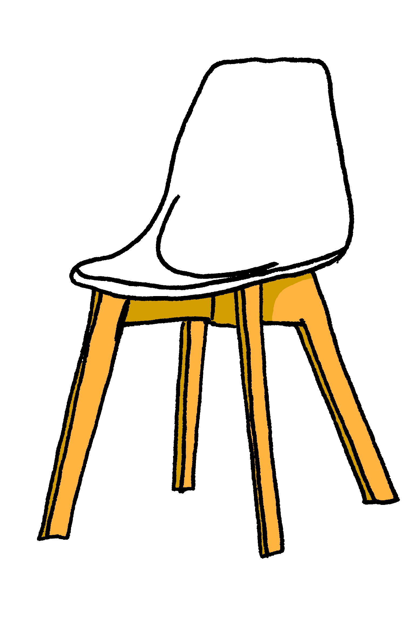
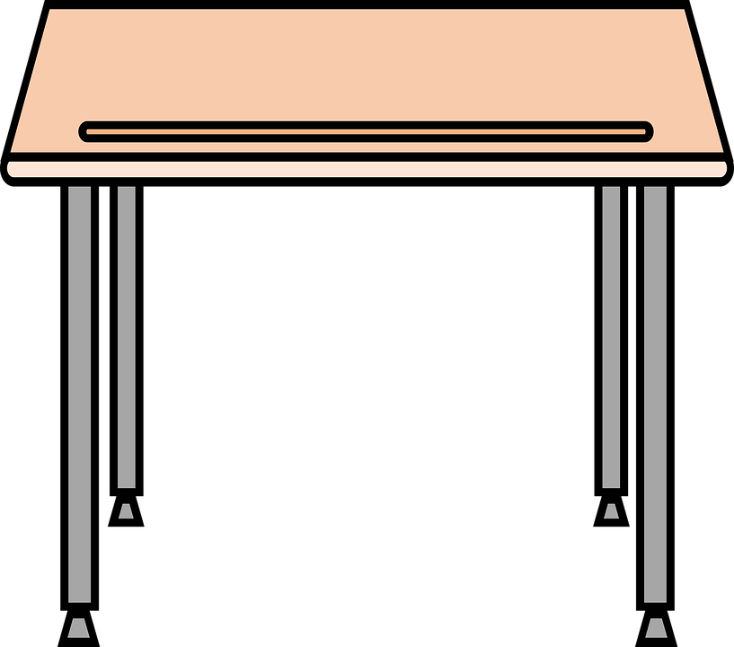
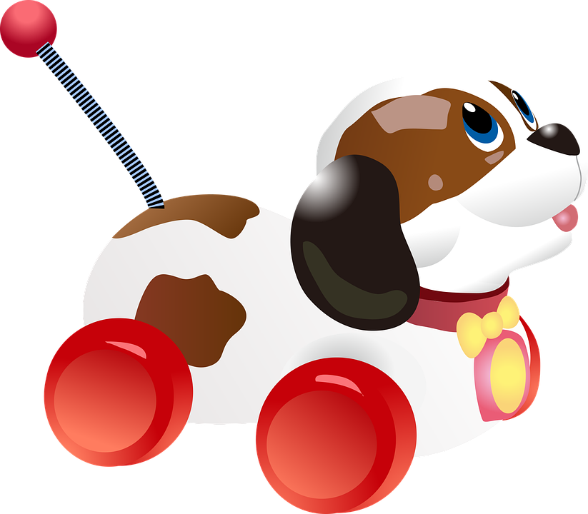
detrás | debajo | en
[behind, below, on]
To say something is on the table, use en:
To say something is behind the table, use detrás:
To say something is below or under the table, use debajo:
detrás
Tienen una silla detrás de la mesa.
[behind]
Note: we use de after detrás and debajo but we don’t say of in English.
en
[on]
Tienen una lámpara en la mesa.
debajo
[under]
Tienen un perro debajo de la mesa.
Notes:
Timing: 2 minutes
Aim: to introduce two new adverbs of position.
Procedure:
Click to present the information.
Elicit English translations for the Spanish examples provided.

Slide 11
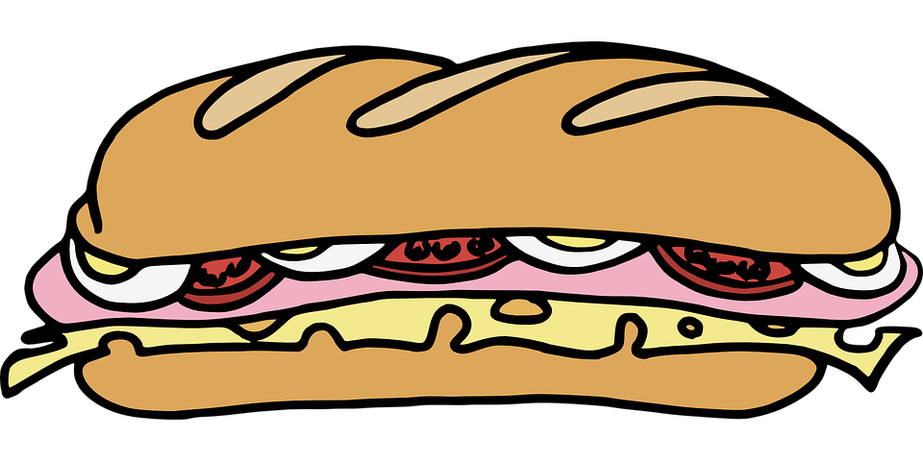
leer
Lee. ¿Dónde tienen las cosas? ¿Es verdad o mentira?
[1/6]
Tenemos una silla debajo de la mesa.
Notes:
[1/6]
Timing: 6 minutes (6 slides)
Aim: to practise written recognition and comprehension of the new adverbs (detrás, debajo) and revisit en.
Procedure:
1. Ensure that pupils understand the task. They need to read what Sofía and Quique are saying and decide whether the sentence is true or false, looking at their table.
2. Teachers elicit the response.
3. Click to reveal answers.

Slide 12
leer
[2/6]
Tenemos unas gomas debajo de la mesa.
Notes:
[2/6]

Slide 13
leer
[3/6]
Tenemos unas lámparas en la mesa.
Notes:
[3/6]

Slide 14
leer
[4/6]
Tenemos un perro detrás de la mesa
Notes:
[4/6]

Slide 15
leer
[5/6]
Tenemos unos libros debajo de la mesa.
Notes:
[5/6]

Slide 16
leer
[6/6]
Tenemos una
ventana detrás de la mesa.
Notes:
[6/6]

Slide 17
¡adiós!
azul

