Slide 1


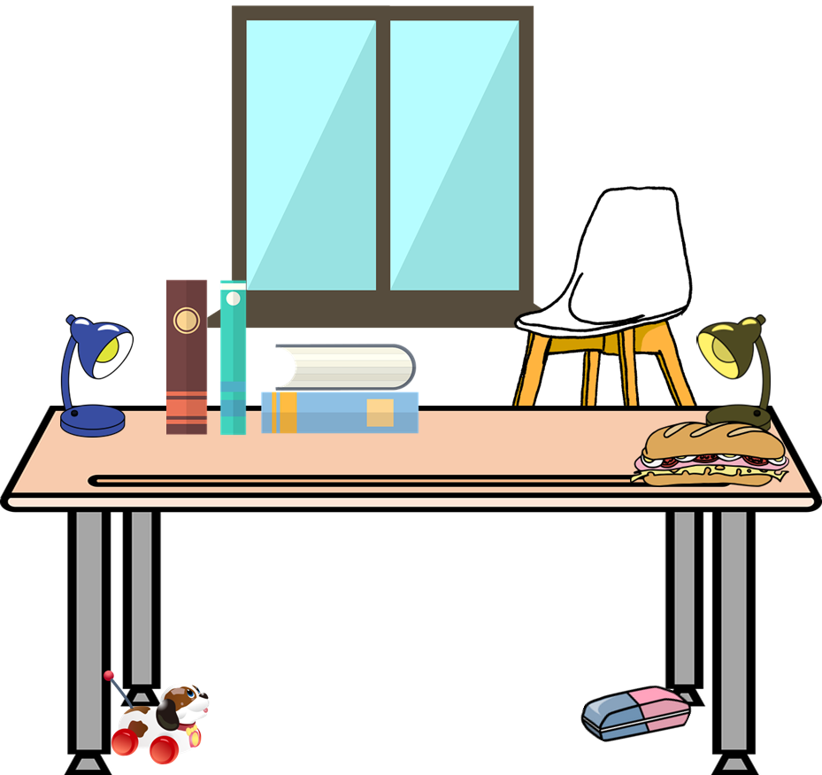
Describing me and others
¿Qué tenemos?
azul
Follow ups 1-5
Notes:
Artwork by Steve Clarke. All additional pictures selected are available under a Creative Commons license, no attribution required.
The frequency rankings for words that occur in this PowerPoint which have been previously introduced in the resources are given in the SOW (excel document) and in the resources that first introduced and formally re-visited those words.
Phonics: revisit [z]
Vocabulary (new words in bold): tienen [8] tenemos [8] espacio [451] gato [1728] goma [4437] lámpara [2978] mesa [187] mentira [1673] oficina [1072] perro [888] regla [1380] ventana [725] verdad [176] aquí [130] de12 [2] debajo [1366] detrás [2044] en1 [6]
Revisit 1: tener [19] tengo [tener 19] tiene [tener 19] casa [106] familia [233] habitación [1069] jardín [1195] libro [230] madre [226] padre [162] problema [145] profesor / profesora [501] silla [1271] estricto [3155] feo [2373] terrible [1246] muy [43] un [6] una [6]
Re-use adjectives: bonito [891]cómodo [2237] diferente [293] divertido [2465] feliz [908] elegante [2742] grande [66] importante [171] independiente [1177] negativo [1804] normal [1000] pequeño [202] tranquilo [1093]
Revisit 2: somos [ser, 7] estamos [estar, 21] activo [1278] cansado [1818] contento [1949] diferente [293] importante [171] independiente [1177] inteligente [2167] pero [30]
Frequency of unknown words:
mencionar [1102] otro [35] desastre [2532] hijos [140]
Source: Davies, M. and Davies, K. (2018). A frequency dictionary of Spanish: Core vocabulary for learners (2nd ed.). Routledge: London
For any other words that occur incidentally in this PowerPoint, frequency rankings will be provided in the notes field wherever possible.

Slide 2






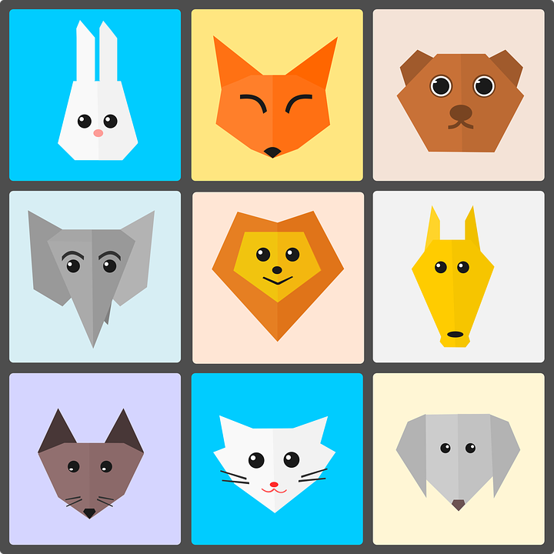
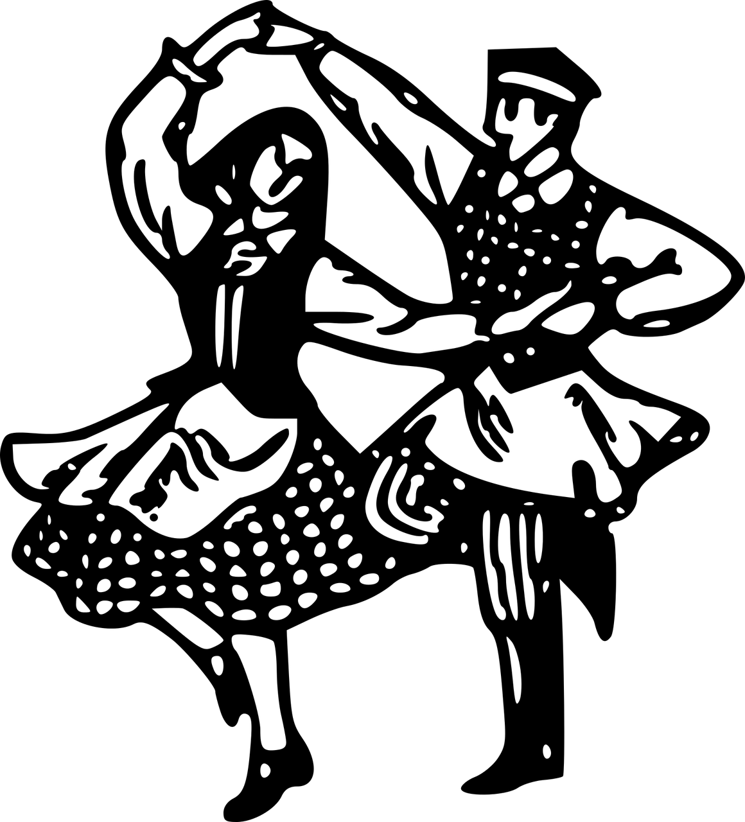
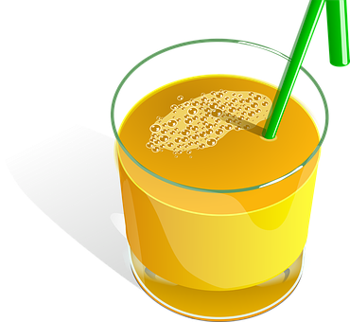



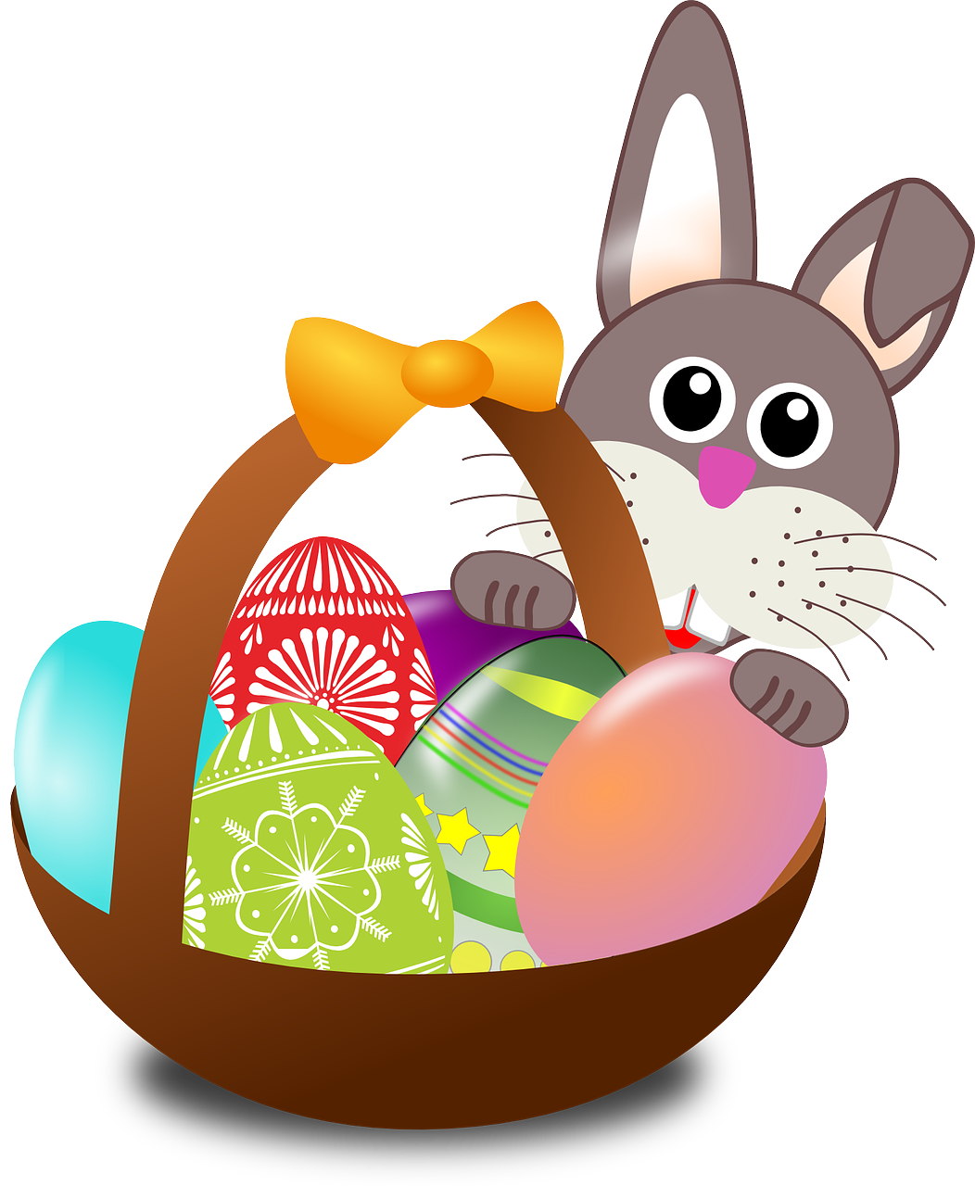
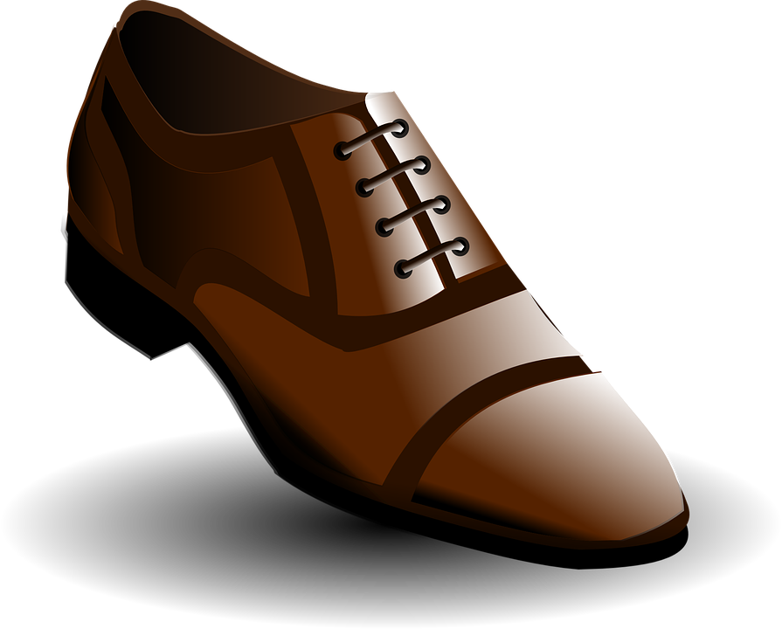

Follow up 1:
[z]
zapato
💡 [z] is always followed by [a] [o] [u]. [z] sounds the same as [c] in front of [e] [i]
[A]
[B]
pronunciar
Persona A
Escucha y escribe
[za] [zo] [zu] [ce] o [ci].
Persona B
Practica.
paz
cien
_ _
[EJ]
c e n a
zoo
100
[2]
_ _
cerca
a z ú c a r
[near]
zumo
[3]
_ _
d a n z a
zona
[4]
c r u c e
_ _
[area]
zapato
[5]
_ _
t r a d i c i ó n
_ _
_ _
[6]
c e r e z a
dulce
celebrar
[sweets]
[to celebrate]
Notes:
Timing: 5 minutes
Aim: to consolidate phonological awareness of the similarities between [za] [zo] [zu] [ce] and [ci].
Procedure:
Part A
pupils listen and write [za] [zo] [zu] [ce] [ci]
The teacher shows the answers for each word, one by one.
Transcript:
cena
azúcar
danza
cruce
tradición
cereza
Part B
Procedure:
Partner A sits with their back to the board whilst partner B reads aloud the first five words that on the first click. Partner A writes the words.
Partner then swap roles. Teacher clicks to bring up the remaining 5 words (and remove the first five for clarity).
Teacher clicks again to bring all words back. Pupils check their spellings.
Teachers should circulate to listen to pupils’ pronunciation and praise/correct as necessary.
Click on each of the words to hear it pronounced.
Frequency of unknown words and cognates:
cena [2542] azúcar [2007] danza [2298] cruce [3514] tradición [1061] cereza [>5000] zoo [>5000] paz [554] cien(to) [440] zona [359] cerca [1042] zumo [>5000] dulce [3450] celebrar [886]
Source: Davies, M. & Davies, K. (2018). A frequency dictionary of Spanish: Core vocabulary for learners (2nd ed.). Routledge: London

Slide 3

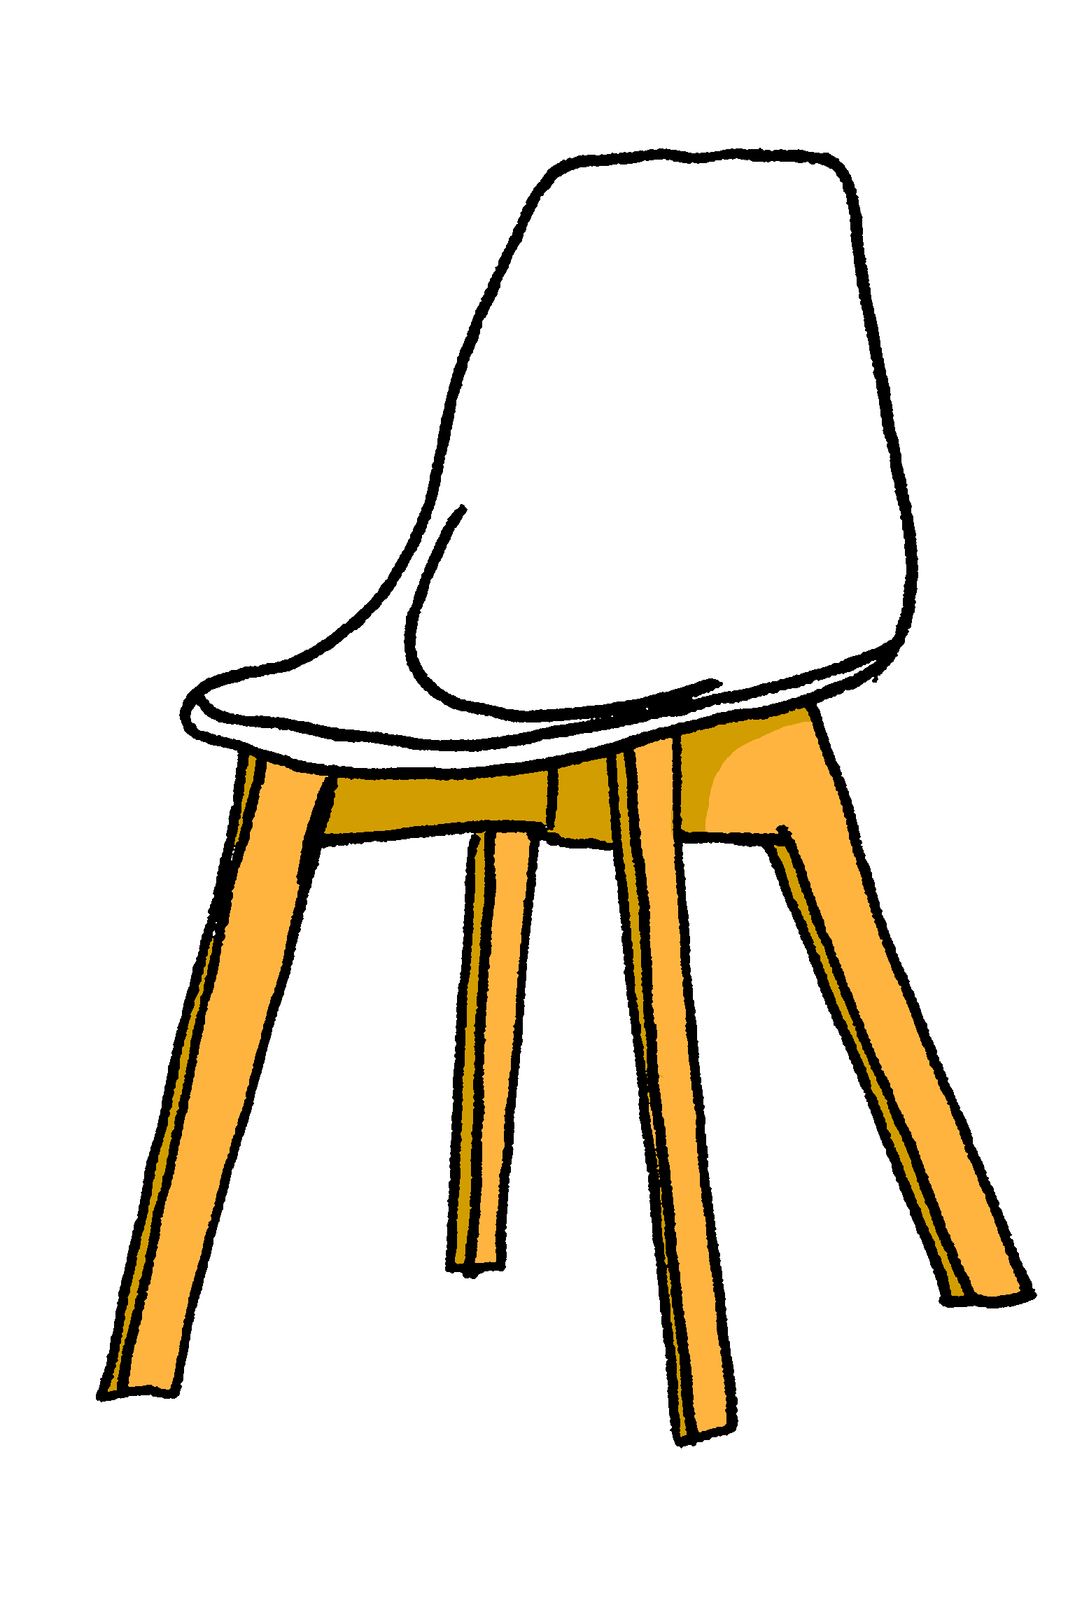
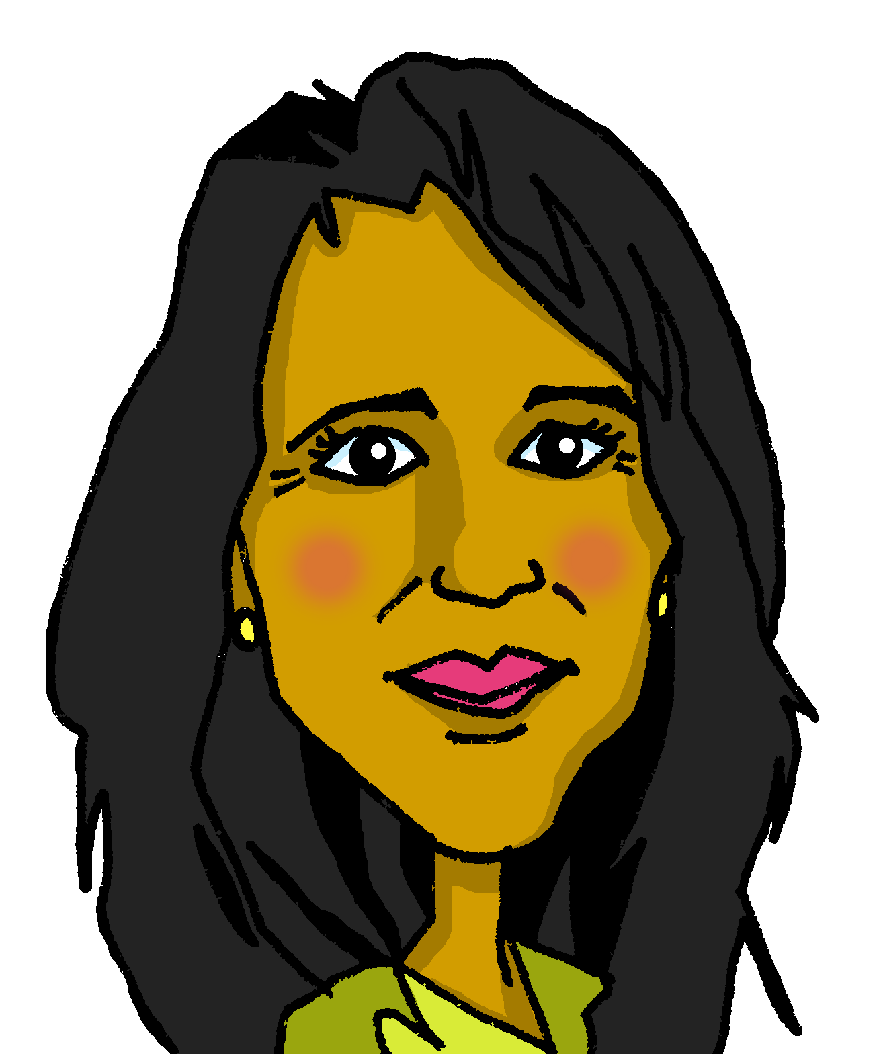


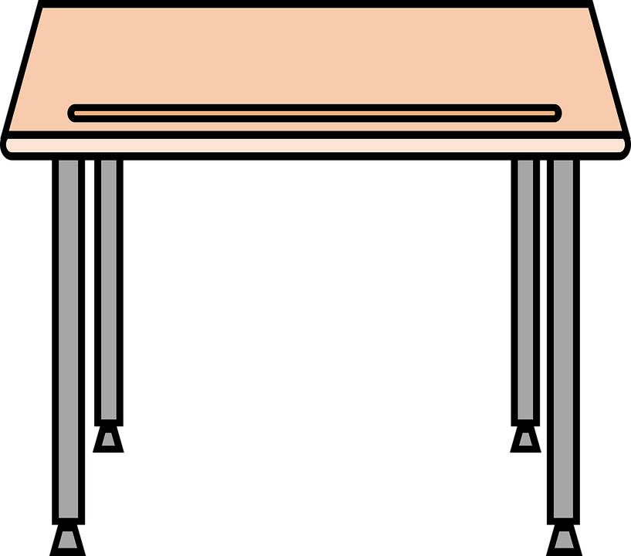

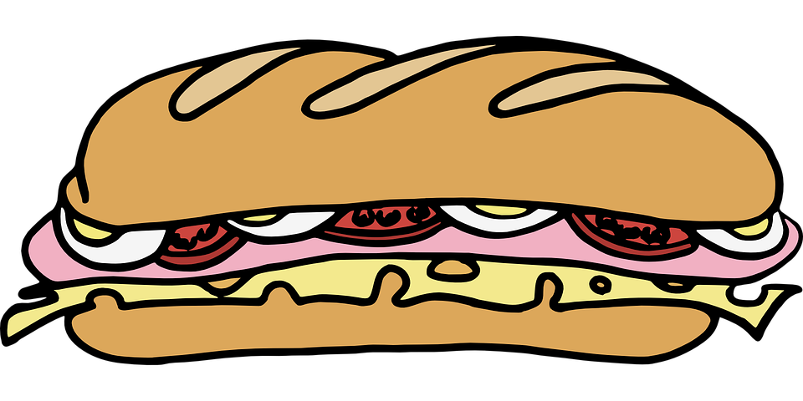
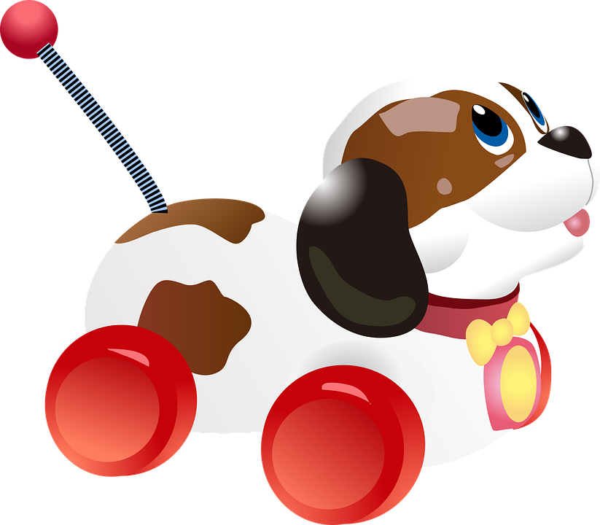
Follow up 2: La mesa de Sofía y Quique
Sofía and Quique share a table and it’s a bit messy.
escuchar
Elena, la madre de Sofía y Quique, lee la lista.
¡Qué desastre*, hijos*!
desastre = disaster
hijos* = children
Notes:
Timing: 4 minutes (two slides)
Use this first slide to set the scene.
Procedure:
1. Read the title and click to bring up the instructions in Spanish.
2. Move to the next slide for the task.
Frequency of unknown words and cognates:
desastre [2532] hijos [140]
Source: Davies, M. & Davies, K. (2018). A frequency dictionary of Spanish: Core vocabulary for learners (2nd ed.). Routledge: London

Slide 4
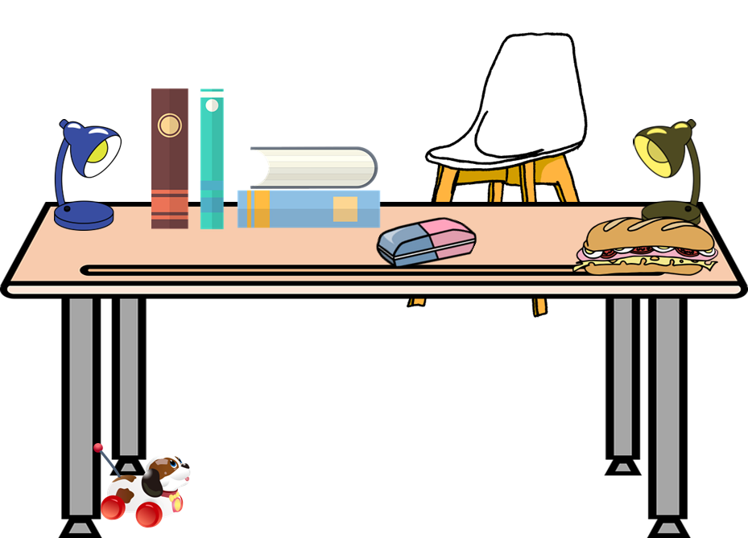
Follow up 2: La mesa de Sofía y Quique
Escucha: ¿Es ‘un, una, unos o unas’?
escuchar
 | un / una / unos / unas | silla | bolígrafo
 | un / una / unos / unas | libros | botellas
 | un / una / unos / unas | regla | bocadillo
 | un / una / unos / unas | goma | estuches
 | un / una / unos / unas | lámparas | cuadernos
E
1
2
¡Qué desastre!
3
4
desastre = disaster
Notes:
Timing: 4 minutes
Aim: to practise aural recognition of un / una / unos / unas and their connection with an appropriate noun.
Procedure:
Read the title and click to bring up the instructions in Spanish.
Do the example (E). (Note: some learners will benefit from being able to circle the words on the sheet).
Click to bring up the answers.
Draw pupils’ attention to the nouns.
Pupils write (or circle) the correct noun, according to its final letter.
Pupils check their answers.
Click to confirm the answers.
Transcript 1:
Ej. ¿Qué tienen? Pues, tienen una [silla]
Tienen unos [libros]
Tienen un [bocadillo]
Tienen una [goma]
Tienen unas [lámparas]
Frequency of unknown words and cognates:
desastre [2532]
Source: Davies, M. & Davies, K. (2018). A frequency dictionary of Spanish: Core vocabulary for learners (2nd ed.). Routledge: London

Slide 5





Follow up 3:
Lee y decide.
menciona = mentions
¿Qué menciona? ¿Qué no menciona?
leer
una silla | un bolígrafo
unos libros | unas botellas
una regla | un bocadillo
una goma | unos estuches
unas lámparas | unos cuadernos
Mamá Elena has forgotten to mention one item.
¿Qué más tienen Sofía y Quique?
Escribe dos listas en inglés .
a chair
a pen
some books
some bottles
a sandwich
a ruler
a rubber
some pencil cases
¡un perro!
some lamps
some exercise books
Notes:
Timing: 4 minutes
Aim: to practise written comprehension of the new vocabulary.
Procedure:
1. Ensure that pupils understand the task. They need to identify and list in English the 5 items that Elena says need tidying, and the 5 items that she doesn’t mention.
2. Pupils write the words in English.
3. Click to reveal answers.
4. Note: the picture clues are available on a mouse click, but first pupils should try to recall as many of the meanings as they can. Most of the words have been taught and revisited before; only goma and lámpara are new. Teachers should judge the most appropriate moment to provide the additional support. If not needed, it can be clicked to appear just prior to revealing the answers.
Frequency of unknown words and cognates:
mencionar [1102]
Source: Davies, M. & Davies, K. (2018). A frequency dictionary of Spanish: Core vocabulary for learners (2nd ed.). Routledge: London

Slide 6

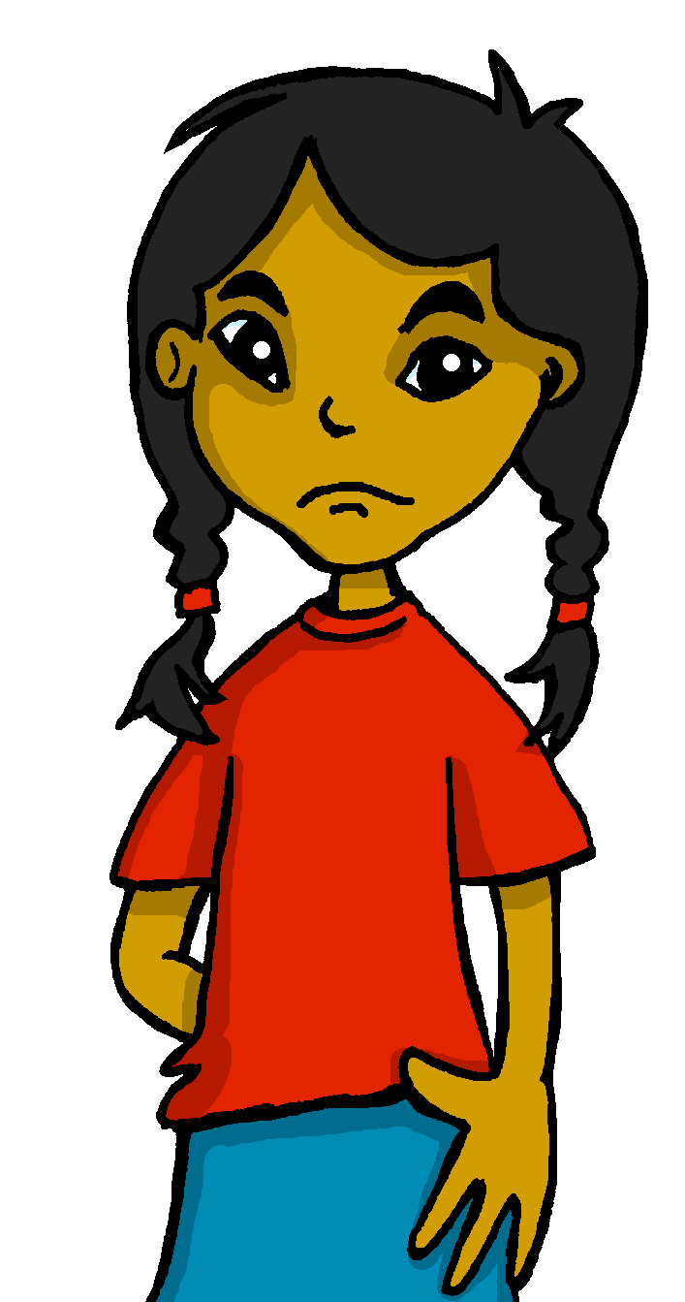
Follow up 4
Problemas de familia
Sofía escucha a Elena, pero no está contenta.
leer
¿Qué menciona Sofía? ¿Cómo responde Elena?
¡Ay, Sofía, es verdad!
Pues, no hay problema.
Tenemos otra mesa.
¿Si tienes una mesa y Quique también tiene una mesa?
¿Qué piensas?
Perfecto, ¿no?
Mamá, ¡estás muy estricta hoy, como mi profesora! Quique y yo tenemos un problema. Ya somos grandes y es importante tener un espacio en casa para estudiar pero no tenemos. ¡Es terrible!
Oh, Sofía, that’s true!
Mum, you are very strict today, like my teacher!
Well, there’s no problem.
We have another table.
Quique and I have a problem.
If you have a table and Quique also has one/a table.
We are big now
and it is important to have a space at home
What do you think?
Perfect, no?
to study but we don’t have (one). It’s terrible!
¿Qué significa en inglés?
menciona = mentions
otro* = another
Notes:
Timing: 5 minutes
Aim: to practise written comprehension of a lot of this week’s revisited vocabulary.
Procedure:
Read the title and instruction and make sure the context is clear. Sofía has been listening to her mum’s scolding about the messy table but she is not happy about it. What does she say? What does Elena respond?
This could be done orally, sentence by sentence with the class working together with the teacher; alternatively, pupils could be give 4 minutes to work on translating it in pairs and then feed back can be giving, using this slide.
Note: if desired, click on Sofía and Elena to hear the dialogue.
Frequency of unknown words and cognates:
mencionar [1102] otro [35]
Source: Davies, M. & Davies, K. (2018). A frequency dictionary of Spanish: Core vocabulary for learners (2nd ed.). Routledge: London

Slide 7


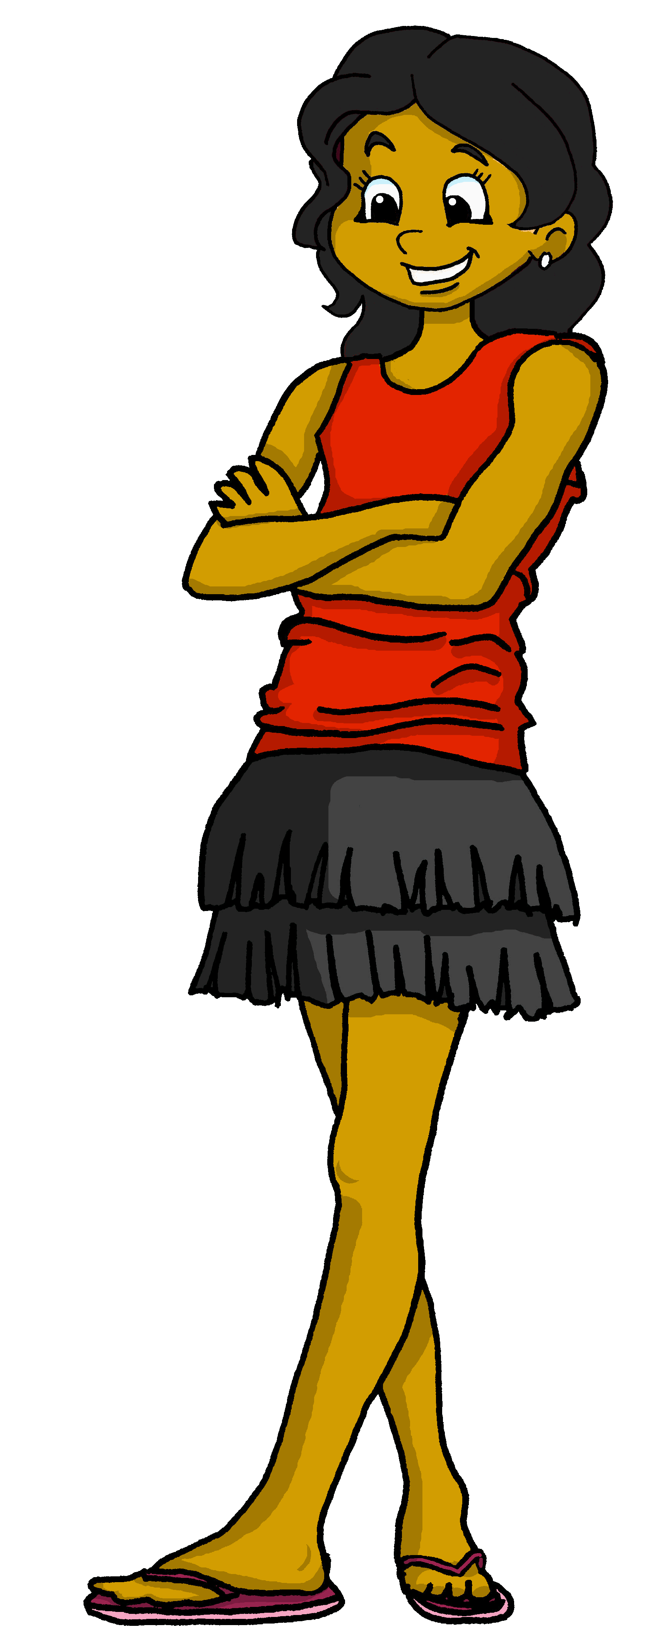
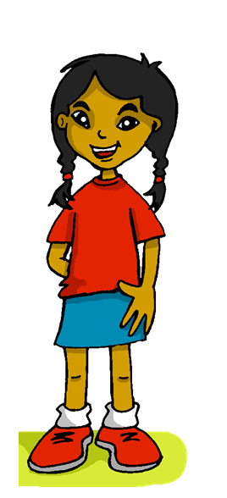
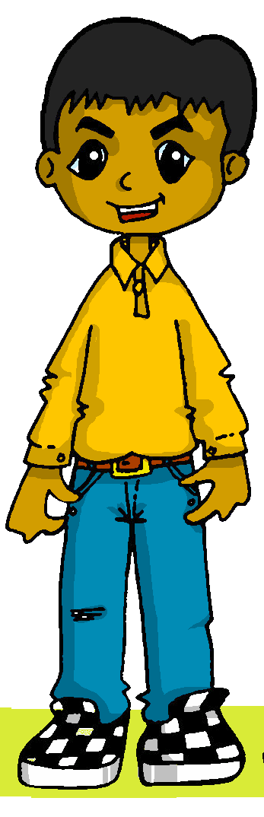

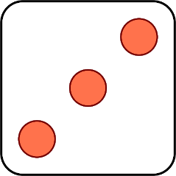
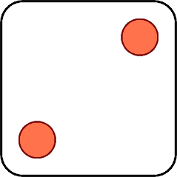

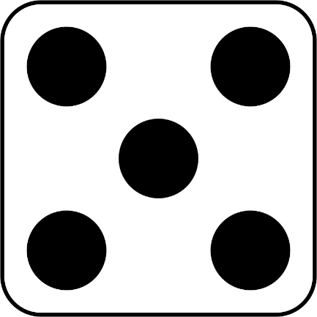

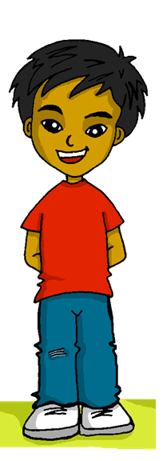
Follow up 5a:
Habla en español.
Quique habla sobre Sofía, Luis y Celia. ¿Qué menciona*?
hablar
No tienen una casa moderna.
¿Tienen una habitación pequeña?
No temenos un espacio útil.
No tiene una familia grande.
Tenemos un jardín bonito.
Tiene una profesora estricta.
1 | She has…
2 | She does not have…
3 | We have…
4 | We do not have…
5 | They do not have…
6 | Do they have…?
1 | a useful space
2 | a big family
3 | a strict teacher (f)
4 | a modern house
5 | a pretty garden
6 | a small room
a / an
some
menciona = mentions
Notes:
Timing: 5 minutes
Aim: to practise oral production of three parts of tener (question and affirmative / negative phrases).
Procedure:
1. Click to ‘roll’ the dice.
2. Pupils translate the verbs and nouns whose numbers correspond to the respective dice to make a short sentence. They say the answer chorally.
3. Click to reveal the correct sentence.
4. Repeat until all six combinations have been said.
Frequency of unknown words and cognates:
mencionar [1102]
Source: Davies, M. & Davies, K. (2018). A frequency dictionary of Spanish: Core vocabulary for learners (2nd ed.). Routledge: London

Slide 8




Follow up 5b:
Escribe en español 📝.
a b ñ
vocabulario
Can you get at least15 points?
 | different (sing.) | tired (f) | intelligent
 | but | we are (trait) | we are (state)
 | strict (m) | I have | s/he, it has
 | problema | very | chair
 | to have, having | behind | below, under
 | rubber | lamp | office
 | they have | we have | space
diferente
cansada
inteligente
x3
pero
somos
estamos
estricto
tengo
tiene
x2
el problema
muy
(la) silla
tener
detrás
debajo
la goma
la lámpara
la oficina
x1
tienen
tenemos
el espacio
Notes:
Aim: to practise written production of vocabulary for this week and previous weeks.
Procedure:
Pupils need to write the Spanish for as many words as possible, aiming to get at least 15 points (but more if possible).
Tell pupils to write the correct word for ‘the’ with all the nouns.
3. Click for Spanish answers.
Note:
The most recently learnt and practised words are pink, words from the first revisit are green and those from the second revisit are blue, thus more points are awarded for them, to recognise that memories fade and more effort (heavy lifting!) is needed to retrieve them.

