Slide 1


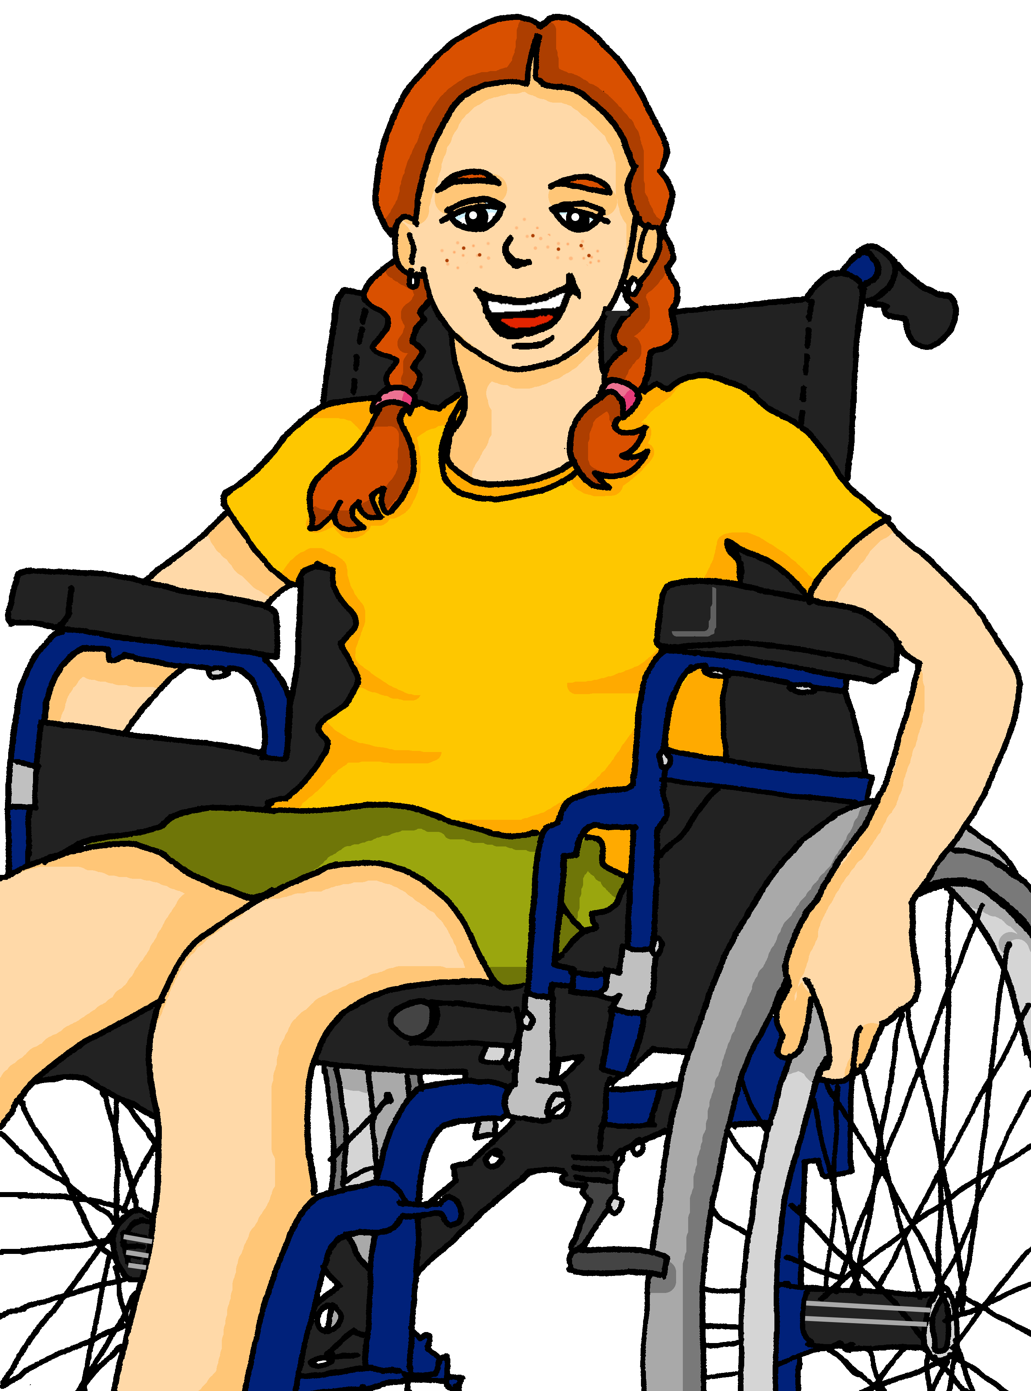

Saying what I and others have
¿Qué tienen?
azul
Follow ups 1-5
Notes:
Artwork by Steve Clarke. All additional pictures selected are available under a Creative Commons license, no attribution required.
The frequency rankings for words that occur in this PowerPoint which have been previously introduced in the resources are given in the SOW (excel document) and in the resources that first introduced and formally re-visited those words.
Phonics: [ce] centro [317] [ci] decir [32] cluster: cerca [1042] celebrar [886] dulce [1861] cero [1731] cocina [1214]
Vocabulary (new words in bold): tienen [8] enorme [631] un poco [76] solo [181] bocadillo [] clase [320] conejo [] cuaderno [3301] hermano [333] hermana [3409] lápiz [3740] libro [230] mochila [>5000] regla [1380] ventana [725] activo [1278] bonito [891] grande [66] nuevo [94] viejo [225] bastante [308] muy [43] de12 [2]
Revisit 1: hay [13] cuántos/cuántas [580] diccionario [3844] flor [739] foto [882] regalo [1986] blanco [372] especial [436] feliz [908] grande [66] importante [171] normal [1000] pequeño [202] rojo [534] útil [3951]
Revisit 2: es [ser, 7] está [estar 21] amigo [210] profesor [510] divertido [2465] lento [1569] rápido [870] serio [856] tranquilo [1093] pesado [2166] también [49] hoy [167] siempre [96] y [4]
Frequency of unknown words:
chatear [>5000] mirar [125] mandar [588]
Source: Davies, M. and Davies, K. (2018). A frequency dictionary of Spanish: Core vocabulary for learners (2nd ed.). Routledge: London
For any other words that occur incidentally in this PowerPoint, frequency rankings will be provided in the notes field wherever possible.

Slide 2




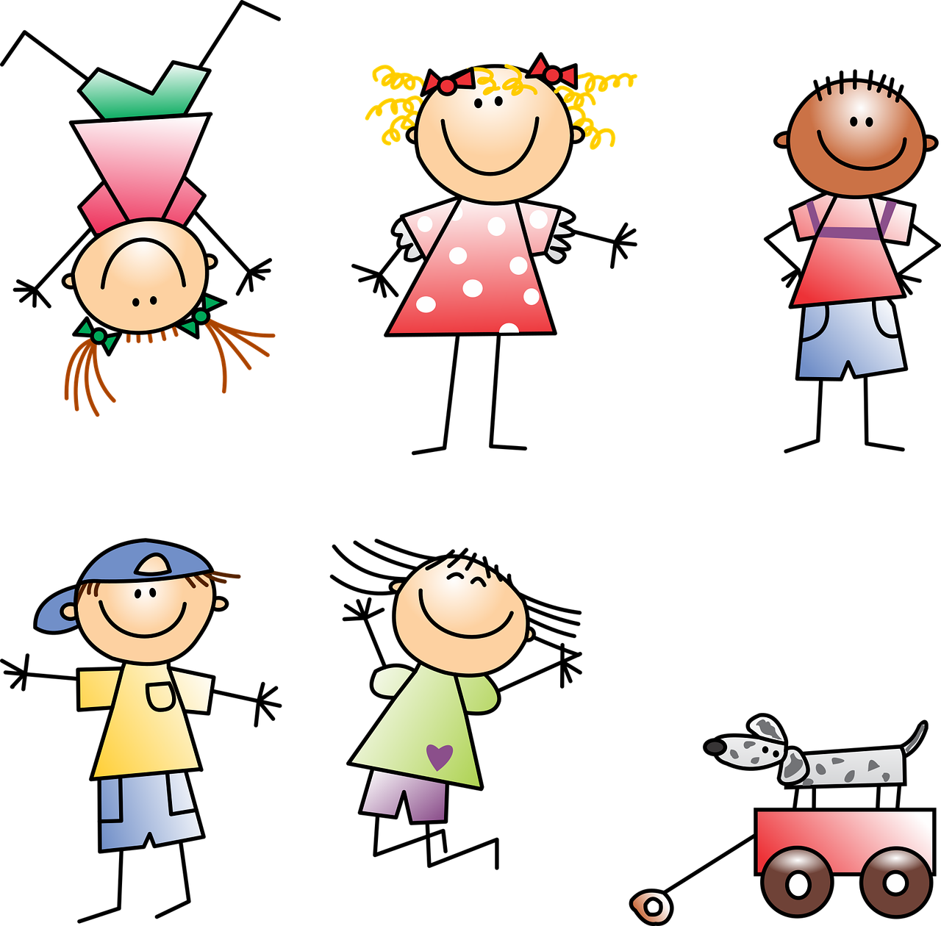









Follow up 1:
[ce]
[ci]
Es un día especial en la escuela.
escuchar
¿Quién tiene qué?
 | ¿Quién? ¿Quiénes? |  | tiene tienen |  | ?
 | Celia Celia y Circe |  | tienen |  | unos dulces
 | Ciro y Cesar Ciro |  | tienen |  | unos lápices
 | Celene y Cintia Celene |  | tiene |  | unos cereales
 | Cecilia y Celestino Cecilia |  | tienen |  | unas celebraciones
 | Cisco y Ceria Cisco |  | tiene |  | unos conciertos
hablar
1
………
………
2
………
………
3
………
………
4
………
………
5
………
………
Notes:
Timing: 5 minutes
Aim: to apply knowledge of the SSC [ce] and [ci] to the transcription of some known and unfamiliar words, and to their oral production.
Procedure:
Teacher explains the scenario. A special day at school. People have some unusual things in school today.
Click to listen. First pupils need to identify whether the sentence refers to one or more people. They write the name or names.
They then write the corresponding form of ‘has/have’.
Click to listen again and pupils transcribe the item.
Elicit answers orally from pupils.
Click to reveal written answers and pictures.
Pupil A practises pronouncing sentence 1. Partner B translates into English.
Transcript:
Celia y Circe tienen unos dulces.
Ciro y César tienen unos lápices.
Celene tiene unos cereales.
Cecilia y Celestino tienen unas celebraciones.
Cisco tiene unos conciertos.
Frequency of unknown words and cognates:
cereal [>5000] celebración [2711]
Source: Davies, M. & Davies, K. (2018). A frequency dictionary of Spanish: Core vocabulary for learners (2nd ed.). Routledge: London

Slide 3



Hay (there is, there are) | tiene (s/he, it has)
Remember!
Hay means there is or there are and tiene means s/he it has.
To say what there is in the class say:
To say what the class has, say:
hay
tiene
En la clase __________ una ventana.
La clase ___________ una ventana.
In the class there is a window.
The class has a window.
💡 The meaning of these sentences is essentially the same. What is different about how they start?
Notes:
Use before Follow up 2.
Timing: 2 minutes
Aim: to revisit the meaning of hay and tiene and to present a useful contrast to practise in the next activity.
Procedure:
Click to present the information in stages.
Elicit English translations for the Spanish examples provided.

Slide 4





Follow up 2:
Quique manda mensajes a Max en Inglaterra.
Hay un problema con el teléfono.
leer
Does the sentence start with ‘La clase…’ or ‘En la clase…?
1
2
La clase no tiene una profesora divertida.
En la clase hay unas flores blancas.


3
4
5
La clase tiene unas reglas amarillas.
En la clase hay solo un regalo especial.


La clase tiene una foto grande.

6
7
8
En la clase hay una ventana muy pequeña.
La clase tiene un póster de un grupo de música.



En la clase hay unos lápices útiles.
Notes:
Timing: 3 minutes
Aim: to use knowledge of tiene and hay to determine how each sentence must begin.
Procedure:
Read the scenario with pupils. They should understand that Quique is sending messages to Max describing his class, but that there is a glitch with the phone. They need to work out how each sentence starts ‘En la clase’ or ‘La clase’.
Do the first one with pupils. They work it out by looking at the verb ‘tiene’, understanding that it means ‘has’ and conclude that the sentence must begin ‘la clase’ for ‘the class has…’.
Pupils write 2-8 and complete the tasks. Alternatively pupils could discuss in pairs and then feed back their answers orally.
Click to correct.
Note: Follow up 3 provides an opportunity to practise comprehension of the full sentences and revisit the vocabulary meanings.

Slide 5
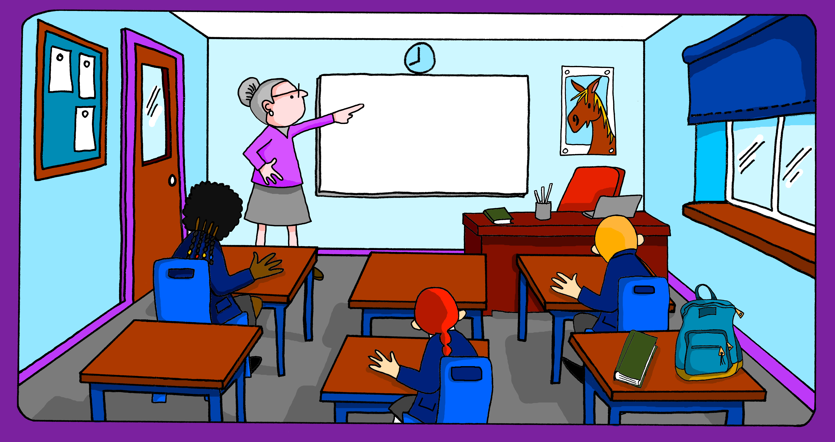




Follow up 3:
Quique manda una foto de la clase a Max.
Mira la foto y la frase. ¿Es verdad o mentira?
leer
Escribe las frases falsas en negativo.
La clase no tiene una profesora divertida.
M
1
La clase tiene una profesora divertida.
V
En la clase no hay solo un regalo especial.
2
En la clase hay unas flores blancas.
M
La clase no tiene una foto grande.
3
En la clase hay solo un regalo especial.
M
4
La clase tiene una foto grande.
En la clase no hay una ventana muy pequeña.
5
La clase tiene unas reglas amarillas.
V
La clase no tiene un póster de un grupo de música.
6
V
En la clase hay unos lápices útiles.
M
solo = only, just
mira = look
manda = sends
7
En la clase hay una ventana muy pequeña.
8
M
La clase tiene un póster de un grupo de música.
Notes:
Timing: 5 minutes
Aim: to use vocabulary knowledge to identify which sentences are true/false; to use knowledge of negation with ‘no’ to re-write the false sentences.
Procedure:
Read the scenario with pupils. They should understand that Quique has sent a photo of his classroom to go with his whatsapp messages describing it. But not every one is true.
Pupils look at the photo and read the sentence, deciding if they are true (V) or false (M).
Click to correct.
For the false (M) sentences, pupils should re-work the sentences (either writing on mini whiteboards or speaking) in the negative.
Click to reveal the correct negative sentences.
Frequency of unknown words:
solo [181] mirar [125] mandar [588]
Source: Davies, M. and Davies, K. (2018). A frequency dictionary of Spanish: Core vocabulary for learners (2nd ed.). Routledge: London

Slide 6




Follow up 4:
Sofía chatea con Krina sobre la escuela.
- Krina, ¿cómo [is] tu clase? ¿Qué [does it have]?
- Tiene muchas [things].
- ¿[How many] ventanas hay?
- [There is] solo [one window] pero es [quite] grande. [Also] tiene unas personas [important].
- ¿Quiénes [are they]?
- [the (male) teacher] Señor Jones y [some] amigos.
- ¿cómo son?
- [Always] son [calm] pero hoy son [a bit] lentos.
- [Are you] feliz hoy?
- Sí, y también estoy muy [fast].
es
tiene
escribir
cosas.
Cuántas
Hay
una ventana
bastante
leer
También
importantes.
hay
son
es
cuántas
bastante
El profesor
unos
cosas
también
estás
importantes
Siempre
tranquilos
un poco
rápida
una ventana
un poco
¿Estás
el profesor
siempre
rápida.
tiene
chatea = chats (online)
son
tranquilos
unos
Notes:
Timing: 10 minutes
Aim: to practise written production of known vocabulary and structures from this and the revisited weeks.
Procedure:
Pupils can number 1 – 17 rather than copy out the whole dialogue.
First, they spend 5 minutes trying to write any of the missing Spanish words that they know.
Note: reassure pupils that it is always important to try written recall from memory first, but that in stage 2 there will be some prompts.
After five* minutes, click to reveal the jumbled answers. Pupils spend another 3 minutes trying to complete the missing translations, using the prompts.
Click to reveal the answers. There is also an audio recording of the full dialogue to listen to.
Note: Click on Krina to hear the full audio.
If time allows, elicit English meanings for each sentence from the whole class, orally.
*Teachers will judge for themselves when to bring up the reading prompts. It may be much sooner, depending on the vocabulary knowledge of the class.
Frequency of unknown words:
chatear [>5000]
Source: Davies, M. and Davies, K. (2018). A frequency dictionary of Spanish: Core vocabulary for learners (2nd ed.). Routledge: London

Slide 7




Follow up extra:
Escribe en español 📝.
a b ñ
vocabulario
Can you get at least15 points?
 | s/he, it is (state) | slow (f) | boring, tiresome (m)
 | also | always | s/he, it is (trait)
 | normal | how many (m, pl) | there is, there are
 | how many (f, pl) | useful | red (m)
 | pencils | window | small (m)
 | very | only | from, of
 | they have | enormous | a bit
está
lenta
pesado
x3
también
siempre
es
normal
cuántos
hay
x2
cuántas
útil
rojo
lápices
(la) ventana
pequeña
muy
solo
de
x1
tienen
enorme
un poco
Notes:
Aim: to practise written production of vocabulary for this week and previous weeks.
Procedure:
Pupils need to write the Spanish for as many words as possible, aiming to get at least 15 points (but more if possible).
Tell pupils to write the correct word for ‘the’ with all the nouns.
3. Click for Spanish answers.

