Slide 1





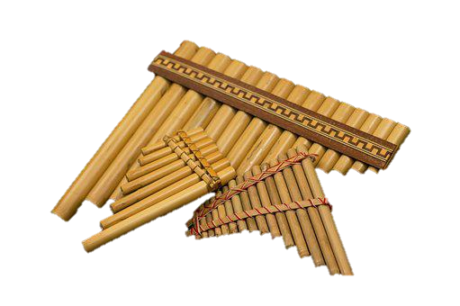
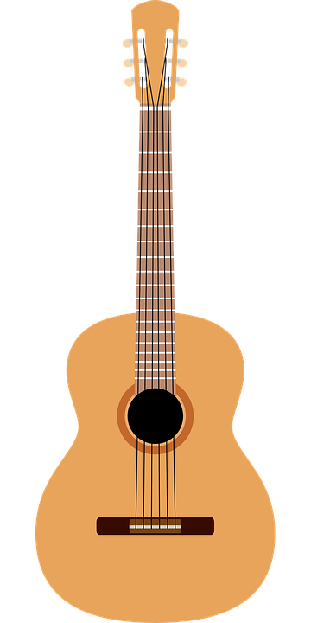

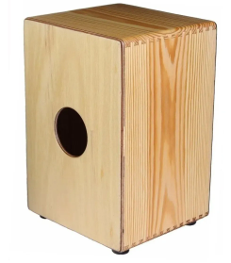
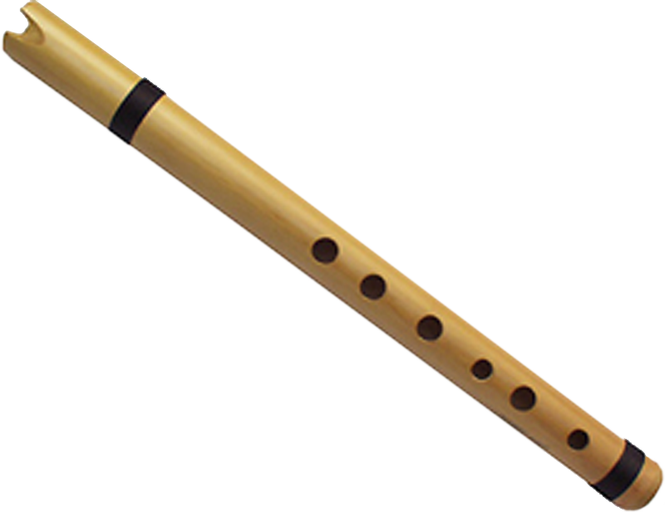
Describing things and people
rojo
Follow ups 1-5
Notes:
Artwork by Steve Clarke. All additional pictures selected are available under a Creative Commons license, no attribution required.
The frequency rankings for words that occur in this PowerPoint which have been previously introduced in the resources are given in the SOW (excel document) and in the resources that first introduced and formally re-visited those words.
For any other words that occur incidentally in this PowerPoint, frequency rankings will be provided in the notes field wherever possible.
Phonics: Source: helado [3024]
Vocabulary: cuidar [751] enseñar [610] participar [593] practicar [1595] guitarra [2705] niño, niña [173] trabajo [152]
Revisit 1: año [46] hambre [1262] razón [306] sed [2214]
Revisit 2: fruta [1925] globo [3765] pelota [2270] queso [3187] sombrero [2289] tarta [>5000] (cognates: pizza [>5000]
yoyó [>5000]
Glossed:
caer [251] llueve (llover) [2134] rodear [912] verano [1139] verbo [3443] cuidado [1822] correctamente [4173]
Source: Davies, M. & Davies, K. (2018). A frequency dictionary of Spanish: Core vocabulary for learners (2nd ed.). Routledge: London

Slide 2



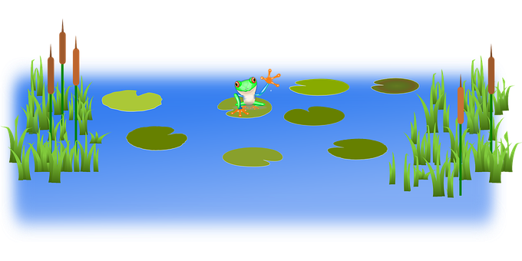
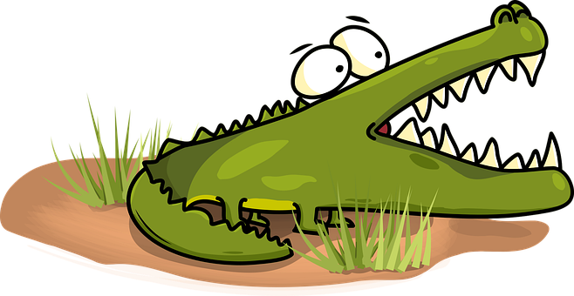
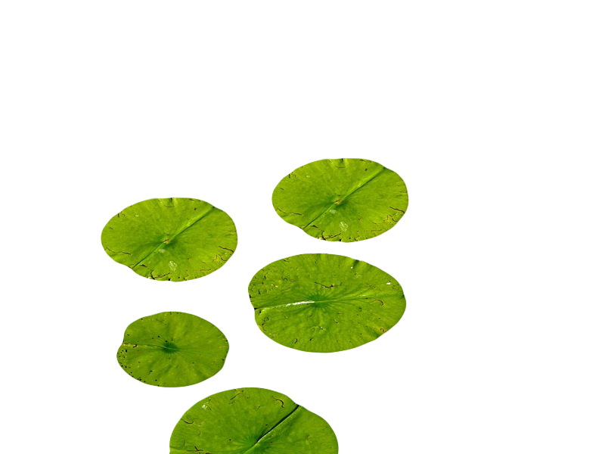
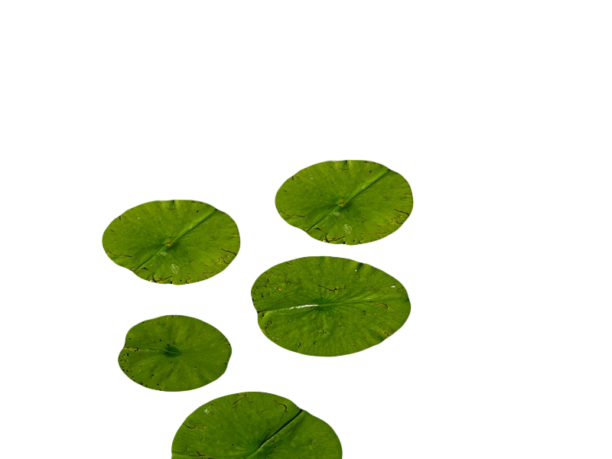

Follow up 1:
cuidado = be careful correctamente = correctly
caer = to fall
[h]
¡Cuidado con el cocodrilo!
hablar
Pronuncia las palabras correctamente para no caer al agua.
Turno 1: Persona A
Turno 2: Persona B
ahí
helado
húmedo
humano
zanahoria
almohada
horror
hablar
hospital
ahora
hoy
Notes:
Timing: 5 minutes
Aim: to practise knowledge of [h] to known and unknown words.
Procedure:
Click to bring up the instruction.
Pupils work in pairs to practise pronunciation. They can choose where to start and have one minute to pronounce all the words correctly (silent h) to avoid being eaten by the crocodile.
Divide the class in A & B and click to indicate it’s ‘persona A’’s turn.
Click to bring up Persona B’s turn.
cuidado [1822] correctamente [4173] caer [251]

Slide 3



Follow up 2:
¡Llueve!
Escribe en inglés.
comprender
necesitar
cuidar
leer
hablar
ver
pasar
5
nadar
enseñar
caminar
4
llevar
3
leer
visitar
comprar
2
jugar
comer
tener
1
llueve = it rains
Notes:
Timing: 5 minutes (two slides)
Aim: to practise written comprehension of a range of infinitive verbs.
Procedure:
Tell pupils to be ready to write the English meanings of verbs they have been learning and practising this week. There will be 16 altogether and they should prepare to work from the bottom of the slide, left to right.
Explain the scenario – it’s raining and the raindrops will splash down and cover the words. They need to write the meanings before the verbs get covered. Tell them they will have 5 seconds to get a headstart on the rain.
Click to start number animation.
Click once more to start raindrops. The timing has been carefully set! Don’t click again or all the raindrops will appear at once.
When finished move to the next slide to check answers.
llueve (llover) [2134]

Slide 4
Follow up 2:
Escribe en inglés.
comprender
necesitar
cuidar
leer
leer
to understand, understanding
to need, needing
to look after, looking after
ver
hablar
pasar
to see, watch; seeing, watching
to talk, talking
to pass, spend; passing, spending
nadar
enseñar
caminar
to swim, swimming
to walk, walking
to show, teach; showing, teaching
llevar
visitar
comprar
leer
to wear, wearing
to read, reading
to visit, visiting
to buy, buying
comer
jugar
tener
to eat, eating
to play, playing
to have, having
Notes:
Procedure:
Elicit responses from the bottom, left to right, from pupils.
Click to bring up a written version of the answer.

Slide 5


Follow up 3:
A Escucha y rodea.
escuchar
¿Quién es?
¿Qué verbo es?
B Escribe en inglés.
E
I | you | s/he
teach | look after
Información extra
___ ________
__ __ ________
__ __ ________
___ ________
___ ________
______ _________
your brother
1
I | you | s/he
play | swim
on the beach
2
I | you | s/he
swim | eat
in the sea
3
I | you | s/he
see | read
a book
4
learn | teach
a dance
I | you | s/he
Spanish words
5
I | you | s/he
prepare | practise
rodea = circle
(el) verbo = verb
Notes:
Timing: 10 minutes
Aim: to practise aural comprehension of singular persons o –ar and –er verbs and previously introduced vocabulary. Connecting sound with meaning.
Procedure:
(Part A)
Read the instruction in Spanish & click to bring further instruction.
Do [E] with them. Click to listen. Pupils circle the correct pronoun (I/she/you) and the corresponding verb. Some pupils would benefit from working on a handout. Alternatively, they can use numbers 1,2,3.
Click for answers
(Part B)
1. Pupils listen to 1-5 and write any extra info give, in English.
Click to reveal answers.
Transcript 1
E. Cuidas a tu hermano.
Juego en la playa.
Nada en el mar.
Lee un libro
Aprendes un baile.
Practicas palabras de español.
rodear [912] verbo [3443]

Slide 6





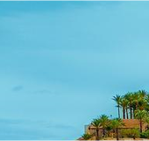
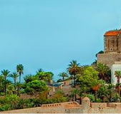
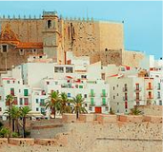
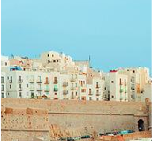
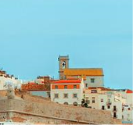
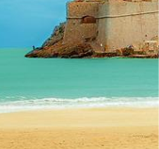
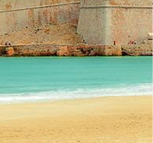

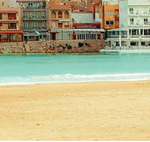
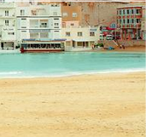
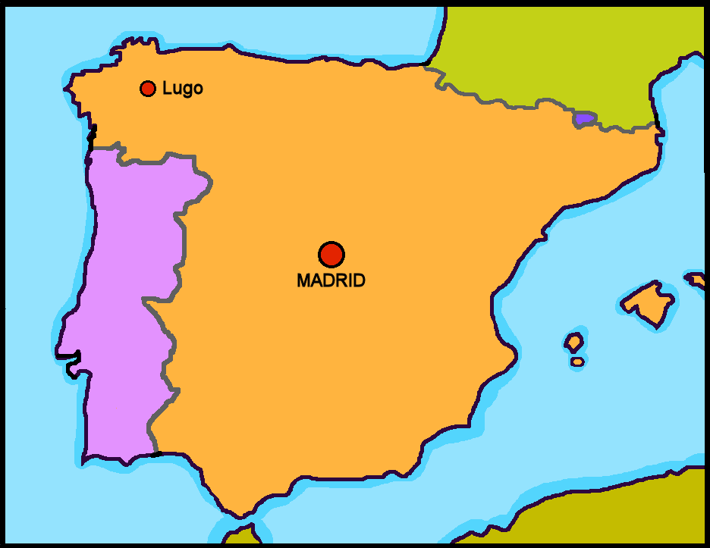

Follow up 4:
¿Dónde está Quique? [1/5]
hablar
to teach
to see
to practise
to eat
to walk
I
You
s/he
En Peñíscola hay un castillo muy famoso.
Peñíscola
Notes:
Timing: 5 minutes
Aim: to correctly use 1^{st,} 2nd and 3rd person singular verbs in oral production.
Procedure:
Pupils select a pronoun on the vertical axis with verb along the horizontal axis.
They translate the short verb phrase (e.g. I – to teach = enseño) to identify the square where they think Quique is.
Click on the square to reveal what is beneath.
Note: pupils might benefit from revisiting the infinitive verbs again before starting the activity. (i.e., enseñar, ver, practicar, comer, caminar).
(!) Quique is hidden behind…
S/he teaches = enseña

Slide 7
Follow up 4:
¿Dónde está Quique? [2/5]
hablar
to teach
to see
to practise
to eat
to walk
I
You
s/he
Notes:
[2/5]
(!) Quique is hidden behind…
I walk= camino

Slide 8
Follow up 4:
¿Dónde está Quique? [3/5]
hablar
to teach
to see
to practise
to eat
to walk
I
You
s/he
Notes:
[3/5]
(!) Quique is hidden behind…
You eat= comes

Slide 9
Follow up 4:
¿Dónde está Quique? [4/5]
hablar
to teach
to see
to practise
to eat
to walk
I
You
s/he
Notes:
[4/5]
(!) Quique is hidden behind…
You practise= practicas

Slide 10
Follow up 4:
¿Dónde está Quique? [5/5]
hablar
to teach
to see
to practise
to eat
to walk
I
You
s/he
Notes:
[5/5]
(!) Quique is hidden behind…
S/he sees= ve

Slide 11







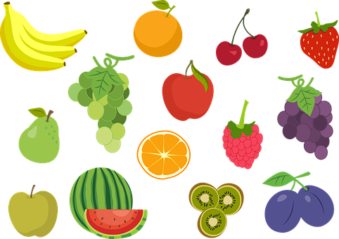





Follow up 5:
Sofía describe un día de verano.

Escribe seis frases.
escribir
[tú]
[yo]
con
por
en
[él]
una canción
una pregunta
una fiesta
un juego
una tarta
un sombrero
un bocadillo
unas palabras
fruta
mi guitarra
en español
en inglés
los niños
la mañana
la tarde
(play)
(practise)
(listen)
(look after)
(eat)
(teach)
(learn)
(eat)
(walk)
(practise)
(talk)
(el) verano = summer
Notes:
Aim: to practise more independent written production of singular persons of –ar, -er verbs, drawing on a variety of previously taught vocabulary.
Procedure:
Pupils write sentences using the third person singular and plural of –AR and –ER verbs to describe (with 6 sentences) any of the activities that Sofía, Quique and Pedro do in Summer.
The Venn diagramm shows what Quique, Sofía and Pedro do and what Sofía / Pedro do. This encourages pupils to practise the singular persons of the verbs introduced this year.
Encourage pupils to extend their sentences with extra details. Model an example with them.
[Yo] + [eat] = como un bocabdillo por la mañana.
Note: Teachers can add a list of verbs to the slide to help pupils, if needed. E.g.
comer, aprender, participar, tener, cantar, necesitar, leer, llevar, nadar
verano [1139]

Slide 12




Follow up extra

Escribe en inglés: can you get at least 15 points?
 | la tarta | después | leer
 | la pelota | el queso | el sombrero
 | la sed | la fruta | el globo
 | el año | el hambre | la razón
 | cuidar | enseñar | participar
 | guitarra | niña | el trabajo
vocabulario
(the) cake
after
to read, reading
x3
(the) ball
(the) cheese
(the) hat
(the) thirst
(the) fruit
(the) balloon
x2
(the) year
(the) hunger
(the) reason
to look after, looking after
to show, teach; showing, teaching
to participate, participating
x1
(the) guitar
(the) girl
(the) work(place)
Notes:
Timing: 5 minutes
Aim: to practise written production of vocabulary from this week and this week’s revisited sets.
Procedure:
1. Give pupils a blank grid. They fill in the English meanings of any of the words they know, trying to reach 15 points in total.
Note:
The most recently learnt and practised words are pink, words from the first revisit are green and those from the second revisit are blue, thus more points are awarded for them, to recognise that memories fade and more effort (heavy lifting!) is needed to retrieve them.

Slide 13
Follow up extra:

Escribe en español: can you get at least 15 points?
 | (the) cake | to read, reading | cheese
 | (the) hat | (the) ball | after
 | (the) fruit | (the) reason | (the) year
 | (the) hunger | (the) thirst | (the) balloon
 | to participate, participating | to look after, looking after | (the) guitar
 | (the) girl | (the) work(place) | To show, teach; showing, teaching
vocabulario
la tarta
leer
el queso
x3
el sombrero
la pelota
después
la fruta
la razón
el año
x2
el hambre
la sed
el globo
participar
cuidar
la guitarra
x1
la niña
el trabajo
enseñar
Notes:
Timing: 5 minutes
Aim: to practise written production of vocabulary from this week and this week’s revisited sets.
Procedure:
1. Give pupils a blank grid. They fill in the Spanish meanings of any of the words they know, trying to reach 15 points in total.
Note:
The most recently learnt and practised words are pink, words from the first revisit are green and those from the second revisit are blue, thus more points are awarded for them, to recognise that memories fade and more effort (heavy lifting!) is needed to retrieve them.

Slide 14
¡adiós!
rojo

Slide 15
follow up 2b:

Handout 5
Escribe en inglés: can you get at least 15 points?
 | la tarta | después | leer
 | la pelota | el queso | el sombrero
 | la sed | la fruta | el globo
 | el año | el hambre | la razón
 | cuidar | enseñar | participar
 | guitarra | niña | el trabajo
vocabulario
x3
x2
x1
Notes:
HANDOUT 5

Slide 16
follow up 2b:

Handout 5
Escribe en español: can you get at least 15 points?
 | (the) cake | to read, reading | cheese
 | (the) hat | (the) ball | after
 | (the) fruit | (the) reason | (the) year
 | (the) hunger | (the) thirst | (the) balloon
 | to participate, participating | to look after, looking after | (the) guitar
 | (the) girl | (the) work(place) | To show, teach; showing, teaching
vocabulario
x3
x2
x1
Notes:
HANDOUT 5

