Slide 1


español, con Sofía

Slide 2










Expressing likes and saying what I and others do
rojo
-AR & -ER verbs:
I, you, s/he
SSC [b] [v]
Notes:
Artwork by Steve Clarke. All additional pictures selected are available under a Creative Commons license, no attribution required.
The frequency rankings for words that occur in this PowerPoint which have been previously introduced in the resources are given in the SOW (excel document) and in the resources that first introduced and formally re-visited those words.
For any other words that occur incidentally in this PowerPoint, frequency rankings will be provided in the notes field wherever possible.
Phonics: Source: ver [38] abuela [783]
Cluster: banco [728] bolsa [1581] vela [2247] viento [814]
Vocabulary: comer [347] jugar [356] llevar² [101] ] preparar [570] canción [982] profesor, profesora [501] después [115]
Revisit 1: grupo [200] favorito [2630] mi [37] tu [53] muy [43] también [49] y [4]
Revisit 2: hay [haber 13] unos [6] unas [6] cuántos [580] cuántas [580]
Glossed:
traducir [2037] baile [2040] sonido [1040] último [188]
Source: Davies, M. & Davies, K. (2018). A frequency dictionary of Spanish: Core vocabulary for learners (2nd ed.). Routledge: London

Slide 3

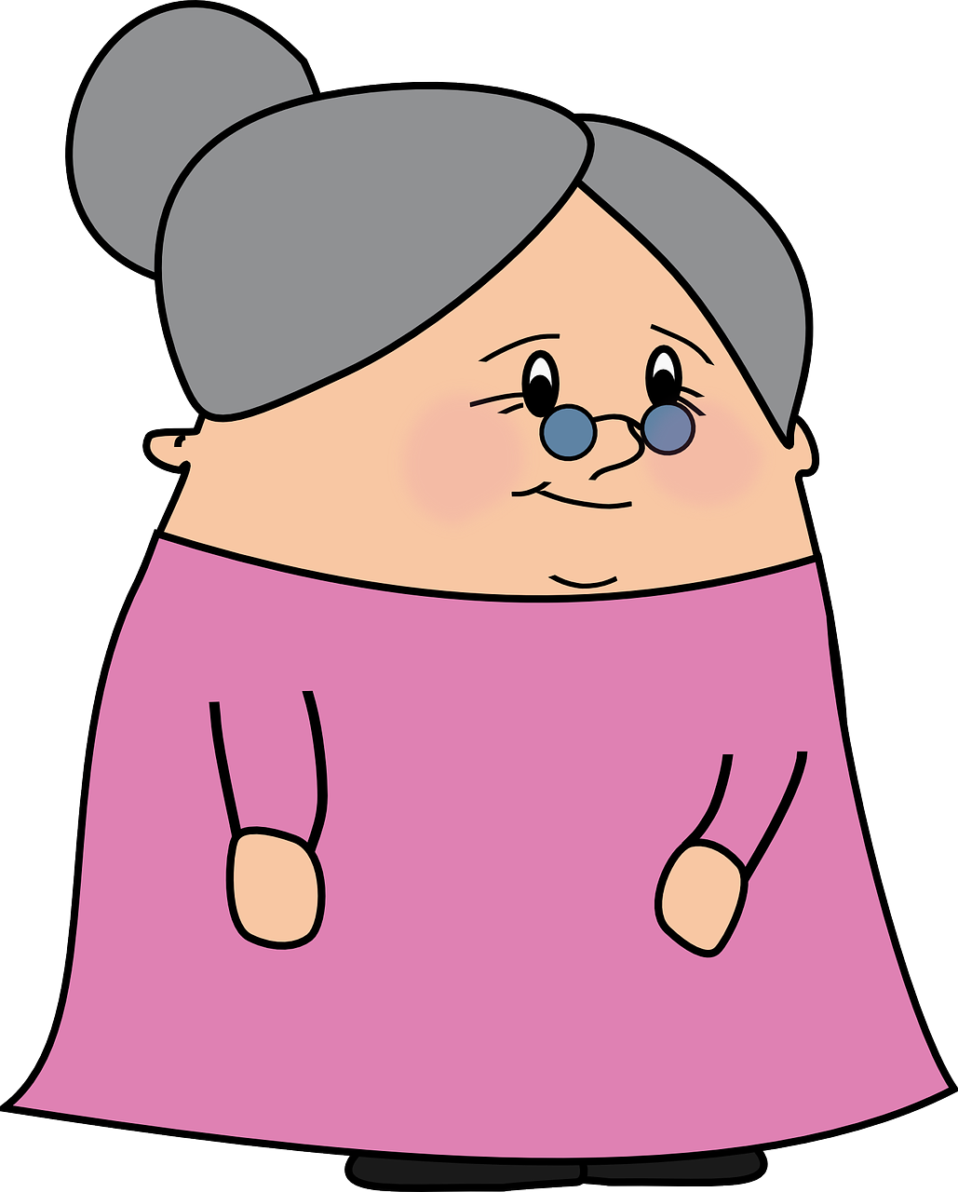
[b]
abuela
pronunciar
Notes:
Timing: 1 minute
Aim: To revisit SSC [b]
Procedure:
To recap and elicit the pronunciation of the individual SSC [b]
Click to bring the picture & get students to repeat (with gesture, if using).
Gesture suggestion :

Slide 4



[v]
ver
Notice [v] has the same sound as [b] ☺.
pronunciar
Notes:
Timing: 1 minute
Aim: To revisit SSC [v]
Procedure:
To recap and elicit the pronunciation of the individual SSC [v]
Click to bring the picture & get students to repeat (with gesture, if using).
Gesture suggestion:

Slide 5

[b]
abuela
pronunciar
[v]
ver
¡No!
¿El sonido es diferente?
(el) sonido - sound
Notes:
Timing: 1 minute
Aim: To revisit SSC [v]
Procedure:
To recap and elicit the pronunciation of the individual SSC [v]
Click to bring the picture & get students to repeat (with gesture, if using).
Gesture suggestion:
sonido [1040]

Slide 6








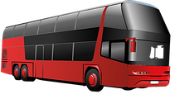





pronunciar
Pronuncia en parejas.
60
bajar
va
oveja
abeja
banco
avispa
abuelo
viento
bus
vela
vender
buscar
subir
to sell
vaca
0
INICIO
Notes:
Timing: 3 minutes
Aim: to practise SSC [b] [v]
Procedure:
Pupils work in pairs to pronounce as many words as they can in 60 seconds.
Click on ‘inicio’ to start timer.
NB. Most of these words have been encountered in Rojo materials, as well as azul (Autumn SOW).
bajar [484] buscar [179] subir [410] vender [528] ver [38] abeja [>5000] abuela [783] avispa [>5000] banco [728] bolsa [1581] bus [3709] oveja [4040] vaca [2775] vela [2247] viento [814]

Slide 7


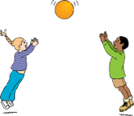
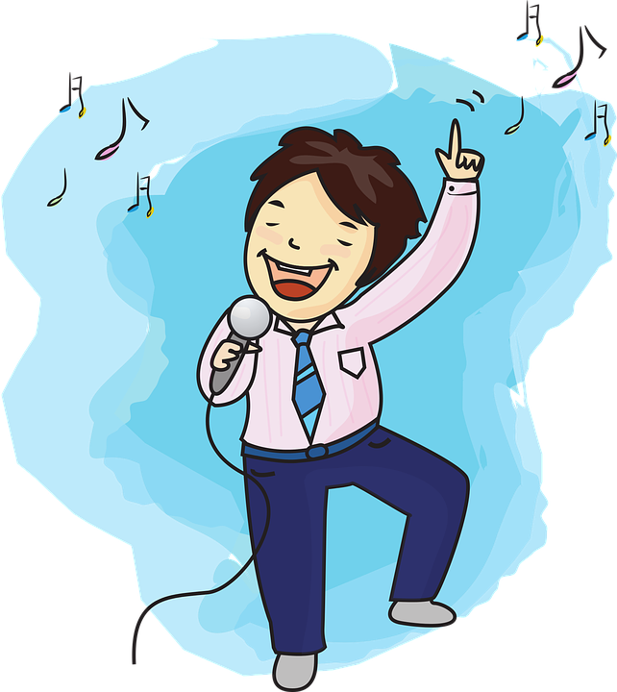
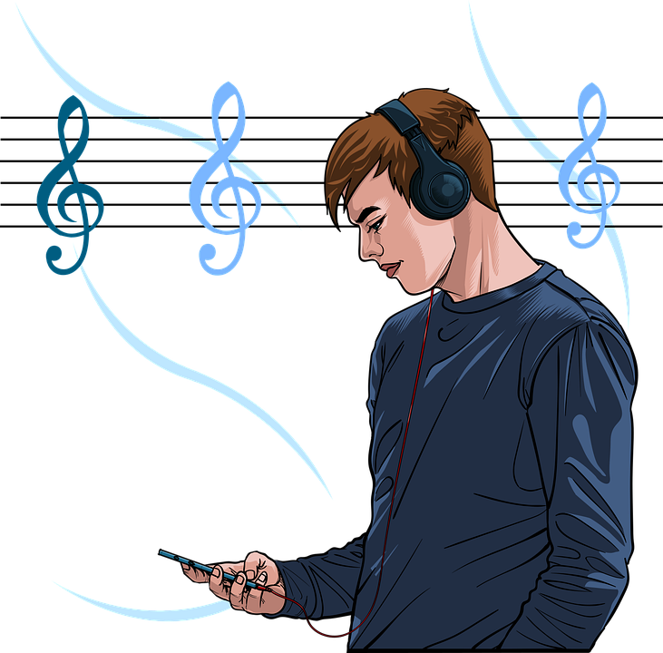

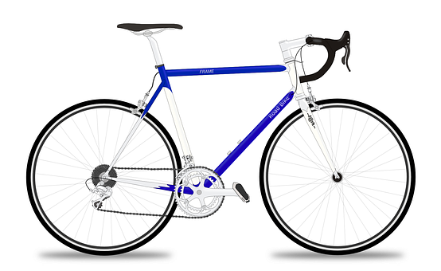




vocabulario
Vocabulario
¿Cómo es en español?
jugar
después
cantar
la canción
after(wards)
j_ _ _r
de _ p_ _ s
c_ n_ _r
la c_ _c_ _n
to see, watch
el juego
(the) song
(the) sport
to eat, eating
to play, playing
after(wards)
to prepare, preparing
(the) game
to take, bring
(the) game
to sing, singing
ver
to play, playing
to see, watch
to sing, singing
to prepare, preparing
to eat, eating
(the) song
(the) sport
after(wards)
To watch, see
to take, bring
el j _ _g _
v _ _
‘Llevar’ also means ‘to wear, wearing’.
to take, bring
comer
llevar
to prepare
el deporte
preparar
ll _ _a _
el d_ p _ _ t_
p _ _ p _ r _ _
c _ m _ _
Notes:
Timing: 5 minutes
Aim: to present and practise written comprehension and read aloud of previously taught vocabulary and new words for this week.
Procedure:
1. Click for an English item. Elicit pronunciation of the Spanish from pupils.
2. Click to cover the Spanish word with a picture.
3. Continue with the remaining items.
4. Optional at this stage: elicit the Spanish from pupils, (English prompts reappear on each mouse click) this time with some written support.

Slide 8


Saying who does what
[-ar & -er verbs: I, you, s/he]
We have learnt that in Spanish, the verb ending changes to indicate the person who the verb refers to.
Whereas –er verbs all have an –e’ in common.
To refer to ‘I’, the ending is the same.
-ar
-er
Llevo una tarta.
Como un bocadillo.
They all have an –a’ in common.
I bring a cake.
I eat a sandwich.
Llevas unos globos.
Comes fruta.
You bring some balloons.
You eat fruit.
Lleva un sombrero.
Come comida española.
S/he brings a hat
S/he eats Spanish food.
Notes:
Timing: 4 minutes
Aim: to revisit singular persons of –ar and –er verbs.
Procedure:
Click through the animations to present the information.
Elicit English translations for the Spanish examples provided.

Slide 9


[1/5]
Lee las frases ¿Qué persona es?
E
leer
hablar
Lees un libro.
Yo
tú
él,ella
Notes:
Timing: 3 minutes
Aim: to recognise the correct verb ending for singular persons of –ar verbs.
Procedure:
Introduce the task.
Click to bring the sentence, and focus pupils attention to the verb in bold.
Elicit response from pupils.
There are 5 sentences in total, including the example.

Slide 10

[2/5]
Lee las frases ¿Qué persona?
1
leer
hablar
Escucha a la profesora.
Yo
tú
él,ella
Notes:
Timing: 3 minutes
Aim: to recognise the correct verb ending for singular persons of –ar verbs.
Procedure:
Introduce the task.
Click to bring the sentence, and focus pupils attention to the verb in bold.
Elicit response from pupils.
There are 5 sentences in total, including the example.

Slide 11
[3/5]
Lee las frases ¿Qué persona?
2
leer
hablar
Lee un libro.
Yo
tú
él,ella
Notes:
Timing: 3 minutes
Aim: to recognise the correct verb ending for singular persons of –ar verbs.
Procedure:
Introduce the task.
Click to bring the sentence, and focus pupils attention to the verb in bold.
Elicit response from pupils.
There are 5 sentences in total, including the example.

Slide 12
[4/5]
Lee las frases ¿Qué persona?
3
leer
hablar
Aprendes vocabulario.
to learn, learning
Yo
tú
él,ella
Notes:
Timing: 3 minutes
Aim: to recognise the correct verb ending for singular persons of –ar verbs.
Procedure:
Introduce the task.
Click to bring the sentence, and focus pupils attention to the verb in bold.
Elicit response from pupils.
There are 5 sentences in total, including the example.

Slide 13

[5/5]
Lee las frases ¿Qué persona?
4
leer
hablar
Nado en la piscina.
Yo
tú
él,ella
Notes:
Timing: 3 minutes
Aim: to recognise the correct verb ending for singular persons of –ar verbs.
Procedure:
Introduce the task.
Click to bring the sentence, and focus pupils attention to the verb in bold.
Elicit response from pupils.
There are 5 sentences in total, including the example.

Slide 14


escuchar
El ultimo día de clase
Sofía habla con Quique.
¿Quién es? ¿Quique o Ángela?
 | (tú) Quique | (ella) Ángela
 | (tú) Quique | (ella) Ángela
E
3
 | (tú) Quique | (ella) Ángela
 | (tú) Quique | (ella) Ángela
1
4
 | (tú) Quique | (ella) Ángela
 | (tú) Quique | (ella) Ángela
2
5
último = last
Notes:
Timing: 7 minutes
Aim: aural recognition the correct verb ending for singular persons of –ar & -er verbs; aural comprehension of vocabulary.
Procedure:
Introduce the task and do the example with them. At this stage pupils focus on recognising the person of the verb and whether it is 2nd or 3rd person.
Click to bring up answers.
Move to next slide to complete part two (comprehension). .
Transcript
E. Llevas un juego.
1. Prepara unos bocadillos.
2. Canta en español.
3. Aprendes una canción.
4. Come tarta.
5. Escuchas a tu amigo.
último [188]

Slide 15
escuchar
La fiesta de fin de curso
el fin de curso =
end of school year
¿Qué actividad es?
hablar
 | verbo
 | You
 | She
 | She
 | You
 | She
 | You
Información extra
a ball |a game
some sandwiches | some cakes
in English | in Spanish
a song | a poem
a cake | a (piece of) fruit
to your teacher | to your friend
E
bring
1
prepares
2
sings
3
learn
4
eats
5
listen
Notes:
Timing: 7 minutes
Aim: aural recognition the correct verb ending for singular persons of –ar & -er verbs; aural comprehension of vocabulary.
Procedure:
Introduce the task and do the example with them. At this stage pupils focus on understanding more information about each sentences.
Pupils write the meaning of the verb and can select any extra info they pick up.
Click to bring up answers.
Transcript
E. Llevas un juego.
1. Prepara unos bocadillos.
2. Canta en español.
3. Aprendes una canción.
4. Come tarta.
5. Escuchas a tu amigo.

Slide 16


leer
El festival de fin de curso 🎉
School assemblies are not very common in Spain but pupils in each year group contribute to the whole school’s end of year show (un festival).
(el) baile - dance
bailar
cantar
escuchar música
comer tarta
aprender un baile
En el festival es normal…
Notes:
Timing: 1 minute
Aim: introduce the context of the task and the idea of ‘festival de fin de curso’.
Procedure:
Teacher reads the English then the Spanish information with pupils.
In the audio version, click the speech bubble to hear the Spanish.
baile [2040]

Slide 17

Follow up 5
traduce = s/he trasnlates
Persona B Lee una frase.
Persona A Lee una frase.
Turno 1
hablar
Turno 2
Persona A traduce.
Persona B traduce.
[yo]
[tú]
[él]
[ella]
como
come
comes
preparo
prepara
preparas
llevo
llevas
lleva
canto
cantas
canta
una canción
una pregunta
una fiesta
un juego
una tarta
un sombrero
unos bocadillos
unas palabras
fruta
en español
en inglés
‘Llevar’ means ‘to wear, and to take’.
¡tiempo!
INICIO
Notes:
Timing: 5 minutes
Aim: to provide read aloud practice and comprehension of this week’s new language.
Procedure:
1. In pairs, students take turns to create a sentence using a word from each set that makes sense. Note that not all combinations are possible.
2. In pairs, pupils translate their partner’s sentence into English.
3. For higher challenge, suggest that only the student creating the sentences faces the board. This ensures that the listener relies only on the aural input for understanding.
Traducir [2037]

Slide 18
¡adiós!
rojo

