Slide 1
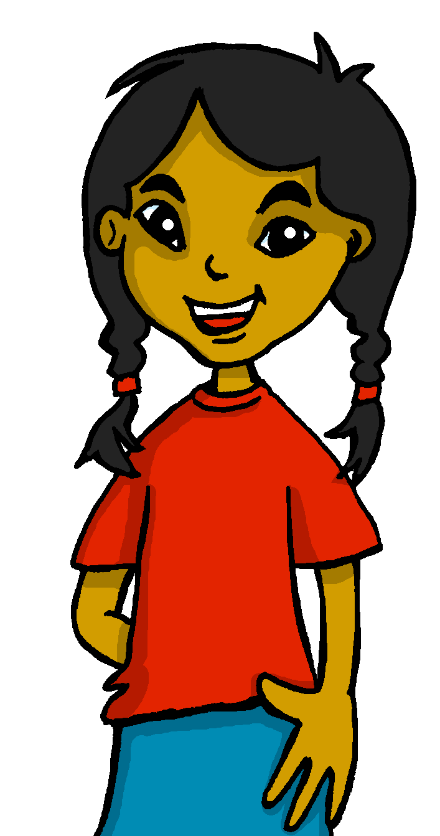
español, con Sofía

Slide 2
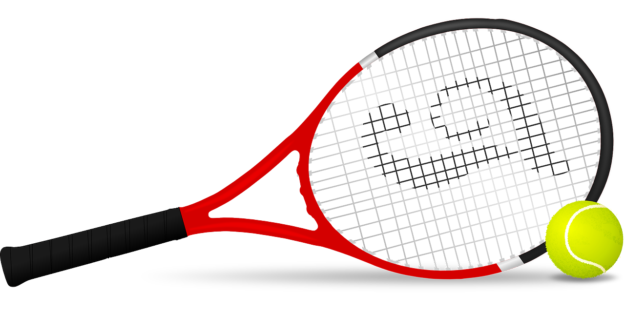
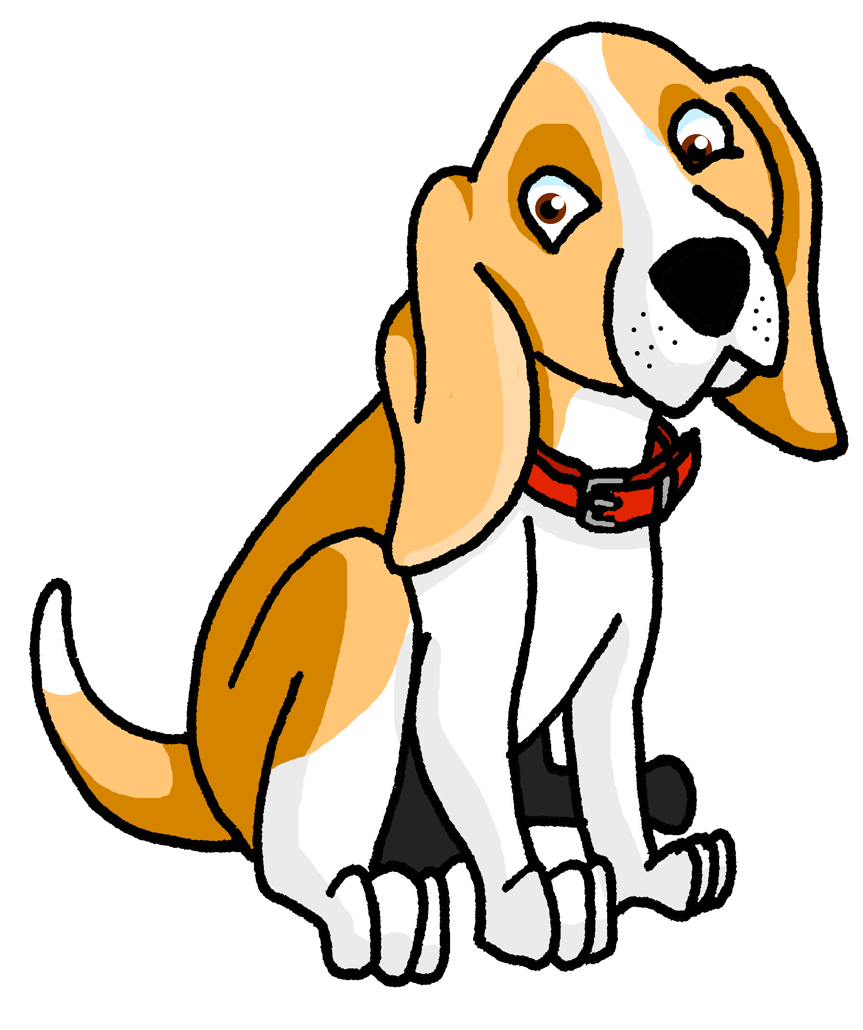
Describing things and people
rojo
Definite articles
(el, la, los, las)
opinion (odiar, amar)
SSC [r] [rr]
NB: AUDIO TO BE ADDED TO THIS LESSON
Notes:
Artwork by Steve Clarke. All additional pictures selected are available under a Creative Commons license, no attribution required.
The frequency rankings for words that occur in this PowerPoint which have been previously introduced in the resources are given in the SOW (excel document) and in the resources that first introduced and formally re-visited those words.
For any other words that occur incidentally in this PowerPoint, frequency rankings will be provided in the notes field wherever possible.
Phonics: [r]|[rr]
Source: parar [706] correr [343] Cluster: caro [2179] carro [1857] pera [>5000] perra [888]
Vocabulary: amar [700] odiar [2211] abuela [783] abuelo [4796] comida [906] las [1] los [1]
Revisit 1: él [9] ella [72] tú [184] yo [28] pero [30]
Revisit 2: un [6] dos [64] tres [134] cuatro [241] cinco [284] seis [438] siete [603] ocho [641] nueve [991] diez [449] once [1701] doce [1138]
Source: Davies, M. & Davies, K. (2018). A frequency dictionary of Spanish: Core vocabulary for learners (2nd ed.). Routledge: London

Slide 3
[r]
parar
pronunciar
Notes:
Timing: 1 minute
Aim: To introduce SSC [r]
Procedure:
To recap and elicit the pronunciation of the individual SSC [r].
Click to bring up the picture and get students to repeat (with gesture, if using).
Gesture suggestion: hold one hand up, palm open and facing away, to signal ‘stop’.

Slide 4
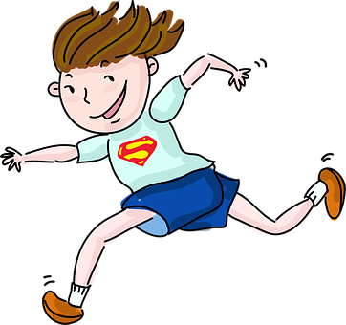
[rr]
correr
pronunciar
Notes:
Timing: 1 minute
Aim: To revisit SSC [rr].
Procedure:
To recap and elicit the pronunciation of the individual SSC [rr].
Click to bring the picture & get students to repeat (with gesture, if using).
Gesture suggestion: Using index and middle fingers to be ‘legs’ mime a fast running movement, moving the hand from right to left across the body.

Slide 5
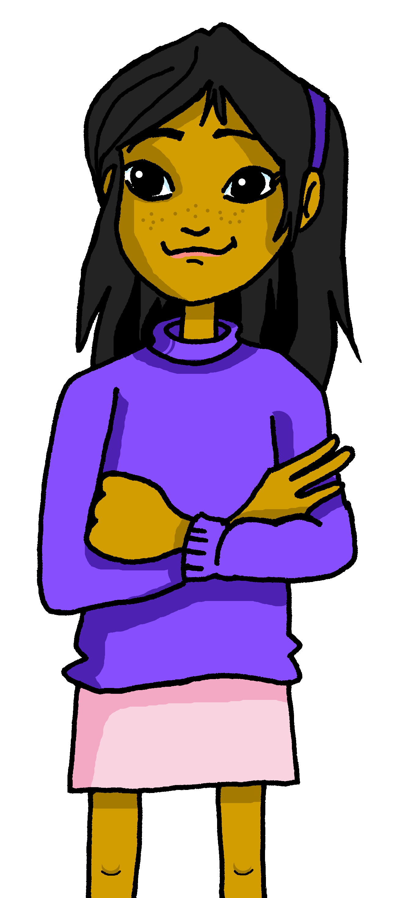
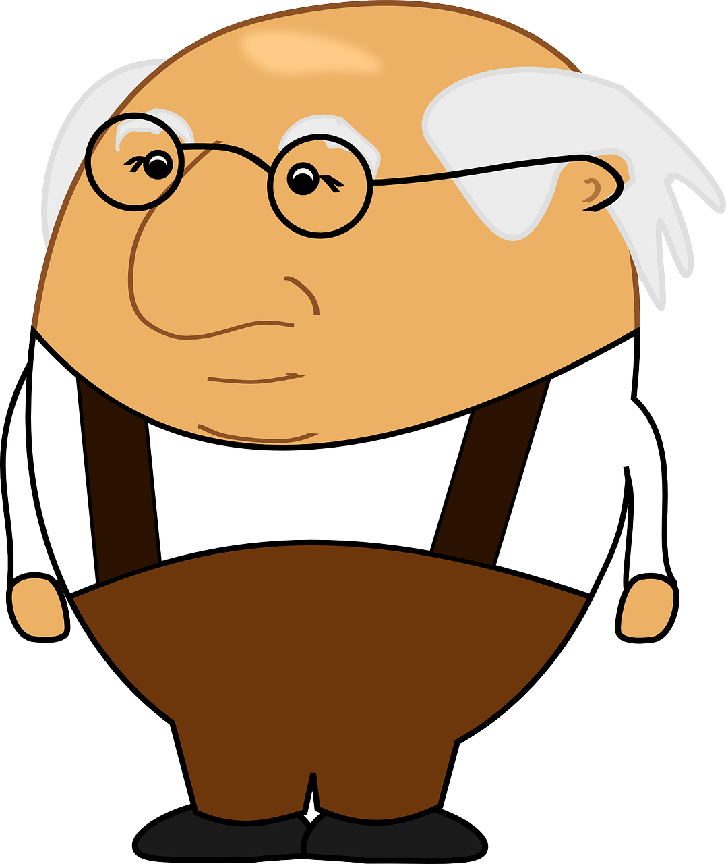
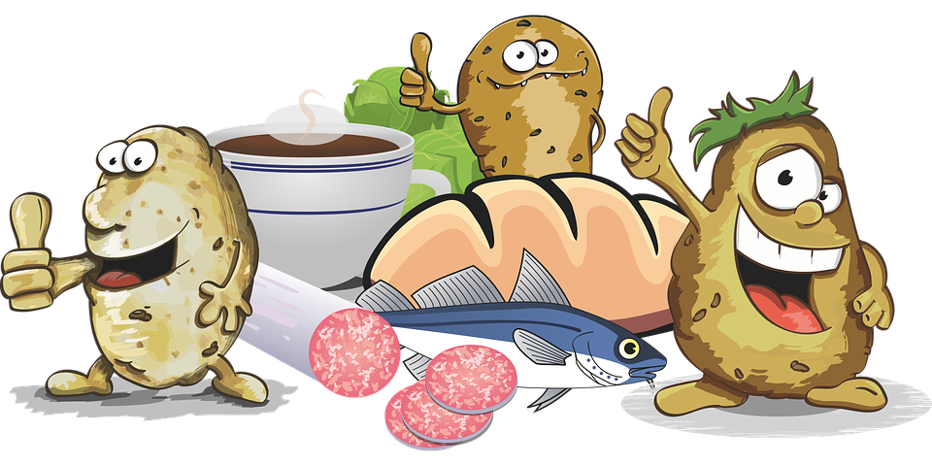
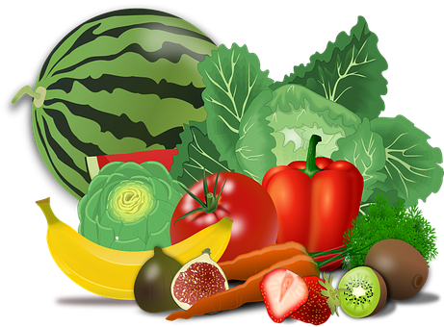
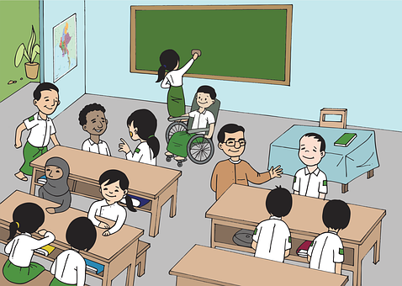
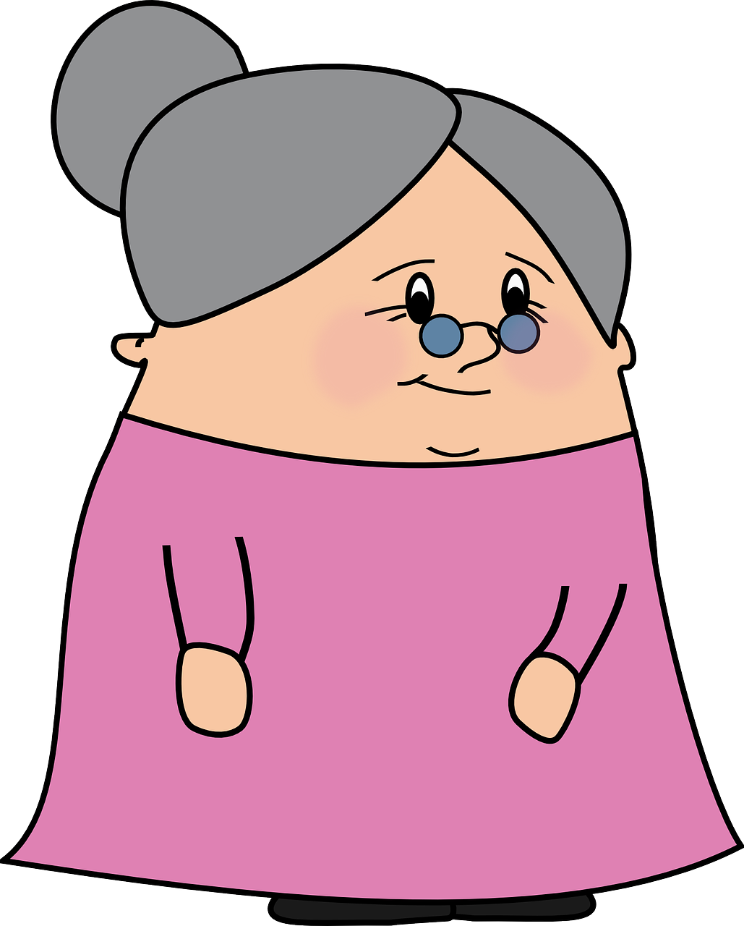
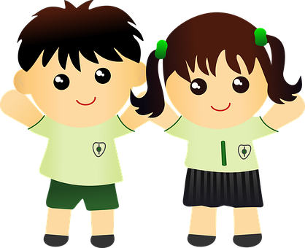
vocabulario
Vocabulario
¿Cómo es en español?
la amiga
la mañana
el abuelo
la comida
odiar
grandad
(the) grandad
la clase
(the) grandma
(the) class, classroom
hate, hating
(the) grandma
to hate, hating
(the) morning
(the) morning
(the) friend (f)
to love, loving
(the) language
to love, loving
(the) uniform
(the) food
(the) food
(the) language
(the) uniform
(the) class
(the) friend (f)
la abuela
amar
el uniforme
el idioma
Notes:
Timing: 5 minutes
Aim: to present and practise written comprehension and read aloud of three items of previously taught vocabulary that we revisit this week and the seven new words.
Procedure: 1. Click for an English item. Elicit pronunciation of the Spanish from pupils.
2. Click to cover the Spanish word with a picture.
3. Continue with the remaining items.
4. Optional at this stage: elicit the Spanish from pupils, (English prompts reappear on each mouse click) this time without written Spanish support.

Slide 6
Singular and plural definite articles
[the]
We have learned that to say the before a singular noun, you use ‘el’ or ‘la’, depending on whether the noun is masculine or feminine.
To say ‘the’ before a plural noun (more than one), use ‘los’ or ‘las’.
Masculine
Feminine
el
grupo
the group
la
tortuga
the tortoise
los
grupos
the groups
las
tortugas
the tortoises
Notes:
Timing: 4 minutes
Aim: to introduce plural form of definite articles, building in prior knowledge of singular definite articles.
Procedure:
Read the grammar explanation on singular definite articles
Click to bring up examples of masculine nouns
Click to bring up examples of feminine nouns.
Click to bring up masculine definite article.
Elicit English meaning from students and click to bring answers.
Click to bring up feminine definite articles.
Elicit English meaning from students and click to bring answers.
Click to bring up grammar explanation on plural definite articles
Click to bring up examples of masculine nouns
Click to bring up examples of feminine nouns.
Click to bring up masculine indefinite article.
Elicit English meaning from students and click to bring answers.
Click to bring up feminine indefinite articles.
Elicit English meaning from students and click to bring answers.

Slide 7
Clasifica las palabras.
⚠ Remember that nouns that en in –e can be either masculine or feminine.
leer
hablar
5
6
7
3
4
2
1
las
las
las
las
los
los
los
la montaña → ______ montañas
la tarta → ______ tartas
la tortuga → ______ tortugas
el deporte → ______ deportes
la silla → ______ sillas
el juego → ______ juegos
el abuelo → ______ abuelos
masculine
feminine
los
las
Notes:
Timing: 5 minutes
Aim: to use the correct plural definite article with a range of previously introduced nouns and new vocabulary from this week.
Procedure:
Introduce the task.
Click to bring noun with definite article and encourage the correct plural form from pupils.
There are 7 nouns in total.

Slide 8
Giving your opinion
In English, we often don’t translate the article (e.g. ‘I love languages’.
[amar, odiar]
We use the definite article after opinion verbs (amar, odiar).
Amo los idiomas.
Odio las mañanas.
I love languages.
I hate mornings.
Notice that in English, the verb also changes when referring to s/he, it ☺.
To mean ‘s/he, it’ with ‘odiar’ and ‘amar’, we remove –ar and add –a.
Ama la clase.
Odia el uniforme.
S/he loves the classroom.
S/he hates the uniform.
Notes:
Timing: 4 minutes
Aim: to introduce 2 opinion verbs in 1st and 3rd person singular; to introduce the use of articles with opinion verbs.
Procedure:
Click through the animations to present the information.
Elicit English translations for the Spanish examples provided.

Slide 9
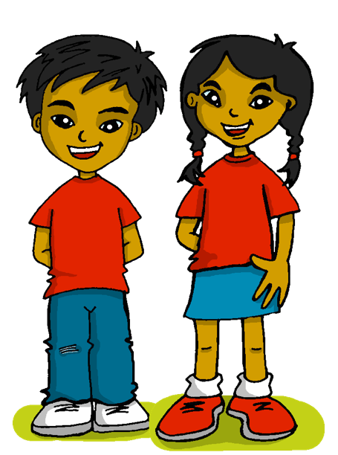
escuchar
Sofía habla.
¿Qué opina? Escribe ☺ o ☹.
¿Es Sofía o Quique? Marca ✅
[1-5]
hablar
Sofía | Quique
Sofía | Quique
E
3
Sofía | Quique
Sofía | Quique
1
4
Sofía | Quique
Sofía | Quique
2
5
Notes:
Timing: 8 minutes [Part 1 ]
Aim: aural recognition of amar and odiar, linking with the right person.; aural comprehension of vocabulary.
Procedure:
Introduce the task and do the example with them. At this stage pupils focus on recognising the person of the verb and whether it is amar or odiar.
Move to next slide to complete part two (vocab comprehension). .
Transcript
E Amo la comida
1 Odia la Tortuga Irene
2 Amo los idiomas
3 Ama las sillas
4 Ama la clase de español
5 Odio las mañanas

Slide 10
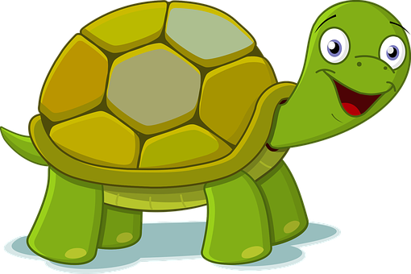
escuchar
Sofía habla.
Escucha. Escribe la palabra.
hablar
 | Amo ____________ .
 | Odia ____________ .
 | Amo ____________ .
 | Ama ____________ .
 | Ama ____________ .
 | Odio ____________ .
E
la comida
3
4
1
la tortuga
E
a
b
c
2
los idiomas
3
las sillas
2
1
4
la clase
5
d
e
f
5
las mañanas
Notes:
Timing: 8 minutes [Part 2]
Aim: aural recognition of amar and odiar, linking with the right person; aural comprehension of vocabulary.
Procedure:
Introduce the task.
Encourage pupils to write the words. Alternatively, they can write the letters (a-f).
Teachers can also elicit English translations to reinforce the noticing of the missing article in some of the English sentences.
Transcript:
E Amo la comida.
1 Odia la Tortuga Irene.
2 Amo los idiomas.
3 Ama las sillas.
4 Ama la clase de español.
5 Odio las mañanas.

Slide 11
¡adiós!
rojo

