Slide 1


español, con Sofía

Slide 2

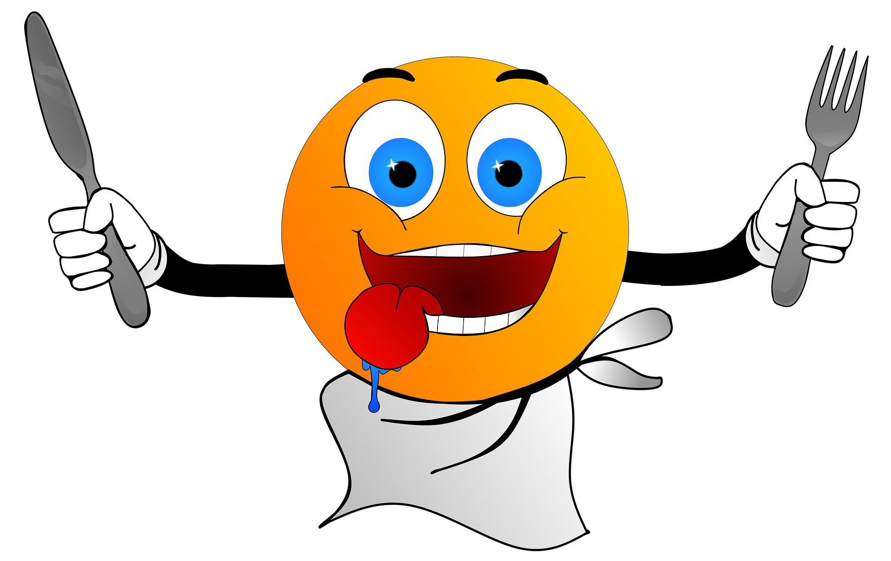


Describing things and people
¡Tengo hambre!
¡Tengo sed!
Tengo nueve años.
rojo
tener
SSC [ñ] vs. [n]
Notes:
Artwork by Steve Clarke. All additional pictures selected are available under a Creative Commons license, no attribution required.
The frequency rankings for words that occur in this PowerPoint which have been previously introduced in the resources are given in the SOW (excel document) and in the resources that first introduced and formally re-visited those words.
For any other words that occur incidentally in this PowerPoint, frequency rankings will be provided in the notes field wherever possible.
Phonics: Revisit [ga] [go] [gu] [ge] [gi] [j]
Vocabulary: año [46] hambre [1262] razón [306] sed [2214]
Revisit 1: conejo [4728] tortuga [>5000] amable [2707] diferente [293] divertido [2465] inteligente [2167] demasiado [494]
Revisit 2: comprender [434] información [326] instrucción [2158] texto [753]
Source: Davies, M. & Davies, K. (2018). A frequency dictionary of Spanish: Core vocabulary for learners (2nd ed.). Routledge: London

Slide 3




pronunciar
[n]
mano
español
[ñ]
¡hola!
Notes:
Timing: 1 minute
Aim: To introduce SSC [n] [ñ]
Procedure:
To recap and elicit the pronunciation of the individual SSC [n] [ñ]
Click to bring the picture & get students to repeat (with gesture, if using).
Gesture suggestion : handshake
Gesture suggestion: mouthe the words ‘hola’ and make a talking gesture with your hand (like a puppet is talking)
Frequency of unknown words:
mano [135]
Source: Davies, M. & Davies, K. (2018). A frequency dictionary of Spanish: Core vocabulary for learners (2nd ed.). Routledge: London

Slide 4


pronunciar
Pilla al intruso: ¿[ñ] o [n]?
Pronuncia las palabras para tu compañero/a.
Él/ella identifica el intruso.
A
B
 | el inglés | el chino | el español
 | pequeño | grande | tranquilo
 | Señor | compañera | Rubén
1
idiomas
2
descripción
3
personas
 | elefante | araña | conejo
 | cantar | pronunciar | acompañar
 | España | Inglaterra | Gran Bretaña
 | lasaña | manzana | naranja
4
animales
5
acción / verbos
6
países
7
comida
Notes:
Timing: 5 minutes
Aim: To consolidate SSC [ñ] and [n].
Procedure:
Introduce the task. Explain that pupil B will turn away from the board, pupil A will pronounce 3 x words and B has to identify the odd one out – the one that has a different [g] sound from the other two.
Pupil Bs turn away. Click for the table of words.
Pupil As pronounce the words. Pupils Bs write down the one they think is the odd one out for all three sets.
Pupil Bs turn back to face the board and the teacher elicits the responses and clicks to confirm.
Repeat steps 2 – 4 with Pupil As.
Optional additional activity (vocabulary) – all pupils turn away from the board and listen to the words again. They try to write down a category in Spanish – or English - for each set of 3 words.
Suggested answers appear on successive mouse clicks.
Transcript:
1. El inglés – el chino – el español
2. pequeño – grande – tranquilo
3. Señor – compañera – Rubén
4. elefante – araña – conejo
5. cantar – pronunciar – acompañar
6. España – Inglaterra – Gran Bretaña
7. lasaña – manzana - naranja

Slide 5





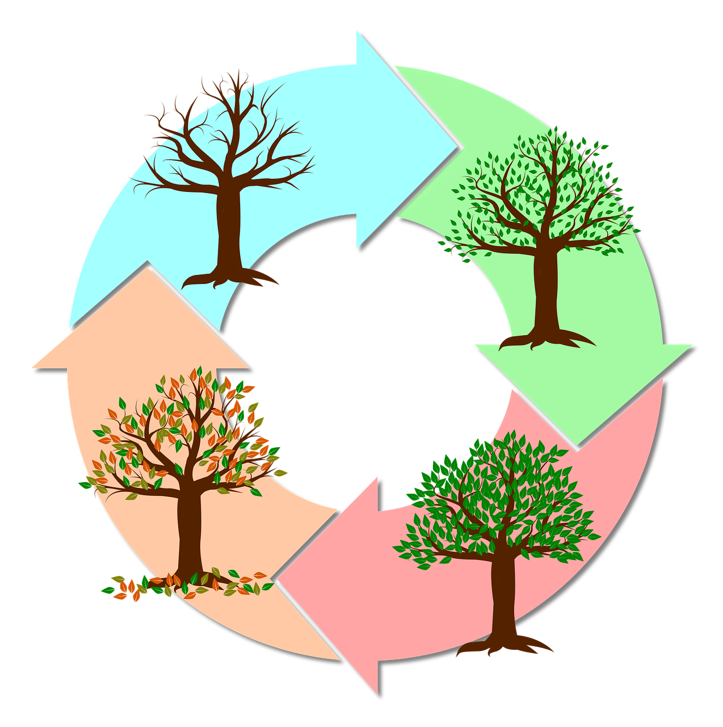
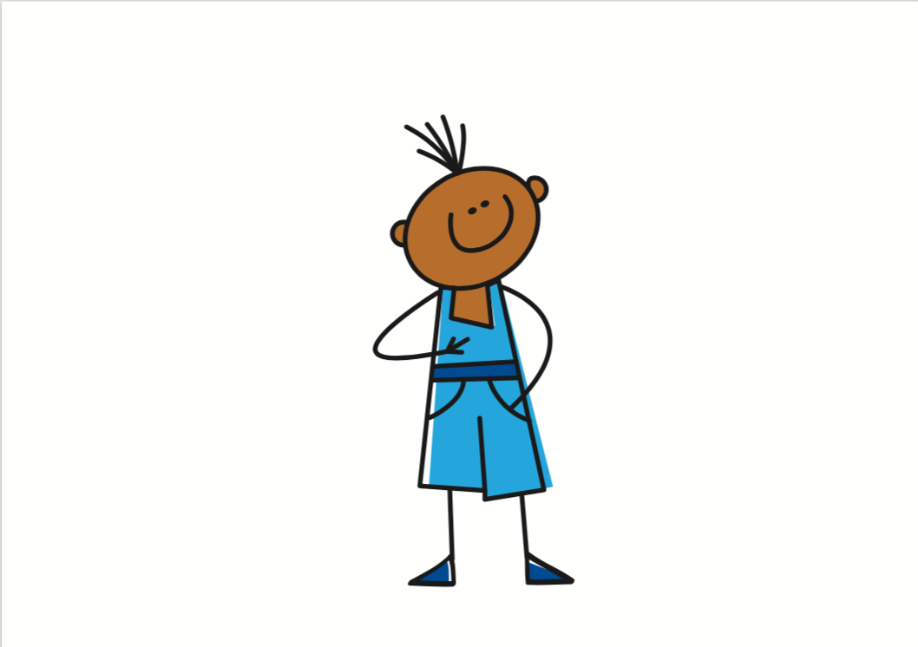
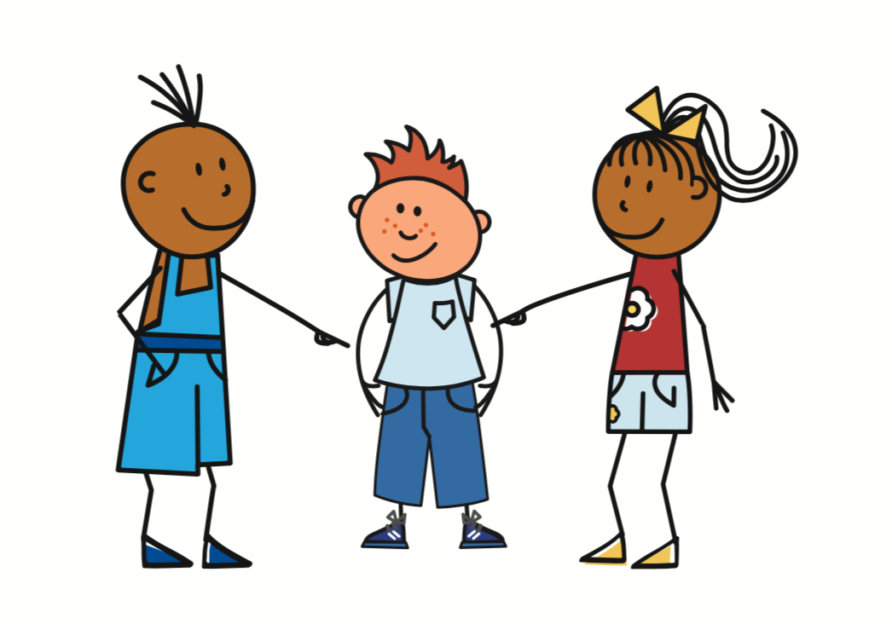
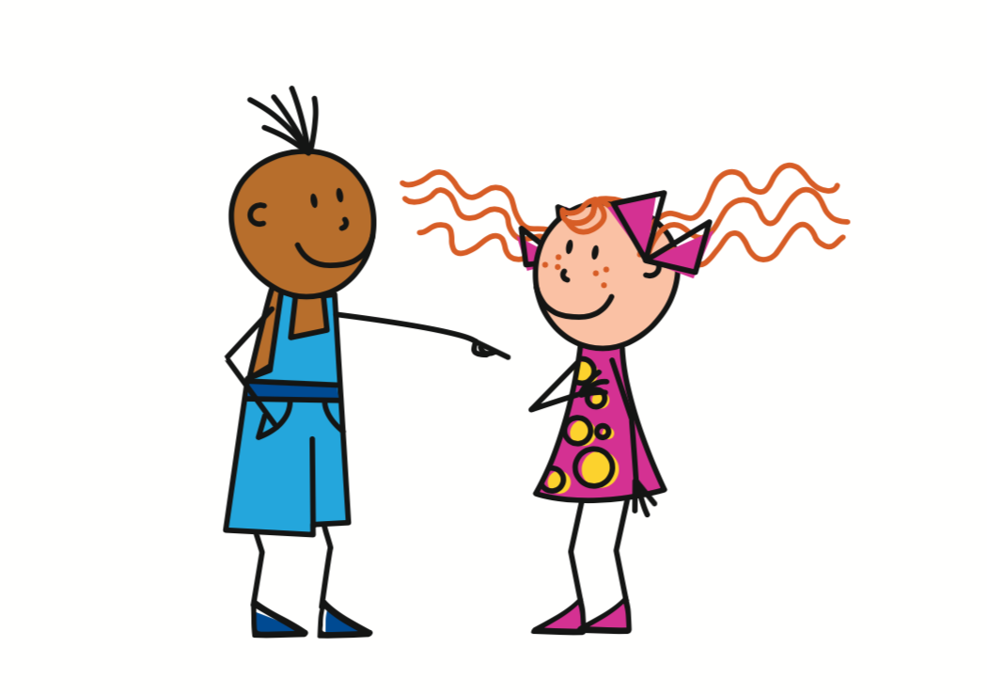

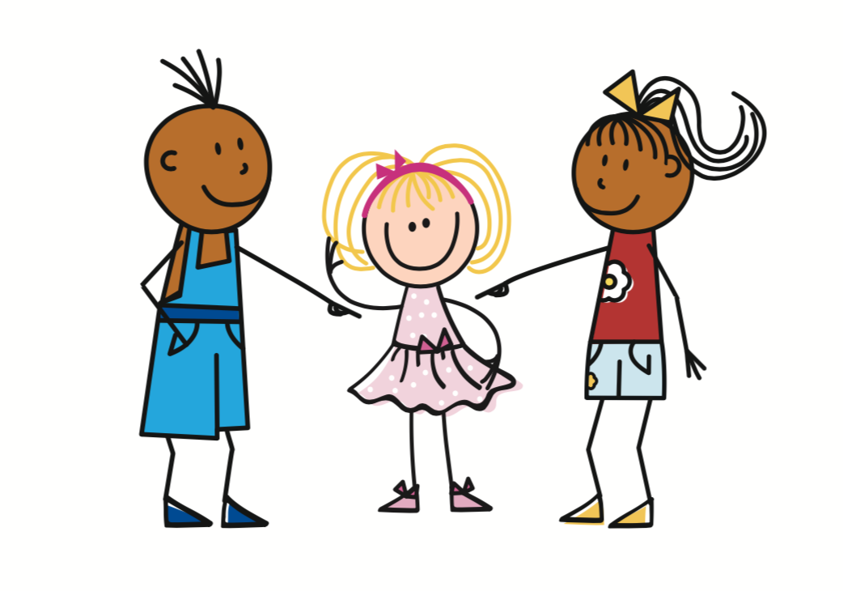
vocabulario
Vocabulario
¿Cómo es en español?
el hambre
el texto
la razón
la instrucción
hunger
(the) reason
el año
la sed
(the) thirst
year
(the) hunger
you have
s/he, it has
(the) information
I have
(the) year
(the) hunger
(the) information
you have
(the) text
(the) text
(the) thirst
s/he, it has
(the) instruction
(the) reason
(the) year
I have
(the) instruction
thirst
tengo
tienes
[have]
tiene
[have]
la información
[have]
Notes:
Timing: 5 minutes
Aim: to present and practise written comprehension and read aloud of six items of previously taught vocabulary that we revisit this week and the four new words.
Procedure:
1. Click for an English item. Elicit pronunciation of the Spanish from pupils.
2. Click to cover the Spanish word with a picture.
3. Continue with the remaining items.
4. Optional at this stage: elicit the Spanish from pupils, (English prompts reappear on each mouse click) this time without written Spanish support.

Slide 6



Tener
You know that tener means ‘to have, having’:
Tengo un perro.
I have a dog.
Tiene un gato.
S/he has a cat.
In Spanish, we sometimes also use tener to mean ‘to be, being’:
We also use tener to say our age:
Tengo hambre.
I am hungry.
Tengo nueve años.
I am nine years old.
Tienes sed.
You are thirsty.
⚠ Word for word, this means ‘I have nine years’.
Tiene razón.
S/he is right.
⚠ These literally mean:
I have hunger.
You have thirst.
S/he has reason/right.
Notes:
Timing: 2 minutes
Aim: to present new uses of tener expressions meaning ‘be’.
Procedure:
1. Click to present the information.
2. Elicit responses from pupils, following the animated question marks.

Slide 7


leer
Quique habla.
el cumpleaños - birthday
Lee las frases. ¿Qué palabra es correcta?
Necesito una fruta. ¡Tengo hambre!
2+2=4. ¡Sí!
Tienes razón.
1
_________!
4
____
Hoy es el cumpleaños* de Nina. Tiene diez años.
¿Dónde está mi botella?
¡Tengo sed!
5
2
____.
___!
Preparo una tarta para ti.
¿Tienes hambre?
La información es correcta. Tiene razón.
3
____
6
_______
años | sed | hambre | razón
Notes:
Timing: 5 minutes
Aim: to consolidate written comprehension of this week’s vocabulary and a range of previously taught vocabulary.
Procedure:
1. Pupils write 1-6 for each speech bubble they note the missing word.
2. Elicit the answers from pupils (for additional pronunciation practice)
3. Click to reveal the written answers.
4. Click on the speech bubble to hear the full audio, if desired. Alternatively use it as a listen and check stage.

Slide 8

escuchar
Sofía describe.
Escucha. ¿Qué opción es correcta?
Luego, escribe la frase en inglés.
nueve años | regalo | I have a present.
hambre | fruta | I am hungry.
razón | conejo | I have a rabbit.
botella| sed | I am thirsty.
tortuga | hambre | I have a tortoise.
sed | grupo favorito | I have a favourite group.
gato| razón | I am right.
hambre | tarta | I have a cake.
1
____________________________________
2
____________________________________
3
____________________________________
4
____________________________________
5
____________________________________
6
____________________________________
7
____________________________________
8
____________________________________
Notes:
Timing: 10 minutes
Aim: to practise aural distinction between tener + noun (with indefinite article) and tener meaning ‘be’ with no article.
Procedure:
Pupils write 1-8.
They listen to each sentence and decide which word completes it, based on the presence or absence of an article.
They then either write or feed back orally the meaning of the sentence.
Click to reveal the correct end to the sentence and the English meaning.
Transcript:
Tengo un [regalo].
Tengo [hambre].
Tengo un [conejo].
Tengo [sed].
Tengo una [tortuga].
Tengo un [grupo favorito].
Tengo [razón].
Tengo una [tarta].

Slide 9
¡adiós!
rojo

