Slide 1
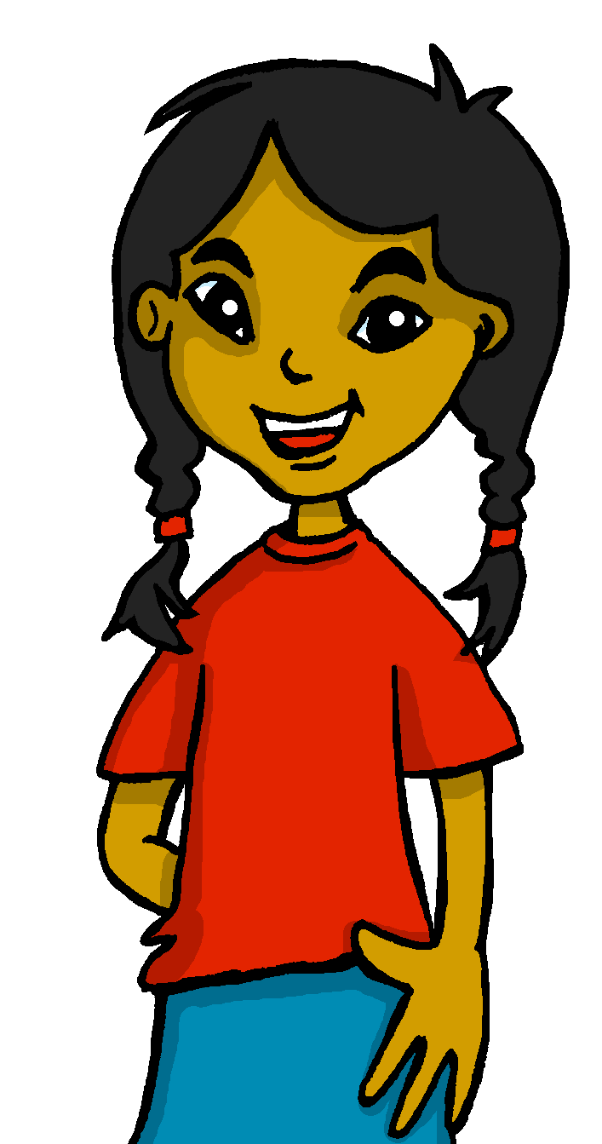
español, con Sofía

Slide 2
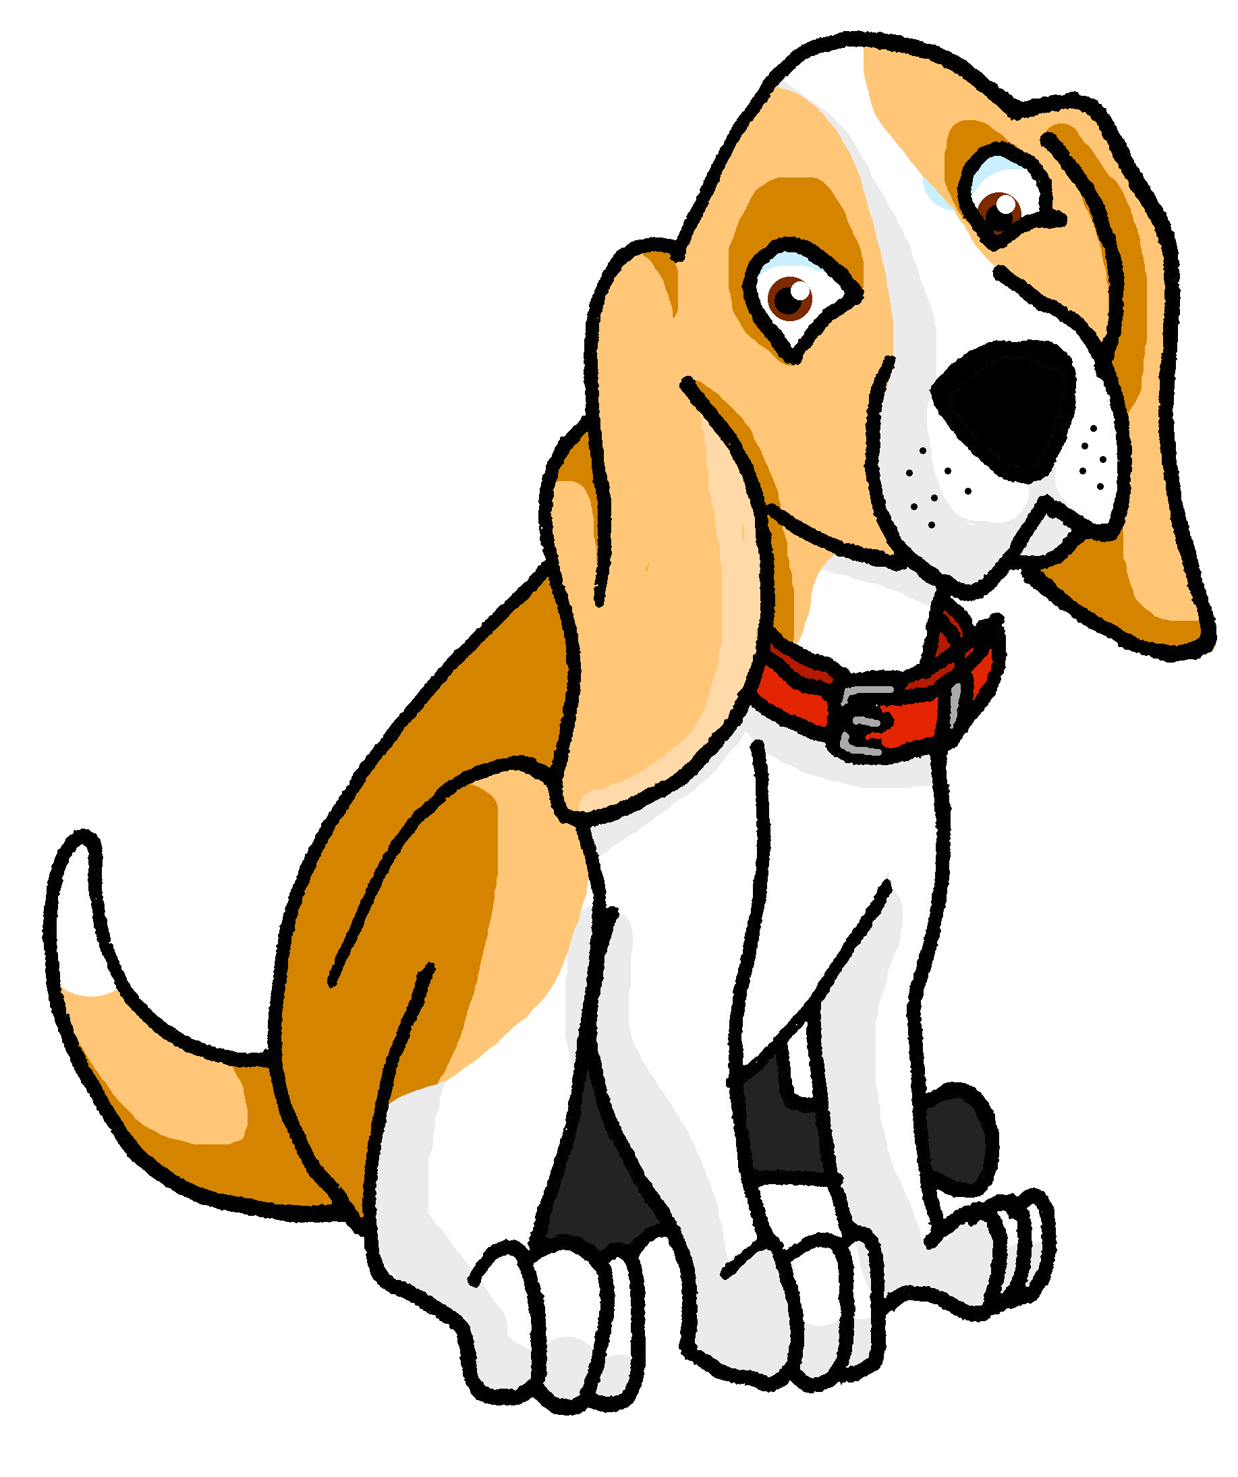
Describing things and people
rojo
possessives mi, tu
revisit SSC [ga] [go] [gu] [ge] [gi] [j]
Notes:
Artwork by Steve Clarke. All additional pictures selected are available under a Creative Commons license, no attribution required.
The frequency rankings for words that occur in this PowerPoint which have been previously introduced in the resources are given in the SOW (excel document) and in the resources that first introduced and formally re-visited those words.
For any other words that occur incidentally in this PowerPoint, frequency rankings will be provided in the notes field wherever possible.
Phonics: Revisit [ga] [go] [gu] [ge] [gi] [j]
Vocabulary: grupo [200] favorito [2630] mi [37] tu [53] muy [43] también [49] y [4]
Revisit 1: alto [231] azul [811] bajo [452] gris [1751] (Revisit: amarillo, bonito, fantástico, pequeño, tranquilo, triste)
Revisit 2: aprender [428] leer [209] ver [38] deporte [1489] idioma [1159] juego [409] de² [2]
Source: Davies, M. & Davies, K. (2018). A frequency dictionary of Spanish: Core vocabulary for learners (2nd ed.). Routledge: London

Slide 3
pronunciar
Pilla al intruso
Pronuncia las palabras para tu compañero/a. Él/ella identifca el intruso.
A
B
 | conejo | genial | elegante
 | imagen | globo | gemelo
 | gris | inteligente | domingo
1
2
3
 | Inglaterra | Bélgica | Portugal
 | abajo | tengo | bajo
 | grupo | tortuga | gesto
4
5
6
Notes:
Timing: 5 minutes
Aim: To revisit SSC [ga] [go] [gu] [ge] [gi] [j]
Procedure:
Introduce the task. Explain that pupil B will turn away from the board, pupil A will pronounce 3 x words and B has to identify the odd one out – the one that has a different [g] sound from the other two.
Pupil Bs turn away. Click for the table of words.
Pupil As pronounce the words. Pupils Bs write down the one they think is the odd one out for all three sets.
Pupil Bs turn back to face the board and the teacher elicits the responses and clicks to confirm.
Repeat steps 2 – 4 with Pupil As.

Slide 4
vocabulario
Vocabulario
¿Cómo es en español?
el deporte
también
el grupo
favorito
mi
(the) group
tu
your
and
my
(the) sport
(the) game
also, too
(the) language
favourite
favourite
very
very
(the) group
(the) language
also, too
your
(the) sport
(the) game
my
and
muy
el juego
y
el idioma
Notes:
Timing: 5 minutes
Aim: to present and practise written comprehension and read aloud of three items of previously taught vocabulary that we revisit this week and the seven new words.
Procedure: 1. Click for an English item. Elicit pronunciation of the Spanish from pupils.
2. Click to cover the Spanish word with a picture.
3. Continue with the remaining items.
4. Optional at this stage: elicit the Spanish from pupils, (English prompts reappear on each mouse click) this time without written Spanish support.

Slide 5
Possessive adjectives
[mi (my) | tu (your)]
To say ‘my’ in Spanish before a singular noun use mi.
To say ‘your’ in Spanish before a singular noun use tu.
It doesn’t matter if the noun is masculine or feminine.
Mi cama es baja.
My bed is low.
Tu amigo es alto.
Your friend is tall.
Remember! Tú (with an accent) means ‘you’.
Notes:
Timing: 2 minutes
Aim: to introduce singular possessive adjectives ‘mi’ and ‘tu’.
Procedure:
Click through the animations to present the information.
Elicit English translations for the Spanish examples given.

Slide 6
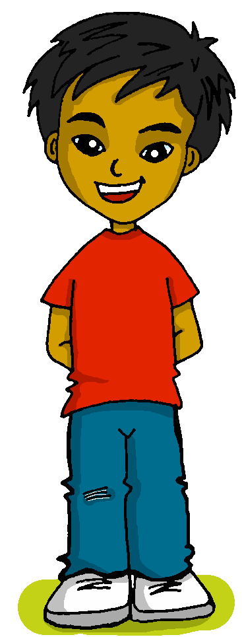
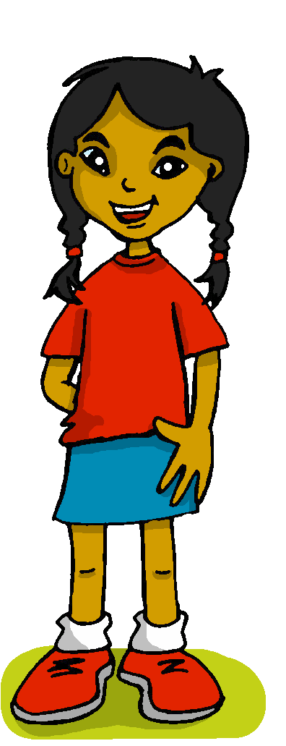
leer
Sofía and Quique are sorting out their things.
Lee las frases. ¿Es Sofía (my) or Quique (your)?
¿Qué es el objeto? ¿Cómo es?
 |  | Sofía (my) Quique (your) | El objeto | Descripción
E | Mi teléfono es muy pequeño. | Sofía | telephone | very small
1 | Tu mochila es azul. | Quique | school bag | blue
2 | Mi música es muy tranquila. | Sofía | music | calm
3 | Mi texto es en español. | Sofía | text | in Spanish
4 | Tu libro es en inglés. | Quique | book | in English
5 | Tu bicicleta es gris. | Quique | bike | grey
6 | Tu botella es amarilla. | Quique | bottle | yellow
7 | Mi pelota es fantástica. | Sofía | ball | fantastic
E
1
2
3
4
5
6
7
Notes:
Timing: 8 minutes
Aim: to practise understanding the new grammar features ‘mi’ and ‘tu’ (reading activity). Attention to the meaning of the vocabulary is also needed to complete the second and third columns.
Procedure:
Do the example with pupils to model the first part of the task. Read the sentence and work out if it refers to ‘Sofía’ (my) or ‘Quique’ (your).
Pupils then do items 1-7.
Teacher elicits answers ‘Sofía’ or Quique’ and clicks to reveal.
Pupils then complete the remaining two columns with the object and the description of it (adjective).
Click to reveal answers one by one.

Slide 7
Tú (you) and tu (your)
In English we stress the pronoun with our voice.
Remember, we sometimes use a pronoun for emphasis or clarity:
Tú aprendes inglés.
You learn/are learning English.
Tú (you) always goes before a verb.
Tu (your) always goes before a noun:
Tu idioma favorito es el inglés.
Your favourite language is English.
Tú (you) and tu (your) sound the same, but you can tell the meaning from the word that follows – verb or noun?
This is exactly the same in questions:
¿Tú ves el elefante?
Do you see the elephant?
Tu animal favorito es el elefante?
Is your favourite animal an elephant?
Notes:
Timing: 2 minutes
Aim: to make the difference between tú (you) and tu (your) clear, as they sound the same. We are going to practise the difference in the next task.
Procedure:
Click through the animations to present the information.
Elicit English translations for the Spanish examples provided.

Slide 8
leer
La clase de Quique prepara preguntas para una clase en Inglaterra.
Lee las preguntas. ¿Es tú (you) o tu (your)?
Escribe la palabra correcta. Escribe la pregunta en inglés.
 |  | tú (you) tu (your) | Pregunta en inglés
1 | ¿Tú tienes un animal? | tú | Do you have a pet?
2 | ¿Tú lees libros en español? | tú | Do you read books in Spanish?
3 | ¿Tu libro favorito es Harry Potter? | tu | Is HP your favourite book?
4 | ¿Tú ves películas en español? | tú | Do you watch films in Spanish?
5 | ¿Tu deporte favorito es el fútbol? | tu | Is your favourite sport football?
6 | ¿Tu película favorita es Spiderman? | tu | Is Spiderman your favourite film?
7 | ¿Tu animal favorito es la girafa? | tu | Is your favourite animal a giraffe?
1
2
3
4
5
6
7
Notes:
Timing: 8 minutes
Aim: to practise written understanding of the difference between tú and tu. Attention to the meaning of the vocabulary is also needed to complete the 2nd column.
Procedure:
Pupils write tú or tu, paying attention to the word that follows the gap.
Teacher elicits answers - for tú pupils can say the word and gesture the writing of the accent, to differentiate from tu.
Pupils then complete the remaining column with the meanings of the questions in English.
Teacher clicks to reveal answers one by one.

Slide 9
¡adiós!
rojo

