Slide 1
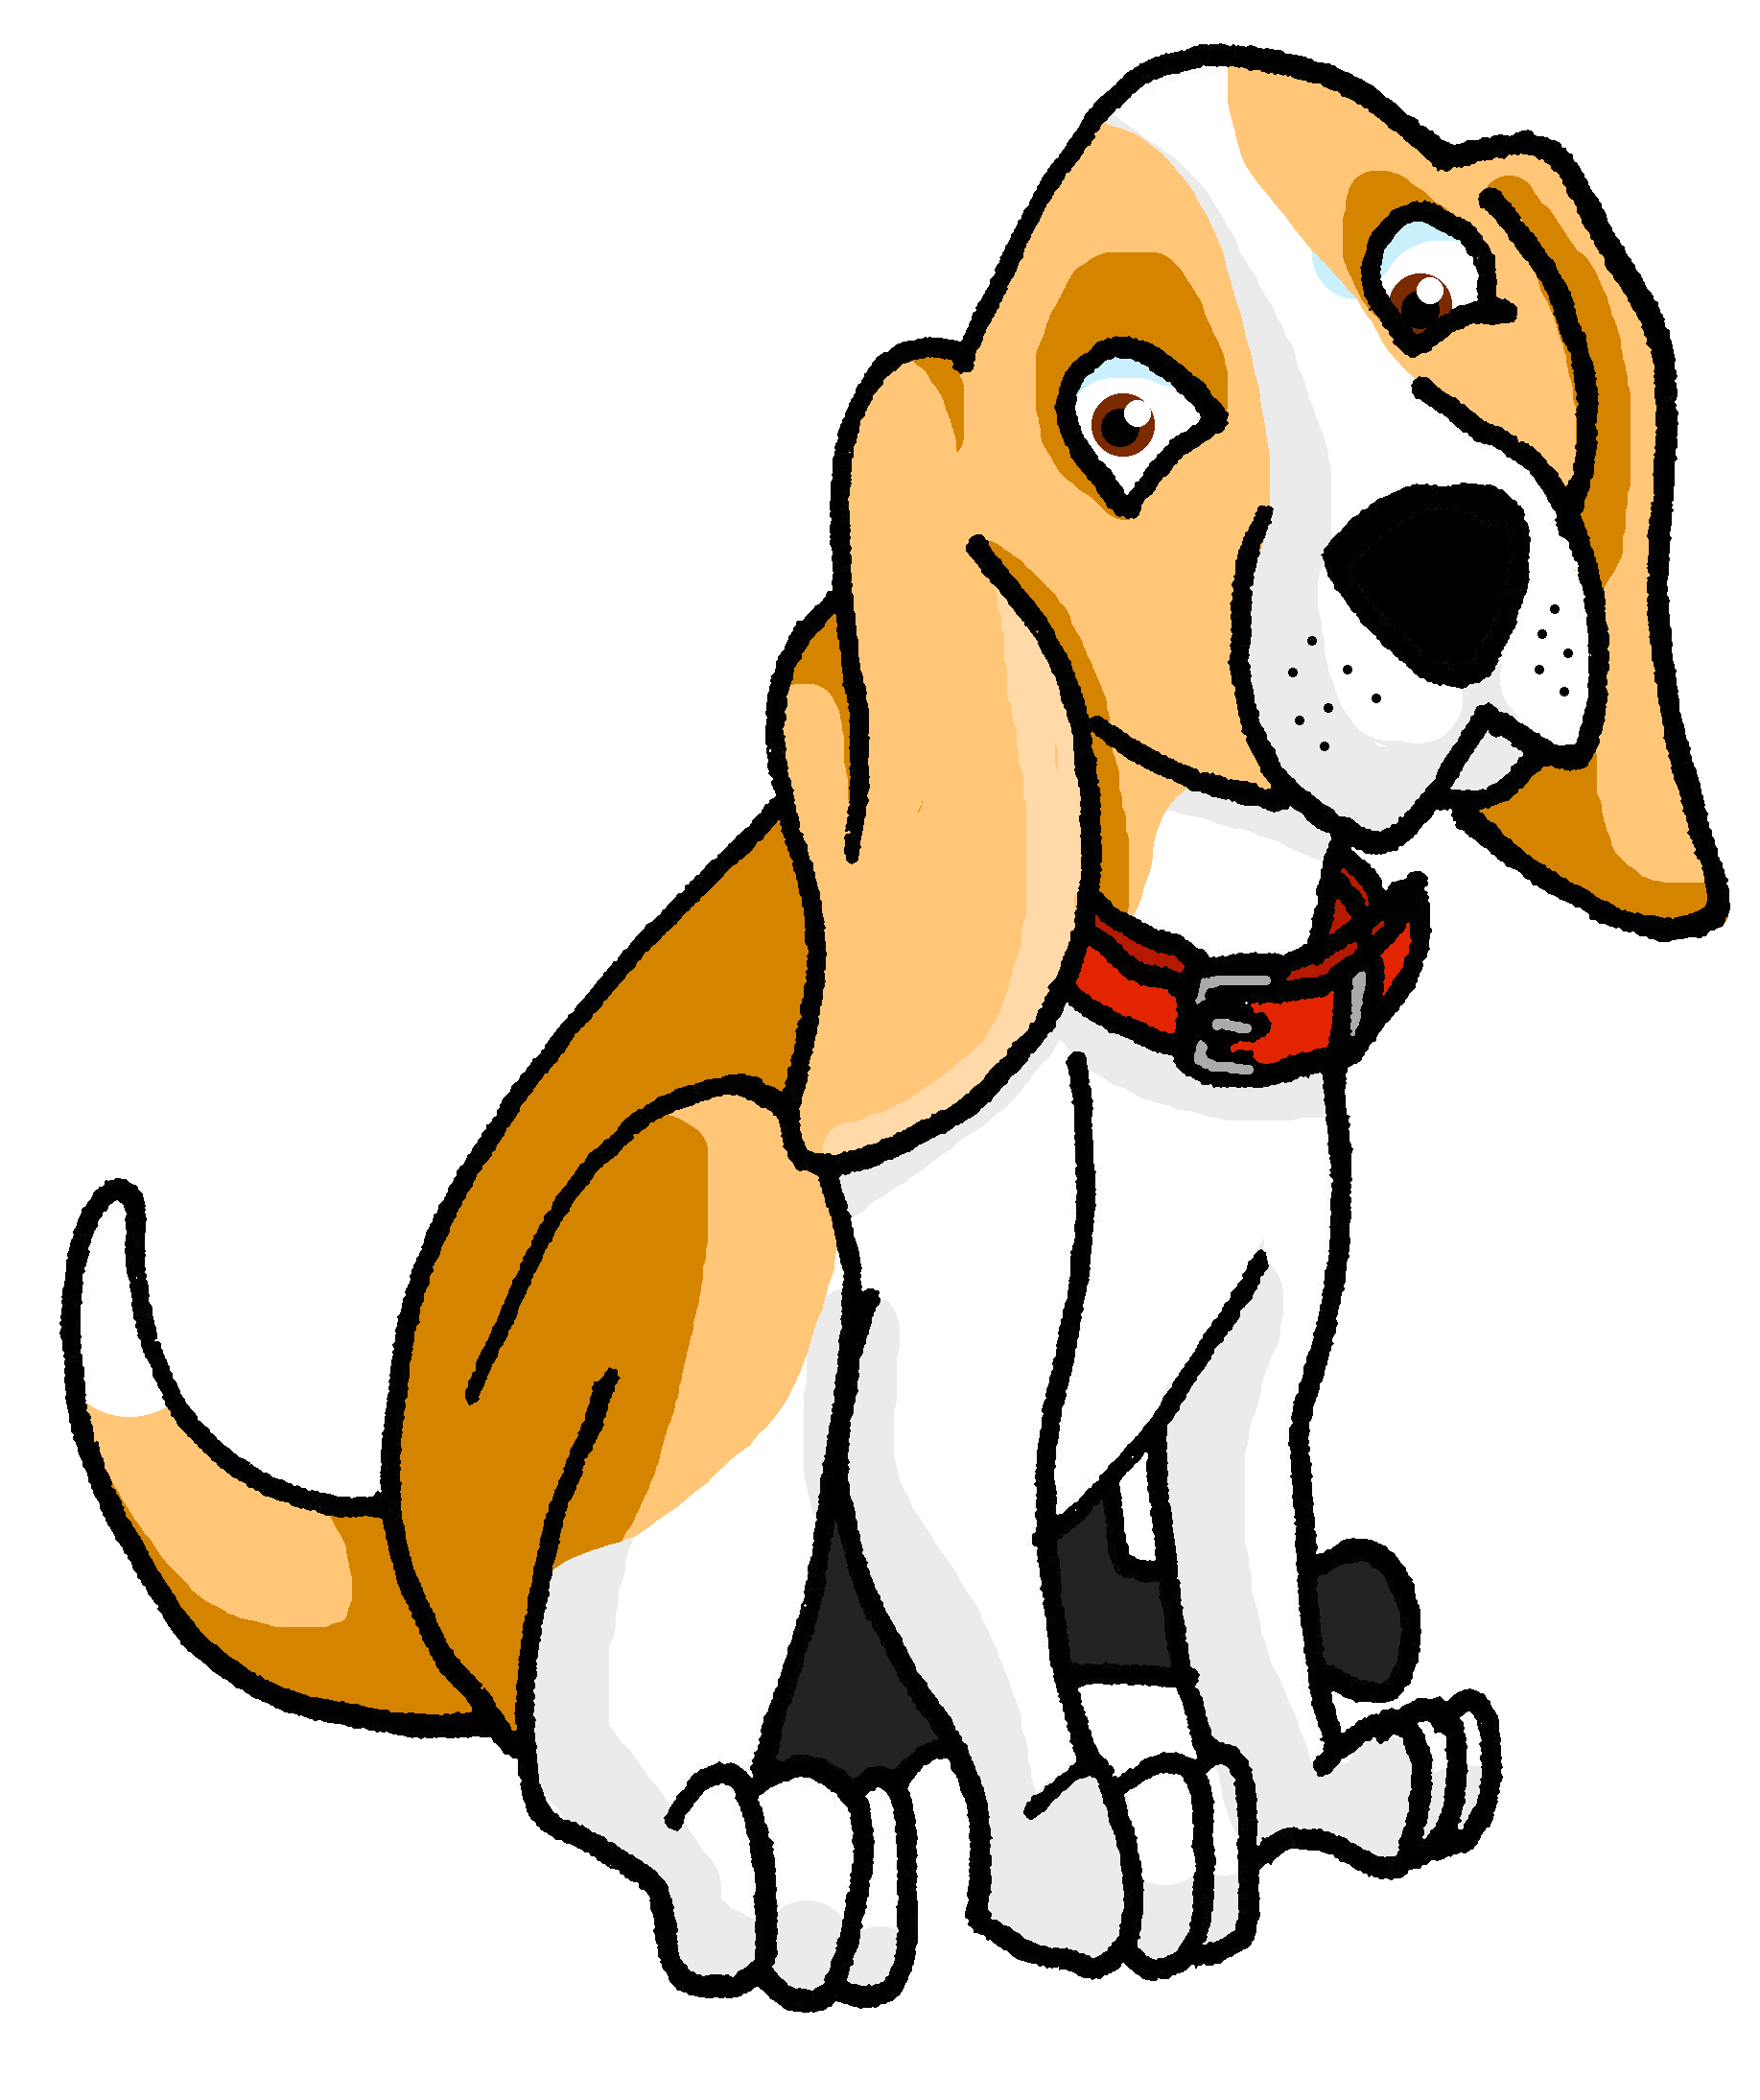
Describing things and people
favourite
rojo
Follow ups 1-5
Notes:
Artwork by Steve Clarke. All additional pictures selected are available under a Creative Commons license, no attribution required.
The frequency rankings for words that occur in this PowerPoint which have been previously introduced in the resources are given in the SOW (excel document) and in the resources that first introduced and formally re-visited those words.
For any other words that occur incidentally in this PowerPoint, frequency rankings will be provided in the notes field wherever possible.
Phonics: Revisit [ga] [go] [gu] [ge] [gi] [j]
Vocabulary: grupo [200] favorito [2630] mi [37] tu [53] muy [43] también [49] y [4]
Revisit 1: alto [231] azul [811] bajo [452] gris [1751] (Revisit: amarillo, bonito, fantástico, pequeño, tranquilo, triste)
Revisit 2: aprender [428] leer [209] ver [38] deporte [1489] idioma [1159] juego [409] de² [2]
Source: Davies, M. & Davies, K. (2018). A frequency dictionary of Spanish: Core vocabulary for learners (2nd ed.). Routledge: London

Slide 2
Follow up 1:
Escucha. ¿[gue/gui] o [ge/gi]?
¡A practicar! Lee las frases. Tu compañero/a identifica los sonidos.
pronunciar
B
A
[ga/go/gu]
[j/ge/gi]
[gue/gui]
Mi conejo Gerardo es muy pequeño y también divertido.
El juguete favorito de mi amigo Gómez es el juego de trenes.
1
4
Mi tortuga Gabriela también es divertida pero es gigante.
Es domingo y Guillermina prepara un guiso.
5
2
La Tomatina es una guerra de tomates, dice Gustavo.
Gerónimo y Gina son gemelos en mi colegio.
3
6
Notes:
Timing: 5 minutes
Aim: to practise aural distinction between hard g [ga/go/go], soft g [j/ge/gi/] and [gue/gui] in a mixture of known and unknown words.
Procedure:
Read the explanation and ensure pupils understand the task.
Pupil Bs turn away from the board, having written 1, 2, 3 and made 3 x columns for [ga/go/gu], [/j/ge/gi] and [gue/gui]
Click to reveal the sentences.
Pupil A reads each sentence (Pupil B may say ‘¡Repite!’, as necessary).
Pupil B ticks his/her columns according to the sounds s/he hears.
Click to correct.
Pupil As turn away. Repeat steps 3 – 6.
Transcript: 1. Mi conejo Gerardo es muy pequeño y también divertido.
2. Mi tortuga Gabriela también es divertida pero es gigante. 3. Gerónimo y Gina son gemelos en mi colegio
4. El juguete favorito de mi amigo Gómez es el juego de trenes. 5. Es domingo y Guillermina prepara un guiso.
6. La Tomatina es una guerra de tomates, dice Gustavo.
Frequency of unknown words and cognates: colegio [628] gigante [2816] gemelo [>5000] juguete [3162] tren [1488] guiso [>5000] guerra [282] tomate [>5000] decir [31]

Slide 3
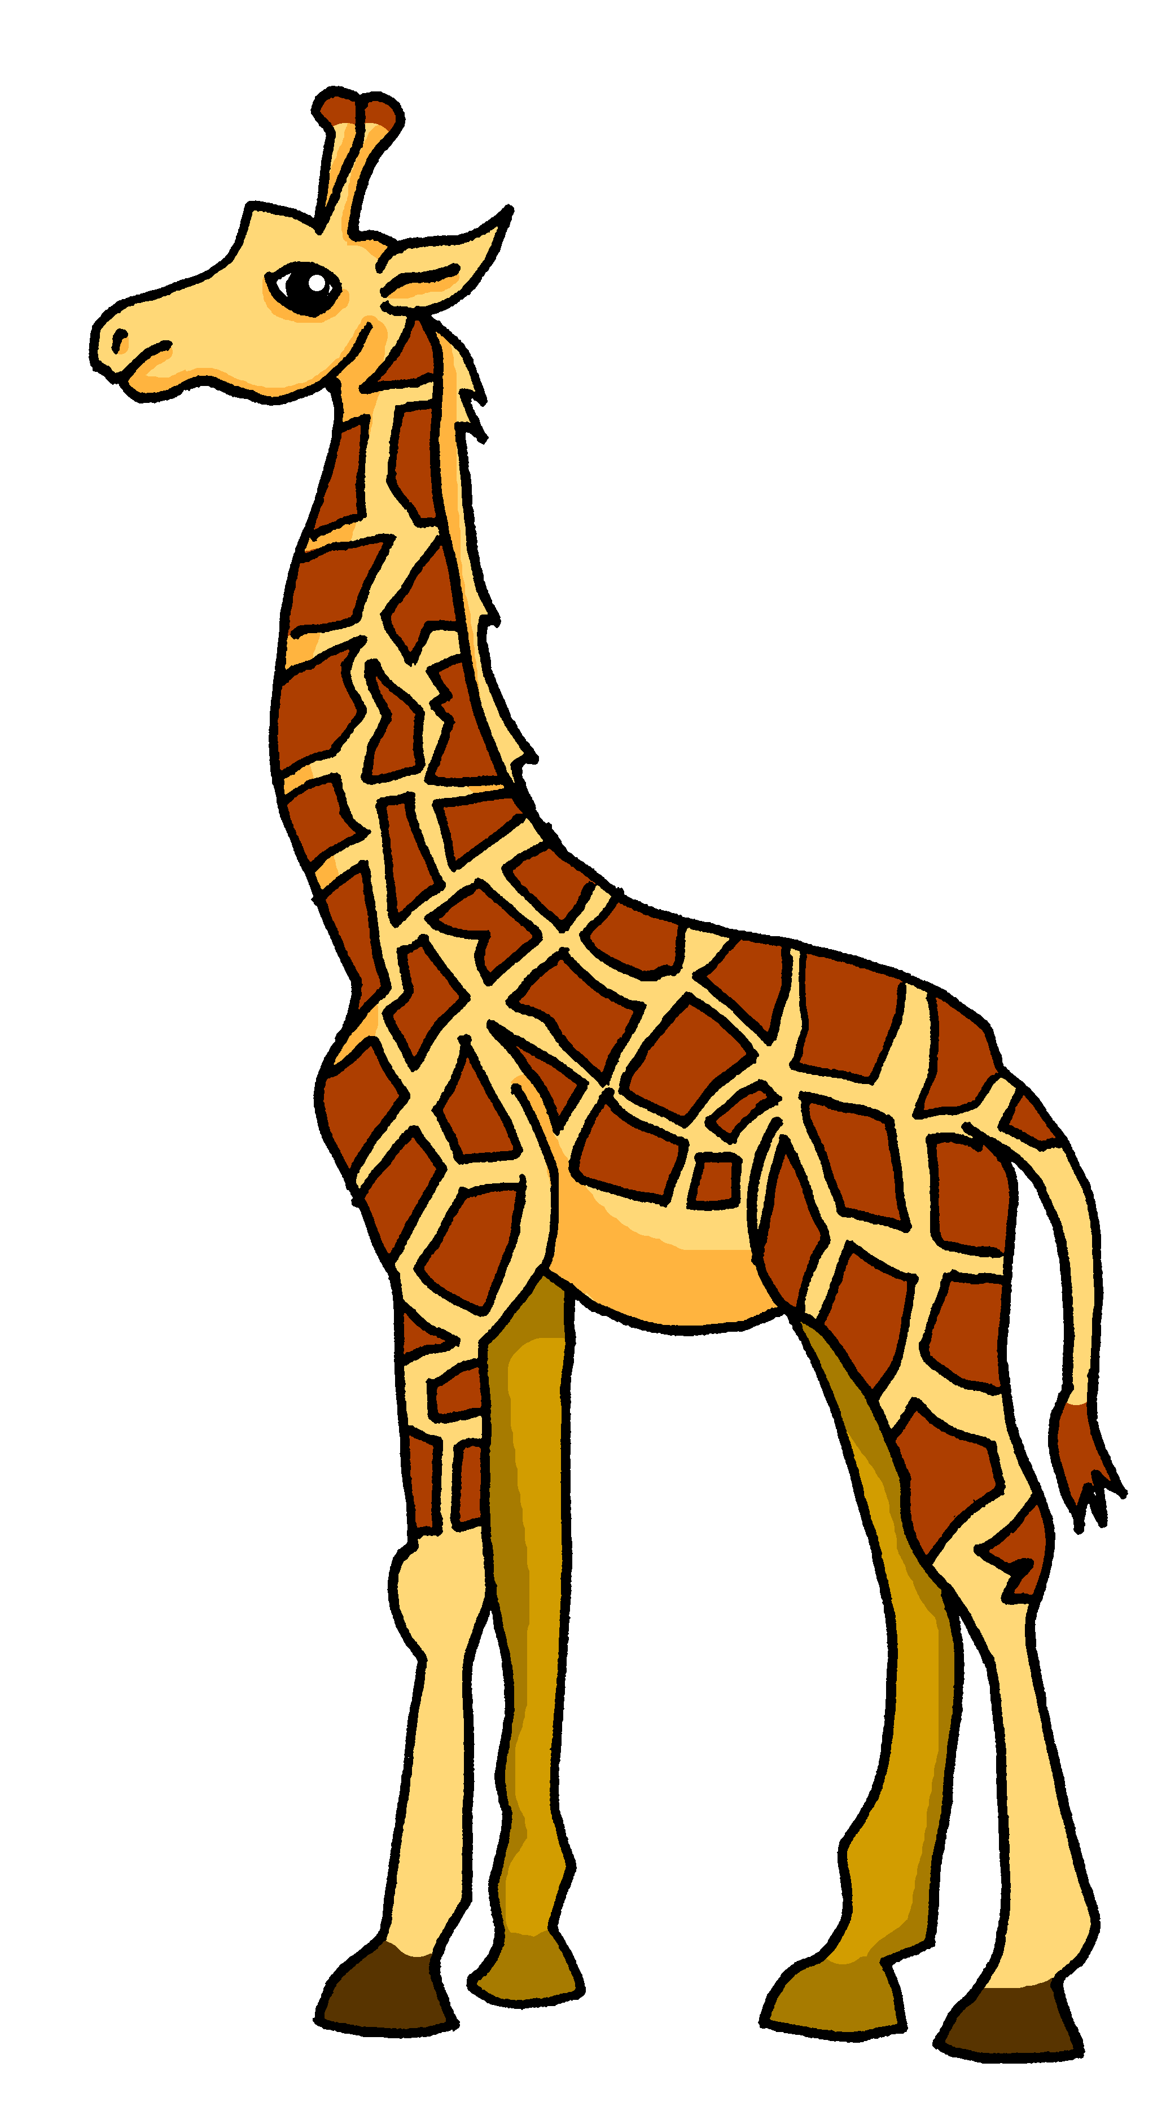
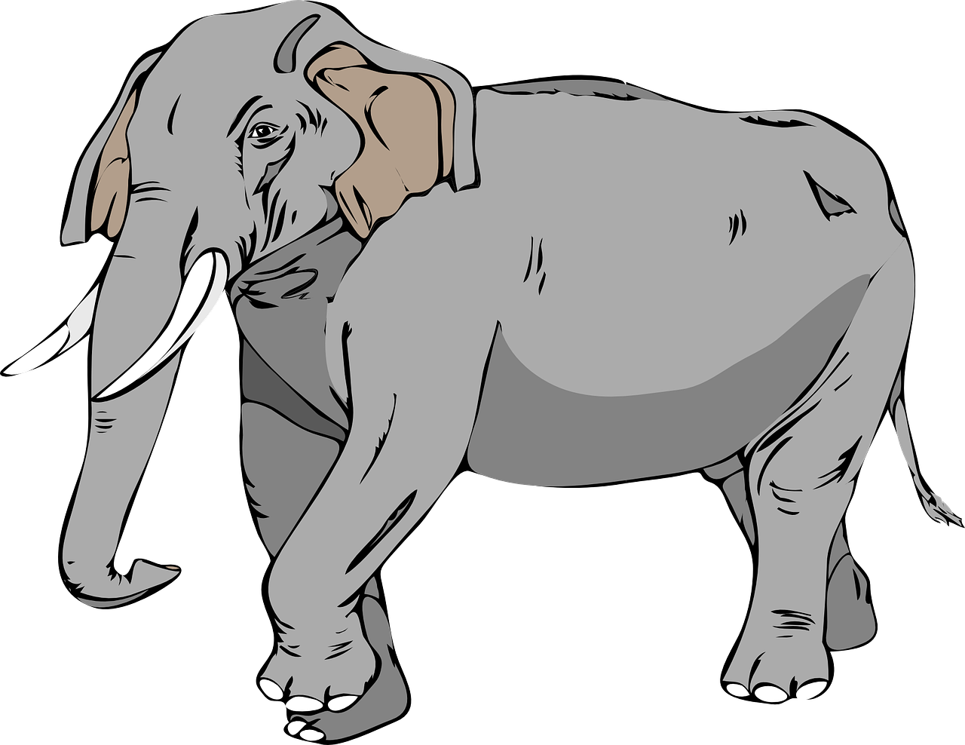
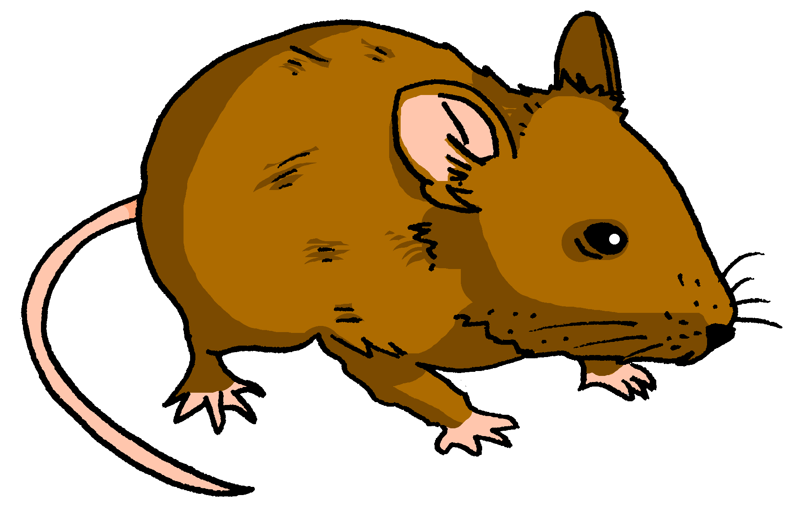
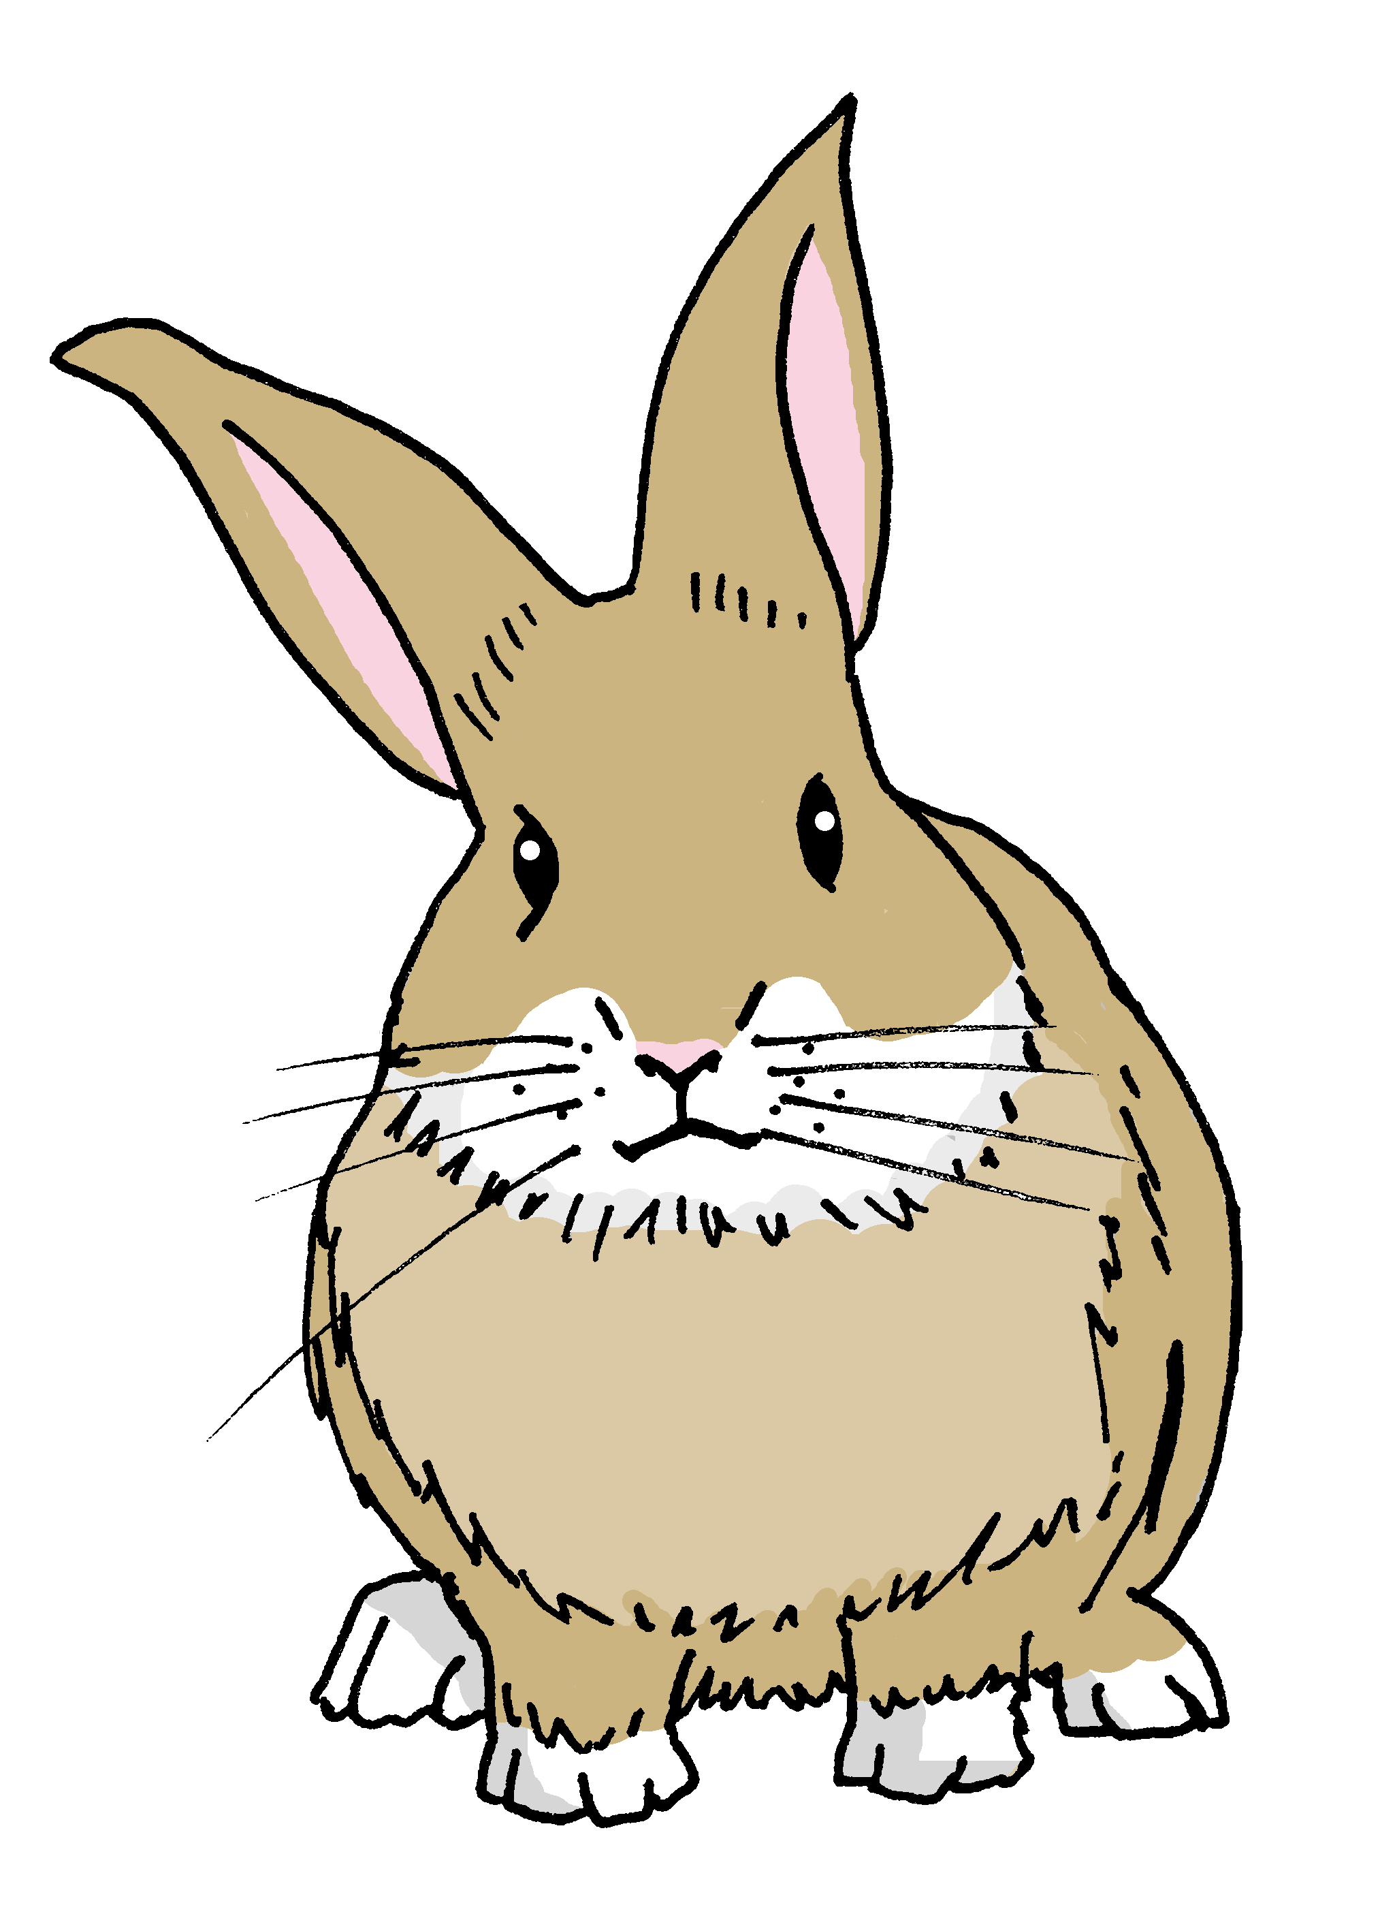
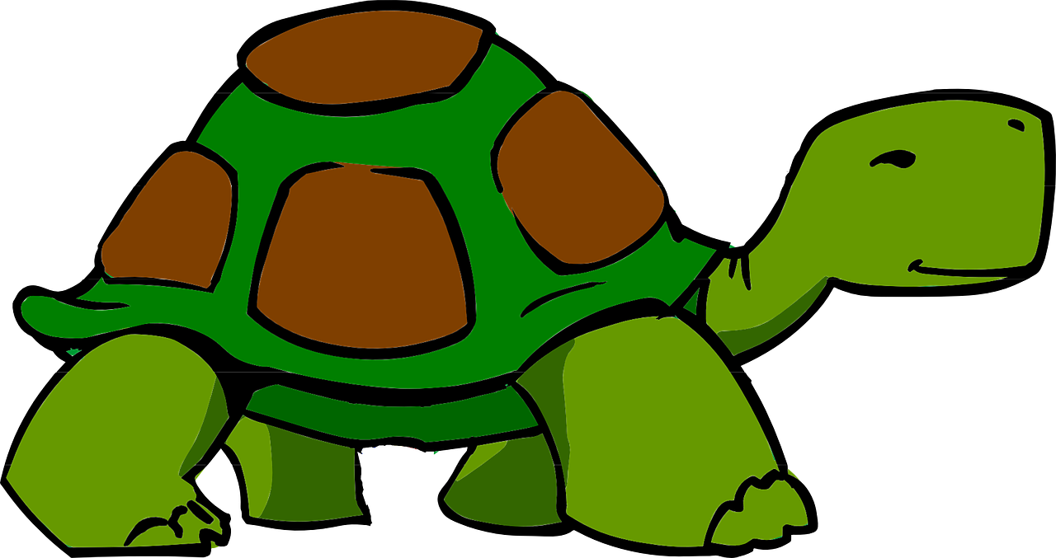
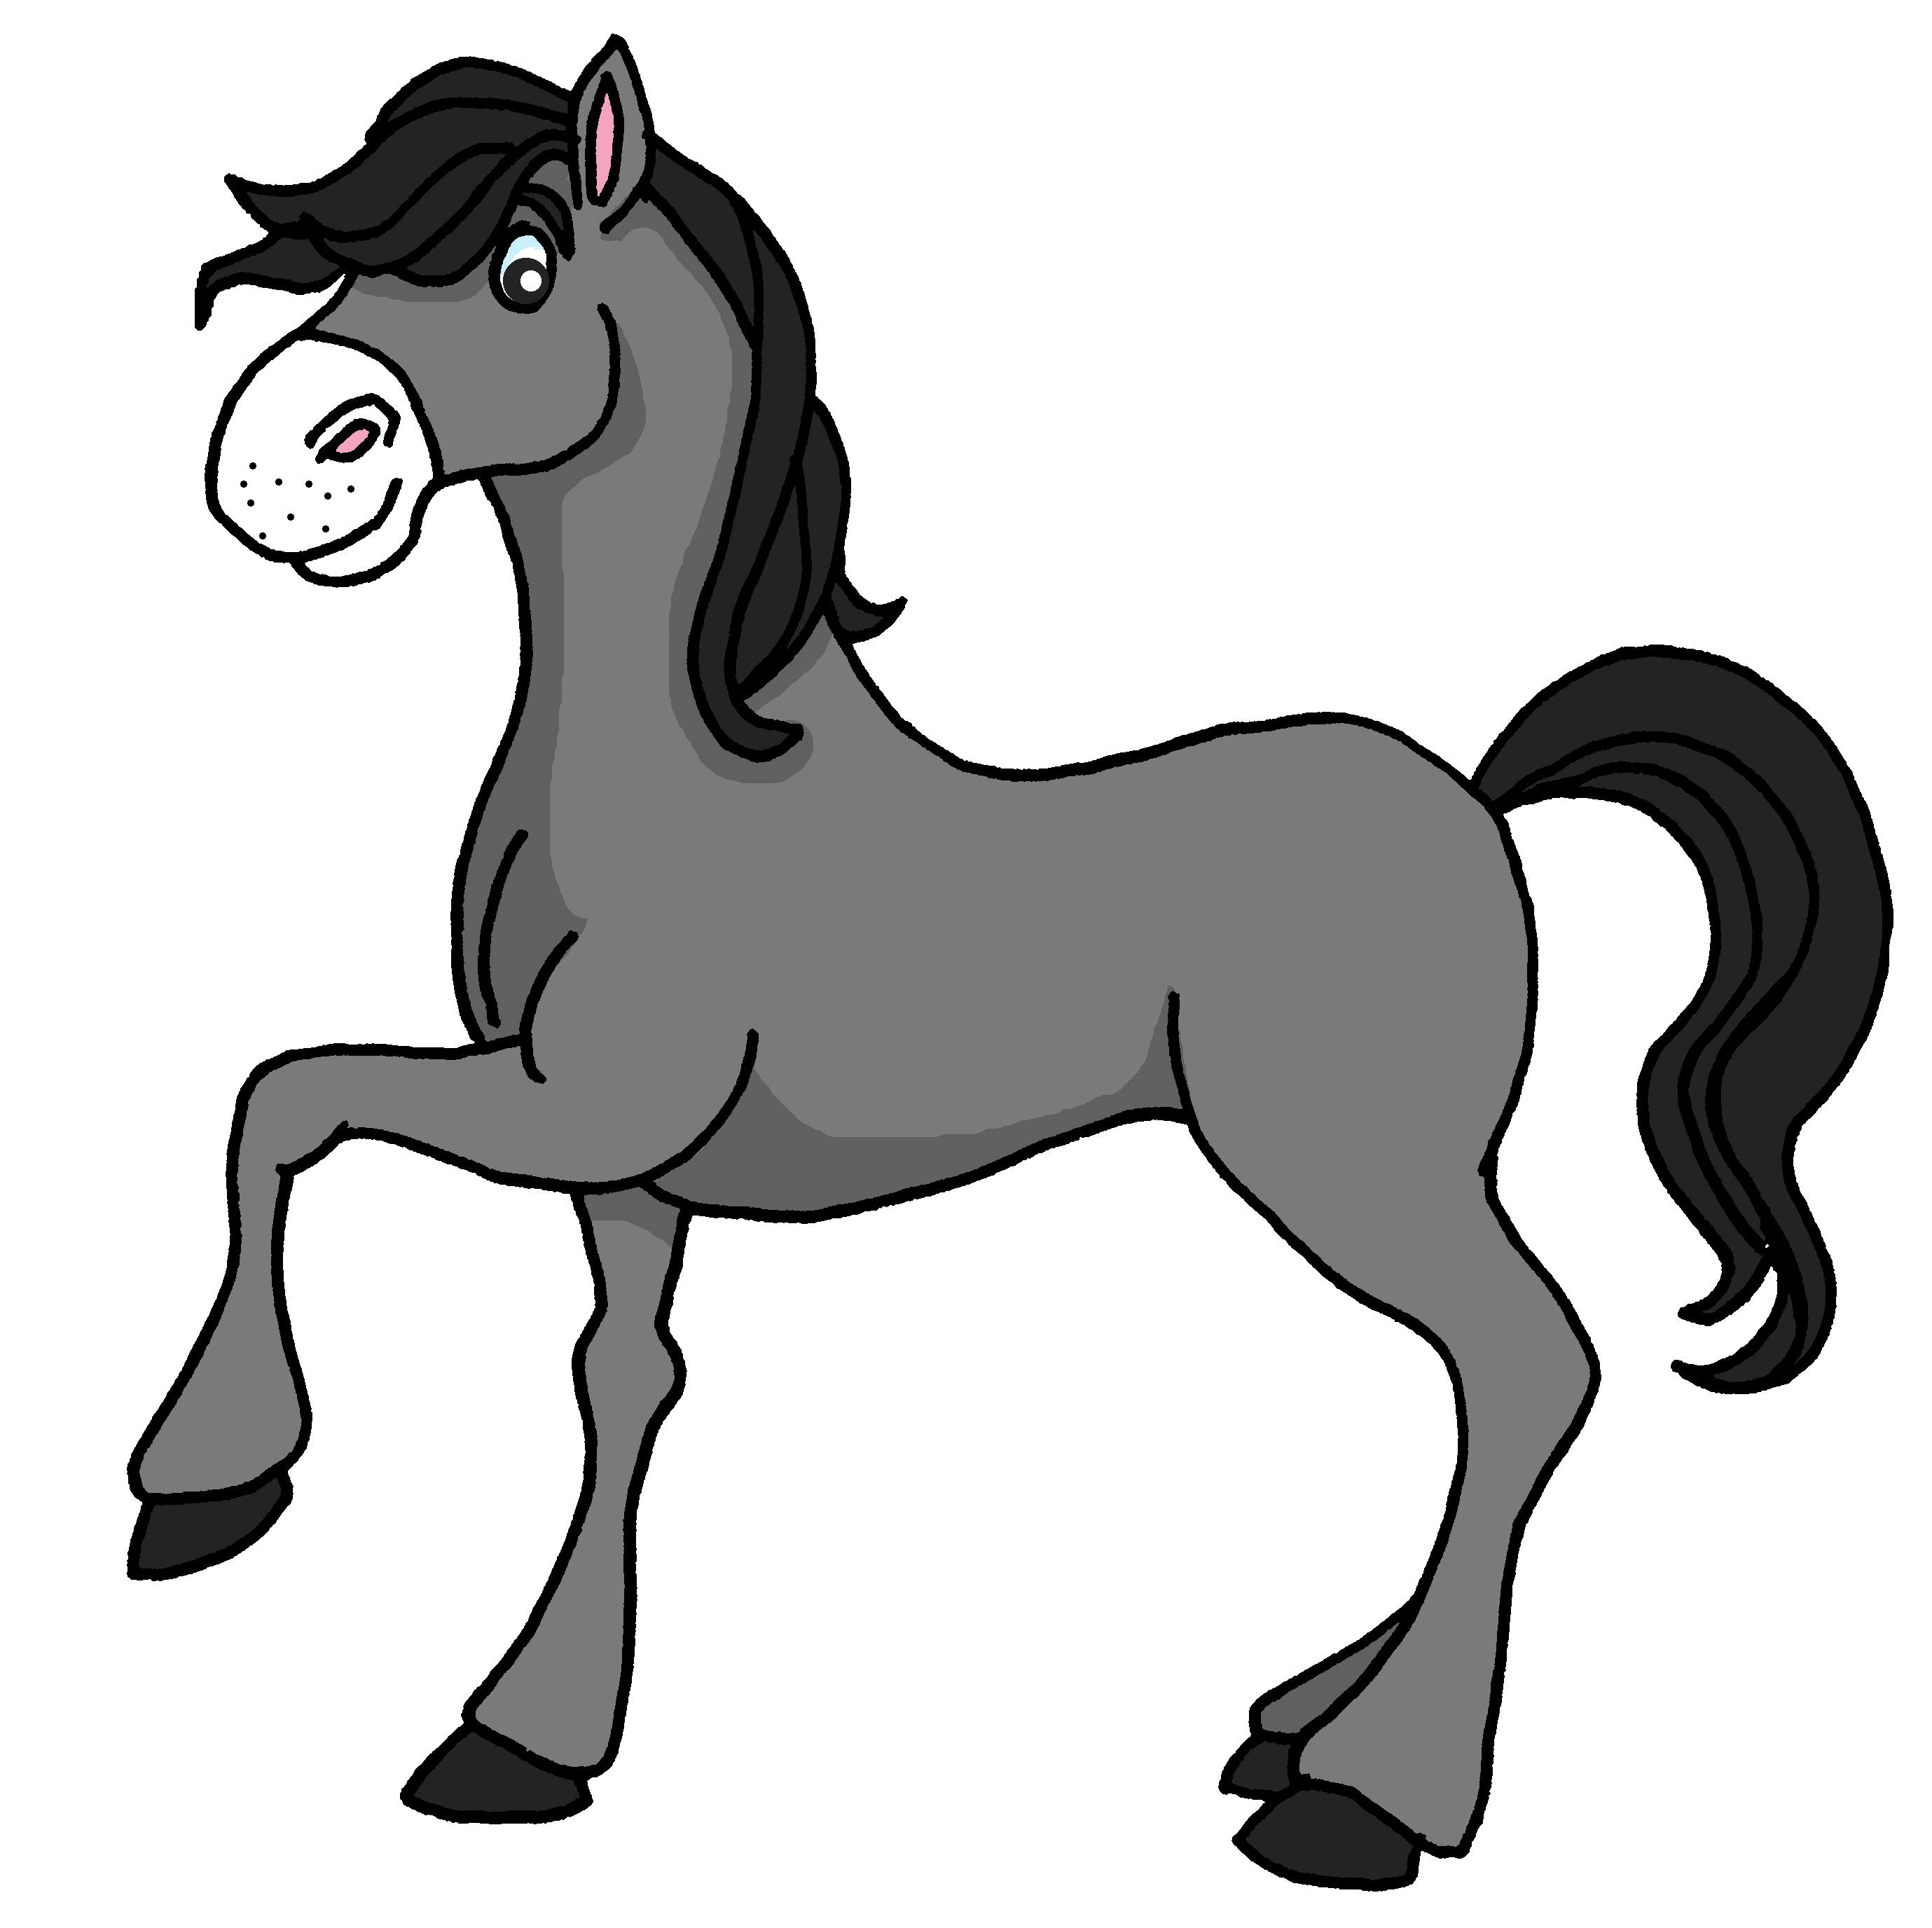
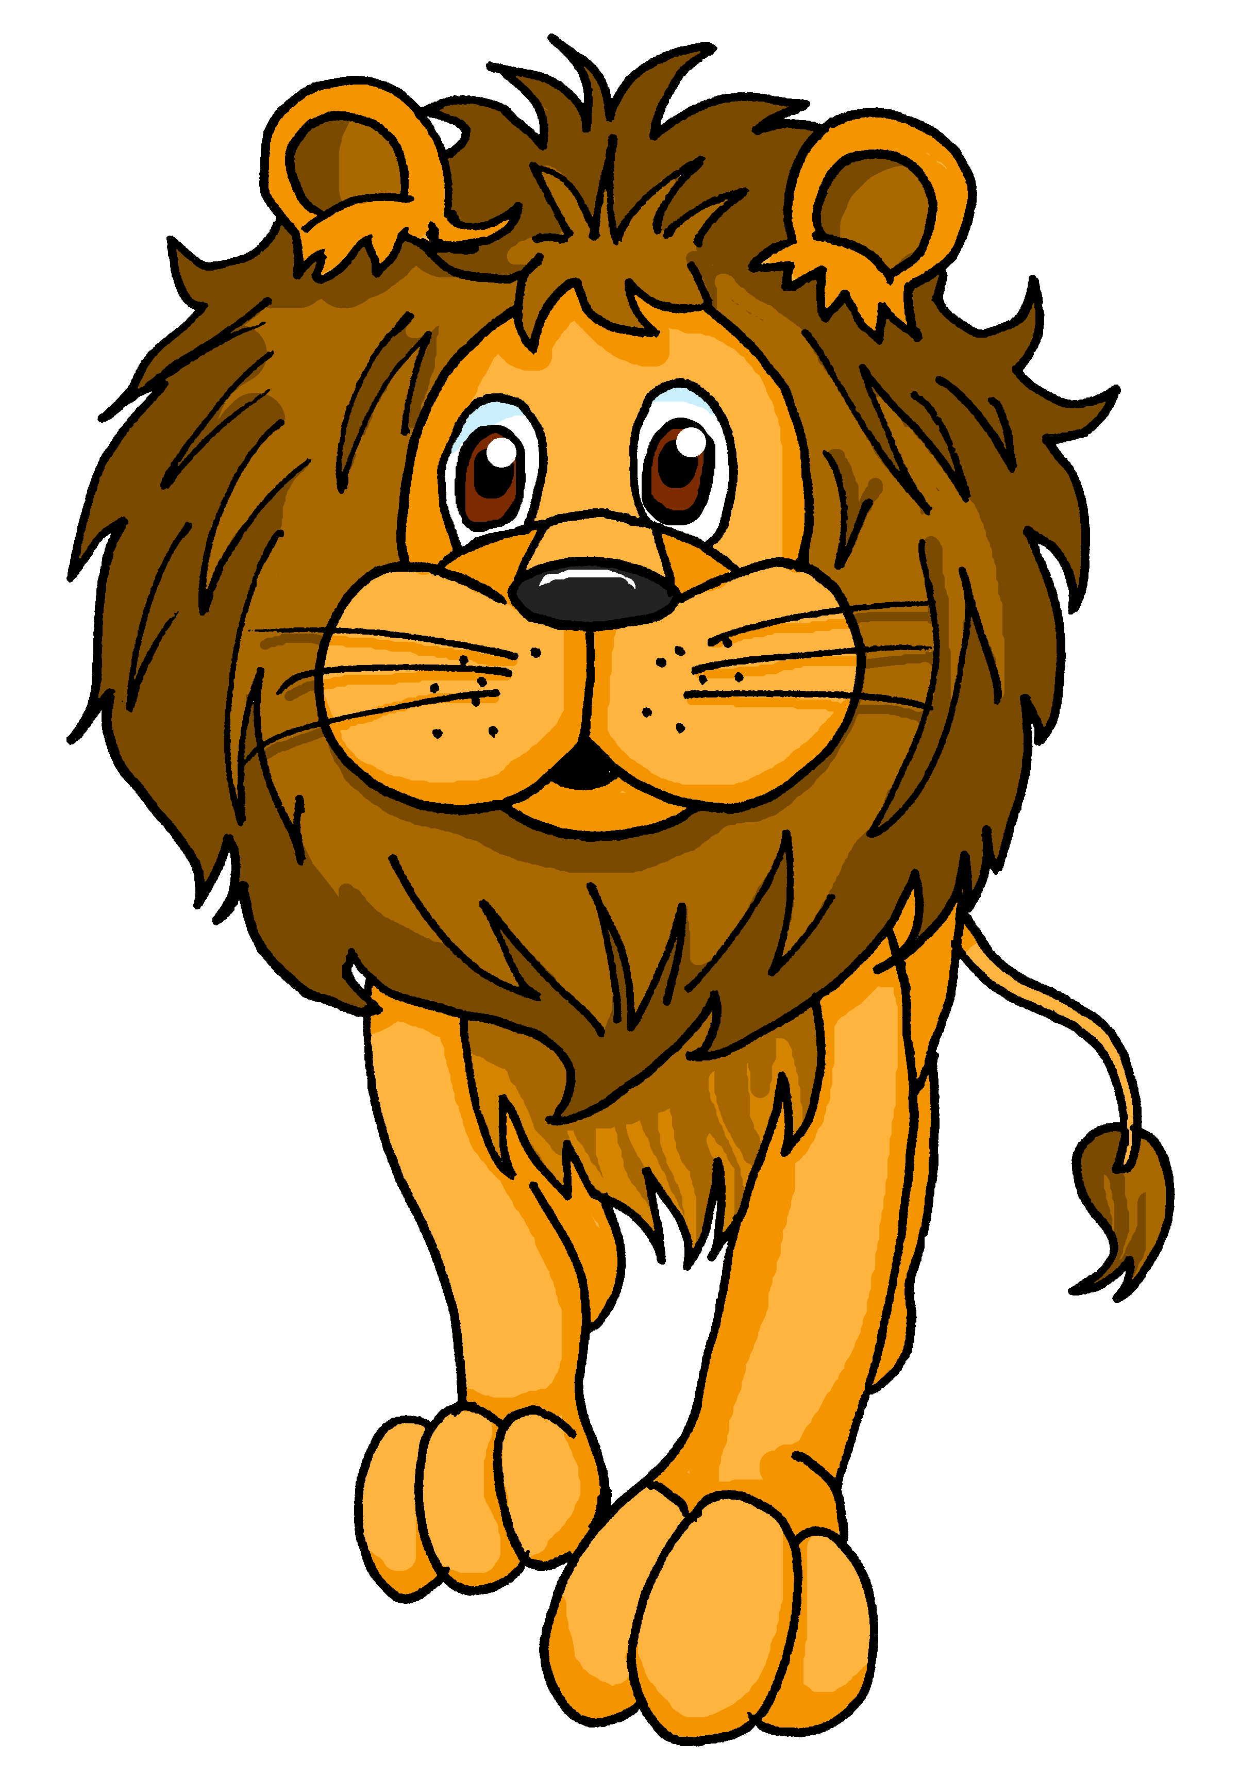
Follow up 2:
El animal favorito de Luis es el conejo. Y tú, ¿tu animal favorito es el conejo?
⚠ Note: in Spanish we say ‘My favourite animal is ‘the dog, the mouse etc.’
hablar
A
Mi animal favorito es el perro.
Keep talking until you have used all 12 animals! Choose the animals in any order.
B
Mi animal favorito es el perro y el gato.
A
Mi animal favorito es el perro, el gato y también
el elefante.
gato (m)
perro (m)
tigre (m)
delfin (m)
girafa (f)
oso (m)
elefante (m)
ratón (m)
conejo (m)
tortuga (f)
caballo (f)
león (m)
Notes:
Timing: 5 minutes
Aim: to practise spoken production of le/la and its connection with masculine/feminine nouns; to practise read aloud of mainly unknown nouns; to practise saying what your favourite animal is using the new adjective ‘favorito’.
Procedure:
Model the task with pupils, using the sequence provided.
Pupils keep talking until they have used all the animals.
Provide support as needed for the class or individuals.
If needed, the pronunciation of each animal and its articles can be heard by click on the animal image.

Slide 4
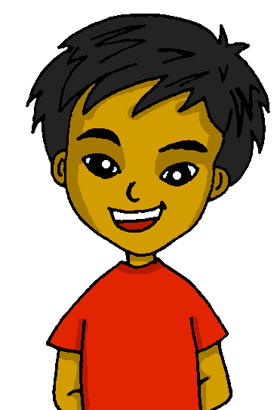
Follow up 3: Quique describe sus* cosas favoritas.
sus - his
Escribe las frases en español.
escribir
leer
 | M_ a_ _ _ _ _ f_ _ _ _ _ _ _ e_ e_ c _ _ _ _ _ _. My favourite animal is a horse.
 | E_ b_n_ _ o, d _ v_ _ _ _ _ o y t_ _ _ _ _ _ m_ _ i_ _ _ _ _ g _ _ _ _. It is pretty, fun and also very intelligent.
 | H_ _ l _ i_ _ _ _ s e_ c_ _ _ y a_ _ _ _ d_ e_ _ _ ñ_ _ e_ c_ _ _ _. I speak English at home and I learn Spanish in class.
 | N_ _ _ _ _ m_ _ _ _ l_ _ l_ _ _ _ s e_ i_ _ l_ _. Normally I read books in English.
 | M_ l_ _ _ _ f_ _ _ _ _ _ _ e_ Dragons in a bag. My favourite book is Dragons in a bag.
Mi animal favorito es el caballo.
E
Es bonito, divertido y también muy inteligente.
1
Hablo inglés en casa y aprendo español en clase.
2
Normalmente leo libros en inglés.
3
4
Mi libro favorito es ‘Dragons in a bag’.
Notes:
Timing: 5 minutes
Aim: to practise written production of vocabulary from this week and previous weeks.
Procedure:
Pupils write the sentences.
Click to correct.

Slide 5
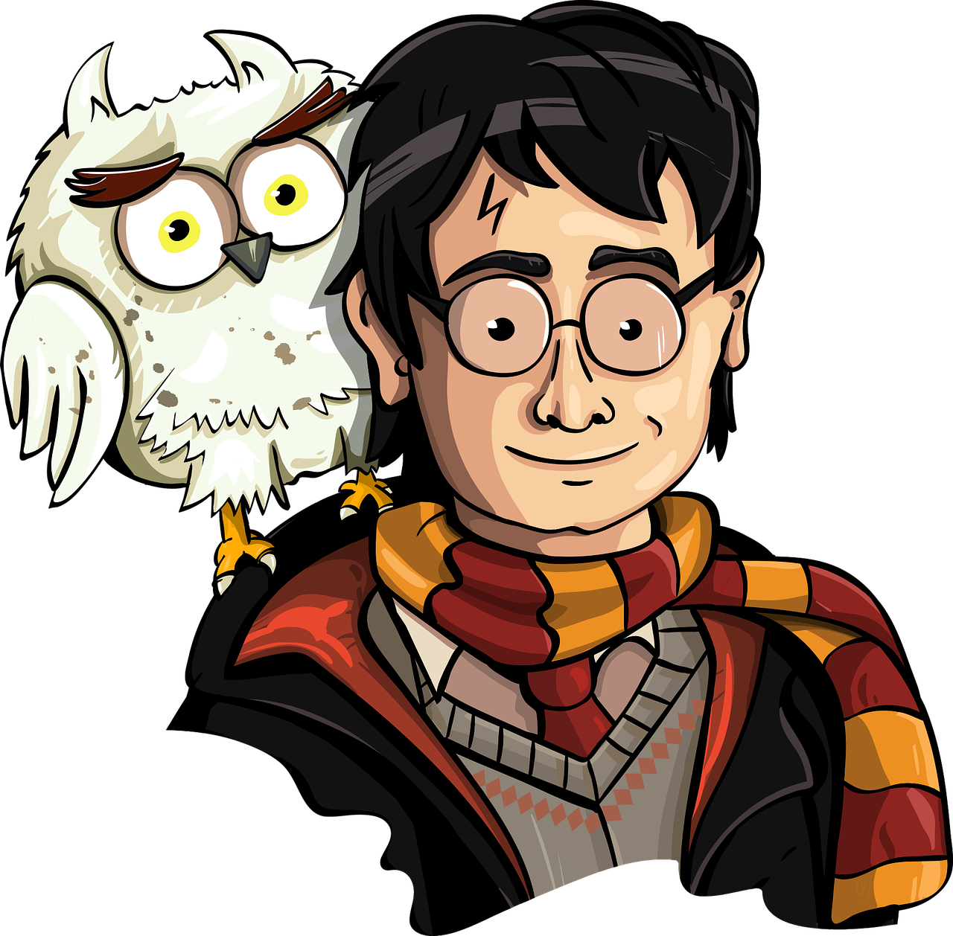
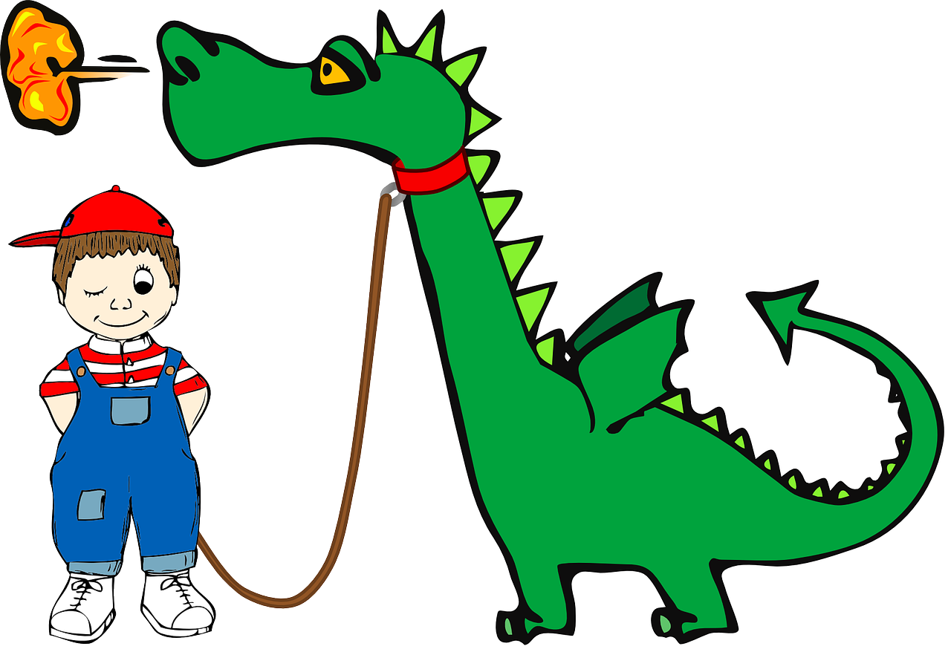
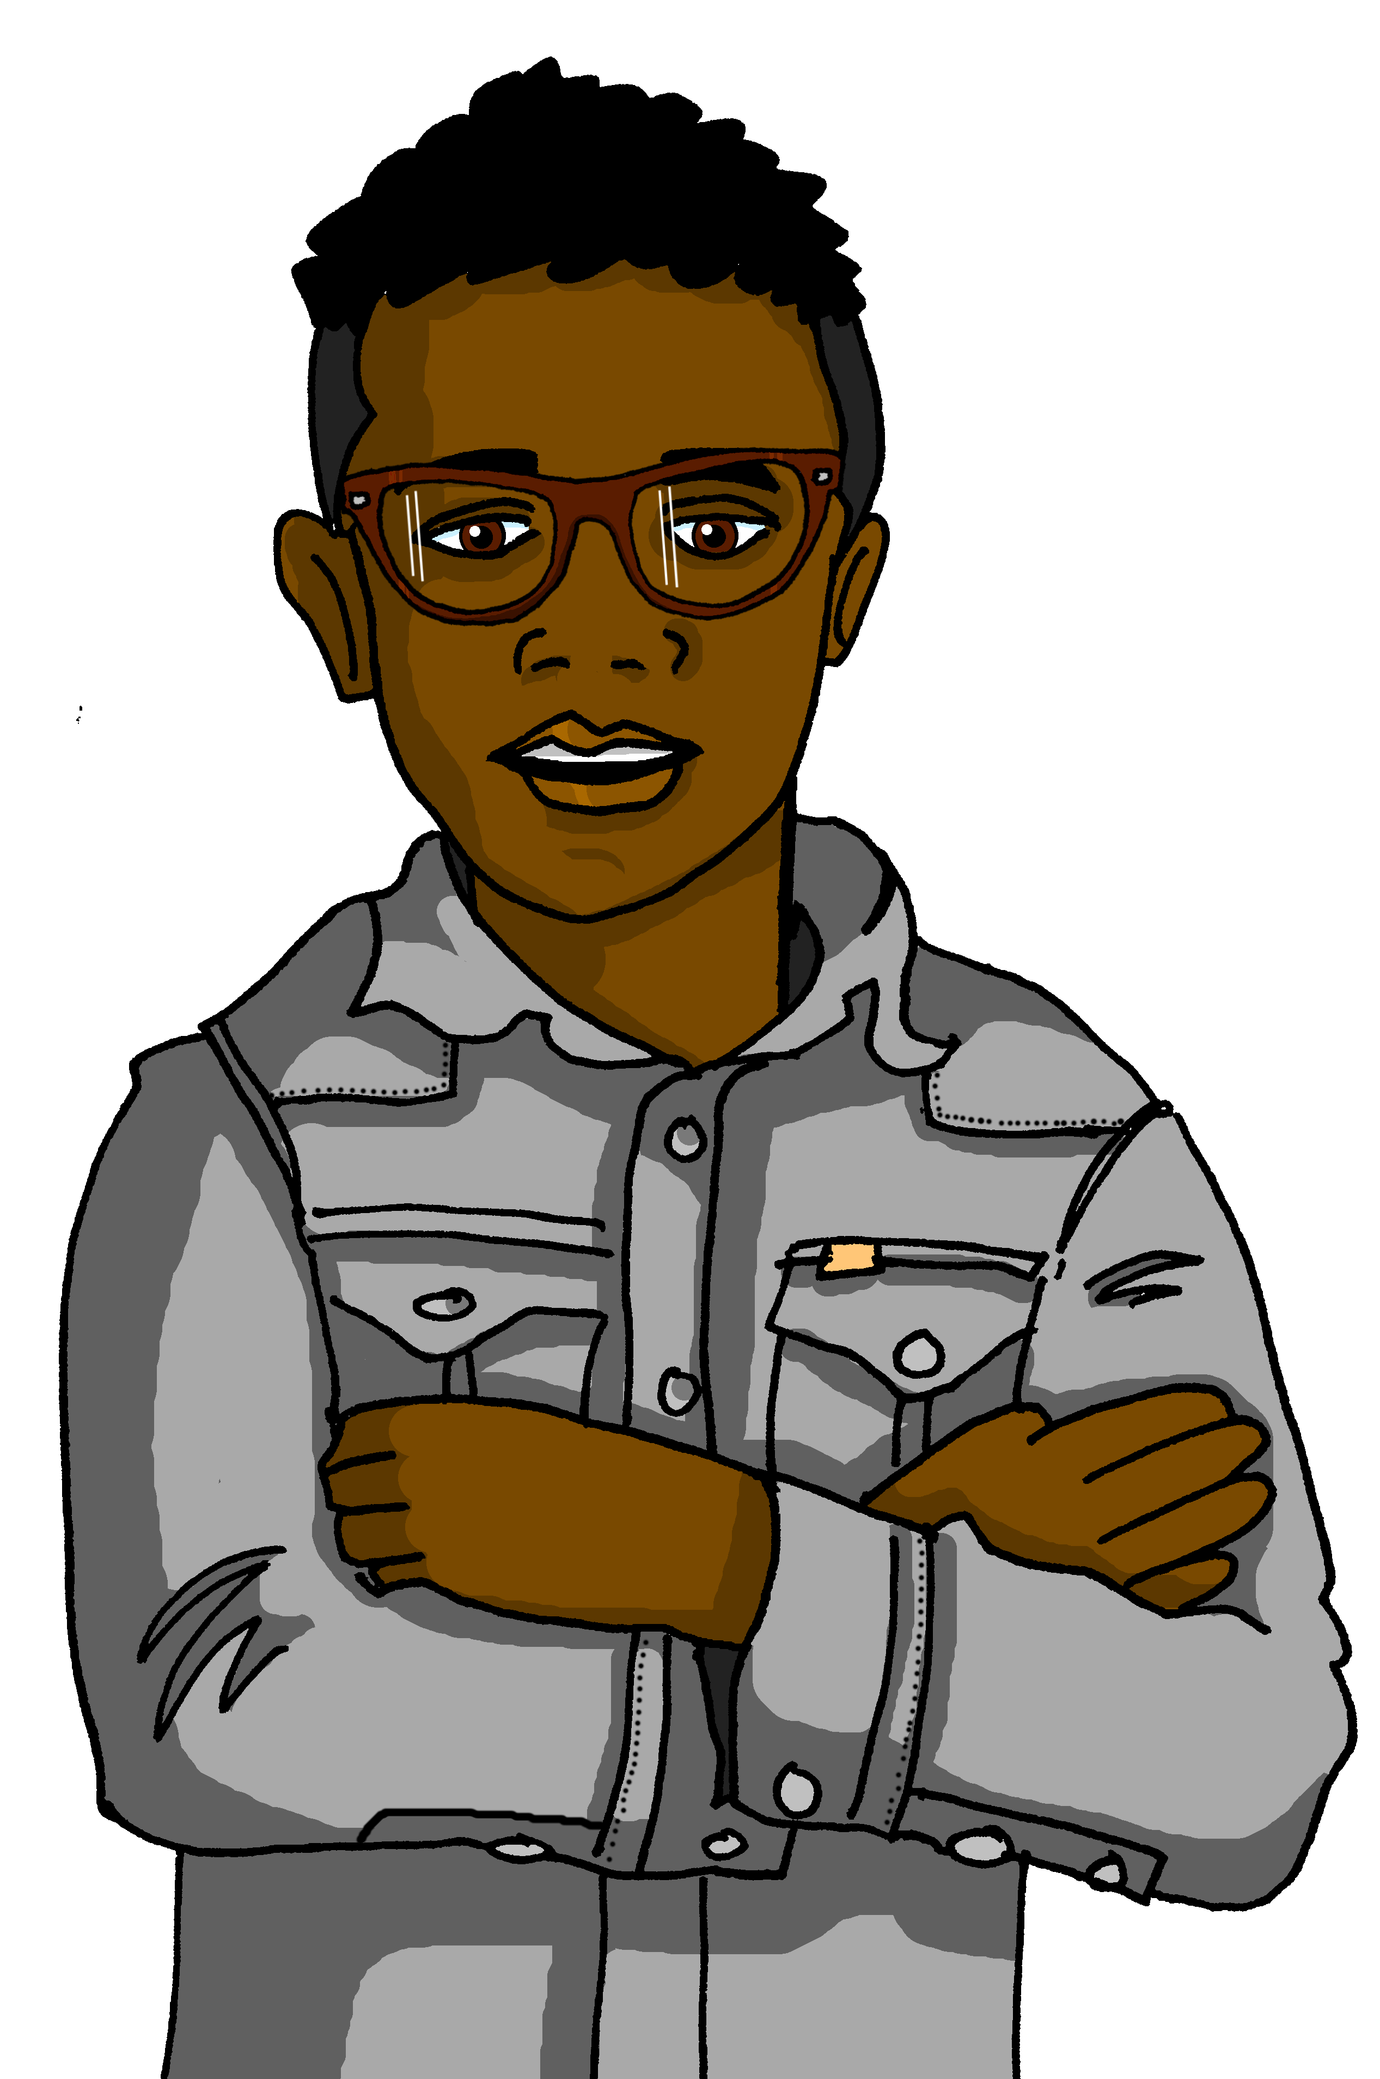
Follow up 3: ¿Quién eres?
A: Ask questions to work out who B has chosen to be.
B: Answer according to your chosen image.
hablar
No.
¡Sí!
¿Tienes un perro?
Sí.
¿Eres C?
¿Tu libro favorito es Harry Potter?
A
B
C
Notes:
Timing: 8-10 minutes (3 slides)
Aim: to practise asking and answering questions.
Procedure:
1. Use this slide to model the task. 2. Click through the animations and ensure that pupils are clear about the task. 3. If needed, teachers can elicit the 4 questions that are needed for this game from pupils to refresh the knowledge before they start:
Tienes un animal? Tu deporte favorito es el fútbol/el tenis? Lees libros en español? Tu libro favorito es Harry Potter/Dragons in a bag?
4. Move to the next slide to do the activity.

Slide 6
Follow up 3: ¿Quién eres? [1/2]
A
B
C
D
hablar
1
E
F
G
H
2
2
3
3
I
J
K
L
4
4
Notes:
DISPLAY THIS SLIDE
Timing: 8-10 minutes
Aim: to practise asking and answering questions.
Procedure: 1. Pupil B chooses one letter – that is the ‘person’ they are.
2. A asks yes/no questions to work out who B is.
The four questions are labelled (1-4) on the right-hand side if the pupils need help: 1. ¿Tienes un animal? 2. ¿Tu deporte favorito es el fútbol/el tenis? 3. ¿Lees libros en español? 4. ¿Tu libro favorito es Harry Potter/Dragons in a bag?
3. Pupil B sí or no.
4. Pupil A keeps going until s/he has worked out which letter B is.
5. Swap roles and play again. Note: this round of the game can be played several times, with pupils taking it in turns. There is a further round of the game with different language to practise on the next slide.

Slide 7
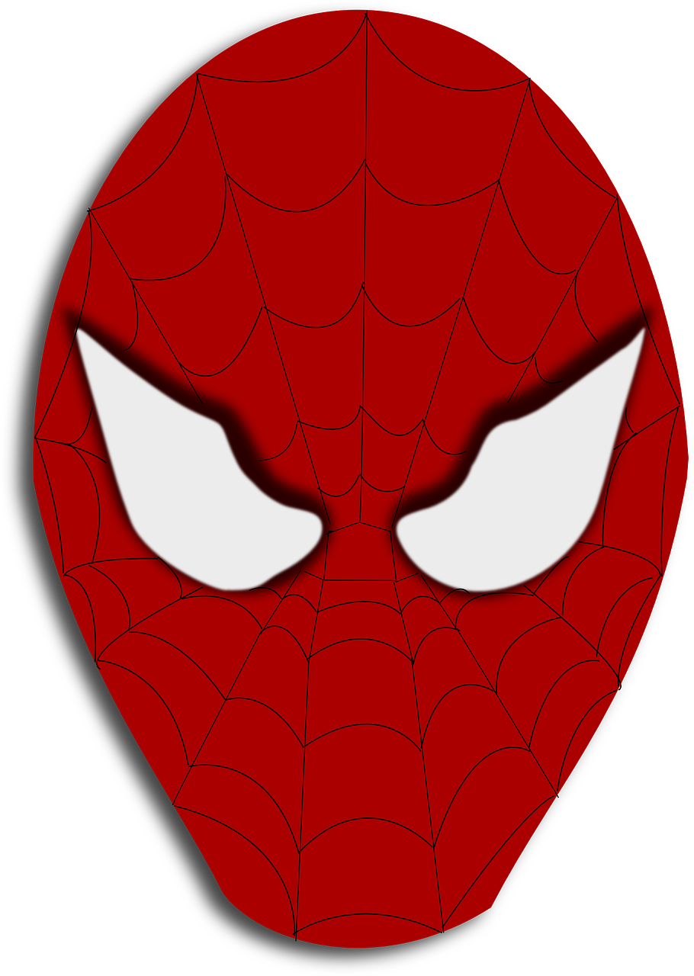
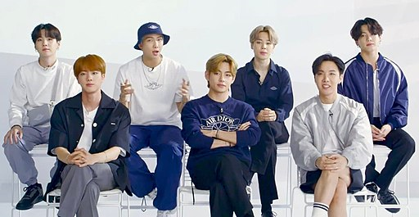
Follow up 3: ¿Quién eres? [2/2]
A
B
C
D
hablar
BTS
BTS
BTS
LM
1
1
E
F
G
H
2
2
BTS
LM
LM
BTS
3
3
I
J
K
L
4
4
LM
BTS
LM
LM
Notes:
DISPLAY THIS SLIDE
This is the 2nd version of the game. Aim: to practise asking and answering questions.
Procedure: 1. Pupil A chooses one letter – that is the ‘person’ they are.
2. B asks yes/no questions to work out who A is.
The four questions are labelled (1-4) on the right-hand side if the pupils need help:
1. ¿Tu película favorita es Spiderman/Encanto?
2. ¿Ves películas en español/inglés?
3. ¿Tu grupo favorito es BTS/Little Mix? 4. ¿Tu animal favorito es el elefante / la girafa?
3. Pupil A says sí or no.
4. Pupil B keeps going until s/he has worked out which letter A is.
5. Swap roles and play again. Note: this round of the game can be played several times, with pupils taking it in turns.
Picture attribution: Albatroswar, CC BY-SA 4.0 via Wikimedia Commons

Slide 8
follow up 5:

Escribe en inglés: can you get at least 15 points?
 | el deporte | ver | de
 | el juego | leer | el idioma
 | gris | y | alto
 | bajo | aprender | azul
 | favorito | el grupo | muy
 | mi | tu | también
vocabulario
(the) sport
to see, seeing
from, of
x3
(the) game
to read, reading
(the) language
grey
and
tall, high
x2
short, low
to learn, learning
azul
favourite
(the) group
very
x1
my
your
also, too
Notes:
Timing: 5 minutes
Aim: to practise written production of vocabulary from this week and this week’s revisited sets.
Procedure: 1. Give pupils a blank grid. They fill in the English meanings of any of the words they know, trying to reach 15 points in total.
Note: The most recently learnt and practised words are pink, words from the first revisit are green and those from the second revisit are blue, thus more points are awarded for them, to recognise that memories fade and more effort (heavy lifting!) is needed to retrieve them.

Slide 9
follow up 5:

Escribe en español: can you get at least 15 points?
 | (the) game | (the) language | from, of
 | to read, reading | to see, seeing | (the) sport
 | short, low | grey | to learn, learning
 | and | tall, high | blue
 | your | very | also, too
 | (the) group | favourite | my
vocabulario
el juego
el idioma
de
x3
leer
ver
el deporte
bajo
gris
aprender
x2
y
alto
azul
tu
muy
también
x1
el grupo
favorito
mi
Notes:
Timing: 5 minutes
Aim: to practise written production of vocabulary from this week and this week’s revisited sets.
Procedure: 1. Give pupils a blank grid. They fill in the Spanish meanings of any of the words they know, trying to reach 15 points in total.
Note: The most recently learnt and practised words are pink, words from the first revisit are green and those from the second revisit are blue, thus more points are awarded for them, to recognise that memories fade and more effort (heavy lifting!) is needed to retrieve them.

Slide 10
¡adiós!
rojo

Slide 11
follow up 2b:

Handout 5
Escribe en inglés: can you get at least 15 points?
 | el deporte | ver | de
 | el juego | leer | el idioma
 | gris | y | alto
 | bajo | aprender | azul
 | favorito | el grupo | muy
 | mi | tu | también
vocabulario
x3
x2
x1
Notes:
HANDOUT 5

Slide 12
follow up 2b:

Handout 5
Escribe en español: can you get at least 15 points?
 | (the) game | (the) language | from, of
 | to read, reading | to see, seeing | (the) sport
 | short, low | grey | to learn, learning
 | and | tall, high | blue
 | your | very | also, too
 | (the) group | favourite | my
vocabulario
x3
x2
x1
Notes:
HANDOUT 5

