Slide 1
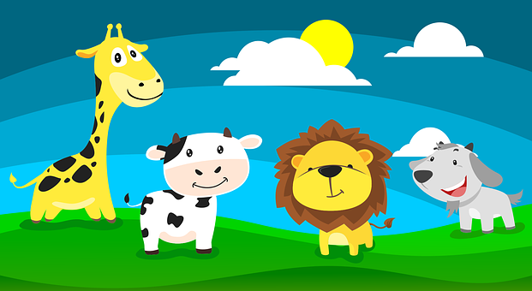
Describing things and people
rojo
Follow ups 1-5
Notes:
Artwork by Steve Clarke. All additional pictures selected are available under a Creative Commons license, no attribution required.
The frequency rankings for words that occur in this PowerPoint which have been previously introduced in the resources are given in the SOW (excel document) and in the resources that first introduced and formally re-visited those words.
For any other words that occur incidentally in this PowerPoint, frequency rankings will be provided in the notes field wherever possible.
Phonics: revisit SSC [ga] [go] [gu] [ge] [gi]
Vocabulary: conejo [4728] tortuga [>5000] amable [2707] diferente [293] divertido [2465] inteligente [2167] demasiado [494] Revisit 1: fruta [1925] globo [3765] pelota [2270] queso [3187] sombrero [2289] tarta [>5000]
Revisit 2: caminar [514] nadar [3604] mar [480] montaña [1464] playa [1475] pueblo [244] el [1] la [1] de² [2] por¹ [15]
Source: Davies, M. & Davies, K. (2018). A frequency dictionary of Spanish: Core vocabulary for learners (2nd ed.). Routledge: London

Slide 2
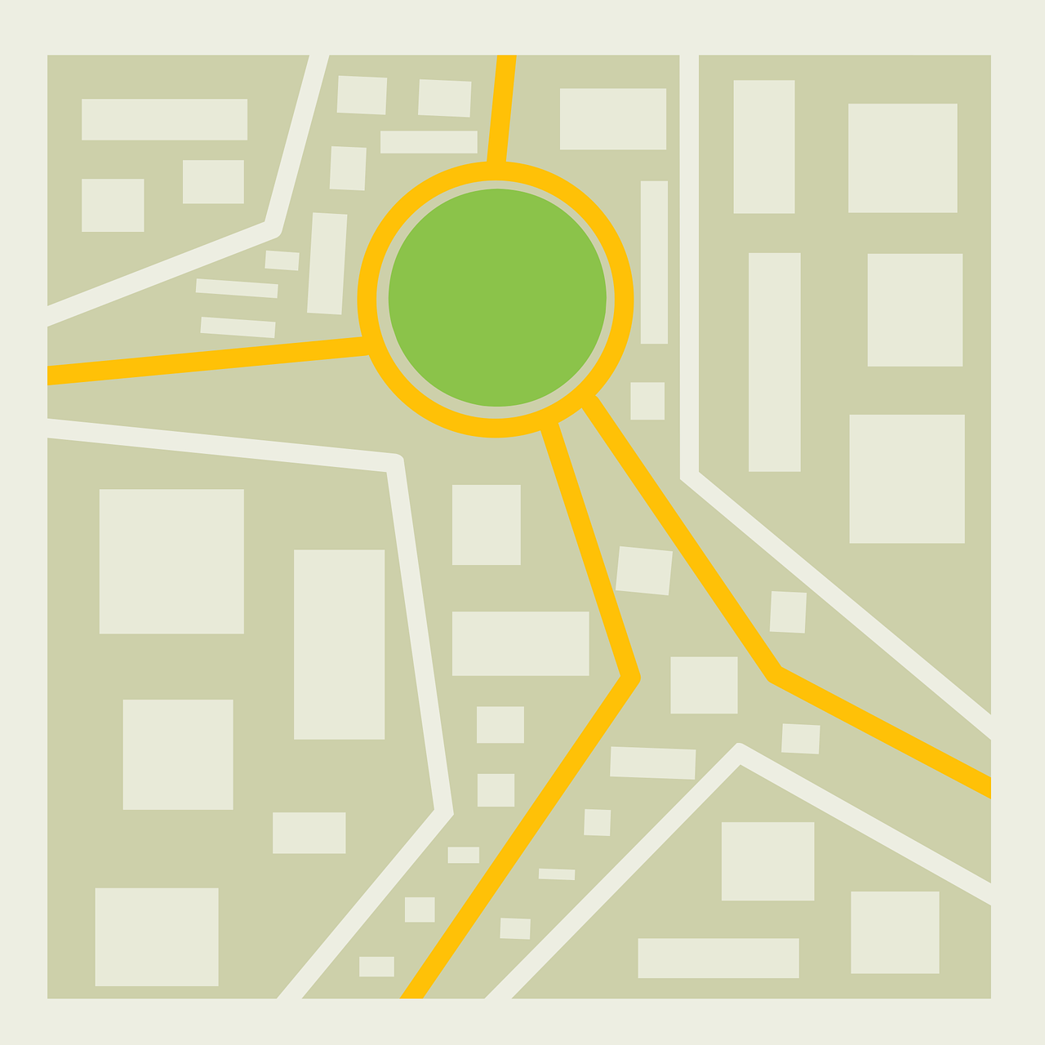
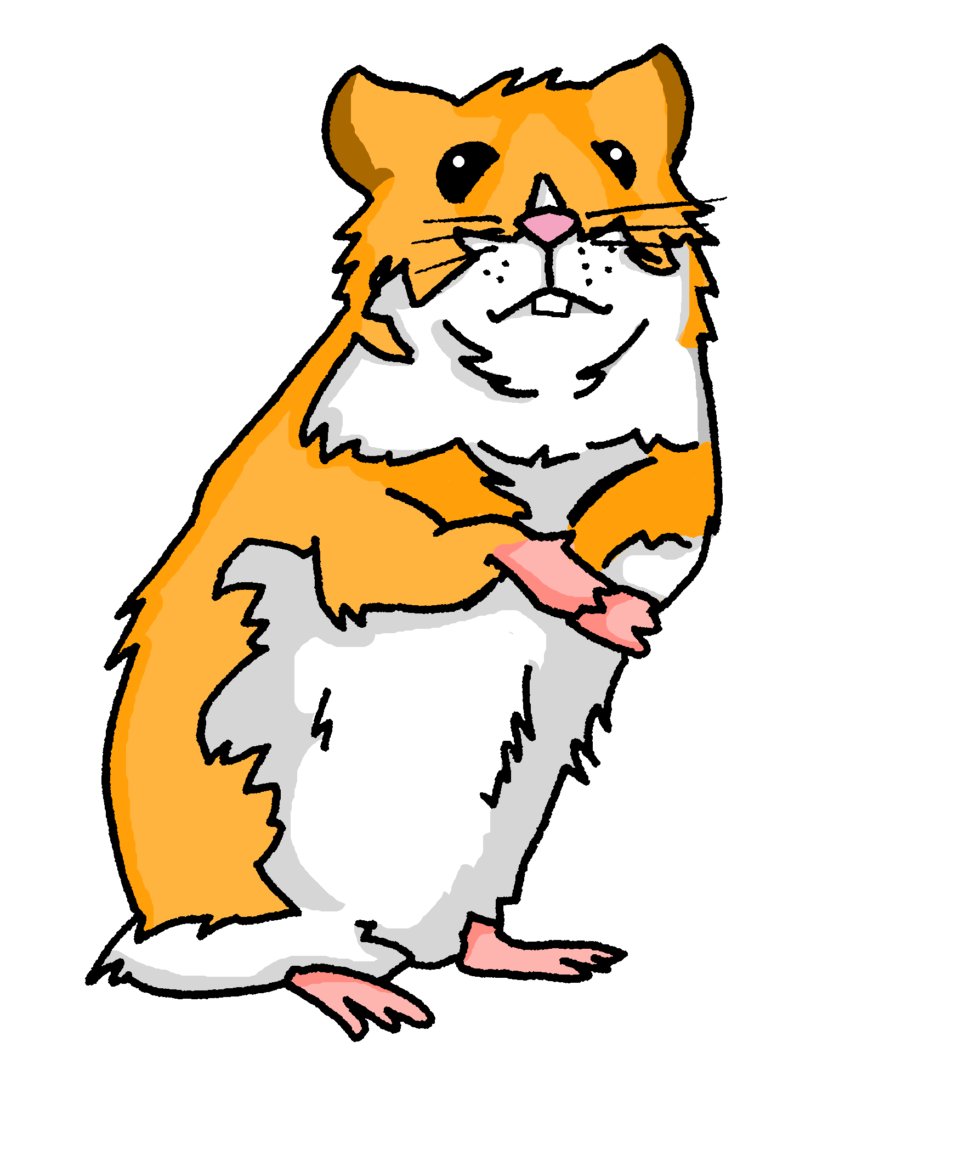
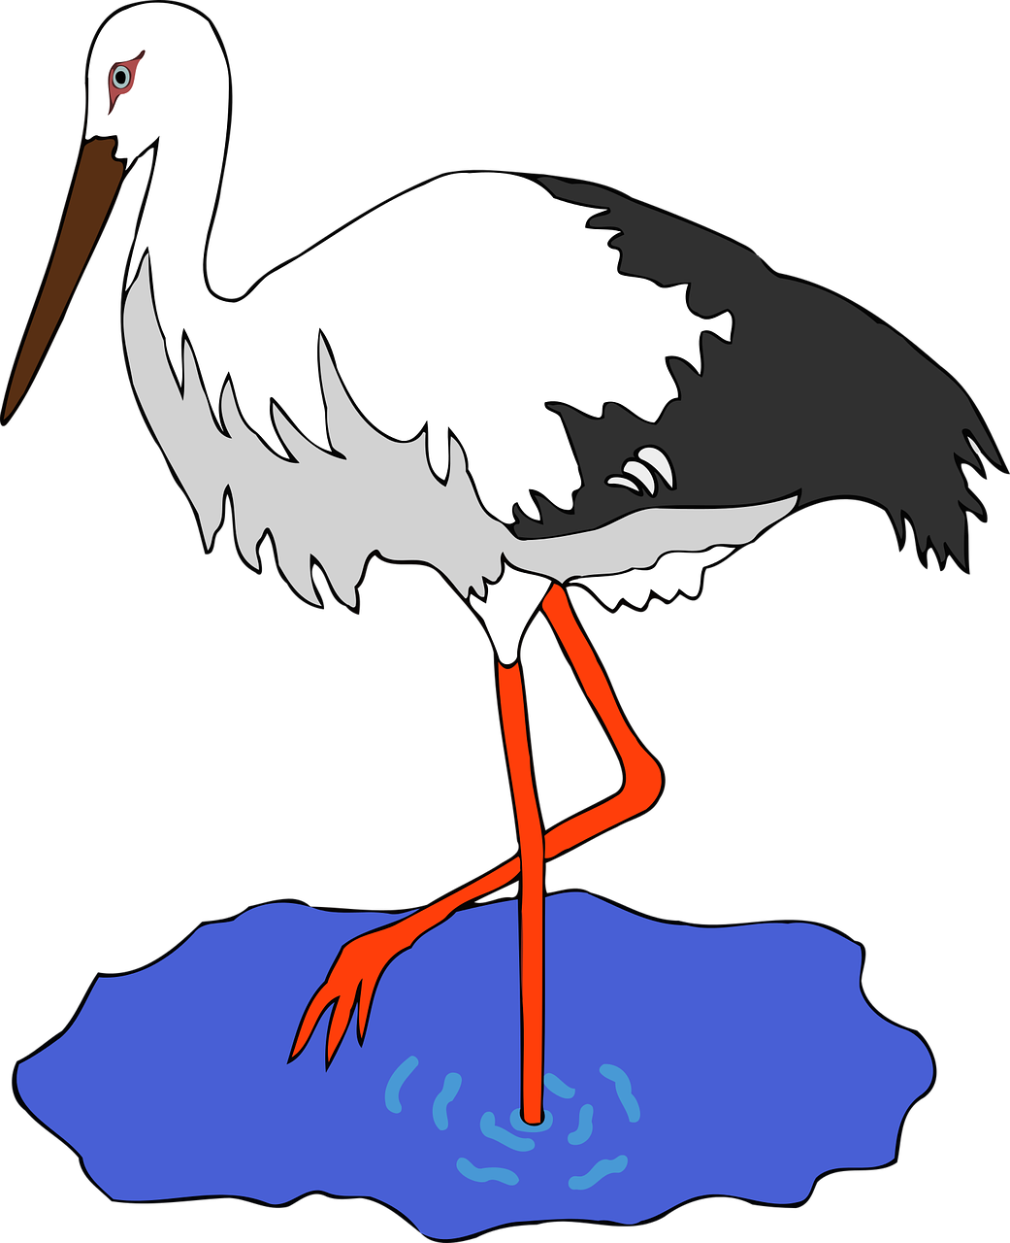
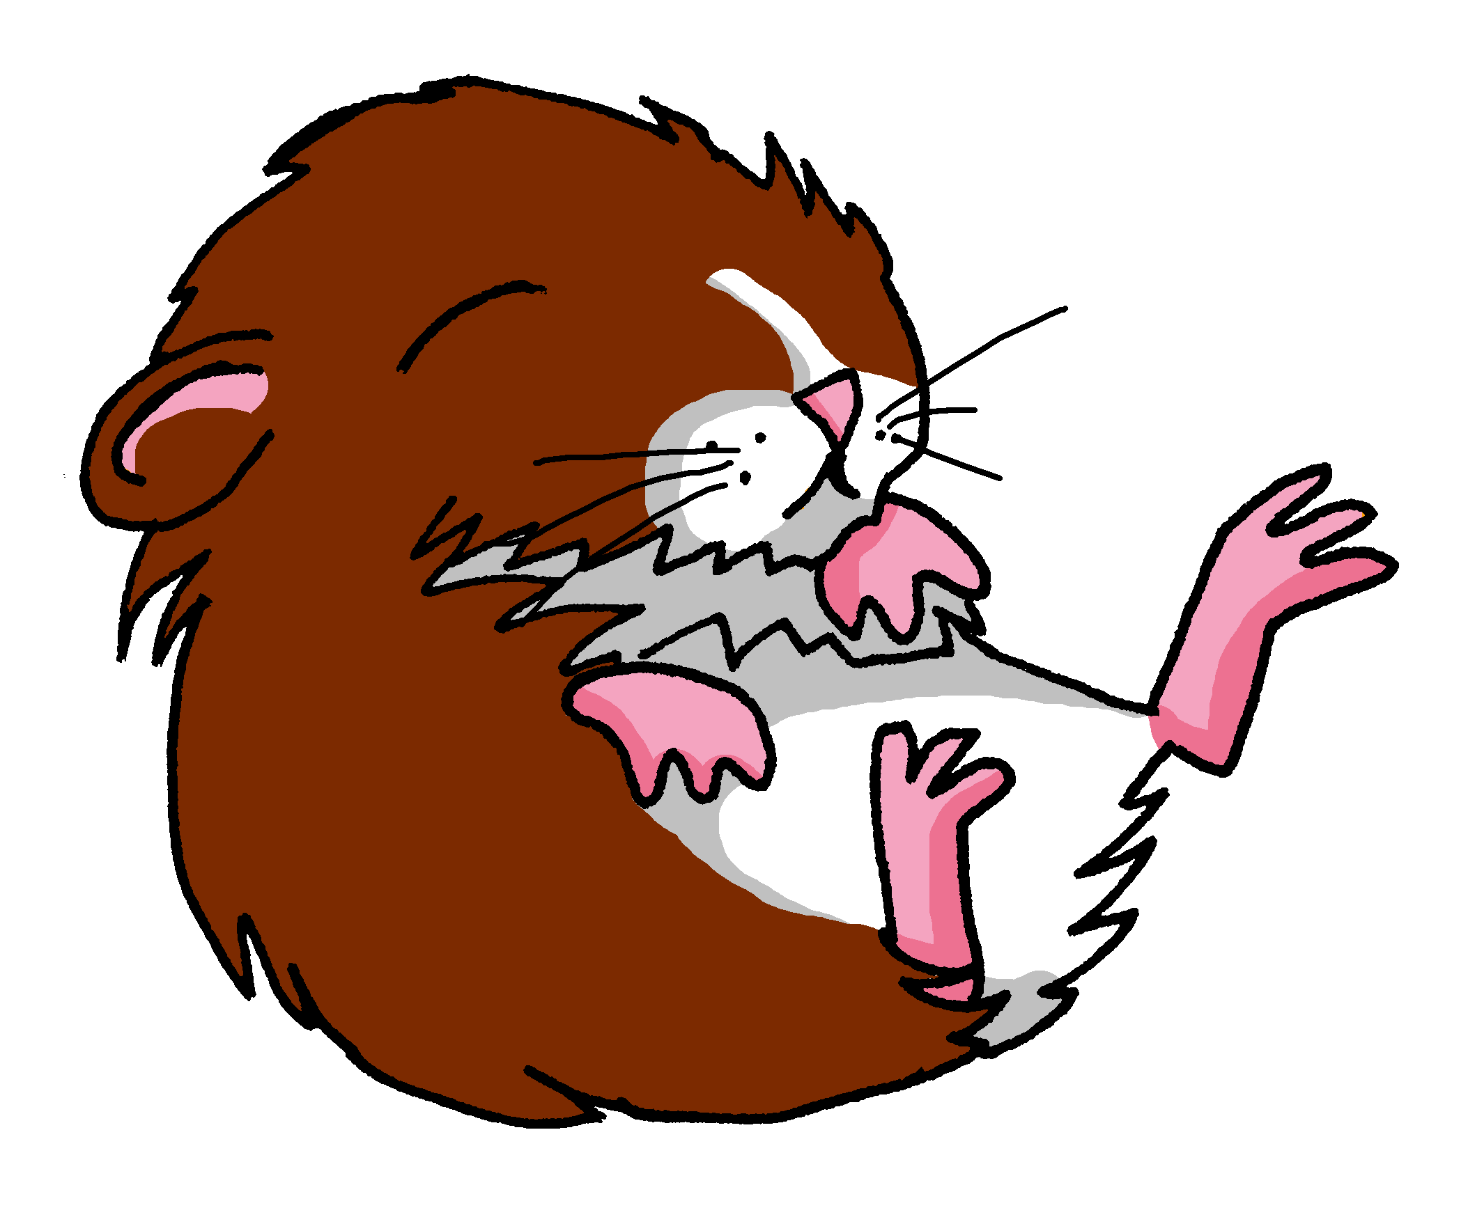
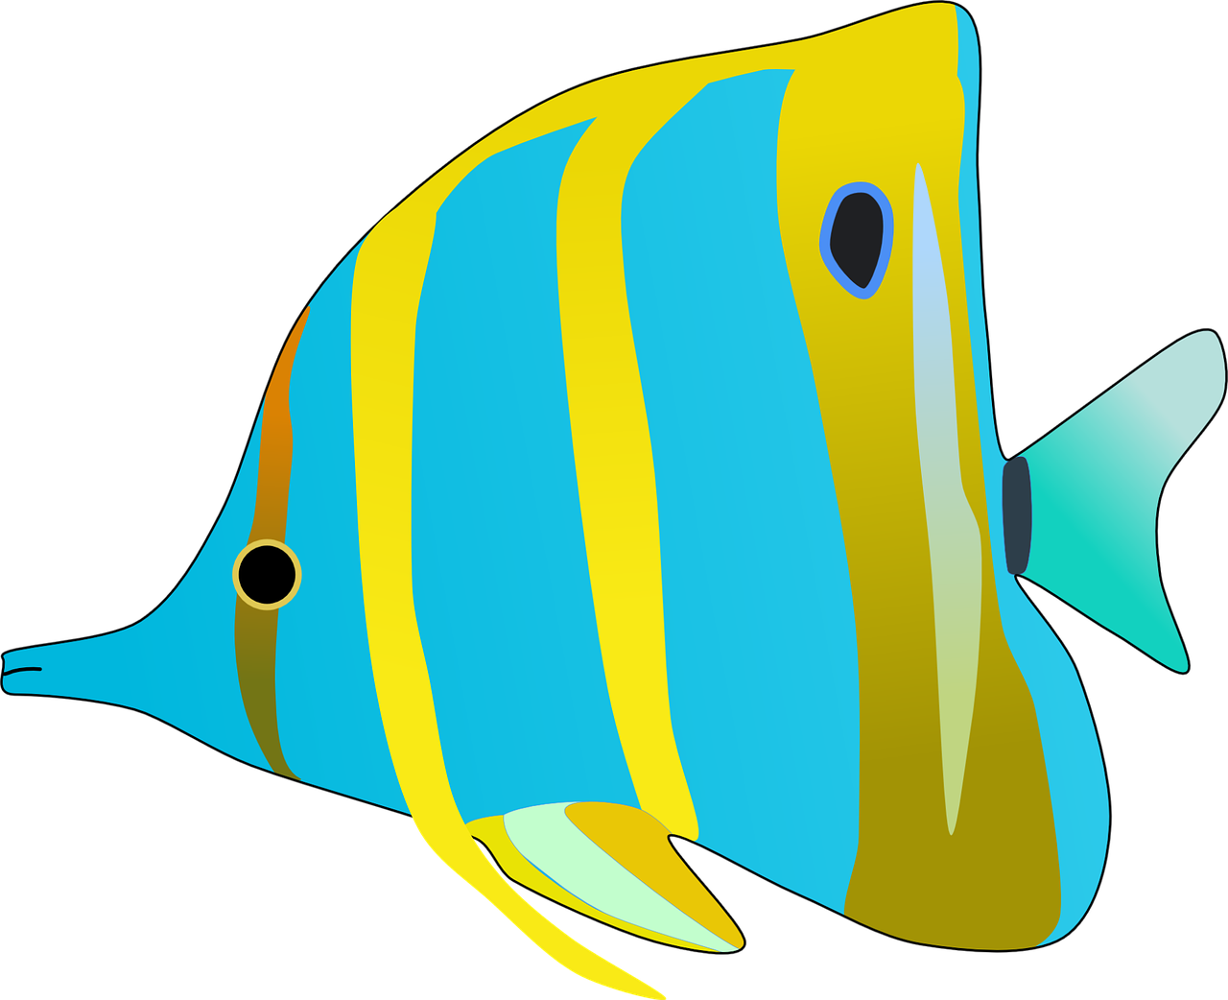
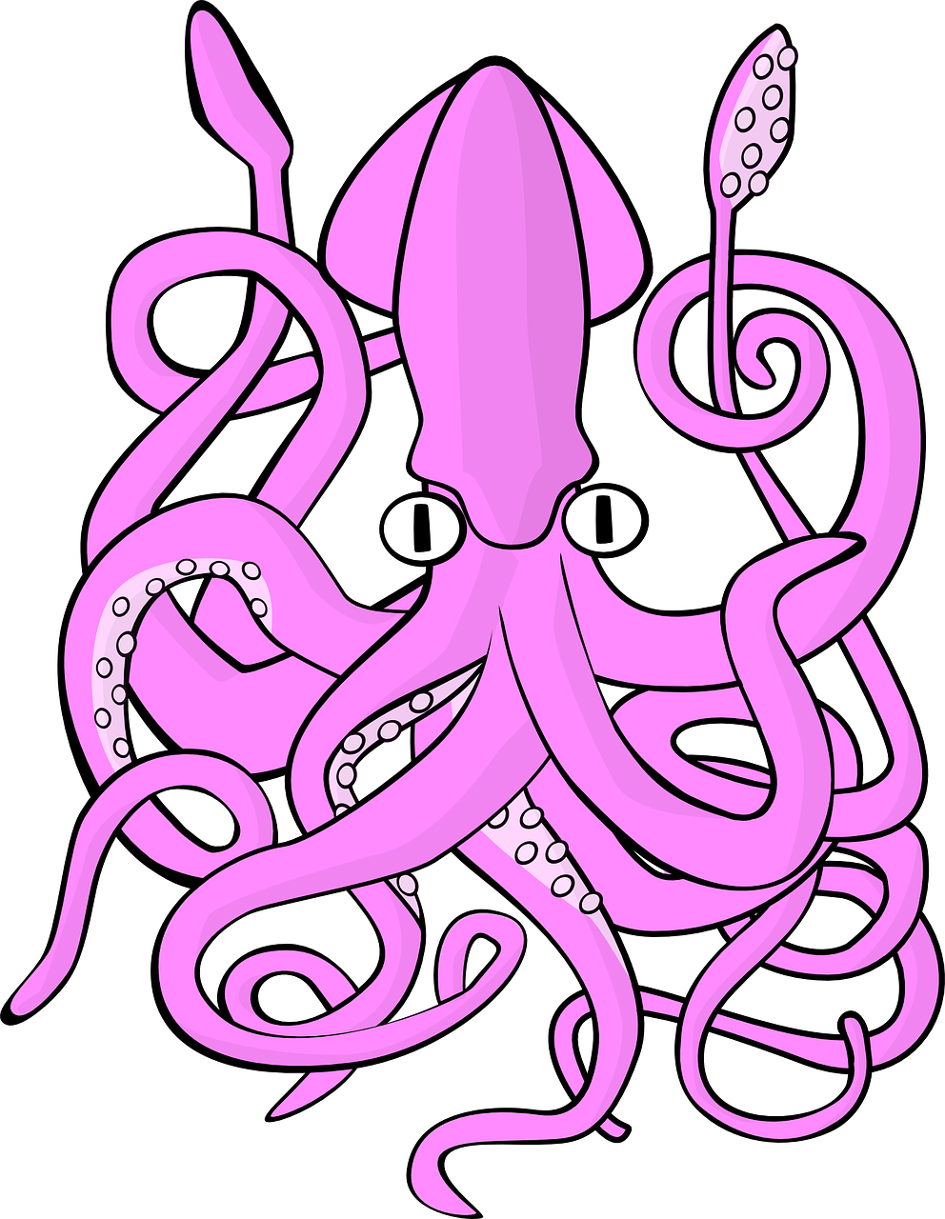
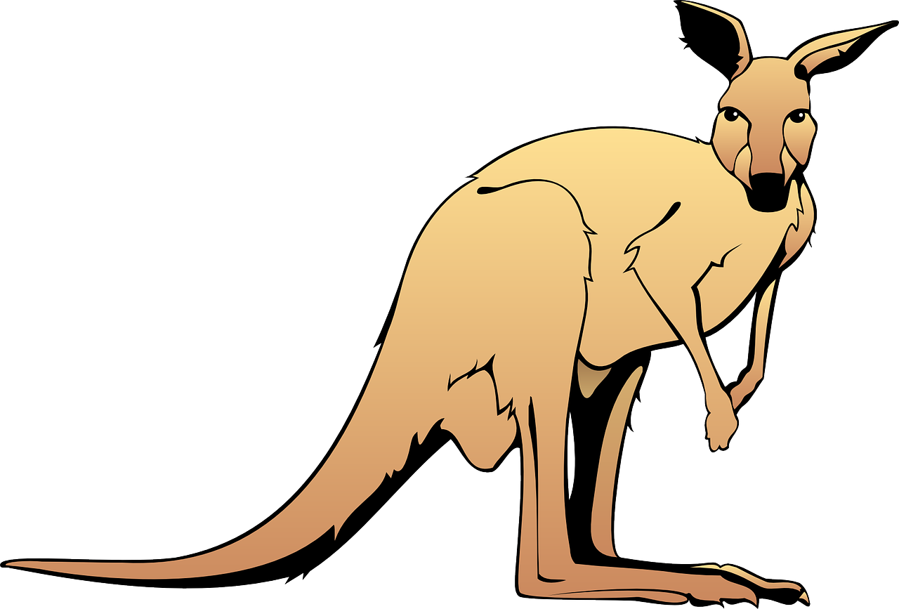
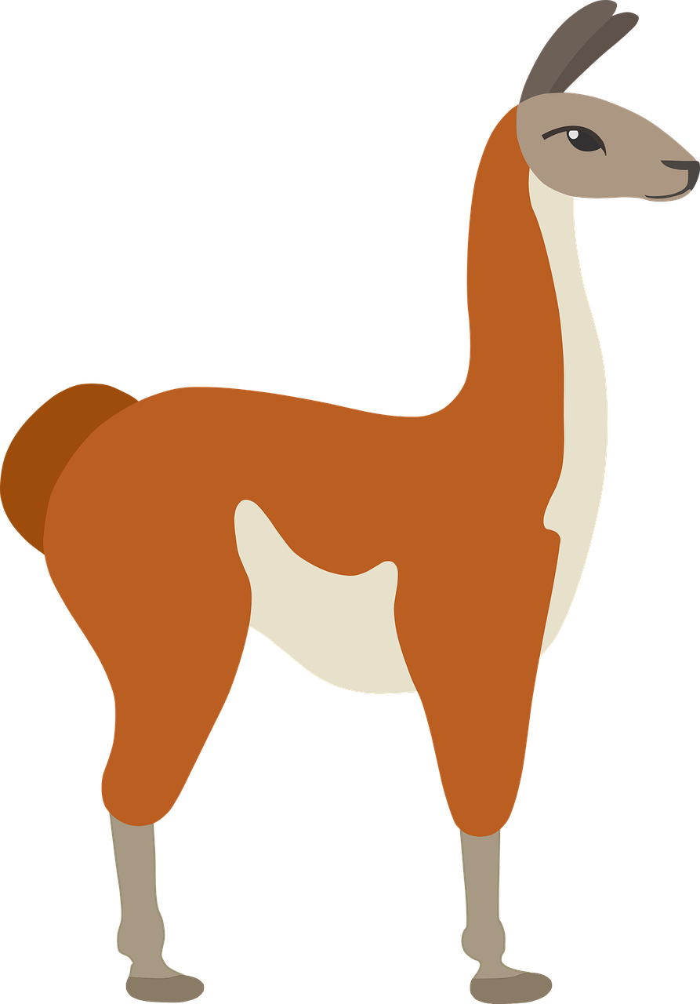
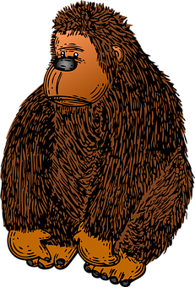
Follow up 1:
Describe la visita de Luis. ¿Qué ve?
prononcer
los gerbos
el pez ángel
la garza
el calamar gigante
el canguro
la iguana
el guanaco
la gorila
Notes:
Timing: 5 minutes
Aim: to practise read aloud of the SSC [ga] [go] [gu] [ge] and [gi].
Procedure:
Click to move the ‘pin’ to an animal enclosure. Pupils pronounce the animal that Luis is visiting.
Click on the animal word to listen and check, if required.
Continue until the pin arrives with the last item.
Transcript: la gorilla
el calamar gigante la iguana
el guanaco el pez ángel el canguro la garza
los gerbos

Slide 3
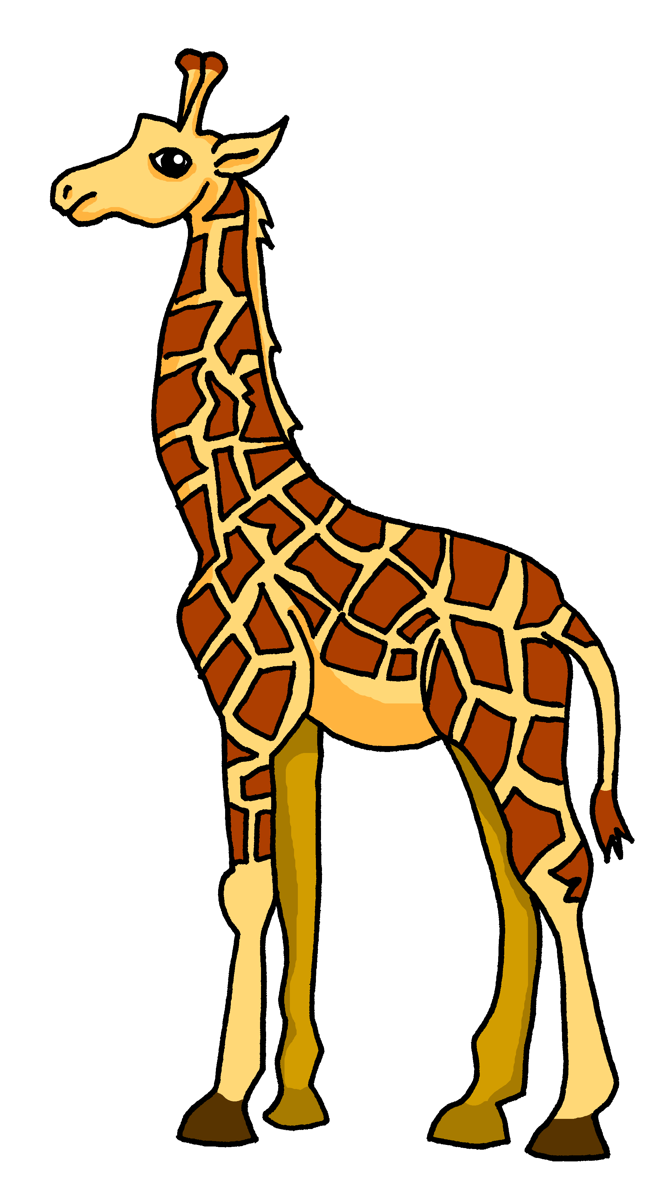
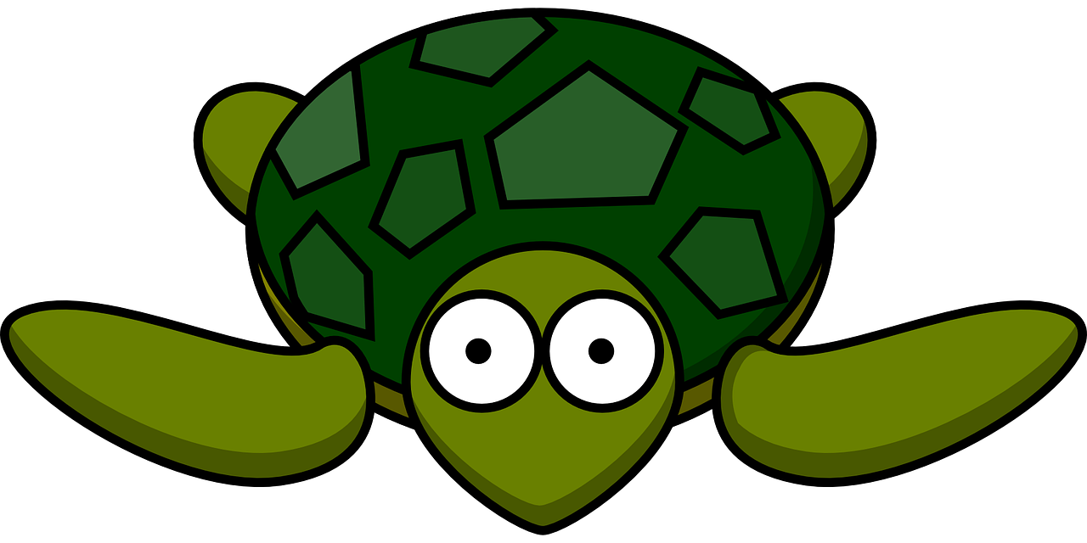
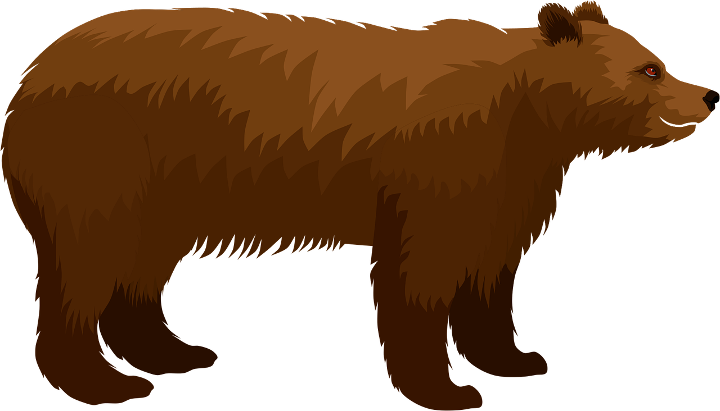
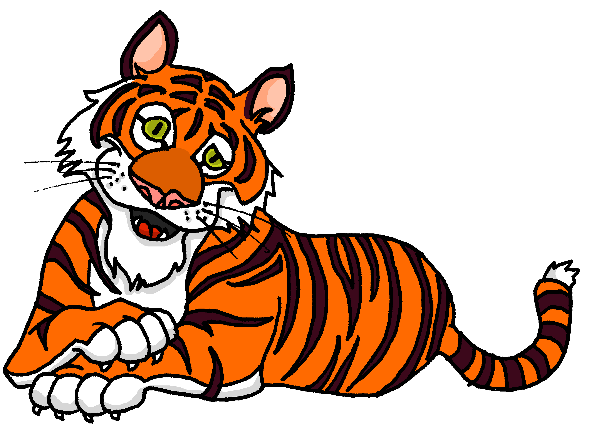
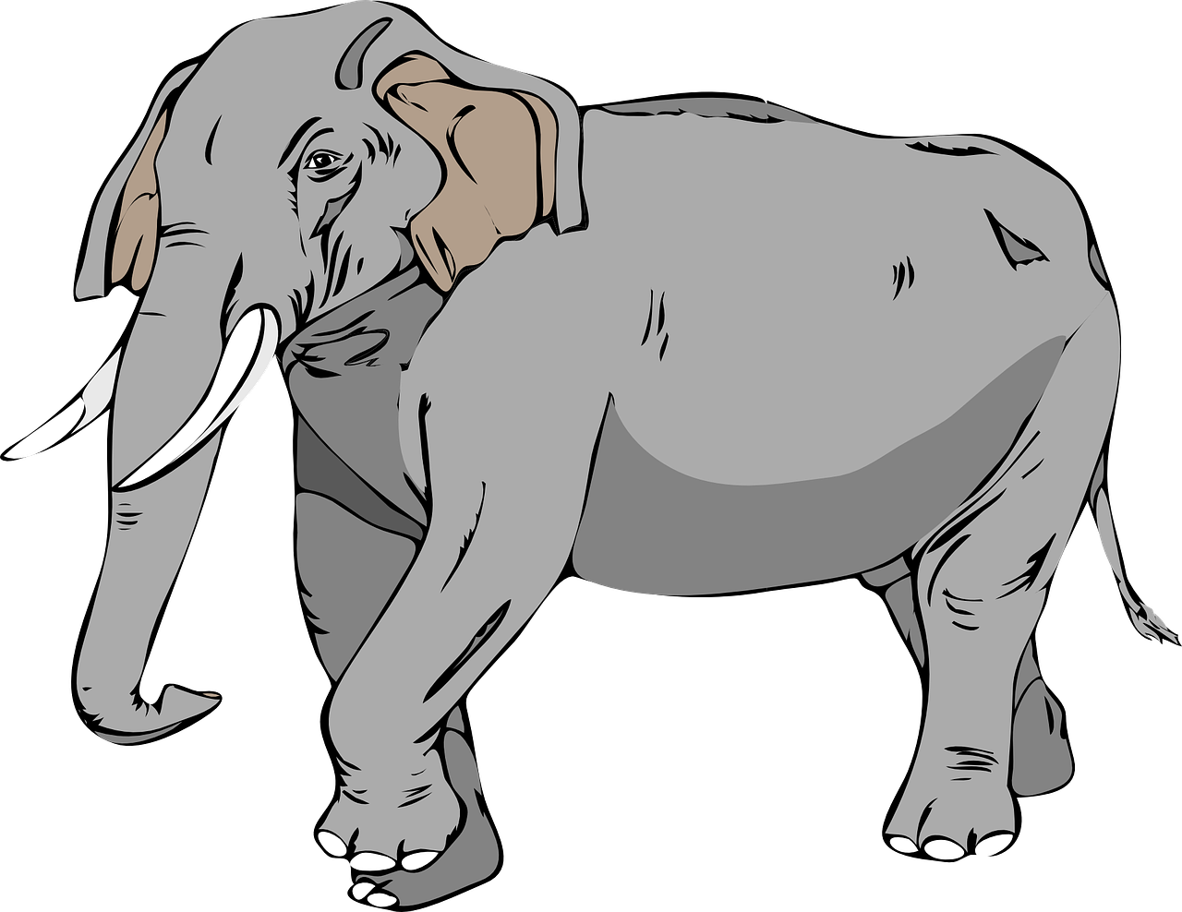
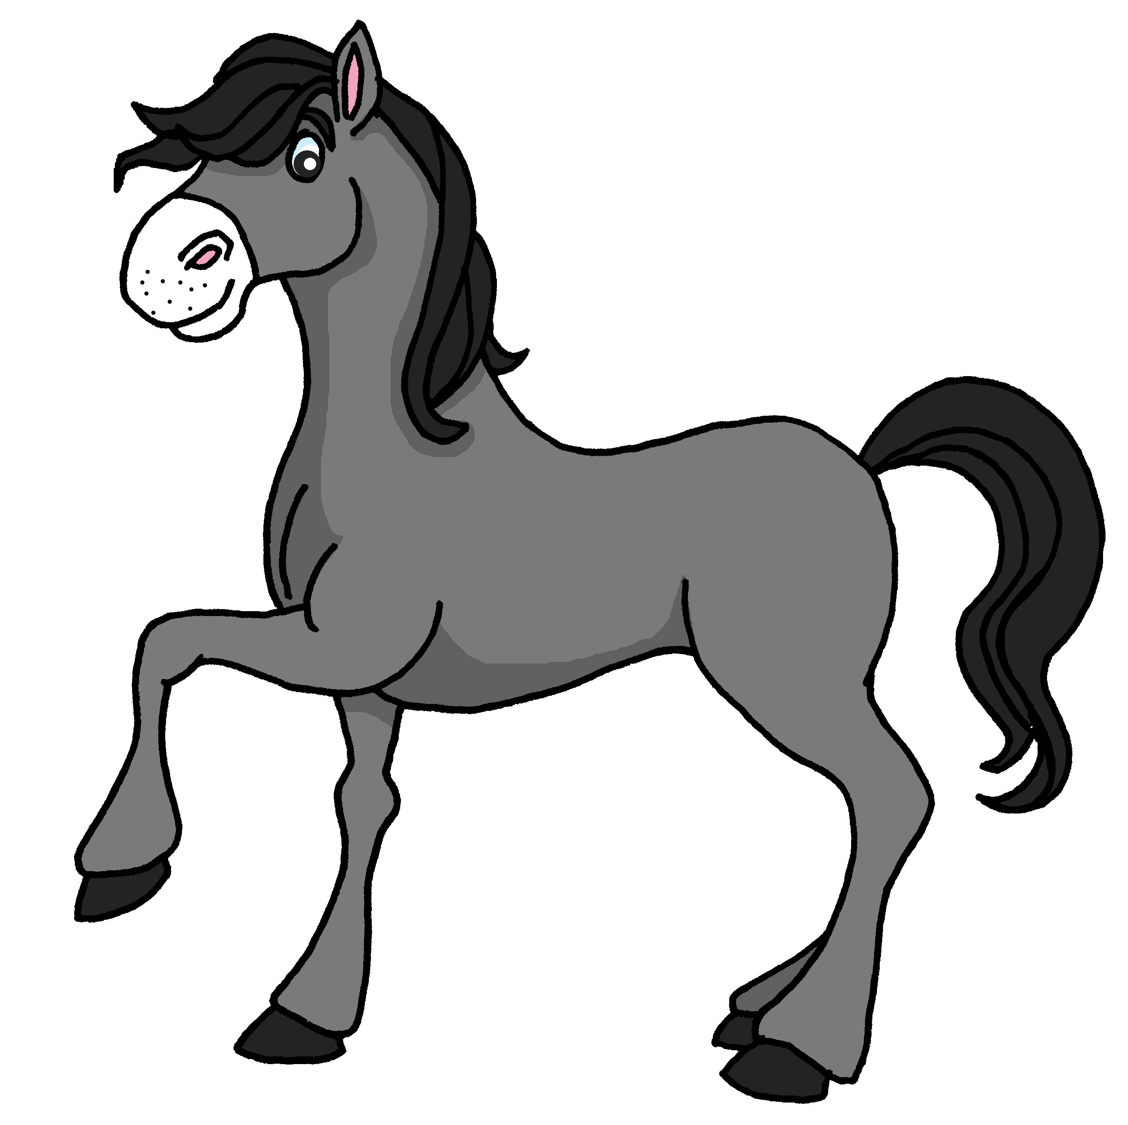
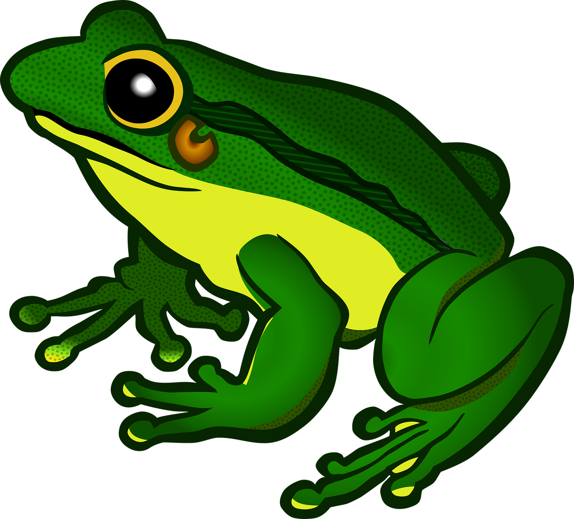
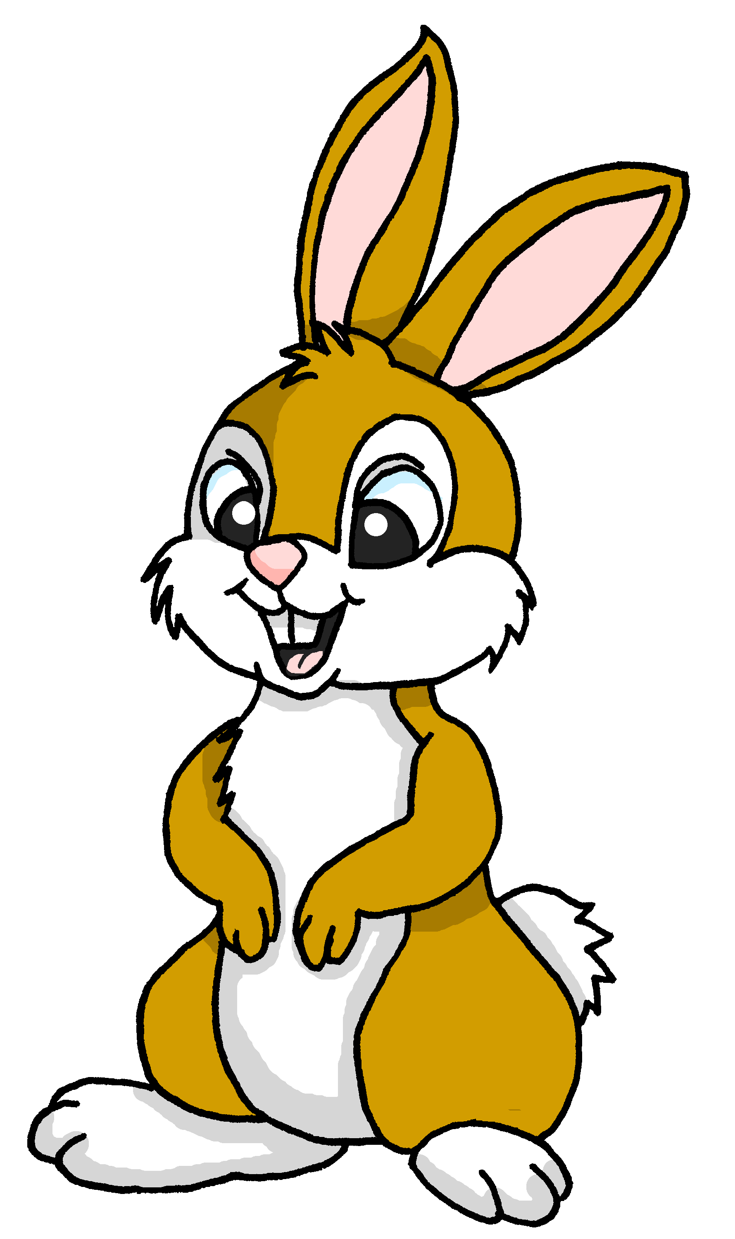
Follow up 2:
Escribe los adjetivos en español.
La jirafa es demasiado tranquila.
La tortuga es demasiado seria.
El oso es demasiado curioso.
El tigre es demasIado rápido y grande.
El elefante es demasiado lento.
El caballo es demasiado nervioso.
La rana es demasiado curiosa.
El conejo es perfecto.
[quiet, calm]
1
escribir
[serious]
Mi animal favorito es el conejo.
2
3
[curious]
4
[fast and big]
5
[slow]
6
[nervous]
7
[curious]
8
[perfect]
Notes:
Timing: 7 minutes
Aim: to practise written production of previously taught adjectives.
Procedure:
Remind pupils that Spanish adjectives sometimes change their endings to match the noun (in this case, the animal) that they describe, but that adjectives already ending in ‘e’ do not change.
Pupils might work on mini whiteboards to allow teachers to check answers one by one, providing feedback after each.
If pupils need more support with the task, teachers could move the English text boxes to the right to reveal the initial 1-2 letters of each adjective.
Elicit full sentences from pupils when checking answers (this could be done chorally) and if desired, click to hear each full sentence.
Clarify the meaning of Luis’s speech bubble and practise the pronunciation.
If time allows, ask pupils to tell you their favourite animal. Note: favorito is an adjective which will be formally introduced and practised in two weeks’ time.

Slide 4
Follow up 3
Vocabulario
¿Qué palabra es?
hablar
palabras
divertida
rápido
lento
amable
feliz
diferente
small (f)
kind, nice
fast
different
intelligent
perfect (f)
big (m, f)
slow
happy
yellow (m)
too
fun(ny) (f)
demasiado
amarillo
inteligente
perfecta
pequeña
grande
Notes:
Timing: 5 minutes
Aim: to practise key vocabulary (newly introduced this week and from previous weeks).
Procedure: 1. Click for an English word. Elicit Spanish translation from pupils.
2. Continue until the final word (demasiado) has been introduced. 3. Elicit choral pronunciation of all words again, clicking to provide an emphasis animation.

Slide 5
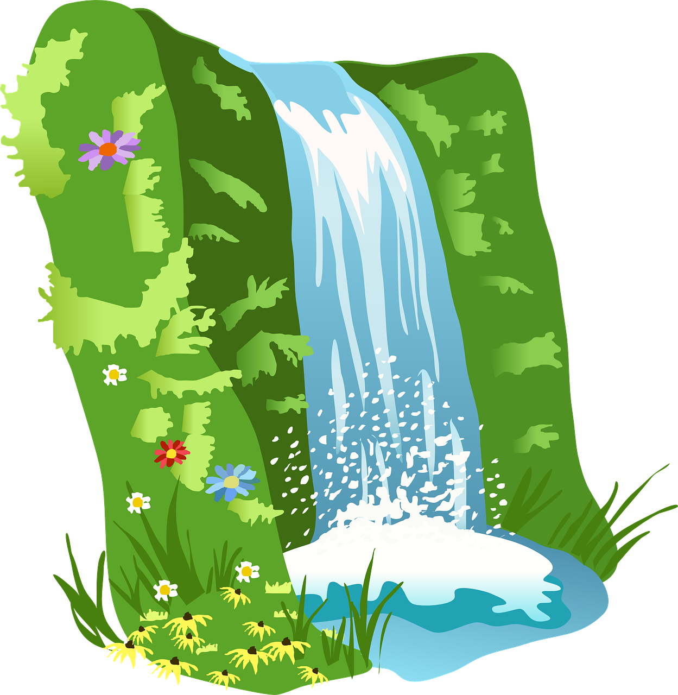
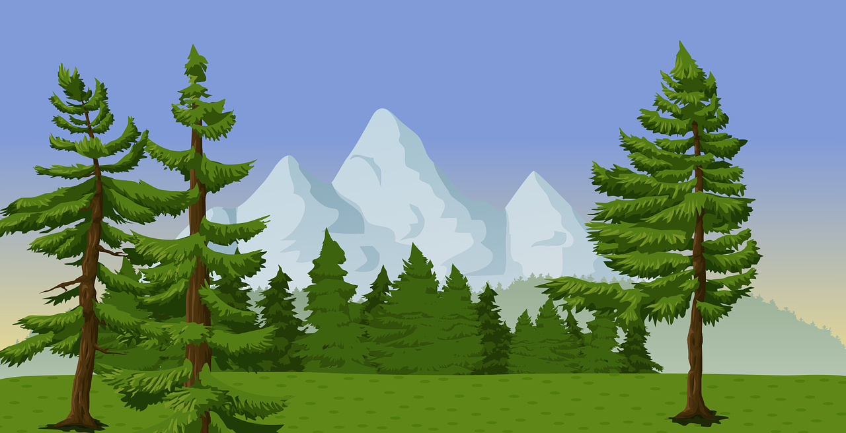
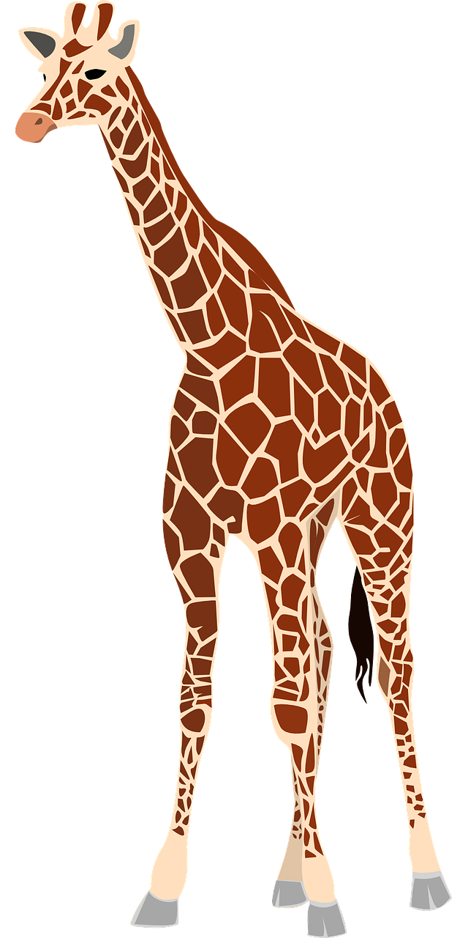
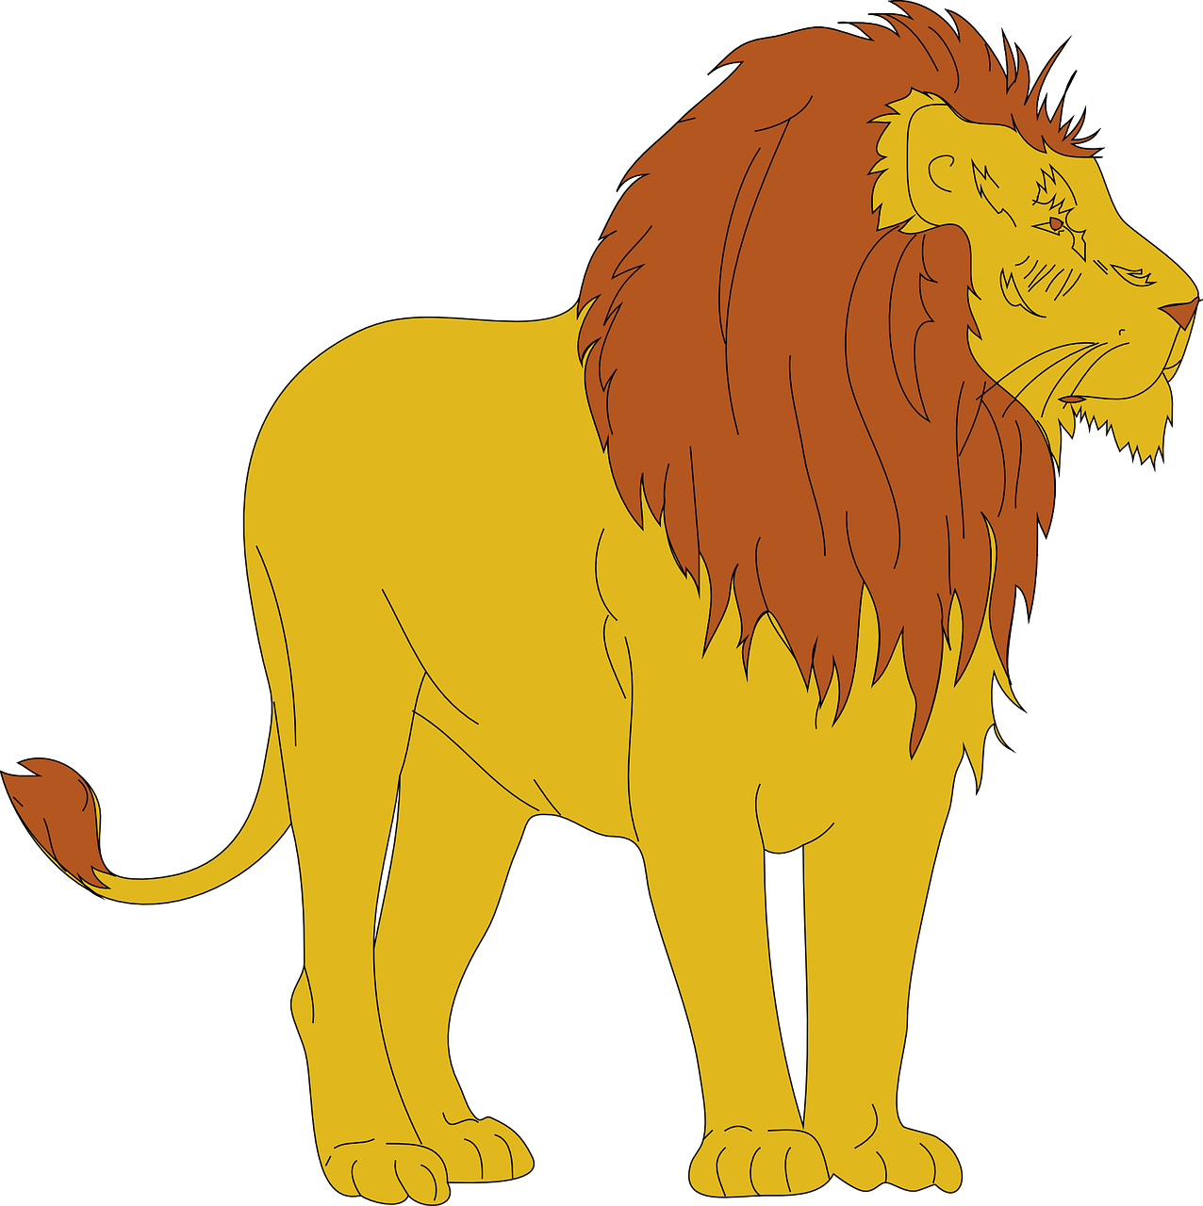
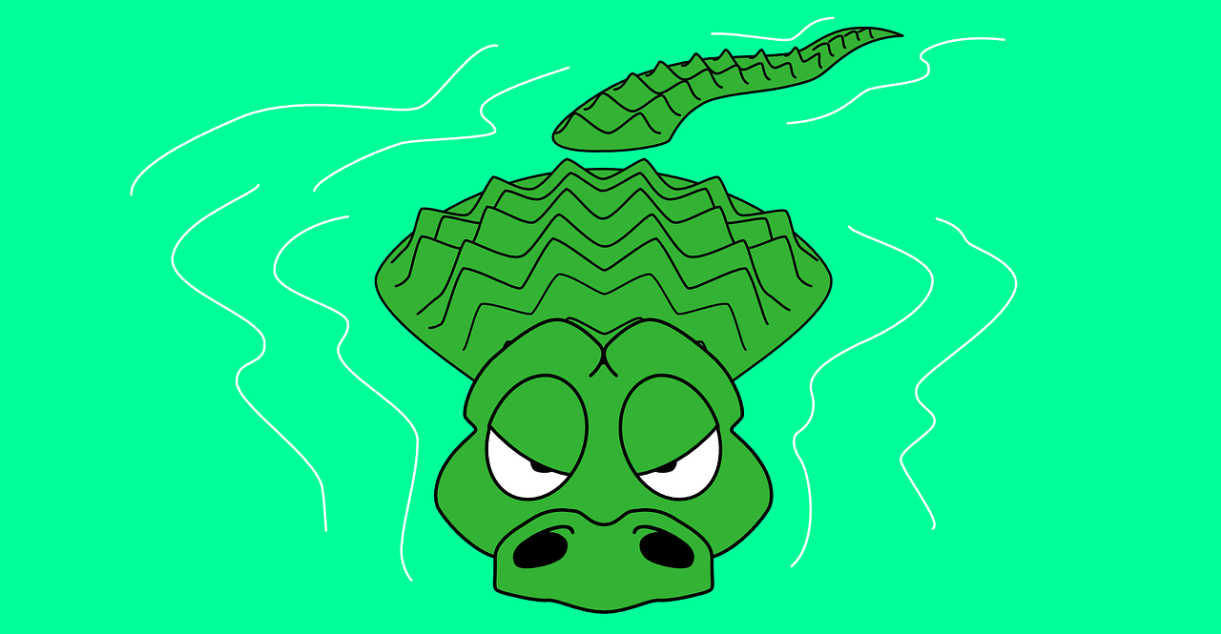
Follow up 4
Escribe una descripción.
escribir
montaña (nf) bosque (nm) – wood oso (nm) – bear
jungla (nf) – jungle catarata (nf) – waterfall cocodrilo (nm) – crocodile
jirafa (nf) – giraffe león (nm) – lion río (nm) – river
[article] [noun] [adjective],
[article] [noun] [adjective],
y en el medio, [article] [noun] [adjective]
Adjectives:
alto, amable, amarillo, azul, bajo, curioso, diferente, divertido, feliz, grande, inteligente, lento, nervioso, pequeño, perfecto, rápido, rojo, serio, tranquilo, triste,
Notes:
Timing: 5 minutes
Aim: to practise written production of previously taught adjectives.
Procedure:
Remind pupils that Spanish adjectives sometimes change their endings to match the noun that they describe, but that adjectives already ending in ‘e’ do not change.
Pupils select one of the pictures and write a description of the scene, using a similar pattern to the one they used last lesson with their poems.

Slide 6
follow up 5:

Escribe en inglés: can you get at least 15 points?
 | el mar | caminar | la playa
 | nadar | por | de
 | el globo | la fruta | la tortuga
 | la fruta | el sombrero | la pelota
 | amable | inteligente | divertida
 | diferente | demasiado | el conejo
vocabulario
(the) sea
to walk, walking
(the) beach
x3
to swim, swimming
through, around, along
from, of
(the) balloon
(the) fruit
(the) tortoise
x2
(the) fruit
(the) hat
(the) ball
nice, kind
intelligent
fun, funny
x1
different
too
(the) rabbit
Notes:
Timing: 5 minutes
Aim: to practise written production of vocabulary from this week and this week’s revisited sets.
Procedure: 1. Give pupils a blank grid. They fill in the English meanings of any of the words they know, trying to reach 15 points in total.
Note: The most recently learnt and practised words are pink, words from the first revisit are green and those from the second revisit are blue, thus more points are awarded for them, to recognise that memories fade and more effort (heavy lifting!) is needed to retrieve them.

Slide 7
follow up 5:

Escribe en español: can you get at least 15 points?
 | (the) beach | through, around, along | from, of
 | to walk, walking | to swim, swimming | (the) sea
 | (the) ball | (the) hat | (the) cake
 | (the) tortoise | (the) fruit | (the) balloon
 | different | too | nice, kind
 | (the) rabbit | fun, funny | intelligent
vocabulario
la playa
por
de
x3
caminar
nadar
el mar
la pelota
el sombrero
la tarta
x2
la tortuga
la fruta
el globo
diferente
demasiado
amable
x1
el conejo
divertido
inteligente
Notes:
Timing: 5 minutes
Aim: to practise written production of vocabulary from this week and this week’s revisited sets.
Procedure: 1. Give pupils a blank grid. They fill in the Spanish meanings of any of the words they know, trying to reach 15 points in total.
Note: The most recently learnt and practised words are pink, words from the first revisit are green and those from the second revisit are blue, thus more points are awarded for them, to recognise that memories fade and more effort (heavy lifting!) is needed to retrieve them.

Slide 8
¡adiós!
rojo

Slide 9
follow up 2b:

Handout 5
Escribe en inglés: can you get at least 15 points?
 | el mar | caminar | la playa
 | nadar | por | de
 | el globo | la fruta | la tortuga
 | la fruta | el sombrero | la pelota
 | amable | inteligente | divertida
 | diferente | demasiado | el conejo
vocabulario
x3
x2
x1
Notes:
HANDOUT 5

Slide 10
follow up 2b:

Handout 5
Escribe en español: can you get at least 15 points?
 | (the) beach | through, around, along | from, of
 | to walk, walking | to swim, swimming | (the) sea
 | (the) ball | (the) hat | (the) cake
 | (the) tortoise | (the) fruit | (the) balloon
 | different | too | nice, kind
 | (the) rabbit | fun, funny | intelligent
vocabulario
x3
x2
x1
Notes:
HANDOUT 5

