Slide 1

Describing things and people
rojo
Follow ups 1-5
Notes:
Artwork by Steve Clarke. All additional pictures selected are available under a Creative Commons license, no attribution required.
The frequency rankings for words that occur in this PowerPoint which have been previously introduced in the resources are given in the SOW (excel document) and in the resources that first introduced and formally re-visited those words.
For any other words that occur incidentally in this PowerPoint, frequency rankings will be provided in the notes field wherever possible.
SSC: Source: gesto [928] página [598]; Cluster: gemelo/a [>5000] genial [2890] colegio [628] imaginar [500]
Vocabulary (new words in bold): alto [231] azul [811] bajo [452] gris [1751] (revisit: amarillo, bonito, fantástico, pequeño, tranquilo, triste)
Revisit 1: hay [haber 13] unos [6] unas [6] cuántos [580] cuántas [580]
Revisit 2: llevar [101] comprar [361] película [944] sombrero [2290] uniforme [2796] con [14]
-
Glossed: añadir [1028] crecer [560] empezar [175] sembrar [2862] completar [2003] poema [1430] propio [183]

Slide 2
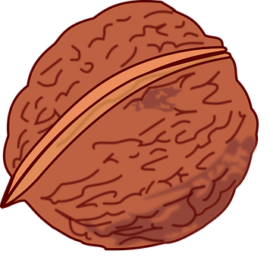






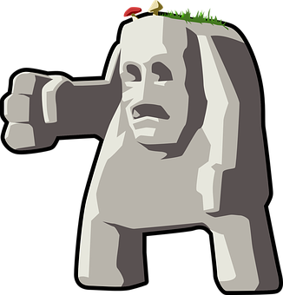

Follow up 1
[ge] [gi]
A Escucha. ¿Qué sonido es?
B ¡A cantar!
Marca
 | ge | gi
 |  |  | _ _ melo
 |  |  | _ _ nial
 |  |  | cole _ _ o
 |  |  | ima _ _ nar
 |  |  | _ _ rasol
 |  |  | _ _ rminar
E
ge
1
ge
2
gi
3
gi
4
gi
5
ge
gente
girasol
germinar
gigante
sembrar = to plant | empezar = to start
crecer = grow
Notes:
Timing: 5 minutes
Aim: to develop phonological awareness of [ge] [gi]
Procedure:
Click to bring up the instruction.
Click to bring up the table and do example together (E).
Students tick and/or write the correct sound [ge] [gi] – they may also challenge themselves to write the whole word.
4. Click to bring up Part B and read instructions. The video includes lyrics to follow along to – there are some unknown words but there are many examples of the [ge] and [gi] sounds to join in with and lots of repetition.
Transcript
[EJ] gemelo
[1] genial
[2] colegio
[3] imaginar
[4] girasol
[5] germinar
https://www.youtube.com/watch?v=r6VNcdPZaX0&ab_channel=123Andr%C3%A9s
© 123 Andrés. All rights reserved.

Slide 3


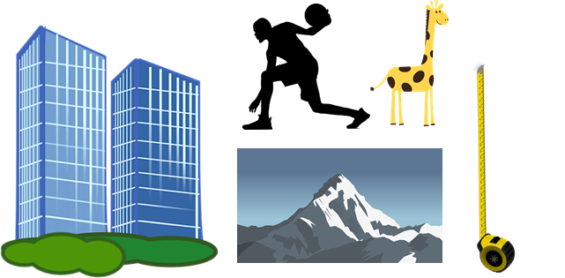

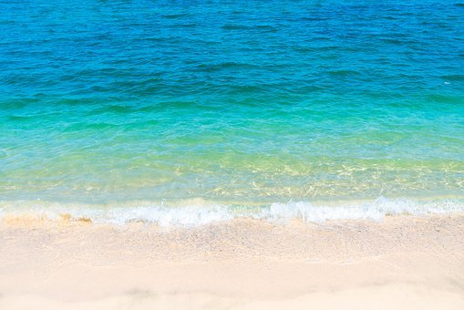


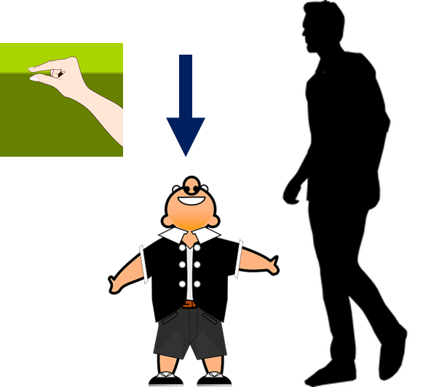
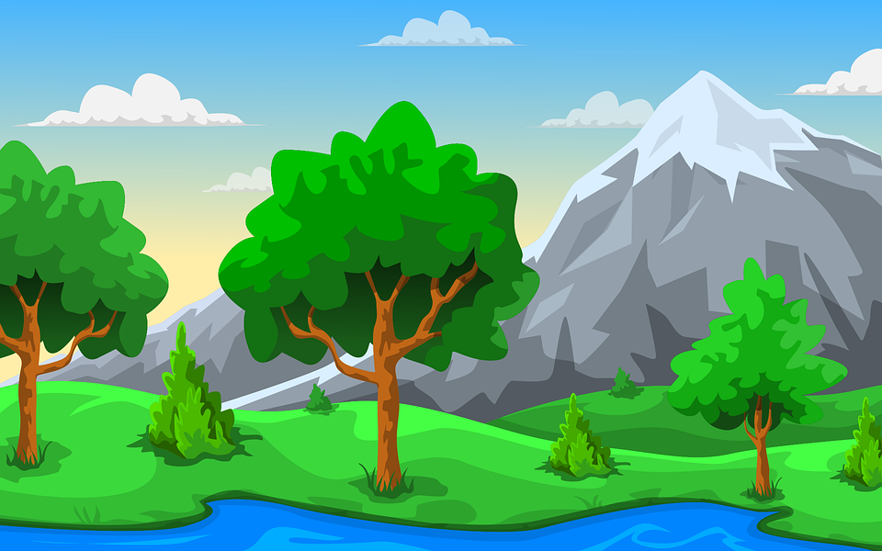
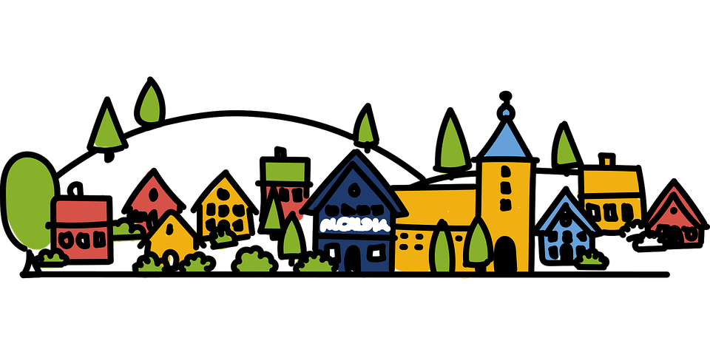
Follow up 2:
¿Qué palabra es?
zula
palabras
sol
alto
azul
hablar
ols
toal
[below]
[above]
arriba
abajo
barria
baajo
gris
rgis
mar
joro
ram
rojo
cielo
locie
[middle]
bajo
joba
medio
diome
montaña
amarillo
pueblo
ñatamon
rialloma
blopue
Notes:
Timing: 5 minutes (this slide has more support – see the next slide for a more challenging alternative)
Aim: to practise key vocabulary (newly introduced this week and from previous weeks).
Procedure:
1. Pupils work in pairs to put the syllables in the correct order.
2. Teacher elicits answers from pupils. Answers appear on clicking the picture.
For a more challenging version see next slide.

Slide 4
Follow up 2:
azul
sol
_ z _ _
hablar
palabras
s _ _
alto
a _ _ _ (m)
[below]
[above]
a _ _ _ b_
abajo
arriba
a _ _ j _
gris
rgis
m _ _
joro
mar
rojo
cielo
c _ _ l _
[middle]
bajo
b _ _ _ (m)
m _ d_ _
medio
m _ _ t _ _ _
amarillo
pueblo
montaña
a _ _ r_ ll _
p _ _ b_ _
Notes:
Timing: 5 minutes (this is the more challenging version of the activity)
Aim: to practise key vocabulary (newly introduced this week and from previous weeks).
Procedure:
1. Pupils work in pairs to produce all of the words orally.
2. Teacher elicits answers from pupils. Answer appear on click the picture.

Slide 5


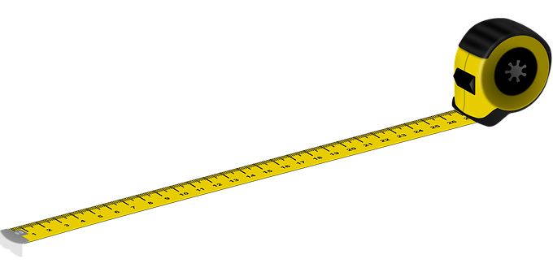

Adjectives following the noun
In English the adjective comes before the noun.
We have already learnt that many adjectives follow the noun:
un sol amarillo
una montaña alta
a yellow sun
a tall mountain
⚠ Remember, adjectives change depending on whether the noun (person, animal, place or thing) they describe is masculine or feminine.
When an adjective ends in –e or consonant, it can describe a feminine or masculine noun.
una montaña gris
un mar azul
a grey mountain
a blue sea
Notes:
REMINDER SLIDE BEFORE FOLLOW UP 3
Timing: 2 minutes
Aim: to revisit post-nominal adjective agreement.
Procedure:
Click through the animations to present the new information.
Elicit English translations for the Spanish examples provided.

Slide 6


Follow up 3:
Añade detalles a los poemas.
pequeño
escribir
leer
El sol _____________ arriba,
la nube _____________ abajo,
y, en el medio, el trigo _____________
y un espantapájaros _____________.
[small]
gris
[grey]
tranquilo | tranquila
alto | alta
bajo | baja
redondo | redonda
azul | gris
rojo | roja
amarillo | amarilla
bonito | bonita
fantástico | fantástica
pequeño | pequeña
triste
feliz
amarillo
[yellow]
triste
[sad]
bonita
La nieve _____________ ,
el frío _____________,
y, en el medio, un río _____________.
[pretty]
azul
[blue]
tranquilo
[calm]
alto
El sol _____________ arriba
el mar _____________ abajo
y, en el medio,
un barco _____________.
[tall]
rojo
[red]
feliz
[happy]
(el) poema = poem
añadir = to add
Notes:
Timing: 5 minutes
Aim: to practise key vocabulary (positions and nouns) & adjectival agreement.
Procedure:
1. Pupils use the list of adjectives and select the correct form (masculine / feminine).
2. For additional challenge, remove the adjectives box or cover most/some of the words, a needed.
3. Click the green audio buttons to listen and check each verse, and click to bring up the written answers.
añadir [1028]

Slide 7
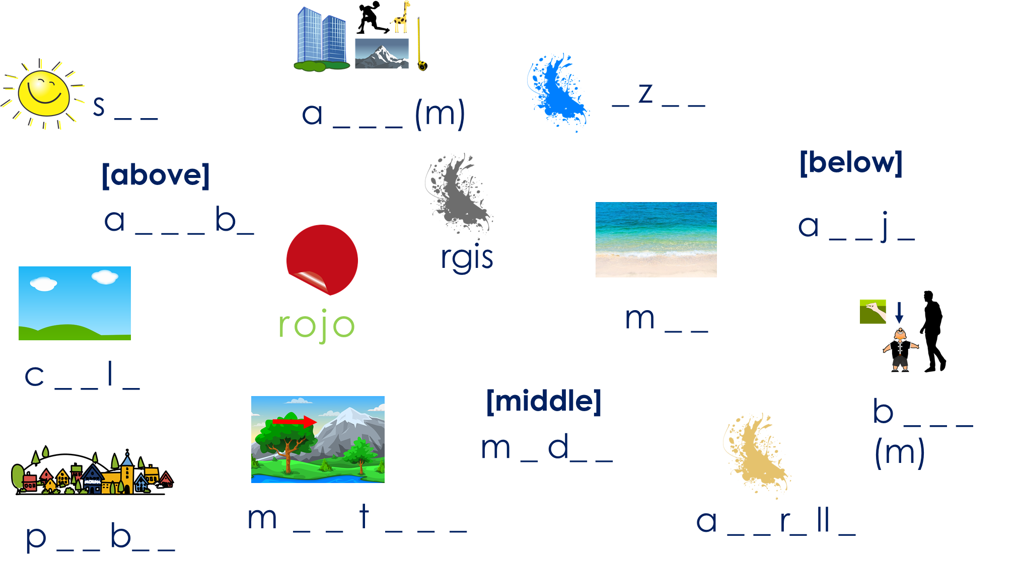

Follow up 4:
completar = to complete
(el) poema = poem
propio = own (m)
Parte 1: Crea tu propio poema.
escribir
_________ [adjective] [position],
_________ [adjective] [position],
y, [position], un _________[adjective]
Other masculine nouns:
sombrero, uniforme, juego, pelota, queso, globo, estuche, amigo
Other feminine nouns:
fruta, pelota, película, tarta, botella, amiga, bicicleta, cámara
Adjectives:
feliz, elegante, pequeño/a, bonito/a, amarillo/a, fantástico/a, redondo/a
Parte 2: Dibuja tu poema.
Notes:
Timing: 5 minutes
Aim: guided written production of pupil’s own poem.
Procedure:
For part 1, pupils can use the frame provided (or the poems used in the lessons) to write their own poem, including adjectives.
Pupils to draw their poem. This would do a very nice display!
completar [2003] poema [1430] propio [183]

Slide 8
Follow up 5: handout
Parte 1: Crea tu propio poema.
Parte 1: Crea tu propio poema.
_________ [adjective] [position],
_________ [adjective] [position],
y, [position], un _________[adjective].
_________ [adjective] [position],
_________ [adjective] [position],
y, [position], un _________[adjective].
_________ _____________ ______________,
_________ _____________ _____________,
y, _____________, un _________ _____________.
_________ _____________ ______________,
_________ _____________ _____________,
y, _____________, un _________ _____________.
Parte 2: Dibuja tu poema.
Parte 2: Dibuja tu poema.
Notes:
Handout

Slide 9



follow up 5:

Escribe en español: can you get at least 15 points?
 | (the) hat | (the) uniform | with
 | to wear, carry | to buy, buying | (the) film
 | how many? (mpl) | how many? (fpl) | calm
 | there is/are | some (mpl) | some (fpl)
 | grey | yellow | pretty
 | tall | blue | short
vocabulario
el sombrero
el uniforme
con
x3
llevar
comprar
la película
¿cuántos?
¿cuántas?
tranquilo
x2
hay
unos
unas
gris
amarillo
bonito
x1
alto
azul
bajo
Notes:
Timing: 5 minutes
Aim: to practise written production of vocabulary from this week and this week’s revisited sets.
Procedure:
1. Give pupils a blank grid. They fill in the Spanish meanings of any of the words they know, trying to reach 15 points in total.
Note:
The most recently learnt and practised words are pink, words from the first revisit are green and those from the second revisit are blue, thus more points are awarded for them, to recognise that memories fade and more effort (heavy lifting!) is needed to retrieve them.

Slide 10
follow up 2b:

Handout 5
Escribe en español: can you get at least 15 points?
 | (the) hat | (the) uniform | with
 | to wear, carry | to buy, buying | (the) film
 | how many? (mpl) | how many? (fpl) | calm
 | there is/are | some (mpl) | some (fpl)
 | grey | yellow | pretty
 | tall | blue | short
vocabulario
x3
x2
x1
Notes:
HANDOUT 5

Slide 11
¡adiós!
rojo

