Slide 1
español, con Sofía

Slide 2
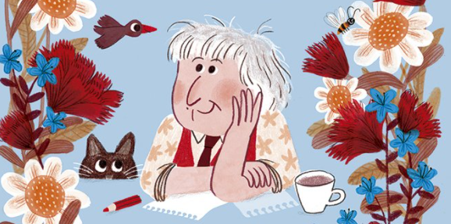
Describing things and people
rojo
Notes:
Artwork by Steve Clarke. All additional pictures selected are available under a Creative Commons license, no attribution required.
The frequency rankings for words that occur in this PowerPoint which have been previously introduced in the resources are given in the SOW (excel document) and in the resources that first introduced and formally re-visited those words.
For any other words that occur incidentally in this PowerPoint, frequency rankings will be provided in the notes field wherever possible.
SSC: [j] ojo [169] rojo [534] pájaro [1607] jueves [1650] jirafa [>5000]
Vocabulary: cielo [620] medio [395] sol [383] arriba [690] abajo [788]
Revisit 1: un [6] dos [64] tres [134] cuatro [241] cinco [284] seis [438] siete [603] ocho [641] nueve [991] diez [449] once [1701] doce [1138]
Revisit 2: cantar [717] escuchar [281] hablar [90] necesitar [276] español [262] frase [1037] inglés [583] fantástico [2501] importante [171] normal [1000]
Glossed: poetisa [>5000] poema [1430]
Source: Davies, M. & Davies, K. (2018). A frequency dictionary of Spanish: Core vocabulary for learners (2nd ed.). Routledge: London
Marta Altés, ‘El libro de Gloria Fuertes para niñas y niños’, Blackie Books. https://blackiebooks.org/catalogo/el-libro-de-gloria-fuertes-para-ninas-y-ninos/

Slide 3
[j]
ojo
pronunciar
Notes:
Timing: 1 minute
Aim: To introduce SSC [j]
Procedure:
Introduce and elicit the pronunciation of the individual SSC [j] and then the source word ‘ojo’ (with gesture, if using).
Click to bring the picture and get pupils to repeat (with gesture, if using).
Pupils to practise in pairs.
Gesture suggestion: point at your eye

Slide 4
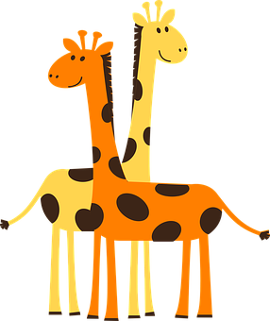
pronunciar
¡A practicar!
rojo
jueves
45 segundos
pájaro
Thurs
cangrejo
conejo
jirafas
INICIO
Notes:
Timing: 2 minutes
Aim: to practise reading aloud [j] in mainly unknown words (pictures provided to support meaning).
Procedure:
Read the explanation and ensure pupils understand the task.
Start the timer.
Pupils do whole-class choral practice, i.e. all speaking simultaneously.

Slide 5
Leer y hablar
Gloria Fuertes: Unos poemas
(el) poema = poems
(la) poetisa = female poet
leer
El título es ‘Paisajes para que los pintes’.
En inglés el título es ‘Landscapes for you to paint.’.
Gloria Fuertes es una poetisa de España.
Notes:
Timing: 2 minutes
Aim: To reintroduce ‘Gloria Fuertes’, the author of the poems, and the name of the collection of poems.
Procedure:
Teachers click to present the information.

Slide 6
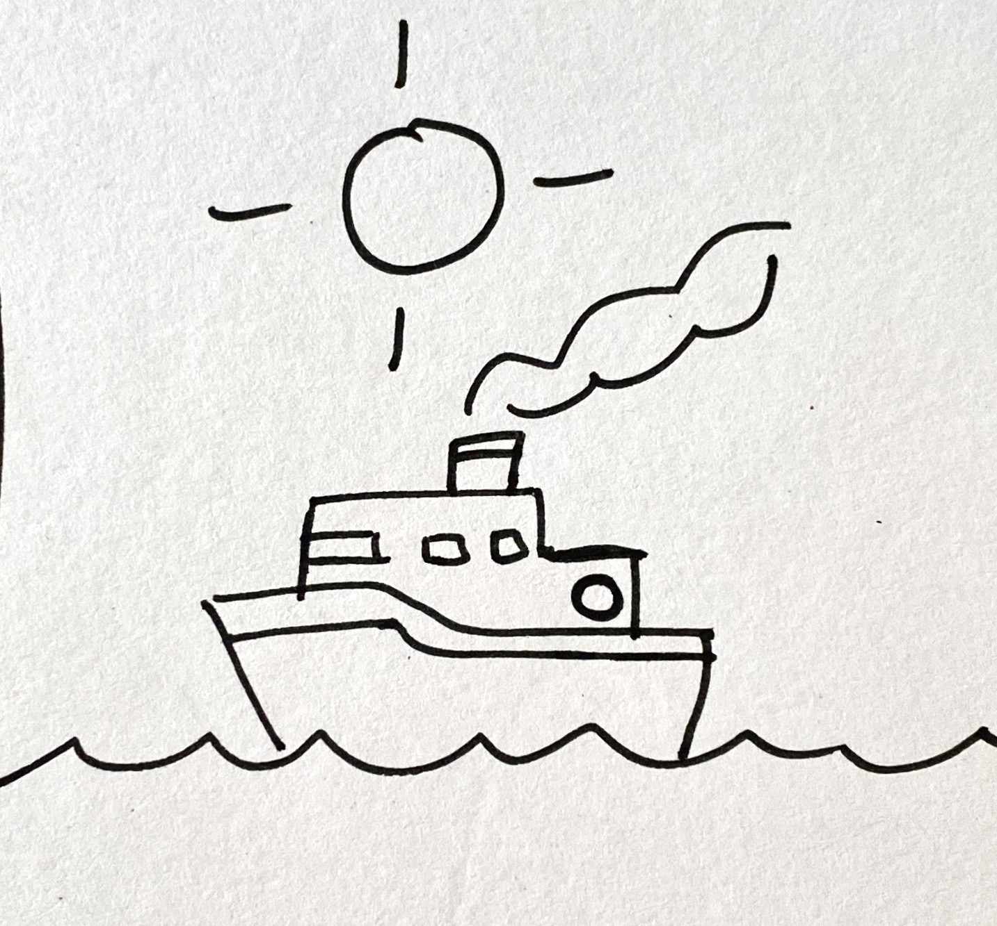
Leer y hablar
Lee el poema. [1/2]
vocabulario
leer
El sol arriba
El mar abajo
y, en el medio,
un barco.
below
sun
a boat
above
middle
sea
abajo
el sol
un barco
arriba
el medio
el mar
Notes:
Timing: 10 minutes (two slides)
Aim: to introduce vocabulary with a longer text; to introduce two of the short poems. [2 slides]
Procedure:
Click to hear the short poem. Pupils follow along with the text.
Give pupils 2-3 minutes with a partner to find the Spanish meanings for the 6 English words.
Elicit Spanish responses chorally, prompting with the English, e.g., ‘sun?’ ‘sol’, muy bien. ☺ Note: click on each English word to reveal the Spanish translation.
Pupils could be asked to read the text aloud in pairs, taking it in turns to read alternate sentences.
Click the audio player to hear the full text again, if desired.
Move to the next slide, and repeat steps 1-5.
Frequency of unknown words and cognates: barco [1384]
Source: Davies, M. & Davies, K. (2018). A frequency dictionary of Spanish: Core vocabulary for learners (2nd ed.). Routledge: London

Slide 7
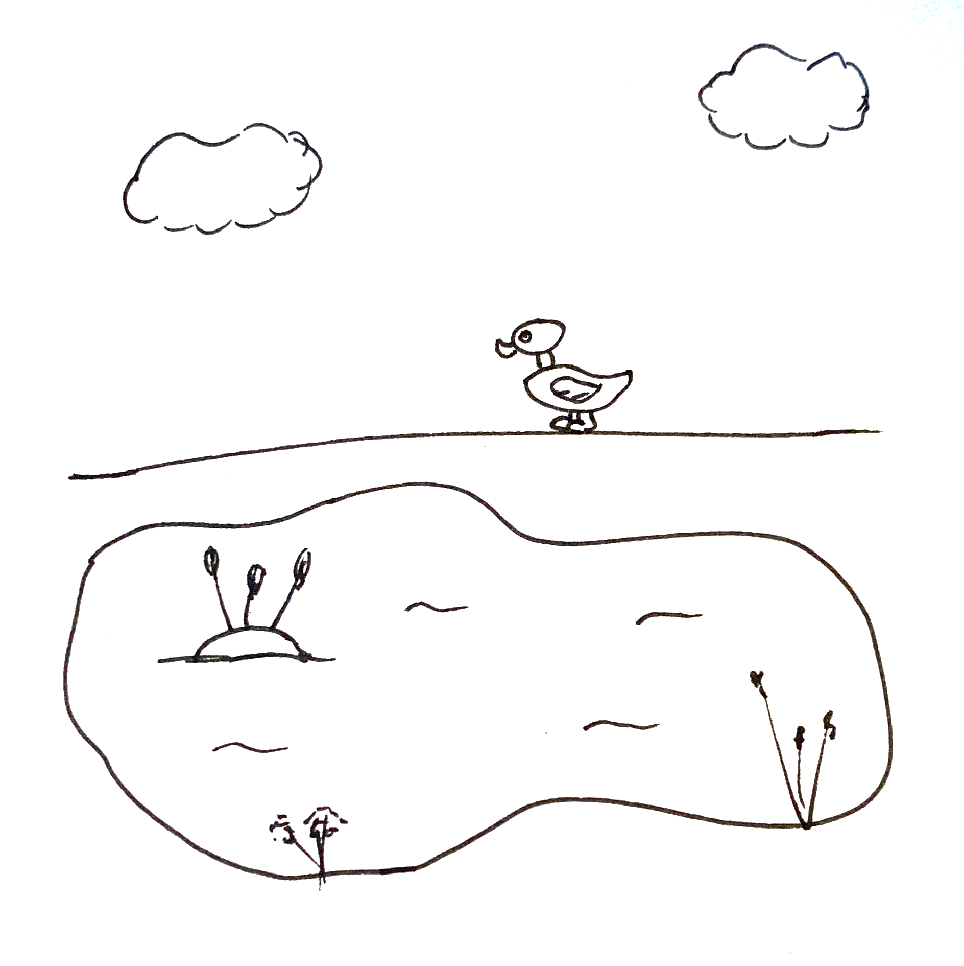
Leer y hablar
Lee el poema. [2/2]
vocabulario
leer
El cielo arriba
El lago abajo
y, en el medio,
un pato.
middle
sky
a duck
above
lake
el medio
el cielo
un pato
arriba
el lago
Notes:
Procedure:
Click to hear the short poem. Pupils follow along with the text.
Give pupils 2-3 minutes with a partner to find the Spanish meanings for the 6 English words.
Elicit Spanish responses chorally, prompting with the English, e.g., ‘sun?’ ‘sol’, muy bien. ☺ Note: click on each English word to reveal the Spanish translation.
Pupils could be asked to read the text aloud in pairs, taking it in turns to read alternate sentences.
Click the poem text to hear the full text again, if desired.
Frequency of unknown words and cognates: pato [4857]
Source: Davies, M. & Davies, K. (2018). A frequency dictionary of Spanish: Core vocabulary for learners (2nd ed.). Routledge: London

Slide 8
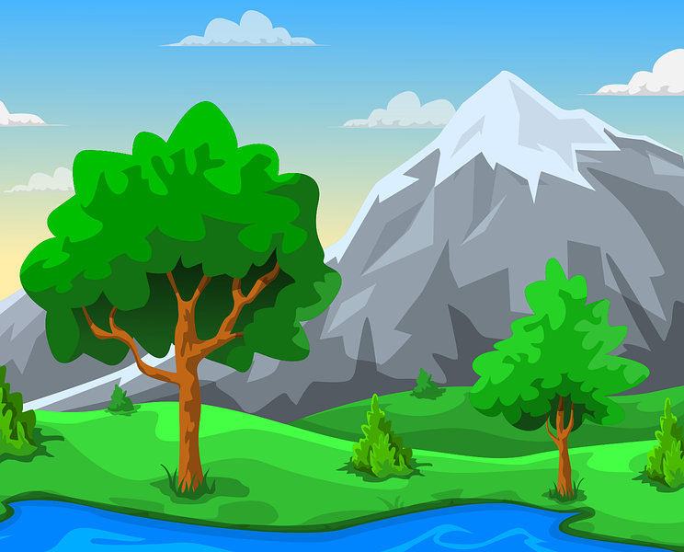
Definite and indefinite articles
[‘a/an & ‘the’]
We have learned that to say a (or an) in Spanish before a noun, you use un or una, depending on whether the noun is masculine or feminine.
Many masculine nouns in –o whereas feminine nouns often end in –a.
To say the before a singular noun, you use ‘el’ or ‘la’.
Masculine
Feminine
un
el
sol
una
montaña
a sun
la
the sun
a mountain
the mountain
un
el
cielo
a beach
a sky
the beach
the sky
una
playa
la
Notes:
Timing: 4 minutes
Aim: to revisit and contrast definite and indefinite articles.
Procedure:
Present the reminder about indefinite articles.
Click to present two masculine nouns and elicit the indefinite article and then the English meanings.
Click to present two feminine nouns and elicit the indefinite article and then the English meanings.
Click to bring up the reminder about definite article.
Repeat steps 2 and 3.
Click to bring up the callout about masculine and feminine noun endings.

Slide 9
escuchar
el verso = verse
Escucha el verso.
¿Menciona un / una, o ‘el / la?
Marca
¿Dónde está?
Marca
 | a/an | the
Escribe✍
above | below | in the middle
E
parque
E
1
pueblo
1
2
playa
2
3
mar
3
4
sol
4
5
montaña
5
Notes:
Timing: 7 minutes
Aim: to practise aural recognition of definite vs. indefinite article and 3 newly introduced vocab items (arriba, abajo, medio); to practise transcription of previously introduced nouns.
Procedure:
Read the title and click to bring up the instructions in Spanish.
Do the example (E) and encourage pupils to write down the Spanish word second time they listen to it.
Click to bring up answers.
Click to bring up part two. This time pupils will hear the noun accompanied by the position (arriba, abajo, medio). They need to identify which one is mentioned for each verse.
Click to bring up answers. Elicit Spanish word from pupils for further practice.
Transcript 1:
E. El parque
1. Un pueblo
2. La playa
3. El mar
4. Un sol
5. Una montaña
Transcript 2:
E. El parque abajo
Un pueblo en el medio
La playa abajo
El mar en el medio
Un sol arriba
Una montaña abajo

Slide 10
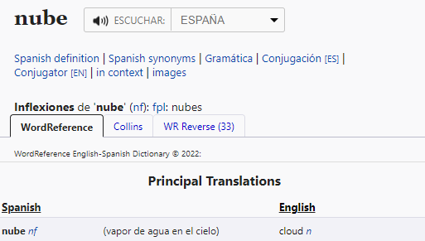
Using reference materials
[understanding symbols]
All dictionaries have symbols with useful information about the type of word, (e.g., noun, adjective) and noun gender (masculine or feminine).
www.wordreference.com
n = noun
m = masculine
f = feminine
Nouns that end in –e could be masculine or feminine, so let’s use a dictionary to figure out the gender.
This can help us find out the grammatical gender of a noun.
feminine
______ nube [the cloud]
la
Ejemplo: nube
una
______ nube [a cloud]
Notes:
Timing: 3 minutes
Aim: to introduce pupils to reference skills – understanding codes in a dictionary in order to find out the gender of a noun.
Procedure:
1. Teachers click to present the information on the slide.
2. Pupils can volunteer the articles.

Slide 11
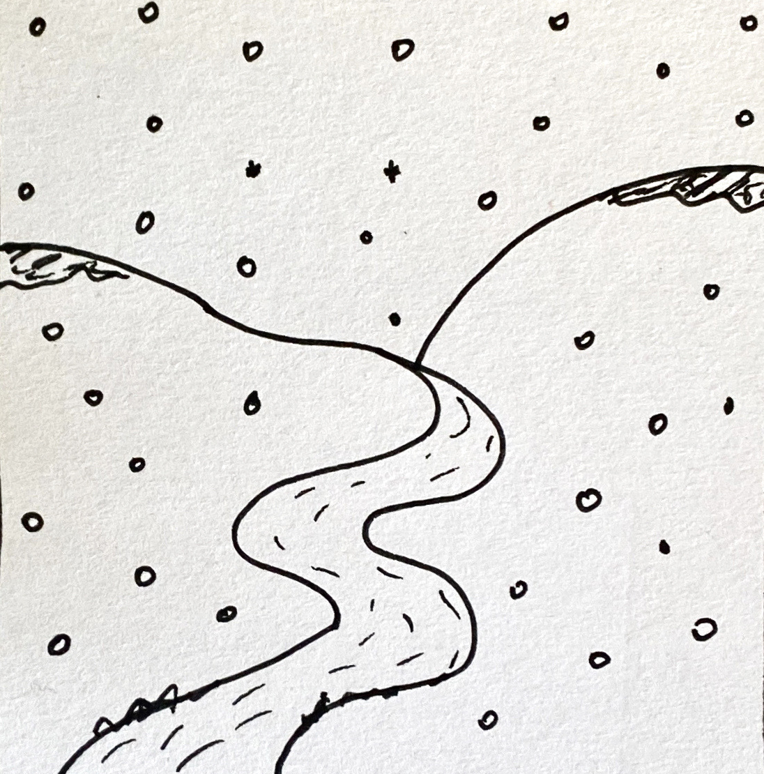
Leer y hablar
Lee el poema: ¿Qué artículo es? [1/4]
el | la
un | una
hablar
leer
frío (nm) = cold
nieve (nf) = snow
río (nm) = river
____ nieve,
____ frío,
y, en el medio, ___ río.
la
[the snow]
el
[the cold]
el
[and, in the middle, the river]
Notes:
Timing: 7 minutes [4 slides]
Aim: To use gender codes in order to be able to use the correct definite and indefinite articles with unknown nouns.
Procedure:
Teachers read the instruction and clarify the meaning of artículo.
Teachers draw pupils’ attention to the codes for each of the nouns (frío, nieve, río).
3. Pupils work in pairs to read the poem aloud, selecting the correct translation for ‘the’ or ‘a/an’.
4. Teacher elicits answers from pupils.
5. Click the picture to hear the full text for the poem, if desired.
6. Pupils can read aloud again (whole class) to practise SSC knowledge, time allowing.

Slide 12
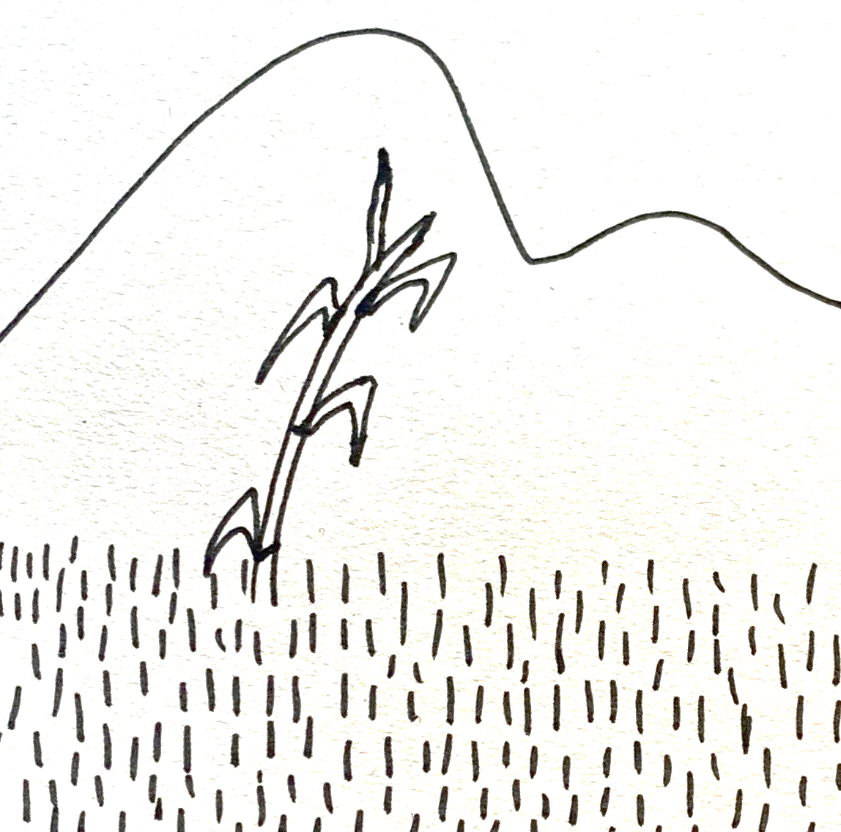
Leer y hablar
Lee el poema: ¿Qué artículo es? [2/4]
el | la
un | una
hablar
leer
caña (nf) = cane
prado (nm) = meadow
____ prado,
____ montaña,
y, en el medio, ___ caña.
el
[the meadow]
la
[the mountain]
una
[and, in the middle, a cane]
Notes:
[2/4]

Slide 13
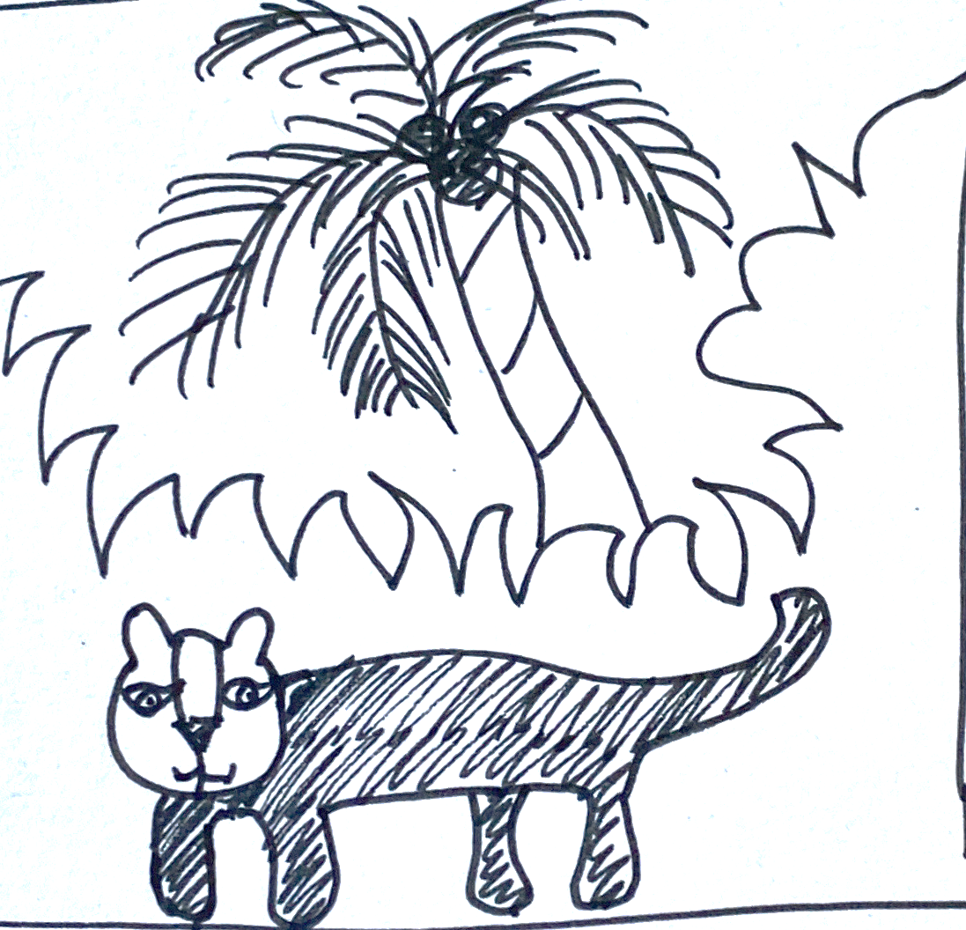
Leer y hablar
Lee el poema: ¿Qué artículo es? [3/4]
el | la
un | una
hablar
leer
palmera (nf) = palm tree
pantera (nf) = panther
selva (nm) = jungle
la
[the jungle
____ selva,
___ palmera,
y, en medio, ___ pantera.
la
[the palm tree]
una
middle
[and, in the _______, a panther]
Notes:
[3/4]

Slide 14
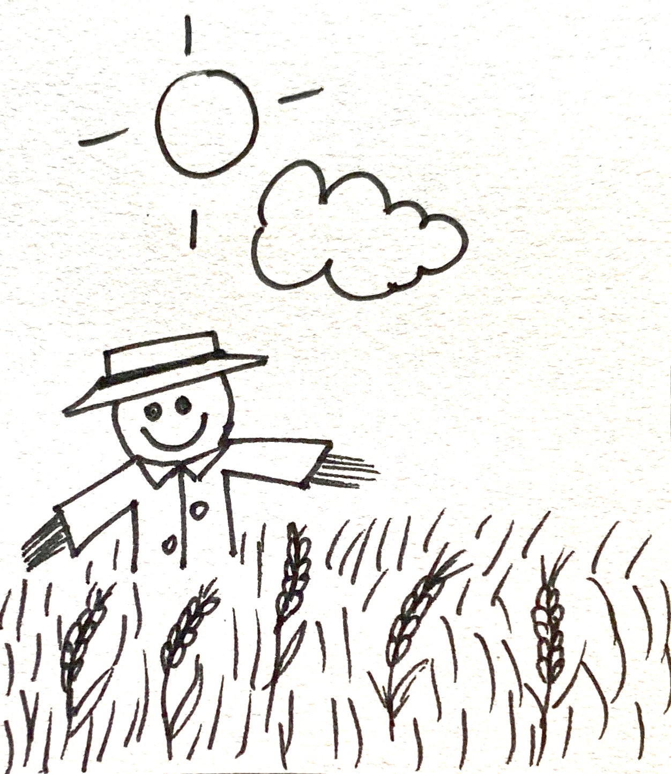
Leer y hablar
Lee el poema: ¿Qué artículo es? [4/4]
el | la
un | una
hablar
leer
espantapájaros (nm)
= scarecrow
nube (nf) = cloud
trigo (nm) = wheat
el
[the meadow _______]
____ sol arriba,
___ nube abajo,
y, en el medio, ___ trigo
y ____ espantapájaros.
above
la
below
[the cloud _______]
el
middle
[and, in the _______, the wheat]
un
[and a scarecrow]
Notes:
[4/4]

Slide 15
¡adiós!
rojo

