Slide 1
Una historia
rojo
Follow ups 1-5
Term 3 Week 13
Notes:
Artwork by Steve Clarke. All additional pictures selected are available under a Creative Commons license, no attribution required.
The frequency rankings for words that occur in this PowerPoint which have been previously introduced in the resources are given in the SOW (excel document) and in the resources that first introduced and formally re-visited those words.
For any other words that occur incidentally in this PowerPoint, frequency rankings will be provided in the notes field wherever possible.
Phonics:
Glossed:
escoger [1918]
Source: Davies, M. & Davies, K. (2018). A frequency dictionary of Spanish: Core vocabulary for learners (2nd ed.). Routledge: London

Slide 2
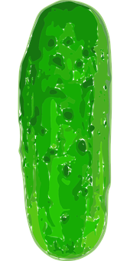
Follow up 1:
¿Cuántas cosas hay?
una
magdalena
Hay …
leer
hablar
dos
pepinillos
tres
piruletas
magdalena
cuatro
salchichas
pepinillo
cinco
helados
piruleta
seis
magdalenas
salchicha
siete
pepinillos
helado
ocho
piruletas
nueve
salchichas
diez
helados
Notes:
Timing: 5 minutes
Aim: guided production of numbers with the vocabulary for the week.
Procedure:
Elicit the number and the food items from pupils, ensuring the use the plural form.

Slide 3
Follow up 2:
Escribe el número y la comida.
escribir
+
=
cuatro
magdalenas
magdalena
+
=
ocho
piruletas
pepinillo
piruleta
=
salchicha
-
siete
pepinillos
helado
=
once
salchichas
+
helados
=
doce
+
+
Notes:
Timing: 5 minutes
Aim: written production of numbers with the vocabulary for the week.
Procedure:
Pupils do the sum and write down the number and fruit; ensure pupils use the plural form.

Slide 4
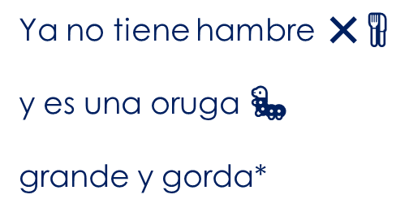
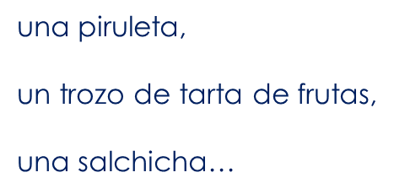
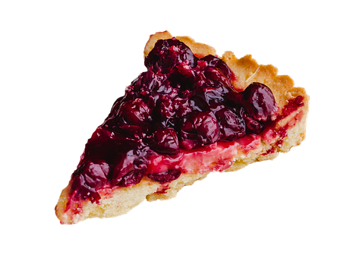
Follow up 3 :
Lee a tu compañero/a.
Tu compañero/a escoge la imagen.
leer
hablar
Es…
A
B
B
A
escoge = s/he chooses
Notes:
Timing: 5 minutes
Aim: Further practice of SSC knowledge and comprehension of key vocabulary introduced this week. Listening to parts of the story told by a partner.
Procedure:
Pupils could work in pairs or groups.
Hand out a set of cards and ask pupils to take turns to read a scene from the story. Partner B chooses the card that goes with the scene and then they swap roles.
escoger [1918]

Slide 5
¡adiós!
rojo

Slide 7
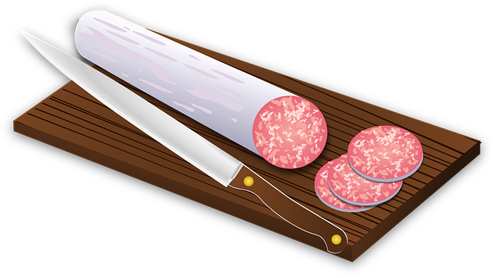

Slide 8
Estoy mejor 😌.

Slide 9
El sábado come un trozo de pastel , un helado, un pepinillo… | una loncha de queso, una loncha de salchichón… | una piruleta, un trozo de tarta de frutas, una salchicha… | una magdalena, y un trozo de sandía.
Tiene dolor* de barriga* 🤢. . | Al día siguiente* la oruga 🐛 come una hoja verde 🍃 y se siente* mejor* 😌 . | Ya no tiene hambre ❌🍴 y es una oruga 🐛 grande y gorda* | Ahora es… una mariposa 🦋 hermosa*.

