Slide 1

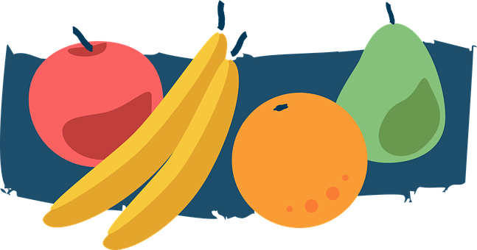

Una historia
rojo
Follow ups 1-5
Term 3 Week 12
Notes:
Artwork by Steve Clarke. All additional pictures selected are available under a Creative Commons license, no attribution required.
The frequency rankings for words that occur in this PowerPoint which have been previously introduced in the resources are given in the SOW (excel document) and in the resources that first introduced and formally re-visited those words.
For any other words that occur incidentally in this PowerPoint, frequency rankings will be provided in the notes field wherever possible.
Phonics:
Glossed:
escoger [1918]
Source: Davies, M. & Davies, K. (2018). A frequency dictionary of Spanish: Core vocabulary for learners (2nd ed.). Routledge: London

Slide 2









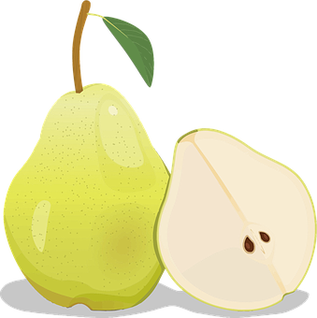



Follow up 1:
¿Cuántas frutas hay?
una
manzana
Hay …
leer
hablar
dos
peras
tres
ciruelas
manzana
cuatro
fresas
ciruela
cinco
naranjas
pera
seis
manzanas
fresa
siete
peras
naranja
ocho
ciruelas
nueve
fresas
diez
naranjas
Notes:
Timing: 5 minutes
Aim: guided production of numbers with the vocabulary for the week.
Procedure:
Elicit the number and the fruit from pupils, ensuring the use of the plural form.

Slide 3

Follow up 2:
Escribe el número y la fruta.
escribir
+
=
seis
manzanas
manzana
+
=
ciruela
siete
peras
pera
fresa
+
=
nueve
ciruelas
naranja
+
=
diez
fresas
+
+
=
doce
naranjas
Notes:
Timing: 5 minutes
Aim: written production of numbers with the vocabulary for the week.
Procedure:
Pupils do the sum and write down the number and fruit; ensure pupils use the plural form.

Slide 4
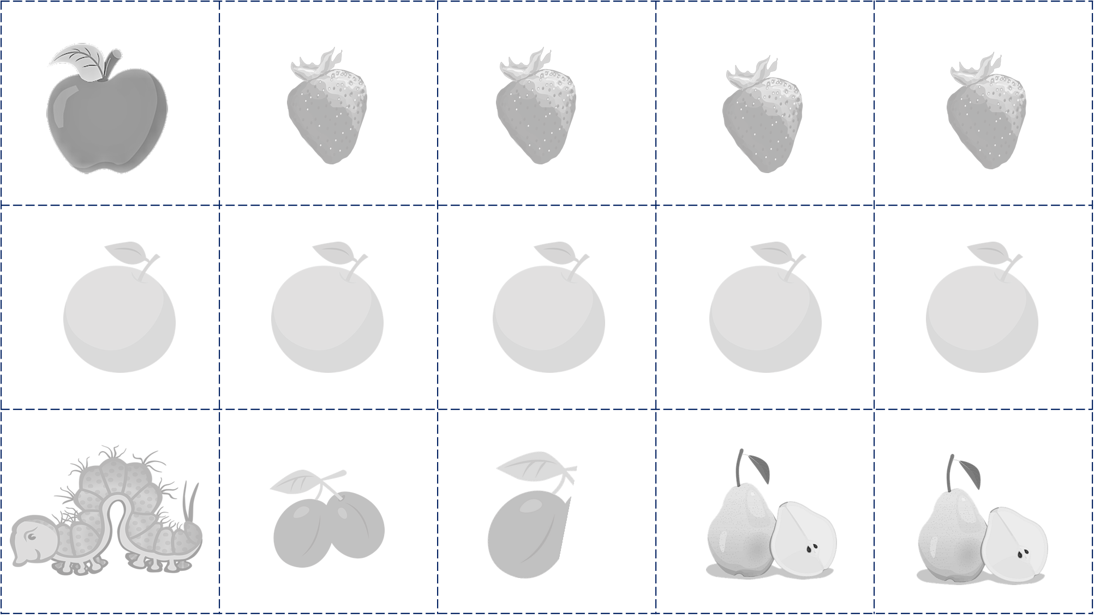
Follow up 3:
Practica el cuento.
hablar
lunes
martes
miércoles
jueves
viernes
manzana
ciruela
pera
fresa
naranja
escoge = s/he chooses
Notes:
Timing: 5 minutes
Aim: to practise days of the week and the vocabulary introduced this week.
Procedure:
Pupils could work in pairs or groups.
Hand out a set of cards and ask pupils to take turns to turns to say sentences practising the vocabulary (some could be encouraged to add adjectives to their sentences so that they get practise agreement of adjectives of colour).
NB. Pupils could colour these in and write sentences in preparation or after the speaking activity.

Slide 5

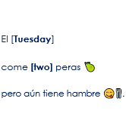
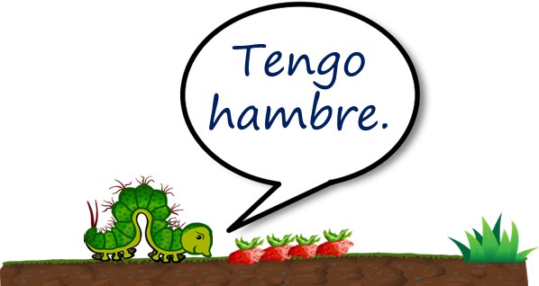
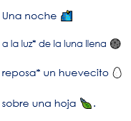
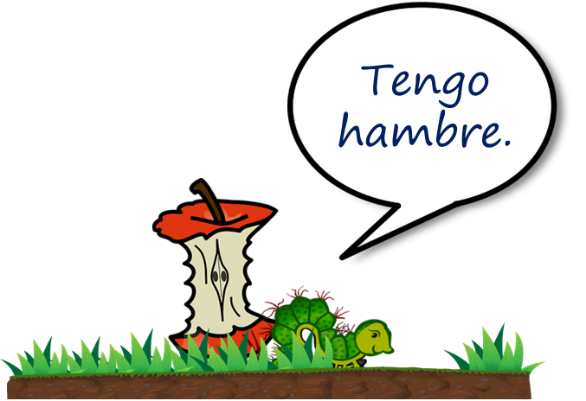

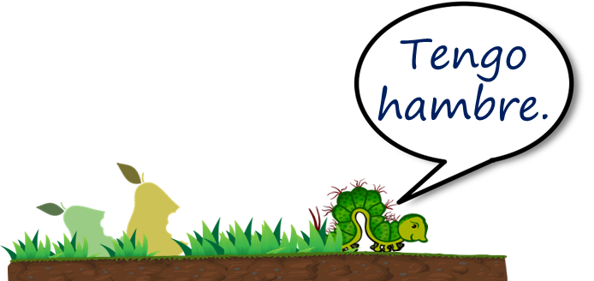
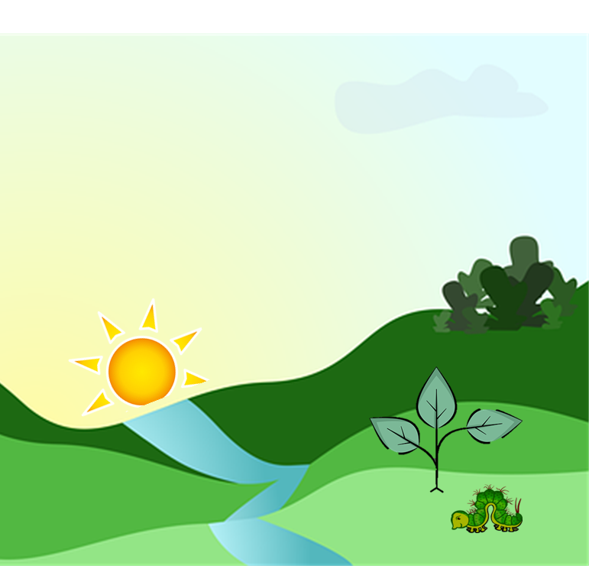
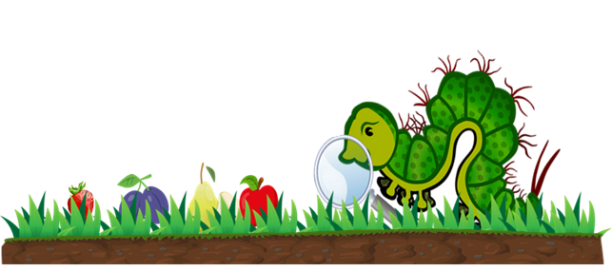
Follow up 4:
Lee a tu compañero/a.
Tu compañero/a escoge la imagen.
leer
hablar
Es…
Es…
B
A
A
B
escoge = s/he chooses
Notes:
Timing: 5 minutes
Aim: Further practice of SSC knowledge and comprehension of key vocabulary introduced this week. Listening to parts of the story told by a partner.
Procedure:
Pupils could work in pairs or groups.
Hand out a set of cards and ask pupils to take turns to read a scene from the story. Partner B chooses the card that goes with the scene and then they swap roles.
escoger [1918]

Slide 6
¡adiós!
rojo

Slide 7


Slide 8


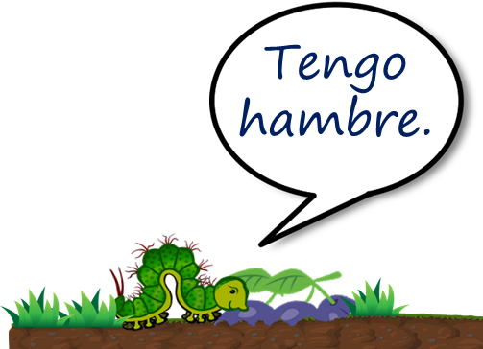

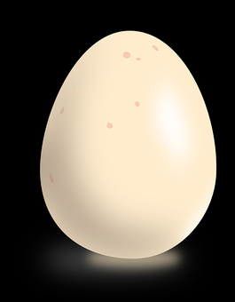

Slide 9
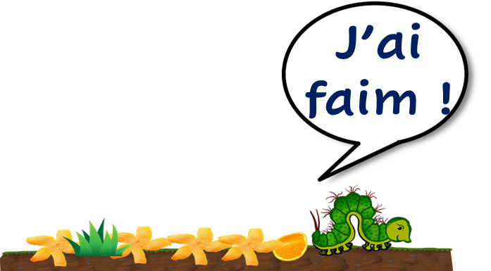
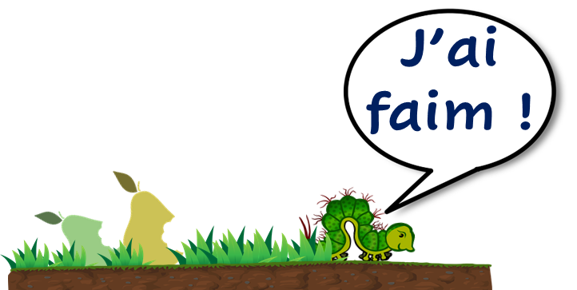
lundi | mardi
jeudi | vendredi
mercredi | dimanche

Slide 10
Una noche 🌃 a la luz* de la luna llena 🌑 reposa* un huevecito 🥚 sobre una hoja 🍃. | Un [Sunday] por la mañana 🌄 una oruga pequeña 🐛 sale del huevecito 🥚. | Tiene mucha hambre 😋🍴 y busca* 🔎 algo* de comer . | El [Thursday] come [four] fresas 🍓 pero aún tiene hambre 😋🍴 .
El [Monday] come [one] manzana 🍎 pero aún tiene hambre 😋🍴. | El [Tuesday] come [two] peras 🍐 pero aún tiene hambre 😋🍴. | El [Wednesday] come [three] ciruelas pero aún tiene hambre 😋🍴 . | El [Friday] come [five] naranjas 🍊 pero aún tiene hambre 😋🍴.

