Slide 1
What do I know now?
rojo
Phonics quiz
Notes:
Artwork by Steve Clarke. All additional pictures selected are available under a Creative Commons license, no attribution required.
This lesson includes a phonics assessment of the SSC practised this year. The ratio of old to new SSC is 50:50.
Phonics: SSC – [ce] [gi] [gui] [gu] [j] [h] [i] [ll] [ñ] [o] [que] [r-/rr] [v] [z]
Word frequency:
buque [3923] disgusto [>5000] debajo [1366] elegir [561] guiar [2422] horno [3602] llover [2134] mover [467] nacer [426] otoño [3504] pedazo [2026] polvo [1643] rabia [2500] unir [760]
Source: Davies, M. & Davies, K. (2018). A frequency dictionary of Spanish: Core vocabulary for learners (2nd ed.). Routledge: London

Slide 2
pronunciar
[o]
[i]
pronunciar
[dust]
[to unite]
polvo
unir
Notes:
2

Slide 3
pronunciar
[z]
[ll]
pronunciar
[piece, bit]
[to rain]
pedazo
llover
Notes:
3

Slide 4
pronunciar
[gui]
[gu]
pronunciar
[to guide, lead]
[displeasure]
guiar
disgusto
Notes:
4

Slide 5
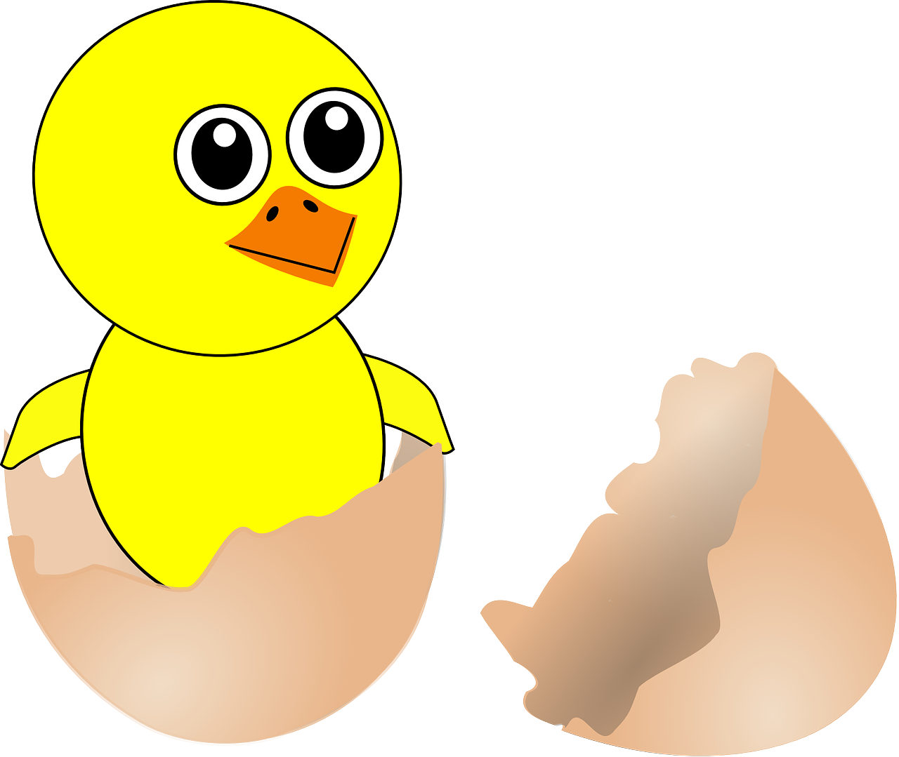
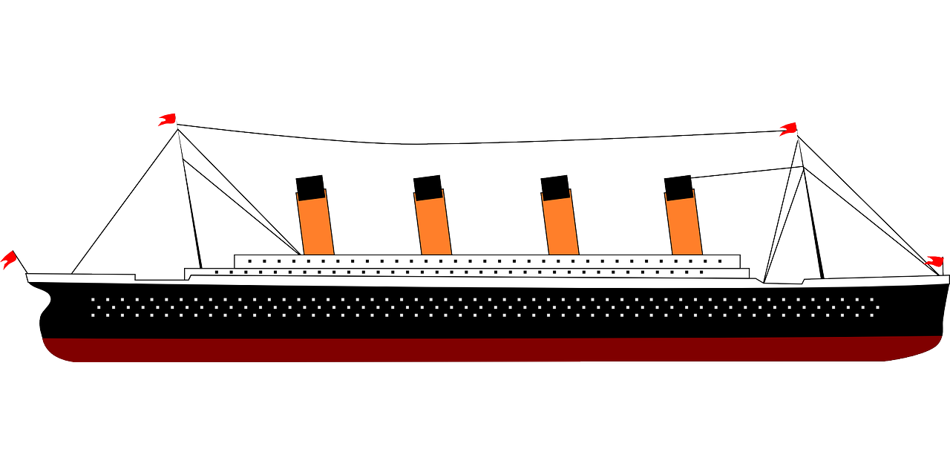
pronunciar
[que]
[ce]
pronunciar
[ship]
[to be born]
buque
nacer
Notes:
5

Slide 6
pronunciar
[gi]
[j]
pronunciar
[to choose]
[under(neath)]
elegir
debajo
Notes:
6

Slide 7
pronunciar
[r-/rr]
[ñ]
pronunciar
[rage]
[autumn]
rabia
otoño
Notes:
7

Slide 8
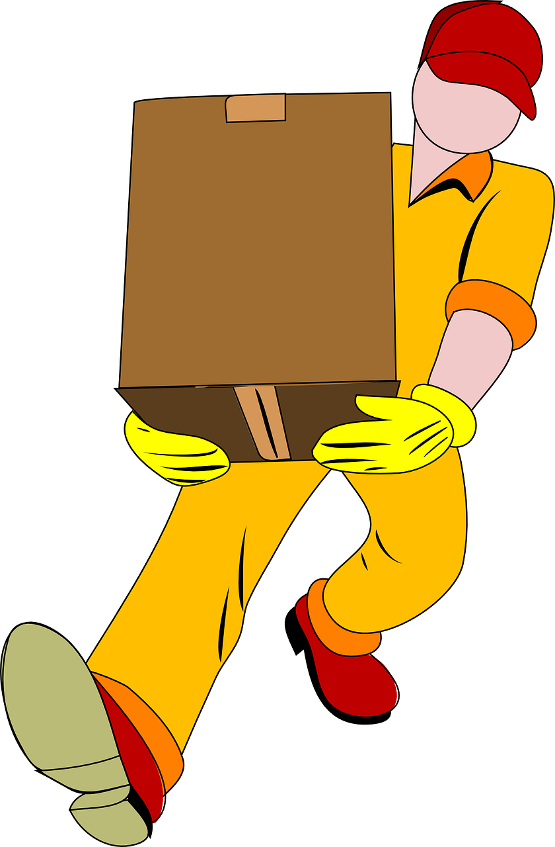
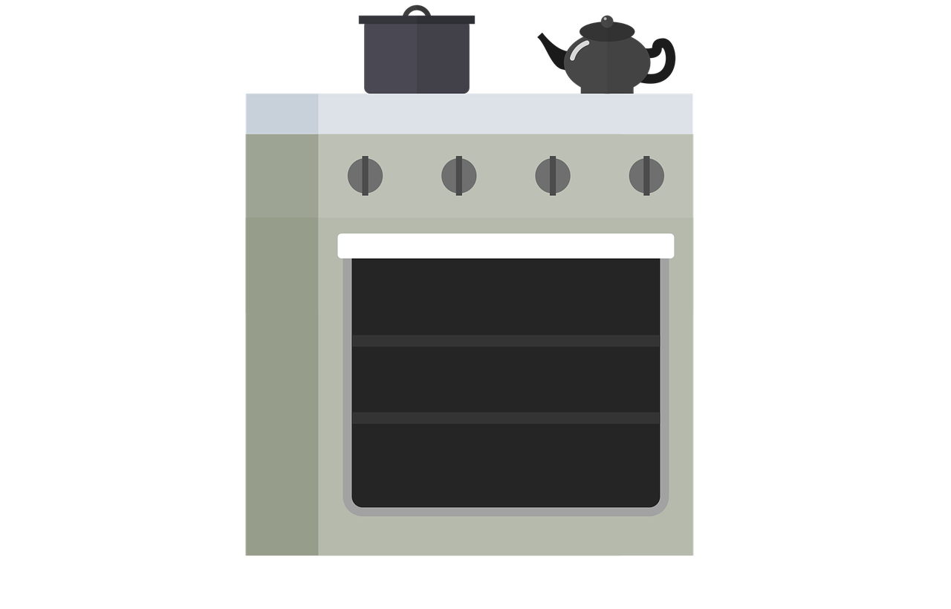
pronunciar
[h]
[v]
pronunciar
[oven]
[to move]
horno
mover
Notes:
8

Slide 9
pronunciar
Pupil name:
Pupil name:
SSC and word | px
polvo
unir
pedazo
llover
guiar
disgusto
buque
nacer
elegir
debajo
rabia
otoño
horno
mover
SSC and word | px
polvo
unir
pedazo
llover
guiar
disgusto
buque
nacer
elegir
debajo
rabia
otoño
horno
mover
Notes:
Pupil feedback and assessment sheet
9

Slide 10
Teacher audio version
SSC and word | px
polvo
unir
pedazo
llover
guiar
disgusto
buque
SSC and word | px
nacer
elegir
debajo
rabia
otoño
horno
mover
Notes:
Teacher audio version for preparation
10

