Slide 1
español, con Sofía

Slide 2
Describing what I and others do
rojo
Poesía ✒
Notes:
With thanks to Clare Seccombe for the idea to use this poem.
Artwork by Steve Clarke. All additional pictures selected are available under a Creative Commons license, no attribution required.
The frequency rankings for words that occur in this PowerPoint which have been previously introduced in the resources are given in the SOW (excel document) and in the resources that first introduced and formally re-visited those words.
For any other words that occur incidentally in this PowerPoint, frequency rankings will be provided in the notes field wherever possible.
Phonics: Revisit SSCs
No new vocabulary
Revisit 1: comprender [434] información [326] instrucción [2158] texto [753]
Revisit 2: familiar [1922] globo [3765] silla [1271] tarta [>5000] regalo [1986] bonito [891] pequeño [202] rojo [534] amarillo [1381]
Glossed: nombre [215] poetisa [>5000] poema [1430] tono [1127] luna [1240] sol [383] tambor [3826] botón [3159] reloj [1683]
Source: Davies, M. & Davies, K. (2018). A frequency dictionary of Spanish: Core vocabulary for learners (2nd ed.). Routledge: London
Image attribution: Marta Altés, ‘El libro de Gloria Fuertes para niñas y niños’, Blackie Books. https://blackiebooks.org/catalogo/el-libro-de-gloria-fuertes-para-ninas-y-ninos/

Slide 3
⚠ Many Spanish female names end in ‘a’.
el nombre = name, noun
Unos nombres españoles
[A] Lee los nombres* con tu compañero/a.
pronunciar
¿Es un nombre de chica o de chico ?
Adela
Valeria
Gala
Vega
Alberto
Gonzalo
Celeste
Ernesto
Victoria
Flavio
Raquel
Quique
Azucena
Paquito
[B] ¿Cuál es tu nombre favorito?
1 minuto
Mi nombre favorito es ‘Quique’.
INICIO
Notes:
Timing: 4 minutes
Aim: To revisit a range SSC with proper nouns.
Procedure:
Clarify that instructions to pupils, ensuring they understand ‘lee’.
Click to bring up further question. Is it a female or male name? They should decide as they read the list aloud.
Model first name with students – Adela – chica. (Click on the female icon to hear the name pronounced, if required).
Click on ‘inicio’ to start the timer’. It’s only one minute but teachers can restart the timer to allow more time for pupils.
Elicit pronunciation from pupils and whether they think it’s a female or male name. Click each gender icon next to the name to hear it pronounced.
Click to bring up the speech bubble.
Click to bring up further question. Pupils to choose their favourite Spanish name from the list. Encourage them to use Sofía’s example to produce a full sentence: Mi nombre favorito es…..

Slide 4
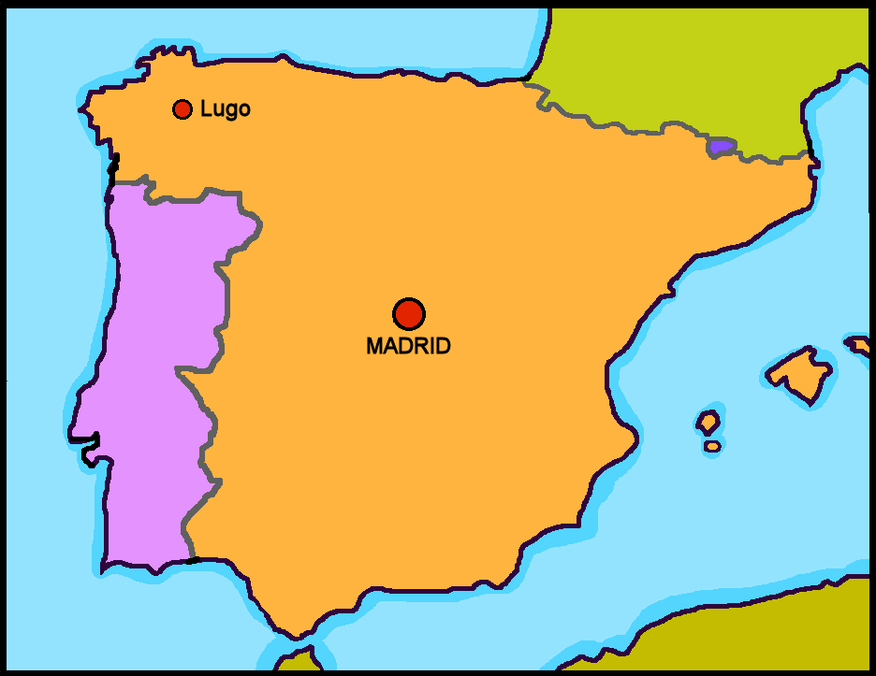
Leer y hablar
Gloria Fuertes
Gloria Fuertes es una poetisa* de España.
leer
Es de Madrid.
un perro.
una silla.
un gato.
triste.
contenta.
seria.
En la imagen está ….
En la imagen hay ….
la poetisa = female poet
Notes:
Timing: 4 minutes
Aim: To introduce ‘Gloria Fuertes’, the author of the poem, using familiar language.
Procedure:
Teachers click to go through the slide. We can give details of her life in the present tense. Students can read aloud (whole class) to practise SSC knowledge.
Image attribution: Marta Altés, ‘El libro de Gloria Fuertes para niñas y niños’, Blackie Books. https://blackiebooks.org/catalogo/el-libro-de-gloria-fuertes-para-ninas-y-ninos/

Slide 5
Leer y hablar
‘Redondo’
Un poema* famoso de Gloria Fuertes es ‘Redondo’.
leer
¿Qué es redondo en inglés ?
Por ejemplo…
la fruta
la pelota
el sombrero
round
Redondo en inglés es ______________.
el poema = poem
Notes:
Timing: 2 minutes
Aim: To introduce ‘redondo’ and revisit previously taught vocabulary.
Procedure:
Teachers click to go through the slide and bring up the different items of vocabulary that are also ‘round’ items.
Elicit answer from pupils.

Slide 6
Leer y hablar
‘Redondo’
¿Qué es redondo? [1/4]
leer
el libro
el globo
el boli
Notes:
Timing: 4 minutes [4 slides] Slide 1/4
Aim: To introduce ‘redondo’ and revisit previously taught vocabulary.
Procedure:
Teachers ask the question and read the three examples. Only one is ‘round’.
Elicit answer from pupils and check English meaning. Pictures are provided to support understanding (but note that there are three too many).

Slide 7
Leer y hablar
‘Redondo’
¿Qué es redondo? [2/4]
leer
la bici
el teléfono
la tarta
Notes:
2/4

Slide 8
Leer y hablar
‘Redondo’
¿Qué no es redondo? [3/4]
leer
la bici
la pelota
el queso
Notes:
3/4

Slide 9
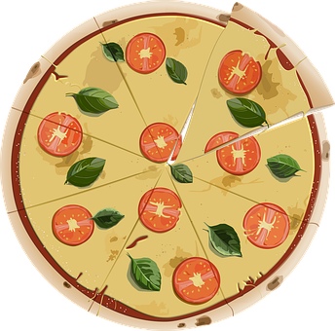
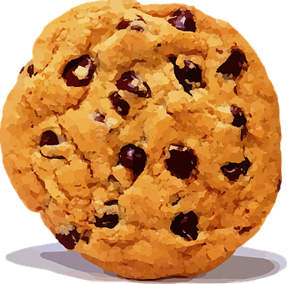
Leer y hablar
‘Redondo’
¿Qué no es redondo? [3/4]
leer
la galleta
la cámara
la pizza
Notes:
4/4

Slide 10
Leer y hablar
‘Redondo’
⚠ Use adjectives ending in ‘o’ to describe a masculine noun. Change the ‘o’ to ‘a’ when the noun described is feminine.
leer
1
la fruta,
la galleta
Redonda es _____________________________.
el sombrero,
el queso
2
Redondo es _____________________________.
el sombrero
la fruta
la galleta
el queso
Notes:
Timing: 4 minutes
Aim: To revisit the pattern of regular singular adjective agreement.
Procedure:
Click to present the reminder call out.
Elicit the Spanish answers from pupils.
Click to hear the sentences, if desired.

Slide 11
escuchar
Escucha el poema: Ordena las frases del poema.
escuchar
Redonda es ____________
Redondo es ____________
Redondo es ____________
de mi tío _____________.
la luna
la galleta
1
Redonda es ____________
Redondo es ____________
Redonda es ____________
Redondo es ____________
5
el sol
el botón
2
6
la pelota
el reloj
3
7
el tambor
Ramón
4
8
a
c
g
e
d
f
b
h
Notes:
Timing: 8 minutes
Aim: listening activity to help students recognise SSCs and words; to link written words with meaning.
NB. There are two versions of the handout to go with this task. For version 1, teachers need to print sets of cards with the different lines and pictures to go with the poem. For version 2, pupils have the words in the handout and no cards are required.
Procedure:
Teachers click on the number buttons to play fragments of the poem.
Students listen and find the right card / write down the word that corresponds to each verse (or number them in the handout).
The answers can be checked item by item by clicking.
Next, pupils match the sentences with the words for each verse. If they are not working with cards, they can write the letter for each picture.
Frequency of unknown words/cognates: luna [1240] sol [383] tambor [3826] botón [3159] reloj [1683]
Poem adapted from Gloria Fuerte’s poem ‘Redondo’.

Slide 12
hablar
Lee el poema con tu compañero/a.
1 minuto
Lee el poema con tono triste 😞.
Lee el poema con tono contento 😊.
el tono = tone
INICIO
Notes:
Timing: 4 minutes
Aim: listening activity to support students practice of SSCs and words; opportunity to listen and join in.
Procedure:
1. Teachers can start by playing the poem in full, and pupils repeat chorally.
2. Pupils work in pairs to read the poem aloud.
3. In pairs, pupils read the poem aloud, in a sad voice.
4. In pairs, pupils read the poem aloud, in a happy-sounding voice.
Frequency of unknown words/cognates: luna [1240] sol [383] tambor [3826] botón [3159] reloj [1683]
Poem adapted from Gloria Fuerte’s poem ‘Redondo’.

Slide 13
¡adiós!
rojo

Slide 14
Redonda es | la luna | Redonda es | la galleta
Redondo es | el sol | Redondo es | el botón
Redonda es | la pelota | Redondo es | el reloj
Redondo es | el tambor | de mi tío | Ramón

