Slide 1
español, con Sofía

Slide 2
Saying how many and describing things
rojo
hay
plural indefinite articles
SSC [que] [qui]
Notes:
Artwork by Steve Clarke. All additional pictures selected are available under a Creative Commons license, no attribution required.
The frequency rankings for words that occur in this PowerPoint which have been previously introduced in the resources are given in the SOW (excel document) and in the resources that first introduced and formally re-visited those words.
For any other words that occur incidentally in this PowerPoint, frequency rankings will be provided in the notes field wherever possible.
Phonics: Revisit SSC [qui] [que] [ce] [ci]
Vocabulary: hay [haber 13] unos [6] unas [6] cuántos [580] cuántas [580]
Revisit 1: aprender [428] leer [209] ver [38] deporte [1489] idioma [1159] juego [409] de² [2]
Revisit 2: tienes [19] botella [1878] estuche [>5000] libro [230] pregunta [507] respuesta [488] sacapuntas [>5000]
Source: Davies, M. & Davies, K. (2018). A frequency dictionary of Spanish: Core vocabulary for learners (2nd ed.). Routledge: London

Slide 3
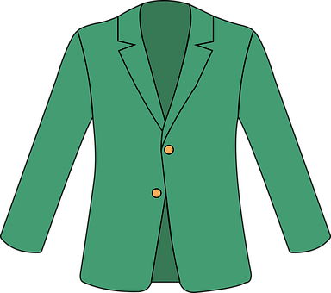
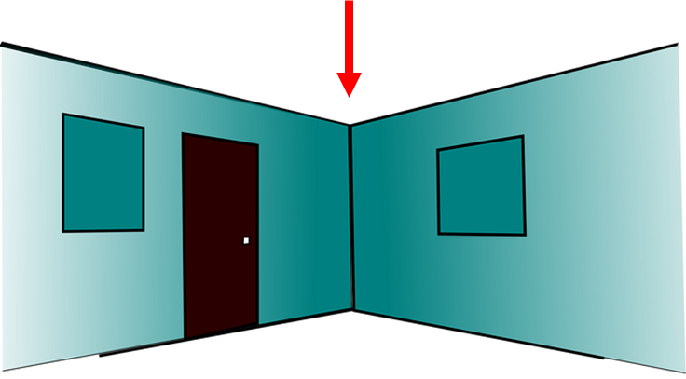
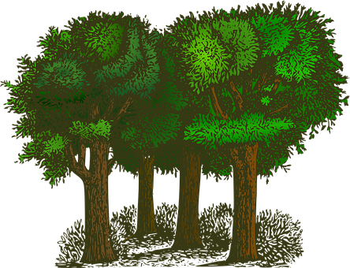
pronunciar
¡A practicar!
adivinar = to guess
Escribe cinco palabras en secreto. Tu compañero/a adivina*.
45 segundos
chaqueta
bosque
dulce
esquina
cien
paquete
aquí
quince
cocina
cinco
tranquilo
peces
INICIO
Notes:
Timing: 4 minutes
Aim: to practise reading aloud [que] [qui] [ce] [ci] with some previously taught vocabulary & unknown words (pictures provided to support meaning).
Procedure:
Read the explanation and ensure pupils understand the task.
Start the timer.
Pupils try to guess their partner’s 5 words by saying them aloud, before the 45 seconds is up.
Swap roles and repeat the game.
Frequency of unknown words and cognates:
bosque [1444] chaqueta [4565] cien [440] cocina [1214] dulce [1860] esquina [1536] paquete [2325] pez [3579] quince [1215]
Source: Davies, M. & Davies, K. (2018). A frequency dictionary of Spanish: Core vocabulary for learners (2nd ed.). Routledge: London

Slide 4
Talking about things in the plural
Indefinite articles [unos/unas]
Remember: to mean ‘a’ or ‘an’ before a singular noun, use un or una.
un libro
una pregunta
a book
a question
To mean ‘some’ before a plural noun, use unos or unas.
unos libros
unas preguntas
some books
some questions
To mean ‘some’ for masculine plural nouns, use _____.
unos
unas
To mean ‘some’ for feminine plural nouns, use ______.
Notes:
Timing: 2 minutes
Aim: to introduce plural indefinite articles.
Procedure:
1. Click to bring up each new part of the explanation.
2. Interactive elicitation: Try to elicit the English meaning in each of the example phrases.
3. After showing the examples (and before showing the final line of text), ask students why it’s ‘unos libros’ but ‘unas preguntas’ to elicit 1) nouns have gender 2) libro is masculine and pregunta is feminine.
4. Ask students if they can think of any other words that could take ‘unos’ or ‘unas’.

Slide 5
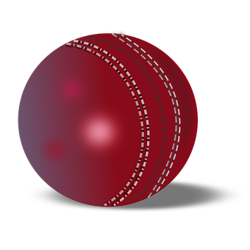
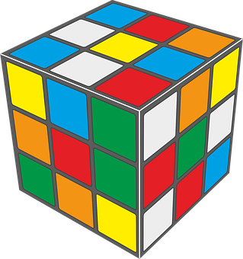
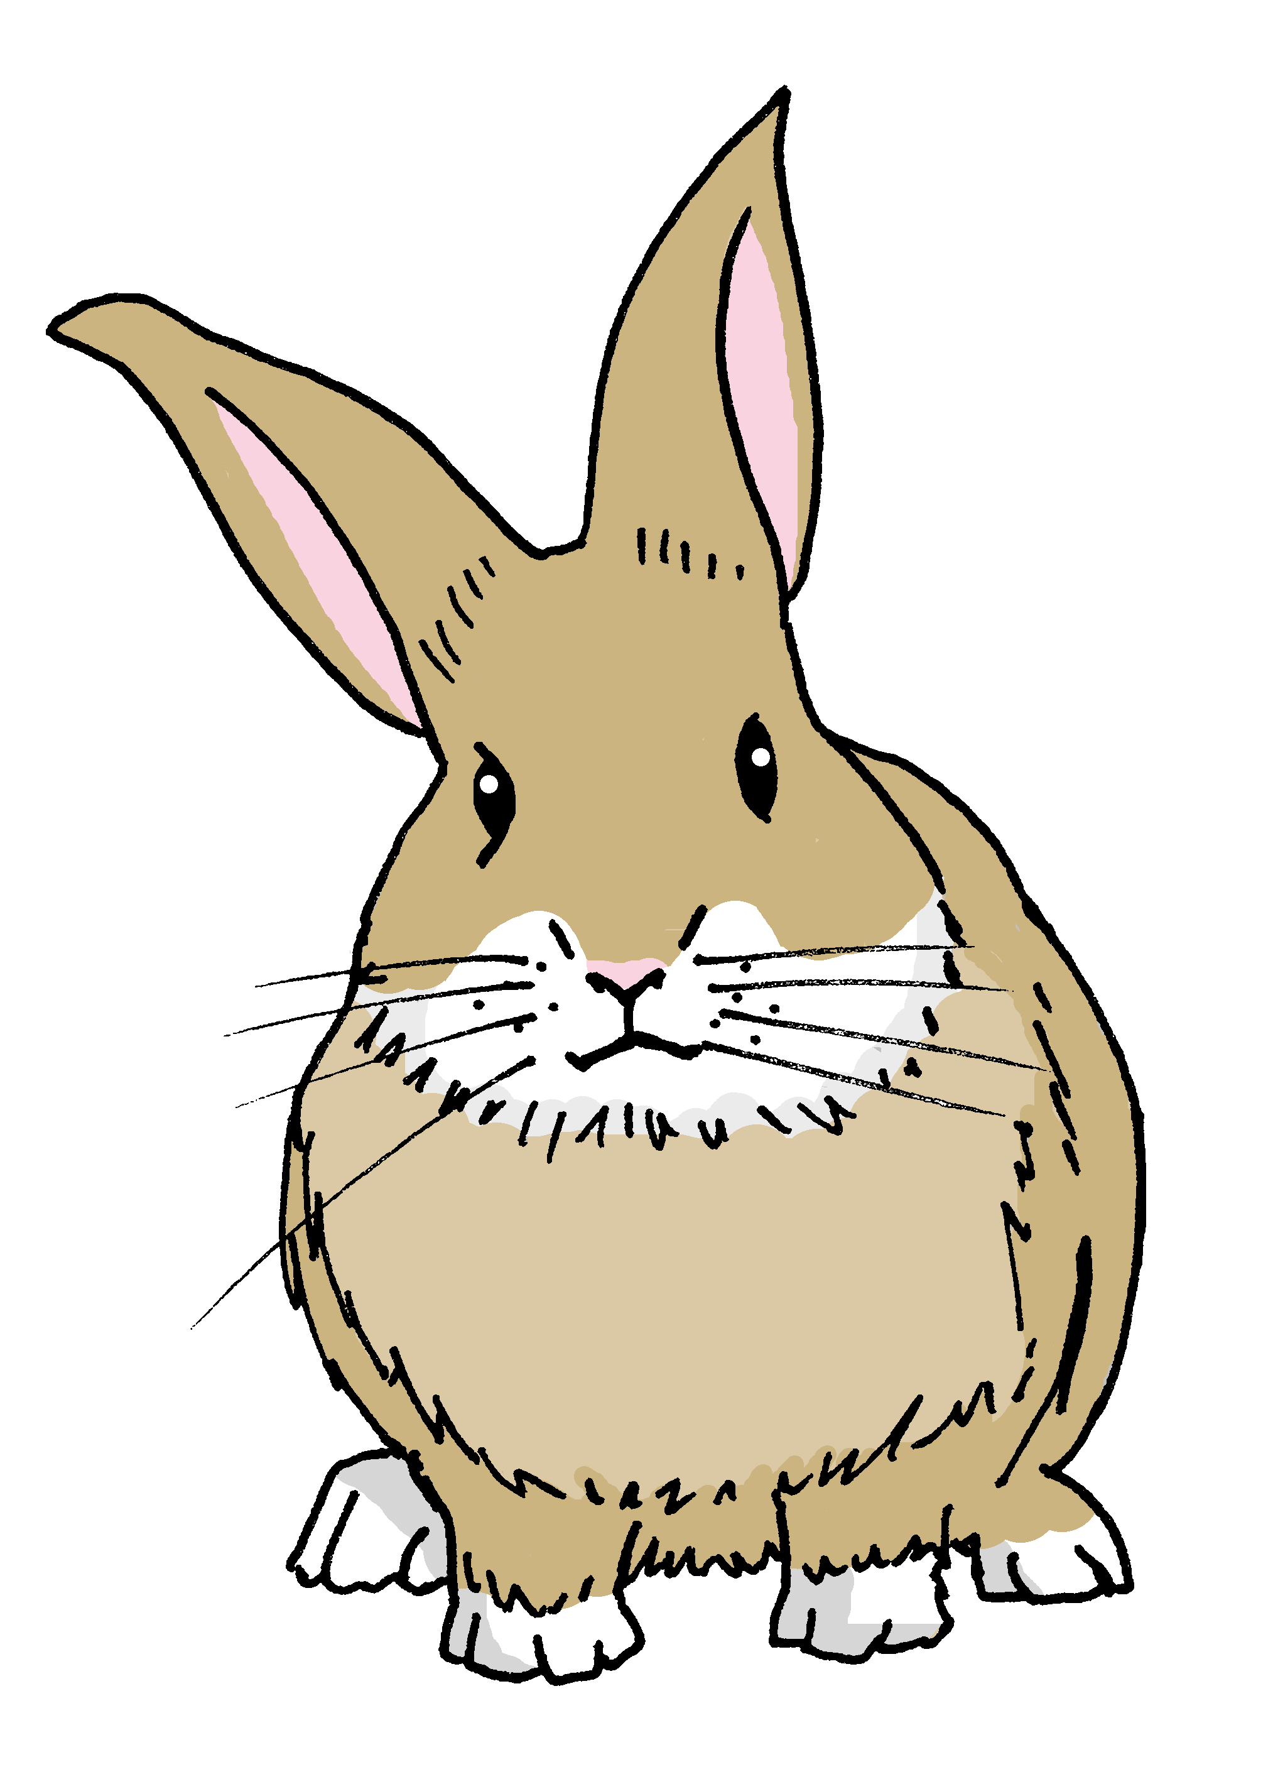
leer
Sofía plans what to pack for her trip to Badajoz. BUT she gets chocolate smudges on her list!
La lista de Sofía.
Is she planning to take one or more than one?
leer
[A] Escribe I o I+.
[B] Escribe el número.
E
unos bolígrafos
I+
1
una cámara
I
4
2
E
E
unas pelotas
1
2
I+
E
3
unos juegos
I+
4
una mochila
I
7
E
E
3
5
unos conejos
I+
6
un cuaderno
I
6
E
E
E
7
unas botellas
E
I+
5
Notes:
Timing: 4 minutes
Aim: to practise written recognition of and distinction between singular and plural indefinite articles; to practise written recall of vocabulary meanings.
Procedure:
Elicit the meaning of ‘La lista de Sofía?’ ‘de’ meaning ‘of’ was introduced in week 5.
Pupils write 1-7 in their books.
Bring up the context of the task and instruction.
Do E with pupils to model the task.
Pupils complete 1-7.
Click to correct.
Click to bring up part B of the activity.
Pupils write the English meaning next to their Part A numbers 1-7..
Click to reveal the answers in number order next to the matching pictures. The teacher can use the Spanish for each item to elicit the numbers. E.g. unas pelotas – ¿qué número es? This provides the opportunity for aural recognition of the vocabulary.
If required, click audio buttons to reinforce the indefinite articles with the nouns.
Transcript
[E] unos bolígrafos
[1] una cámara
[2] unas pelota
[3] unos juegos
[4] una mochila
[5] unos conejos
[6] un cuaderno
[7] unas botellas

Slide 6
Hay
[there is, there are]
To mean ‘there is’ or ‘there are’ in Spanish use ‘hay’.
Use ‘hay’ with singular and plural nouns.
Hay unos estuches.
Hay una respuesta.
There are some pencil cases.
There is an answer.
Sentences with ‘hay’ often start with ‘en’.
En mi mochila hay unas tartas.
In my school bag there are some cakes.
Notes:
Timing: 2 minutes
Aim: to introduce ‘hay’
Procedure:
Read the grammar explanation on hay (there is / there are).
Elicit English translation for the Spanish examples provided.
NB. Students haven’t yet practised the silent ‘H’ in Spanish phonics (although they have met ‘hablar’ and ‘hoy’), so practise the pronunciation of ‘hay’ here.
It might help students to know that it sounds similar to the English letter ‘I’!

Slide 7
escuchar
Sofía viaja con la familia: What has she managed to pack?
Ahora escucha y lee
¿Es diferente?
Escucha y marca.
Escribe ✍
There is | There are
unos bolígrafos
un bolígrafo
E
E
una cámara
una cámara
1
1
unas pelotas
unas pelotas
2
2
3
unos juegos
un juego
3
4
4
una mochila
una mochila
5
5
unos conejos
un conejo
6
6
un cuaderno
unos cuadernos
7
7
unas botellas
unas botellas
Notes:
Timing: 8 minutes
Aim: to practise aural comprehension of ‘hay’ and its correct translation into English.
Procedure:
Read the title and click to bring up the instructions in Spanish. Pupils write 1-7.
Do the example (E). Make it clear that the meaning of ‘hay’ in English is dependent on the number (singular/plural) of the noun that follows.
Do 1-7 and click to correct.
Now we see Sofía’s original list. Pupils listen again – now that Sofía has done her packing a few numbers of items have changed. Is each item the same or different. Pupils tick or cross. Pupils also transcribe what they hear, as they are able.
Click to correct.
Transcript
[E] Hay un bolígrafo.
[1] Hay una cámara.
[2] Hay unas pelotas.
[3] Hay un juego.
[4] Hay una mochila.
[5] Hay un conejo.
[6] Hay unos cuadernos.
[7] Hay unas botellas.

Slide 8
pronunciar
¿Cuántos?
⚠ The question word ‘¿cuántos?’ agrees with the gender and number of the noun it describes.
How many?
¿Cuántos bolígrafos hay?
[How many pens are there?]
Rachel Hawkes / Emma Marsden
Notes:
Timing: 1 minute
Aim: To introduce question word ¿cuántos?
Procedure:
Pupils listen and repeat the key question word (include gesture if possible).
Display the word and get them to repeat one more time.
Elicit the English meaning.
Reveal the sentence and elicit the English translation from students.
Click to reveal speech bubble with reminder for agreement of this question word.

Slide 9
pronunciar
¿Cuántas?
⚠ The question word ‘¿cuántas?’ agrees with the gender and number of the noun it describes.
How many?
¿Cuántas botellas hay?
[How many bottles are there?]
Rachel Hawkes / Emma Marsden
Notes:
Timing: 1 minute
Aim: To introduce question word ¿cuántos?
Procedure:
Pupils listen and repeat the key question word (include gesture if possible)
Display the word and get them to repeat one more time
Elicit the English meaning.
Reveal the sentence and elicit the English translation from students.
Click to reveal speech bubble with reminder for agreement of this question word.

Slide 10
hablar
Completa la pregunta y la respuesta. [1/5]
leer
os
¿Cuánt____
______ hay?
globos
doce
globo
Hay
cinco
globos
dos
regalos
Notes:
Timing: 3 minutes (5 slides)
Aim: to consolidate the agreement of the question word forms ‘cuántos’ & ‘cuántas’; to practise comprehension of numbers and plural indefinite articles.
Procedure:
Read the question and model it with the two possible answers: cuántos or cuántas.
Elicit answer from students.
Click to bring up the correct ending ‘cuántos’. Click the callout to hear the full question, as required.
Elicit the correct noun and noun form (i.e. plural).
Elicit the full sentence response, which takes account of information given by the picture (i.e. the number of balloons).
Click on the picture to hear the full sentence response.
Repeat steps 1-6 with the remaining four slides.

Slide 11
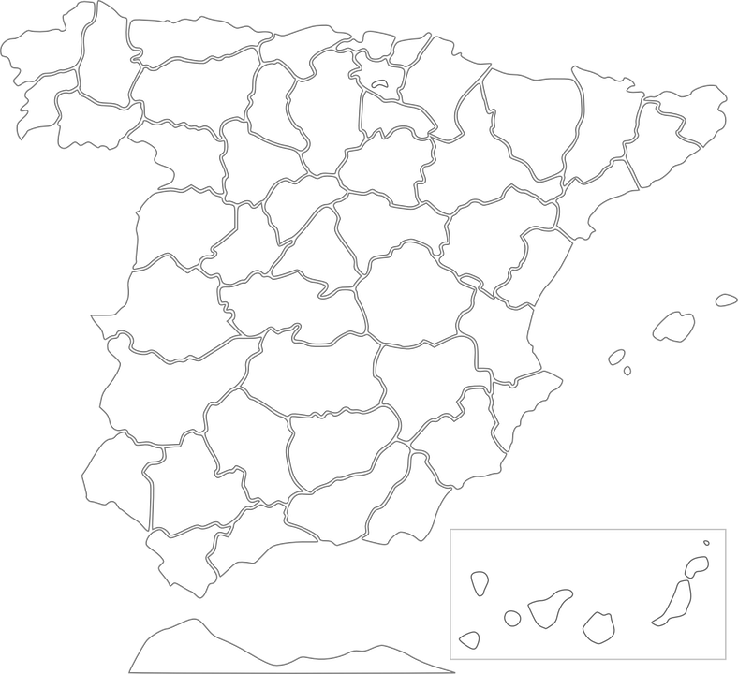
hablar
Completa la pregunta y la respuesta. [2/5]
leer
1
Alquézar
os
Alcudia
¿Cuánt____
______ hay?
3
2
Calaceite
pueblos
4
Medinaceli
diez
pelota
1
4
2
Hay
ocho
pueblo
3
unos
pueblos
Notes:
[2/5]

Slide 12
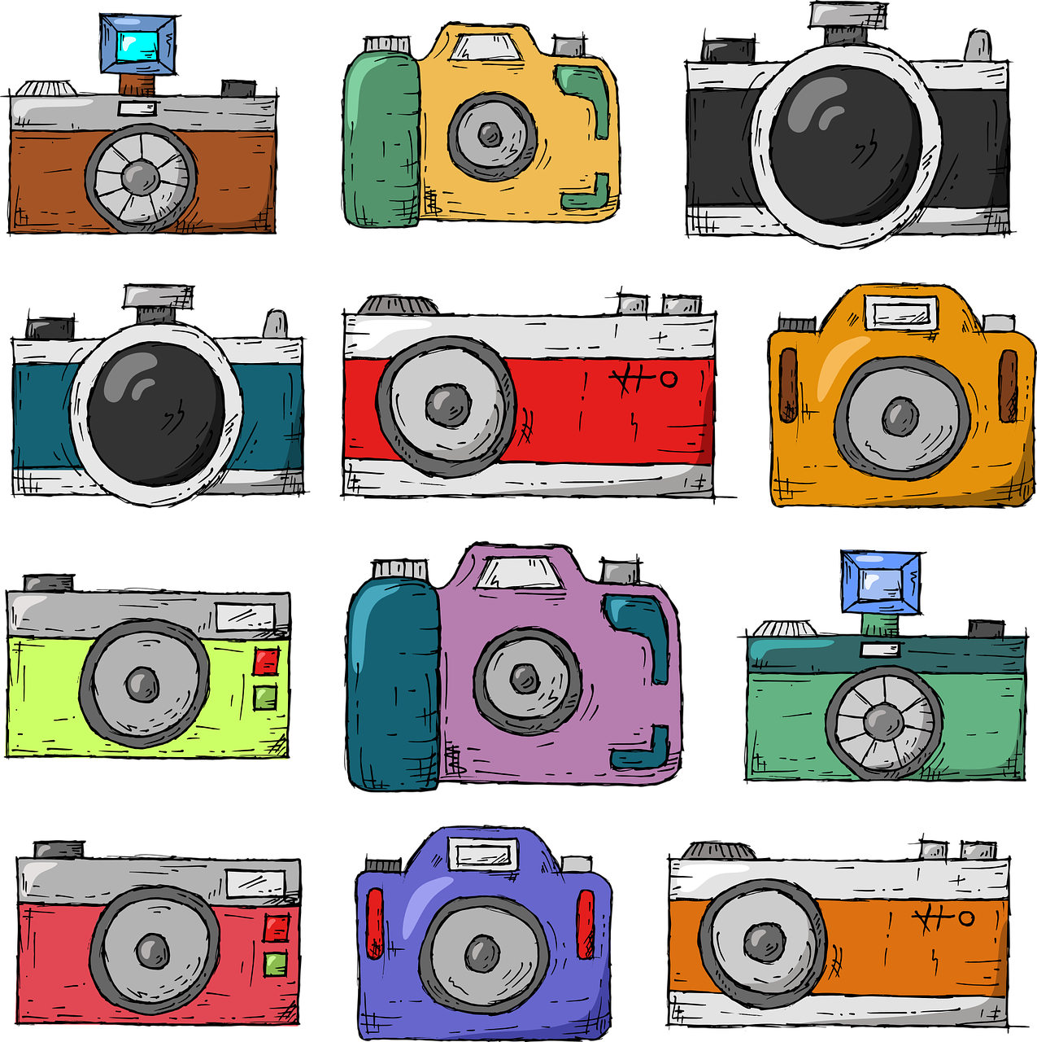
hablar
Completa la pregunta y la respuesta. [3/5]
leer
as
¿Cuánt____
______ hay?
cámaras
doce
cámara
Hay
once
cámaras
diez
camas
Notes:
[3/5]

Slide 13
hablar
Completa la pregunta y la respuesta. [4/5]
leer
Soy español.
as
¿Cuánt____
______ hay?
Necesito un cuaderno.
frases
Hay unos sombreros.
cinco
frase
⚠ Remember! Nouns that end in –e could be masculine or feminine.
hay
una
frases
unas
fruta
Notes:
[4/5]

Slide 14
hablar
Completa la pregunta y la respuesta. [5/5]
leer
os
¿Cuánt____
______ hay?
deportes
nueve
idiomas
Hay
seis
deporte
siete
deportes
Notes:
[5/5]

Slide 15
¡adiós!
rojo

