Slide 1
español, con Sofía

Slide 2
Describing me and others do
rojo
tener: I & you
Numbers 1-12
SSC [qui]
Notes:
Artwork by Steve Clarke. All additional pictures selected are available under a Creative Commons license, no attribution required.
The frequency rankings for words that occur in this PowerPoint which have been previously introduced in the resources are given in the SOW (excel document) and in the resources that first introduced and formally re-visited those words.
For any other words that occur incidentally in this PowerPoint, frequency rankings will be provided in the notes field wherever possible.
Phonics - SSC: [qui] equipo [373] quince [1215]
Vocabulary (new words in bold): un [6] dos [64] tres [134] cuatro [241] cinco [284] seis [438] siete [603] ocho [641] nueve [991] diez [449] once [1701] doce [1138]
Revisit 1: pasar [68] visitar [792] mamá [675] mañana [402] papá [865] semana [301] tiempo [80] por2 [15] Revisit 2: tiene [19] amigo [210] amiga [210] bicicleta [3684] cama [609] gato [1728]
Source: Davies, M. & Davies, K. (2018). A frequency dictionary of Spanish: Core vocabulary for learners (2nd ed.). Routledge: London

Slide 3
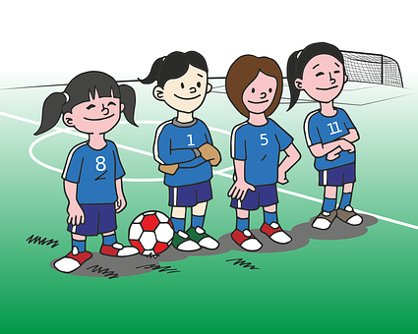
[qui]
equipo
pronunciar
Notes:
Timing: 1 minute
Aim: To introduce SSC [qui]
Procedure:
To present and elicit the pronunciation of the individual SSC [qui]
Click to bring up the picture & get students to repeat (with gesture, if using).
Gesture suggestion : handshake

Slide 4
[qui]
quince
pronunciar
Notes:
Timing: 1 minute
Aim: To present SSC [qui]
Procedure:
To recap and elicit the pronunciation of the individual SSC [qui]
Click to bring up the picture & get students to repeat (with gesture, if using).
Gesture suggestion : mime 3 x 5 by holding up right hand and flashing it three times.

Slide 5
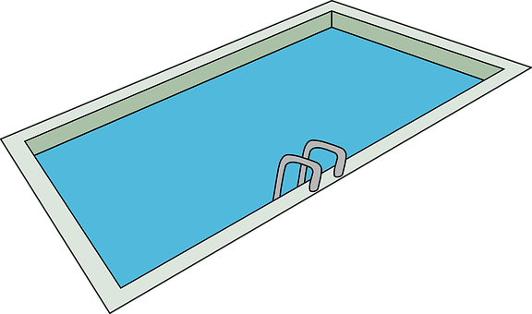
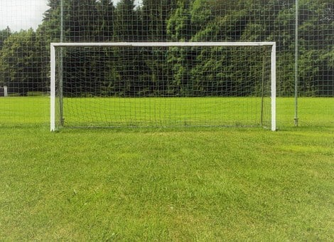
escuchar
Escucha. ¿Es ‘ci’ o ‘qui’?
[left]
E
1
qui
ci
iz____erda
pis___na
3
4
2
qui
silen__o
___én
ci
qui
es____na
Notes:
Timing: 5 minutes
Aim: to differentiate [qui] from previously taught SSC [ci]
Procedure:
Read the instruction and do the example [E] with pupils. Pupils to write the correct SSCs [ci], or [qui].
Do 1-4.
Go through answers by eliciting the Spanish word from pupils, and click to bring up answers.
Give pupils 1 minute to work in pairs to practise pronunciation.
Transcript:
E parque
1 pescado
2 barco
3 quien
4 pequeño

Slide 6
vocabulario
Practica el vocabulario: los números
uno
dos
tres
Notes:
Timing: 5 minutes (8 slides) Aim: to introduce numbers 1-12.
Procedure: 1. For each set of three numbers (123,456,789,101112), first click to present and say (or use audio version) the number, and pupils repeat. Numbers are animated to appear in digit first, then written word. Teachers to say each number twice, and then elicit from pupils.
2. Move to the 2nd slide with the same numbers. This time the digit and gapped written word appear together. Try to elicit from pupils but respond to any hesitation by providing the spoken number again. (In the audio version, click on the digit to hear the audio, as needed). 3. Repeat steps 1-2 for the other 9 numbers.

Slide 7
vocabulario
Practica el vocabulario: los números
u_o
d_s
tr_s
Notes:
[2/8]

Slide 8
vocabulario
Practica el vocabulario: los números
cuatro
cinco
seis
Notes:
[3/8]

Slide 9
vocabulario
Practica el vocabulario: los números
c_ _tr_
c_nc_
se_s
Notes:
[4/8]

Slide 10
vocabulario
Practica el vocabulario: los números
siete
ocho
nueve
Notes:
[5/8]

Slide 11
vocabulario
Practica el vocabulario: los números
si_t_
_ch_
n_ev_
Notes:
[6/8]

Slide 12
vocabulario
Practica el vocabulario: los números
diez
once
doce
Notes:
[7/8]

Slide 13
vocabulario
Practica el vocabulario: los números
vocabulario
d_e_
_nc_
d_c_
Notes:
[8/8]

Slide 14
Leer y hablar
Lee los números en el orden correcto.
cuatro
once
siete
leer
hablar
diez
cinco
dos
60
doce
seis
ocho
tres
nueve
uno
- - - - - - - - - - - - - - - - - - - - - - - - - - - - - - -
uno
dos
tres
cuatro
cinco
seis
siete
ocho
nueve
diez
once
doce
0
INICIO
Notes:
Timing: 3 minutes
Aim: to consolidate written comprehension and pronunciation of numbers.
Procedure:
Teacher reads the instruction in Spanish.
Pupils work in pairs to say the numbers in order (1-12). They have one minute.
Click to trigger the timer.
After one minute, elicit the answers chorally from the class, click to bring up each answer, just after pupils have said it. (In the audio version, we hear the numbers again, as they appear, in order, underneath.)

Slide 15
Tener: I have & s/he, it has
[to have | having]
We have already seen that the verb tener means ‘to have’.
I
you
tengo
tienes
To mean I have, use ‘______’.
To mean you have, use ‘______’.
Tengo una botella.
Tienes un juego.
You have a/one game.
I have a bottle.
Tengo tres botellas.
Tienes cuatro juegos.
I have three bottles.
You have four games.
⚠ To talk about something in the plural (more than one), Spanish often adds an ‘s’ to the end of nouns ending in –o, -a or –e.
Notes:
Timing: 2 minutes
Aim: to revisit 1st and 2nd person singular of ‘tener’ & introduce plural marking of regular nouns.
Procedure:
Present the information, using the animated sequence.
Elicit English translation for the Spanish examples provided.

Slide 16
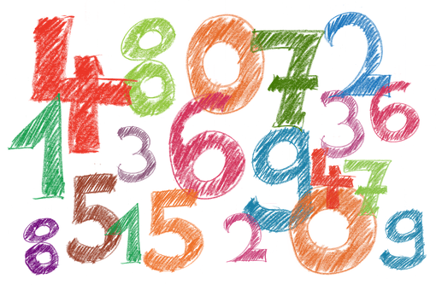
escuchar
¿1 o +1?
Sofía compite con Quique: ¿Quién tiene qué?
Marca
 | Sofía (I) | Quique (you)
1 | 1+
número
⚠Remember this also means ‘a/an’.
E
un
1
dos
2
cuatro
3
una
4
seis
5
cinco
competir = to compete, competing
Notes:
Timing: 7 minutes
Aim: to practise aural comprehension of ‘tengo’ & ‘tiene’ and recognition of singular/plural nouns; in addition, to practise transcription of some numbers.
Procedure:
Read the title & click to bring up the instructions in Spanish, and the first two parts of the table.
Do the example (E). At this stage pupils identify if it is I or s/he and if the person has 1 or more than 1 item.
Click to bring up animation / answers.
Click to bring up the 3rd part of the table. Listen again, and pupils write down the numbers in words.
Click to correct.
Note: written comprehension of the sentences is the next activity on the next slide.
Transcript
[E] Tengo un dibujo
[1] Tienes dos juegos.
[2] Tienes cuatro pelotas.
[3] Tengo una bici.
[4] Tienes seis diccionarios de inglés.
[5] Tengo cinco cámaras,

Slide 17
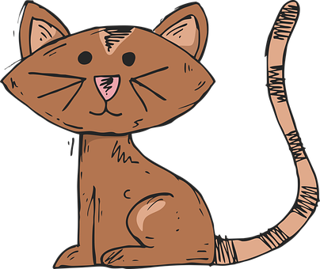
Tener: I have & s/he, it has
[to have | having]
S/he, it
tiene
To mean s/he or it has, use ‘______’.
Ángela tiene un gato.
Ángela has a/one cat.
She has a/one cat.
Ángela tiene dos gatos.
Ángela has two cats.
She has two cats.
Notes:
Timing: 2 minutes
Aim: to revisit 3rd person singular of ‘tener’ & plural marking of regular nouns.
Procedure:
Present the information, using the animated sequence.
Elicit English translation for the Spanish examples provided.

Slide 18
leer
Lee las frases y decide.
Tengo un dibujo.
leer
Tiene dos juegos.
Tiene cuatro pelotas.
Tengo una bici.
Tiene seis diccionarios de inglés.
Tengo cinco cámaras.
a. Who has more items?
b. Who could play tennis?
c. Who could look up words in a dictionary?
d. Who has more valuable items?
e. Whose items do you prefer?
Quique
Quique
Quique
Notes:
Timing: 4 minutes
Aim: to practise comprehension of 1st and 2nd person singular of –tener, key vocabulary & numbers.
Procedure:
Teacher to read the task instruction in Spanish. Sofía is talking to Ángela about herself (I) and Quique (he).
Pupils to read the sentences and discuss in pairs questions a-e.
NB. This task brings together comprehension and pupils’ individual perceptions. For c-e, there is no right or wrong answer to the questions.

Slide 19
Leer y hablar
Lee los números en el orden correcto.
leer
hablar
60
- - - - - - - - - - - - - - - - - - - - - - - - - - - - - - -
uno
dos
tres
cuatro
cinco
seis
siete
ocho
nueve
diez
once
doce
0
INICIO
Notes:
Timing: 3 minutes
Aim: to consolidate numbers in oral production.
Procedure:
Teacher reads the instruction in Spanish.
Pupils work in pairs to say the numbers in order (1-12). They have one minute.
Click to trigger the timer.
To bring up answers, each number disappears on click, and the correct answer appears. (In the audio version, audio is attached to numbers, as they re-appear.)

Slide 20
escuchar
Escribe 8 números.
Notes:
Suggested additional activity - Bingo
Aim: to practise aural comprehension of numbers.
Procedure:
Pupils write down 8 digits. They can repeat numbers, if they wish.
The teacher calls out numbers 1-12, in any order.
Pupils call ‘¡Bingo!’ if they have a horizontal row of four numbers checked off, and then play resumes for a full house.
Note: A great alternative is to play ‘strip bingo’; this is where pupils have a strip of paper and write down 6 numbers in any order from left to right. As the teacher calls out numbers, pupils can only rip off matching numbers from either end of their strip, if they hear them called. It is the pupil whose final remaining number is called, who wins.

Slide 21
¡adiós!
rojo

