Slide 1

Saying what I and others do
rojo
Follow ups 1-5
Notes:
Artwork by Steve Clarke. All additional pictures selected are available under a Creative Commons license, no attribution required.
The frequency rankings for words that occur in this PowerPoint which have been previously introduced in the resources are given in the SOW (excel document) and in the resources that first introduced and formally re-visited those words.
For any other words that occur incidentally in this PowerPoint, frequency rankings will be provided in the notes field wherever possible.
Phonics - SSC: [qui] equipo [373] quince [1215]
Vocabulary (new words in bold): un [6] dos [64] tres [134] cuatro [241] cinco [284] seis [438] siete [603] ocho [641] nueve [991] diez [449] once [1701] doce [1138]
Revisit 1: pasar [68] visitar [792] mamá [675] mañana [402] papá [865] semana [301] tiempo [80] por2 [15]
Revisit 2: tiene [19] amigo [210] amiga [210] bicicleta [3684] cama [609] gato [1728]
Glossed words: adivinar [2201] abuela [783] palabra [192] resultado [502] suma [2001] ella [72] más [23] igual [263]
Source: Davies, M. & Davies, K. (2018). A frequency dictionary of Spanish: Core vocabulary for learners (2nd ed.). Routledge: London

Slide 2





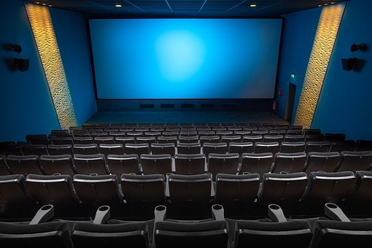
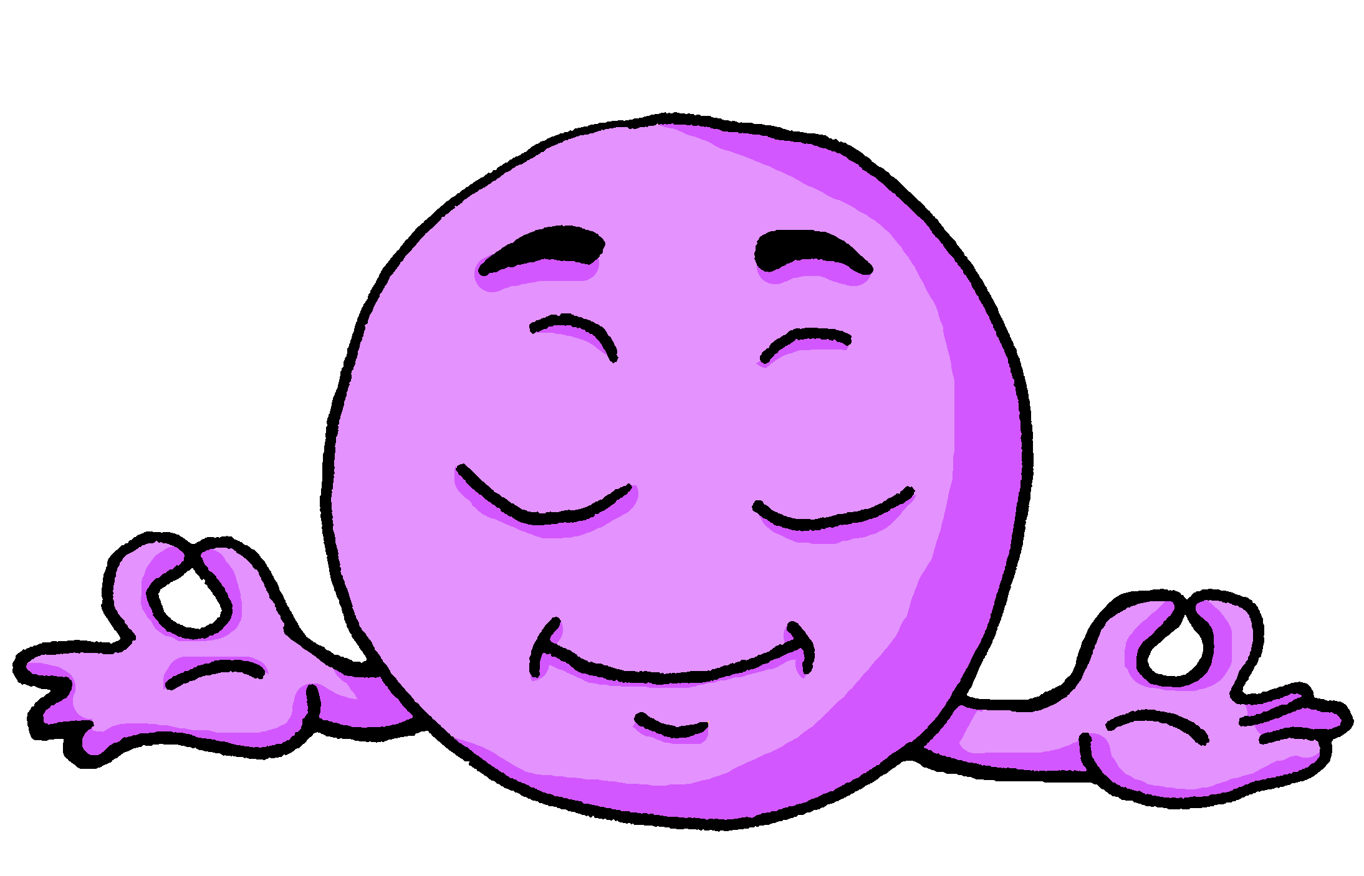
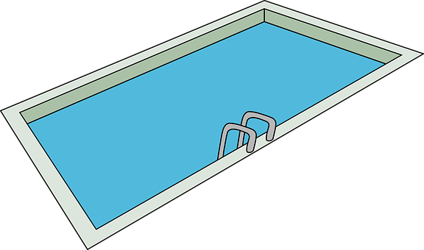

Follow up 1
[qui] [ci]
A Escucha. ¿Qué sonido es?
pronunciar
This is a ‘k’ sound.
⚠ This is a ‘th’ sound.
B Escribe una palabra*.
Tu compañero/a adivina*.
Marca
 | qui | ci
 |  |  | a ___
 |  |  | ___ ne
 |  |  | tran __ lo
 |  |  | pis ___ na
 |  |  | po ___ to
 |  |  | mari ___ ta
¿Tienes [____] ?
Do you have…?
E
quí
bicicleta
1
ci
cocina
equipo
cine
mariquita
2
qui
aquí
3
ci
piscina
poquito
4
qui
quince
tranquilo
[little bit]
5
qui
la palabra = word
adivina = guess
Notes:
Timing: 5 minutes
Aim: to practise aural distinction and transcription of [qui] and [ci].
Procedure:
Part A
Click to bring up the instruction.
Click to bring up reminder of [qui] [ci] sound-writing correlation.
Click to bring up the table and do example together (E).
Students tick and/or write the correct sound [ci] [qui].
Alternatively, they could turn away from the board and try to transcribe the full word.
Transcript
[EJ] aquí
[1] cine
[2] tranquilo
[3] piscina
[4] poquito
[5] mariquita
Part B
Click to bring up reminder the instructions.
Partner A writes down one word, partner B tries to guess by asking ‘¿tienes…? + one of the words on the board.
Teachers circulate to listen to pupils’ pronunciation and praise/correct as necessary.

Slide 3

Follow up 1:
pronunciar
con un seis
y un cuatro
tengo la cara
de mi retrato
el retrato = portrait
Notes:
Timing: 2 minutes
Aim: to understand and join in with a short numbers rhyme
Procedure:
Click to play the clip and listen and read along.
Unpack the meaning with pupils; they know all the words except for ‘retrato’, which is glossed, and ‘la cara’, which they may work out from the surrounding words they know and the illustration. They will learn ‘cara’ in Azul.
When they have the meaning (With a six and a four, I have the face of my portrait), click to play through another couple of times. Pupils will enjoy trying to draw it as they join in with the words.
Unknown words and/or cognates:
cara [337] retrato [2266]
Source: Davies, M. & Davies, K. (2018). A frequency dictionary of Spanish: Core vocabulary for learners (2nd ed.). Routledge: London

Slide 4


Follow up 2:
Completa los números.
escribir
leer
 | la suma | el resultado ✍
 | dos (+) cuatro =
 | cinco (+) seis =
 | tres (+) dos =
 | ocho (+) uno =
 | doce (-) dos =
 | doce (-) ocho =
 | diez (-) tres =
E
seis
6
1
once
11
2
cinco
5
3
nueve
9
4
diez
10
5
cuatro
4
la suma = sum
el resultado = result
más = plus; more
menos = minus
igual a = equals
6
siete
7
Notes:
Timing: 5 minutes
Aim: To practise the reading comprehension of numbers.
Procedure:
Do the example with pupils.
Click to reveal the answer in word and digit, and click to hear the audio for the full sum.
Highlight the glossed words más, menos and igual a and their meanings, and make clear that this is how these sums are spoken in Spanish.
Pupils do items 1-6.
Click to listen, click and correct answers.
Unknown words and/or cognates:
más [23] menos [117] igual [263]
Source: Davies, M. & Davies, K. (2018). A frequency dictionary of Spanish: Core vocabulary for learners (2nd ed.). Routledge: London

Slide 5

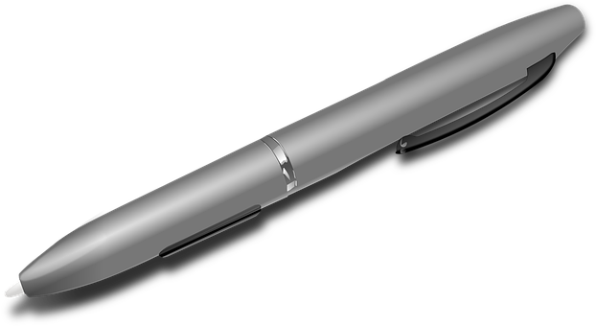
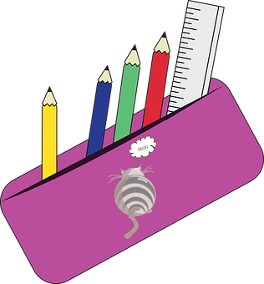






Follow up 3
A Escucha. ¿Qué número es?
B Escucha otra vez. ¿Qué imagen es?
escuchar
Escribe el número en español.
5
2
1
 | número en español ✍
?
?
?
?
?
?
E
siete
?
?
?
?
?
1
tres
E
once
?
?
?
2
?
?
dos
?
?
?
3
3
4
4
ocho
5
doce
Notes:
Timing: 10 minutes
Aim: to practise aural comprehension of numbers, and revisiting vocabulary, connecting sound with meaning.
Procedure:
(Part A)
Read the instruction in Spanish & click to bring further instruction. Ensure it’s clear for pupils they should write the word rather than just the number.
Do [E] with them. Click to listen.
Click for answers
(Part B)
Click to bring further instruction & pictures. Pupils to listen one more time and match the statements (E-5) with the pictures.
Do [E] with them. Click to listen.
Transcript 1:
[E] Tengo siete botellas.
[1] Tienes tres estuches.
[2] Tengo once preguntas.
[3] Tengo dos tartas.
[4] Tengo ocho globos.
[5] Tengo doce bolígrafos

Slide 6




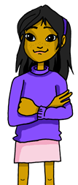

Follow up 4:
Tener: I have & you have.
[to have | having]
We have already seen the verb tener means ‘to have’.
I
You
tengo
To refer to I, we use ‘______’.
tienes
To refer to you, we use ‘_______’.
Tengo dos sombreros.
Tienes tres regalos.
You have three gifts.
I have two hats.
⚠ To talk about something in the plural (more than one), Spanish often adds an ‘s’ to the end of the noun ending in –o, -a or –e.
Notes:
Timing: 2 minutes
Aim: To revisit tener in 1st and 2nd person singular.
Procedure:
Read the grammar explanation on tener (to have).
Elicit English translation for the Spanish examples provided.

Slide 7
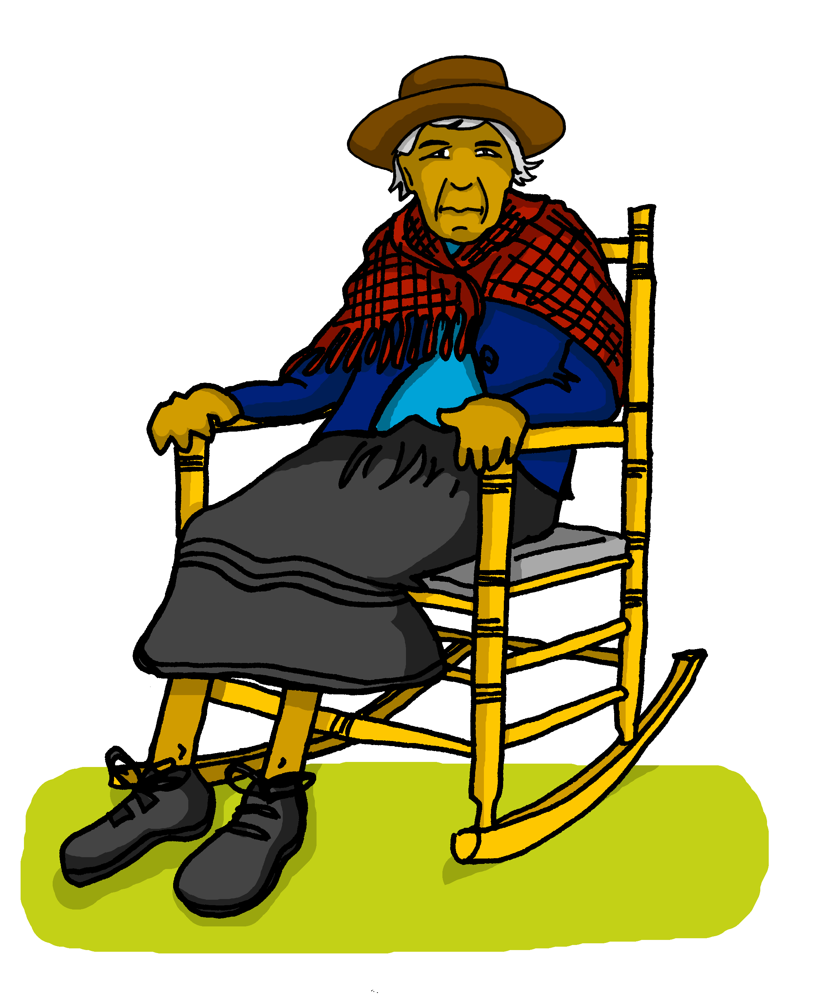

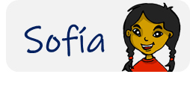
Follow up 4:
Sofía manda mensajes a la abuela.
¿Quién es?
Lee las frases.
Marca
leer
E
3
Sofía (I) | Abuela Valeria (you)
Tengo cinco preguntas.
¡Tienes un teléfono lento!
[E]
1
4
[1]
¿Tienes cuatro regalos para mí?
Tengo un conejo nervioso.
[2]
[3]
[4]
2
5
[5]
Tienes
dos casas muy bonitas.
¿Tienes seis cámaras?
para mí = for me
Notes:
Timing: 5 minutes
Aim: to practise written comprehension of tener in the 1st and 2nd persons singular.
Procedure:
Read the title & click to explain the context of the task.
Click to bring further instructions in Spanish.
Do [E] with them to model the task and draw their attention to the verb (tengo). Is it Sofía talking about her or is she talking to her grandma (you).
Pupils complete 1-5.
Click through the animations to bring up answers. If desired, click on the numbered buttons to hear sentence audio.
Ask pupils to translate the verbs
[E] I have five questions
[1] Do you have four presents for me?
[2] You have two pretty houses.
[3] You have a slow telephone!
[4] I have a nervous rabbit.
[5] Do you have six cameras?

Slide 8

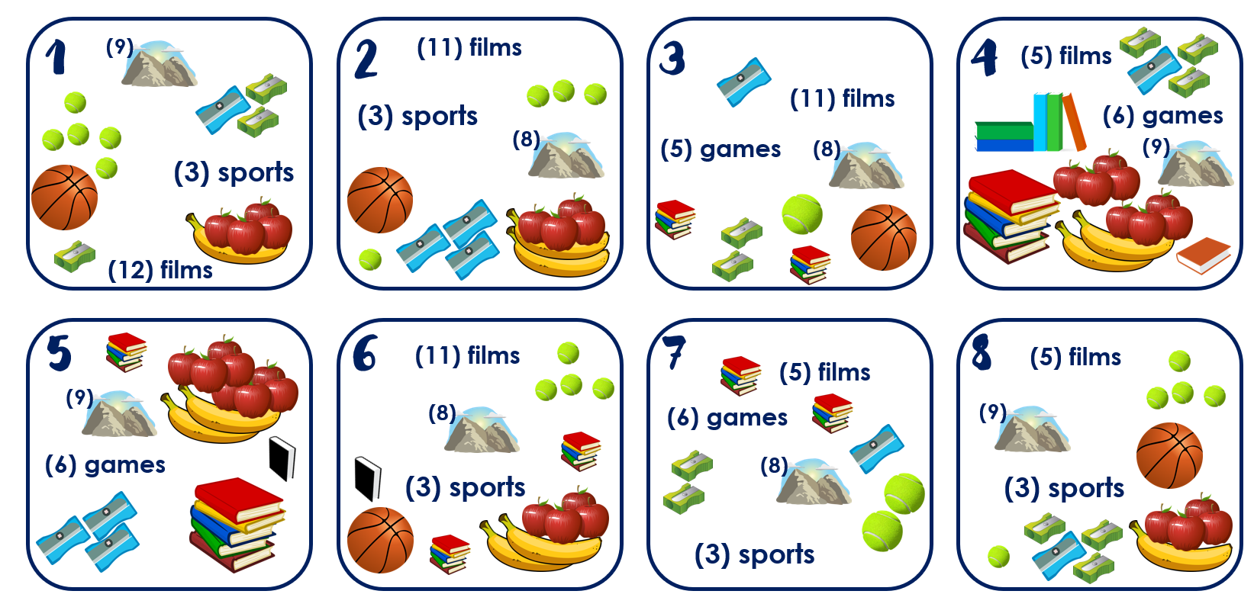
Follow up 4:
Escribe un número en secreto (1-8).
¿Tienes seis juegos?
¿Tienes cinco películas?
¿Tienes once películas?
¿Tienes tres deportes?
Sí 😊
Tu compañero adivina.
hablar
No…
No…
¡Sí…!
¡No…!
¡Tienes el número 3!
adivina= guesses
Notes:
Timing: 5 minutes (two slides)
Aim: to practise oral production of ‘tienes’, numbers and key vocabulary. Aural comprehension of key vocabulary & numbers.
Note: This version of the speaking task expects students to retrieve a wider range of vocabulary as well as numbers, and use the correct form of ‘tener’ (2nd person singular). There is an alternative version on the next slide, which includes the vocabulary. That version still requires students to use the correct verb form and question syntax/intonation, and correct number.
Procedure:
1. Read the instruction in Spanish and ask pupils to choose one card and write a number (NB. Some pupils would benefit from a printed copy of the cards).
2. Click to bring up the instructions and clarify “adivina”.
3. Click through the animations to model an example. The card in the example is number 3. Emphasize the importance of asking the full question using ‘tienes…?’

Slide 9

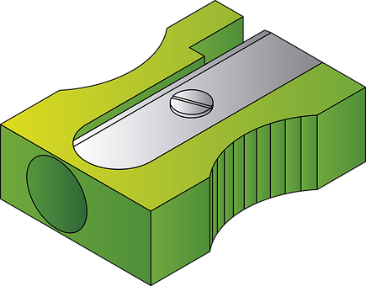









handout follow up 5 (cards)
1
(9)
2
(11) films
3
4
(5) films
(3) sports
(11) films
(6) games
(8)
(5) games
(8)
(9)
(3) sports
(12) films
5
6
(11) films
7
8
(5) films
(5) films
(9)
(8)
(9)
(6) games
(6) games
(8)
(3) sports
(3) sports
(3) sports
Notes:
DISPLAY DURING THE SPEAKING TASK

Slide 10
handout follow up 5 (cards)
1
(9) montañas
(4) sacapuntas
(6) pelotas
(3) deportes
(5) frutas
(12) películas
2
(11) películas
(3) deportes
(5) pelotas
(3) sacapuntas
(6) frutas
(8) montañas
3
(3) sacapuntas
(11) películas
(5) juegos
(8) montañas
(10) libros
(2) pelotas
4
(5) películas
(6) juegos
(11) libros
(4) sacapuntas
(10) frutas
(9) montañas
5
(11) libros
(10) frutas
(9) montañas
(6) juegos
(9) montañas
(3) sacapuntas
6
(11) películas
(5) pelotas
(8) montañas
(11) libros
(6) libros
(3) deportes
7
(5) películas
(6) juegos
(3) sacapuntas
(10) libros
(8) montañas
(3) deportes
8
(5) películas
(4) sacapuntas
(6) pelotas
(9) montañas
(3) deportes
(5) frutas
Notes:
Note: Alternative format for the speaking activity, giving more support. It is often beneficial to repeat speaking tasks. In this instance, students could first use this supported version of the task, and then repeat the task with a different partner, referring only to the picture table on the previous slide.

Slide 11




Follow up 5:
Escribe en inglés: Can you get at least 15 points?
 | la bicicleta | la cama | el gato
 | por | tiene | la amiga
 | la mañana | la semana | el tiempo
 | pasar | visitar | la mamá
 | diez | cinco | doce
 | siete | once | nueve
 | cuatro | ocho | seis
(the) bicycle
(the) bed
(the) cat
vocabulario
vocabulario
x3
through, along
s/he, it has
(the) friend (f)
(the) morning
(the) week
(the) time
x2
to pass, spend (time)
to visit, visiting
(the) mum
ten
five
twelve
seven
eleven
nine
x1
four
eight
six
Notes:
Timing: 6 minutes
Aim: to practise written production of vocabulary for this week and previous weeks.
Procedure:
1. Pupils need to write the English for as many words as possible, aiming to get at least 15 points (but more if possible).
2. Click for English answers.

Slide 12
Follow up:
Escribe en español: Can you get at least 15 points?
 | (the) bicycle | (the) bed | (the) cat
 | through, along | s/he, it has | (the) friend (f)
 | (the) morning | (the) week | (the) time
 | to pass, spend (time) | to visit, visiting | (the) mum
 | six | nine | eight
 | five | ten | eleven
 | four | seven | twelve
la bicicleta
la cama
el gato
vocabulario
vocabulario
x3
por
tiene
la amiga
la mañana
la semana
el tiempo
x2
pasar
visitar
la mamá
seis
nueve
ocho
cinco
diez
once
x1
cuatro
siete
doce
Notes:
Timing: 6 minutes
Aim: to practise written production of vocabulary for this week and previous weeks.
Procedure:
1. Pupils need to write the Spanish for as many words as possible, aiming to get at least 15 points (but more if possible).
2. Click for Spanish answers.

Slide 13
Follow up 5:
Escribe en inglés: Can you get at least 15 points?
 | la bicicleta | la cama | el gato
 | por | tiene | la amiga
 | la mañana | la semana | el tiempo
 | pasar | visitar | la mamá
 | diez | cinco | doce
 | siete | once | nueve
 | cuatro | ocho | seis
vocabulario
vocabulario
x3
x2
x1
Notes:
HANDOUT

Slide 14
Follow up:
Escribe en español: Can you get at least 15 points?
 | (the) bicycle | (the) bed | (the) cat
 | through, along | s/he, it has | (the) friend (f)
 | (the) morning | (the) week | (the) time
 | to pass, spend (time) | to visit, visiting | (the) mum
 | six | nine | eight
 | five | ten | eleven
 | four | seven | twelve
vocabulario
vocabulario
x3
x2
x1
Notes:
HANDOUT

Slide 15
¡adiós!
rojo

