Slide 1


español, con Sofía

Slide 2

Saying what I and others do
Actividades
rojo
-ER verbs:
I, you, s/he, it
SSC [que]
Notes:
Artwork by Steve Clarke. All additional pictures selected are available under a Creative Commons license, no attribution required.
The frequency rankings for words that occur in this PowerPoint which have been previously introduced in the resources are given in the SOW (excel document) and in the resources that first introduced and formally re-visited those words.
For any other words that occur incidentally in this PowerPoint, frequency rankings will be provided in the notes field wherever possible.
SSC: Introduce [que] paquete [2325] queso [3187]
Vocabulary: comprender [434] información [326] instrucción [2158] texto [753]
Revisit 1: caminar [514] nadar [3604] mar [480] montaña [1464] playa [1475] pueblo [244] el [1] la [1] de² [2] por¹ [15]
Revisit 2: tener [19] tengo [19] bolígrafo [>5000] cámara [903] cuaderno [3301] fruta [1925] mochila [>5000] pelota [2270] teléfono [866] un [6] una [6]
Source: Davies, M. & Davies, K. (2018). A frequency dictionary of Spanish: Core vocabulary for learners (2nd ed.). Routledge: London

Slide 3


[que]
paquete
pronunciar
⚠ You know the SSC [ca], [co], [cu]. The same /k/ sound in front of ‘e’ is [que] because [ce] is always a soft ‘c’ sound. E.g. celebrar.
Notes:
Timing: 1 minute
Aim: to introduce SSC [que]
Procedure:
To elicit the pronunciation of the individual SSC [que]
Click to bring up the picture and get students to repeat (with gesture, if using).
Gesture suggestion : with both hands, draw the shape of a rectangle in 3 moves (top, sides, bottom).

Slide 4







escuchar
Escucha. ¿Es ‘ca’, ‘co’ o ‘que’?
E
1
que
ca
par____
pes___do
4
que
pe____ño
2
3
bar__
que
co
___so
Notes:
Timing: 5 minutes
Aim: to recognise [que] with two previously learnt SSCs: ‘CA’ and ‘CO’. All of these SSCs share the /k/ phoneme.
Procedure:
Read the instruction and do the example [E] with pupils. Pupils to write the correct SSCs [ca], [co] or [que].
Do items1-4.
Go through answers by eliciting the Spanish word from pupils, and click to bring up answers.
Give pupils 1 minute to work in pairs to practise pronunciation.
Transcript:
E parque
1 pescado
2 barco
3 queso
4 pequeño
Frequency of unknown words:
barco [1384] parque [1354] pescado [3449] queso [3187]
Source: Davies, M. & Davies, K. (2018). A frequency dictionary of Spanish: Core vocabulary for learners (2nd ed.). Routledge: London

Slide 5


vocabulario
Practica el vocabulario:
¡Excelente!
3. necesitar
8. comprender
5. visitar
6. el pueblo
1. caminar
10. la instrucción
9. el texto
2. nadar
4. escuchar
7. la información
to walk, walking
to visit, visiting
instruction
to swim, swimming
to listen, listening
to need, needing
village
to understand, understanding
information
text
Notes:
Timing: 5 minutes
Aim: to practise written comprehension and spoken pronunciation of vocabulary.
Procedure:
1. Students write 1-10 in books.
2. Ask students to say the Spanish word out loud and then write down the English translation before the word has faded away (5 seconds per word).
3. Click for English translation to be highlighted.
4. Repeat for all 10 items.
5. Check answers by eliciting the Spanish from students, (i.e. so that they are translating back from their written English into spoken Spanish).
6. Note: click on the English meanings to hear the Spanish pronounced, if needed.

Slide 6


Knowing who does what
⚠ We don’t need pronouns because the verb ending tells us who is doing the action.
[–er verbs: ‘I’ versus ‘you’]
We know to mean ‘I’ and ‘you’ with a verb, the verb ending changes.
To mean ‘I’ with a verb, we remove –er and add -o.
To mean ‘you’ with a verb, we remove –er and add –es.
Ejemplo: comprender
I
You
Comprendo la instrucción.
Comprendes la instrucción.
I understand the instruction.
You understand the instruction.
Notes:
Timing: 3 minutes
Aim: to introduce 2nd person singular for –er verbs, building on the 1st person singular (introduced in term 2 week 5).
Procedure:
Click through the animations to present the new information.
Elicit English translations for the Spanish examples provided.

Slide 7






escuchar
Sofía habla con Quique: ¿Quién es? [1/6]
Escucha y escribe ‘A’ o ‘B’.
E
A
→
B
Escucha y escribe el verbo. ¿Qué imagen es correcta?
E
Comprendo
a
b
c
______________________
Notes:
Timing: 7 minutes [6 slides in total: Slide 1/6]
Aim: to practise aural recognition of 1st and 2nd person of –er verbs (singular)
Procedure:
Read the title and click to bring up the instructions in Spanish. Pupils need to identify to which person each statement refers to (I / YOU), They can write A or B.
Do the example (E).
Now click once more to bring up part 2. Pupils listen again to the same statement, write down the verb in Spanish and identify the picture that corresponds to the extra information in the sentence.
Click to bring up the written form of the verb and identify the correct letter/picture.
Transcript
[E] Comprendo el texto

Slide 8

escuchar
Sofía habla con Quique: ¿Quién es? [2/6]
Escucha y escribe ‘A’ o ‘B’.
1
A
→
B
Escucha y escribe el verbo. ¿Qué imagen es correcta?
?
E
Aprendes
a
b
c
______________________
Notes:
[6 slides in total: Slide 2/6]
[1] Aprendes un idioma

Slide 9
escuchar
Sofía habla con Quique: ¿Quién es? [3/6]
Escucha y escribe ‘A’ o ‘B’.
2
A
→
B
Escucha y escribe el verbo. ¿Qué imagen es correcta?
E
Comprendes
a
b
c
______________________
Notes:
[6 slides in total: Slide 3/6]
[2] Comprendes el texto

Slide 10
escuchar
Sofía habla con Quique: ¿Quién es? [4/6]
Escucha y escribe ‘A’ o ‘B’.
3
A
→
B
Escucha y escribe el verbo. ¿Qué imagen es correcta?
3
Leo
a
b
c
______________________
Notes:
[6 slides in total: Slide 4/6]
[3] Leo un libro

Slide 11


escuchar
Sofía habla con Quique: ¿Quién es? [5/6]
Escucha y escribe ‘A’ o ‘B’.
4
A
→
B
Escucha y escribe el verbo. ¿Qué imagen es correcta?
4
Ves
a
b
c
______________________
Notes:
[6 slides in total: Slide 5/6]
[4] Ves un deporte

Slide 12


escuchar
Sofía habla con Quique: ¿Quién es? [6/6]
Escucha y escribe ‘A’ o ‘B’.
5
A
→
B
Escucha y escribe el verbo. ¿Qué imagen es correcta?
5
Veo
a
b
c
______________________
Notes:
[6 slides in total: Slide 6/6]
[5] Veo el mar

Slide 13


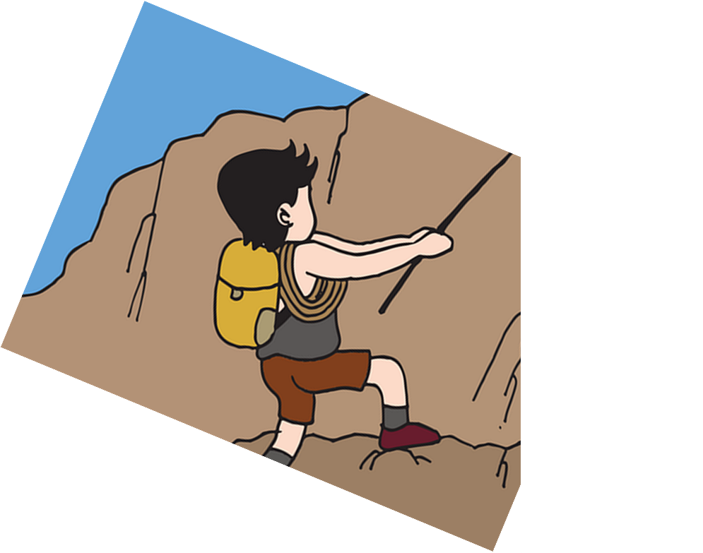
leer
Lee la frase y traduce al inglés.🗣
[1/5]
Lees un libro.
text
question
book
instruction
5
4
the
a
an
3
read
watch
learn
understand
2
I
You
1
Notes:
Timing: 5 minutes [5 slides, 5 items] Slide 1/5
Aim: to practise comprehension of 1st and 2nd person singular of –er verbs, key vocabulary & definite and indefinite articles in reading.
Procedure:
Tell students they need to use the words, starting from the bottom, to climb up the mountain (so that they translate the sentence!).
Ask students to work in pairs to practise first.
Click to trigger the timer (15 seconds per sentence).
Ask a volunteer from a pair to say the Spanish sentence out loud and the English translation.
Click on the Spanish sentence, as required, to hear the pronunciation.
Repeat with the next 4 sentences (there are 5 in total).

Slide 14
Leer y hablar
Lee la frase y traduce al inglés.🗣
[2/5]
leer
Comprendo la instrucción.
5
text
instruction
film
language
4
the
a
an
3
understand
learn
watch
buy
2
I
You
1
Notes:
Slide 2/5

Slide 15
Leer y hablar
Lee la frase y traduce al inglés.🗣
[3/5]
leer
Aprendes un juego.
game
information
sport
language
5
the
a
an
4
listen
read
understand
learn
3
I
You
2
1
Notes:
Slide 3/5

Slide 16
Leer y hablar
Lee la frase y traduce al inglés.🗣
[4/5]
leer
Comprendes español en clase.
class
home
in
5
at
4
Spanish
English
3
read
watch
learn
understand
2
I
You
1
Notes:
Slide 4/5

Slide 17
Leer y hablar
Lee la frase y traduce al inglés.🗣
[5/5]
leer
Veo una película.
sea
5
beach
film
mountain
4
an
a
the
3
read
visit
sing
watch
2
I
You
1
Notes:
Slide 5/5

Slide 18
¡adiós!
rojo

