Slide 1
español, con Sofía

Slide 2
Describing me and others do
rojo
-ar verbs: I, you, s/he, it
SSC [ga] [go] [gu]
Notes:
Artwork by Steve Clarke. All additional pictures selected are available under a Creative Commons license, no attribution required.
The frequency rankings for words that occur in this PowerPoint which have been previously introduced in the resources are given in the SOW (excel document) and in the resources that first introduced and formally re-visited those words.
For any other words that occur incidentally in this PowerPoint, frequency rankings will be provided in the notes field wherever possible.
Phonics - SSC: ganar [295] lago [2151] gusano [4217]
Vocabulary: pasar [68] visitar [792] mamá [675] mañana [402] papá [865] semana [301] tiempo [80] por² [15]
Revisit 1: cantar [717] escuchar [281] hablar [90] necesitar [276] español [262] frase [1037] inglés [583] fantástico [2501] importante [171] normal [1000]
Revisit 2: eres [7] (recycle adjectives) de1 [2] Inglaterra [n/a] España [n/a] Perú [n/a]
Glossed words: a [8] rutina [3050]
Source: Davies, M. & Davies, K. (2018). A frequency dictionary of Spanish: Core vocabulary for learners (2nd ed.). Routledge: London

Slide 3
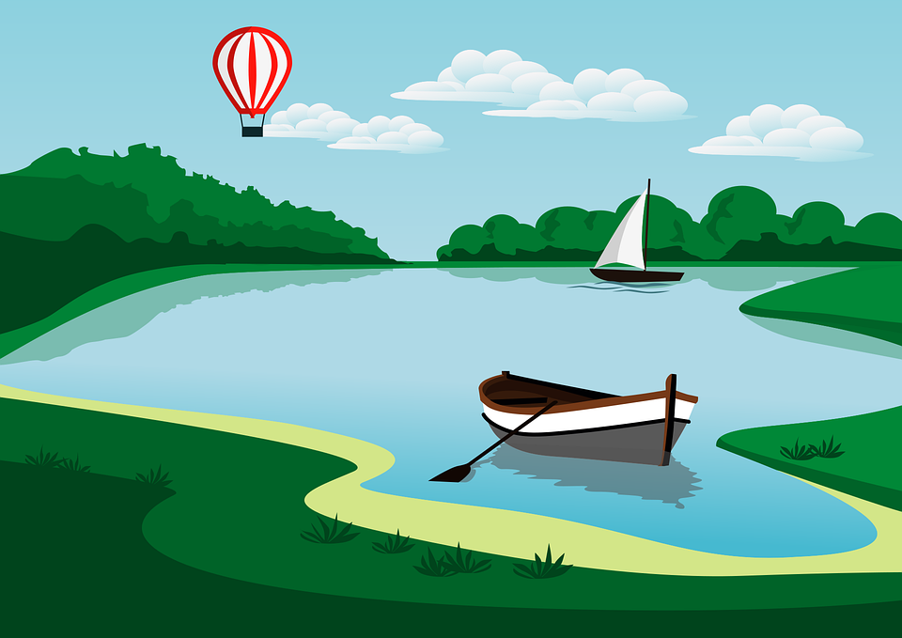
[ga]
ganar
pronunciar
[go]
lago
[gu]
gusano
Notes:
Timing: 1 minute
Aim: To revisit SSC [ga] [go] [gu]
Procedure:
To recap and elicit the pronunciation of the individual SSC [ga] [go] [gu]
Click to bring the picture & get students to repeat (with gesture, if using).
Gesture suggestion for ganar: lift your fist up in two goes.
Gesture suggestion for lago: rowing – two movements
Gesture suggestion for gusano: with index finger, lift up and down three times.

Slide 4
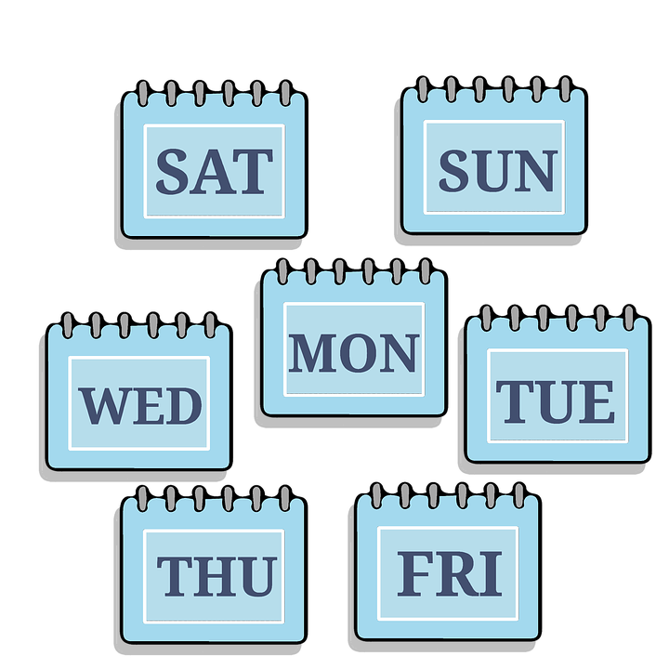
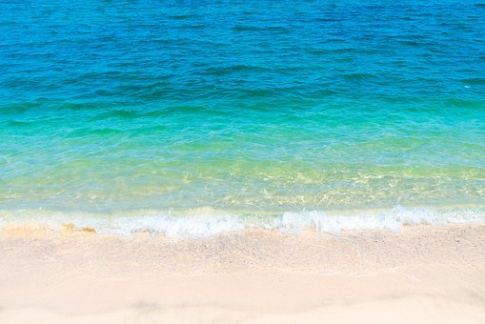
Vocabulario
- - -
¿Es un, una, el, la?
escuchar
[el]
[un]
- - -[ ]- - -
__ montaña the mountain
__ cuaderno the exercise book
__ mañana the morning
__ semana
a week
__ mar the sea
__ pueblo the village
__ pelota a ball
__ playa the beach
__ sacapuntas
a pencil sharpener
[la]
[una]
- - -
Notes:
Timing: 5 minutes
Aim: to practise aural distinction between un and una; to present the new vocabulary for this week in sound and writing, and with English meanings.
Procedure:
Click for each word to appear with audio (without article).
Pupils say ‘el’, ‘la’, ‘un’, ‘una’, depending on the noun’s gender.
Click again for it to disappear into the corresponding pacperson’s mouth.
Transcript el mar
la mañana
una semana
un sacapuntas
el pueblo
la playa
el cuaderno
una pelota
la montaña

Slide 5
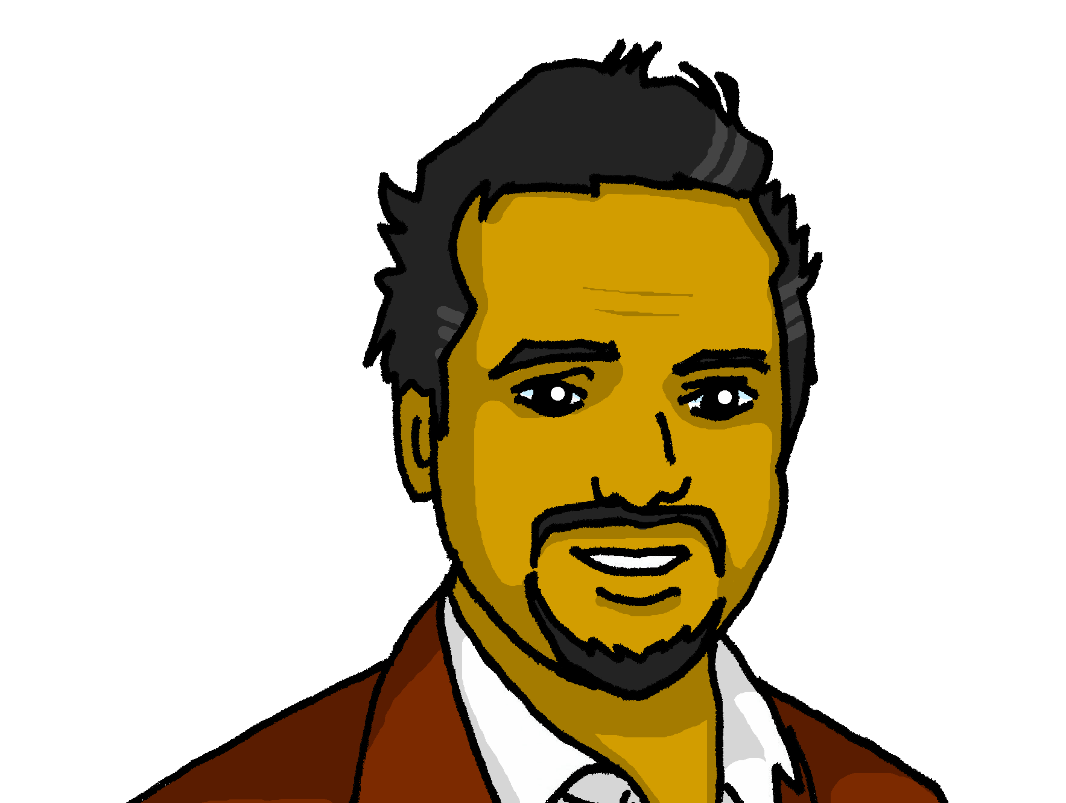
vocabulario
la mamá
el papá
[mum]
[dad]
pasar
visitar
[to pass, spend (time)]
[to visit, visiting]
la mañana
la semana
[morning]
[week]
⚠ Use por for in with times of day: e.g. por la mañana (in the morning)
por
el tiempo
[in (times of day) through, around, along]
[time]
Notes:
[1/3]
Timing: 3 minutes
Aim: to introduce new vocabulary.
Procedure 1. Pupils either work by themselves or in pairs, reading out the words and recapping their English meaning (1 minute). 2. Then, in the next slide, students try to recall the English orally (chorally), looking at the Spanish (1 minute). 3. Then, in the following slide, they to recall the Spanish meanings orally (again, chorally), looking at the English (1 minute).
Notes:
Note that images/words won’t disappear and appear in this activity as in previous resources.

Slide 6
vocabulario
m_ _
la mamá
d_ _
el papá
mum
dad
to pass, spend (time)
to p_ _ _, s_ _ _ _ (t_ _ _)
to visit, visiting
pasar
t_ v_ _ _ _, v_ _ _ _ _ _ _
visitar
m_ _ _ _ _ _
w_ _ _
la semana
morning
la mañana
week
in (times of day)
i_ (t_ _ _ _ o_ d_ _)
t_ _ _
por
time
el tiempo
Notes:
[2/3]
Procedure: 1. Students try to recall the English orally (chorally), looking at the Spanish (1 minute). 2. Elicit answers and click to reveal
3. Then, in the following slide, they to recall the Spanish meanings orally (again, chorally), looking at the English (1 minute).

Slide 7
vocabulario
el papá
mum
l_ m_ _ _
dad
e_ p_ _ _
la mamá
to pass, spend (time)
p_ _ _ _
to visit, visiting
visitar
pasar
visitar
week
la semana
morning
la mañana
l_ s_ _ _ _ _
l_ m_ _ _ _ _
in (times of day)
el tiempo
p_ _
e_ t_ _ _ _ _
por
time
Notes:
[2/3]
Procedure: 1. Students recall the Spanish meanings orally (again, chorally), looking at the English (1 minute)
2. Click to reveal the answers.

Slide 8
Knowing who does what
⚠ We don’t need pronouns because the verb ending tells us who is doing the action.
[–ar verbs: ‘I’ versus ‘s/he, it’]
To mean ‘I’ with a verb, we remove –ar and add -o.
To mean ‘you’ with a verb, we remove –ar and add –as.
I
you
Camino por la playa.
Caminas por la playa.
I walk along the beach.
You walk along the beach.
Notes:
Timing: 3 minutes
Aim: to introduce 2nd person singular for –ar verbs.
Procedure:
Click through the animations to present the new information.
Elicit English translations for the Spanish examples provided.

Slide 9
escuchar
Sofía habla a Quique: ¿De quién habla?
¿Qué más menciona? Marca
Marca
 | Sofía (I) | Quique (you)
object | place | person
En inglés
E
fruit
a film
1
(with) dad
2
along the beach
3
(with) dad
4
(with) mum
5
(small) bag
in class
Notes:
Timing: 7 minutes
Aim: to practise aural recognition of 1st and 2nd person of –ar verbs (singular); to practise comprehension of vocabulary in short sentences.
Procedure:
Read the title and click to bring up the instructions in Spanish. Pupils need to identify to which person each statement refers to (I / YOU)
Do the example (E).
Click to bring up the answers.
Pupils listen again to understand more information from each sentence. Pupils can either write 1A/B/C, etc.. or if they have the printout they can put an X in the correct box. Some pupils can also write the key words in English.
Click to bring up answers (tick and English words) and get pupils to check their answers.
Transcript:
[E] Necesito una fruta.
[1] Compro una película con papá.
[2] Caminas por la playa.
[3] Hablo con papá.
[4] Pasas tiempo con mamá.
[5] Llevas una mochila pequeña en clase.
NB. If pupils find part 2 of the task particularly challenge, you could adapt it and make it more accessible by:
Adding pictures and getting pupils to label.
Giving pupils English words and they number / label them.

Slide 10
Multiple meanings of ‘por’
[prepositions]
You learnt ‘por’ is a preposition that is often used with verbs of movement.
It can be translated in different ways in English.
Ejemplo:
Camino por la playa.
Camino por el pueblo.
I walk along the beach.
I walk around the village.
We also use ‘por’ to indicate the time of the day (morning, evening). In this case, it is translated as ‘in’.
Ejemplo:
Nado en el mar por la mañana.
I swim in the sea in the morning.
Notes:
Timing: 2 minutes
Aim: to introduce two key prepositions en & por
Procedure:
Read the grammar explanation on gender in Spanish.
Click to bring up examples of singular masculine and feminine nouns.

Slide 11
leer
Sofía escribe a* Quique sobre la rutina* por la mañana.
Escucha las frases: ¿’en’ o ‘por’?
¿en inglés?
escuchar
Marca
 | in | around
[E] Escuchas la radio por la mañana.
[1] Nadas en el mar.
[2] Camino por el pueblo.
E
1
2
[3] Necesito un cuaderno en clase.
3
[4] Canto por la casa.
4
[5] Por la mañana, pasas tiempo con mamá.
5
a = to
la rutina = routine
el tiempo = time
Notes:
Timing: 8 minutes (2 slides)
Aim: to practise written comprehension of t 1st & 3rd person singular verb endings with a range of regular –ar verbs; multiple translation of ‘por’
Procedure:
Read the title & click to explain the context of the task. Pupils to listen and annotate whether it’s ‘en’ or ‘por’ (NB. Some pupils could attempt this task prior to listening. Note that both ‘en’ and ‘por’ could work for #4.
Click through the animations to bring up answers.
Pupils to read the sentences aloud again and the decide the correct translation of ‘en’ and ‘por’. (next task focuses on comprehension at sentence level, including the person of the verb).
(slide 2). Read the instruction (traduce las frases al inglés).
Pupils to complete the translation task.
Click through the animations to bring up answers.

Slide 12
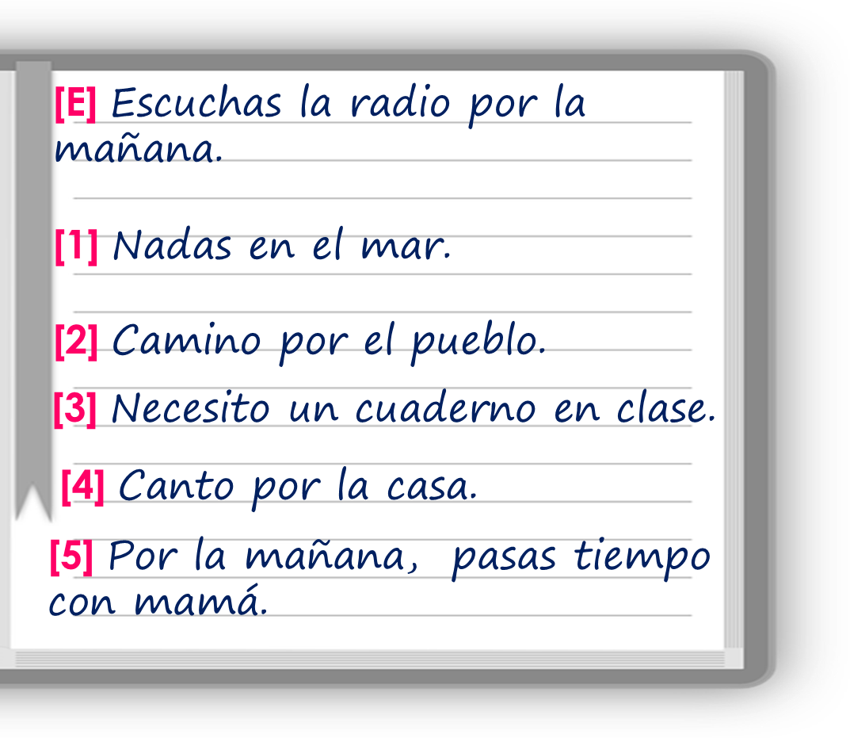
leer
Traduce las frases al inglés.
escuchar
 | ____ listen to the radio __ the ________.
 | ____ ______ in the sea.
 | ___ walk ________ the village.
 | __ ______ an exercise book ____ class.
 | __ sing ________ the house.
 | ___ ____ _________, ____ _______ time with mum.
E
You
in
morning
1
You
swim
2
I
around
3
I
need
in
4
I
around
morning
you
In
spend
the
5
a = to
la rutina = routine
el tiempo = time
Notes:
Aim: to practise written comprehension of t 1st & 3rd person singular verb endings with a range of regular –ar verbs; multiple translation of ‘por’
Procedure:
(slide 2). Read the instruction (traduce las frases al inglés).
Pupils to complete the translation task.
Click through the animations to bring up answers.
Click the audio buttons to listen again, if desired.

Slide 13
hablar
¡Habla! Say the Spanish sentence. [1/4]
You do not need all of the words!
You buy a film
15
Compras una película.
S
compro
un
una
regalo
compras
bonito
el
película
0
INICIO
Notes:
Time: 5 minutes
(Slide 1/4)
Aim: to practise oral sentence building. Targeted features: 1st & 3rd person singular; prepositions Procedure:
1. Click for English sentence and Spanish prompt words. 2. Click inicio to start the timer.
3. Pupils select from the words given to create and say the sentence out loud before the time elapses. 4. Click for the Spanish sentence to appear.

Slide 14
hablar
¡Habla! Say the Spanish sentence. [2/5]
You do not need all of the words!
I listen to Spanish in the morning.
15
Escucho español por la mañana.
S
español
mañana
escucho
en
España
escuchas
por
la
0
INICIO
Notes:
Time: 5 minutes
(Slide 2/4)
Aim: to practise oral sentence building. Targeted features: 1st & 3rd person singular; prepositions Procedure:
1. Click for English sentence and Spanish prompt words. 2. Click inicio to start the timer.
3. Pupils select from the words given to create and say the sentence out loud before the time elapses. 4. Click for the Spanish sentence to appear.

Slide 15
hablar
¡Habla! Say the Spanish sentence. [3/4]
You do not need all of the words!
You walk in / through the mountain with dad.
15
Caminas por la montaña con papá.
S
camino
mamá
caminas
con
montaña
papá
por
la
0
INICIO
Notes:
Time: 5 minutes
(Slide 3/4)
Aim: to practise oral sentence building. Targeted features: 1st & 3rd person singular; prepositions Procedure:
1. Click for English sentence and Spanish prompt words. 2. Click inicio to start the timer.
3. Pupils select from the words given to create and say the sentence out loud before the time elapses. 4. Click for the Spanish sentence to appear.

Slide 16
hablar
¡Habla! Say the Spanish sentence. [3/4]
You do not need all of the words!
I walk with a hat along the beach.
15
Camino con un sombrero por la playa.
S
camino
sombrero
caminas
playa
en
por
el
un
la
con
0
INICIO
Notes:
Time: 5 minutes
(Slide 4/4)
Aim: to practise oral sentence building. Targeted features: 1st & 3rd person singular; prepositions Procedure:
1. Click for English sentence and Spanish prompt words. 2. Click inicio to start the timer.
3. Pupils select from the words given to create and say the sentence out loud before the time elapses. 4. Click for the Spanish sentence to appear.

Slide 17
¡adiós!
rojo

