Slide 1

Saying what I and others do
rojo
Follow ups 1-5
Notes:
Artwork by Steve Clarke. All additional pictures selected are available under a Creative Commons license, no attribution required.
The frequency rankings for words that occur in this PowerPoint which have been previously introduced in the resources are given in the SOW (excel document) and in the resources that first introduced and formally re-visited those words.
For any other words that occur incidentally in this PowerPoint, frequency rankings will be provided in the notes field wherever possible.
Phonics - SSC: ganar [295] lago [2151] gusano [4217]
Vocabulary: pasar [68] visitar [792] mamá [675] mañana [402] papá [865] semana [301] tiempo [80] por² [15]
Revisit 1: cantar [717] escuchar [281] hablar [90] necesitar [276] español [262] frase [1037] inglés [583] fantástico [2501] importante [171] normal [1000]
Revisit 2: eres [7] (recycle adjectives) de1 [2] Inglaterra [n/a] España [n/a] Perú [n/a]
Source: Davies, M. & Davies, K. (2018). A frequency dictionary of Spanish: Core vocabulary for learners (2nd ed.). Routledge: London

Slide 2

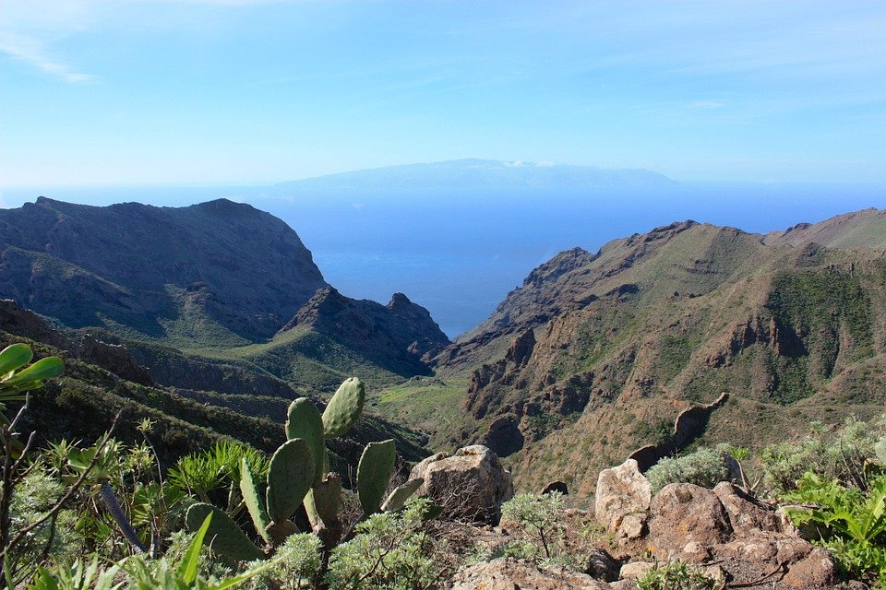





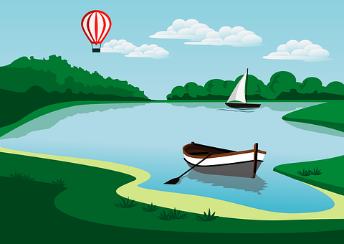

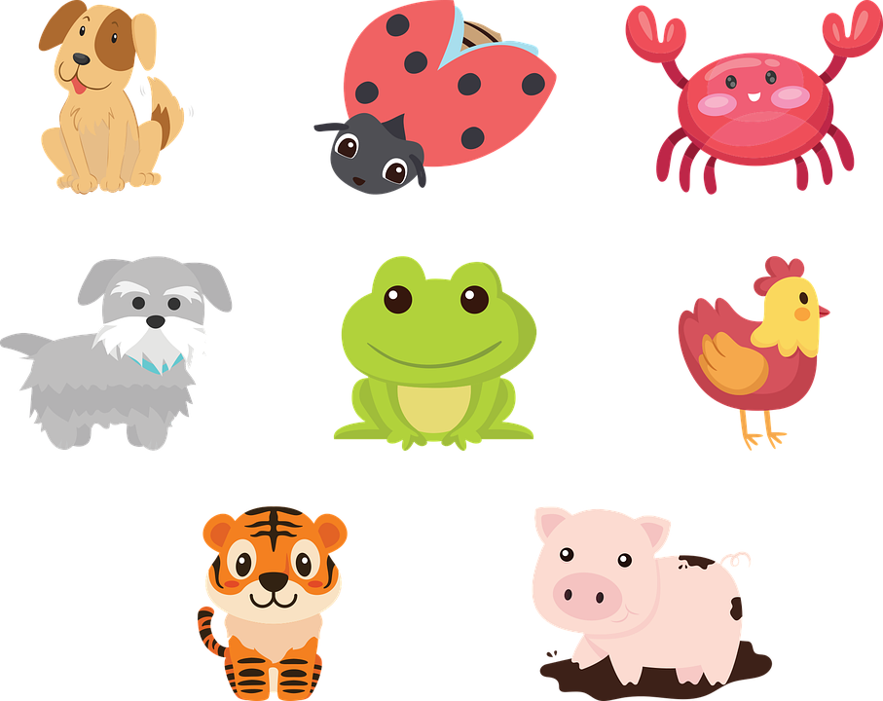
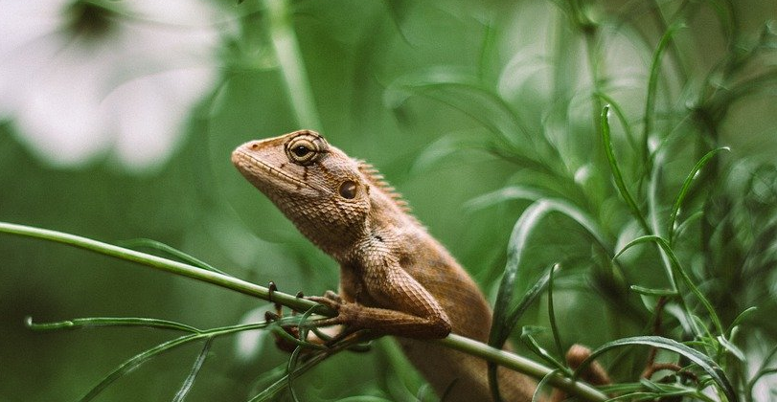

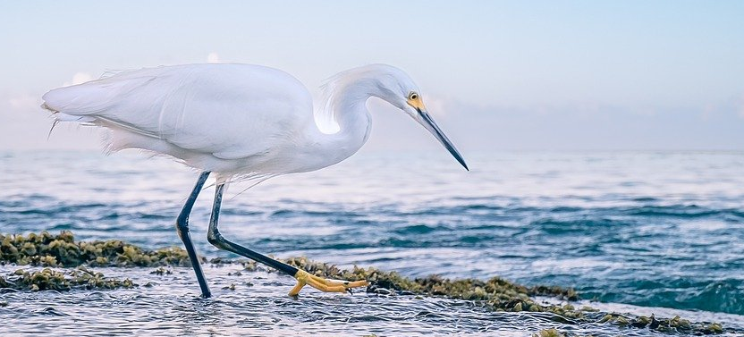

Follow up 1
[ga] [go] [gu]
A Escucha. Escribe [ga] [go] or [gu].
La Gomera es una isla
de [1] fue _ _ , [2] a_ _a y vistas
[3] con la _ _ s y [4] la _ _ nas.
y una fauna nunca vista.
el [5] murciéla _ _ , y el [6] la _ _ rto.
[7] y una _ _ rza bien lista.
go
gu
go
gu
go
ga
ga
B Practica el poema con tu pareja.
INICIO
Notes:
Timing: 5 minutes
Aim: to develop phonological awareness of [ga] [go] [gu]
Procedure:
Part A
Pupils write 1 – 7.
Either click to hear each line of the poem individually OR play the slower version of the whole poem (.mp3 icon on the top right of the photo of Gomera).
Click to correct answers.
Listen to the poem spoken a little faster (.mp3 icon next to the timer on the right of the slide).
Part B
Procedure:
1. Click on ‘inicio’ to start the timer.
2. Pupils work in pairs to recite the poem.
Transcript
La Gomera es una isla
de fuego, agua y vistas
con lagos y lagunas
y una fauna nunca vista.
el murciélago, y el largarto,
y una garza bien lista.
NB. All bold words in Part A are unknown to pupils (pictures are provided to clarify meaning).
Frequency of unknown words and/or cognates:
isla [810] agua [204] fuego [884] garza [[5000]] lagarto [5000] lago [2151] laguna [3378] murciélago [[5000]] vista [408] nunca [158]
Source: Davies, M. & Davies, K. (2018). A frequency dictionary of Spanish: Core vocabulary for learners (2nd ed.). Routledge: London

Slide 3

Follow up 2:
Knowing who does what
⚠ We don’t need pronouns because the verb ending tells us who is doing the action.
[–ar verbs: ‘I’, ‘you’, ‘s/he, it’]
In Spanish, the words for ‘I’ and ‘s/he’ (pronouns) are often unnecessary.
To mean ‘I’ with a verb, we remove –ar and add -o.
To mean ‘you’ with a verb, we remove –ar and add –as.
To mean ‘s/he, it’ with a verb, we remove –ar and add –a.
Notes:
Timing:
Aim: to revisit 1st, 2nd & 3rd person singular of –ar verbs.
Procedure:
Click through the animations to present the new information.
Elicit English translations for the Spanish examples provided.

Slide 4




Follow up 2:
la abuela = grandma
hace = s/he does/makes
Sofía pasa tiempo con la abuela Valeria.
¿Quién es?
leer
Visito el pueblo con mi abuela.
Sofía (I) | la abuela (she)
¿Qué?
pueblo casa
playa mar
montaña pueblo
mañana teléfono
tarta regalo
pueblo playa
E
Nada en el mar con Quique.
1
2
Camino por la montaña.
3
Habla con un familiar por la mañana.
4
Compra el regalo para Rubén y Ángela.
5
Llevo un sombrero por la playa.
Notes:
Timing: 10 minutes (4+6)
Aim: To practise written comprehension of 1st and 3rd person singular and connect these to their meaning; to identify nouns from the indefinite articles; to understand new and previously taught nouns and adjectives.
Part 1
Procedure:
Read the scenario with pupils. They should understand that Sofía is visiting Grandma Valeria in Perú, and she is writing a list of what she does and grandma does in the morning. She has smudged some of her writing, though. Can they still work out who does what?
Do the first one with pupils. They work out ‘quién’ by looking at the verb ending (o / a), they work out ‘qué’ by looking at the article,. Click to work through the task in small steps, highlighting in pink the relevant parts of the sentence.
Pupils write 1 – 5 and complete the tasks.
Click to correct.
Click the blue buttons to hear the sentences. This can be used as a ‘listen and check’.

Slide 5
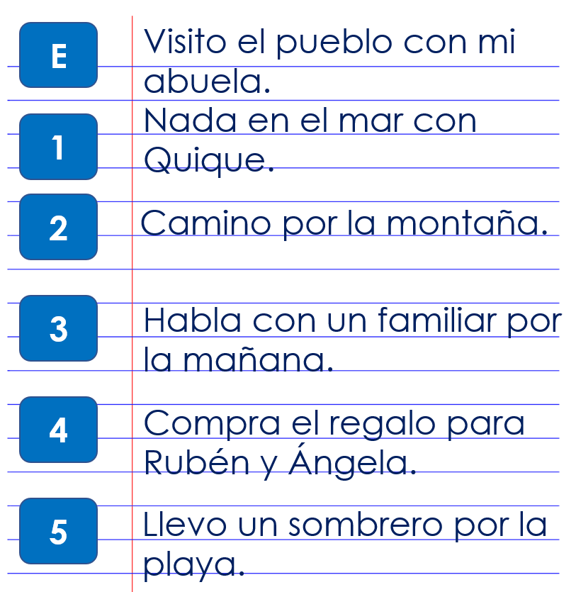
Follow up 2:
la abuela = grandma
hace = s/he does/makes
As part of her English homework, Sofía has tried to translate her list into English but she’s made some mistakes. Can you help her?
leer
E | You visit the beach with your grandma.
1 | I swim in the lake with Quique.
2 | She walks in the sea.
3 | You talk with a relative for the morning.
4 | You buy a ruler for Rubén and Ángela.
5 | She wears a hat in the village.
I
village
my
She
s
lake
I
walk
mountain.
She
talks
in
She
s
present
I
wear
along
beach.
Notes:
Timing: 4 minutes
Aim: To practise written comprehension of 1st and 3rd person singular and connect these to their meaning; to identify nouns from the indefinite articles; to understand new and previously taught nouns and adjectives.
Part 2
Procedure:
Read the scenario with pupils.
Do the first one with pupils.
Pupils write 1 – 5 and complete the tasks.
Click to correct.

Slide 6

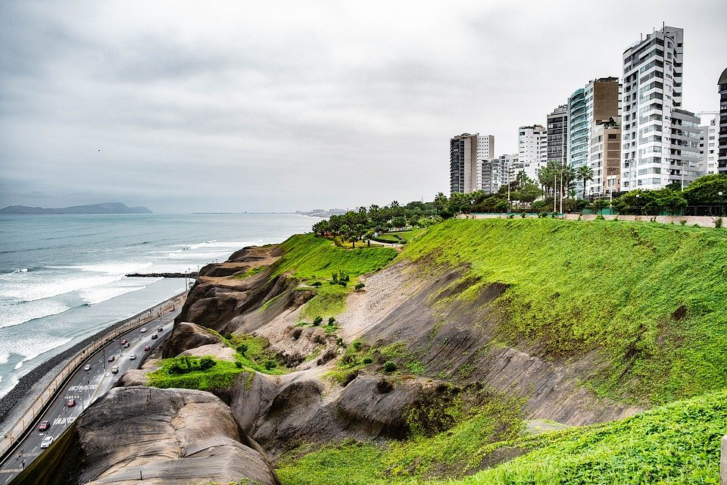
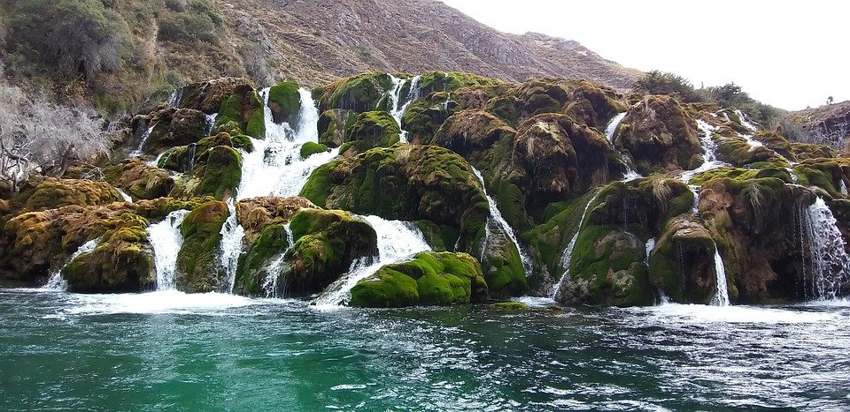
Follow up 3:
Lima es la capital de Perú y está en el océano Pacífico.
leer
En Perú, Sofía visita Huancaya. Es un pueblo muy bonito y está en Lima.
Huancaya
Lima
Notes:
Timing: 1 minute
Aim: to locate the photo used in the stimulus for the speaking task.
Text translation: In Perú, Sofía visits Huancaya. It’s a very pretty village and it’s in Lima.

Slide 7
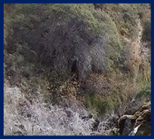
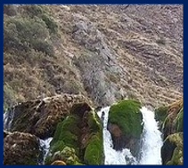
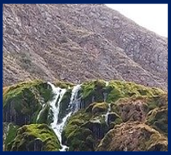
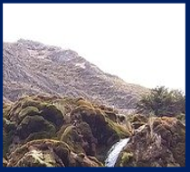
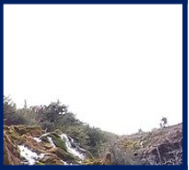
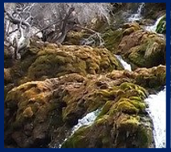
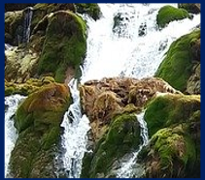
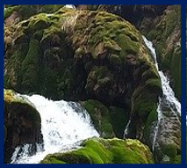
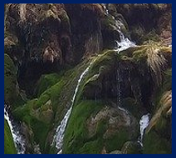
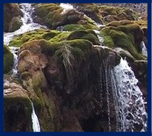

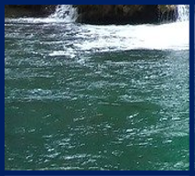
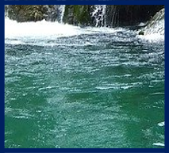
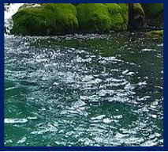
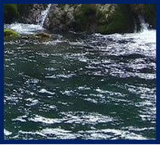
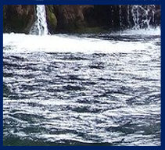
Follow up 3:
¿Dónde está Sofía? [1/4]
Huancaya es un pueblo muy bonito en Lima, Perú.
hablar
to walk
to sing
to swim
to buy
to listen
I
You
s/he
Notes:
Timing: 5 minutes
Aim: to correctly use 1^{st,} 2nd and 3rd person singular verbs in oral production.
Procedure:
Pupils select a verb form on the vertical axis with an adjective along the horizontal axis.
They translate the short sentence (e.g. I – to walk = Camino) to identify the square where they think Sofía is.
Click on the square to reveal what is beneath.
Note: pupils might benefit from revisiting the infinitive verbs again before starting the activity. (i.e., caminar, cantar, nadar, comprar, escuchar).
(!) Sofía is hidden behind….
Caminas

Slide 8
Follow up 3:
¿Dónde está Sofía? [2/4]
hablar
to walk
to sing
to swim
to buy
to listen
I
You
s/he
Notes:
Timing: 5 minutes [2/4]
Aim: to correctly use 1^{st,} 2nd and 3rd person singular verbs in oral production.
Procedure:
Pupils select a verb form on the vertical axis with an adjective along the horizontal axis.
They translate the short sentence to identify the square where they think Sofía is.
Click on the square to reveal what is beneath.
(!) Sofía is hidden behind….
Nada

Slide 9
Follow up 3:
¿Dónde está Sofía? [3/4]
hablar
to walk
to sing
to swim
to buy
to listen
I
You
s/he
Notes:
Timing: 5 minutes [3/4]
Aim: to correctly use 1^{st,} 2nd and 3rd person singular verbs in oral production.
.
Procedure:
Pupils select a verb form on the vertical axis with an adjective along the horizontal axis.
They translate the short sentence to identify the square where they think Sofía is.
Click on the square to reveal what is beneath.
(!) Sofía is hidden behind….
compro

Slide 10
Follow up 3:
¿Dónde está Sofía? [4/4]
hablar
to walk
to sing
to swim
to buy
to listen
I
You
s/he
Notes:
Timing: 5 minutes [3/4]
Aim: to correctly use 1^{st,} 2nd and 3rd person singular verbs in oral production.
.
Procedure:
Pupils select a verb form on the vertical axis with an adjective along the horizontal axis.
They translate the short sentence to identify the square where they think Sofía is.
Click on the square to reveal what is beneath.
(!) Sofía is hidden behind….
canta

Slide 11



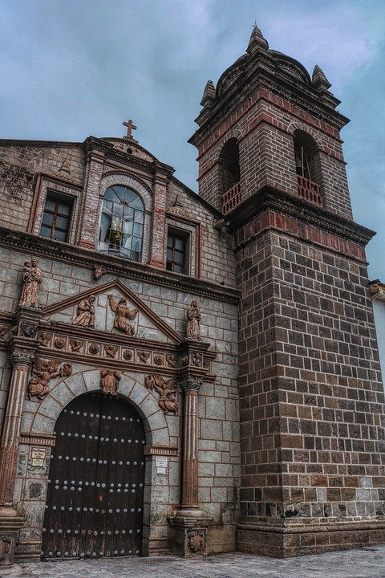
Follow up 4:
B Traduce la postal.
Lee y escribir
¡[Hello] Ángela!
¡Hola Ángela!
[I am] en Lima [with] mi abuela [and]
estoy muy [happy]. [In] [the morning],
[I sing] and Quique [(he) swims]. Mi abuela [(she) speaks] [with] mi mamá. La familia en Perú es muy [important]. También [I spend] tiempo [around] [the village] de Ayacucho. Es [pretty]. [Do you sing] en casa?
Hasta pronto 👋, Sofía
Ángela Flores García
Ayacucho
Notes:
Timing: 8 minutes
Aim: to correctly use a range of present tense verb forms and key vocabulary from this week.
Procedure:
Pupils could number 1-16 for the gaps and translate each [prompt] into Spanish.
Go to the next slide to check answers and listen to a recording of the text.

Slide 12
Follow up 4:
B Traduce la postal.
Lee y escribir
¡[Hello] Ángela!
¡Hola Ángela!
¡Hola Ángela!
[I am] en Lima [with] mi abuela [and]
Estoy en Lima con mi abuela y
estoy muy [happy]. [In the morning],
estoy muy contenta. Por la mañana,
[I sing] and Quique [(he) swims].
Canto and Quique nada.
Ángela Flores García
Mi abuela [(she) speaks] [with] mi mamá.
Mi abuela habla con mi mamá.
La familia en Perú es muy [important].
La familia en Perú es muy importante.
También paso tiempo por
el pueblo de Ayacucho.
También [I spend] tiempo [around] [the village] de Ayacucho.
Es [pretty]. [Do you sing] en casa?
Es bonito. Cantas en casa?
Hasta pronto 👋, Sofía
Ayacucho
Notes:
Timing: 8 minutes
Aim: to correctly use a range of present tense verb forms and key vocabulary from this week.
Procedure:
Click to reveal answers and click the .mp3 player to listen to a recording of the text.

Slide 13




Follow up:
Escribe en inglés: Can you get at least 15 points?
 | eres | España | Perú
 | fantástico | importante | Inglaterra
 | el español | la frase | el inglés
 | cantar | hablar | necesitar
 | el tiempo | por | escuchar
 | la mañana | (el) papá | la semana
 | pasar | visitar | (la) mamá
you are
Spain
Peru
vocabulario
vocabulario
x3
fantastic
important
England
Spanish
phrase
English
x2
to sing, singing
to speak, speaking
to need, needing
time
through, in
to listen, listening
morning
dad
week
x1
to spend, spending
to visit, visiting
mum
Notes:
Timing: 6 minutes
Aim: to practise written production of vocabulary for this week and previous weeks.
Procedure:
1. Pupils need to write the English for as many words as possible, aiming to get at least 15 points (but more if possible).
2. Click for English answers.
pasar [68] visitar [792] mamá [675] mañana [402] papá [865] semana [301] tiempo [80] por² [15]
Revisit 1: cantar [717] escuchar [281] hablar [90] necesitar [276] español [262] frase [1037] inglés [583] fantástico [2501] importante [171] normal [1000]
Revisit 2: eres [7] (recycle adjectives) de1 [2] Inglaterra [n/a] España [n/a] Perú [n/a]

Slide 14
Follow up:
Escribe en inglés: Can you get at least 15 points?
 | eres | España | Perú
 | fantástico | importante | Inglaterra
 | el español | la frase | el inglés
 | cantar | hablar | necesitar
 | el tiempo | por | escuchar
 | la mañana | (el) papá | la semana
 | pasar | visitar | (la) mamá
vocabulario
vocabulario
x3
x2
x1
Notes:
HANDOUT

Slide 15
Follow up:
Escribe en español: Can you get at least 15 points?
 | you are (trait) | Spain | Peru
 | fantastic | important | England
 | (the) Spanish | (the) phrase | (the) English
 | to sing, singing | to speak, speaking | to need, needing
 | (the) time | through, in | to listen, listening
 | (the) morning | (the) dad | (the) week
 | to spend (time) | to visit, visiting | (the) mum
eres
España
Perú
vocabulario
vocabulario
x3
fantástico
importante
Inglaterra
el español
la frase
el inglés
x2
cantar
hablar
necesitar
el tiempo
por
escuchar
la mañana
(el) papá
la semana
x1
pasar
visitar
(la) mamá
Notes:
Timing: 6 minutes
Aim: to practise written production of vocabulary for this week and previous weeks.
Procedure:
1. Pupils need to write the Spanish for as many words as possible, aiming to get at least 15 points (but more if possible).
2. Click for Spanish answers.
pasar [68] visitar [792] mamá [675] mañana [402] papá [865] semana [301] tiempo [80] por² [15]
Revisit 1: cantar [717] escuchar [281] hablar [90] necesitar [276] español [262] frase [1037] inglés [583] fantástico [2501] importante [171] normal [1000]
Revisit 2: eres [7] (recycle adjectives) de1 [2] Inglaterra [n/a] España [n/a] Perú [n/a]

Slide 16
Follow up:
Escribe en español: Can you get at least 15 points?
 | you are (trait) | Spain | Peru
 | fantastic | important | England
 | (the) Spanish | (the) phrase | (the) English
 | to sing, singing | to speak, speaking | to need, needing
 | (the) time | through, in | to listen, listening
 | (the) morning | (the) dad | (the) week
 | to spend (time) | to visit, visiting | (the) mum
vocabulario
vocabulario
x3
x2
x1
Notes:
HANDOUT

