Slide 1
Saying what I and others do
rojo
Follow ups 1-5
Notes:
Artwork by Steve Clarke. All additional pictures selected are available under a Creative Commons license, no attribution required.
The frequency rankings for words that occur in this PowerPoint which have been previously introduced in the resources are given in the SOW (excel document) and in the resources that first introduced and formally re-visited those words.
For any other words that occur incidentally in this PowerPoint, frequency rankings will be provided in the notes field wherever possible.
Phonics: SSC [ga] and [go] - ganar [295] lago [2151]
Vocabulary: caminar [514] nadar [3604] mar [480] montaña [1464] playa [1475] pueblo [244] el [1] la [1] en² [5] por¹ [15]
Revisit 1: familiar [1922] globo [3765] silla [1271] tarta [>5000] regalo [1986] bonito [891] pequeño [202] rojo [534] amarillo [1381] Revisit 2: ser [7] soy [7] es [7] siempre [96] normalmente [1696] (recycle adjectives)
Glossed words: ella [72] sobre [62]
Source: Davies, M. & Davies, K. (2018). A frequency dictionary of Spanish: Core vocabulary for learners (2nd ed.). Routledge: London

Slide 2
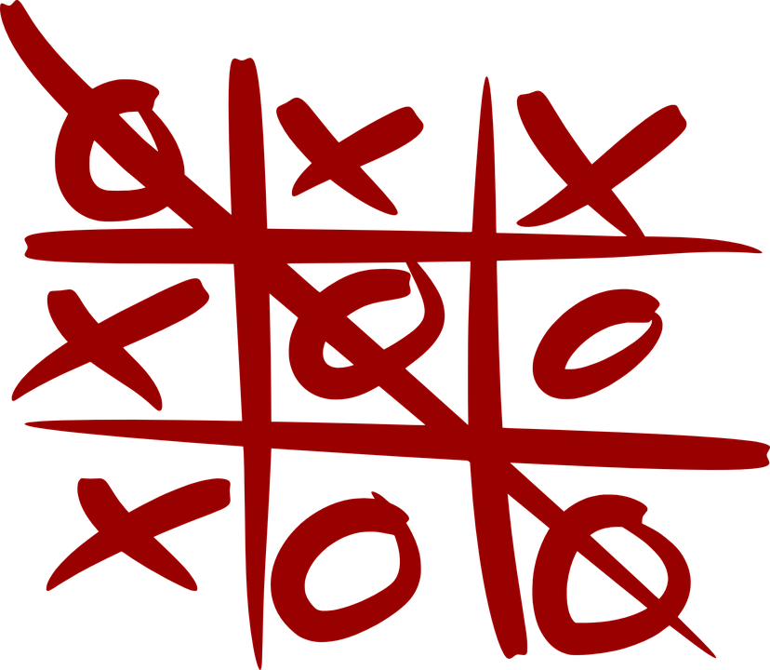
Follow up 1
[ga] ganar
[go] lago
A Escucha. ¿Qué sonido es?
B Lee las palabras en orden alfabético.
Marca
domingo
ganar
fuego
 | ga | go
 |  |  | ma _ _
 |  |  | ne _ _ r
 |  |  | pe _ _ r
 |  |  | al _ _
 |  |  | jue _ _
 |  |  | pa _ _ r
 |  |  | fue _ _
negar
pegar
45 segundos
E
g o
algo
lago
gato
1
g a
tengo
juego
ga
pagar
mago
2
3
go
[something]
algo
gato
negar
4
go
domingo
juego
pagar
5
ga
fuego
lago
pegar
6
go
ganar
mago
tengo
INICIO
Notes:
Timing: 5 minutes
Aim: to develop phonological awareness of [go] in contrast with [ga]
Procedure:
Part A
Click to bring up the instruction.
Click to bring up the table table and do example together (E).
Students tick and/or write the correct sound [ga] [go]
Part B
Procedure:
Read the instruction in Spanish.
Ensure meaning of ‘orden alfabético’ is clear and elicit first word from a volunteer.
3. Click on ‘inicio’ to start the timer.
4. Elicit responses from students. Answers are animated (one click per word).
Transcript [E] mago
[1] negar
[2] pegar
[3] algo
[4] juego
[5] pagar
[6] fuego
NB. All words in Part A are unknown to pupils (pictures are provided to clarify meaning). In Part B, we include both the two source words (lago / ganar) and a words already encountered in the SOW (gato, tengo, domingo).
Mago [4573] negar [770] pegar1 [1135] algo [110] juego [409] pagar [377] fuego [884]

Slide 3
Follow up 2:
el familiar = the (male) relative la familiar = the (female) relative
[A] Escribe “un” / “una” o “el” / “la”.
vocabulario
 | definite (the) | indefinite (a/an)
 | ____ montaña | ____ montaña
 | ____ regalo | ____ regalo
 | ____ silla | ____ silla
 | ____ mar | ____ mar
 | ____ playa | ____ playa
 | ____ familiar | ____ familiar
 | ____ pueblo | ____ pueblo
[B] Escribe el número.
E
la
una
3
4
1
1
el
un
E
E
E
2
la
una
3
el
un
una
6
4
la
E
E
E
5
el
un
6
el
un
5
2
E
E
Notes:
Timing: 5 minutes
Aim: to practise written recall of definite and indefinite articles with previously taught vocabulary; to practise written recall of word meanings.
Procedure: 1. Do E of part A with pupils and click to correct. 2. Pupils write 1 – 6 and complete them (Note: they do not need to copy out the nouns as well). 3. Click to feed back responses. 4. Click to bring up part B of the activity.
5. Do E with pupils to model the task.
6. Pupils write 1-6 and the English meaning.
7. Click to reveal the answers in number order next to the matching pictures. 8. Draw pupils’ attention to the callout about ‘el/la familiar’
9. If required, click audio buttons to reinforce the new definite articles with the nouns.
.

Slide 4
en & por
[prepositions]
To say ‘in’ in Spanish, we use ‘en’.
You can decide which translation is best by looking at the context ☺.
Ejemplo:
Nado en el lago.
I swim in the lake.
‘Por’ is a preposition that is often used with verbs of movement.
It can be translated in different ways in English.
Ejemplo:
Camino por la playa.
Camino por el pueblo.
I walk along the beach.
I walk around the village.
Notes:
Timing: 2 minutes
Aim: to re-introduce two key prepositions en and por.
Procedure:
Click to present the information.
Click to bring up examples and elicit pupil translations, orally.

Slide 5
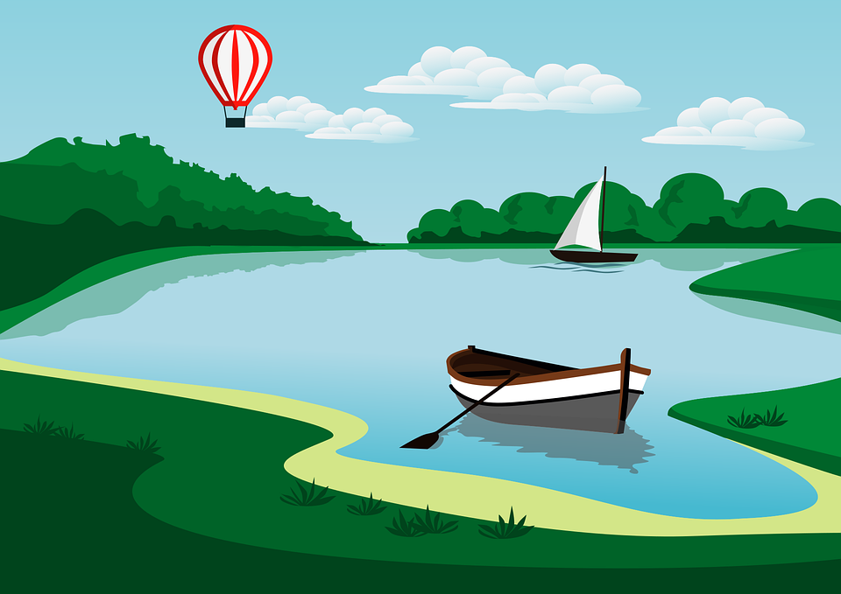
leer y hablar
Lee las frases.
Camino
en
por
Nado
el pueblo
el mar
el lago
la playa
la montaña
I walk along the beach.
I swim in the lake.
I walk in / through the mountain(s).
I swim in the sea.
I walk around the village.
Notes:
Timing: 4 minutes
Aim: to practise using the correct preposition (en/por) in a supported, oral interpreting task.
Procedure:
Click to bring up an English sentence prompt.
Pupils say the sentence aloud, selecting the correct verb and preposition.
Click to indicate the correct verb and preposition.
Click on the English sentence prompt to hear Spanish audio.
Repeat for the rest of the items.
Transcript:
Nado en el mar Camino por el pueblo Camino por la montaña Nado en el lago Camino por la playa

Slide 6
leer
El diario de Sofía: Sofía habla sobre ella* y Quique.
sobre = about ella = she / her*
 | He swims with __ hat in ___ _______.
 | __ talk to Ángela in ____ ________.
 | I _____ ___ __ friend ______ the village.
 | __ sing in English ___ ____ ________.
 | I buy __ balloon ___ ____ _______.
 | _ ______ a bottle ____ the __________.
 | ___ ______ ______ uniform _______ ____ beach.
E
a
the
sea
[E] Nada con un sombrero en el mar.
[1] Hablo con Ángela en la casa.
[2] Camino con una amiga por el pueblo.
1
I
the
house
a
2
walk
with
around
I
house
the
3
in
[3] Canto en inglés en la casa.
[4] Compro un globo en la playa.
beach
a
on
4
the
[5] Necesito una botella en la montaña.
[6] Camina con uniforme por la playa.
5
I
need
in
mountains
He
along
walks
with/in
the
6
Notes:
Timing: 7 minutes
Aim: to practise written comprehension of definite and indefinite articles and key vocabulary (including possible translations for ‘por’); to revisit 1st & 3rd person singular verb endings with a range of regular –ar verbs.
Procedure:
Read the title and click to explain the context of the task.
Complete the example with pupils to model the activity.
Pupils complete 1-6, writing the translation in English.
Click through the animations to bring up answers.
If desired, elicit each sentence in Spanish from pupils to practise reading aloud, then click each audio button to hear each sentence.

Slide 7
Follow up 3:
Knowing who does what
⚠ We don’t need pronouns because the verb ending tells us who is doing the action.
[–ar verbs: ‘I’ versus ‘s/he, it’]
In Spanish, the words for ‘I’ and ‘s/he’ (pronouns) are often unnecessary.
To mean ‘I’ with a verb, we remove –ar and add -o.
To mean ‘s/he, it’ with a verb, we remove –ar and add –a.
Ejemplo: llevar
I
s/he, it
Llevo un sombrero en la montaña.
LLeva uniforme en el pueblo.
I wear a hat in the mountain(s).
S/he wears a uniform in the village.
Notes:
Timing: 10 minutes
Aim: to introduce 1st person singular for –ar verbs, building on the concept of the infinitive.
Procedure:
Click through the animations to present the new information.
Elicit English translations for the Spanish examples provided.

Slide 8
Follow up 3:
Sofía habla con mamá Elena sobre* ella* y el primo Luis.
escuchar y escribir
A Escucha y escribe el verbo.
B ¿Es una pregunta o una respuesta?
 | verbo en español
 | __________ a mi amigo en la clase
 | __________ en inglés con el profesor
 | __________ una tarta en playa
 | __________ el cuaderno en la excursion
 | __________ por la montaña
 | __________ con un familiar en el pueblo
Escribe ¿? o .
E
Escucho
.
1
¿
Canta
?
2
Compra
.
3
¿
Necesito
?
4
¿
Camina
?
5
Hablo
.
sobre = about ella = she / her*
Notes:
Timing: 5 minutes
Aim: to practise transcription of correct verb forms (1st and 3rd persons singular); to practise aural recognition of question and statement intonation patterns.
Procedure:
Read the title / context of the activity.
Click x1 to bring up instruction in Spanish. First time they listen to it, pupils to write the verb. Second time, pupils should identify whether the sentences are a statement or a question and write the appropriate punctuation.
Do the example with them. Click to listen and bring up answer.
Pupils listen to 1-5.
Click to reveal answers.
Note: Follow up 4 focuses on understanding the meaning of these sentences.
Transcript:
[E] Escucho a mi amigo en la clase.
[1] ¿Canta en inglés con el profesor?
[2] Compra una tarta en la playa.
[3] ¿Necesito el cuaderno en la excursión?
[4] ¿Camina por la montaña?
[5] Hablo con un familiar en el pueblo.

Slide 9
Follow up 4:
la excursión = trip
B Traduce las frases.
Lee y escribir
 | Escucho a mi amigo en la clase. | ___ _______ to my friend in __________.
 | ¿Canta en inglés con el profesor? | ¿ _____ he _____ ___ ________ with ___ (male) ___________?
 | Compra una tarta en la playa | ___ _______ a cake ___ _____ __________.
 | ¿Necesito el cuaderno en la excursión*? | ¿ ___ ___ _______ ___ ________ ________ on the trip?
 | ¿Camina por la montaña? | ¿ _____ ____ _____ _______ the mountain(s)?
 | Hablo con un familiar en el pueblo. | __ _____ to a _________ in ___ __________.
E
I
listen
class
Does
sing
in
English
the
1
teacher
2
He
buys
on
the
beach
Do
I
need
the
exercise
book
3
Does
he
walk
through
4
5
talk
relative
the
village
I
Notes:
Timing: 5 minutes
Aim: reading comprehension of 1st & 3rd person singular forms of –ar verbs (including questions as well as vocabulary for this week and previous weeks)
Procedure:
Read the instruction in Spanish.
Do the example with pupils. Paying attention to the verb ending and the number of spaces provided.
Pupils do 1-5.
Go through answers.
If desired, click to listen to audio.
Transcript:
[E] Escucho a mi amigo en la clase.
[1] ¿Canta en inglés con el profesor?
[2] Compra una tarta en la playa.
[3] ¿Necesito el cuaderno en la excursión?
[4] ¿Camina por la montaña?
[5] Hablo con un familiar en el pueblo.

Slide 10
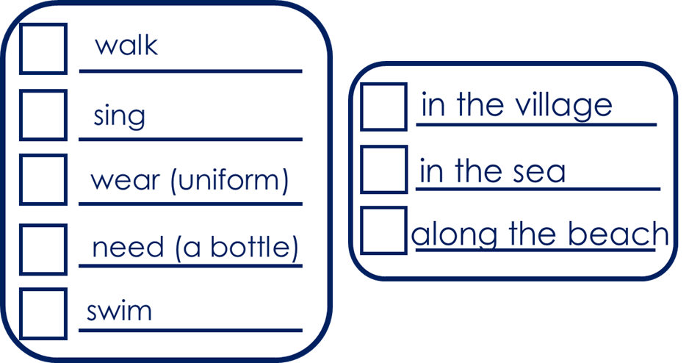
Follow up 5:
Pregunta y responde: What does Luis do? And Sofía?
Persona A
Turno 1
hablar
Pregunta (¿?) y marca
Person A Use your prompt card to ask questions. E.g. Does he walk along the beach?
Person B Use your card to answer ‘yes’ or ‘no.
Persona B
Escucha y responde.
Then swap roles.
Notes:
Timing: 5 minutes (four slides)
Aim: to develop fluency in using 3rd person singular of –ar verbs using intonation questions. Procedure: 1. Divide the class into A and B. Pupils can work in pairs or work chorally, in two class halves.
2. Pupil A asks questions to find out what Luis does, and where. 3. Pupil B answers “yes / no” according to their card (a card describing what Luis or Sofía does).
This is Pupil A’s task – Turno 1.
If needed, first practise further with the class. Elicit the question forms of the verbs and then of the locations from pupils, and then click the audio buttons to check.
Move briefly to the next slide to show “turno 2” and model further if necessary.

Slide 11
Follow up 5
Respuestas
hablar
Persona A
Persona B
walk
walk
sing
sing
wear (uniform)
speak (Spanish)
need (a bottle)
buy a fruit
swim
wear (uniform)
Notes:
ANSWER SLIDE Pupils will have noted answers on their task sheets.
Procedure:
Click to reveal answers for pupils to check.

Slide 12
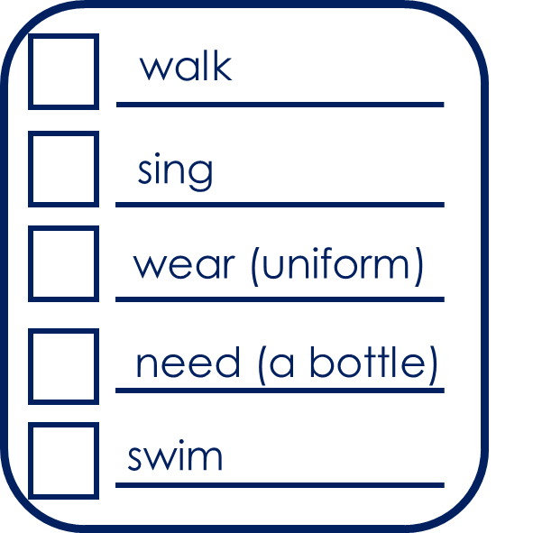
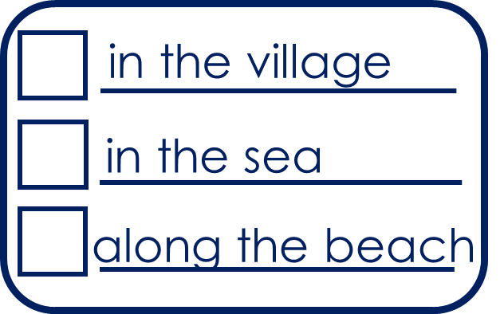
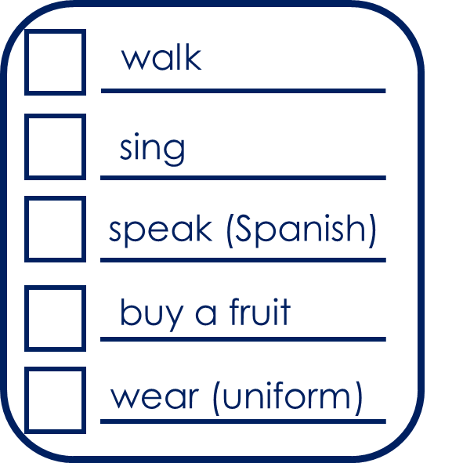
to print
Persona A
Persona B
1 Pregunta y marca
1 Escucha y responde.
|
|
|
|
|
|
|
|
|
|
|
|
|
|
2 Pregunta y marca
2 Escucha y responde.
Notes:
HANDOUT

Slide 13
Follow up EXTRA:
Escribe en inglés: Can you get at least 15 points?
 | es | siempre | normalmente
 | la silla | ser | soy
 | roja | amarillos | el familiar
 | de² | bonita | pequeñas
 | el | la | por
 | la montaña | la playa | el pueblo
 | caminar | nadar | el mar
vocabulario
s/he, it is (trait)
always
usually
vocabulario
x3
(the) chair
to be, being (trait)
I am (trait)
red (f)
yellow (mpl)
(the) relative
x2
from, of
pretty (f)
small (f)
the (m)
the (f)
through, around, along
(the) mountain
(the) beach
(the) village
x1
to walk, walking
(to swim, swimming
(the) sea
Notes:
Timing: 6 minutes
Aim: to practise written production of vocabulary for this week and previous weeks.
Procedure:
1. Pupils need to write the English for as many words as possible, aiming to get at least 15 points (but more if possible).
2. Click for English answers.

Slide 14
Follow up EXTRA 2:
Escribe en español: Can you get at least 15 points?
 | s/he, it is (trait) | always | usually
 | (the) chair | to be, being (trait) | I am (trait)
 | red (m) | yellow (m) | (the) relative
 | from, of | pretty (m) | small (m)
 | the (m) | the (f) | through, around, along
 | (the) mountain | (the) beach | (the) village
 | to walk, walking | to swim, swimming | (the) sea
es
siempre
normalmente
vocabulario
vocabulario
x3
la silla
ser
soy
rojo
amarillo
el / la familiar
x2
de
bonito
pequeño
el
la
por
la montaña
la playa
el pueblo
x1
caminar
nadar
el mar
Notes:
Timing: 6 minutes
Aim: to practise written production of vocabulary for this week and previous weeks.
Procedure:
1. Pupils need to write the Spanish for as many words as possible, aiming to get at least 15 points (but more if possible).
2. Click for Spanish answers.

