Slide 1
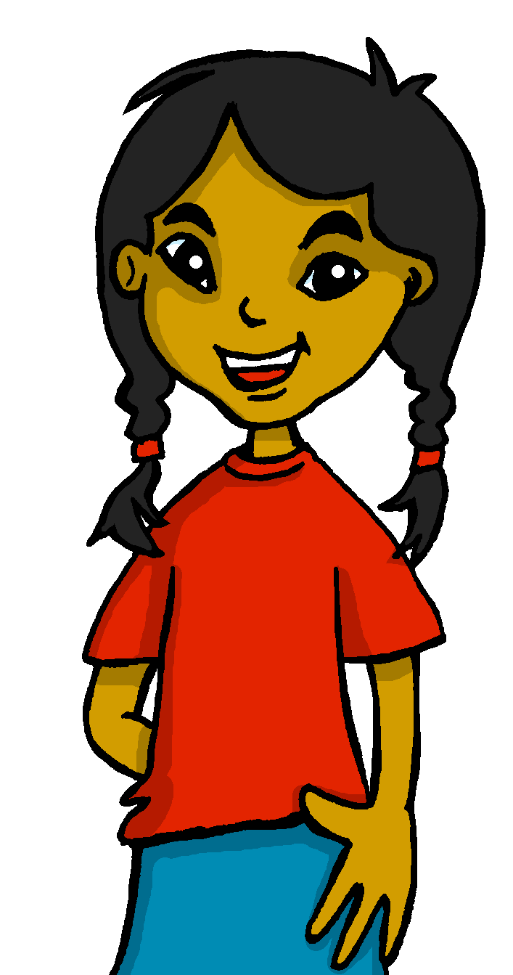
español, con Sofía

Slide 2
Describing me and others do
rojo
Infinitives: -ar verbs
SSC [l] [ll]
Notes:
Artwork by Steve Clarke. All additional pictures selected are available under a Creative Commons license, no attribution required.
The frequency rankings for words that occur in this PowerPoint which have been previously introduced in the resources are given in the SOW (excel document) and in the resources that first introduced and formally re-visited those words.
For any other words that occur incidentally in this PowerPoint, frequency rankings will be provided in the notes field wherever possible.
SSC: [l] and [ll]
Vocabulary (new words in bold): llevar [101] comprar [361] película [944] sombrero [2290] uniforme [2796] con [14]
Revisit 1: tienes [19] botella [1878] estuche [>5000] libro [230] pregunta [507] respuesta [488] sacapuntas [>5000] Revisit 2: elegante [2742] feliz [908] triste [1371] ¿dónde? [161]
Glossed words: amarillo [>5000] llama [3059] camello [>5000] collar [4362] lavar [1676] llover [2134] paloma [3182] lobo [3816]
Source: Davies, M. & Davies, K. (2018). A frequency dictionary of Spanish: Core vocabulary for learners (2nd ed.). Routledge: London

Slide 3
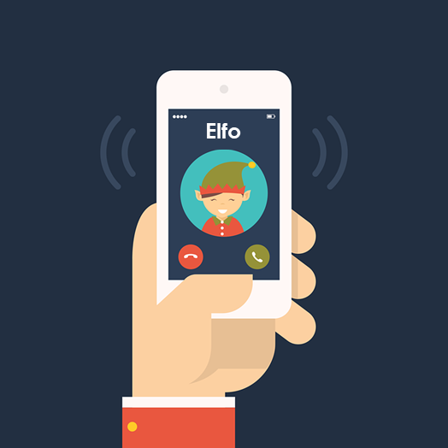
[l]
libro
pronunciar
[ll]
llamar
Notes:
Timing: 1 minute
Aim: To revisit SSC [l] [ll]
Procedure:
To recap and elicit the pronunciation of the individual SSC [ll] [l]
Click to bring the picture & get students to repeat (with gesture, if using).
Gesture suggestion for libro: use two hands to pretend to open a book
Gesture suggestion for llamar: with your right hand, pretend to answer the phone, then repeat with the left hand. Two gestures = two syllables of the word.

Slide 4
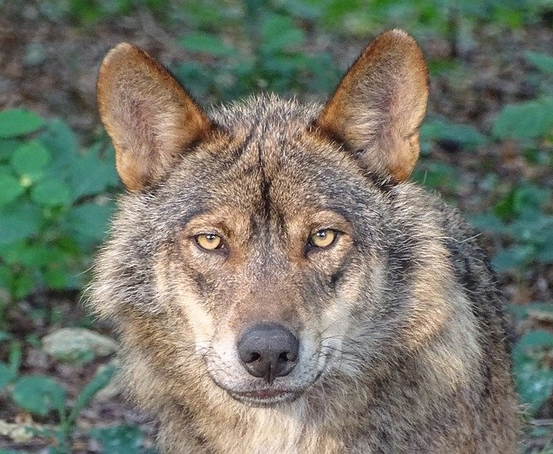
[ll]
pronunciar
40
collar
llover
lobo
llama
amarillo
paloma
lavar
camello
INICIO
Notes:
Timing: 2 minutes
Aim: to practise the pronunciation of SSC [ll] in contrast with [l] in familiar and a few unfamiliar words.
Procedure: 1. Start the timer. Pupil A tries to read aloud all of the words within the 60 seconds allowed.
2. Pupil B listens. If Pupil A pronounces [ll] in an English way by mistake, Pupil B can direct him/her to start again from the beginning. 3. They swap roles and repeat the task.
Note: ensure pupils know they don’t need to rush too much. They have 5 seconds per word. If preferred, remove the timer altogether.
Frequency of unknown words and cognates (1 is the most frequent word in French):
amarillo [>5000] llama [3059] camello [>5000] collar [4362] lavar [1676] llover [2134] paloma [3182] lobo [3816]

Slide 5
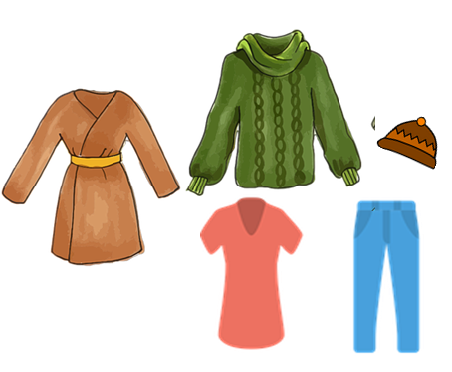
vocabulario
Vocabulario
un uniforme
una película
un sombrero
[a uniform]
[a film]
[a hat]
[to buy, buying]
comprar
[to wear, wearing]
llevar
Notes:
Timing: 3 minutes (one slide)
Aim: to introduce key vocabulary for the context of weekend and weekday activities.
Procedure: 1. Pupils either work in pairs, reading the Spanish words out loud and looking at the English meanings (1 minute). 2. Then the teacher removes the English words or pictures (one by one) and pupils try to recall the English orally (chorally), looking at the Spanish (1 minute). 3. Then the Spanish meanings are removed (one by one) and pupils try to recall them orally (again, chorally), looking at the English (1 minute) 4. Further rounds of learning can be facilitated by one pupil turning away from the board, and his/her partner asking him/her the meanings (‘Cómo se dice X en español?’). This activity can work from L2 → L1 or L1 → L2.

Slide 6
palabras
___ libro a book
__ tarta a cake
__ camisa a shirt
00
00
___ película a film
00
00
__ teléfono a phone
00
__ bicicleta a bycicle
___ caballo a horse
00
00
__ uniforme a uniform
00
00
__ sombrero a hat
¡Qué desorden!
Sofía has mixed up all her flashcards.
Ordena el vocabulario de Sofía.
hablar
__ teléfono a phone
00
un
___ libro a book
00
__ camisa a shirt
una
00
__ tarta a cake
00
__ bicicleta a bicycle
___ caballo a horse
00
___ película a film
00
00
00
__ sombrero a hat
00
__ uniforme a uniform
Notes:
Timing: 3 minutes (one slide)
Aim: to introduce key vocabulary for the context of weekend and weekday activities.
Procedure: Pupils either work in pairs or chorally as a class, reading the Spanish words out loud, including the correct article, and the English meanings.

Slide 7
Knowing who does what
It is also the form of a verb you see in a dictionary.
[–ar verbs: ‘I’]
We know the infinitive verb tells us the general meaning.
Remember: You can also begin a sentence with the infinitive:
In English, this is often written ‘to + verb’.
In Spanish, the infinitive of the verb often ends in –ar.
To mean ‘I’ with a verb, the verb ending changes.
We remove –ar and add –o.
Ejemplo
General meaning
I
Es importante hablar
hablar
Hablo en clase
It’s important to talk.
+ o
I speak in class.
Notes:
Timing: 3 minutes
Aim: to introduce 1st person singular for –ar verbs, building on the concept of the infinitive.
Procedure:
Click through the animations to present the new information.
Elicit English translations for the Spanish examples provided.

Slide 8
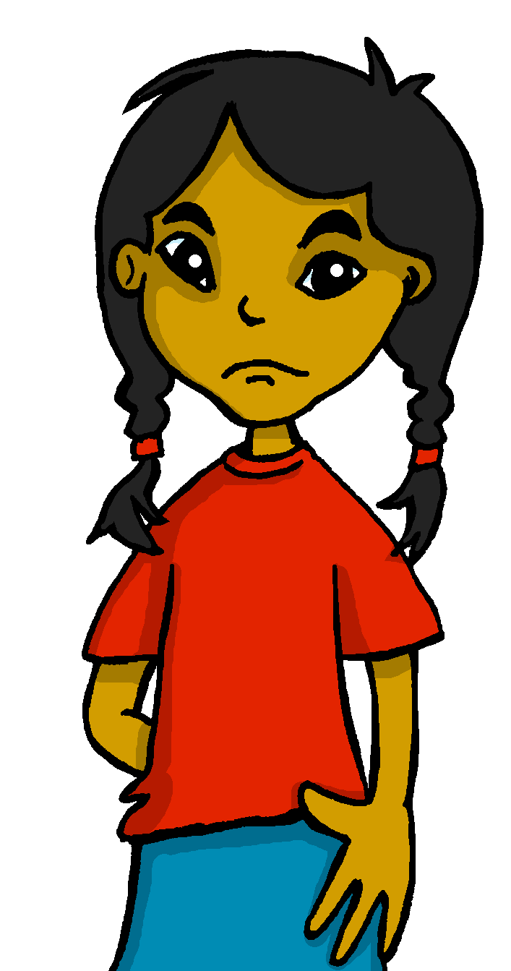
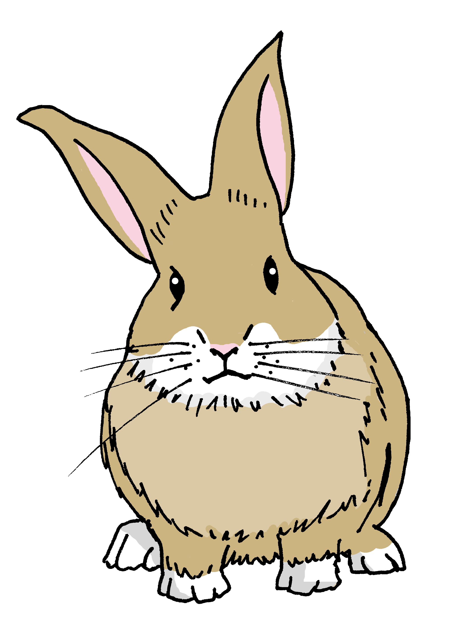
leer
Agua 💧 en los deberes de Sofía.
¡Pancho!
¡Lo siento!
Pancho has spilled water all over Sofia’s English homework.
Lee las frases y marca.
Hablo con un amigo.
Escribe el verbo en inglés.
E
General meaning | I
-Italk-
I talk to a friend.
Llevo un sombrero.
Verbo
1
I wear a hat.
Remember: When the sentence begins the infinitive, we use the –ing form of the verb in English.
Iwear
[E]
I talk
2
Cantar es fantástico.
[1]
I wear
It is fantastic to sing.
-tosing-
3
Escuchar es importante.
singing
[2]
Listening is important.
Listening
[3]
4
Necesito uniforme en clase.
listening
I need uniform in class.
Ineed
[4]
I need
Notes:
Timing: 7 minutes
Aim: to practise written comprehension of 1st person singular verbs VS. infinitive verbs.
Procedure:
Read the title and click to explain the context of the task.
Click to bring further instructions in Spanish.
Do [E] with them to model the task and draw their attention to the verb (hablo). Is it the general meaning or does it refer to ‘I’?
Pupils complete 1-5.
Click through the animations to bring up answers.
Ask pupils to translate the verbs into English. Remind students about the translation of the infinitive form of the verb in Spanish.
If desired, click on the green buttons to hear audio for each sentence.

Slide 9
Knowing who does what
⚠ We don’t need pronouns because the verb ending tells us who is doing the action.
[–ar verbs: ‘I’ versus ‘s/he, it’]
In Spanish, the words for ‘I’ and ‘s/he’ (pronouns) are often unnecessary.
To mean ‘I’ with a verb, we remove –ar and add -o.
To mean ‘s/he, it’ with a verb, we remove –ar and add –a.
Ejemplo: llevar
I
s/he, it
Llevo uniforme en clase.
LLeva un sombrero en casa.
I wear uniform in class.
S/he wears a hat at home.
Notes:
Timing: 3 minutes
Aim: to introduce 1st person singular for –ar verbs, building on the concept of the infinitive.
Procedure:
Click through the animations to present the new information.
Elicit English translations for the Spanish examples provided.

Slide 10
escuchar
Sofía compara su* semana* con Luis.
¿Quién es?
Escucha y marca.
Marca.
Sofía (I) | El primo Luis (he)
Verbo en español
Info extra
E
habla
(with) a friend
1
llevo
uniform
2
necesita
pencil case
3
compro
school bag
4
compra
cake
su = his/her
(la) semana = week
5
hablo
in Spanish
Notes:
Timing: 7 minutes
Aim: to practise aural recognition of 1st vs. 3rd person singular.
Procedure:
Read the context and click to bring up further instruction.
Pupils write 1-5 in their books.
Click to listen to the example. Pupils tick whether they can hear the 1st or 3rd person singular.
Do the example with them.
Play 1-5.
Go through answers for 1-5.
Click to bring up part 2 of the task- this time pupils write the verb and note any extra information in English.
Transcript:
Ej. Habla con una amiga.
Llevo uniforme.
Necesita un estuche.
Compro una mochila.
Compra una tarta.
Hablo en español.

Slide 11
¡adiós!
rojo

