Slide 1
español, con Sofía

Slide 2
Describing me and others
rojo
Actividades en clase
Infinitives: -ar verbs
SSC [l] and [ll]
Notes:
Artwork by Steve Clarke. All additional pictures selected are available under a Creative Commons license, no attribution required.
The frequency rankings for words that occur in this PowerPoint which have been previously introduced in the resources are given in the SOW (excel document) and in the resources that first introduced and formally re-visited those words.
For any other words that occur incidentally in this PowerPoint, frequency rankings will be provided in the notes field wherever possible.
- SSC: [l] libro [1477], [ll] llamar [122]
- Vocabulary: - Vocabulary: cantar [717] escuchar [281] hablar [90] necesitar [276] español [262] frase [1037] inglés [583] fantástico [2501] importante [171] normal [1000]
Revisit 1: tiene [19] amigo [210] amiga [210] bicicleta [3684] cama [609] gato [1728] Revisit 2: clase [320] [en clase] curioso [1811] lento [1569] rápido [870] hoy [167]
Glossed words: peligro [1170] abierto [654]
Source: Davies, M. & Davies, K. (2018). A frequency dictionary of Spanish: Core vocabulary for learners (2nd ed.). Routledge: London

Slide 3
[l]
libro
pronunciar
Notes:
Timing: 1 minute
Aim: To introduce SSC [l]
Procedure:
Introduce and elicit the pronunciation of the individual SSC [l] and then the source word ‘libro’ (with gesture, if using).
Click to bring the picture & get students to repeat (with gesture, if using).
Gesture suggestion: use two hands to pretend to open a book.

Slide 4
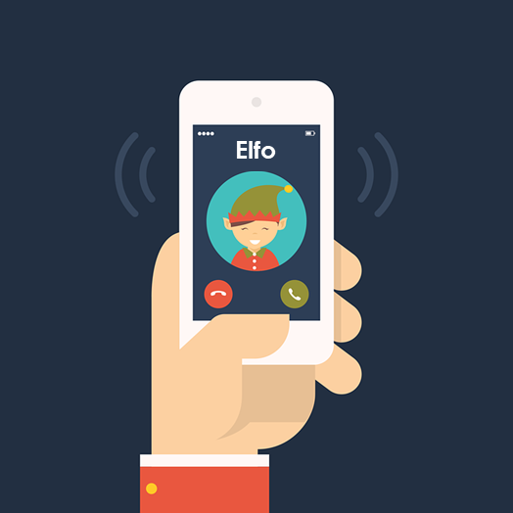
[ll]
llamar
pronunciar
[to call]
Notes:
Timing: 1 minute
Aim: to introduce SSC [ll]
Procedure:
Introduce and elicit the pronunciation of the individual SSC [ll] and then the source word ‘llamar’(with gesture, if using).
Click to bring the picture & get students to repeat (with gesture, if using).
Gesture suggestion: use two hands up around mouth, palms facing outward, to mime calling out to someone.

Slide 5
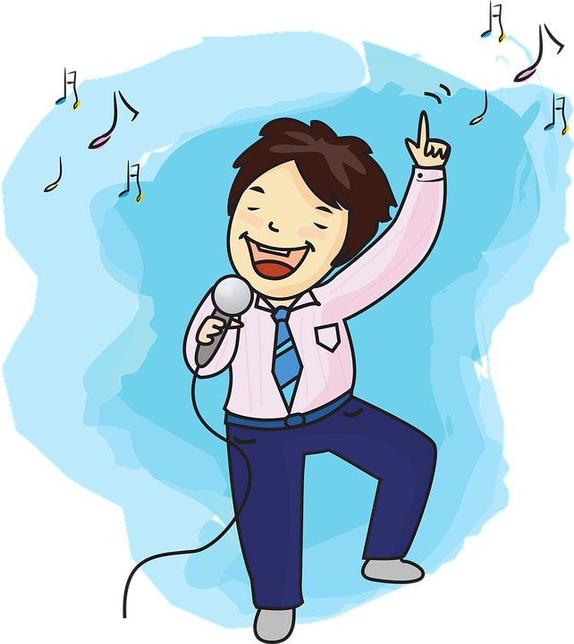
vocabulario
Vocabulario
cantar
escuchar
[to listen, listening]
[to sing, singing]
necesitar
hablar
[to talk, talking]
[to need, needing]
Notes:
Timing: 3 minutes (one slide)
Aim: to introduce key vocabulary for the context of classroom instructions (a range of infinitive verbs).
Procedure: 1. Pupils either work in pairs, reading the Spanish words out loud and looking at the English meanings (1 minute). 2. Then the teacher removes the English words or pictures (one by one) and pupils try to recall the English orally (chorally), looking at the Spanish (1 minute). 3. Then the Spanish meanings are removed (one by one) and pupils try to recall them orally (again, chorally), looking at the English (1 minute) 4. Further rounds of learning can be facilitated by one pupil turning away from the board, and his/her partner asking him/her the meanings (‘Cómo se dice X en español?’). This activity can work from L2 → L1 or L1 → L2.

Slide 6
vocabulario
Vocabulario
importante
imposible
sano
escuchar
normal
fantástico
necesitar
cantar
to sing, singing
to need, needing
to listen, listening
fantastic
healthy
normal
important
impossible
Notes:
Timing: 3 minutes
Aim: to revisit infinitive verbs, 2 adjectives from Autumn term and introduce 3 new adjectives (normal, fantástico, importante).
Procedure: 1. Elicit pronunciation from pupils for the Spanish words (there are some cognates whose pronunciation can be tricky for English speakers – words ending in –ble).
2. Click for an English prompt.
3. Elicit the Spanish word from pupils. 4. Continue until all 8 items have been seen and heard.

Slide 7
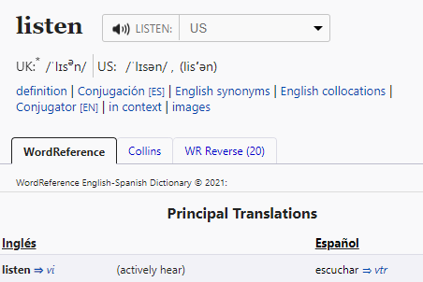
Infinitives: -ar verbs
The infinitive form of a verb is the form you see in a dictionary.
[to ______]
The infinitive often describes the general meaning of the verb.
In English, this is often written ‘to + verb’:
It’s important to listen.
In Spanish, many infinitives end in –ar:
Es importante escuchar.
You can also begin a Spanish sentence with the infinitive:
In this case, we translate the Spanish infinitive with the –ing form of the verb in English.
Escuchar es importante.
Listening is important.
Notes:
Timing: 3 minutes
Aim: to introduce the notion of infinitive –AR verbs and their two positions and two English translations.
Procedure:
Click through the animations to present the new information.
Elicit English translations for the Spanish examples provided.
https://www.wordreference.com/es/translation.asp?tranword=listen

Slide 8
escuchar
En clase: actividades.
El señor Valero habla. Escucha.
¿Dónde está el infinitivo?
Escucha otra vez y escribe.
Marca
at the beginning | at the end
infinitivo en español
adjetivo en inglés
E
escuchar
important
1
necesitar
normal
2
hablar
fantastic
3
cantar
healthy
4
hablar
important
5
cantar
fantastic
Notes:
Timing: 7 minutes
Aim: to practise aural recognition of the infinitive verbs and the two positions in a sentence.
Procedure:
Read the context and click to bring up further instructions.
Pupils write 1-5 in their books.
Click to listen to the example. Pupils tick whether they can hear the infinitive verb at the beginning of the sentence, or at the end.
Do the example with them. Play once and focus their attention on the –ar ending.
Play 1-5.
Go through answers for 1-5 part 1 (identifying the position of the infinitive).
Click to bring up part 2 of the task (listening out for infinitive).
Pupils to listen one more time and write down the infinitive – most able pupils can also write the adjective in English.
Transcript:
Ej. Es importante escuchar.
Necesitar es normal.
Hablar en español es fantástico.
Es sano cantar.
Es importante hablar.
Cantar es fantástico.

Slide 9
leer
Sofía escribe.
After a term in her school, Sofía writes what she’s learned.
E
Es importante hablar con el señor Valero.
Completa las frases ✍.
to
talk
[E] It is important ____ _________ to Mr Valero.
[1] _____________ help is normal.
[2] It is fantastic ____ __________ in Spanish.
[3] _____________ to Quique in class is always _____________.
[4] It is ____________ ___ ___________ and to talk to Ángela.
[5] ___________ to a question is _____________.
1
Necesitar ayuda es normal.
Needing
2
Es fantástico cantar en español.
to
sing
3
Hablar con Quique en clase es siempre imposible.
Talking
impossible
4
Es sano escuchar y hablar con Ángela.
healthy
to
listen
5
Escuchar una pregunta es importante.
Listening
important
Notes:
Timing: 7 minutes
Aim: to practise written comprehension of key adjectives and –ar verbs, including both possible translations into English (to __ / ing)
Procedure:
Read the title and click to explain the context of the task (Sofía reflects on what she’s learned in lessons).
Click to bring further instructions in Spanish (completa las frases en español).
Do [E] with them to model the task. Remind students about the English translation of the infinitive form of the verb in Spanish.
Students complete 1-5.
Click through the animations to bring up answers.

Slide 10
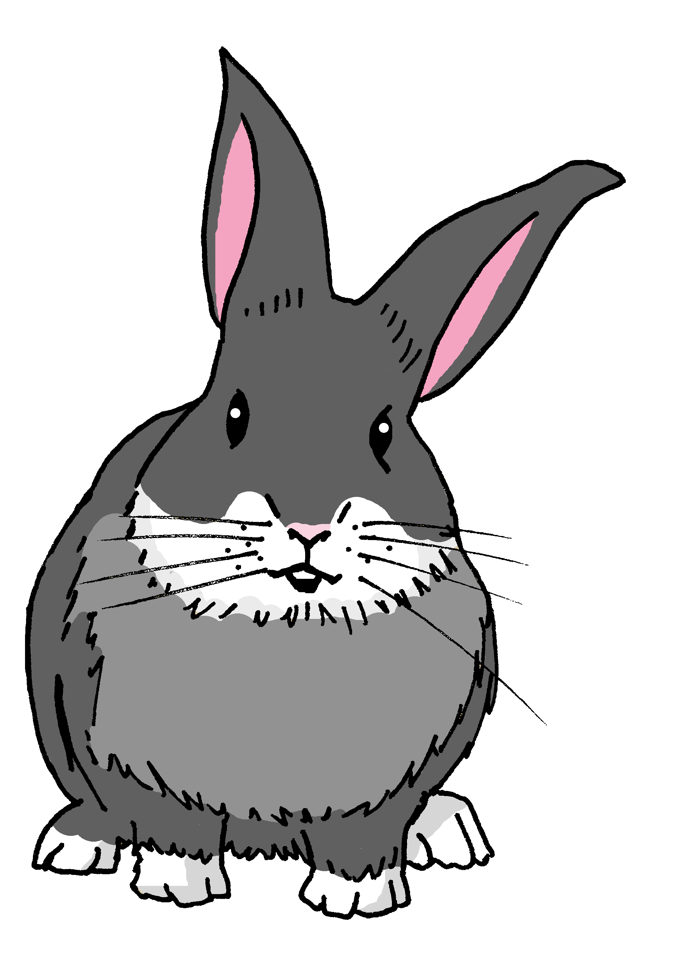
hablar
Una puerta está abierta: ¡Manchita está en peligro! [1/5]
leer
Read the sentence aloud with your partner before Manchita gets to the door.
Es importante [to talk] en clase.
Es importante hablar en clase.
cantar
escuchar
hablar
una puerta = a door abierto = open/opened
peligro = danger
Notes:
Timing: 5 mins [5 slides in total] [1/5]
Aim: to practise read aloud of this week’s language and spoken production of infinitive verbs.
Procedure:
Teacher reads the title and elicits English translation from students.
Click to bring up the English instruction.
Pupils work in pairs to say the sentence aloud in Spanish. Encourage most able to translate it too.
Once Manchita disappears, the infinitive is removed from the board & 3 options are provided.
Elicit answers from students.

Slide 11
hablar
Una puerta está abierta: ¡Manchita está en peligro! [2/5]
leer
Read the sentence aloud with your partner before Manchita gets to the door.
Es normal necesitar un bolígrafo.
Es normal [to need] un bolígrafo.
cantar
necesitar
escuchar
una puerta = a door abierto = open/opened
peligro = danger
Notes:
[2/5]

Slide 12
hablar
Una puerta está abierta: ¡Manchita está en peligro! [3/5]
leer
Read the sentence aloud with your partner before Manchita gets to the door.
Escuchar es sano.
[Listening] es sano.
cantar
escuchar
hablar
una puerta = a door abierto = open/opened
peligro = danger
Notes:
[3/5]

Slide 13
hablar
Una puerta está abierta: ¡Manchita está en peligro! [4/5]
leer
Read the sentence aloud with your partner before Manchita gets to the door.
Es fantástico hablar en español.
Es fantástico [to talk] en español.
hablar
cantar
necesitar
una puerta = a door abierto = open/opened
peligro = danger
Notes:
[4/5]

Slide 14
hablar
Una puerta está abierta: ¡Manchita está en peligro! [5/5]
leer
Read the sentence aloud with your partner before Manchita gets to the door.
Necesitar una palabra es normal.
[Needing] una palabra es normal.
cantar
hablar
necesitar
una puerta = a door abierto = open/opened
peligro = danger
Notes:
[5/5]

Slide 15
¡adiós!
rojo

