Slide 1
Saying what I and others have
rojo
Follow ups 1-5
Notes:
Artwork by Steve Clarke. All additional pictures selected are available under a Creative Commons license, no attribution required.
The frequency rankings for words that occur in this PowerPoint which have been previously introduced in the resources are given in the SOW (excel document) and in the resources that first introduced and formally re-visited those words.
For any other words that occur incidentally in this PowerPoint, frequency rankings will be provided in the notes field wherever possible.
- SSC: [l] libro [1477], [ll] llamar [122]
- Vocabulary: cantar [717] escuchar [281] hablar [90] necesitar [276] español [262] frase [1037] inglés [583] fantástico [2501] importante [171] normal [1000]
Revisit 1: tiene [19] amigo [210] amiga [210] bicicleta [3684] cama [609] gato [1728] Revisit 2: clase [320] [en clase] curioso [1811] lento [1569] rápido [870] hoy [167]
Glossed words: volcán [4254] el/la [1] su [12] primo [1451]
Source: Davies, M. & Davies, K. (2018). A frequency dictionary of Spanish: Core vocabulary for learners (2nd ed.). Routledge: London

Slide 2
[l]
libro
pronunciar
Notes:
Timing: 1 minute
Aim: to recap SSC [l]
Procedure:
Introduce and elicit the pronunciation of the individual SSC [l] and then the source word ‘libro’ (with gesture, if using).
Click to bring the picture & get students to repeat (with gesture, if using).
Gesture suggestion: use two hands to pretend to open a book.

Slide 3
[ll]
llamar
pronunciar
[to call]
Notes:
Timing: 1 minute
Aim: to recap SSC [ll]
Procedure:
Introduce and elicit the pronunciation of the individual SSC [ll] and then the source word ‘llamar’(with gesture, if using).
Click to bring the picture & get students to repeat (with gesture, if using).
Gesture suggestion: use two hands up around mouth, palms facing outward, to mime calling out to someone.

Slide 4
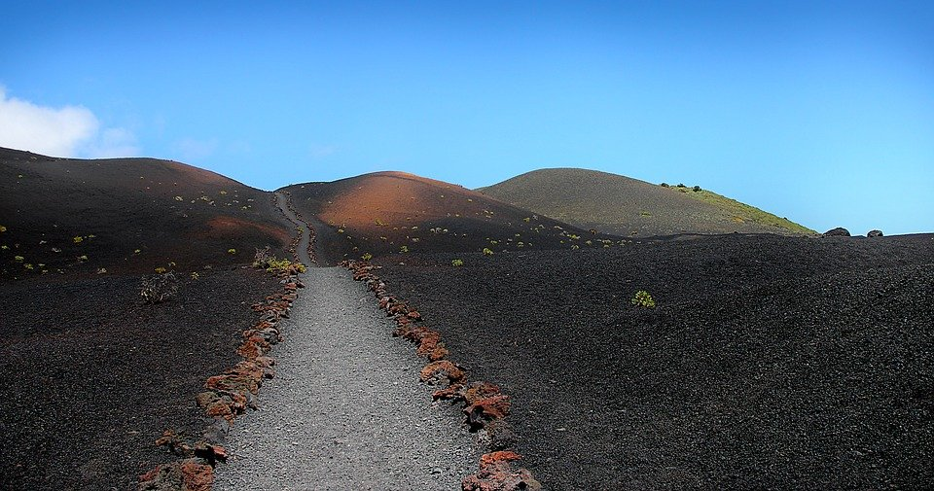
Follow up 1
[l] libro
[ll] llamar
A Escucha.
Escribe [l] o [ll].
B Escribe una ciudad*.
Tu compañero/a adivina*.
 | ciudad
 | T o l e d o
 | S e v i l l a
 | M o n t i l l a
 | V a l e n c i a
 | T o m e l l o s o
 | L a P a l m a
La Palma tiene un volcán activo
Montilla Valencia
Sevilla Toledo
La Palma Tomelloso
Teruel Melilla
1
__
2
__
3
__
4
__
5
__
(una) ciudad = (a) city
6
__
adivinar = to guess
(un) volcán = (a) volcano
Notes:
Timing: 5 minutes
Aim: to develop phonological awareness of [l] and [ll].
Procedure: Part A
Click to listen to each city name.
Pupils write the missing letter or letters.
Click to check.
Click to bring up and read the information about La Palma.
Part B
Click to bring up instruction.
Partner A writes down one city, partner B tries to guess by asking ‘¿tienes…? + one of the cities on the board.
3. Teachers circulate to listen to pupils’ pronunciation and praise/correct as necessary.
Transcript [1] Toledo
[2] Sevilla
[3] Montilla
[4] Valencia
[5] Tomelloso
[6] La Palma

Slide 5
Follow up 2:
Vocabulario
¡Excelente!
vocabulario
3. español
8. inglés
5. importante
6. hablar
1. escuchar
10. normal
9. cantar
2. una amiga
4. necesitar
7. un cuaderno
to listen, listening
important
normal
a friend (f)
to need, needing
Spanish
to talk, talking
English
an exercise book
to sing, singing
Notes:
Timing: 5 minutes Aim: to practise written comprehension and spoken pronunciation of vocabulary.
Procedure: 1. Students write 1-10 in books.
2. Ask students to say the Spanish word and write down the English translation before the word has faded away (5 sec per word)
3. Click for English translation to be highlighted. 4. Repeat for all 11 items.
5. Check answers by eliciting the Spanish from students, (i.e. so that they are translating back from their written English into spoken Spanish).
Note: Students have not yet done numbers but will be taught them explicitly in Week 7. However, in the next few weeks, certain activities will prime for them. Here the teacher can say the number when eliciting the answers, but support understanding by holding up the appropriate number of fingers each time. Obviously, the items proceed in number order in any case, so the finger gesture is more to draw learners attention to the sound – meaning connection of the number with the Spanish word for that number.
ANSWERS 1. escuchar
2. una amiga
3. español
4. necesitar
5. importante
6. hablar
7. un cuaderno
8. inglés
9. cantar
10. normal

Slide 6
Follow up 3:
Sofía habla con su* primo*, Luis.
Escucha. ¿Qué infinitivo es?
escuchar
Escribe la letra, y el adjetivo en inglés.
A
B
 | imagen | adjetivo | información extra
E
A
fantastic
in class
1
B
normal
teacher
[to need, needing]
[to sing, singing]
2
C
healthy
a friend
3
D
important
Spanish class
C
D
4
C
impossible
a pencil
5
C
important
Spanish
[to listen, listening]
[to talk, talking]
su = his/her | (el) primo = male cousin con = with
Notes:
Timing: 5 minutes
Aim: to practise aural comprehension of this week’s new vocabulary.
Procedure:
Read the title / context of the activity.
Click x2 to bring up instruction in Spanish.
To support pupils, elicit Spanish for A-D.
Do the example with them. Click to listen and bring up answer.
Pupils listen to 1-5. The first time of listening, pupils write the letter. The second time, pupils aim to write down the English meaning of the adjective. More proficient pupils can attempt to write down any extra information.
Click to reveal answers.
Transcript:
Ej. Es fantástico cantar en clase.
Necesitar al profesor es normal.
Es sano hablar con un amigo.
Escuchar en clase de español es importante.
Hablar con un lápiz es imposible
Es importante hablar español.

Slide 7
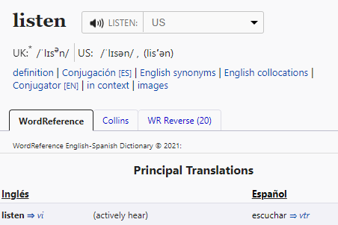
Follow up 4:
Infinitives [-ar verbs]
The infinitive form of a verb is the form you see in a dictionary.
[to ______]
The infinitive often describes the general meaning of the verb.
In English, this is often written ‘to + verb’:
It’s important to listen.
In Spanish, many infinitives end in –ar:
Es importante escuchar.
You can also begin a Spanish sentence with the infinitive:
In this case, we translate the Spanish infinitive with the –ing form of the verb in English.
Escuchar es importante.
Listening is important.
Notes:
Timing: 10 minutes (3 slides in total)
Aim: to revisit the rule for the translation of the infinitives into English.
Procedure:
1. Click to bring up each new part of the explanation.
2. Elicit the English for the Spanish examples.

Slide 8
Follow up 4:
A Lee las frases.
leer
Marca la opción correcta para el verbo.
 | Frase en español
 | Es fantástico cantar el domingo.
 | Hablar en clase es importante.
 | Es normal necesitar una mochila.
 | Escuchar a* un sacapuntas es imposible.
 | Es fantástico hablar rápido en español.
 | Es normal necesitar un amigo en clase.
verbo en inglés
to sing | singing | to talk | talking
to listen | listening | talking | to talk
singing | to sing | needing | to need
talking | to talk | listening | to listen
needing | to need | to talk | talking
singing | needing | to sing | to need
E
1
2
3
4
5
a = to
Notes:
Timing: 5 minutes
Aim: to revisit the position of the infinitive in Spanish and its translation into English.
Procedure:
Read the instruction in Spanish.
Click to bring up further instruction and clarify meaning.
Do the example with pupils. Paying attention to the position of the infinitive, pupils to identify the correct translation.
Pupils do 1-5.
Go through answers.

Slide 9
Follow up 4:
B Escribe las frases en inglés.
leer
a = to
 | Frase en español | Frase en inglés
 | Es fantástico cantar el domingo.
 | Hablar en clase es importante.
 | Es normal necesitar una mochila.
 | Escuchar a* un sacapuntas es imposible.
 | Es fantástico hablar rápido en español.
 | Es normal necesitar un amigo en clase.
E
It’s fantastic to sing on Sunday.
1
Talking in class is important.
2
It’s normal to need a school bag.
Listening to a pencil sharpener is impossible.
3
It’s fantastic to talk fast in Spanish.
4
It’s normal to need a friend in class.
5
Notes:
Timing: 5 minutes
Aim: to practise written comprehension of infinitives and adjectives.
Procedure:
Read the instruction in Spanish.
Pupils use their notes from [A] to translate the sentences.

Slide 10
Follow up 5
Persona B Lee una frase.
Persona A Lee una frase.
Turno 1
hablar
Turno 2
Persona A traduce.
Persona B traduce.
importante
sano
imposible
fantástico
normal
un cuaderno
un lápiz
una palabra
una frase
en español
en inglés
una pregunta
una respuesta
hablar
cantar
escuchar
necesitar
es
traduce = s/he translates
¡tiempo!
INICIO
Notes:
Timing: 5 minutes Aim: to provide read aloud practice and comprehension of this week’s new language.
Procedure: 1. In pairs, students take turns to create a sentence using a word from each set that makes sense. Note that not all combinations are possible.
2. In pairs, pupils translate their partner’s sentence into English.
3. For higher challenge, suggest that only the student creating the sentences faces the board. This ensures that the listener relies only on the aural input for understanding.

Slide 11
Follow up [extra]:
Escribe 5 frases en español.
escribir
un cuaderno
un lápiz
una palabra
una frase
en español
en inglés
una pregunta
una respuesta
importante
sano
imposible
fantástico
normal
[to talk]
[to listen]
[to sing]
[to need]
es
Notes:
Timing: 8 minutes
Aim: to practise written comprehension and production (of infinitive verbs).
Procedure: Pupils write five sentences and translate them into English.

Slide 12
Follow up [extra]:
Escribe en español: Can you get at least 15 points?
 | slow (m) | fast (f) | today
 | a cat | in class | curious (f)
 | a friend (f) | a bicycle | a bed
 | normal | s/he, it has | a friend (m)
 | a phrase | fantastic | important
 | to speak, speaking | Spanish | English
 | to sing, singing | to need, needing | to listen, listening
lento
rápida
hoy
vocabulario
vocabulario
x3
un gato
en clase
curiosa
una amiga
una bicicleta
una cama
x2
normal
tiene
un amigo
una frase
fantástico
importante
hablar
español
inglés
x1
cantar
necesitar
escuchar
Notes:
Timing: 6 minutes
Aim: to practise written production of vocabulary for this week and previous weeks.
Procedure:
1. Pupils need to write the Spanish for as many words as possible, aiming to get at least 15 points (but more if possible).
2. Click for Spanish answers.

Slide 13
Follow up [extra]:
Escribe en español: Can you get at least 15 points?
 | slow (m) | fast (f) | today
 | a cat | in class | curious (f)
 | a friend (f) | a bicycle | a bed
 | normal | s/he, it has | a friend (m)
 | a phrase | fantastic | important
 | to speak, speaking | Spanish | English
 | to sing, singing | to need, needing | to listen, listening
vocabulario
vocabulario
x3
x2
x1
Notes:
Handout

