Slide 1
Saying how many and describing things
rojo
Phonics
Easter activities
Notes:
Artwork by Steve Clarke. All additional pictures selected are available under a Creative Commons license, no attribution required.
The frequency rankings for words that occur in this PowerPoint which have been previously introduced in the resources are given in the SOW (excel document) and in the resources that first introduced and formally re-visited those words.
For any other words that occur incidentally in this PowerPoint, frequency rankings will be provided in the notes field wherever possible.
Source: Davies, M. & Davies, K. (2018). A frequency dictionary of Spanish: Core vocabulary for learners (2nd ed.). Routledge: London

Slide 2
pronunciar
[ga]
[go]
pronunciar
gafas
bigote
Notes:
Phonics quiz
Timing: flexible during Week 11 Procedure:
Print out one set of these 14 phonics cards.
Working with one pupil at a time, elicit the pronunciation of each word.
Say: You have not learnt these words, but you have learnt how to read aloud these sounds, so just have a go at reading each word aloud.
Focus only on the accurate pronunciation of the target SSC and tolerate any other inaccuracies.
Use the pupil scoring sheet at the end of this presentation to assess SSC knowledge and give feedback.
Note: Whilst working with individual children, others can be doing the Easter activities at the end of this presentation.
2

Slide 3
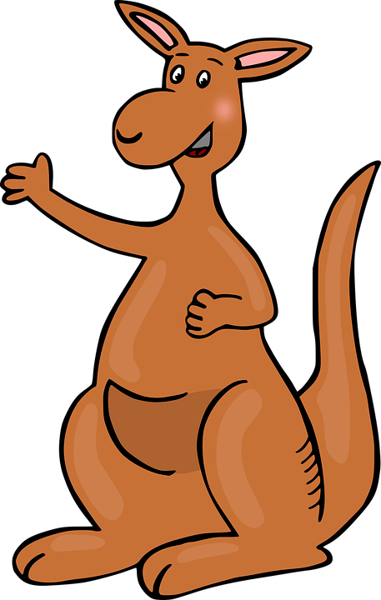
pronunciar
[gu]
[i]
pronunciar
canguro
fin
Notes:
3

Slide 4
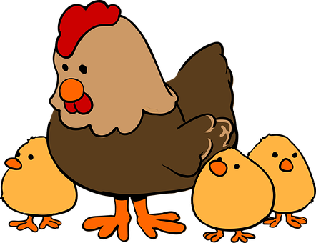
pronunciar
[l]
[ll]
pronunciar
sol
gallina
Notes:
4

Slide 5
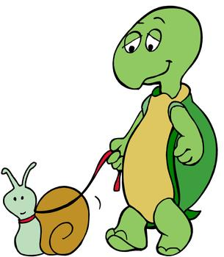
pronunciar
[e]
[u]
pronunciar
lentamente
nube
Notes:
5

Slide 6
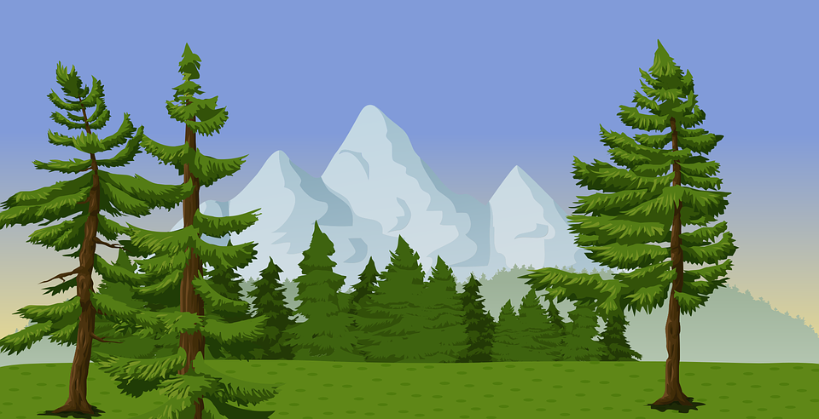
pronunciar
[que]
[qui]
pronunciar
bosque
química
Notes:
6

Slide 7
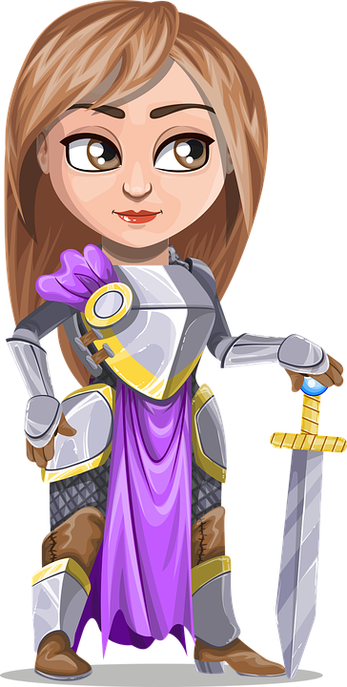
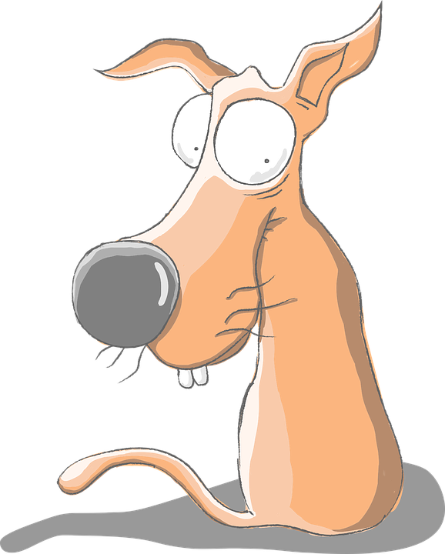
pronunciar
[co]
[ce]
pronunciar
cola
princesa
Notes:
7

Slide 8
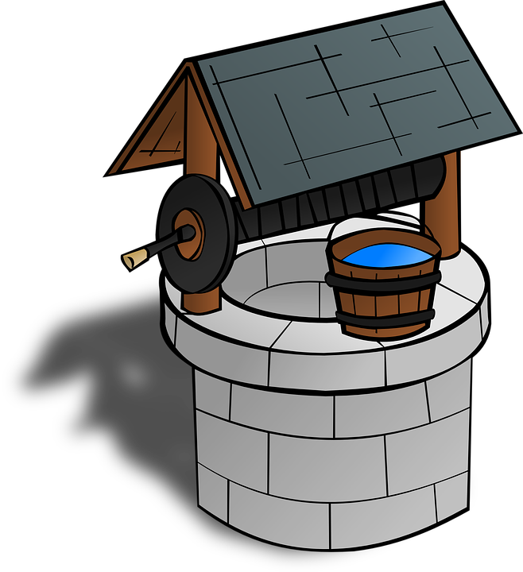
pronunciar
[ci]
[z]
pronunciar
cima
pozo
Notes:
8

Slide 9
pronunciar
Pupil name:
Pupil name:
SSC and word | px
gafas
bigote
canguro
fin
sol
gallina
lentamente
nube
bosque
química
cola
princesa
cima
pozo
SSC and word | px
gafas
bigote
canguro
fin
sol
gallina
lentamente
nube
bosque
química
cola
princesa
cima
pozo
Notes:
Pupil feedback and assessment sheet
9

Slide 10
Teacher audio version
SSC and word | px
gafas
bigote
canguro
fin
sol
gallina
lentamente
SSC and word | px
nube
bosque
química
cola
princesa
cima
pozo
Notes:
Teacher audio version for preparation
10

Slide 11
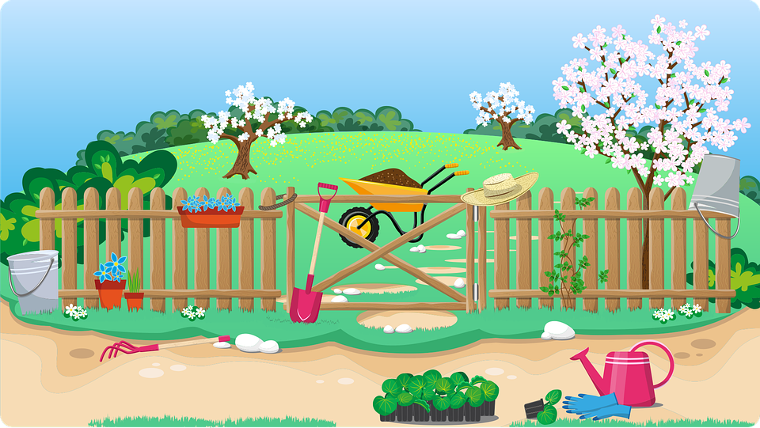
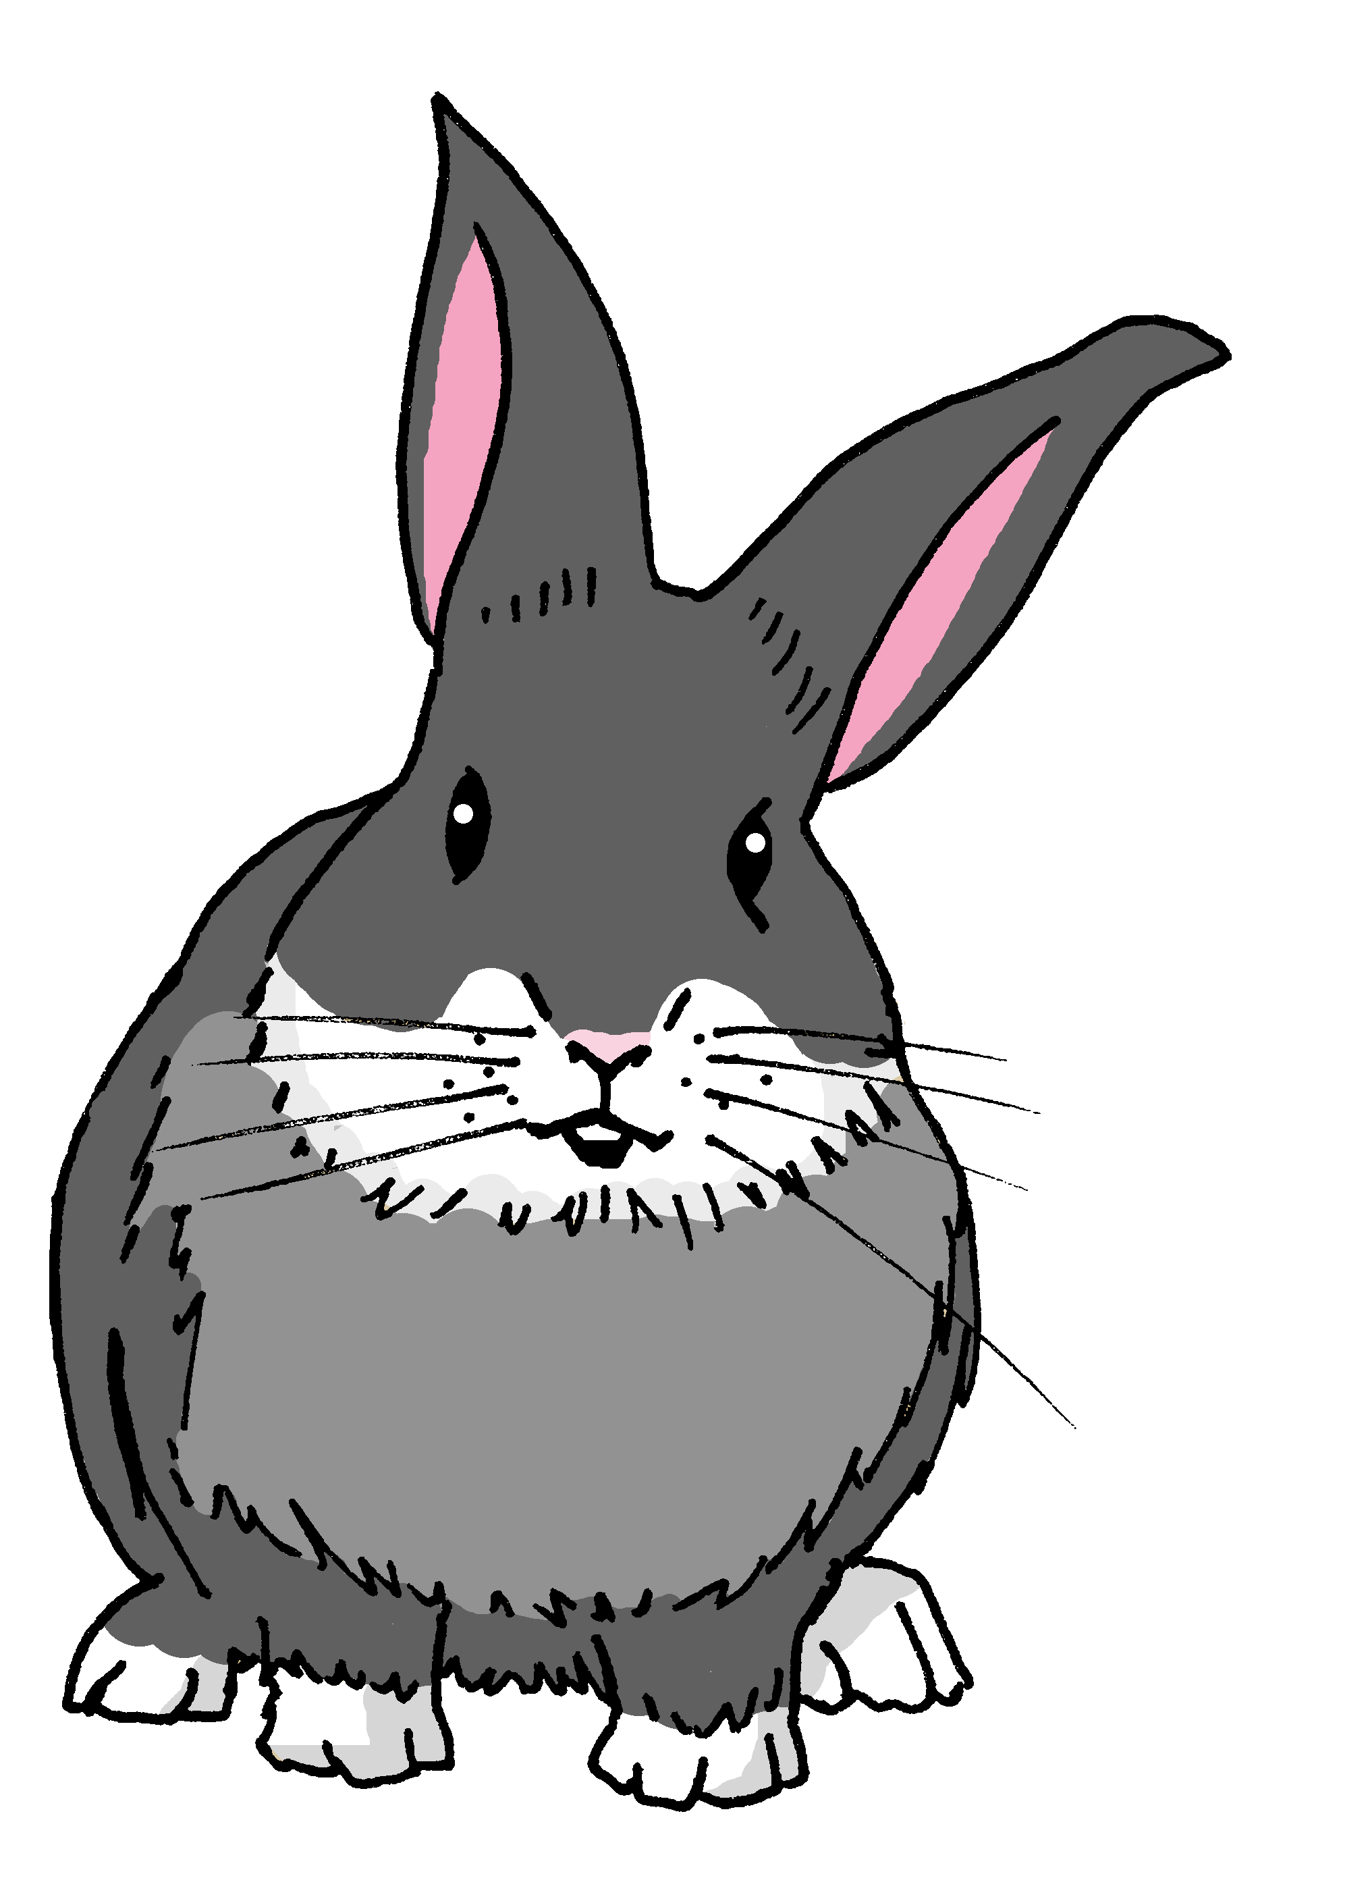
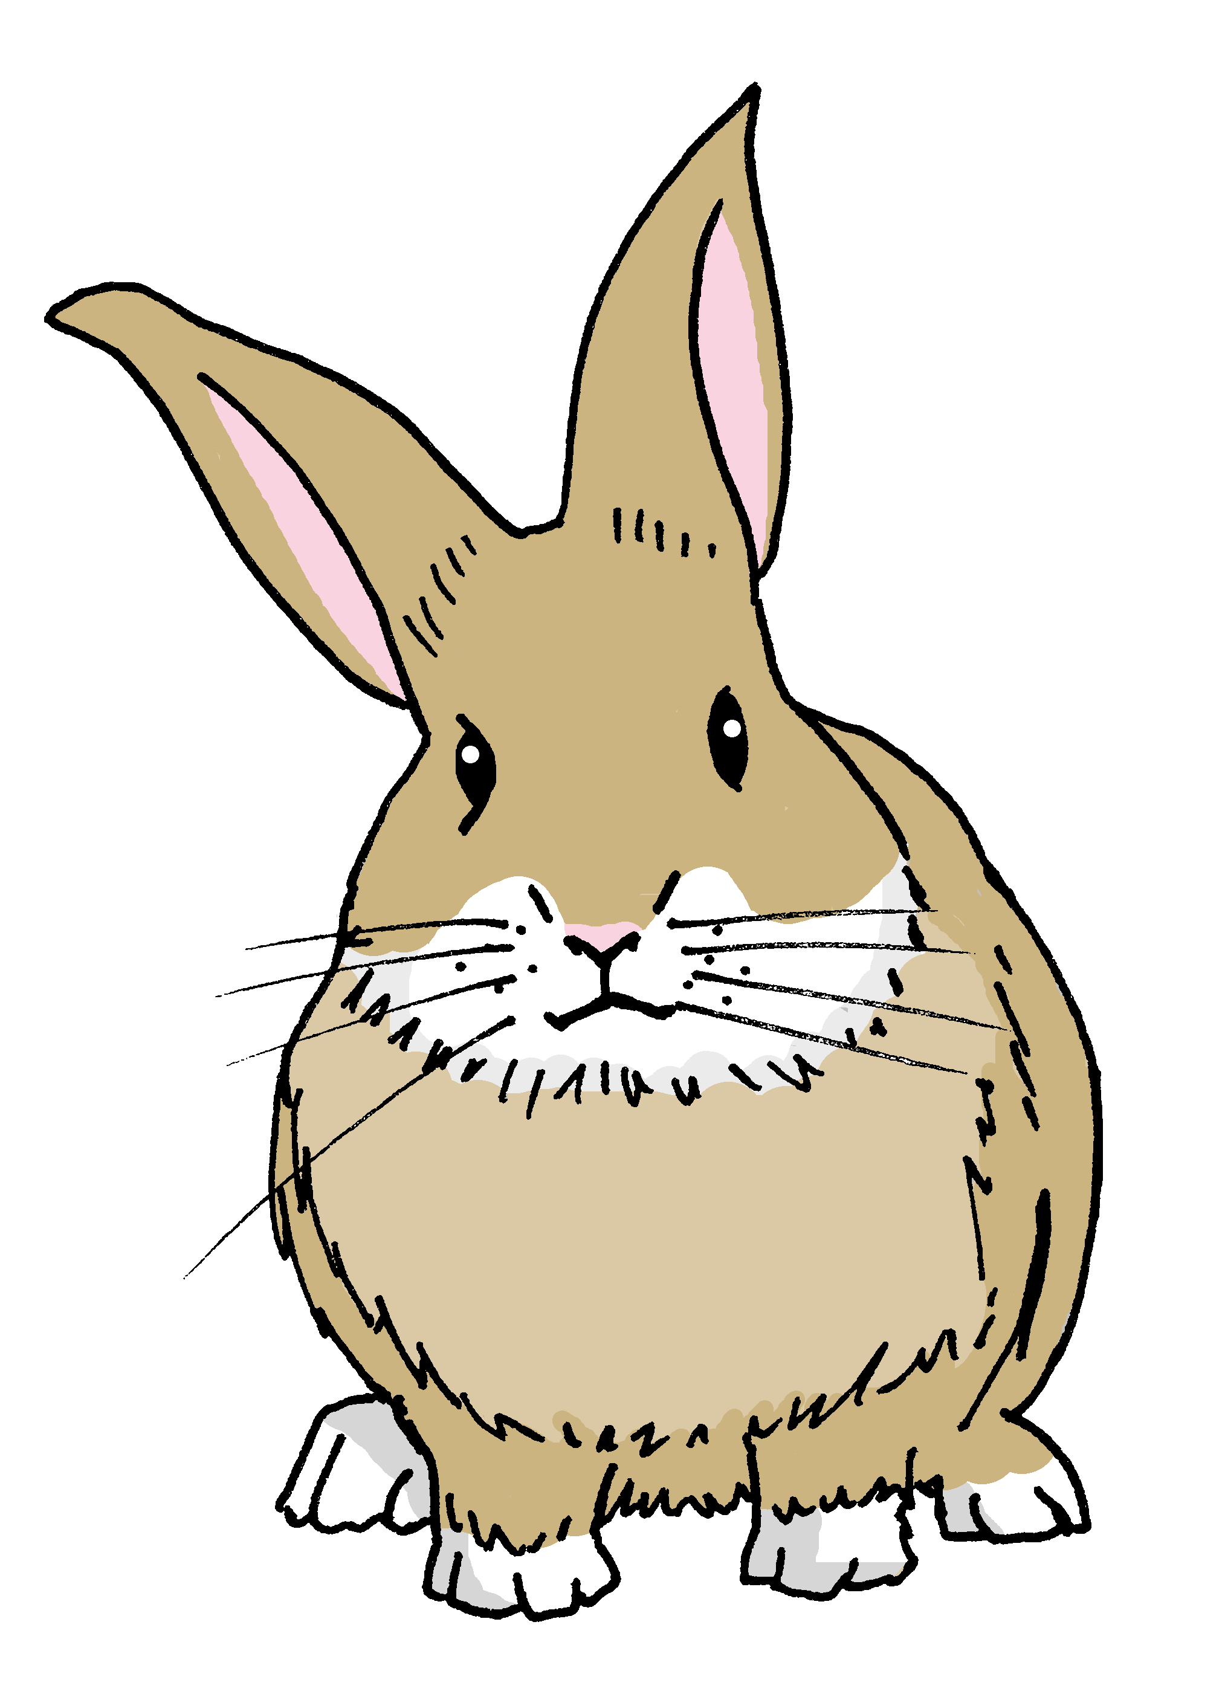
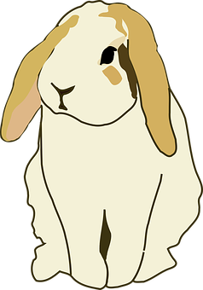
huevos 🥚
Busca 🔎 en la imagen
conejos 🐰
flores 🌷
1 Escribe ✍
¿Cuántos huevos hay?
Hay _____ ___________.
¿Cuántos conejos hay?
Hay _____ ___________.
¿Cuántas flores 🌷 rosas hay?
Hay _____ ___________ rosas.

Slide 12
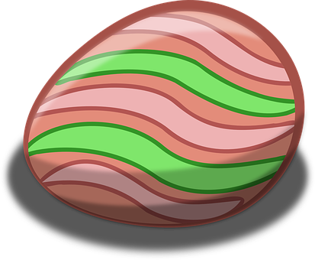
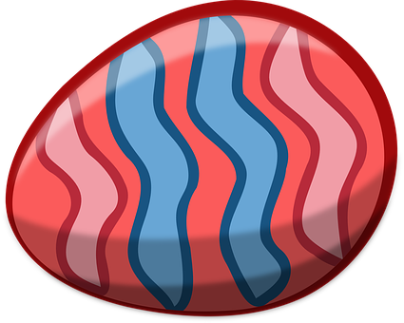
¿Qué es el mensaje?
l
c
u
i
a
s
e
p
f
2 Use the eggs to decipher the message
f
e
l
i
c
e
s
P
a
s
c
u
a
s
3 Unscramble the letters to translate the message into English.
Happy
Easter
pahpy sEtare ➡ _ _ _ _ _ _ _ _ _ _ _

