Slide 1
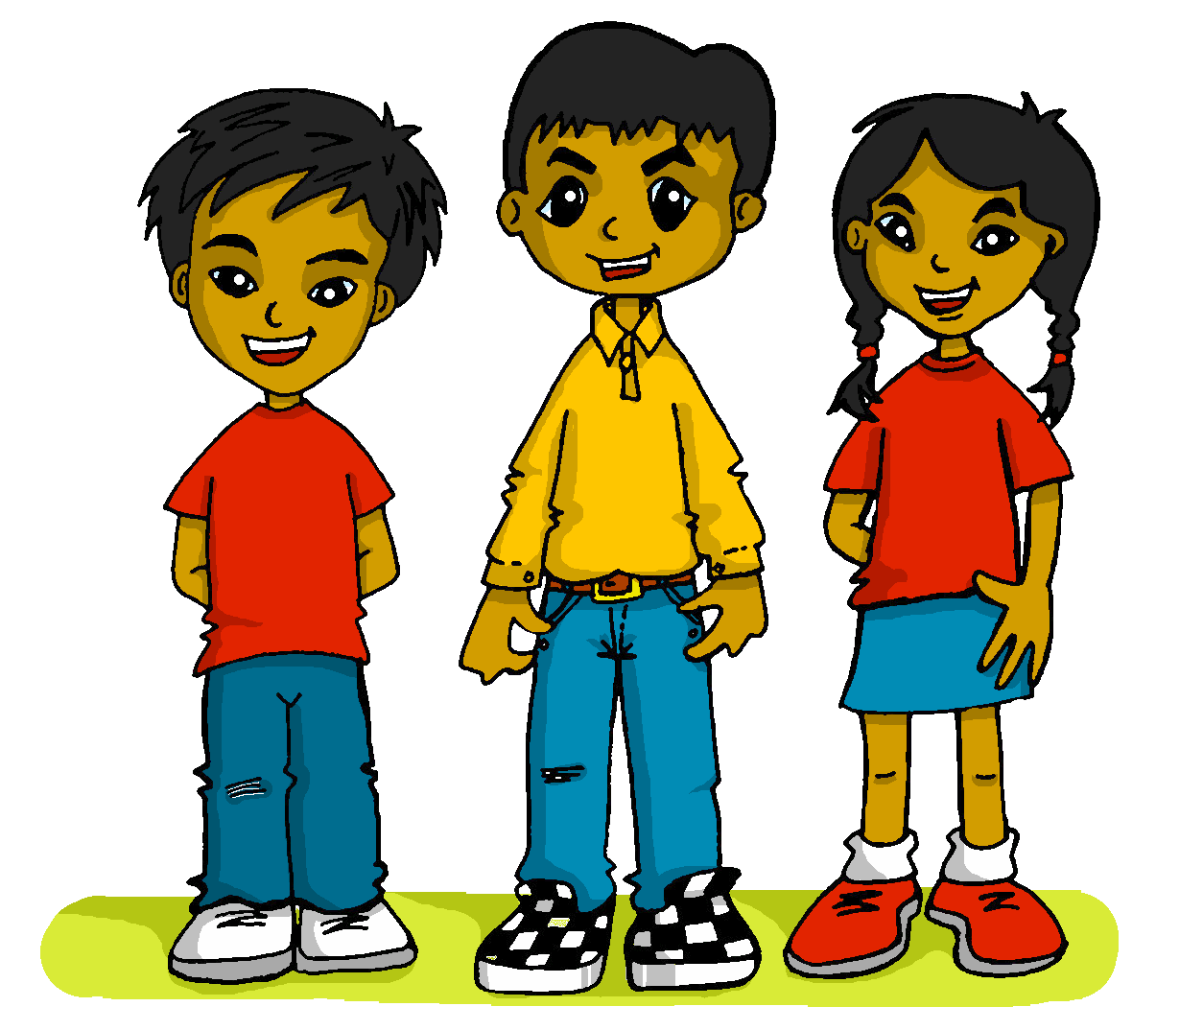
español, con Sofía
¡Felices pascuas!

Slide 2
Saying how many and describing things
rojo
Knowledge quiz
Notes:
Artwork by Steve Clarke. All additional pictures selected are available under a Creative Commons license, no attribution required.
The frequency rankings for words that occur in this PowerPoint which have been previously introduced in the resources are given in the SOW (excel document) and in the resources that first introduced and formally re-visited those words.
For any other words that occur incidentally in this PowerPoint, frequency rankings will be provided in the notes field wherever possible.
This lesson includes an assessment of the vocabulary and grammar knowledge from the first two terms of this year’s course. There is a phonics assessment in Week 11. Note: there are no follow up activities this week, but there is an Easter activity at the end of the quiz. This could be used in a follow up slot, more than once, during this week, as appropriate. The quiz can be completed on paper with pupils writing numbered answers. Alternatively there is a word document for printing. There is an answer sheet for teachers. Alternatively, answers are provided on slides for pupils to correct their own or a partner’s.
Source: Davies, M. & Davies, K. (2018). A frequency dictionary of Spanish: Core vocabulary for learners (2nd ed.). Routledge: London

Slide 3
escuchar
Vocabulary
At home, Nina speaks Aymara, a language spoken by Aymara people of Peru and Bolivia. She is learning Spanish at school, like you. Help Nina by answering the questions in this quiz.
A For each question, put a cross (x) under the English meaning that matches what you hear.
You will hear each Spanish word twice. Choose one correct answer only.
 | A | B | C | D
1. | fast | pretty | slow | yellow
 | ☐ | ☐ | ☐ | ☐
2. | week | always | seven | Saturday
 | ☐ | ☐ | ☐ | ☐
3. | Tuesday | text | cake | three
 | ☐ | ☐ | ☐ | ☐
1
2
3
Notes:
Timing: 20-25 minutes (all assessment slides)
Aim: to practise aural comprehension of vocabulary taught in weeks 1-12 of the course.
Procedure:
1. Click the audio buttons to play each item. (The words are recorded twice with a pause to allow pupils to process the information).
2. Pupils can either write 1C, etc.. or if they have the assessment on a print out they can put a X in the correct box.
3. After items 1-3, continue to the next slide to complete the remainder of the task.
Transcript:
1. bonito ….. bonito
2. sábado…..sábado
3. tarta…..tarta
4. en…..en
5. normalmente…..normalmente
6. España…..España

Slide 4
escuchar
Vocabulary
A For each question, put a cross (x) under the English meaning that matches what you hear.
You will hear each Spanish word twice. Choose one correct answer only.
 | A | B | C | D
4. | through | in | no | from
 | ☐ | ☐ | ☐ | ☐
5. | normally | Wednesday | normal | uniform
 | ☐ | ☐ | ☐ | ☐
6. | Spain | England | English | Spanish
 | ☐ | ☐ | ☐ | ☐
4
5
6
Notes:
Timing: 20-25 minutes (all assessment slides)
Aim: to practise aural comprehension of vocabulary taught in weeks 1-23 of the course.
Procedure:
1. Click the audio buttons to play each item. (The words are recorded twice with a pause to allow pupils to process the information).
2. Pupils can either write 1C, etc.. or if they have the assessment on a print out they can put a X in the correct box.
Transcript:
1. bonito ….. bonito
2. sábado…..sábado
3. tarta…..tarta
4. en…..en
5. normalmente…..normalmente
6. España…..España

Slide 5
escuchar
Vocabulary
B For each question, put a cross (x) under the type of word you hear. You will hear each Spanish word twice. Choose one correct answer only.
This word is a good example of …
 | A | B | C | D
Ej. | food ☐ | a place ☐ | an object ☐ | a greeting ☐
1. | a country ☐ | a day of the week ☐ | an activity ☐ | a number ☐
2. | a greeting ☐ | a colour ☐ | a place ☐ | an object ☐
3. | a mood or character ☐ | a day of the week ☐ | a number ☐ | an activity ☐
4. | a number ☐ | a greeting ☐ | food ☐ | an object ☐
1
2
3
4
5
Notes:
Procedure:
1. Click the audio buttons to play each item. (The words are recorded twice with a pause to allow pupils to process the information).
2. Pupils can either write 1C, etc.. or if they have the assessment on a print out they can put a X in the correct box.
3. When complete, continue to the next task.
Transcript:
el pueblo…el pueblo
leer…leer
hola…hola
doce…doce
una cama…una cama

Slide 6
escuchar
Grammar
C Put a cross (x) next to the person or people that the sentence is about. You will hear each Spanish sentence twice.
1. | I | ☐ | you | ☐ | he/she | ☐
2. | I | ☐ | you | ☐ | he/she | ☐
3. | I | ☐ | you | ☐ | he/she | ☐
4. | I | ☐ | you | ☐ | he/she | ☐
5. | I | ☐ | you | ☐ | he/she | ☐
 | I | ☐ | you | ☐ | he/she | ☐
1
2
3
4
5
6
Notes:
Procedure:
1. Click the audio buttons to play each item. (The words are recorded twice with a pause to allow pupils to process the information).
2. Pupils can either write 1C, etc.. or if they have the assessment on a print out they can put a X in the correct box.
3. When complete, continue to the reading.
Transcript:
1. Canto en clase.
2. Lleva un sombrero.
3. Tienes tiempo.
4. Lees un libro.
5. Está en la playa.
6. Necesito un bolígrafo.

Slide 7
leer
A Translate the underlined Spanish word to complete each English sentence.
1. Comprendo la información. I _____________ the information.
2. Hay ocho deportes. There are ___________ sports.
3. El libro es en español. The book is in_____________ .
4. Necesitas uniforme? Do you _______ a uniform?
5. Es un juego? Is it a _____________ ?
6. Max compra una película. Max buys a _____________ .
7. Camino con un sombrero. I walk _________ a hat.
8. La frase es importante. The _____________ is important.
9. El mar es fantástico. The __________ is fantastic.
10. Señor Valero camina. Mr Valero _____________ .
Notes:
Aim: to practise written recall of previously taught vocabulary.
Procedure:
Ensure that the task is clear.
Pupils could write 1 – 10 and the individual English word meanings (or they could fill in if they have printed assessment sheets).

Slide 8
escribir
B Translate the underlined English words to complete the Spanish sentence.
1. It’s a mountain. Es _____ __________. (write two words)
2. The text is excellent. _____ ________ es excelente. (write two words)
3. Talking in class is normal. _________ en clase es normal. (write one word)
4. She is always pleased! ¡ ___________ está contenta! (write one word)
5. You are fast today. Estás rápido ________. (write one word)
6. Where? In Peru? ¿__________? ¿En Perú? (write one word)
7. It’s important to have a friend (m). Es importante tener ____ ___________. (write two words)
8. There are three languages in Peru. Hay_________ idiomas en Perú. (write one word)
Notes:
Aim: to practise written production of previously taught vocabulary.
Procedure:
Ensure that the task is clear.
Pupils could write 1 – 10 and the individual English word meanings (or they could fill in if they have printed assessment sheets).

Slide 9
escribir
C Write the opposite word in Spanish.
1. rápido - ________________ 2. nervioso - _____________ 3. triste - __________________
4. presente - ______________
5. la mamá - ________
Notes:
Aim: to practise written production of previously taught vocabulary.
Procedure:
Ensure that the task is clear.
Pupils could write the answers only (or they could fill in if they have printed assessment sheets).

Slide 10
leer
Grammar
Like English, Aymara doesn’t have grammatical gender and adjectives go before the noun. Verb forms are different, too. Help Nina with her Spanish grammar by answering the questions in this part of the quiz.
A
1 | ☐ I ☐ you _{[singular]} ☐ she, he, it | Estoy elegante ahora. |  | 4 | ☐ I ☐ you _{[singular]} ☐ she, he, it | Aprende inglés.
2 | ☐ I ☐ you _{[singular]} ☐ she, he, it | Ves un juego. |  | 5 | ☐ I ☐ you _{[singular]} ☐ she, he, it | Escucho la frase.
3 | ☐ I ☐ you _{[singular]} ☐ she, he, it | Nada cada semana. |  | 6 | ☐ I ☐ you _{[singular]} ☐ she, he, it | Eres fantástico.
Notes:
Aim: to practise written recall of previously taught grammar.
Procedure:
Ensure that the task is clear.
Pupils could write the correct English pronouns (or they could fill in if they have printed assessment sheets).

Slide 11
leer
Grammar
B Put a (X) next to the English meaning that seems best for the Spanish word in bold.
1. Es importante aprender. | a) learning | ☐
 | b) to learn | ☐
2. Nadar es normal. | a) to swim | ☐
 | b) swimming | ☐
C Put a (X) next to the words that could finish this sentence. Remember the personal ‘a’.
1. Veo ... | a) papá. | ☐
 | b) la información. | ☐
2. Visito a... | a) una amiga. | ☐
 | b) la playa. | ☐
Notes:
Aim: to practise written recall of previously taught grammar.
Procedure:
Ensure that the task is clear.
Pupils could write the correct English pronouns (or they could fill in if they have printed assessment sheets).

Slide 12
escribir
D Write the Spanish word for ‘a’. 1. _______ uniforme (m) 2. _______ instrucción (f)
E Write the Spanish word for ‘the’.
1. ________ mañana. (f) 2. ________ inglés. (m) F Write the Spanish word for ‘some’. 1. _______ cuadernos (mpl) 2. _______ cámaras (fpl)
G Write the Spanish word for ‘how many’.
1. ¿ ________ mochilas? (fpl) 2. ¿ ________ globos? (mpl)
Notes:
Aim: to practise written production of previously taught grammar
Procedure:
Ensure that the task is clear.
Pupils could write the answers only (or they could fill in if they have printed assessment sheets).

Slide 13
¡adiós!
rojo

Slide 14
escuchar
Vocabulary
At home, Nina speaks Aymara, a language spoken by Aymara people of Peru and Bolivia. She is learning Spanish at school, like you. Help Nina by answering the questions in this quiz.
A For each question, put a cross (x) under the English meaning that matches what you hear.
You will hear each Spanish word twice. Choose one correct answer only.
 | A | B | C | D
1. | fast | pretty | slow | yellow
 | ☐ | ☐ | ☐ | ☐
2. | week | always | seven | Saturday
 | ☐ | ☐ | ☐ | ☐
3. | Tuesday | text | cake | three
 | ☐ | ☐ | ☐ | ☐
1
2
3
Notes:
Timing: 20-25 minutes (all assessment slides)
Aim: to practise aural comprehension of vocabulary taught in weeks 1-12 of the course.
Procedure:
1. Click the audio buttons to play each item. (The words are recorded twice with a pause to allow pupils to process the information).
2. Pupils can either write 1C, etc.. or if they have the assessment on a print out they can put a X in the correct box.
3. After items 1-3, continue to the next slide to complete the remainder of the task.
Transcript:
1. bonito ….. bonito
2. sábado…..sábado
3. tarta…..tarta
4. en…..en
5. normalmente…..normalmente
6. España…..España

Slide 15
escuchar
Vocabulary
A For each question, put a cross (x) under the English meaning that matches what you hear.
You will hear each Spanish word twice. Choose one correct answer only.
 | A | B | C | D
4. | through | in | no | from
 | ☐ | ☐ | ☐ | ☐
5. | normally | Wednesday | normal | uniform
 | ☐ | ☐ | ☐ | ☐
6. | Spain | England | English | Spanish
 | ☐ | ☐ | ☐ | ☐
4
5
6
Notes:
Timing: 20-25 minutes (all assessment slides)
Aim: to practise aural comprehension of vocabulary taught in weeks 1-23 of the course.
Procedure:
1. Click the audio buttons to play each item. (The words are recorded twice with a pause to allow pupils to process the information).
2. Pupils can either write 1C, etc.. or if they have the assessment on a print out they can put a X in the correct box.
Transcript:
1. bonito ….. bonito
2. sábado…..sábado
3. tarta…..tarta
4. en…..en
5. normalmente…..normalmente
6. España…..España

Slide 16
escuchar
Vocabulary
B For each question, put a cross (x) under the type of word you hear. You will hear each Spanish word twice. Choose one correct answer only.
This word is a good example of …
 | A | B | C | D
Ej. | food ☐ | a place ☐ | an object ☐ | a greeting ☐
1. | a country ☐ | a day of the week ☐ | an activity ☐ | a number ☐
2. | a greeting ☐ | a colour ☐ | a place ☐ | an object ☐
3. | a mood or character ☐ | a day of the week ☐ | a number ☐ | an activity ☐
4. | a number ☐ | a greeting ☐ | food ☐ | an object ☐
1
2
3
4
5
Notes:
Procedure:
1. Click the audio buttons to play each item. (The words are recorded twice with a pause to allow pupils to process the information).
2. Pupils can either write 1C, etc.. or if they have the assessment on a print out they can put a X in the correct box.
3. When complete, continue to the next task.
Transcript:
el pueblo…el pueblo
leer…leer
hola…hola
doce…doce
una cama…una cama

Slide 17
escuchar
Grammar
C Put a cross (x) next to the person or people that the sentence is about. You will hear each Spanish sentence twice.
1. | I | ☐ | you | ☐ | he/she | ☐
2. | I | ☐ | you | ☐ | he/she | ☐
3. | I | ☐ | you | ☐ | he/she | ☐
4. | I | ☐ | you | ☐ | he/she | ☐
5. | I | ☐ | you | ☐ | he/she | ☐
 | I | ☐ | you | ☐ | he/she | ☐
1
2
3
4
5
6
Notes:
Procedure:
1. Click the audio buttons to play each item. (The words are recorded twice with a pause to allow pupils to process the information).
2. Pupils can either write 1C, etc.. or if they have the assessment on a print out they can put a X in the correct box.
3. When complete, continue to the reading.
Transcript:
1. Canto en clase.
2. Lleva un sombrero.
3. Tienes tiempo.
4. Lees un libro.
5. Está en la playa.
6. Necesito un bolígrafo.

Slide 18
leer
A Translate the underlined Spanish word to complete each English sentence.
1. Comprendo la información. I _____________ the information.
2. Hay ocho deportes. There are ___________ sports.
3. El libro es en español. The book is in_____________ .
4. Necesitas uniforme? Do you _______ a uniform?
5. Es un juego? Is it a _____________ ?
6. Max compra una película. Max buys a _____________ .
7. Camino con un sombrero. I walk _________ a hat.
8. La frase es importante. The _____________ is important.
9. El mar es fantástico. The __________ is fantastic.
10. Señor Valero camina. Mr Valero _____________ .
understand
eight
Spanish
need
game
film
with/in
sentence
sea
walks/is walking
Notes:
Aim: to practise written recall of previously taught vocabulary.
Procedure:
Ensure that the task is clear.
Pupils could write 1 – 10 and the individual English word meanings (or they could fill in if they have printed assessment sheets).

Slide 19
escribir
B Translate the underlined English words to complete the Spanish sentence.
1. It’s a mountain. Es _____ __________. (write two words)
2. The text is excellent. _____ ________ es excelente. (write two words)
3. Talking in class is normal. _________ en clase es normal. (write one word)
4. She is always pleased! ¡ ___________ está contenta! (write one word)
5. You are fast today. Estás rápido ________. (write one word)
6. Where? In Peru? ¿__________? ¿En Perú? (write one word)
7. It’s important to have a friend (m). Es importante tener ____ ___________. (write two words)
8. There are three languages in Peru. Hay_________ idiomas en Perú. (write one word)
una montaña
El texto
Hablar
Siempre
hoy
Dónde
un amigo
tres
Notes:
Aim: to practise written production of previously taught vocabulary.
Procedure:
Ensure that the task is clear.
Pupils could write 1 – 10 and the individual English word meanings (or they could fill in if they have printed assessment sheets).

Slide 20
escribir
C Write the opposite word in Spanish.
1. rápido - ________________ 2. nervioso - _____________ 3. triste - __________________
4. presente - ______________
5. la mamá - ________
lento
tranquilo
feliz/contento
ausente
el papá
Notes:
Aim: to practise written production of previously taught vocabulary.
Procedure:
Ensure that the task is clear.
Pupils could write the answers only (or they could fill in if they have printed assessment sheets).

Slide 21
leer
Grammar
Like English, Aymara doesn’t have grammatical gender and adjectives go before the noun. Verb forms are different, too. Help Nina with her Spanish grammar by answering the questions in this part of the quiz.
A
1 | ☐ I ☐ you _{[singular]} ☐ she, he, it | Estoy elegante ahora. |  | 4 | ☐ I ☐ you _{[singular]} ☐ she, he, it | Aprende inglés.
2 | ☐ I ☐ you _{[singular]} ☐ she, he, it | Ves un juego. |  | 5 | ☐ I ☐ you _{[singular]} ☐ she, he, it | Escucho la frase.
3 | ☐ I ☐ you _{[singular]} ☐ she, he, it | Nada cada semana. |  | 6 | ☐ I ☐ you _{[singular]} ☐ she, he, it | Eres fantástico.
Notes:
Aim: to practise written recall of previously taught grammar.
Procedure:
Ensure that the task is clear.
Pupils could write the correct English pronouns (or they could fill in if they have printed assessment sheets).

Slide 22
leer
Grammar
B Put a (X) next to the English meaning that seems best for the Spanish word in bold.
1. Es importante aprender. | a) learning | ☐
 | b) to learn | ☐
2. Nadar es normal. | a) to swim | ☐
 | b) swimming | ☐
C Put a (X) next to the words that could finish this sentence. Remember the personal ‘a’.
1. Veo ... | a) papá. | ☐
 | b) la información. | ☐
2. Visito a... | a) una amiga. | ☐
 | b) la playa. | ☐
Notes:
Aim: to practise written recall of previously taught grammar.
Procedure:
Ensure that the task is clear.
Pupils could write the correct English pronouns (or they could fill in if they have printed assessment sheets).

Slide 23
escribir
D Write the Spanish word for ‘a’. 1. _______ uniforme (m) 2. _______ instrucción (f)
E Write the Spanish word for ‘the’.
1. ________ mañana. (f) 2. ________ inglés. (m) F Write the Spanish word for ‘some’. 1. _______ cuadernos (mpl) 2. _______ cámaras (fpl)
G Write the Spanish word for ‘how many’.
1. ¿ ________ mochilas? (fpl) 2. ¿ ________ globos? (mpl)
un
una
la
el
unos
unas
Cuántas
Cuántos
Notes:
Aim: to practise written production of previously taught grammar
Procedure:
Ensure that the task is clear.
Pupils could write the answers only (or they could fill in if they have printed assessment sheets).

