Slide 1
español, con Sofía

Slide 2
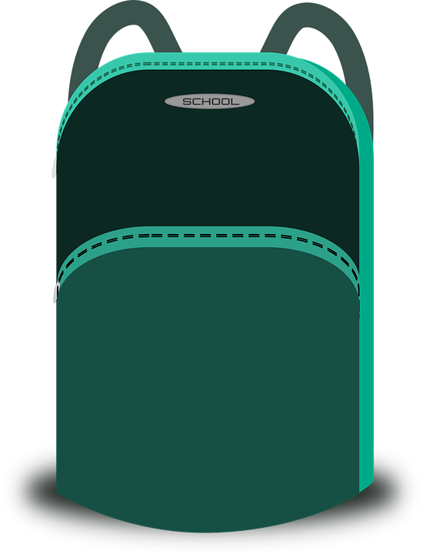
Saying what I and others have
Tengo…
Gender & indefinite articles un / una
tener (to have); tengo (I have)
SSC [ce]
rojo
Notes:
Artwork by Steve Clarke. All additional pictures selected are available under a Creative Commons license, no attribution required.
The frequency rankings for words that occur in this PowerPoint which have been previously introduced in the resources are given in the SOW (excel document) and in the resources that first introduced and formally re-visited those words.
For any other words that occur incidentally in this PowerPoint, frequency rankings will be provided in the notes field wherever possible.
Phonics: centro [317]
Vocabulary: tener [19] tengo [19] bolígrafo [>5000] cámara [903] cuaderno [3301] fruta [1925] mochila [>5000] pelota [2270] teléfono [866] un [6] una [6]
Frequency of unknown words:
la [1] practicar [1595] compañero [551] dos [64] excrusión [4699] lista [1189] montaña [1464]
Source: Davies, M. and Davies, K. (2018). A frequency dictionary of Spanish: Core vocabulary for learners (2nd ed.). Routledge: London

Slide 3
pronunciar
[ce]
centro
Notes:
Timing: 1 minute
Aim: to introduce SSC [ce]
Procedure:
Introduce and elicit the pronunciation of the individual SSC [ce] and then the source word ‘centro’ (with gesture, if using).
Click to bring up the picture and get pupils to repeat (with gesture, if using).
Suggested gesture: For ‘centre’, pupils can bring their two index fingers together to touch as per the image where arrows converge in a central point.

Slide 4
pronunciar
Escucha: ¿Cuántas veces escuchas [ce]?
Marca .
How many times can you hear [ce]?
escuchar
La cebra Merce come césped caliente.
The zebra Merce eats hots grass.
Practica con tu compa؜ñero /a.
practica = practise
compañero = partner
Notes:
Timing: 2 minutes
Aim: to develop phonological awareness of [ce]
Procedure:
Teacher reads the instruction in Spanish. Use gesture to ensure meaning of ‘cuántas veces’ (how many times) is clear. Click x1 to bring up the rest of the instruction (‘marca’). Pupils to keep a tally of how many times they hear [ce]
Click to bring up answers (x 4 clicks in total, 3 x [ce])
Click to bring up next task. Pupils to practise the sentence out loud (it combines [ce] with previously met SSC [ca] [co] [cu].
Transcript: La cebra Merce come césped caliente.
Frequency of unknown words:
practicar [1595] compañero [551]
Source: Davies, M. and Davies, K. (2018). A frequency dictionary of Spanish: Core vocabulary for learners (2nd ed.). Routledge: London

Slide 5
Gender in Spanish
This is grammatical, not biological gender! A house (una casa) is not female, it is a feminine noun.
Indefinite articles: a/an
In Spanish, things, as well as people and animals, are either masculine or feminine. We say that they have gender.
To say a (or an) in Spanish use un before a masculine noun and una before a feminine noun.
Most masculine nouns end in –o and most feminine nouns end in –a.
Masculine
Feminine
un
__ universo
una
a universe
___ casa
a house
un
__ teléfono
an idea
a phone
una
___ idea
un
a bear
una
a bed
__ oso
___ cama
Notes:
Timing: 3 minutes
Aim: to introduce grammatical gender and singular indefinite articles (un/una).
Procedure:
Click to present the new information about gender and indefinite articles in Spanish.
Click to bring up three examples of masculine nouns with their indefinite article ‘un’.
Click to bring up three examples of feminine nouns with their indefinite article ‘una’.
Click to provide the salient pattern: that most masculine nouns end in –o and most feminine nouns in –a.
These example nouns are all taken from the SSC source/cluster words from weeks 1-8 except teléfono [866]. pupils should already familiar with these from their phonics learning.

Slide 6
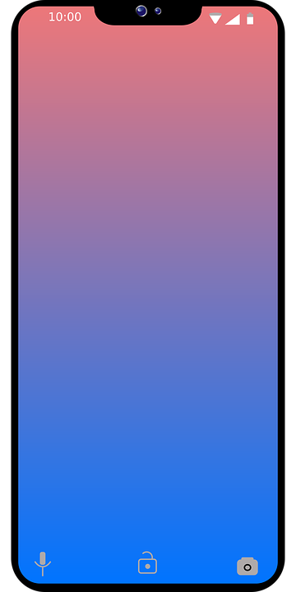
vocabulario
¿Es ‘un’ o ‘una?
a b ñ
It’s common to say ‘boli’ instead of ‘bolígrafo’.
vocabulario
vocabulario
vocabulario
vocabulario
vocabulario
vocabulario
[un]
[una]
__ bolígrafo a pen
__ fruta a (piece of) fruit
__ oso a bear
__ cámara a camera
__ teléfono a phone
__ pelota a ball
__ cuaderno an exercise book
__ mochila a rucksack
Notes:
Timing: 5 minutes
Aim: to practise aural distinction between un and una; to present the new vocabulary for this week in sound and writing, and with English meanings.
Procedure:
Click for each word to appear with audio (without article).
Pupils say ‘un’ or ‘una’, depending on the noun ending.
Click again for it to disappear into the corresponding pacperson’s mouth.
Transcript fruta teléfono pelota mochila oso bolígrafo cuaderno cámara

Slide 7
escuchar
Una excursión a la montaña
Quique and his friends are going on a school trip to the mountains.
escuchar
La señora Cano lee la lista .
excursión= excursion
la montaña = mountain
¿Es un o una?
 | un / una | cuaderno | cámara
 | un / una | teléfono | pelota
 | un / una | cámara | bolígrafo
 | un / una | oso | fruta
 | un / una | mochila | teléfono
E
E
1
1
2
2
3
3
4
4
Notes:
Timing: 4 minutes
Aim: to practise aural recognition of un / una and its connection with an appropriate noun.
Procedure:
Read the title and click to bring up the instructions in Spanish.
Do the example (E). (Note: some learners will benefit from being able to circle the words on the sheet).
Click to bring up the answers.
Draw pupils’ attention to the nouns.
Pupils write (or circle) the correct noun, according to its final letter.
Click to bring up a 2nd set of audio buttons to hear the article and noun together.
Pupils check their answers.
Click to confirm the answers.
Transcript 1:
Ej. Un [cuaderno]
Una [pelota]
Un [bolígrafo]
Una [fruta]
Una [mochila]
Transcript 2:
Ej. Un cuaderno
Una pelota
Un bolígrafo
Una fruta
Una mochila
Frequency of unknown words:
excrusión [4699] la [1] montaña [1464]
Source: Davies, M. and Davies, K. (2018). A frequency dictionary of Spanish: Core vocabulary for learners (2nd ed.). Routledge: London

Slide 8
leer
Lee y escribe dos listas en inglés .
What do they need for the school trip?
un cuaderno | una pelota
un teléfono | un bolígrafo
una cámara | una fruta
una mochila | un oso
dos = two
lista = list
an exercise book
a ball
a phone
a pen
a camera
a piece of fruit
a bear
a rucksack, bag
Notes:
Timing: 4 minutes
Aim: to practise written comprehension of the new vocabulary.
Procedure:
1. Ensure that pupils understand the task. They need to identify and list in English the 5 items that are needed for the trip, and the three items that Quique and friends should leave at home. 2. Pupils write the words in English.
3. Click to reveal answers – they appear from left to right.
4. Note: the pictures are provided to give additional support for word comprehension as pupils have only met these words briefly, at the start of the lesson.
Frequency of unknown words:
dos [64] lista [1189]
Source: Davies, M. and Davies, K. (2018). A frequency dictionary of Spanish: Core vocabulary for learners (2nd ed.). Routledge: London

Slide 9
tener:
tengo
[to have | having]
[I have]
In Spanish the verb tener means ‘to have’.
To say ‘I have’ we say ‘tengo’.
Tengo un cuaderno.
Tengo una fruta.
I have an exercise book.
I have a (piece of) fruit.
Notes:
Timing: 2 minutes
Aim: to introduce ‘tener’ & 1st person singular, tengo.
Procedure:
Click to present the information about tener (to have).
Elicit English translations for the Spanish examples provided.

Slide 10
hablar y escuchar
Habla 💬.
hablar
Persona A: Round 1
hablar
Persona B: Round 1
 | un / una
1. Tengo | ___ | pelota
 | Which noun must it be?
1
una
Person A says: Tengo una… (but not the noun!)
Person B hears ‘una’ and ticks the correct noun. Is it ‘teléfono’ or ‘pelota’?
You have to be very clear when you say un or una!
Notes:
Timing: 1 minute to model, 7 minutes for the task, 2 to check answers.
Aim: to model the speaking task.
Procedure:
1. Click to model each step and explain it. 2. Then give out the handouts. (two slides at the end of the presentation)

Slide 11
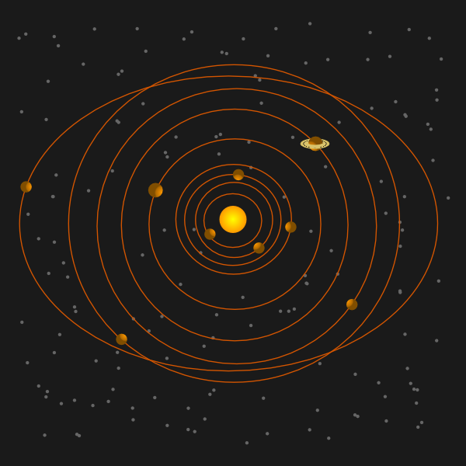
hablar y escuchar
Corrige ✅.
Check your answers.
hablar
hablar
Persona A: Round 1
Persona B: Round 1
 | un / una
1. Tengo | ___ | cuaderno
2. Tengo | ___ | teléfono
3. Tengo | ___ | cámara
4. Tengo | ___ | oso
5. Tengo | ___ | casa
 | Which noun must it be?
1
2
3
4
5
un
un
una
un
una
Notes:
DO NOT DISPLAY DURING THE TASK Timing: 1 minute
Aim: to give feedback to all pupils on Round 1.
Procedure:
Elicit the half sentence for number 1 from A pupils.
Click to reveal the correct article.
Elicit the noun from B pupils.
Click to confirm the correct noun.
Continue for items 2 – 5.
Then go to the next slide to give feedback on Round 2.

Slide 12
hablar y escuchar
Corrige ✅.
Check your answers.
hablar
hablar
Persona B: Round 2
Persona A: Round 2
 | un / una
1. Tengo | ___ | mochila
2. Tengo | ___ | cámara
3. Tengo | ___ | universo
4. Tengo | ___ | fruta
5. Tengo | ___ | bolígrafo
 | Which noun must it be?
1
2
3
4
5
una
una
un
una
un
Notes:
DO NOT DISPLAY DURING THE TASK Timing: 1 minute
Aim: to give feedback to all pupils on Round 2.
Procedure:
Elicit the half sentence for number 1 from B pupils.
Click to reveal the correct article.
Elicit the noun from A pupils.
Click to confirm the correct noun.
Continue for items 2 – 5.

Slide 13
vocabulario
Escribe en inglés 📝.
a b ñ
Can you get at least15 points?
 | estás | allí | ¿cómo?
 | soy | contento | estoy
 | ahora | cansado | estar
 | siempre | ser | de1
 | tener | un cuaderno | una
 | un bolígrafo | un | una mochila
 | una pelota | tengo | una cámara
vocabulario
vocabulario
vocabulario
vocabulario
vocabulario
you are (trait)
there
How?
x3
I am (trait)
ready
I am (state)
now
tired
to be | being (state)
x2
always
to be | being (trait)
from
to have | having
an exercise book
a / an (feminine)
a pen
a / an (masculine)
a school bag
x1
a ball
I have
a camera
Notes:
Note: this can be a follow up activity, if needed.
Timing: 6 minutes
Aim: to practise written comprehension of vocabulary from last week and this week.
Procedure: 1. Give pupils a blank grid. They fill in the English meanings of any of the words they know, trying to reach 15 points in total.
Note: The most recently learnt and practised words are pink, words from the previous week are green and those from two weeks ago are blue, thus more points are awarded for them, to recognise that memories fade and more effort (heavy lifting!) is needed to retrieve them.

Slide 14
¡adiós!
rojo

Slide 15
Handout speaking
¡A hablar!
Persona A: Round 1
Persona A: Round 2
 | un / una
1. Tengo | ___ | cuaderno
2. Tengo | ___ | teléfono
3. Tengo | ___ | cámara
4. Tengo | ___ | oso
5. Tengo | ___ | casa
 | Which noun must it be?
1
2
3
4
5
Notes:
Person A handout

Slide 16
Handout speaking
¡A hablar!
Persona B: Round 1
Persona B: Round 2
 | Which noun must it be?
1
2
3
4
5
 | un / una
1. Tengo | ___ | mochila
2. Tengo | ___ | cámara
3. Tengo | ___ | universo
4. Tengo | ___ | fruta
5. Tengo | ___ | bolígrafo
Notes:
Person B handout

Slide 17
Handout vocabulario
Escribe en inglés 📝.
a b ñ
Can you get at least15 points?
 | estás | allí | ¿cómo?
 | soy | contento | estoy
 | ahora | cansado | estar
 | siempre | ser | de1
 | tener | un cuaderno | una
 | un bolígrafo | un | una mochila
 | una pelota | tengo | una cámara
vocabulario
vocabulario
vocabulario
vocabulario
vocabulario
x3
x2
x1
Notes:
Note: this can be a follow up activity, if needed.
Timing: 6 minutes
Aim: to practise written comprehension of vocabulary from last week and this week.
Procedure: 1. Give pupils a blank grid. They fill in the English meanings of any of the words they know, trying to reach 15 points in total.
Note: The most recently learnt and practised words are pink, words from the previous week are green and those from two weeks ago are blue, thus more points are awarded for them, to recognise that memories fade and more effort (heavy lifting!) is needed to retrieve them.

