Slide 1
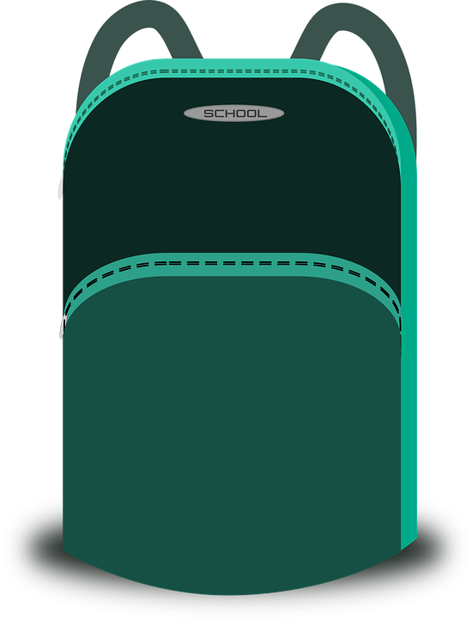
Saying what I and others have
Tengo…
rojo
Follow ups 1-5
Notes:
Artwork by Steve Clarke. All additional pictures selected are available under a Creative Commons license, no attribution required.
The frequency rankings for words that occur in this PowerPoint which have been previously introduced in the resources are given in the SOW (excel document) and in the resources that first introduced and formally re-visited those words.
For any other words that occur incidentally in this PowerPoint, frequency rankings will be provided in the notes field wherever possible.
Phonics: centro [317]
Vocabulary: tener [19] tengo [19] bolígrafo [>5000] cámara [903] cuaderno [3301] fruta [1925] mochila [>5000] pelota [2270] teléfono [866] un [6] una [6]
Frequency of unknown words:
practicar [1595] trabalenguas [>5000] fantástico [2501] importante [171] mi [37]
Source: Davies, M. and Davies, K. (2018). A frequency dictionary of Spanish: Core vocabulary for learners (2nd ed.). Routledge: London
Source: Davies, M. & Davies, K. (2018). A frequency dictionary of Spanish: Core vocabulary for learners (2nd ed.). Routledge: London

Slide 2
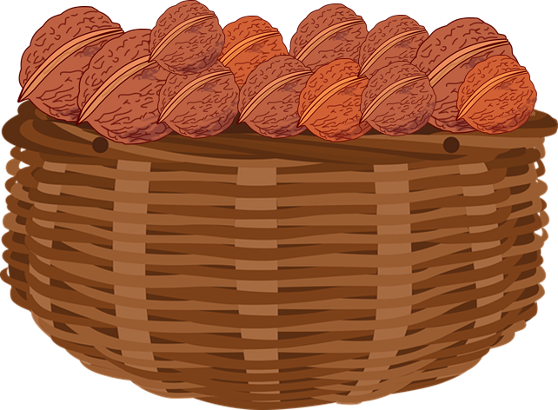
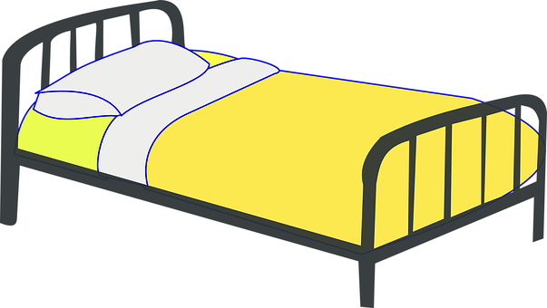
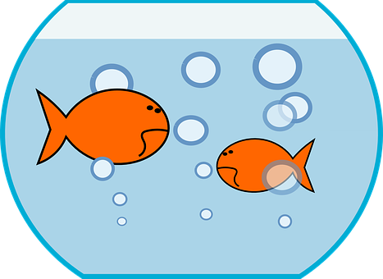
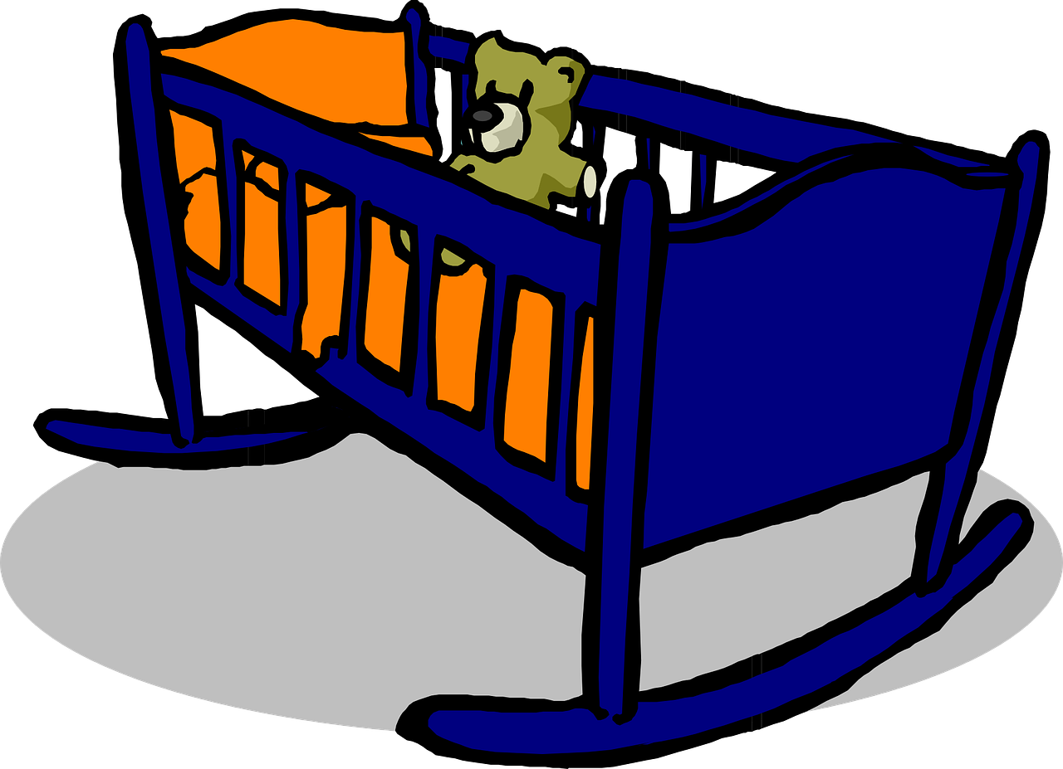
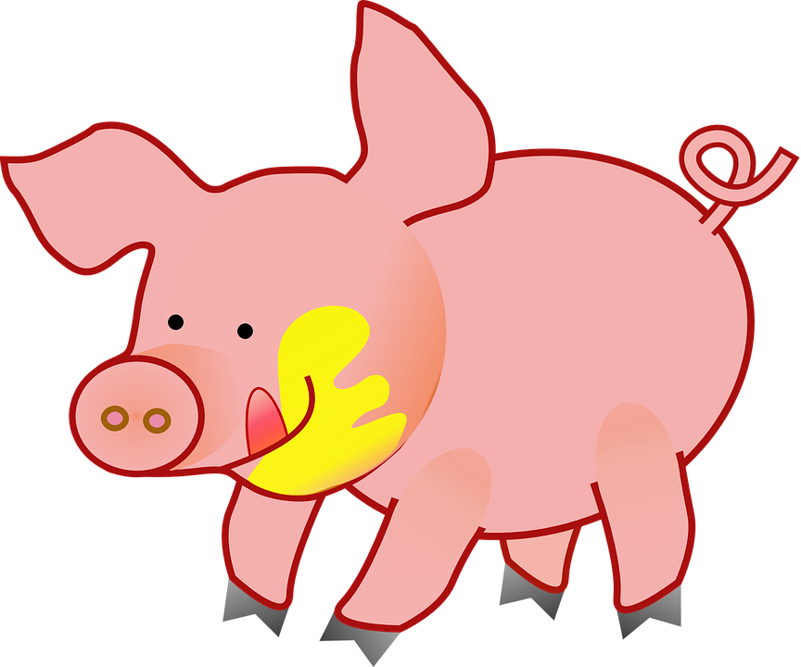
Follow up 1
[ca] [co] [cu] vs. [ce]
Escucha y marca .
B
Practica el trabalenguas.
pronunciar
 | ca | co | cu | ce
 |  |  |  |  | _ _ sa
 |  |  |  |  | _ _ ro
 |  |  |  |  | _ _ ma
 |  |  |  |  | _ _ na
 |  |  |  |  | pe _ _ ra
 |  |  |  |  | _ _ na
Cena cena …
E
c o
[thing]
(Dine on, dine on…
las nueces de la cesta.
1
c e
…nuts from the basket.)
2
c a
Dice dice
(Say, say…
3
c e
¡hay peces en la pecera!
4
c e
…there are fish in the fish bowl.)
5
c u
Crece crece
(Grow, grow…
la cerdita Celeste.
practica = practise
el trabalenguas = tongue twister
… little pig Celeste.)
Notes:
Timing: 5 minutes
Aim: to develop phonological awareness of [ce] in contrast with [ca] [co] [cu] and practise SSC [ce] in a read aloud task.
Procedure:
Click to bring up the instruction.
Click to bring up table and do example together (E).
pupils tick and/or write the correct sound [ca] [co] [cu] [ce].
Click to reveal answers and elicit pupils’ pronunciation of each word.
Click to bring up Part B and read instructions.
Click to bring up and listen to each sentence of the poem.
Allow pupils to practise in pairs.
Practise one more time as a whole class.
Transcript Part A: [EJ] cosa
[1] cero
[2] cama [3] cena
[4] pecera
[5] cuna
Transcript Part B: Cena cena las nueces de la cesta. Dice dice hay peces en la pecera Crece crece la cerdita Celeste.
Frequency of unknown words:
practicar [1595] trabalenguas [>5000]
Source: Davies, M. and Davies, K. (2018). A frequency dictionary of Spanish: Core vocabulary for learners (2nd ed.). Routledge: London

Slide 3
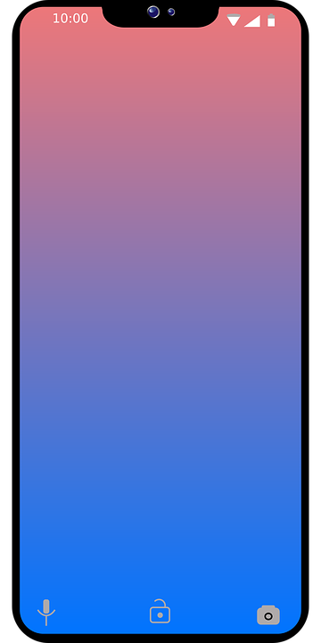
Follow up 2:
B
¿Qué imagen es?
A Escribe ‘a’ en español.
c
g
a
b
leer
_________ bolígrafo.
_________ pelota.
_________ cámara.
_________ fruta.
_________ cuaderno.
_________ idea.
_________ mochila.
_________ teléfono.
un
una
b
una
f
e
d
f
una
h
un
c
a
h
una
d
una
g
e
un
Notes:
Timing: 5 minutes
Aim: to practise written production of the correct indefinite articles and their association with some previously taught nouns (with regular –o / -a endings).
Procedure:
1. Read the instruction in Spanish.
2. Pupils to identify the gender of the nouns and write the correct indefinite article.
3. Pupils match the pictures to the words to reinforce their understanding.

Slide 4
Follow up 3:
Tener:
tengo
[to have | having]
[I have]
In Spanish the verb tener means ‘to have’ or ‘having’.
To say ‘I have’ we say ‘tengo’.
Tengo un cuaderno.
Tener un cuaderno es normal.
I have an exercise book.
Having an exercise book is normal.
Notes:
Timing: 1 minute
Aim: to recap ‘tener’ & 1st person singular, tengo.
Procedure:
Click to present the information about tener (to have).
Elicit English translations for the Spanish examples provided.

Slide 5
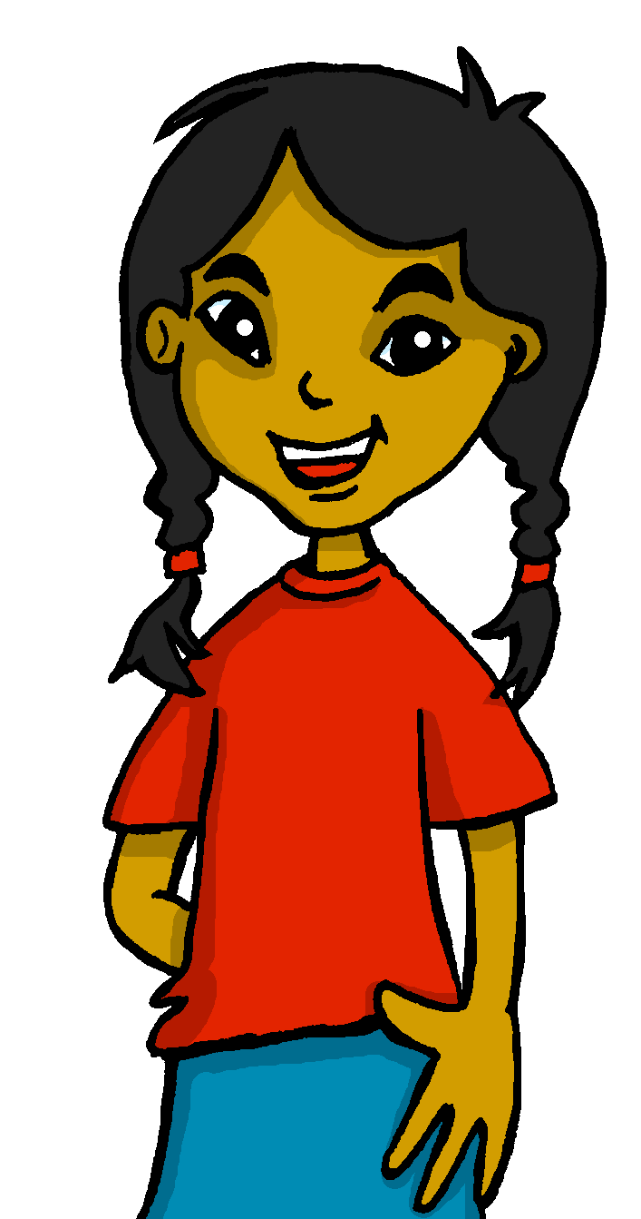
Follow up 3:
Sofía escribe. ¿Qué es en inglés?
Escribe 📝.
Tengo un bolígrafo en clase.
leer
I have a pen in class.
________
____
____
Tengo una cámara en casa.
I have a camera at home.
________
____
____
Tener una cámara en casa es fantástico.
Having a camera at home is fantastic.
________
____
____
Tener un bolígrafo en clase es importante.
Having a pen in class is important.
________
____
____
Tengo una fruta y una pelota en mi mochila.
I have a piece of fruit and a ball in my
bag.
________
____
___
mi – my
_________
Notes:
Timing: 4 minutes
Aim: to practise written comprehension of and differentiation between tener and tengo and un / una.
Procedure:
Pupils read phrases 1 – 5 and write the full sentence translation in English.
Do question 1 as an example.
Give pupils 3 minutes to complete 2 – 5.
Elicit responses and click to reveal full sentences.
Frequency of unknown cognates:
fantástico [2501] importante [171] mi [37]
Source: Davies, M. & Davies, K. (2018). A frequency dictionary of Spanish: Core vocabulary for learners (2nd ed.). Routledge: London

Slide 6
Follow up 4
Habla con un compañero/a.
1
hablar
un
cámara.
I have…
Tengo
una
cama.
[1/9]
¡tiempo!
compañero = partner
INICIO
Notes:
Timing: 5 minutes (9 slides)
Aim: to practise oral production of tengo and the correct indefinite article un / una, and read aloud / selection of this week’s new vocabulary.
Procedure:
Read the instructions in Spanish. Pupils have 10-15 seconds to translate the sentence out lout.
Click to bring up the picture prompt and inicio to start timer.
Click to bring up answers.
Frequency of unknown cognates:
compañero [551]
Source: Davies, M. & Davies, K. (2018). A frequency dictionary of Spanish: Core vocabulary for learners (2nd ed.). Routledge: London

Slide 7
Follow up 4
Habla con un compañero/a.
2
hablar
un
bolígrafo.
I have…
Tengo
una
cuaderno.
[2/9]
¡tiempo!
compañero = partner
INICIO
Notes:
Frequency of unknown cognates:
compañero [551]
Source: Davies, M. & Davies, K. (2018). A frequency dictionary of Spanish: Core vocabulary for learners (2nd ed.). Routledge: London

Slide 8
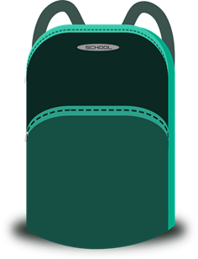
Follow up 4
Habla con un compañero/a.
3
hablar
un
pelota.
I have…
Tengo
una
mochila.
[3/9]
¡tiempo!
compañero = partner
INICIO
Notes:
3/9
Frequency of unknown cognates:
compañero [551]
Source: Davies, M. & Davies, K. (2018). A frequency dictionary of Spanish: Core vocabulary for learners (2nd ed.). Routledge: London

Slide 9
Follow up 4
Habla con un compañero/a.
4
hablar
un
fruta.
I have…
Tengo
una
teléfono.
[4/9]
¡tiempo!
compañero = partner
INICIO
Notes:
4/9
Frequency of unknown cognates:
compañero [551]
Source: Davies, M. & Davies, K. (2018). A frequency dictionary of Spanish: Core vocabulary for learners (2nd ed.). Routledge: London

Slide 10
Follow up 4
Habla con un compañero/a.
5
hablar
un
pelota.
I have…
Tengo
una
cuaderno.
[5/9]
¡tiempo!
compañero = partner
INICIO
Notes:
5/9
Frequency of unknown cognates:
compañero [551]
Source: Davies, M. & Davies, K. (2018). A frequency dictionary of Spanish: Core vocabulary for learners (2nd ed.). Routledge: London

Slide 11
Follow up 4
Habla con un compañero/a.
6
hablar
Tengo
un
boli.
I have a pen.
bolígrafo.
[6/9]
¡tiempo!
compañero = partner
INICIO
Notes:
6/9
Frequency of unknown cognates:
compañero [551]
Source: Davies, M. & Davies, K. (2018). A frequency dictionary of Spanish: Core vocabulary for learners (2nd ed.). Routledge: London

Slide 12
Follow up 4
Habla con un compañero/a.
7
hablar
I have a bag.
Tengo
una
mochila.
[7/9]
¡tiempo!
compañero = partner
INICIO
Notes:
7/9
Frequency of unknown cognates:
compañero [551]
Source: Davies, M. & Davies, K. (2018). A frequency dictionary of Spanish: Core vocabulary for learners (2nd ed.). Routledge: London

Slide 13
Follow up 4
Habla con un compañero/a.
8
hablar
Tengo
cuaderno.
I have an exercise book.
un
[8/9]
¡tiempo!
compañero = partner
INICIO
Notes:
8/9
Frequency of unknown cognates:
compañero [551]
Source: Davies, M. & Davies, K. (2018). A frequency dictionary of Spanish: Core vocabulary for learners (2nd ed.). Routledge: London

Slide 14
Follow up 4
Habla con un compañero/a.
9
hablar
Tengo
pelota.
I have an ball.
una
[9/9]
¡tiempo!
compañero = partner
INICIO
Notes:
9/9
Frequency of unknown cognates:
compañero [551]
Source: Davies, M. & Davies, K. (2018). A frequency dictionary of Spanish: Core vocabulary for learners (2nd ed.). Routledge: London

Slide 15
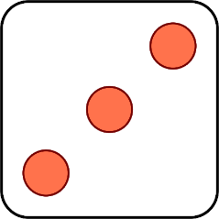
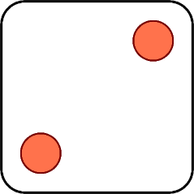
Follow up 5:
Escribe en español 📝.
escribir
1 | camera
2 | pen
3 | school bag
4 | bear
5 | house
6 | fruit
1 | ball
2 | idea
3 | phone
4 | exercise book
5 | school bag
6 | pen
[I have]
and
[a / an]
[a / an]
Tengo una casa y un cuaderno.
Tengo una mochila y una pelota
Tengo un bolígrafo (boli) y un teléfono.
Tengo una cámara y una mochila
Tengo un oso y una idea.
Notes:
Timing: 5 minutes
Aim: to practise oral production of ‘tengo’ and nouns introduced in week 9, together with the correct indefinite article.
Procedure: 1. Click to ‘roll’ the dice.
2. pupils write the whole sentence
3. Click to reveal the correct sentence.
4. Repeat until all combinations have been tried.

Slide 16
Follow up 5:
a b ñ
Escribe en español 📝.
vocabulario
Can you get at least15 points?
 | How? | I am (trait) | you are (trait)
 | there | I am (state) | pleased (f)
 | to be|being (state) | to be|being (trait) | now
 | tired (m) | from1 | always
 | camera | I have | to have | having
 | a / an (feminine) | a school bag | a ball
 | a / an (masculine) | a pen | an exercise book
¿cómo?
soy
eres
x3
contenta
allí
estoy
estar
ser
ahora
x2
cansado
de
siempre
una cámara
tengo
tener
una
una mochila
una pelota
x1
un
un bolígrafo (boli)
un cuaderno
Notes:
Timing: 6 minutes
Aim: to practise written production of vocabulary for this week and previous weeks.
Procedure:
1. Pupils need to write the Spanish for as many words as possible, aiming to get at least 15 points (but more if possible).
2. Click for Spanish answers.

