Slide 1
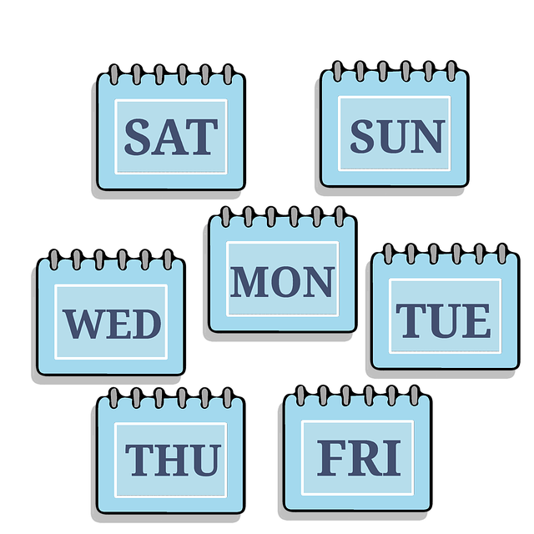
Describing me and others
¿Qué día es?
lun
mar
mié
jue
vier
rojo
sáb
dom
Follow ups 1-5
Notes:
Artwork by Steve Clarke. All additional pictures selected are available under a Creative Commons license, no attribution required.
Frequency of new vocabulary and phonics:
- Vocabulary: qué [50] día [65] lunes [1370] martes [3101] miércoles [1816] jueves [1650] viernes [1259] sábado [1179] domingo [693]
- SSC: source words: casa [106] dos [64] elefante [>5000] idea [247] universo [1603] + cluster: cama [609] contar [172] cucaracha [>5000]
The frequency rankings for words that occur in this PowerPoint which have been previously introduced in these resources are given in the SOW and in the resources that first introduced and formally re-visited those words.
For any other words that occur incidentally in this PowerPoint, frequency rankings will be provided in the notes field wherever possible.
Frequency of unknown words:
adivinar [2201] practicar [1595] traducir [2037] frase [1036] sonido [1040] trabalenguas [>5000] y [4] muy [43]
Source: Davies, M. and Davies, K. (2018). A frequency dictionary of Spanish: Core vocabulary for learners (2nd ed.). Routledge: London

Slide 2
Follow up 1
[ca] [co] [cu]
A
B
pronunciar
escuchar
Escucha. ¿Qué sonido* es?
¡Practica el trabalenguas!
 | ca | co | cu
 |  |  |  | _ _ n a
 |  |  |  | _ _ n
 |  |  |  | _ _ m a
 |  |  |  | _ _ e n t a
 |  |  |  | _ _ a n d o
 |  |  |  | _ _ n t a
Cuando Carlos
canta con Paca
en Salamanca,
Concha cuenta con Lucas en la cuna.
E
c u
1
c o
2
c a
3
c u
4
c u
5
c a
sonido = sound
practica = practise
el trabalenguas = tonguetwister
Notes:
Timing: 5 minutes
Aim: to develop phonological awareness of [ca] [co] [cu].
Procedure:
Click to bring up the instruction.
Click to bring up the table and do example together (E).
Pupils tick and/or write the correct sound [ca] [co] [cu].
4. Click to bring up Part B and read instructions.
5. Clarify the meaning of ‘trabalenguas’ (tongue twister).
6. Practise as a whole class and then allow pupils to practise it again in pairs.
Transcript [EJ] cuna
[1] con
[2] cama [3] cuenta
[4] cuando
[5] canta
Frequency of unknown words:
practicar [1595] sonido [1040] trabalenguas [>5000]
Source: Davies, M. and Davies, K. (2018). A frequency dictionary of Spanish: Core vocabulary for learners (2nd ed.). Routledge: London

Slide 3
Follow up 2:
Escucha.
B
A
Use the correct words to
rewrite the sentences.
There are some extra ones!
Escucha. ¿Qué palabra es?
escuchar
E
I am (state) | he is (state) | you are (state)
estoy
sábado
en
hoy
es
1
Monday | Tuesday | Thursday
E
Hoy es sábado.
2
day | today | What
día
lunes
hoy
miércoles
es
1
3
it is (trait) | you are | nervous
Es miércoles.
es
cómo
hoy
día
qué
de
4
Friday | Saturday | Sunday
2
¿Qué día es hoy?
5
day | today | What
estoy
está
hoy
sano
triste
feliz
3
6
I am (state) | he is (state) | you are (state)
Hoy estoy feliz.
es
hoy
está
tranquilo
viernes
4
Hoy es viernes. Está tranquilo.
Notes:
Timing: 5 minutes
Aim: to practise aural comprehension of this week’s new vocabulary and revisit adjectives from week 2-6.
Procedure:
(Part A) Click to listen. Pupils circle the correct word (if they have the sheet printed). If not, they can use numbers 1,2,3,4. Click for answers.
(Part B) Pupils listen to 1-5 and write the sentences, selecting from the options given (there are additional words that are not needed).
Click to reveal answers.
Transcript (Part A):
Ejemplo: Estoy
1. Hoy es jueves
2. día
3. es
4. sábado
5. hoy
6. está
Transcript (Part B):
Ejemplo: Hoy es sábado. 1. Es miércoles. 2. ¿Qué día es hoy? 3. Hoy estoy feliz. 4. Hoy es Viernes. Está tranquilo.

Slide 4
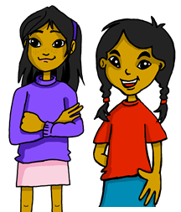
Follow up 3:
Lee: ¿Qué día es? ¿Cómo está?
Sofía is writing in her diary.
y = and
muy = very
leer
What day is it?
How is she feeling?
Escribe en inglés 📝.
miércoles
Estoy muy feliz pero
1. Sofía is (feeling) ______________ but tired on _____________.
2. Sofía is (feeling) elegant and ______________ on ______________.
3. On ______________ , Sofía is (feeling) very nervous.
4. Sofía is feeling ______________. It’s ___________.
cansada.
happy
viernes
Wednesday
Estoy elegante y
rápida.
fast
miércoles
Friday
Estoy nerviosa 😥.
Sunday
domingo
Estoy tranquila. ¡Es
domingo!
calm
Notes:
Timing: 5 minutes
Aim: To practise days of the week and adjectives in reading comprehension.
Procedure:
1. Read the title.
2. Click x2 to bring up instructions in English. Point at the different days of the week in which Sofía has written in her diary (jueves / viernes / lunes …).
3. Click x2 to bring up the English & Spanish instructions.
4. Do number 1 with pupils – draw pupils’ attention to the day of the week (Thursday) in sentence 1, elicit translation into Spanish and ask them to find ‘jueves’ in Sofía’s diary.
Frequency of unknown words:
y [4] muy [43]
Source: Davies, M. and Davies, K. (2018). A frequency dictionary of Spanish: Core vocabulary for learners (2nd ed.). Routledge: London

Slide 5
Follow up 4:
¡Escapa!
¡Rápido!
Con tu compañero, traduce.
hablar
I am (state)
Use the hints to help you.
slow
serious
e l _ g _ _ t _
r _ p _ d _
l _ n _ _
e _ t_ y
c _ r _ _ s _
h _ _
e _
n _ _ v_ _ s _
e _ t _ s
s _ r _ _
¿C_ m _?
¿ayuda? 🆘
30 segundos
fast
how
you are (state)
it is (trait)
nervous
elegant
today
traduce = translate
INICIO
Notes:
Timing: 2 minutes
Aim: revisit vocabulary (adjectives + I am [temporary]). Pupils translate the words orally to find their way out of the maze.
(2 slides)
Procedure:
Read the instructions in Spanish. You can elicit English translation from pupils – ‘rápido’ is revisited; escapar [899] is used for the purpose of the activity.
Click to bring up the Spanish instruction – clarify that they need to find their way out by translating the words into Spanish. Draw their attention to the hints and go through the list to prepare pupils for the activity. The ‘state’ refers to estar and ‘trait’ to ser.
Click ‘inicio’ to start the timer.
Repeat process with next slide.
Frequency of unknown words:
traducir [2037]
Source: Davies, M. and Davies, K. (2018). A frequency dictionary of Spanish: Core vocabulary for learners (2nd ed.). Routledge: London

Slide 6
Follow up 4
¡Rápido!
¡Escapa!
Traduce*.
hablar
¿ayuda? 🆘
serious
Use the hints to help you.
calm
fast
e l _ g _ _ t _
e _
r _ p _ d _
tr _ _ qui_ _
e _ t_ y
c _ r _ _ s _
h _ _
n _ _ v_ _ s _
f _ l _ z
s _ r _ _
¿C_ m _?
nervous
30 segundos
I am (state)
How?
lost
calm
sad
happy
today
it is (trait)
traduce = translate
INICIO
Notes:
Frequency of unknown words:
traducir [2037]
Source: Davies, M. and Davies, K. (2018). A frequency dictionary of Spanish: Core vocabulary for learners (2nd ed.). Routledge: London

Slide 7
escribir
Escribe dos (2) frases (¡en secreto!) 🤫
¡Hola! | Hoy es | lunes | y estoy | serio | seria
¡Buenos días! |  | martes |  | nervioso | nerviosa
¡Buenos días! |  | miércoles |  | curioso | curiosa
¡Buenas tardes! |  | jueves |  | rápido | rápida
 |  | viernes |  | lento | lenta
 |  | sábado |  | contento | contenta
 |  | domingo |  | feliz | feliz
 |  |  |  | elegante
Y in Spanish means and. Pronounce it like the ‘i’ in Spanish idea.
frase = sentence, phrase
y - and
Notes:
Timing: 3 minutes
Aim: guided written production of ‘es’ + days of the week & ‘estoy’ (for temporary states) + adjectives.
Read the instructions in Spanish.
Ask pupils to write down two sentences, in English and Spanish, ensuring their partners don’t see them.
Frequency of unknown words:
frase [1036] y [4]
Source: Davies, M. and Davies, K. (2018). A frequency dictionary of Spanish: Core vocabulary for learners (2nd ed.). Routledge: London

Slide 8
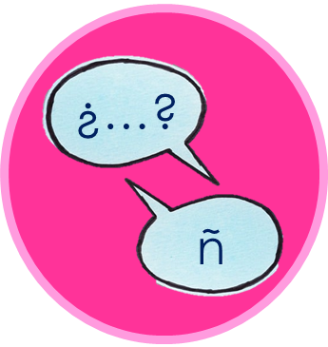
hablar
adivina = guess
frase = sentence
y - and
Adivina la frase de tu compañero.
Can you guess each sentence in less than a minute?
hablar
hablar
¡Hola! | Hoy es | lunes | y estoy | serio | seria
¡Buenos días! |  | martes |  | nervioso | nerviosa
¡Buenos días! |  | miércoles |  | curioso | curiosa
¡Buenas tardes! |  | jueves |  | rápido | rápida
 |  | viernes |  | lento | lenta
 |  | sábado |  | contento | contenta
 |  | domingo |  | feliz | feliz
 |  |  |  | elegante
60
segundos
Y in Spanish means and. Pronounce it like the ‘i’ in Spanish idea.
0
INICIO
Notes:
Timing: 3 minutes
Aim: to practise using ‘hoy es’, days of the week, ‘estoy’ + adjectives in guided oral production.
This activity is also called “trapdoor”. The pupil needs to start off the sentence every time they don’t guess the right word in their partner’s sentence providing an excellent guided practice opportunity for pupils.
Procedure:
Tell pupils they need to guess their partner’s secret sentence, starting from the left (Hola / Buenos días), moving towards the right (hoy es…).
Tell them that each time the partner goes wrong (i.e. selects and says a wrong word), s/he has to go back to the beginning and start again.
You can model the activity by asking pupils to guess your own secret sentence.
NB.
As the sentence frame has both the masculine and feminine form of the adjective, some groups might benefit from strategy sharing – if they choose the masculine form of the adjective and their partners say the sentence is incorrect, encourage them to try the same sentence with the feminine form rather than trying with a different adjective (otherwise it can take them a long time to guess the sentence)
3. Click “inicio” to start the timer for the first person in a pair to start.
Frequency of unknown words:
adivinar [2201] frase [1036] y [4]
Source: Davies, M. and Davies, K. (2018). A frequency dictionary of Spanish: Core vocabulary for learners (2nd ed.). Routledge: London

Slide 9
Follow up 5:
Escribe en español 📝.
escribir
¿Qué día es? | Today is…
¿Cómo estás? | I am (feeling…)
Notes:
Timing: 10 minutes
Aim: to practise written production of es, the days of the week, estoy and adjectives.
Procedure:
Pupils write a set of short statements, following the model: Hoy es (lunes). Estoy cansado/a.

Slide 10
Los días
cantar
Notes:
OPTIONAL A catchy video to practise the days of the week with. It is repetitive only includes a little additional, unfamiliar language.
URL: https://www.youtube.com/watch?v=NOf6i8LBFDk

