Slide 1
Describing me and others
Soy de Perú.
Soy de Perú y España.
rojo
Follow ups 1-5
Notes:
Artwork by Steve Clarke. All additional pictures selected are available under a Creative Commons license, no attribution required.
The frequency rankings for words that occur in this PowerPoint which have been previously introduced in NCELP resources are given in the NCELP SOW and in the resources that first introduced and formally re-visited those words.
Phonics: casa [106] dos [64] elefante [>5000] idea [247] universo [1603] + bailar [1323] beber [1085] oso [4449] té [2552] tú [184]
Vocabulary: eres [7] (recycle adjectives) de1 [2] Inglaterra [n/a] España [n/a] Perú [n/a]
Revisit: clase [320] [en clase] curioso [1811] lento [1569] rápido [870] hoy [167]
Frequency of unknown words:
palabra [192]
Source: Davies, M. and Davies, K. (2018). A frequency dictionary of Spanish: Core vocabulary for learners (2nd ed.). Routledge: London
For any other words that occur incidentally in this PowerPoint, frequency rankings will be provided in the notes field wherever possible.
Source: Davies, M. & Davies, K. (2018). A frequency dictionary of Spanish: Core vocabulary for learners (2nd ed.). Routledge: London

Slide 2
Follow up 1
[a]
[e]
[o]
[u]
[i]
A
B
pronunciar
Escucha. ¿Qué palabra* es?
Complete the poem with a word that rhymes.
[1]
casa | cosa
Con a, casa en __________.
Málaga
[2]
luna | lana
Con e, Inés con _________.
Andrés
[3]
masa | mesa
Con i, aquí en _________.
Madrid
[4]
rosa | risa
Con o, el oso ___________.
Pol
[5]
dedo | dado
Con u, el universo _________.
[6]
lima | lema
azul
curioso Andrés azul Pol Cortés Málaga
Madrid
palabra = word
Notes:
Timing: 5 minutes
Aim: to practise aural comprehension of the SSC [a] [e] [i] [o] [u].
Procedure:
Click to bring up the prompts.
Click on each number to listen to the words.
Click for the answers.
Transcript [1] cosa
[2] luna
[3] masa [4] risa
[5] dedo
[6] lima
Aim: to develop phonological awareness of [a] [e] [i] [o] [u] and identify patterns of rhyme.
Procedure:
Click to bring up the instruction.
Click to bring up the first line.
Click to bring up the different options.
Clarify meanings and identify proper nouns.
Click to bring up the answer for line 1.
Click to bring up the other four lines & give pupils time to choose their own combinations.
Click to bring answers (x4)
Frequency of unknown words:
palabra [192]
Source: Davies, M. and Davies, K. (2018). A frequency dictionary of Spanish: Core vocabulary for learners (2nd ed.). Routledge: London

Slide 3
Follow up 2:
Escucha.
A
Circle the 2 words mentioned.
escuchar
escuchar
Escribe 📝.
E
I am | calm | you are | serious
B
Write down the words.
1
you are | fast | he is | slow
1. es __________________
2. siempre _____________
3. eres _________________
4. normalmente __________
5. serio _________________
6. soy __________________
7. feliz __________________
8. rápido _______________
9. de ________________
she is ; he is
2
normally | always | you are | he is
always
you are
3
it is | you are | nervous | serious
normally
4
sad | always | normally | happy
serious
I am
5
elegant | I am | you are | happy
happy
6
in | I am | you are | from
fast
from
🏆 Can you spot the question?
Notes:
Timing: 5 minutes
Aim: to practise aural comprehension of this week’s new vocabulary
Procedure:
Click to listen. pupils circle the 2 correct words (if they have the sheet printed). If not, they can use numbers 1,2,34. Click for answers.
pupils refer to their listening table, and write the corresponding vocabulary into the gaps in Section B.
Click to reveal answers.
Transcript: E. Soy tranquilo 1. Es lento 2. Normalmente es rápido 3. Eres serio
4. ¿Eres siempre feliz? 5. Eres elegante
6. Soy de Perú.

Slide 4
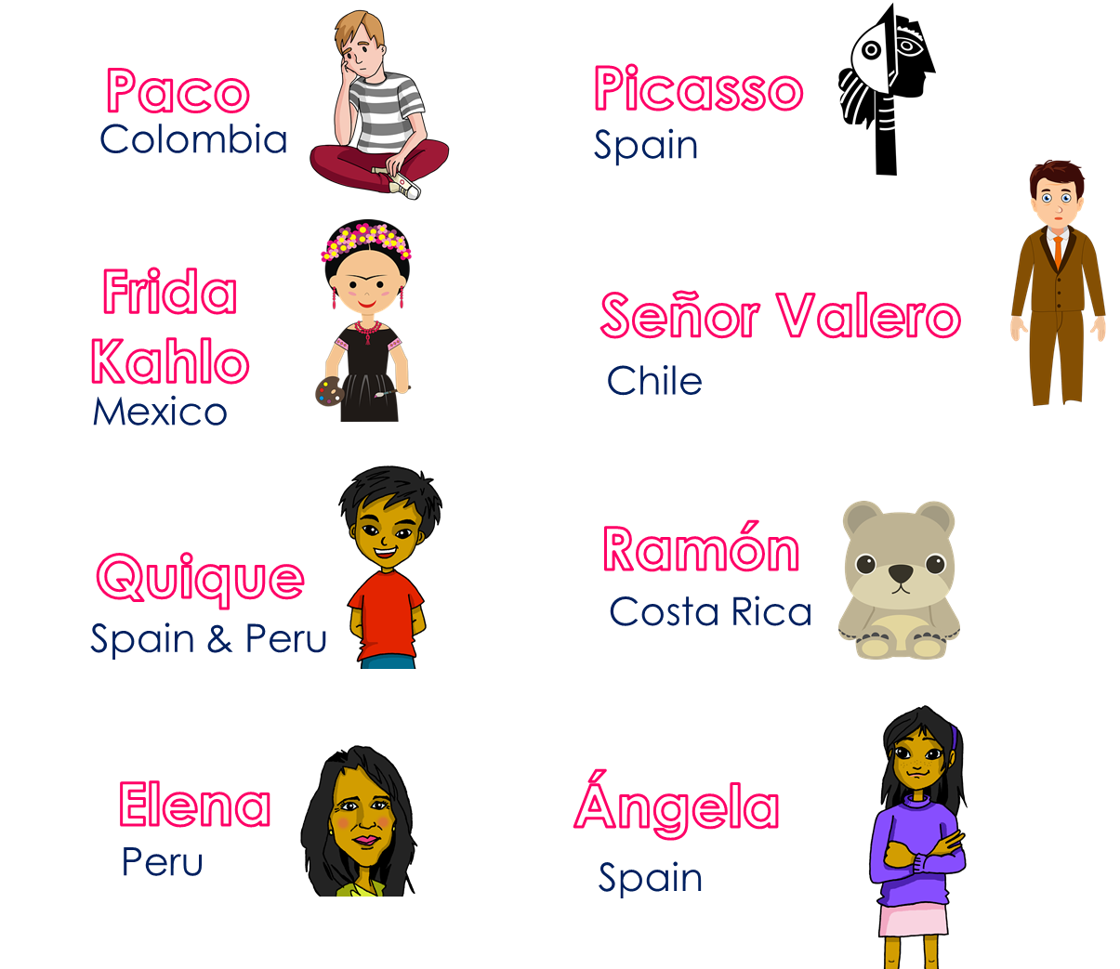
Follow up 3:
Ask your partner questions to guess their secret character.
hablar
hablar
1 minuto
¿Eres de Perú?
¿Eres Elena?
¿Eres de España?
¿Eres de…?
S
¡No!
¡Sí, soy de Perú!
¡Sí, soy Elena!
0
INICIO
Notes:
Time: 5-8 minutes
Aim: To use raised intonation and adjectival agreement in oral production to guess their partner’s characters as quickly as possible.
Read the title in Spanish and click to bring a brief explanation of the instructions.
Tell pupils they are going to work in pairs. Partners take it in turns to ask yes/no questions to try to figure out the other player’s character. The partner guessing needs to use raised question intonation and the correct adjectival agreement to narrow down their options correctly! Explain this to the pupils - they have to pronounce the adjective correctly, with the correct ending, otherwise their partner cannot guess who they are.
Click x2 to bring the speech bubbles to make sure pupils are clear about what the exchange should look like (¿Eres de ..? / Sí / No).
Click x2 to model an example & read the speech bubbles (“¿Eres de España?” / ¡No!). Show pupils on the board how that means Picasso / Quique / Ángela are not the secret character & click to bring X shape to cover her. Click x2 to trigger the next question (¿Eres de Perú?) The response is “Yes” so we now know it’s Elena.
Teachers can model another round with the whole class (getting pupils to ask the questions) before getting them started in pairs.
3. Give pupils 30 seconds to write down 4 names (mixture of nationalities). Click on “Inicio” to trigger timer.
4. Display next slide while they are working in paris.
NB. Print the template slide (slide 20) in A5 so that pupils can cross out as they play.
At the end of the game, point out to them that grammar features (in this case masc/fem adjective endings) often help us to pinpoint the correct meaning more quickly, but not always!
Adjectives used in the task:

Slide 5
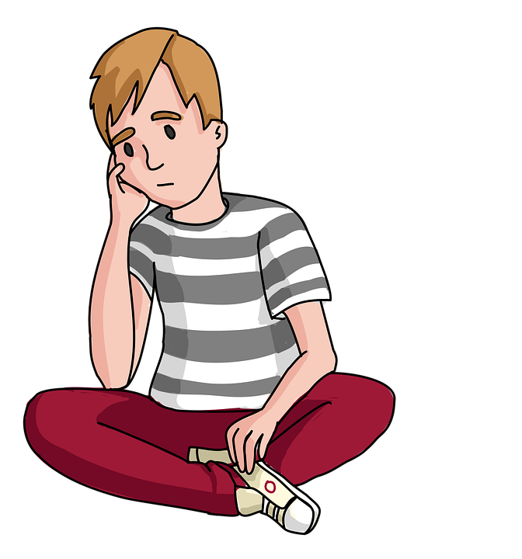
Follow up 4:
Paco
Picasso
¿Eres de…?
hablar
Colombia
Spain
Frida Kahlo
Señor Valero
Chile
Mexico
Ramón
Quique
¡Sí, soy de…!
Costa Rica
Spain & Peru
¡No!
Elena
Ángela
Peru
Spain
Notes:
(slide 2)

Slide 6
Follow up 4:
Escribe en español📝.
escribir
1 | I am elegant.
2 | You are from Spain.
3 | S/he is from Peru.
4 | I am from England.
Soy elegante.
¿Soy elegante?
Eres de España.
¿Eres de España?
Es de Perú.
¿Es de Perú?
Soy de Inglaterra.
¿Soy de Inglaterra?
Can you make these sentences into a question?
España
Inglaterra
Notes:
Timing: 5-8 minutes
Aim: to produce full sentences using ‘soy’ & ‘eres’ with permanent traits & origin + using ‘de’
Read the instructions in Spanish.
Ask pupils to complete translate the sentences into Spanish, using the correct verb (‘soy’ & ‘eres’).
Encourage early finishers to turn the statements into questions, paying attention to question marks & practise raised intonation out loud.

Slide 7
Follow up 5:
a b ñ
Escribe en español 📝.
vocabulario
Can you get at least15 points?
 | Where? | I am (state) | there
 | S/he is (state.) | here | absent
 | now | sad | How?
 | curious (f) | in class | today
 | normally | I am (trait) | happy
 | you are (trait) | nervous (m) | s/he is (trait)
 | always | from | quiet (f)
¿dónde?
estoy
allí
x3
está
aquí
ausente
ahora
triste
¿cómo?
x2
curiosa
en clase
hoy
normalmente
soy
feliz
eres
nervioso
es
x1
siempre
de
tranquila
Notes:
Timing: 6 minutes
Aim: to practise written production of vocabulary for this week and previous weeks.
Procedure:
1. Pupils need to write the Spanish for as many words as possible, aiming to get at least 15 points (but more if possible).
2. Click for Spanish answers.

