Slide 1
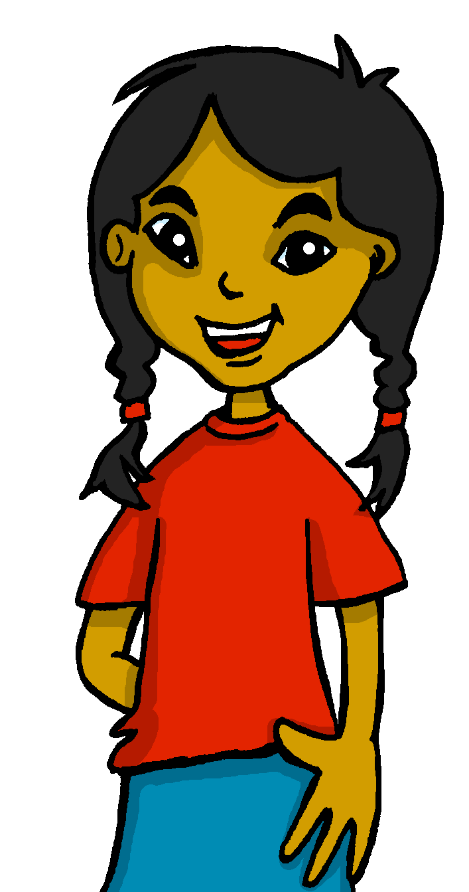
español, con Sofía

Slide 2
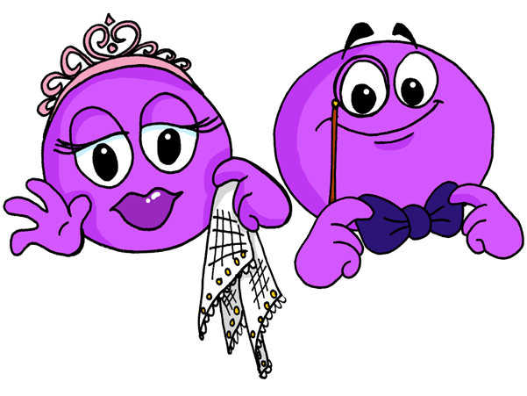
Describing me and others
¿Cómo es?
rojo
Ser: ‘to be’ for permanent traits: soy & es
SSC [e] [i]
Notes:
Artwork by Steve Clarke. Pronoun pictures from NCELP (www.ncelp.org). All additional pictures selected from Pixabay and are available under a Creative Commons license, no attribution required.
Introduce: ser [7] soy [7] es [7] siempre [96] normalmente [1696] Revisit: cansado [1818] contento [1949] nervioso [1521] serio [856] tranquilo [1073] ahora [81] ¿cómo? [151]
Source: Davies, M. and Davies, K. (2018). A frequency dictionary of Spanish: Core vocabulary for learners (2nd ed.). Routledge: London
The frequency rankings for words that occur in this PowerPoint which have been previously introduced in these resources are given in the SOW and in the resources that first introduced and formally re-visited those words.
For any other words that occur incidentally in this PowerPoint, frequency rankings will be provided in the notes field wherever possible.

Slide 3
[e]
elefante
pronunciar
[i]
idea
Notes:
Timing: 2 minutes
Aim: To practise SSC [e] [i]
Procedure:
Click to trigger [e] and get pupils to repeat – this is also a great opportunity to check whether they remember the source word.
Click to trigger the source word [elefente] & get pupils to repeat.
Repeat the process with [i]
Once both source words are on display, click to trigger first picture [idea] – ask pupils to pronounce the word that matches the picture. Click again to repeat the process with [elefante]
For further practice, pupils work in pairs. One pupil uses a gesture, the partners elicits the source word.

Slide 4
[e]
tres
pronunciar
[i]
interesante
Notes:
Timing: 2 minutes
Aim: To apply their understanding of SSC [e] [i] in a new context (two new words – tres & interesante).
Click to trigger [e] and get pupils to repeat
Click to bring a cluster word [tres] & elicit pronunciation from pupils.
Repeat with [i] and [interesante].
For further practice, pupils work in pairs with the cluster (tres, interesante, idea, elefante). One pupil uses a gesture, the partners elicits the source word. Note: pupils will understand the meaning of interesante, but it is worth practising the word several types and drawing attention to the different number of syllables in the English word interesting. Most people say ‘interesting’ as three syllables – we swallow the 4th syllable. In Spanish no vowel gets swallowed so you have to pronounce all five syllables. Pupils can practise counting through the fingers of one hand.

Slide 5
hablar
¡Caos!
Sofía has spilled hot chocolate on her vocab book.
ay…
Lee en español.
1 minuto
feliz
nervioso
elegante
happy
nervous
elegant
rápido
lento
curioso
fast
slow
curious
tranquilo
serio
contento
quiet
0
serious
content
INICIO
Notes:
Timing: 4 minutes
Aim: To recall previously introduced adjectives and use them in oral production.
Procedure:
Read the instructions.
Ask for a volunteer to translate one of the words – “chocolate stains” fly out on if you mouse over and click on them.
Tell pupils they have 1 minute to translate and say out loud as many adjectives as possible.
Click on inicio to start the timer.
Go through answers as a whole class to ensure you revise the vocabulary together.

Slide 6
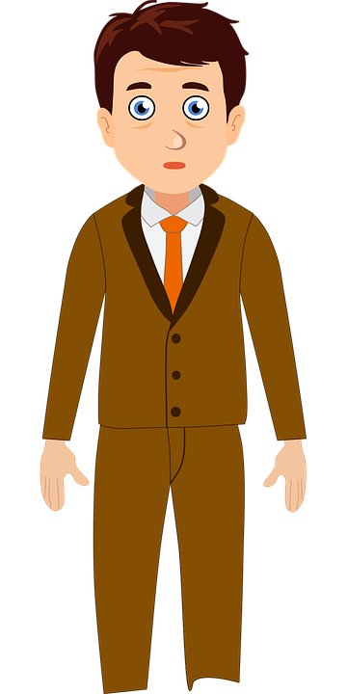
SER: soy and es
[to be, being: I am vs. s/he, it is]
In Spanish, the verb ser means ‘to be’ when describing general traits.
Señor Valero
Soy feliz.
Es serio.
I am (generally) happy.
He is (generally) serious.
soy
To mean I am for general traits in Spanish, use _______.
es
To mean she, he or it is for general traits use _______.
Notes:
Timing: 2 minutes
Aim: to introduce the use of ser when describing permanent traits (1st & 3rd person singular).
pupils have learned ‘estar’ for temporary states and location. In this lesson we concentrate on ser but we don’t yet explicitly introduce the notion of two verbs for ‘to be’ in Spanish.
Procedure:
Click to present the new information.
Elicit English translations for the Spanish examples provided.

Slide 7
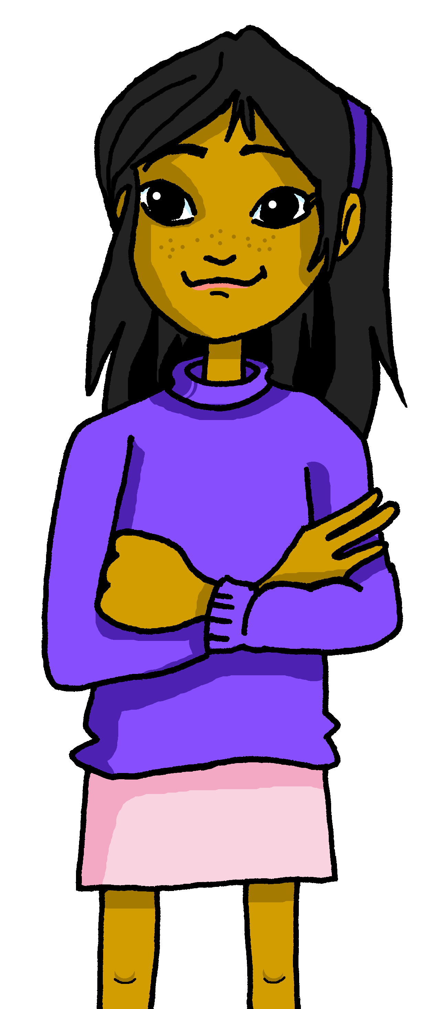
escuchar
Sofía habla 💬 con el señor Valero.
Who is she describing?
escuchar
Escucha el adjetivo ¿Es Ángela o Quique?
Escribe el verbo y marca .
⚠ Adjectives that end in ‘o’ change to an ‘a’ when the person or animal being described is female.
 | Sofía (herself) | or (s/he)
soy
¿en inglés ?
Ej
es
Quique
slow
1
es
Ángela
fast
2
soy
3
es
Ángela
4
nervous
soy
5
Notes:
Time: 5 minutes
Aim: to listen out for the verbs ‘soy’ & ‘es’ and understand the person they refer to.
Procedure:
1. Read the instructions in Spanish. Tell pupils Sofía is talking to Mr. Valero and they need to figure out if she’s describing herself or one of her friends.
2. Click to bring up the two instructions and make sure pupils know they need to: 1) write down the verb and 2) decide if it refers to Sofía or a friend of hers. You can ask pupils which verb they can expect when Sofía is describing herself (soy) and when she is describing a friend (es).
3. Go through the answers (these are animated – one click for the verb, another click for the tick).
4. Click to bring up the speech bubble and read the information re masculine / feminine form of the adjective.
5. Click to bring up the instruction – pupils listen one more time to statements 1, 2 & 4 and decide if Sofía is describing Quique or Ángela. Encourage them to write the adjective in English too.
Transcript
EJ Soy feliz
Es lento
Es rápida
Soy tranquila
Es nerviosa
Soy curiosa

Slide 8
vocabulario
a b ñ
vocabulario
vocabulario
vocabulario
normalmente
💡 Put siempre and normalmente at the start OR at the end but not in the middle of the sentence.
siempre
Notes:
Time: 2 minutes
Aim: to introduce two new adverbs of frequency.
Procedure:
Say the Spanish adverb and get pupils to repeat. You can use gesture to reinforce meaning.
Click to bring animated picture for ‘normalmente’ and elicit English meaning from pupils.
Click one more time to trigger animation – wave animation, which is the gesture we use for “normalmente”. Ask pupils to repeat.
Click to bring animated picture for ‘siempre’ and elicit English meaning from pupils.
Click one more time to trigger animation – font change of siempre. We use a straight line (Right to left). Ask pupils to repeat.
If you use gestures, you can give pupils 1 minute to practise in pairs.

Slide 9
escuchar
Escucha y escribe 📝.
Soy elegante.
Soy elegante.
escuchar
1
1. _______ elegante siempre.
Soy
3
I am
s/he, it is
Ángela
Quique
2
happy
serious
elegant
1
always
normally
¡escribe!
Notes:
Timing: 8 minutes (four slides)
Aim: to bring together sh/e is and I am, challenging pupils to recognise meaning of the verb form and the vocabulary revisited and introduced in this lesson (adjectives & two adverbs).
Procedure:
Read the instructions in Spanish.
Tell pupils you will play a sentence out loud twice and they will have to hold the sentence in their working memory (picturing it in their heads!) for 3 seconds.
Click to start the timer. When time is up, the word “escribe” will come up.
Pupils then write the sentence.
(NB. They can choose to use the help on the board or without looking – encourage pupils to choose their own level of challenge).
4. Click to show the answer to the whole question.
5. Click again for the different forms of the verb in (I, s/he). Elicit answer from pupils & click for correct answer. 6. Click for Angela and Quique and ask pupils who could say the sentence – Angela, Quique or either of them.
7. Click to show answers.
8. Click for the possible translation for the adjective, elicit answer from pupils & click for correct answer.
9. Click for the possible translation for the adverb, elicit answer from pupils & click for correct answer. 10. Continue for the next four slides.

Slide 10
escuchar
Escucha y escribe 📝.
escuchar
2
Es
2. _____ nervioso normalmente.
3
I am
s/he, it is
Ángela
Quique
2
nervous
serious
curious
1
always
normally
¡escribe!

Slide 11
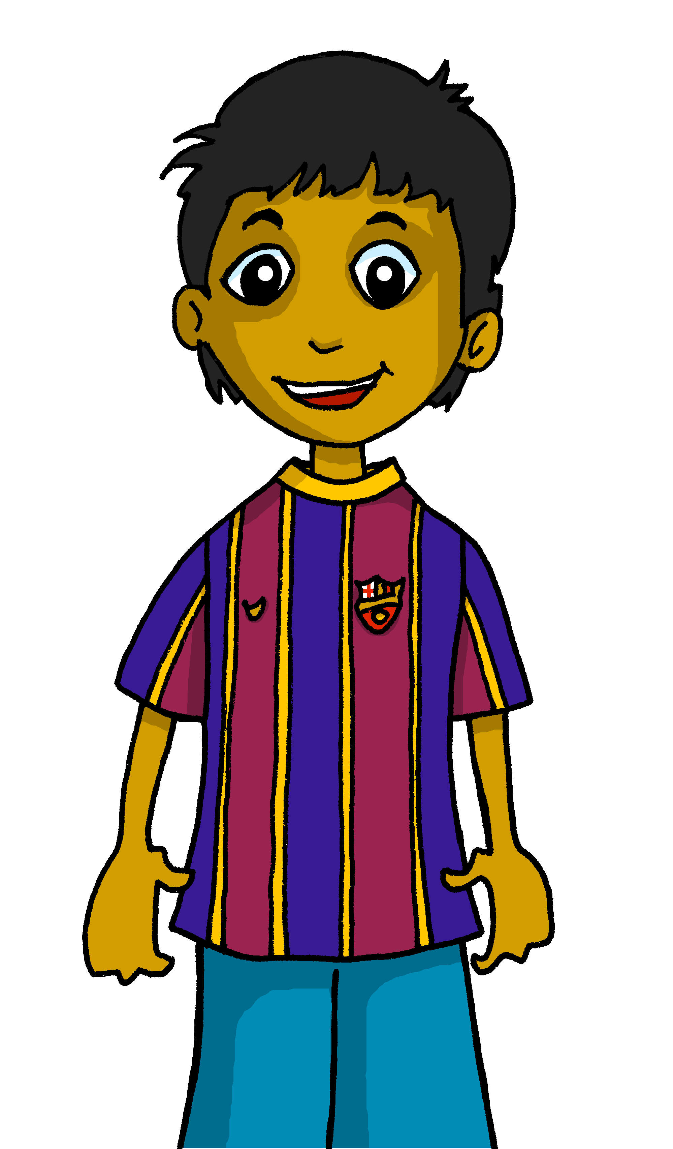
escuchar
Escucha y escribe 📝.
Soy curiosa.
escuchar
3
soy
3. Normalmente _______ curiosa.
3
I
s/he
Rubén
Ángela
2
happy
serious
curious
1
always
normally
¡escribe!

Slide 12
escuchar
Escucha y escribe 📝.
escuchar
4
es
4. Siempre _______ feliz.
3
I
s/he
Rubén
Ángela
2
happy
serious
nervous
1
always
normally
¡escribe!

Slide 13
vocabulario
¿Cómo es?
a b ñ
serio
vocabulario
vocabulario
vocabulario
vocabulario
elegante
💡 ¿Cómo es? asks How is she/he/it normally? In English, we say ‘What is s/he, it like?’
seria
Notes:
Timing: 5 minutes (8 slides)
Aim: to revisit adjective vocabulary from previous weeks.
Procedure:
Read the three Spanish words out loud to model pronunciation. Elicit the right answer from pupils.
Remind pupils that some adjectives change their ending to match the gender of the person or animal they describe. Ensure pupils recognise that the emojis with longer lashes are female emojis.
2. Repeat with the 4 four slides.

Slide 14
vocabulario
¿Cómo es?
a b ñ
feliz
vocabulario
vocabulario
vocabulario
vocabulario
tranquila
nervioso

Slide 15
vocabulario
¿Cómo es?
a b ñ
tranquila
vocabulario
vocabulario
vocabulario
vocabulario
elegante
serio

Slide 16
vocabulario
¿Cómo es?
a b ñ
vocabulario
vocabulario
vocabulario
seria
vocabulario
feliz
serio

Slide 17
vocabulario
¿Cómo es?
a b ñ
curiosa
vocabulario
vocabulario
vocabulario
vocabulario
nerviosa
nervioso

Slide 18
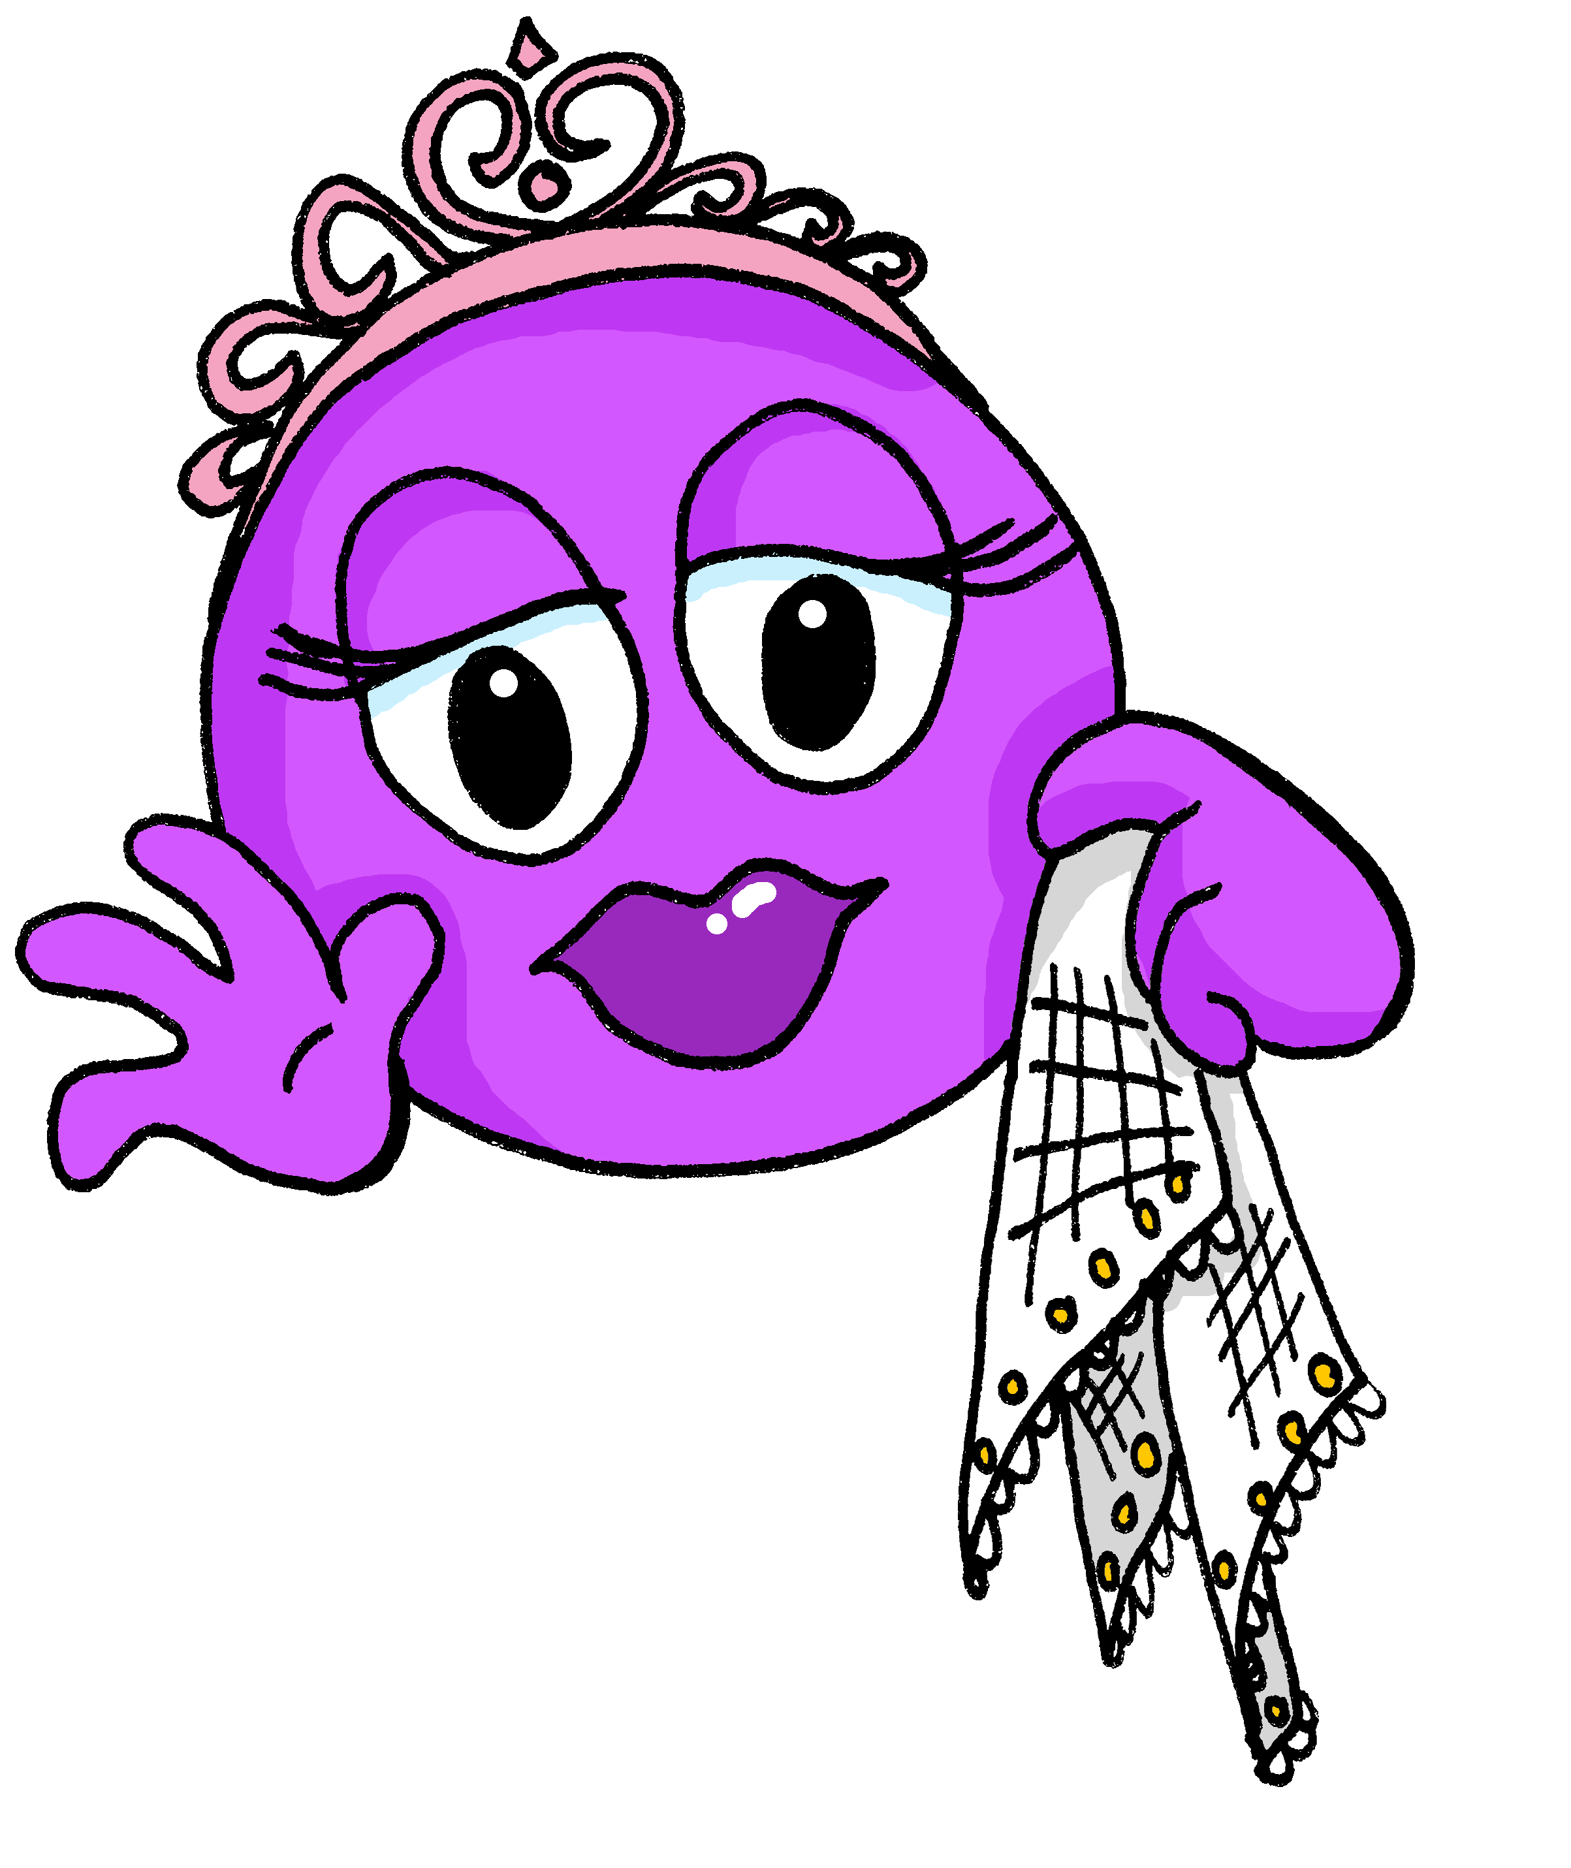
vocabulario
¿Cómo es?
a b ñ
elegante
vocabulario
vocabulario
vocabulario
vocabulario
seria
tranquila

Slide 19
vocabulario
¿Cómo es?
a b ñ
elegante
vocabulario
vocabulario
vocabulario
vocabulario
feliz
tranquilo

Slide 20
vocabulario
¿Cómo es?
a b ñ
tranquila
vocabulario
vocabulario
vocabulario
vocabulario
feliz
tranquilo

Slide 21
¡adiós!
rojo

