Slide 1


español, con Sofía

Slide 2



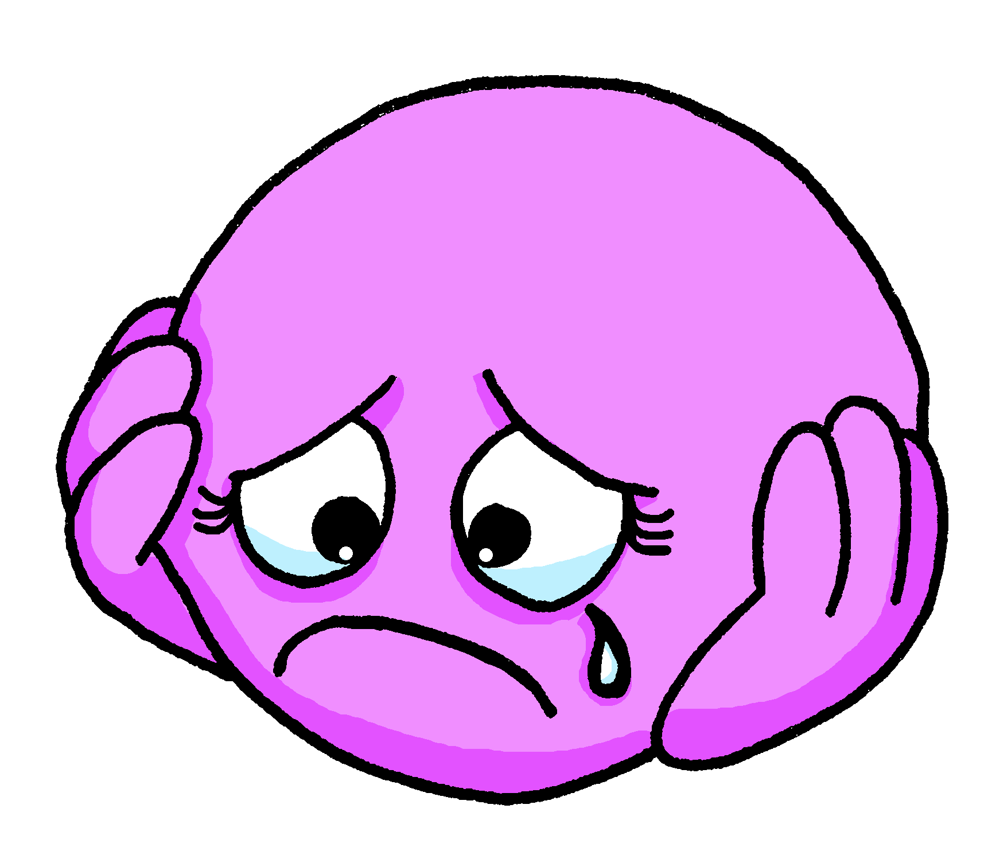

Describing me and others
¿Cómo está?
rojo
Revisit ‘estar’
Adjective agreement (o → a ; -e & -z).
SSC [a] [o] [u]
Notes:
Artwork by Steve Clarke. Pronoun pictures from NCELP (www.ncelp.org). All additional pictures selected from Pixabay and are available under a Creative Commons license, no attribution required.
The frequency rankings for words that occur in this PowerPoint which have been previously introduced in these resources are given in the SOW and in the resources that first introduced and formally re-visited those words.
For any other words that occur incidentally in this PowerPoint, frequency rankings will be provided in the notes field wherever possible.
Phonics:
Frequency of new vocabulary:
elegante [2742] feliz [908] triste [1371] dónde [161] + revisiting week 2-4 adjectives
Revisit 1: estás [21] sí [45] no [11] en1 [5] ¡Buenos días! [103/65] ¡Buenas tardes! [103/392] adiós [2309]
Frequency of unknown words:
preguntar [219] el [1] intruso [>5000]
Source: Davies, M. and Davies, K. (2018). A frequency dictionary of Spanish: Core vocabulary for learners (2nd ed.). Routledge: London
Source: Davies, M. and Davies, K. (2018). A frequency dictionary of Spanish: Core vocabulary for learners (2nd ed.). Routledge: London

Slide 3

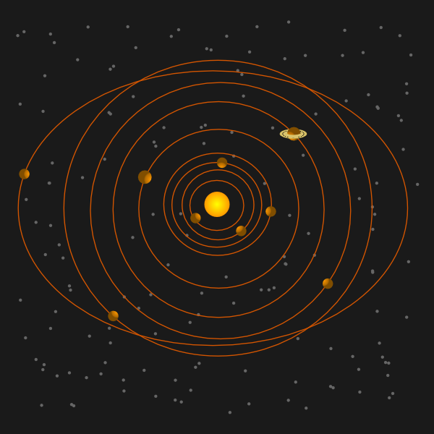


pronunciar
dos
[o]
pronunciar
casa
[a]
universo
[u]
Notes:
Timing: 2 minutes
Aim: To practise SSC [a] [o] [u].
Procedure:
Click to trigger [o] and get pupils to repeat – this is also a great opportunity to check whether they remember the source word.
Click to trigger the word [dos] and source word & get pupils to repeat.
Repeat the process with [a] and [u].
Once all the source words are on display, click to trigger first picture [casa] – ask pupils to pronounce the word that matches the picture. Repeat 2 more times to go through all the source words.
For further practice, pupils work in pairs. One pupil uses a gesture, the partners elicits the source word.

Slide 4
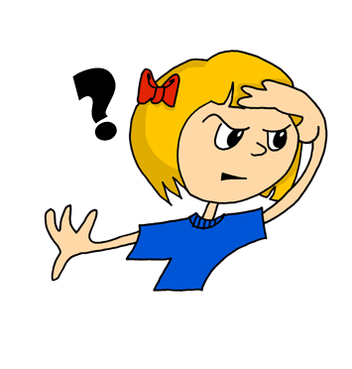

¿dónde?
pronunciar
where?
¿Dónde está?
[Where is s/he, it?]
Rachel Hawkes / Emma Marsden
Notes:
Timing: 2 minutes
Aim: To present question word ¿dónde?
Procedure:
Pupils listen and repeat the key question word (include gesture if possible)
Display the word and get them to repeat one more time.
Elicit English meaning.
Reveal the sentence.
Note: more practice of understanding and responding to dónde can be done in class, with the teacher asking ‘Dónde está (Jack)?’ and pupils pointing ‘Allí’, and then the teacher can contrast two questions – Cómo está and Dónde está so that pupils need to focus on the difference in meaning between the two, and respond appropriately, using suitable adjectives and adverbs.

Slide 5





pronunciar
Pregunta* en español.
pegunta = ask
Where is (Tumbes)? It is in (Peru).
pronunciar
Tumbes
Ambato
Tumaco
Granada
1 minuto
[Perú]
[Ecuador]
[Colombia]
[España]
Malambo
Burgos
Macas
Sicuani
S
[Colombia]
[España]
[Ecuador]
[Perú]
Pamplona
Catacaos
Sogamoso
Cuenca
0
[España]
[Perú]
[Colombia]
[Ecuador]
INICIO
Notes:
Timing: 4 minutes
Aim: to practise application of phonics knowledge in read aloud of place names; to practise spoken production of Dónde está…? Está en…
Procedure:
Pupils work in pairs, asking and answering questions. Where is XXX? It is in XXX.
They race against the timer, trying to ask and answer about all places in one minute.
Frequency of unknown words:
preguntar [219]
Source: Davies, M. and Davies, K. (2018). A frequency dictionary of Spanish: Core vocabulary for learners (2nd ed.). Routledge: London

Slide 6

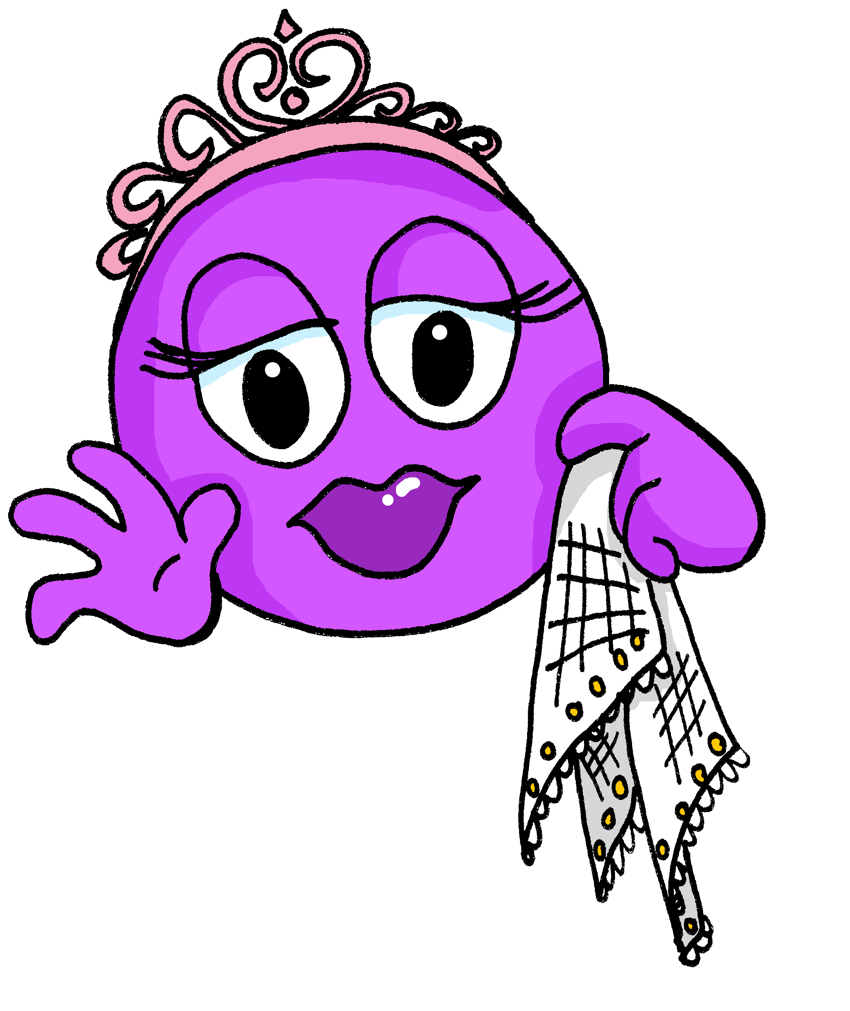
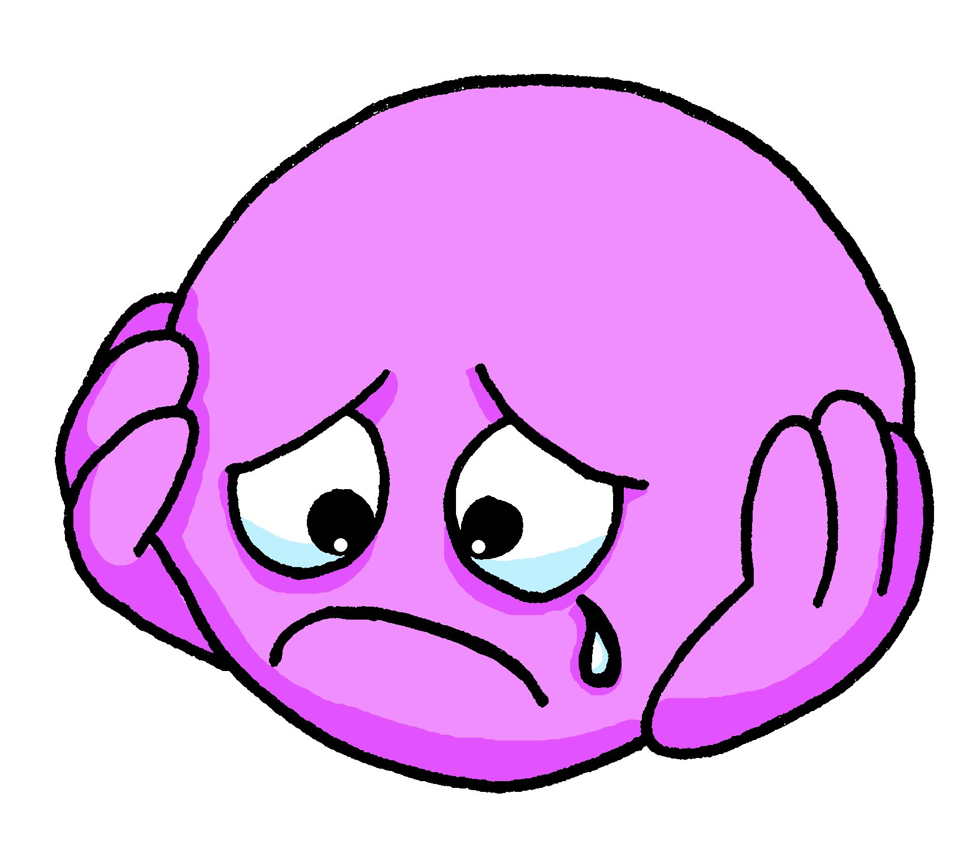

vocabulario
a b ñ
vocabulario
vocabulario
elegante
triste
feliz
Notes:
Timing: 2 minutes
Aim: to introduce 3 new items of vocabulary.
Procedure:
Click to trigger the picture. Say the Spanish word and get pupils to repeat.
Click again to bring up the word and get pupils to repeat one more time. Elicit English meaning.
Repeat with the other two adjectives.
NB. pupils haven’t learned ssc [z] yet so this will need extra practice.

Slide 7
vocabulario
a b ñ
triste
vocabulario
vocabulario
rápido
elegante
Notes:
Timing: 3 minutes (5 slides)
Aim: To embed the meaning of the new words.
Procedure:
Read the three Spanish words out loud to model pronunciation. Elicit the right answer from pupils.
2. Repeat with the 4 four slides.

Slide 8
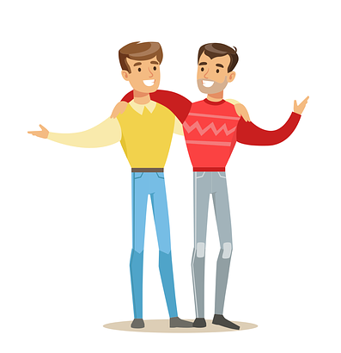
vocabulario
a b ñ
feliz
vocabulario
vocabulario
triste
nervioso

Slide 9
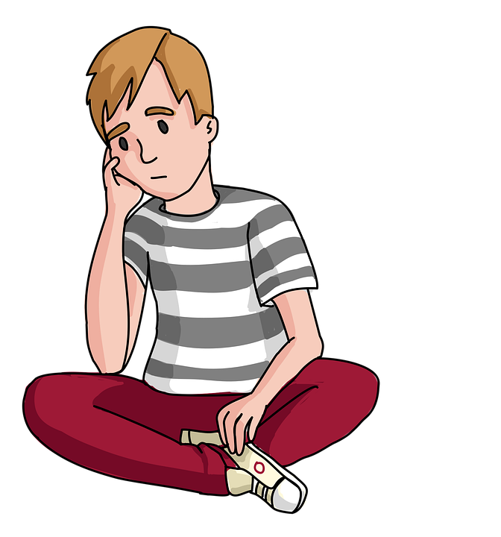
vocabulario
a b ñ
lento
vocabulario
vocabulario
triste
elegante

Slide 10
vocabulario
a b ñ
lento
vocabulario
vocabulario
feliz
rápido

Slide 11
vocabulario
a b ñ
triste
vocabulario
vocabulario
tranquilo
contento

Slide 12
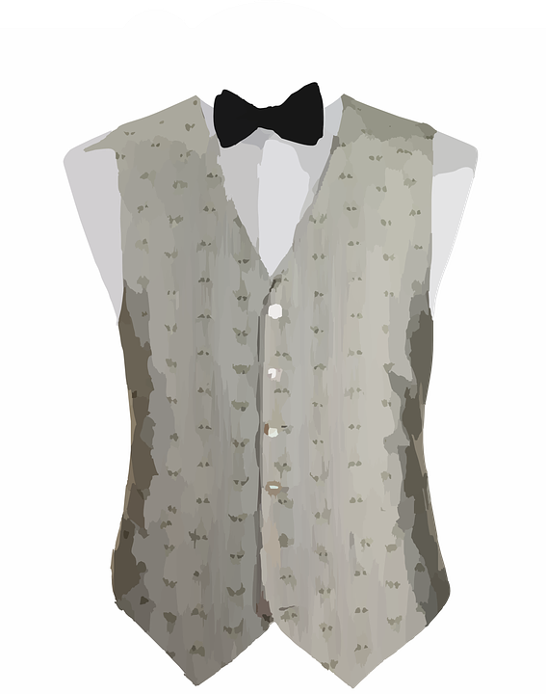
vocabulario
a b ñ
vocabulario
vocabulario
e_eg_n_e
elegante
triste
tr_ _t_
feliz
f_l_z
Notes:
Timing: 2 minutes
Aim: to recall the 3 new items of vocabulary.
Procedure:
Click to trigger the clues for the Spanish word and elicit word from a pupil.
Click to bring up the Spanish word. The next image will automatically appear.
Click to trigger the clues for the Spanish word and elicit word from a pupil.
Roll back the animations and repeat the process.

Slide 13

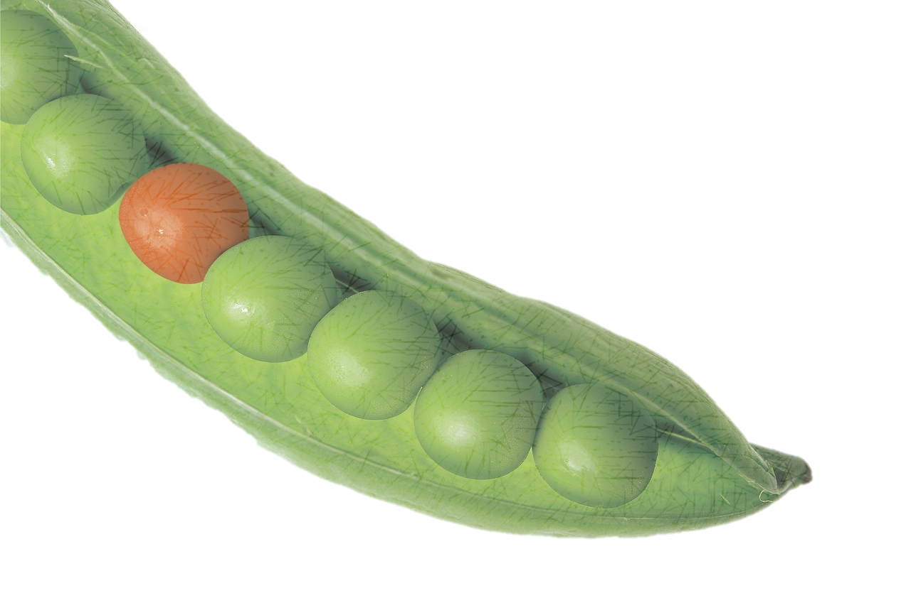
leer
Lee ¿Dónde está el intruso?
contento | tranquilo
Ej
ahora
curioso
1
 | rápida | seria
nervioso
2
¿cómo? |  | ¿dónde?
lento
3
seria | cansada
serio
4
hoy |  | ahora
tranquila
5
nervioso | curioso
intruso = intruder → odd one out
Notes:
Timing: 5 minutes
Aim: To revisit week 2-4 vocabulary and encourage pupils to notice patterns.
Procedure:
Ask pupils to work in pairs to spot the odd-one-out in each series of words. They need to be ready to give a reason.
Do the example with them (ejemplo). Read the words out loud and ask for a volunteer. The odd one out is “ahora” because “contento” & “tranquilo” are both adjectives (& end in –o – are masculine), whereas “ahora” means “now” so it’s an adverb. Check that pupils remember that “ahora” is now.
Elicit pupils’ reponses. Answers are animated – click to bring the answer (the font of the odd-one-out changes to pink on click).
Frequency of unknown words:
el [1] intruso [>5000]
Source: Davies, M. and Davies, K. (2018). A frequency dictionary of Spanish: Core vocabulary for learners (2nd ed.). Routledge: London

Slide 14

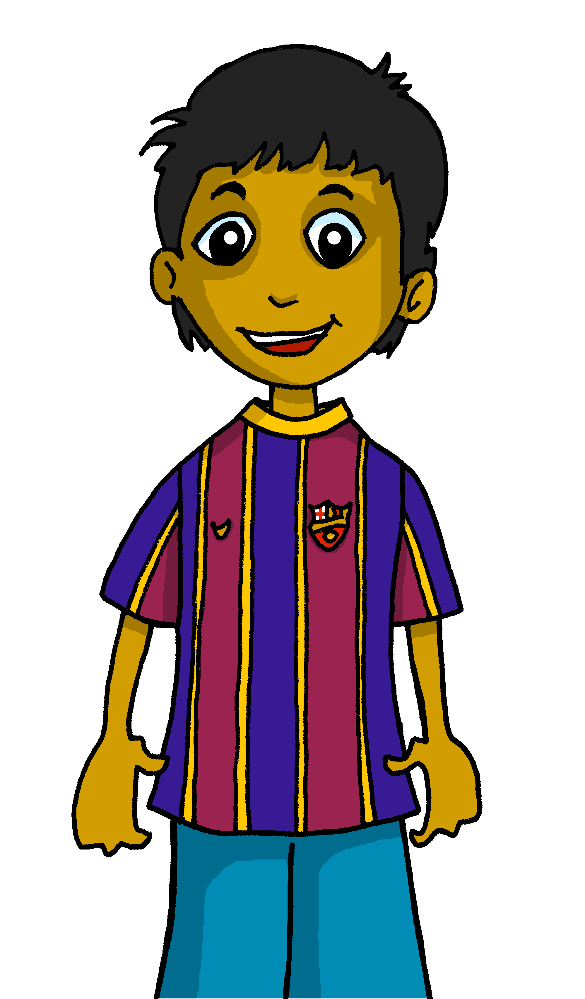

Gender agreement with adjectives
Remember, some adjectives change to match the gender (male or female) of the noun they describe.
As you know, masculine adjectives that end in ‘o’ change to an ‘a’ when the person or animal being described is female.
Rubén está contento.
Sofía está contenta.
Rubén is pleased.
Sofía is pleased.
Notes:
Timing: 2 minutes (two slides)
Aim: to recap the knowledge about adjectives ending in –o.
Procedure:
Click through the animations.
Elicit the English translations for the examples from pupils.

Slide 15

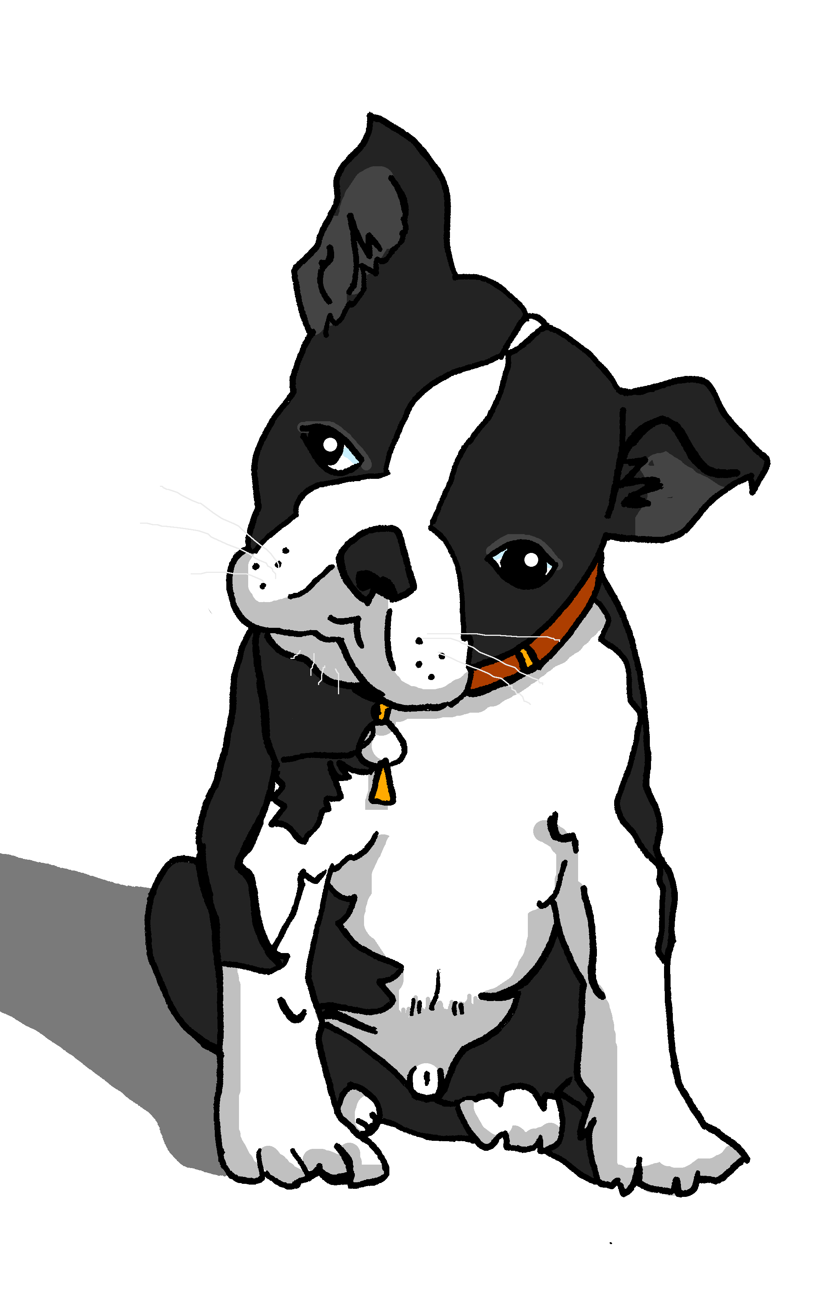
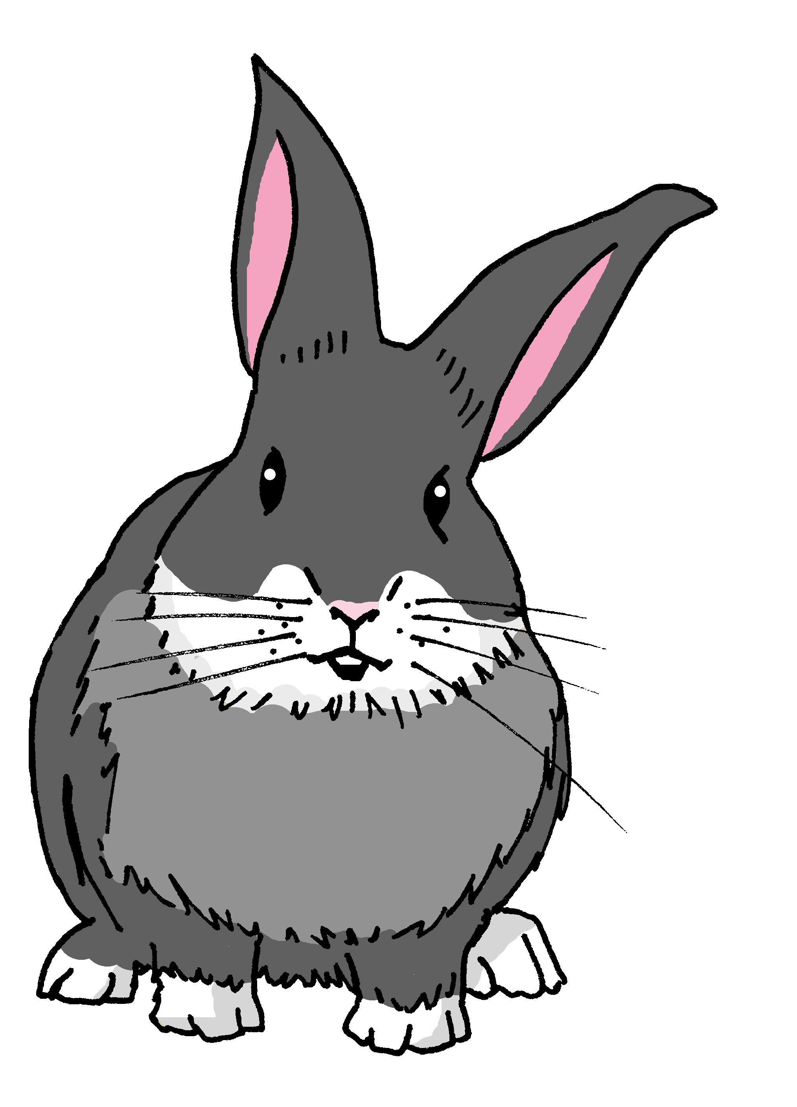
Gender agreement with adjectives
When an adjective ends in –e or -z it can describe a female and male person or animal. It does not change.
Quique está feliz.
Santi está triste.
Quique is (feeling) happy.
Santi is (feeling) sad.
Sofía está feliz.
Manchita está triste.
Sofía is (feeling) happy.
Manchita is (feeling) sad.
Notes:
Aim: to present new information about adjectives ending in –e or –z.
Procedure:
Click through the animations.
Elicit the English translations for the examples from pupils.

Slide 16




leer
In his diary, Quique has described how his friends are feeling today.
¡Ay ay ay! He’s spilled hot chocolate on it so we can’t see whom he’s describing. ¿Sofía o Rubén? ¿or could it be either?
Lee.
Marca y escribe 📝.
Sofía hoy está tranquila.
Rubén está lento.
adjetivo | Sofía | Rubén | los dos | inglés
Sofía está triste.
tranquila
calm
lento
slow
Rubén está feliz aquí.
triste
sad
Sofía está curiosa hoy.
feliz
happy
Rubén está elegante ahora.
curiosa
curious
elegante
elegant
Notes:
Timing: 8 minutes
Aim: to practise understanding of regular adjective agreement.
Procedure:
1. Read the task title in Spanish & click x2 to trigger the English.
2. Ask pupils to write down the adjective & the person it refers to (Sofía, Rubén or los dos). Encourage them to write down the English meaning too.
3. The answers are animated – click x2 to bring the adjective and the tick, then click again to reveal the name in the diary. For those statements that could be both, you can ask pupils to guess who they think it is (Sofía or Rubén?!).
4. Click one more time for the English translation.

Slide 17
¡adiós!
rojo

