Slide 1


español, con Sofía

Slide 2


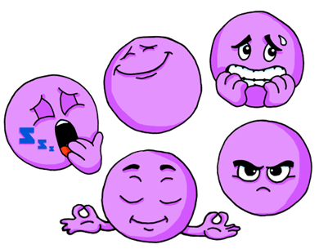
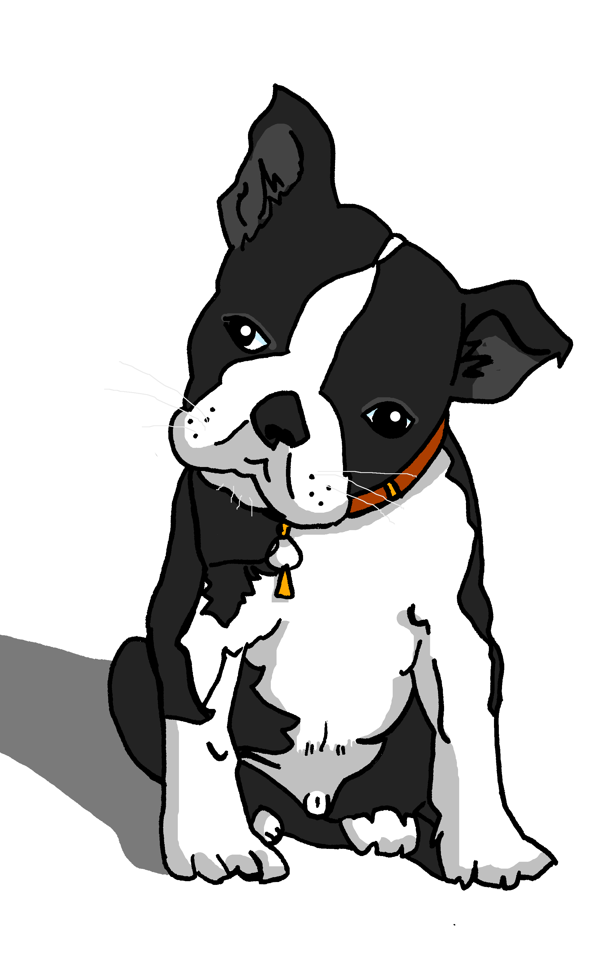
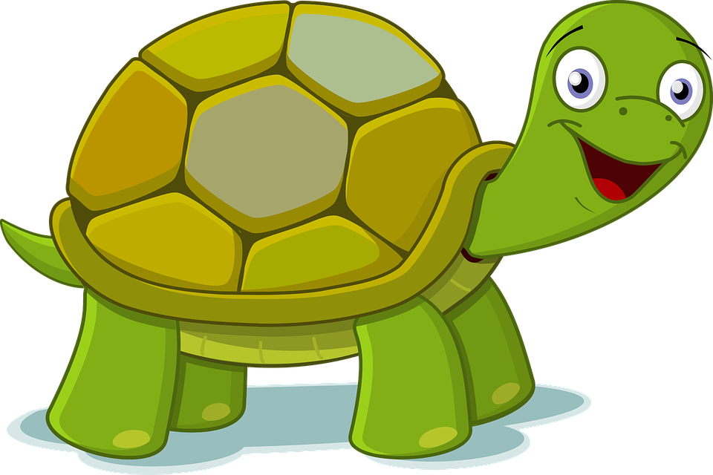
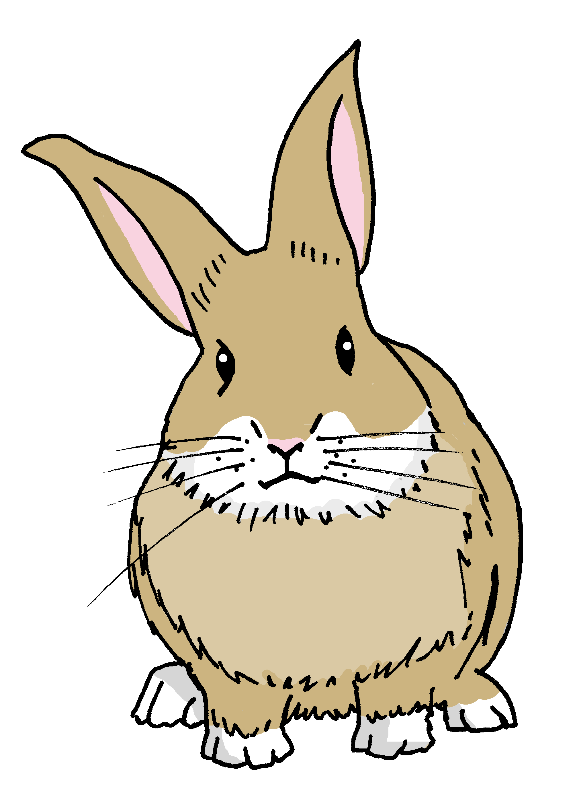
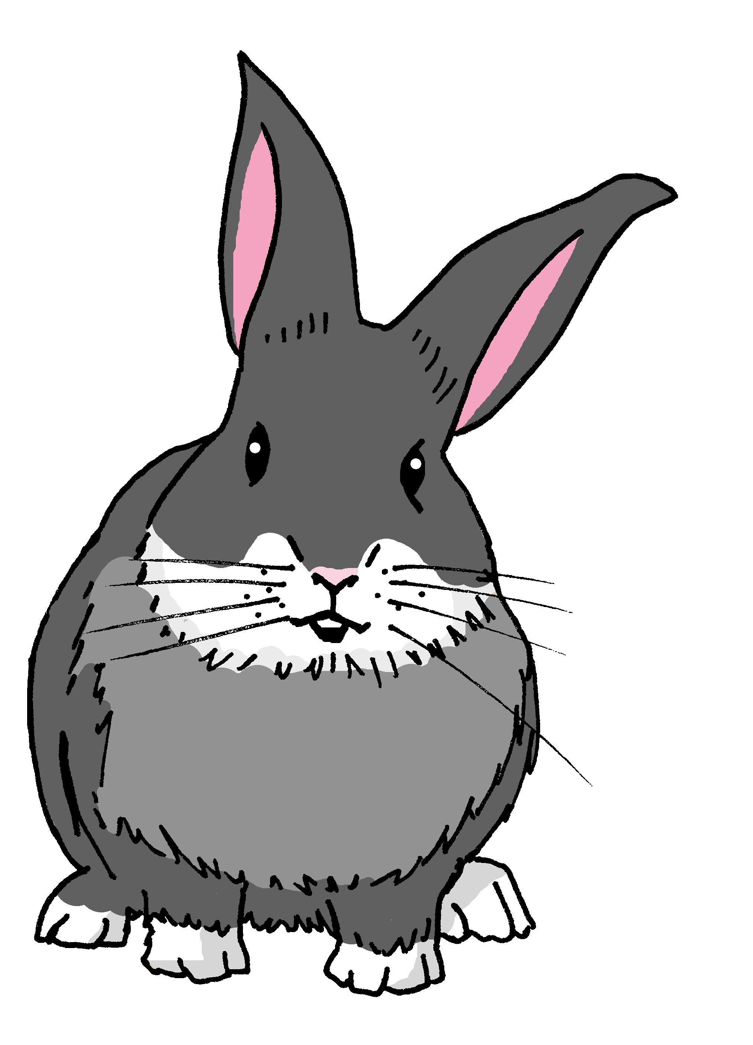
Describing me and others
¿Cómo estás?
Review of ‘estar’:
location & mood
regular adjectival agreement (o → a)
SSC [i]
rojo
Term 1 Week 4
Notes:
Artwork by Steve Clarke. All additional pictures selected are available under a Creative Commons license, no attribution required.
The frequency rankings for words that occur in this PowerPoint which have been previously introduced in NCELP resources are given in the NCELP SOW and in the resources that first introduced and formally re-visited those words.
Phonics: idea [247]
Vocabulary: clase [320] [en clase] curioso [1811] lento [1569] rápido [870] hoy [167]
Revisit 1: estar [21] estoy [21] está [21] presente [1114] ausente [>5000] aquí [130] allí [197] hola [1245]
For any other words that occur incidentally in this PowerPoint, frequency rankings will be provided in the notes field wherever possible.
Frequency of unknown words:
que [50] inglés [583]
Source: Davies, M. and Davies, K. (2018). A frequency dictionary of Spanish: Core vocabulary for learners (2nd ed.). Routledge: London

Slide 3


pronunciar
[i]
idea
pronunciar
Notes:
Timing: 1 minute
Aim: To introduce SSC [i]
Procedure:
Introduce and elicit the pronunciation of the individual SSC [i] and then the source word ‘idea’ (with gesture, if using).
Click to bring up the picture and get pupils to repeat (with gesture, if using).
Pupils to practise in pairs.
Note: This is a brief introduction to the SSC for this week. Pupils will practise this and other SSC in the follow ups this week.
Gesture: Point with index finger to temple and then into the air, miming a sudden ‘eureka’ moment!

Slide 4




escuchar
Escucha y escribe 📝.
¿Qué es en inglés ?
escuchar
1
2
3
está
estoy
estás
ayuda
🆘
I am / you are / s/he is
¿que? – What…?
inglés – English
Notes:
Timing: 2 minutes
Aim: to revisit the three forms of estar encountered so far (estoy, estás, está).
Procedure:
Read the instructions in Spanish.
Ask pupils to write numbers 1-3.
Click on number one to play the sound.
Tell pupils the word they hear.
Click elsewhere on the slide to reveal answers (x3).
Click one more time to prompt the question ¿en inglés?
Elicit translation into English from pupils.
Click on ayuda to reveal the three options (I am / you are / s/he) should they need further support.
Answers:
está – s/he is
estoy – I am
estás – you are
Frequency of unknown words:
que [50] inglés [583]
Source: Davies, M. and Davies, K. (2018). A frequency dictionary of Spanish: Core vocabulary for learners (2nd ed.). Routledge: London

Slide 5


vocabulario
Unjumble the words.
¿Qué es en inglés ?
a b ñ
presente
serious
vocabulario
a) sen pre te
_________
b) to con ten
contento
_________
nervous
c) qui tran lo
tranquilo
absent
_________
d) rio se
serio
_________
present
e) vio ner so
nervioso
_________
pleased
f) sen au te
ausente
_________
calm
Notes:
Timing: 3 minutes
Aim: To revisit key adjectives from weeks 1&2.
Procedure:
Read the instruction in Spanish
Click to trigger the answer for the first jumbled adjective – click one more time to trigger the arrow that links the word with the English meaning.
Elicit Spanish words from pupils (a-f), click onCe to trigger the Spanish word & one more time to link the Spanish word with the English translation.
NB. Pupils haven’t learned ssc [qui] yet so this will need extra practice. Use “key” gesture as a hook to embed the sound in their memory.
Frequency of unknown words:
que [50] inglés [583]
Source: Davies, M. and Davies, K. (2018). A frequency dictionary of Spanish: Core vocabulary for learners (2nd ed.). Routledge: London

Slide 6

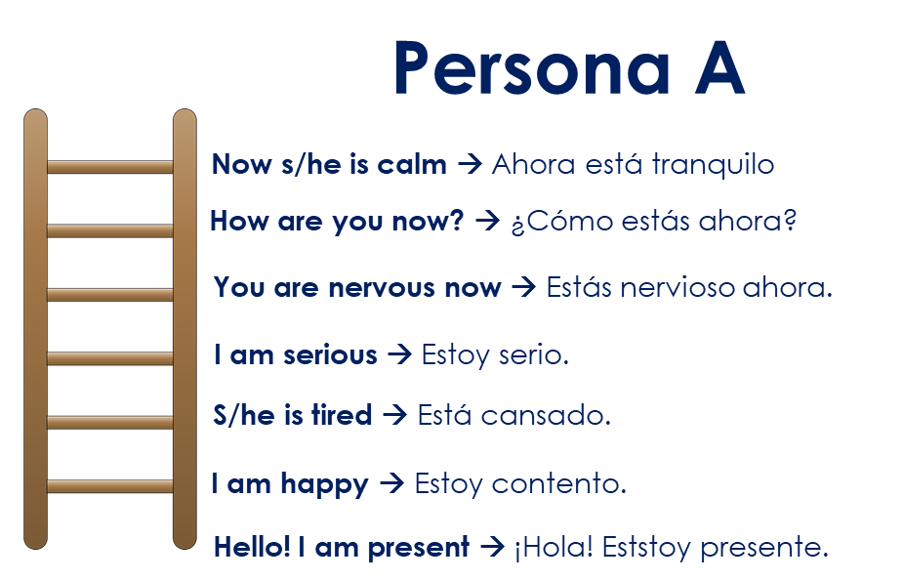
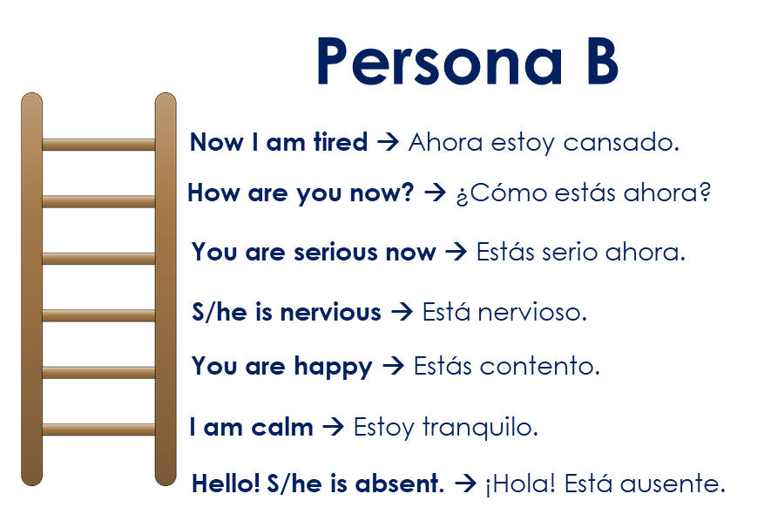

hablar
Escucha a tu compañero y escribe en español.
Can you climb to the top of the ladder?
Your partner will ask you to translate a sentence.
Use the clues to translate the sentence.
¿Correcta? Climb up one step!
¿Incorrecta? Start from the bottom again!
How high up can you get in one minute?
Take turns to be the teacher ☺
¡H_ l_! E_t_y _qu_ .
¡Hola! Estoy aquí
Hello! I am here.
→ ¡Hola! Estoy aquí.
Notes:
Timing: 5 minutes (3 slides)
Aim: to bring together the three forms of estar learned so far (estoy, está, está) + adjectives from week 1 + 2. The aim is for pupils to translate correctly as many sentences as they can in 1 minute.
Procedure:
Read the instruction in Spanish (Escucha a tu compañero y traduce la frase al español).
Click to trigger instructions in English.
Pair pupils and ask them to choose A or B.
Next two slides have the 1-minute timer for each turn (A + B)
Note: the final two slides in the presentation are handouts to be printed for this activity.

Slide 7

hablar
Escucha a tu compañero y escribe en español.
hablar
Can you climb to the top of the ladder?
1 minuto
Persona B
is the teacher.
0
¡Hola! ….
¡H_ l_! E_t_y _qu_ .
INICIO

Slide 8
hablar
Escucha a tu compañero y escribe en español.
Can you climb to the top of the ladder?
hablar
1 minuto
Persona A is the teacher.
0
¡Hola! ….
¡H_ l_! E_t_y _qu_ .
INICIO

Slide 9

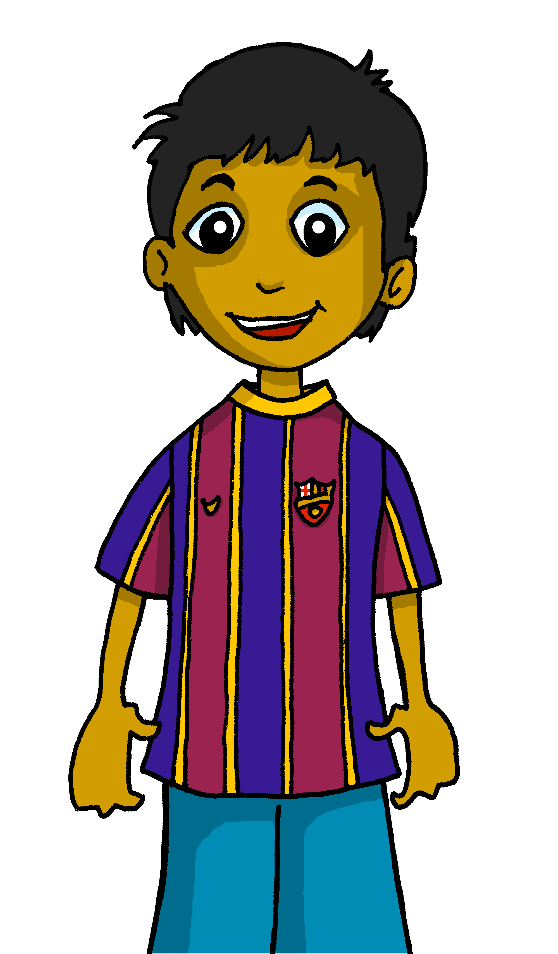

Gender and agreement on adjectives
In Spanish, adjectives change depending on whether the person or animal they describe is male or female.
Adjectives that are masculine (end in ‘o’) change to an ‘a’ when the person or animal being described is female.
Rubén está contento.
Sofía está contenta.
Rubén is pleased.
Sofía is pleased.
Notes:
Timing: 2 minutes
Aim: to use the feminine form of regular adjectives (-o changing to –a) when describing people (and animals).
Procedure:
Present the information about gender and adjective agreement.
Elicit the English translation for the Spanish examples provided.
Note: here we practise singular regular adjective agreement with people and animals. Soon we will also introduce inanimate feminine and masculine nouns and teach the concept of grammatical (not biological) gender more explicitly.

Slide 10

leer
Santi está… hoy.
leer
hablar
curiosa
curioso
Notes:
Timing: 3 minutes (7 slides)
Aim: to practise written recognition of the masculine and feminine adjective forms when describing people and animals and introduce three new items of vocabulary (lento (slow), rápido (fast) and curioso (curious)).
Procedure:
Read the phrases out loud, pointing at the two options for the gap.
[Check that they know that Santi is a male name! He’s Rubén’s dog. We will also meet Manchita (female rabbit), Irene (female tortoise) and see Pancho again (male rabbit).
Pupils read the whole sentence out loud, selecting the correct form of the adjective. [Elicit meaning of curioso as this is the firm time they come across it].
Repeat for the next six slides.

Slide 11
leer
Manchita está ... ahora en casa.
leer
hablar
nervioso
nerviosa

Slide 12
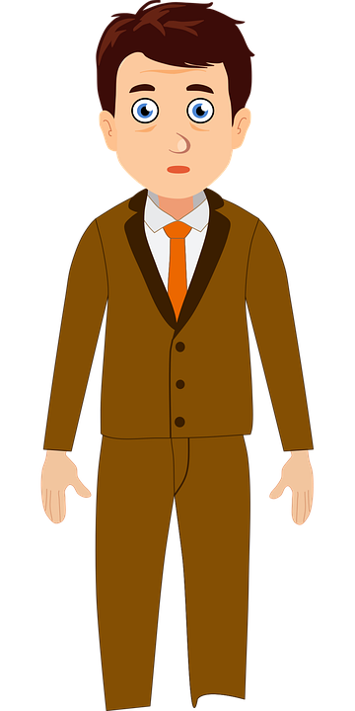
leer
El señor Valero está… en clase.
leer
hablar
serio
seria

Slide 13
leer
Irene está… ahora.
leer
hablar
rápida
rápido

Slide 14
leer
Pancho está … hoy.
leer
hablar
lenta
lento

Slide 15
leer
Santi está … hoy en casa.
leer
hablar
cansado
cansada

Slide 16
leer
Irene está… en clase.
leer
hablar
contento
contenta

Slide 17
escuchar
Escucha a Sofía.
Listen and choose the correct adjective. Who is Sofía describing?
escuchar
 |  |  |  |  | Santi | Irene
 | curioso | curiosa | rápido | rápida
 | lento | lenta | curioso | curiosa
 | rápida | rápido | nerviosa | nervioso
 | tranquilo | tranquila | lento | lenta
 | seria | serio | tranquila | tranquilo
 | nerviosa | nervioso | contenta | contento
 | cansado | cansada | rápido | rápida
Remember! Santi is male, Irene is female.
E
1
2
3
4
5
6
Notes:
Timing: 5 minutes
Aim: to practice aural comprehension of the adjective ending in order to recognise the gender of the character being described.
Procedure:
Read the instructions in Spanish out loud.
Click to reveal the instruction in English.
Do the example with them.
Pupils write 1-6 in their books. (Note: some learners will benefit from being able to circle the words on the sheet).
Ask them to write the adjective they hear & decide if Sofía is describing Santi (a male dog) or Irene (a female tortoise). They will hear each sentence twice.
Transcript:
EJ. Está rápido.
1. Está curiosa.
2. Está rápida hoy.
3. Está tranquilo en clase.
4. ¿Hoy? ¡Hoy está serio!
5. Ahora está nerviosa.
6. Está cansada hoy.

Slide 18
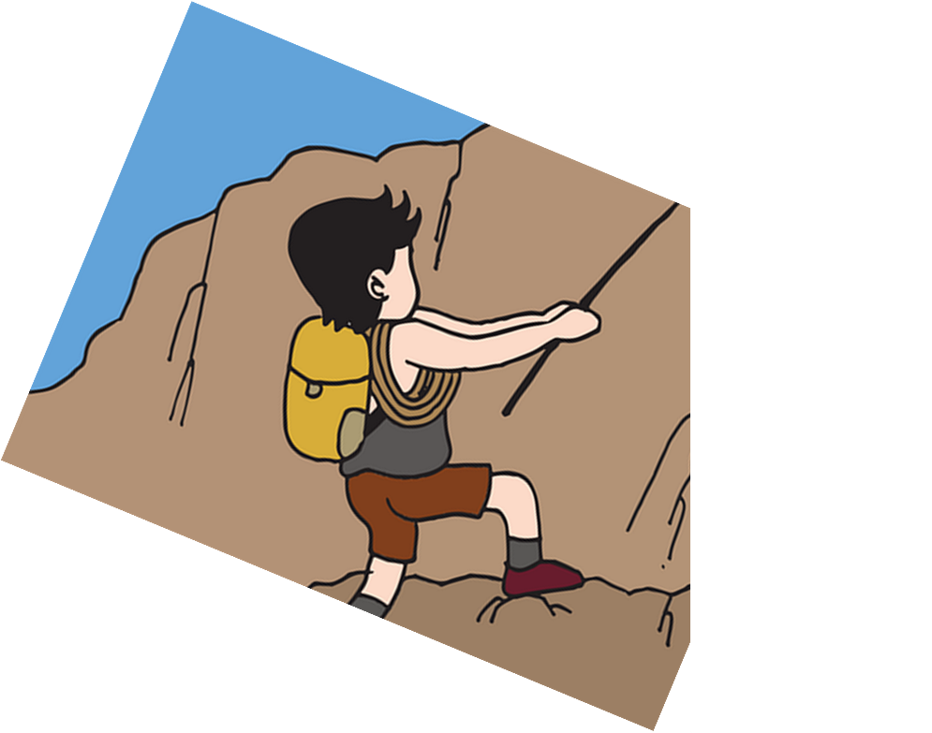
hablar
[1/4]
Lee en español.
She is tired now.
5
4
hoy
ahora
ahora
en clase
en casa
3
cansada
nervioso
cansado
cansada
nerviosa
2
estoy
estás
está
está
1
Notes:
Timing: 3 minutes
Aim: to use the correct form of the adjective in oral production.
Procedure:
Tell pupils they need to use the words, starting from the bottom, to climb up the mountain (And translate the sentence!).
Ask pupils to work in pairs to practise first.
Click to trigger the timer (5 seconds per sentence).
Ask a volunteer from a pair to say the Spanish sentence out loud – next slide reveals the answer.
Repeat with the next 3 sentences (there are 4 in total).

Slide 19
hablar
[2/4]
Lee en español.
I am nervous today.
5
4
hoy
hoy
ahora
en clase
en casa
3
cansada
nervioso
nerviosa
cansado
nerviosa
2
estoy
estoy
estás
está
1

Slide 20
hablar
[3/4]
Lee en español.
He is curious at home.
5
4
hoy
ahora
en clase
en casa
en casa
3
curioso
curiosa
nervioso
nerviosa
curioso
2
estoy
estás
está
está
1

Slide 21
hablar
[4/4]
I am fast in class.
Lee en español.
[Irene]
5
4
hoy
ahora
en clase
en clase
en casa
3
rápida
lento
lenta
rápida
rápido
2
estoy
estoy
estás
está
1

Slide 22


vocabulario
Escribe en inglés 📝.
a b ñ
Can you get at least 15 points?
 | aquí | allí | estoy
 | buenas tardes | adiós | ausente
 | ¿cómo? | cansado | clase
 | serio | contenta | tranquilo
 | nerviosa | estás | ahora
 | está | hoy | rápida
 | curioso | en clase | lento
vocabulario
here
there
I am (state, location)
x3
Good afternoon
goodbye
absent
leer
How?
tired (m)
class
x2
serious
pleased, happy (f)
calm (m)
nervous (f)
You are (state, location)
now
s/he is (state, location)
today
fast (f)
x1
curious (m)
in class
slow (m)
Notes:
Timing: 5 minutes
Aim: to practise written comprehension of vocabulary from last week and this week.
Procedure:
1. Give pupils a blank grid. They fill in the English meanings of any of the words they know, trying to reach 15 points in total.
Note:
The most recently learnt and practised words are pink, words from the previous week are green and those from two weeks ago are blue, thus more points are awarded for them, to recognise that memories fade and more effort (heavy lifting!) is needed to retrieve them.

Slide 23
¡adiós!
rojo

Slide 24
Handout: Persona A
A_ _ r_ e_t_ tr_ _qu_ l_.
E_t_ s n_rv_o_o ah_r_.
E_t_ y s_r_ _.
Persona A→ Persona B
E_t_ c_ _s_d_.
Now I am tired. → Ahora estoy cansado.
You are serious now. → Estás serio ahora.
E_t_ c_ _t_ nt_.
He is nervous. → Está nervioso.
¡H_l_! E_t_ y pr_s_nt_.
You are happy. → Estás contento.
I am calm. → Estoy tranquilo.
Hello! He is absent. → ¡Hola! Está ausente.
Notes:
Handout Persona A

Slide 25
Handout: Persona B
A_ _ r_ e_t_y c_ _ s_d_.
E_t_ _ s_ r_o ah_r_.
E_t_ n_rv_o_o.
Persona B → Persona A
E_t_ _ co_t_ _t_.
Now he is calm. → Ahora está tranquilo.
You are nervous now. → Estás nervioso ahora.
I am serious. → Estoy serio.
E_t_y tr_nqu_l_.
He is tired. → Está cansado.
¡H_l_! E_t_ aus_nt_.
I am happy → Estoy contento.
Hello! I am present. → ¡Hola! Estoy presente.
Notes:
Handout Persona B

Slide 26
Handout vocabulario
a b ñ
Escribe en inglés 📝.
Can you get at least 15 points?
 | aquí | allí | estoy
 | buenas tardes | adiós | ausente
 | ¿cómo? | cansado | clase
 | serio | contento | tranquilo
 | nervioso | estás | ahora
 | está | hoy | rápido
 | curioso | en clase | lento
vocabulario
x3
x2
x1
Notes:
Timing: 10 minutes (two slides, but the two tasks can be split over two days, as required)
Aim: to practise written comprehension and then written production of vocabulary from last week and this week.
Procedure:
1. Give pupils a blank grid. They fill in the English meanings of any of the words they know, trying to reach 15 points in total.
Note:
The most recently learnt and practised words are pink, words from the previous week are green and those from two weeks ago are blue, thus more points are awarded for them, to recognise that memories fade and more effort (heavy lifting!) is needed to retrieve them.

