Slide 1
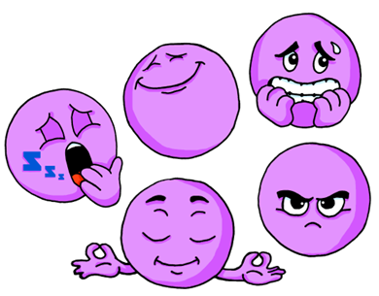
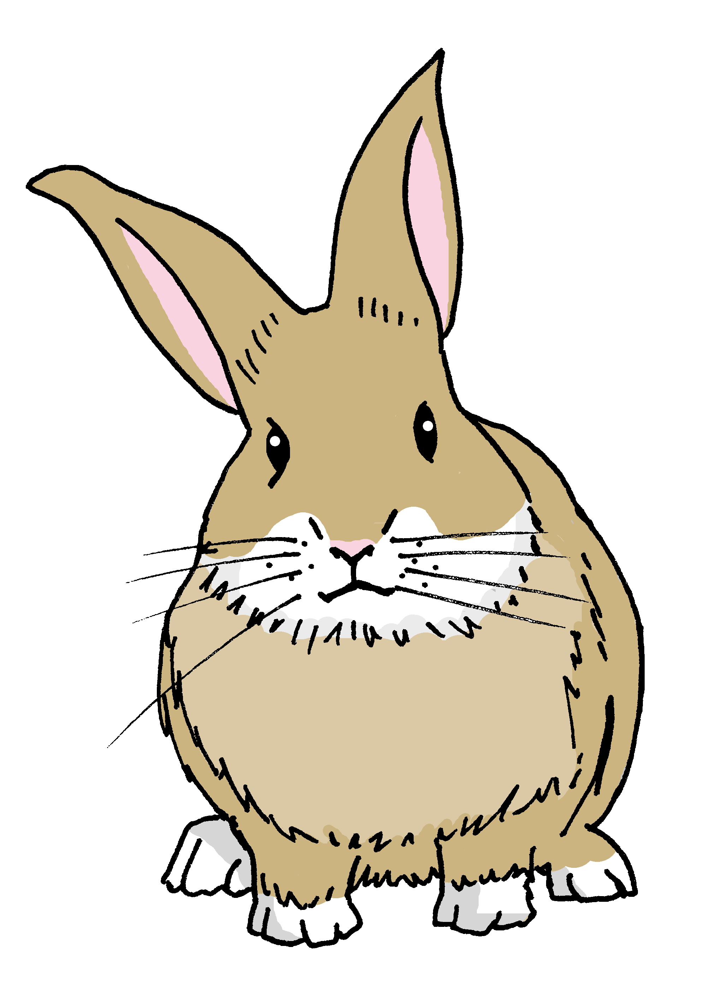
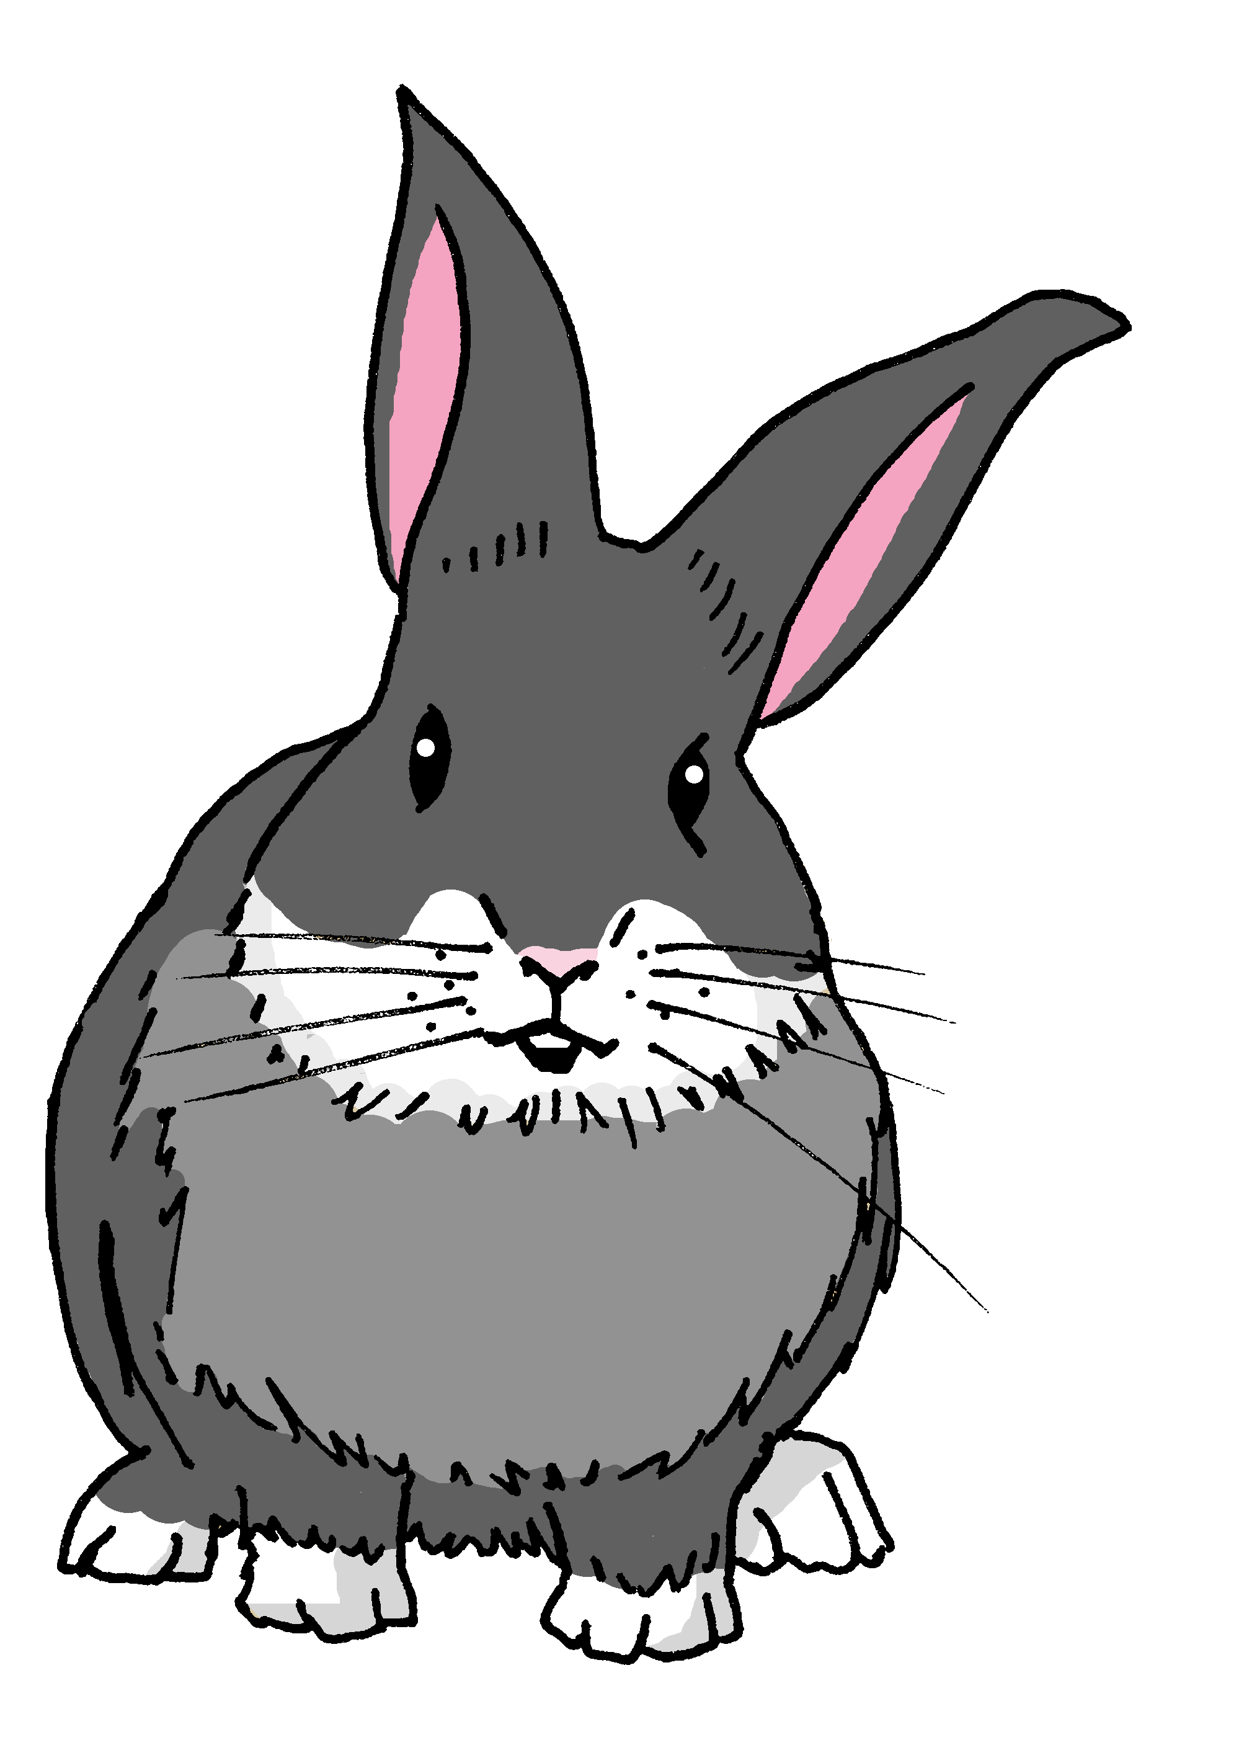
Describing me and others
¿Cómo estás?
rojo
Follow ups 1-5
Term 1 Week 4
Notes:
Artwork by Steve Clarke. Pronoun pictures from NCELP (www.ncelp.org). All additional pictures selected from Pixabay and are available under a Creative Commons license, no attribution required.
Frequency of new vocabulary and phonics:
Phonics: [u] source word: universe [1603]
Vocabulary: clase [320] [en clase] curioso [1811] lento [1569] rápido [870] hoy [167]
The frequency rankings for words that occur in this PowerPoint which have been previously introduced in these resources are given in the SOW and in the resources that first introduced and formally re-visited those words.
For any other words that occur incidentally in this PowerPoint, frequency rankings will be provided in the notes field wherever possible.
Frequency of unknown words:
describir [1272] la [1] persona [108]
Source: Davies, M. and Davies, K. (2018). A frequency dictionary of Spanish: Core vocabulary for learners (2nd ed.). Routledge: London

Slide 2
Follow up 1:
[i]
idea
[e]
elefante
Escucha y escribe 📝.
pronunciar
Listen to these Spanish speakers introducing themselves.
What are their names? Fill the gaps with [e] or [i].
E
E l e n a
_
_
1
I s a b e l
_
_
Remember that proper nouns start with a capital letter!
2
A d r i á n
_
3
E v i t a
These are all popular names in Peru!
_
_
4
D i e g o
_
_
5
L u i s
_
Notes:
Timing: 5 minutes
Aim: to practise aural comprehension and written production of the SSC [e] and [i].
Procedure:
Click to bring up the prompts.
Click on E to hear the ejemplo (example). pupils write down the missing letters and volunteer the name.
Click for answer.
Continue with items 1-5.
Transcript [ejemplo] Lugo [1] Palma [2] Puno [3] Piura
[4] Tacna
[5] Granada

Slide 3
Follow up 2:
Sometimes we refer to people by name in a sentence:
Irene is here.
In Spanish, we often don’t need to use the pronoun:
Irene está aquí.
Here we use the pronoun she because we don’t need to repeat Irene.
She is tired now.
⚠ This means that está can mean is and he is, she is, it is.
Está cansada ahora.
[is]
[She is]
Notes:
Timing: 5 minutes (two slides)
Aim: to draw attention to pronouns in English and Spanish and the multiple meanings of ‘está’ (is, he is, she is, it is).
Procedure:
Click to present the information.
Ensure pupils’ understanding of the key term ‘pronoun’.

Slide 4
Follow up 2:
Lee y escribe 📝.
Inés está en clase. ________ ________ ___ __________.
Irene está en casa. Está contenta. ________ _____ ___ _______. _______ ________.
¿Isandro? No, está lento. ______ ? ___ _________ __________.
¿Cómo está Inessa? Está curiosa ahora. _____ ______ _______? ______ _______________ ________.
¿Ileanna está nerviosa? No, está cansada. ___ __________ _________? ____ ________ _______.
Write the English meaning of está for each sentence:
leer
Inés
is
in
class
Irene
is
at
home
She is
pleased
Isandro
No,
he is
being slow
How
is
Inessa
She is
feeling curious
now
Is
Ileanna
nervous
No
she is
tired
Notes:
Procedure:
Pupils write 1 – 5 and the English translation of está as best fits each sentence.
Click to trigger answers.
Note: The rest of the English translations are provided to enable pupils focus all their attention on the different meanings of está.

Slide 5
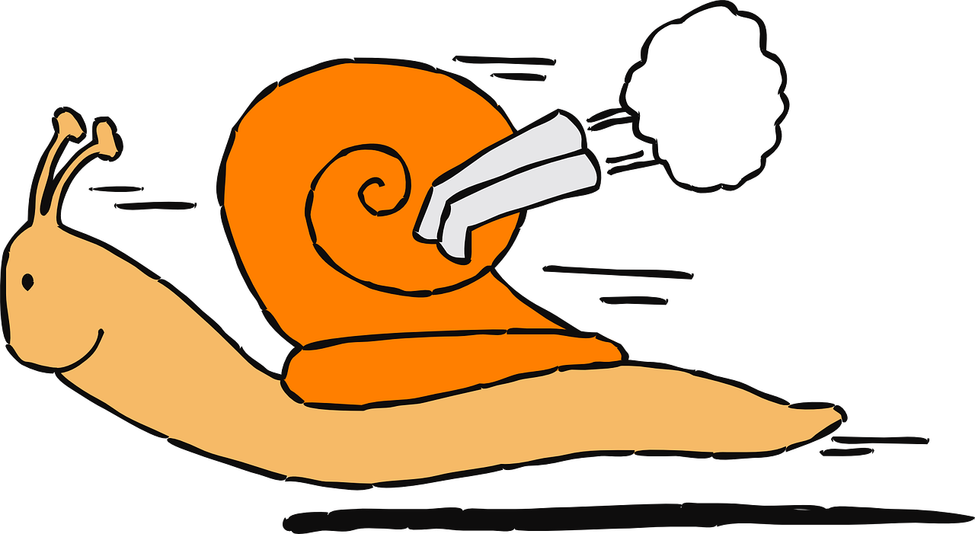
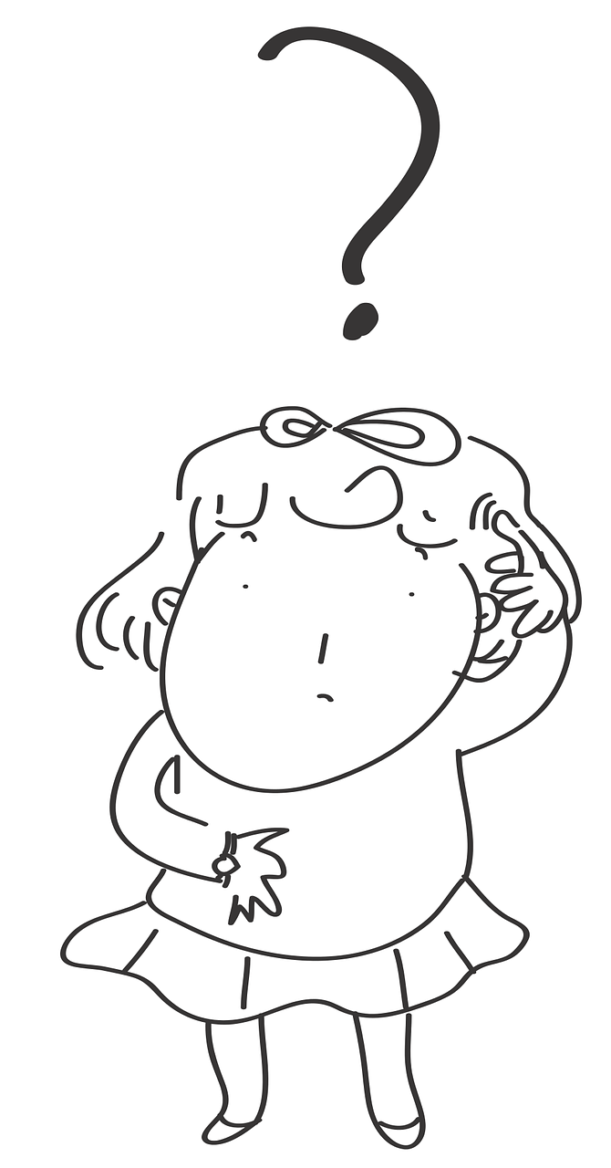
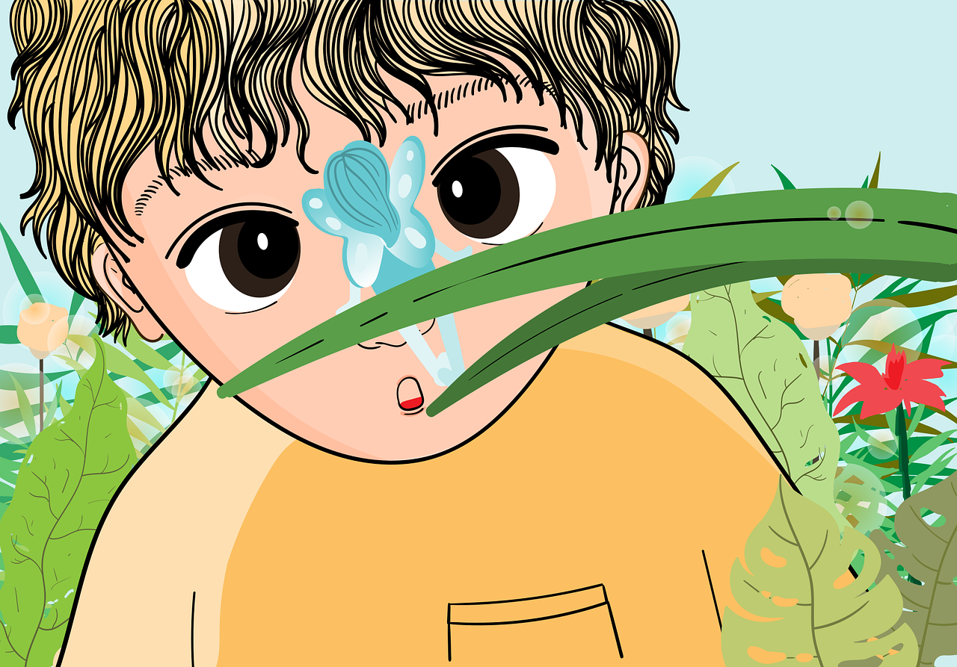
Follow up 3:
Habla y describe* a la persona*.
Irina
Irina
rápido | rápida
lento | lenta
curioso | curiosa
contento | contenta
cansado | cansada
hablar
Diego
1 minuto
Diego
describe = describe
la = the
persona = person
0
INICIO
Notes:
Timing: 5 minutes
Aim: to practise oral production of known adjectives with correct gender agreement.
Procedure: 1. Start the timer. Click for image.
2. pupils say the adjective that describes the image, with the correct ending. 3. Explain that the emojis with longer eyelashes require feminine adjective agreement. 4. A list of adjectives is provided to support production at this stage. The task can be repeated 2-3 times, and the words can be removed, as appropriate, to challenge full recall.
Frequency of unknown words:
describir [1272] la [1] persona [108]
Source: Davies, M. and Davies, K. (2018). A frequency dictionary of Spanish: Core vocabulary for learners (2nd ed.). Routledge: London

Slide 6
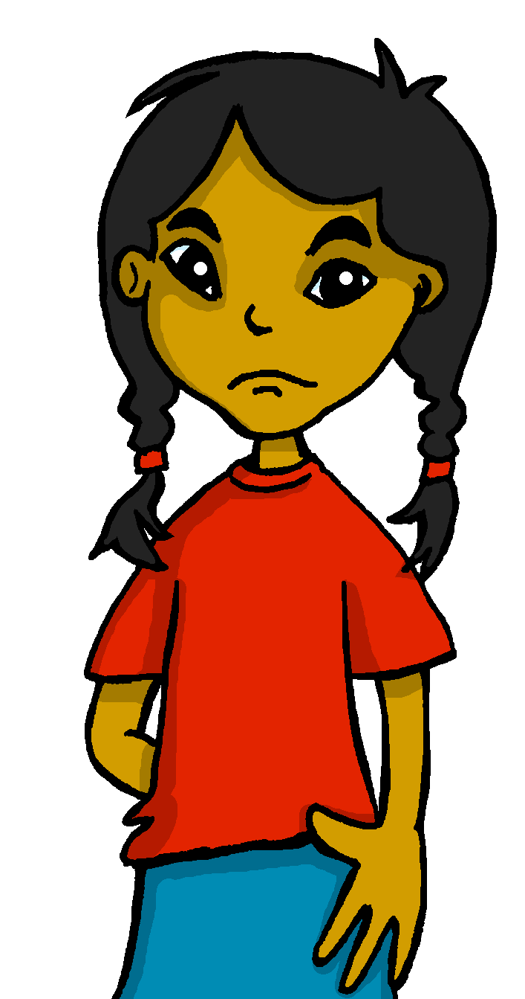
Follow up 4:
Escribe 📝.
escribir
Manchita está seria hoy.
Santi está lento hoy.
1. Manchita is serious today.
4. Santi is slow today.
Irene está contenta en clase.
2. Irene is happy in class.
Sofía está nerviosa ahora.
5. Sofía is nervous now.
Quique está curioso ahora.
3. Quique is curious now.
¿Cómo estás hoy en clase?
________________________
[I am…]
Notes:
Timing: 10 minutes
Aim: to practise written production of the correct form of the adjective.
Procedure:
Tell pupils to translate sentences 1-5, paying careful attention to the correct form of the adjective.
Draw pupils’ attention to the translation of “is” (she/he/it IS).
If needed, recap adjectives before starting attempting the sentences in full.
Extra: Challenge pupils to write a sentence about how they are feeling today, using the correct form of “estar”.

Slide 7
Follow up 5:
Escribe en español 📝.
a b ñ
Can you get at least 15 points?
vocabulario
 | Good afternoon | absent | there
 | I am | goodbye | here
 | How? | serious (f) | class
 | happy (m) | calm/quiet (m) | tired (m)
 | fast (f) | curious (m) | in class
 | you are | slow (m) | s/he is
 | now | today | nervous (m)
vocabulario
buenas tardes
ausente
allí
x3
estoy
adiós
aquí
¿Cómo
seria
clase
x2
contento
tranquilo
cansada
rápida
curioso
en clase
estás
lento
está
x1
ahora
hoy
nervioso
Notes:
Timing: 5 minutes
Aim: to practise written production of vocabulary from last week and this week.
Procedure: 1. Give pupils a blank grid. They fill in the Spanish meanings of any of the words they know, trying to reach 15 points in total.
Note: The most recently learnt and practised words are pink, words from the previous week are green and those from two weeks ago are blue, thus more points are awarded for them, to recognise that memories fade and more effort (heavy lifting!) is needed to retrieve them.

Slide 8
Handout Follow up 5:
Follow up 5:
a b ñ
Escribe en inglés 📝:
Can you get at least 15 points?
 | Good afternoon | absent | there
 | I am | goodbye | here
 | How? | serious (f) | class
 | happy (m) | calm/quiet (m) | tired (m)
 | fast (f) | curious (m) | in class
 | you are | slow (m) | s/he is
 | now | today | nervous (m)
vocabulario
x3
x2
x1
Notes:
Timing: 10 minutes (two slides, but the two tasks can be split over two days, as required)
Aim: to practise written comprehension and then written production of vocabulary from last week and this week.
Procedure: 1. Give pupils a blank grid. They fill in the English meanings of any of the words they know, trying to reach 15 points in total.
Note: The most recently learnt and practised words are pink, words from the previous week are green and those from two weeks ago are blue, thus more points are awarded for them, to recognise that memories fade and more effort (heavy lifting!) is needed to retrieve them.

