Slide 1


español, con Sofía
Term 1 Week 3

Slide 2


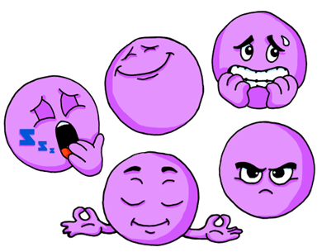

Describing me and others
¿Cómo estás?
Estar: estoy, estás, está for temporary state
SSC [e]
rojo
Notes:
Artwork by Steve Clarke. All additional pictures selected are available under a Creative Commons license, no attribution required.
The frequency rankings for words that occur in this PowerPoint which have been previously introduced in NCELP resources are given in the NCELP SOW and in the resources that first introduced and formally re-visited those words.
cansado [1818] contento [1949] nervioso [1521] serio [856] tranquilo [1073] ahora [81] ¿cómo? [151]
For any other words that occur incidentally in this PowerPoint, frequency rankings will be provided in the notes field wherever possible.
Source: Davies, M. & Davies, K. (2018). A frequency dictionary of Spanish: Core vocabulary for learners (2nd ed.). Routledge: London

Slide 3


pronunciar
[e]
elefante
pronunciar
Notes:
Timing: 1 minute
Aim: To introduce SSC [e]
Procedure:
Introduce and elicit the pronunciation of the individual SSC [e] and then the source word ‘elefante’ (with gesture, if using).
Click to bring the picture & get pupils to repeat (with gesture, if using).
Pupils to practise in pairs.

Slide 4



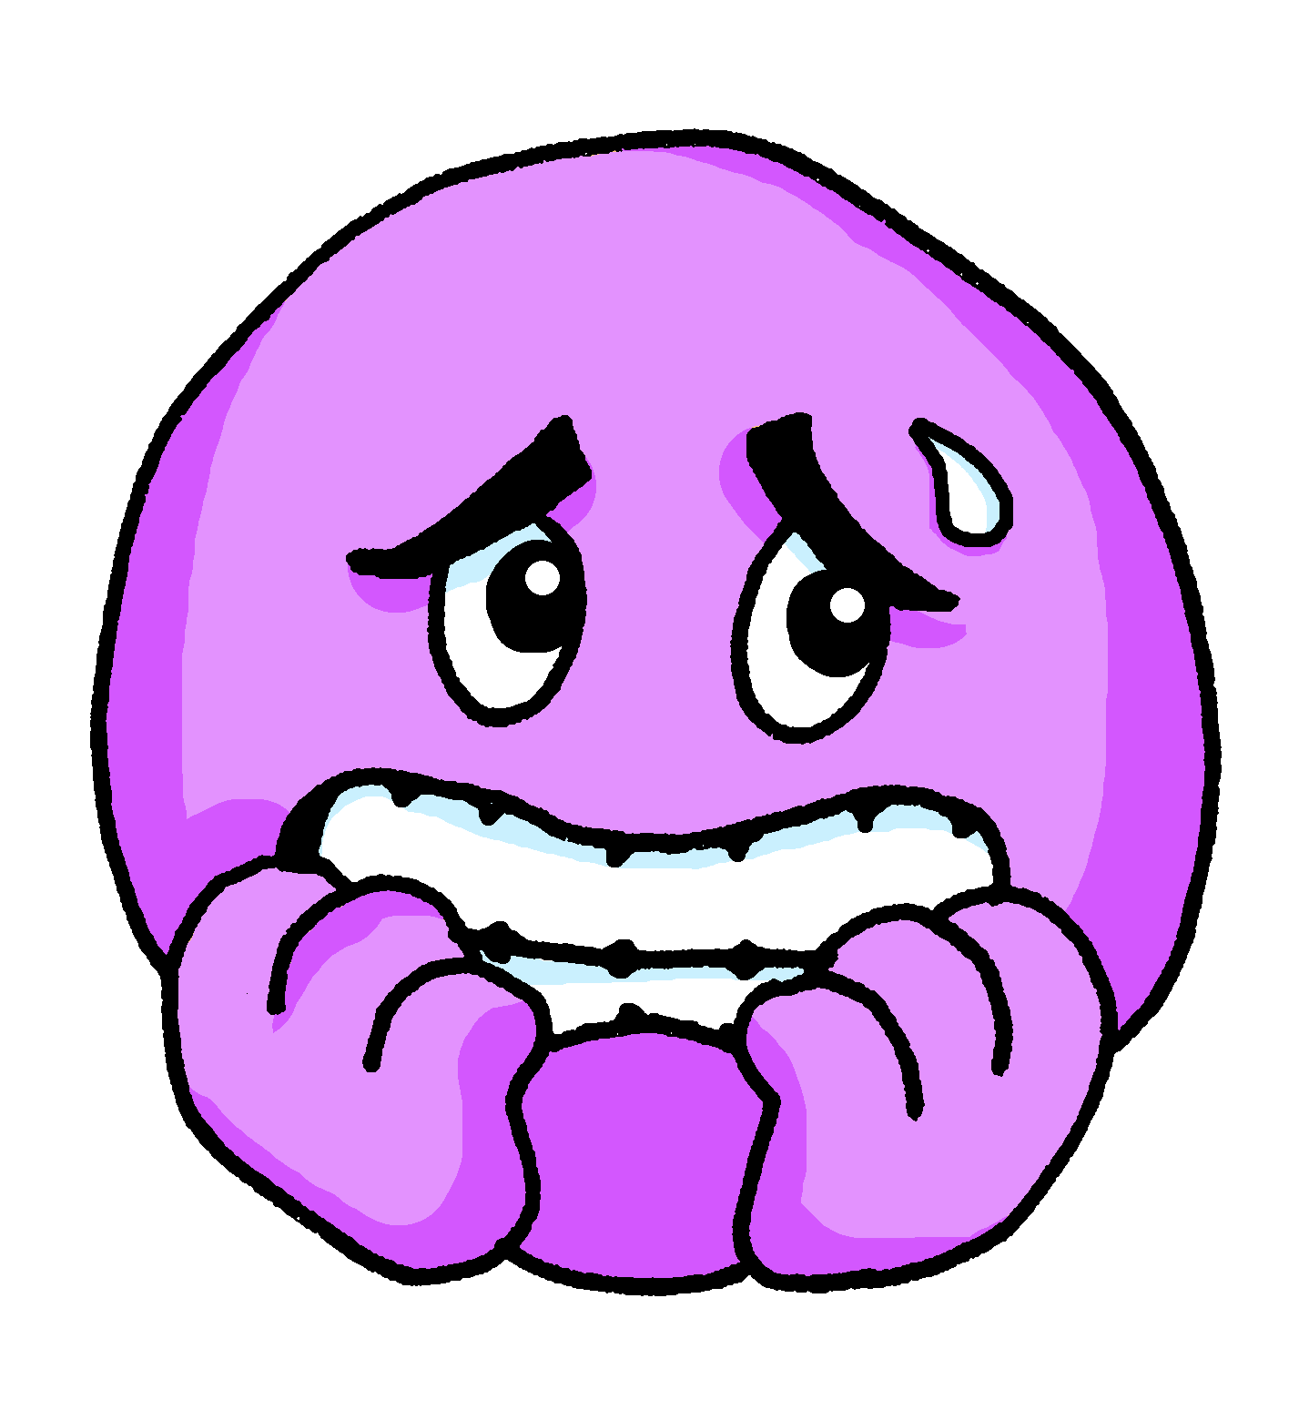

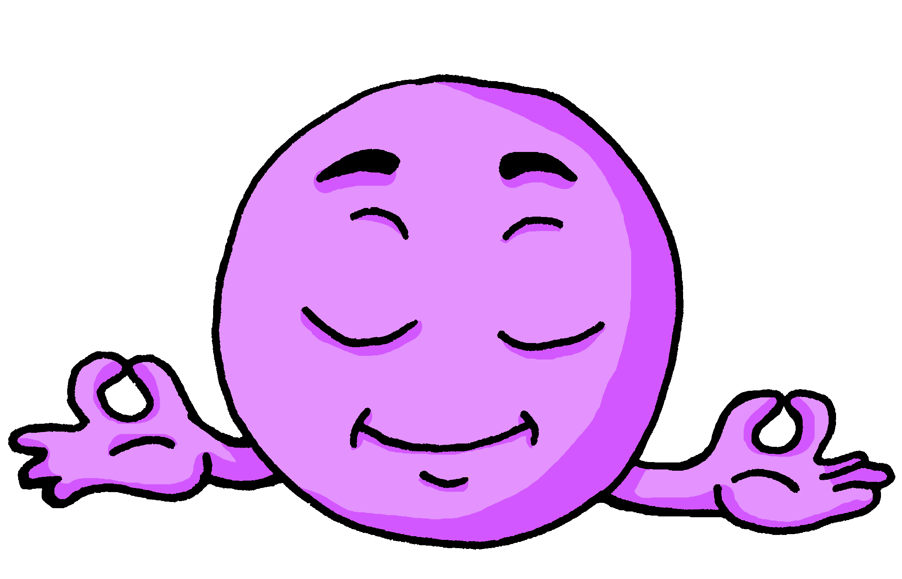
vocabulario
a b ñ
cansado
serio
contento
nervioso
tranquilo
Notes:
Timing: 3 minutes
Aim: to introduce 5 new items of vocabulary.
Procedure:
Click to trigger the picture and the word.
Say the Spanish word and get pupils to repeat.
Elicit English meaning.
Repeat with the other 4 adjectives.
NB. pupils haven’t learned ssc [qui] yet so this will need extra practice.
Use “key” gesture as a hook to embed the sound in their memory.
pupils have learnt the word ‘aquí’, which contains the same SSC. The teacher can remind them of this.
One of the characters is called ‘Quique’ and he features in this lesson, giving further opportunity to practise this SSC.
Note: 3 of the 5 new vocabulary items contain this week’s SSC [e]. Draw pupils’ attention to this.

Slide 5
vocabulario
a b ñ
cansado
serio
tired
Notes:
Timing: 3 minutes
Aim: to embed the meaning of the new words.
Procedure:
1. Read the two Spanish words out loud to model pronunciation. Elicit the right answer from pupils.
2. Repeat with the next four slides.

Slide 6
vocabulario
a b ñ
cansado
contento
pleased

Slide 7
vocabulario
a b ñ
tranquilo
serio
quiet / calm

Slide 8
vocabulario
a b ñ
serio
tranquilo
serious

Slide 9
vocabularioestar
a b ñ
nervioso
contento
nervous

Slide 10

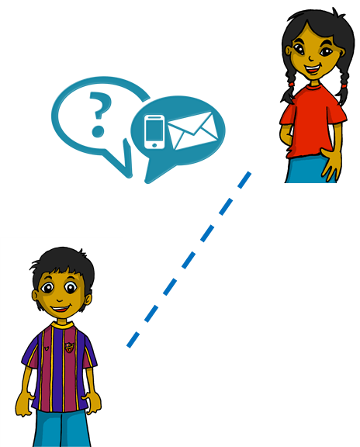


estar
estar
[to be | being]
We have already learned that In Spanish the verb estar means ‘to be’ when describing location.
Sofía, ¿Estás en España?
Sí, estoy en Lugo.
Sofía, Are you in Spain?
Yes, I am in Lugo.
We also use estar when describing mood or temporary state.
⚠ In English, we often use a verb with
‘-ing’ to talk about a temporary state (‘right now’). For example:
I am feeling tired /You are being silly.
Estoy contento.
I am pleased.
Estás nervioso.
I am (feeling) pleased.
You are nervous.
You re (feeling) nervous.
Notes:
Timing: 3 minutes
Aim: to build on their prior knowledge of the use of estar for location, to learn to use estar (I am / you are) for temporary state.
Procedure:
Read the grammar recap on estar for location, and new explanation on estar for temporary state. Make sure pupils are clear about the I / you pictures as these will come up in consecutive lessons.
Elicit English translations for the Spanish examples provided.

Slide 11
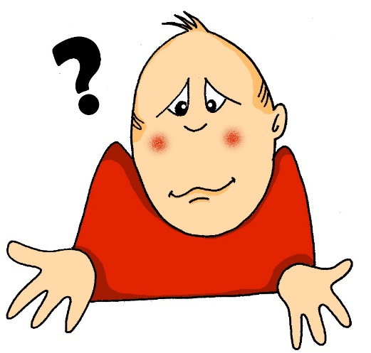

vocabulario
¿Cómo?
a b ñ
how?
¿Cómo estás?
¿Cómo estás ahora?
[How are you?]
[How are you now?]
Rachel Hawkes / Emma Marsden
Notes:
Timing: 1 minute
Aim: To introduce question word ¿cómo? (how) and the final new word for this lesson, ahora (now).
Procedure:
Click to trigger picture and word.
Pupils listen to teacher (or audio) and repeat cómo (include gesture if desired)
Tell pupils the meaning ‘how’ and click to display the English.
Click to trigger the first question: ¿cómo estás?
Elicit the meaning from pupils.
Click to reveal the meaning.
Repeat for ¿cómo estás ahora? (Note: this is the first time pupils have seen this word. They will need to be told the meaning (now)).

Slide 12


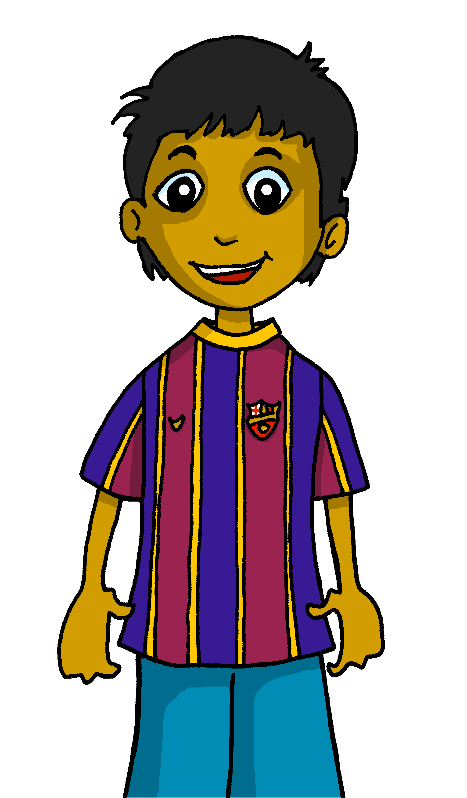

leer
Úrsula, ¿estás?
Rubén, ¿cómo estás?
Rubén, ¿estás?
leer
El señor Valero
Está ausente.
Estoy tranquilo.
Sí, estoy aquí.
Rubén
Úrsula
Notes:
Timing: 3 minutes (two slides)
Aim: to practise hearing and reading questions and answers using estoy, estás, está, recycling vocabulary from previous lesson and new vocabulary from this lesson.
Procedure:
Click to bring up the teacher calling the first pupil. Teacher says: “Rubén, ¿estás?”
Click to bring up Rubén’s answer: “Sí, estoy aquí.”
Click to bring the teacher’s next call. “Rubén, ¿cómo estás?”.
Click to bring up Rubén’s answer: “Estoy tranquilo”.
Click to bring up the teacher’s next call. “Úrsula, ¿estás?”
Click to bring up Rubén’s answer: ”Está ausente.”
Ensure meanings are clear and practise pronunciation.
NB. Adjectival agreement will be introduced and practised next week. That is why this week’s lesson focuses only on Rubén and Quique.

Slide 13


leer
En clase.
leer
Estoy cansado.
¿Cómo estás, Quique?
Sofía
Quique
Notes:
Timing: 3 minutes (two slides)
Aim: to practise answering “estás” questions, recycling vocabulary from previous lesson.
Procedure:
Click to bring up Sofía asking Quique how he is: “¿Cómo estás, Quique?”
Click to bring up Quique’s answer: “Estoy cansado”.
Ensure that the meaning is clear, and practise pronunciation.

Slide 14


leer
leer
¿Cómo estás ahora, Quique?
¿ahora? ¡Estoy contento!
Notes:
Procedure:
Click to bring up Sofía asking Quique how he is now: “¿Cómo estás ahora, Quique?”
Click to bring up Quique’s answer: “¿Ahora? ¡Estoy contento!”.
Ensure that the meaning is clear, and practise pronunciation.
Frequency of additional vocabulary used:
minuto [478] después (afterwards, later) [115] are used to enrich the context of the story.
Provide English translation to pupils.
Source: Davies, M. & Davies, K. (2018). A frequency dictionary of Spanish: Core vocabulary for learners (2nd ed.). Routledge: London

Slide 15
estar
estar
[to be | being]
Remember that we use estar (‘to be’) when describing location and mood or temporary state.
To say s/he is, use está.
Está contento.
¿Está nervioso?
He is pleased.
Is he nervous?
Remember: change a statement into a question by raising your voice at the end.
Spanish uses two question marks – the one at the front is upside down!
Notes:
Timing: 3 minutes
Aim: to remind pupils of the two uses for estar; to recap how to form raised intonation questions (introduced in week 2).
Procedure:
1. Click to trigger the information.
2. Elicit English translations for the Spanish examples provided.
3. Practise in pairs, saying either a question or a statement, and partners translate into English what they hear.

Slide 16


escuchar
Escucha a Quique.
Who does he describe?
A) Marca ✅ ‘I’, ‘you’ o ‘he’.
escuchar
 | Quique (I) | You | He
B) Escribe📝.Write down the number.
Listen again. Where can you hear the following adjectives?
E
5
1
quiet / calm
nervous
pleased
serious
tired
2
4
3
E
4
1
3
2
5
6
🏆 Can you spot the questions?
Notes:
Timing: 8 minutes
Aim: to practise aural comprehension of the verbs ‘estoy’, ‘está’ ‘estás’ and recognise the person of the verb they refer to.
Procedure:
1. Ask pupils to write 1-6 in their books.
2. Read the instruction in Spanish from the board.
3. Tell them that they will hear Quique talking about herself, to one of his friends, or about one of his friends.
4. Do the example with them.
5. Play 1-6. Pupils identify to whom Quique refers (himself, talking to a friend or about one of his friends) and write I, you, he.
6. Play the six utterances again. Remind them about the raised intonation and also the question word ‘cómo?’.
Challenge pupils to put their hands up when they hear the two questions.
Part 2
7. Play utterances one more time. This time pupils need to identify where they can hear the adjectives & write down the number of the sentence in which they are mentioned.
Transcript
E. Estoy contento.
Está serio.
¿Estás cansado?
Estoy serio.
Está nervioso ahora.
Estás tranquilo.
¿Cómo estás ahora?

Slide 17
leer
leer
¿Quique? ¿estás?
Notes:
Timing: 30 seconds
Aim: to provide the context for the next activity (trying to find where Quique is).
Procedure:
1. Read speech bubble aloud with the class.

Slide 18
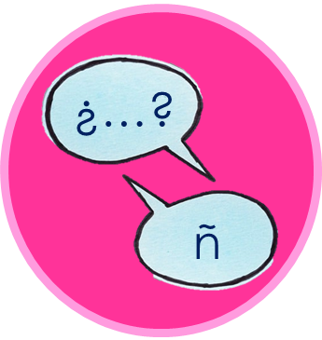














hablar
quiet
hablar
pleased
nervous
serious
tired
I am
You are
He is
Notes:
Timing: 2 minutes (or more, if time allows) (3 slides – more in follow up)
Aim: to correctly use the verbs ‘estoy’, ‘está’ and ‘estás’ in oral production, together with newly learnt vocabulary items.
(!) Quique is hidden behind… You are pleased / estás contento.
Procedure:
Pupils select a verb form on the vertical axis with an adjective along the horizontal axis.
They translate the short sentence to identify the square where they think Quique is.
Click on the square to reveal what is beneath.
Note: pupils might benefit from revisiting the adjectives again before starting the activity.
NB. There are 3 different slides in total, with Quique located in different locations. Teachers to decide how much practice is needed. Note that some slides might take a long time if pupils “cannot find Quique” which will translate into loads of practice opportunities.

Slide 19
hablar
quiet
pleased
nervous
serious
hablar
tired
I am
You are
He is
Notes:
Quique is hidden behind… I am quiet / estoy tranquilo.
NB. Pupils might question this one as he is flying in the air!!

Slide 20
hablar
pleased
nervous
serious
hablar
quiet
tired
I am
You are
He is
Notes:
Quique is hidden behind…. He is tired / está cansado.

Slide 21
¡adiós!
rojo

