Slide 1
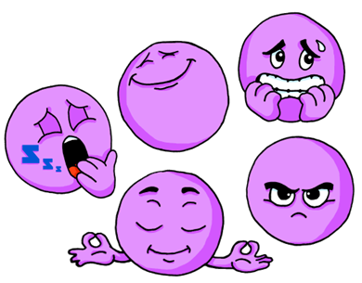
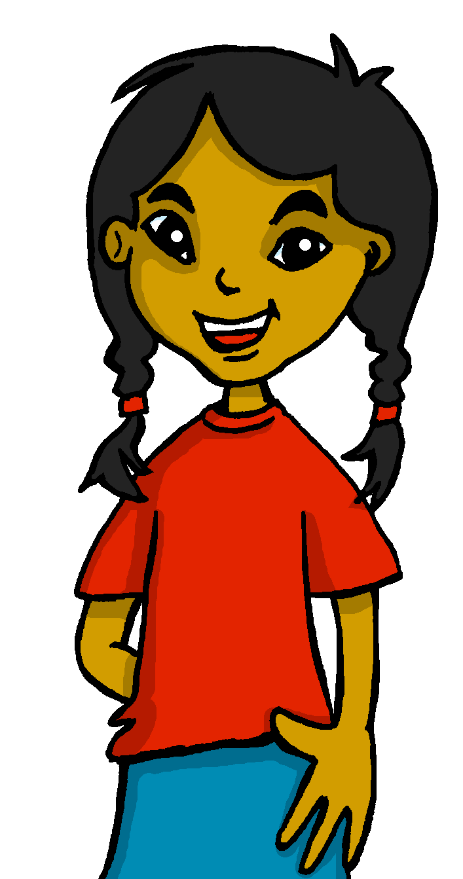
Describing me and others
¿Cómo estás?
rojo
Follow ups 1-5 Week 3
Term 1 Week 3
Notes:
Artwork by Steve Clarke. All additional pictures selected are available under a Creative Commons license, no attribution required.
The frequency rankings for words that occur in this PowerPoint which have been previously introduced in NCELP resources are given in the NCELP SOW and in the resources that first introduced and formally re-visited those words.
Phonics: elefante [>5000]
Vocabulary: cansado [1818] contento [1949] nervioso [1521] serio [856] tranquilo [1073] ahora [81] ¿cómo? [151]
For any other words that occur incidentally in this PowerPoint, frequency rankings will be provided in the notes field wherever possible.
Frequency of unknown words:
repetir [512]
Source: Davies, M. and Davies, K. (2018). A frequency dictionary of Spanish: Core vocabulary for learners (2nd ed.). Routledge: London

Slide 2
Follow up 1:
[e]
elefante
Escucha.
pronunciar
A
B
pronunciar
3
Escucha y repite*.
‘Elefante’ is number ________.
(3) Tres en elefante
1
2
(2) Dos en estrella
3
(1) Una en tren
¿Qué es?
e
Es la letra __________
repite = repeat
Notes:
Timing: 5 minutes
Aim: to practise aural comprehension of the SSC [e].
Procedure:
Click to bring up the prompts.
Click on each audio symbol to listen to the words.
Click for the number answers.
Click to bring up task B.
Click on each phrase to hear it.
Pupils repeat.
Clarify meanings.
8. Click the audio player to play the whole poem. Pupils join in.
Transcript Part A: [1] Elegante [2] Normalmente [3] Elefante
Part B:
Tres en elefante Dos en estrella Una en tren ¿qué es? Es la letra ‘e’.

Slide 3
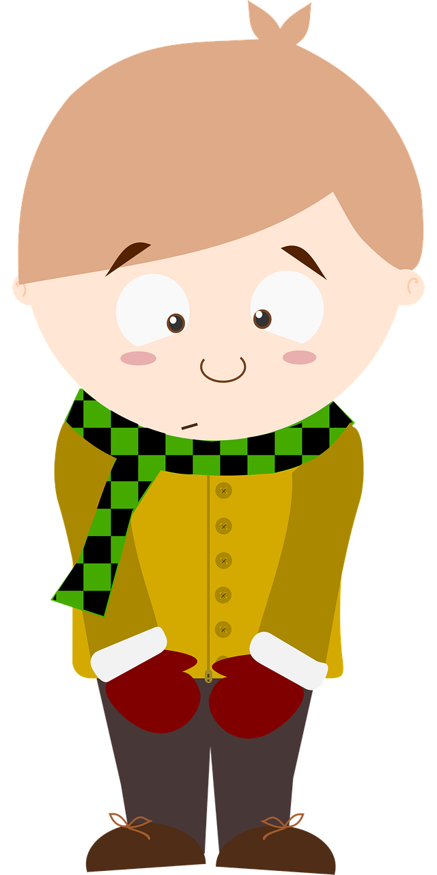
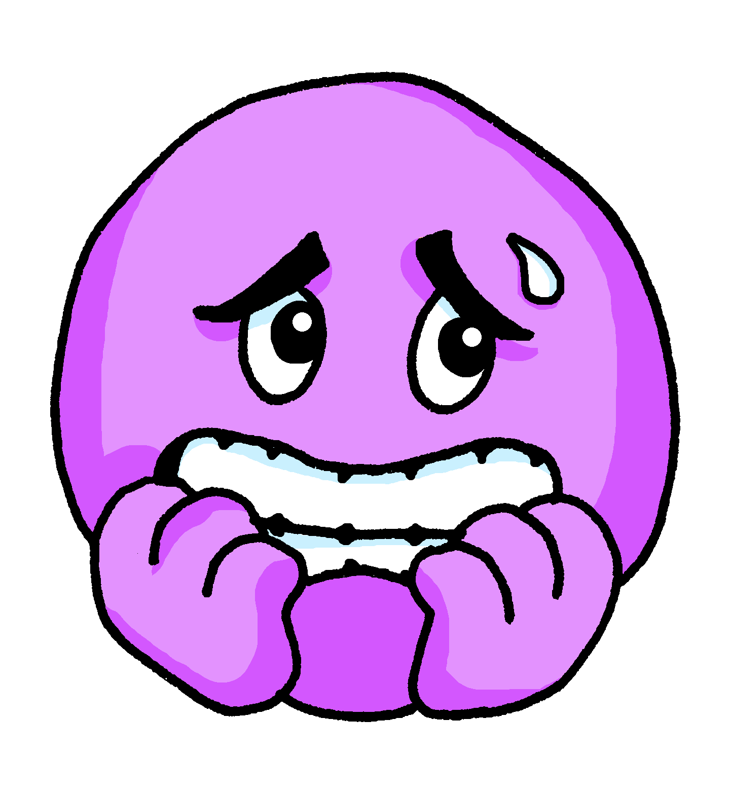
Follow up 2:
Sometimes we refer to people by name in a sentence:
Emanuel is here.
In Spanish, we often don’t need to use the pronoun.
Emanuel está aquí.
Here we use the pronoun he because we don’t need to repeat Emanuel.
He is nervous.
⚠ This means that está can mean is and he is, she is, it is.
Está nervioso.
[is]
[He is]
Notes:
Timing: 5 minutes (two slides)
Aim: to draw attention to pronouns in English and Spanish and the multiple meanings of ‘está’ (is, he is, she is, it is).
Procedure:
Click to present the information.
Ensure pupils’ understanding of the key term ‘pronoun’.

Slide 4
Follow up 2:
Lee y escribe 📝.
Elena está en casa. ________ ________ ___ __________.
Eduardo está en clase. Está contento. ________ _____ ___ _______. _______ ________.
¿Eva? No, está ausente. ______ ? ___ _________ __________.
¿Cómo está Edgar? Está tranquilo ahora. _____ ______ _______? ______ _________ ________.
¿ Enrique está nervioso? No, está serio. ___ __________ _________? ____ ________ _______.
Write the English meaning of está for each sentence:
leer
Elena
is
at
home
Eduardo
is
in
class.
He is
pleased
Eva
No,
she is
absent
How
is
Edgar
He is
calm
now
Is
Enrique
nervous
No
he is
serious
Notes:
Procedure:
Pupils write 1 – 5 and the English translation of está as best fits each sentence.
Click to trigger answers.
Note: The rest of the English translations are provided to enable pupils focus all their attention on the different meanings of está.

Slide 5
Follow up 3a:
Escribe en inglés 📝.
a b ñ
Can you get at least 15 points?
 | aquí | allí | estoy
 | hola | presente | ausente
 | sí | España | adiós
 | en | Buenos días | Buenas tardes
 | nervioso | estás | ahora
 | está | ¿cómo? | serio
 | cansado | tranquilo | contento
vocabulario
here
there
I am (state, location)
x3
hello
present
absent
yes
Spain
goodbye
x2
in
Good morning
Good afternoon
nervous
you are (state, location)
now
s/he is (state, location)
How?
serious
x1
tired
quiet, calm
pleased
Notes:
Timing: 10 minutes (two slides, but the two tasks can be split over two days, as required)
Aim: to practise written comprehension and then written production of vocabulary from last week and this week.
Procedure: 1. Give pupils a blank grid. They fill in the English meanings of any of the words they know, trying to reach 15 points in total.
2.
Note: The most recently learnt and practised words are pink, words from the previous week are green and those from two weeks ago are blue, thus more points are awarded for them, to recognise that memories fade and more effort (heavy lifting!) is needed to retrieve them.

Slide 6
Follow up 3b:
Escribe en español 📝.
a b ñ
Can you get at least 15 points?
 | absent | present | hello
 | I am | there | here
 | Good afternoon | yes | goodbye
 | no | Spain | Good morning
 | pleased | calm/quiet | tired
 | serious | you are | s/he is
 | now | How? | nervous
vocabulario
ausente
presente
hola
x3
estoy
allí
aquí
Buenas tardes
sí
adiós
x2
no
España
Buenos días
contento
tranquilo
cansado
serio
estás
está
x1
ahora
¿Cómo?
nervioso
Notes:
Procedure: 1. Give pupils a blank grid. They fill in the Spanish meanings of any of the words they know, trying to reach 15 points in total.
Note: The most recently learnt and practised words are pink, words from the previous week are green and those from two weeks ago are blue, thus more points are awarded for them, to recognise that memories fade and more effort (heavy lifting!) is needed to retrieve them.

Slide 7
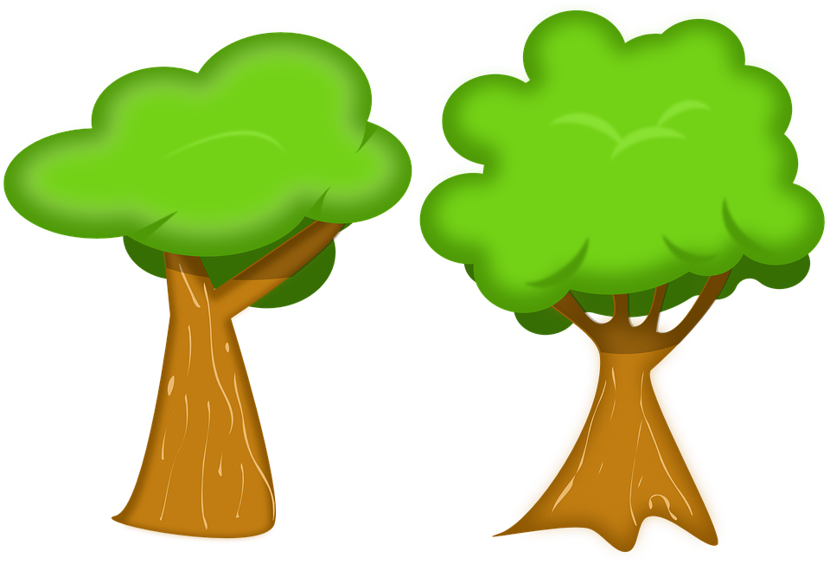
Follow up 4:
hablar
quiet
pleased
nervous
serious
tired
I am
You are
He is
Notes:
Timing: 5 minutes
Aim: to correctly use the verbs ‘estoy’, ‘está’ and ‘estás’ in oral production, together with newly learnt vocabulary items.
Procedure:
Pupils select a verb form on the vertical axis with an adjective along the horizontal axis.
They translate the short sentence to identify the square where they think Quique is.
Click on the square to reveal what is beneath.
Note: pupils might benefit from revisiting the adjectives again before starting the activity.
(!) Quique is hidden behind….
He is nervous / está nervioso.

Slide 8
pleased
hablar
quiet
nervous
serious
tired
I am
You are
He is
Notes:
Quique is hidden behind….
I am nervous / estoy nervioso.

Slide 9
Follow up 5:
Escribe 📝.
serio
¿
nervioso
?
?
cansado
escribir
tranquilo
I am serious. ______________________
2. Rubén is calm. ______________________
3. You are nervous. ______________________
4. Are you tired? ______________________
5. Quique is pleased. ______________________
6. Is he calm? ______________________
Estoy serio.
estás
leer
Rubén está tranquilo.
Estás nervioso.
está
Don’t forget capital letters and full stops!
Rubén
¿Estás cansado?
Quique está contento.
contento
está
¿Está tranquilo?
estoy
Quique
estás
está
¿
tranquilo
Notes:
Timing: 5 minutes
Aim: to practise written word meaning recognition and correct written reproduction, with appropriate punctuation for sentences and questions.
Procedure: 1. Pupils write the English and then the Spanish, using (or not) the Spanish words around the outside. 2. Click to remove support words and provide the answers to each sentence.
Note: Pupils who want to challenge themselves to work from memory, can turn away from the board once they have written the English sentence prompts.

Slide 10
¡adiós!
rojo

Slide 11
Handout Follow up 3a
Follow up 3a:
a b ñ
Escribe en inglés 📝:
Can you get at least 15 points?
 | aquí | allí | estoy
 | hola | presente | ausente
 | sí | España | ¿dónde?
 | en | Buenos días | Buenas tardes
 | nervioso | estás | ahora
 | está | ¿cómo? | serio
 | cansado | tranquilo | contento
vocabulario
x3
x2
x1
Notes:
Timing: 10 minutes (two slides, but the two tasks can be split over two days, as required)
Aim: to practise written comprehension and then written production of vocabulary from last week and this week.
Procedure: 1. Give pupils a blank grid. They fill in the English meanings of any of the words they know, trying to reach 15 points in total.
Note: The most recently learnt and practised words are pink, words from the previous week are green and those from two weeks ago are blue, thus more points are awarded for them, to recognise that memories fade and more effort (heavy lifting!) is needed to retrieve them.

Slide 12
Handout Follow up 3a
Handout Follow up 3a
Follow up 3b:
a b ñ
Escribe en inglés 📝:
Can you get at least 15 points?
 | absent | present | hello
 | I am | there | here
 | Good afternoon | yes | in
 | no | Spain | Good morning
 | pleased | calm/quiet | tired
 | serious | you are | s/he is
 | now | How? | nervous
vocabulario
x3
x2
x1
Notes:
Timing: 10 minutes (two slides, but the two tasks can be split over two days, as required)
Aim: to practise written comprehension and then written production of vocabulary from last week and this week.
Procedure: 1. Give pupils a blank grid. They fill in the English meanings of any of the words they know, trying to reach 15 points in total.
Note: The most recently learnt and practised words are pink, words from the previous week are green and those from two weeks ago are blue, thus more points are awarded for them, to recognise that memories fade and more effort (heavy lifting!) is needed to retrieve them.

