Slide 1
español, con Sofía

Slide 2
Describing me and others
Answering the register
Estar: estoy, está , estás for location
SSC [u]
rojo
español
Term 1 Week 2
Notes:
Artwork by Steve Clarke. Pronoun pictures from NCELP (www.ncelp.org). All additional pictures selected from Pixabay and are available under a Creative Commons license, no attribution required.
Frequency of new vocabulary and phonics:
Phonics: [u] source word: universe [1603]
Vocabulary: estás [21] sí [45] no [11] en1 [5] ¡Buenos días! [103/65] ¡Buenas tardes! [103/392] adiós [2309] Source: Davies, M. and Davies, K. (2018). A frequency dictionary of Spanish: Core vocabulary for learners (2nd ed.). Routledge: London
The frequency rankings for words that occur in this PowerPoint which have been previously introduced in these resources are given in the SOW and in the resources that first introduced and formally re-visited those words.
For any other words that occur incidentally in this PowerPoint, frequency rankings will be provided in the notes field wherever possible.

Slide 3
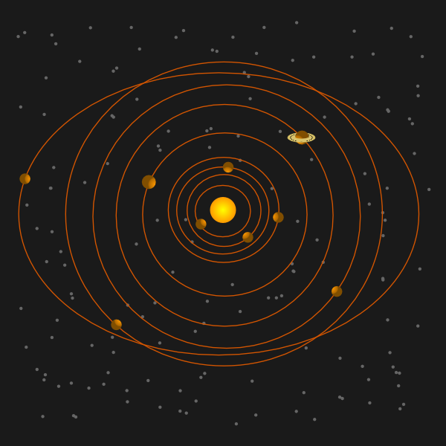
pronunciar
[u]
universo
pronunciar
Notes:
Timing: 1 minute
Aim: To introduce SSC [u]
Procedure:
Introduce and elicit the pronunciation of the individual SSC [u] and then the source word ‘universo’ (with gesture, if using).
Click to bring on the picture and get pupils to repeat (with gesture, if using).

Slide 4
vocabulario
a b ñ
¡Buenos días!
Good morning! (Literally, good days!)
¡Buenas tardes!
Good afternoon! (Literally, good afternoons!)
¡Adiós!
Goodbye!
Notes:
Timing: 1 minute
Aim: To introduce buenos días / buenas tardes & adiós.
Procedure:
Introduce and elicit the pronunciation of the phrases, practising orally with the visual support, then providing the word.
Ensure that literal and equivalent English meanings are clear.

Slide 5
vocabulario
a b ñ
1
3
2
Notes:
Timing: 1 minute
Aim: To recognise aurally the new 3 items of vocabulary.
Procedure:
Teachers say one of the phrases and pupils use their finger to show which picture corresponds to the phrase.

Slide 6
estar
estar
[to be | being]
In Spanish the verb estar means ‘to be’ when describing location.
Estoy aquí.
Está allí.
I am here.
He is there.
She is there.
Notes:
Timing: 1 minute
Aim: to revisit estar (to be for location), before introducing 2nd person singular and question formation.
Procedure:
Present the grammar explanation of “estar”, “estoy” and “está”. Make sure pupils are clear about the I / you pictures as these will come up in consecutive lessons.
Elicit English translation for the Spanish examples provided.

Slide 7
estar
estar
[to be | being]
To say you are, use estás.
Estás presente.
Estás en España.
In Spanish, change a statement into a question by raising your voice at the end.
You are present.
You are in Spain.
¿Estás presente?
¿Estás en España?
Are you present?
Are you in Spain?
Notes:
Timing: 2 minutes
Aim: to introduce estás (you are).
Procedure:
Present the grammar explanation of “estar” and “estás”.
2. Elicit English translations for the Spanish examples provided).
Note: Raised intonation questions will be practised formally again in Week 5.

Slide 8
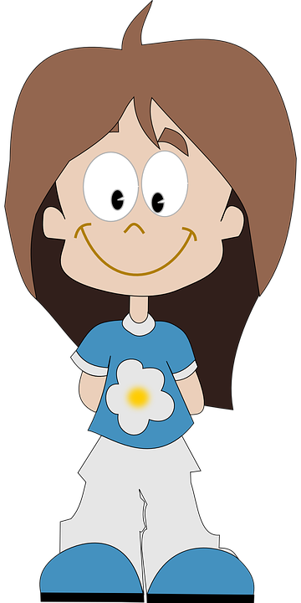
leer
Rubén, ¿estás?
Úrsula, ¿estás allí?
leer
Sí, presente
Sí
Úrsula
Rubén
Notes:
Timing: 2 minutes
Aim: to practise written comprehension and matching sound to print of “estás” questions, recycling vocabulary from previous lesson.
Procedure:
Click to bring up the teacher calling the first pupil. Teacher says: “Úrsula, ¿estás?”
Click to bring up Úrsula’s answer: “sí.”
Click to bring the teacher’s next call. “Rubén, ¿estás?”.
Click to bring up Rubén’s answer: “Sí, presente”. Ensure meaning is clear and practise pronunciation.

Slide 9
escuchar
Escucha.
La señora Mora is taking the register now.
escuchar
Is it a question or a statement? Write ¿…? or .
 | Coral, estás presente
 | Lara, estás presente
 | Lorna, estás allí
 | Tamara, estás presente
 | Carlos, estás aquí
 | Paloma, estás presente
 | Gaspar, estás allí
leer
E
.
1
¿
?
2
¿
?
3
¿
?
¿Coral?
4
.
5
.
6
¿
?
Notes:
Timing: 5 minutes
Aim: to practise attending to raised intonation question intonation in aural comprehension with written support. To then practise processing the two structures for meaning.
Procedure:
1. Ask pupils to write 1-6 in their books.
2. Tell them that they will hear a statement or a question using the verb ‘estás’ (you are).
3. When they listen they should decide if it is a question or a statement. They could be asked to note Q or S.
4. Then they should punctuate the questions and statements with ¿…? or . 5. Click to reveal the answers. 6. Ensure that the English meanings are clear. You are vs Are you.
Transcript:
Coral, estás presente.
Lara, ¿estás presente?
Lorna, ¿estás allí?
Tamara, ¿estás presente?
Carlos, estás aquí.
Paloma, estás presente.
Gaspar, ¿estás allí?

Slide 10
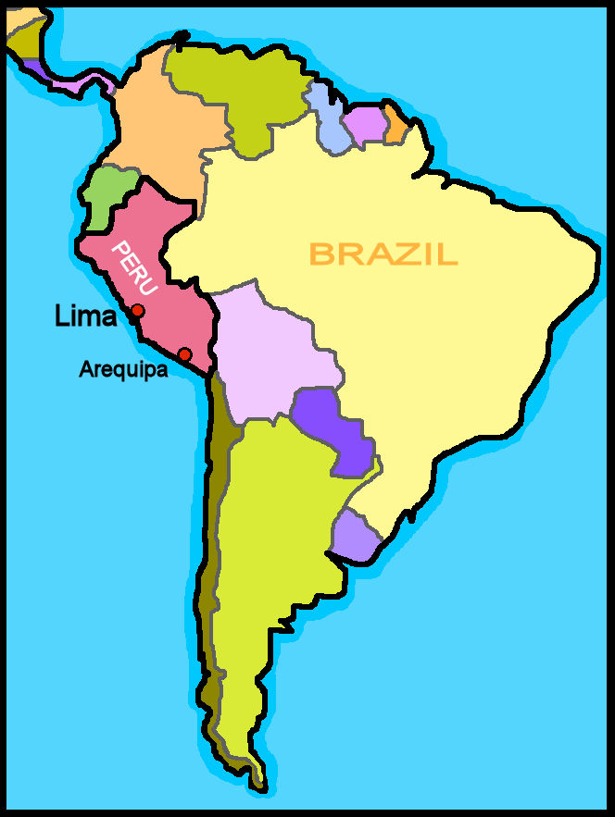
hablar
¿Lima está en Perú?
hablar
Sí, está en Perú.
No, está en Brasil.
Notes:
Timing: 2 minutes (four slides)
Aim: to present intonation questions using ‘está’ and responses using ‘está’ as ‘it is (in/located)’. Last lesson they practised ‘está’ meaning she / he is.
Procedure:
Ask pupils “¿Lima está en Perú?” and read out loud the two options, using the names in the map to model their options.
A pupil reads the option he/she thinks is the correct out loud.
Click for the correct answer to be highlighted.
Elicit the translation of 'está’ so that it is clear to them that ‘está’ stands for two words in English, here - it and is.
Notes: i) In the next series of slides we extend practice answering the question ¿XXX está en YYY? and answering with Sí or No. ii) Note that we are not doing negative sentences yet. The negative answers give a positive answer. No, está en… (No, it is in…). iii) The names of cities and countries do contain SSCs [a] and [u] and several SSCs not encountered before.
iv) pupils might not know where Machu Picchu is (an opportunity to learn about it!) but they probably know it is not in the UK ☺ .
<div>Icons made by <a href="https://www.freepik.com" title="Freepik">Freepik</a> from <a href="https://www.flaticon.com/" title="Flaticon">www.flaticon.com</a></div>
<div>Icons made by <a href="https://www.freepik.com" title="Freepik">Freepik</a> from <a href="https://www.flaticon.com/" title="Flaticon">www.flaticon.com</a></div>

Slide 11
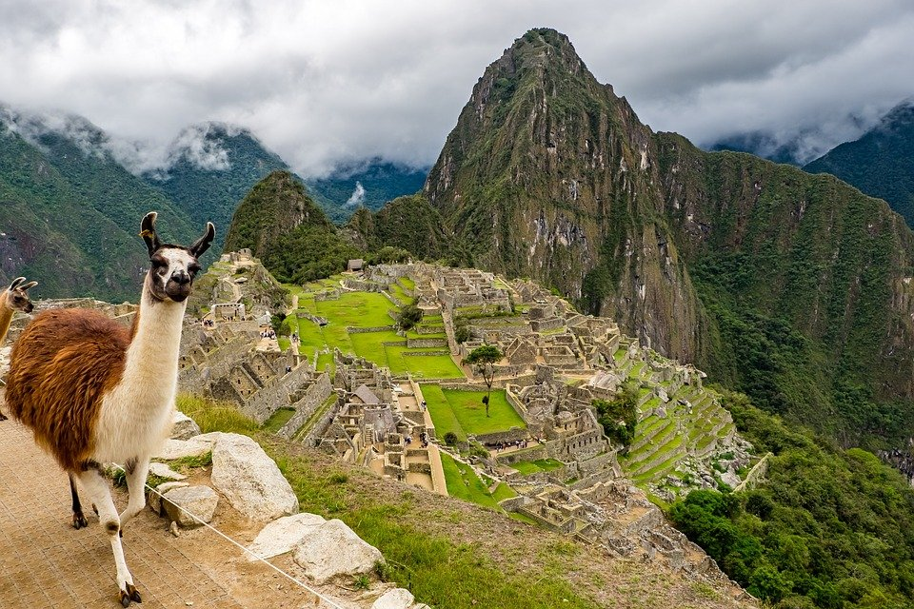
hablar
¿Machu Picchu está en Inglaterra?
hablar
No, está en Perú.
Sí, está en Inglaterra.

Slide 12
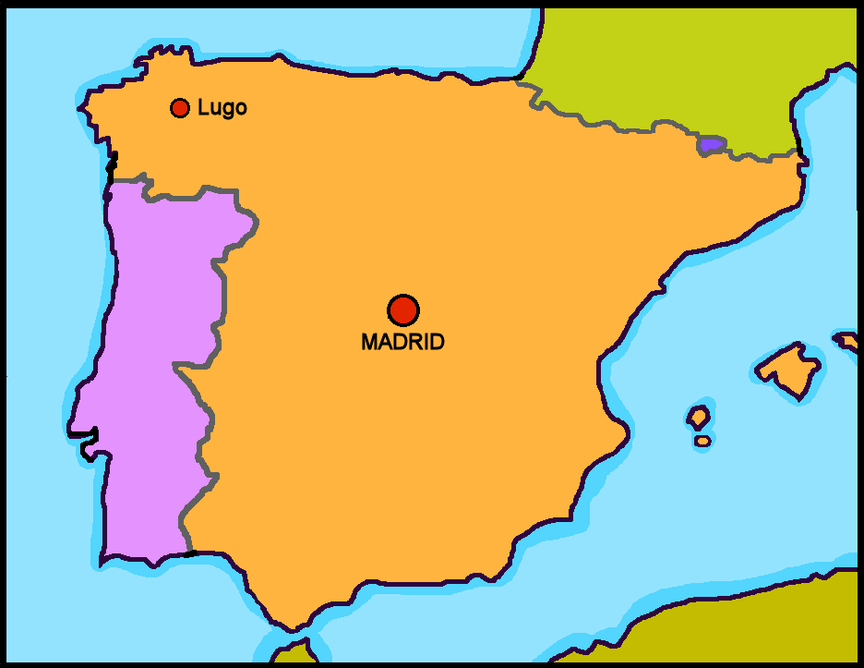
hablar
¿Sofía está en Madrid?
hablar
Sí, está en Madrid.
No, está en Lugo.

Slide 13
hablar
¿Lugo está en España?
hablar
No, está en Inglaterra.
Sí, está en España.

Slide 14
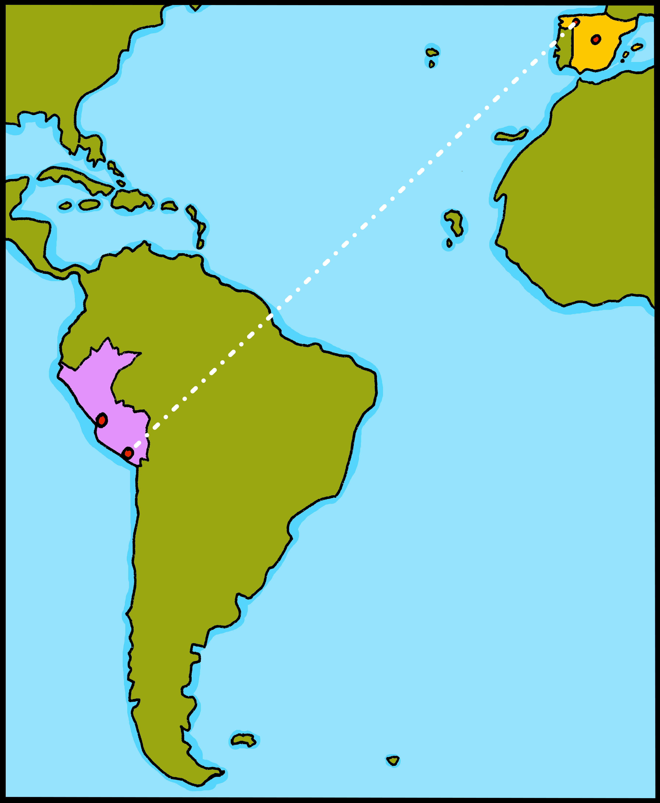
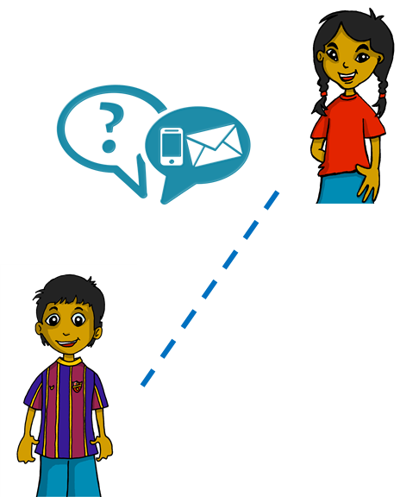
leer
Sofía gets lots of messages from her friends while she is in Perú.
Lee.
leer
1
you are
Estoy en Perú. ☺
I am
Rubén
2
4
she/he is
she/he is
Está en Madrid. ☺
Estoy en Lugo. ☺
you are
I am
3
5
are you
you are
¿Estás en Cuba?. ☺
Estás en España. ☺
I am
you are
Notes:
Timing: 5 minutes
Aim: to understand ‘estoy’ + ‘estás’ + ‘está’ in a reading task.
Procedure:
Read the context. Tell pupils Sofía is receiving messages from different friends.
Read the first message. Ask pupils to tell you if the message says ‘I am’ or ‘you are’.
Click to reveal the answer.
Continue with items 2 – 5.

Slide 15
hablar
You are going to talk about places with your partner. Write down the prompts 1-6.
hablar
Persona A
Persona B
1 | I am…
2 | I am…
3 | you are…
4 | I am…
5 | you are…
6 | you are…
1 | I am…
2 | you are…
3 | I am…
4 | you are…
5 | I am…
6 | you are…
Notes:
Timing: 10 minutes (four slides)
Aim: to practise spoken production of ‘estoy’ + ‘estás’.
Procedure:
Read the instructions.
pupils are in pairs A + B. They write down the six corresponding prompts.

Slide 16
hablar
Example:
Estoy…
…en Brasil.
hablar
Persona A
Persona B

in Brazil.
1 | I am…
You are
Perú
I am
Brasil
Notes:
Aim: to model the task.
Procedure:
Click to bring up each element of the task.
Explain that pupils are building sentences together.
Model how Persona B has to listen to Persona A’s verb to know which location to respond.
Tell pupils that there are six sets of places for each person and they will both have a turn to play each role.

Slide 17
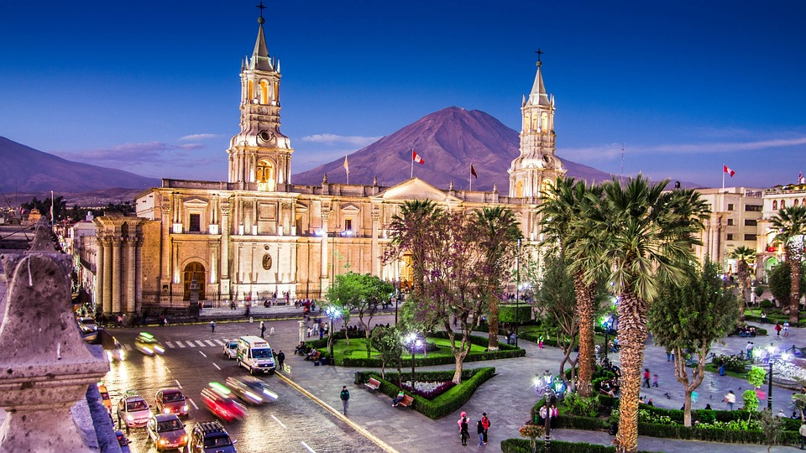
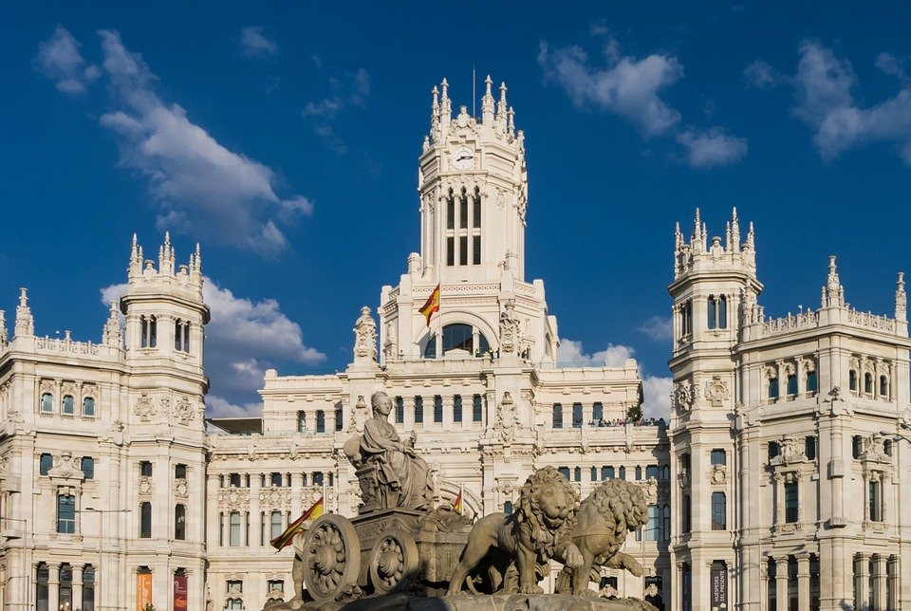
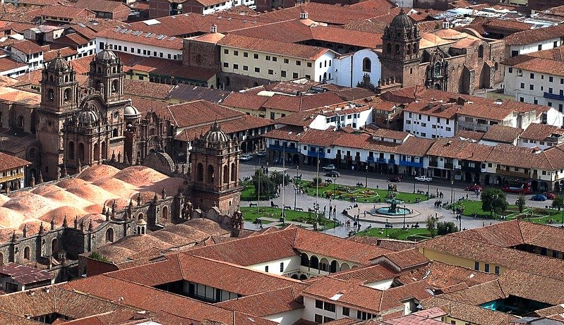
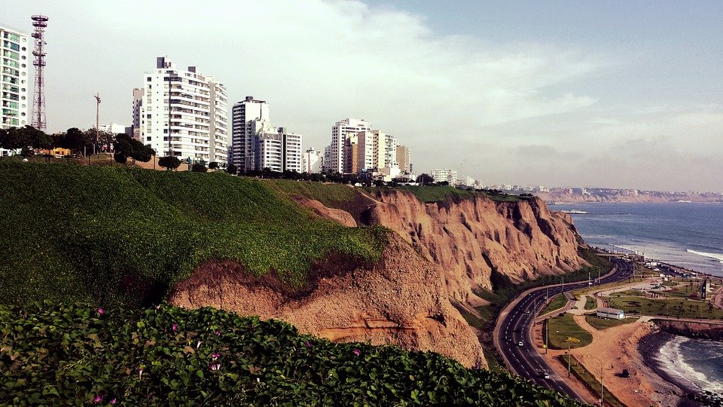
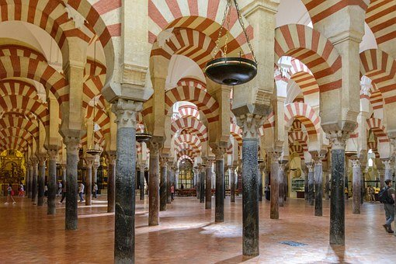
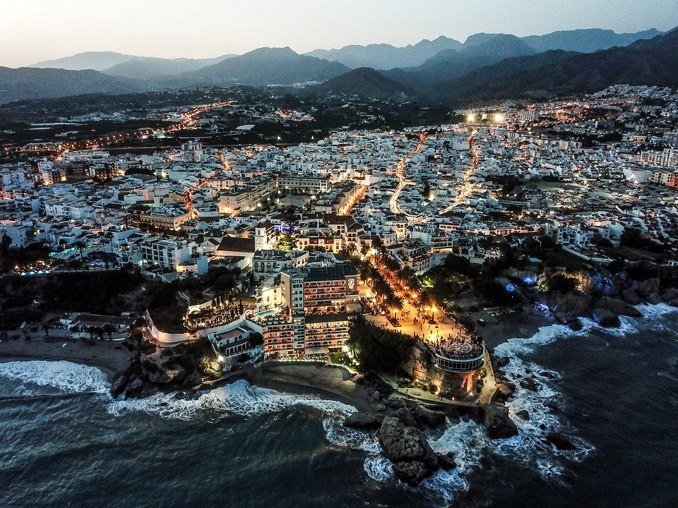
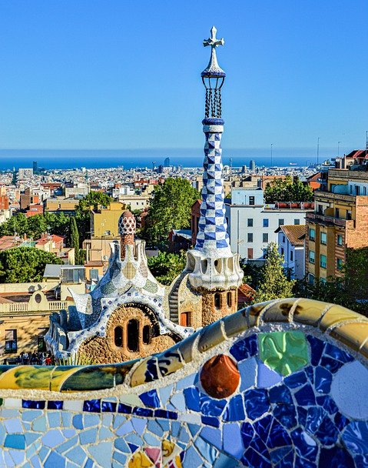
hablar
Persona B
1 | 2 | 3
4 | 5 | 6
Arequipa
Madrid
Cusco
hablar
you are
you are
I am
I am
Lima
Córdoba
Lima
I am
you are
Málaga
España
Inglaterra
I am
you are
I am
Barcelona
Perú
España
you are
I am
you are
Notes:
Do not click to bring up the places until Person A has turned away from the board.
Procedure:
Person A turns away from the board with his/her list of prompts.
Click to bring up the place options.
Person A says his/her first verb ‘estoy’.
Person B answers accordingly ‘en Lima’
Person A records the answer.
Continue with items 2 – 6.
Then swap roles using the next slide.

Slide 18
hablar
Persona A
1 | 2 | 3
4 | 5 | 6
Inglaterra
Córdoba
Lima
hablar
you are
you are
I am
I am
España
Málaga
Madrid
I am
you are
Brasil
Arequipa
Barcelona
I am
you are
I am
Perú
Cusco
Lima
you are
I am
you are
Notes:
Do not click to bring up the places until Person B has turned away from the board.
Procedure:
Person B turns away from the board with his/her list of prompts.
Click to bring up the place options.
Person B says his/her first verb ‘estoy’.
Person A answers accordingly ‘en España’
Person B records the answer.
Continue with items 2 – 6.

Slide 19
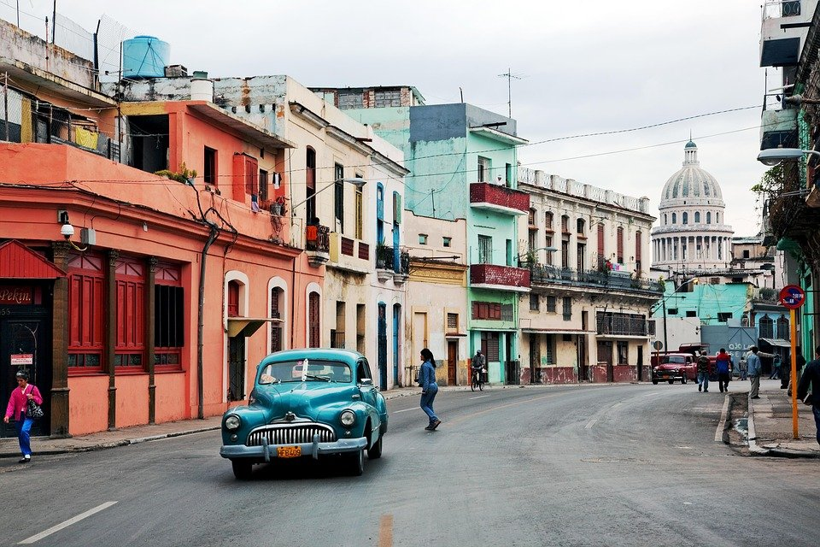
leer
Lee. ¿Dónde está Rubén?
dónde - where
leer
Cuba
La Habana
Perú
Arequipa
España
Barcelona
Madrid
Arequipa
Sofía está en ________________
Notes:
Note: if needed, this task can be done as one of the five follow ups during the week. It is repeated as Follow up 2 for the week.
Timing: 5 minutes
Aim: to see and understand “estoy” + “estás” in an extended reading task.
Procedure:
Read the instructions. Tell pupils Sofía is texting Rubén and we need to figure out where Sofía is.
Read the options in order to practise SSCs and develop pupils’ awareness of Spanish speaking countries and cities. Model pronunciation of “Barcelona” as pupils haven’t encountered [c] yet.
Then play the video with the message exchange (hover the cursor over the word ‘message’ to see play button).
Click to bring the prompt to answer the question “¿Dónde está Sofía?”
Click to bring answer & elicit full answer from pupils.
Note: dónde is glossed here. It is used incidentally in this task, in which predominantly raised intonation questions are practised. Dónde will be introduced formally next week.

Slide 20
¡adiós!
rojo

