Slide 1
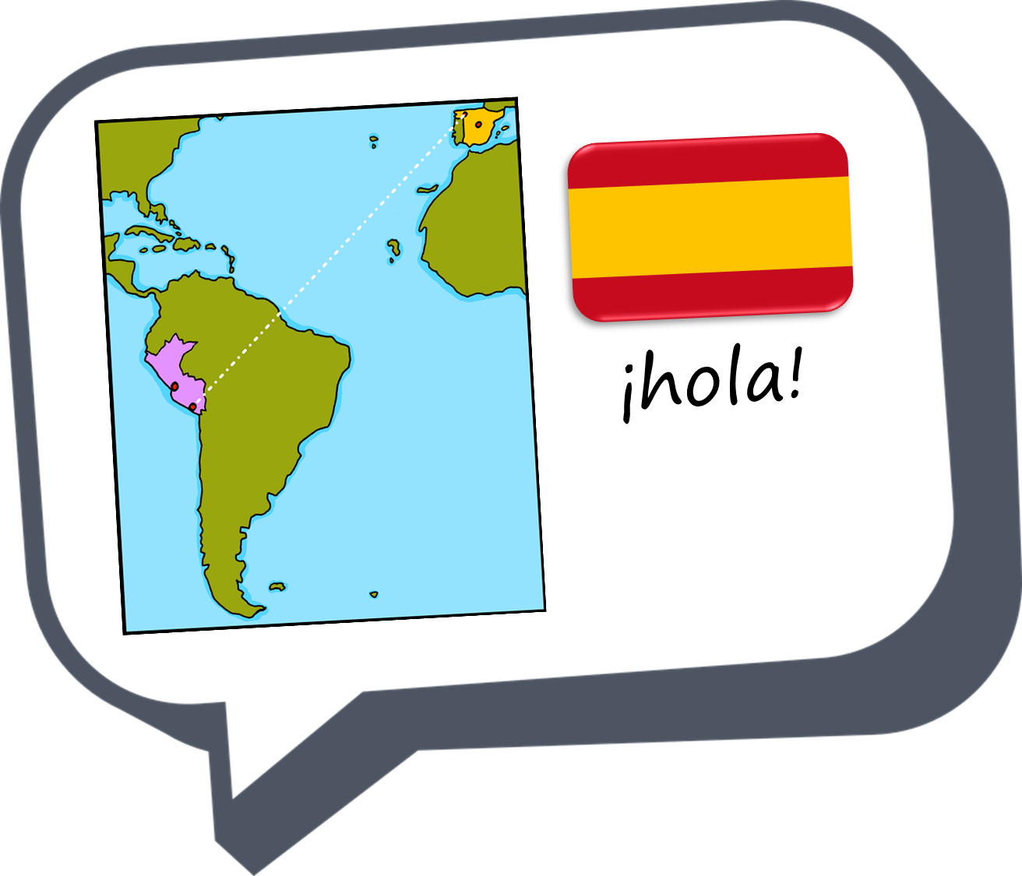


Describing me and others
Answering the register
rojo
español
Follow ups 1-5
Term 1 Week 1
Notes:
Artwork by Steve Clarke. Pronoun pictures from NCELP (www.ncelp.org). All additional pictures selected from Pixabay and are available under a Creative Commons license, no attribution required.
Frequency of new vocabulary and phonics:
Phonics: [a] [o] source: casa [106] dos [64]
Vocabulary: estar [21] estoy [21] está [21] presente [1114] ausente [>5000] aquí [130] allí [197] hola [1245]
to be - I am, s/he is (estar)
Note that this first lesson of the year teaches language that can be continuously recycled as lesson routine every lesson in Y3/4.
The idea would be that the class teacher (whether or not s/he teaches the class Spanish) can re-use the language as part of the daily routine with the class.
The frequency rankings for words that occur in this PowerPoint which have been previously introduced in these resources are given in the SOW and in the resources that first introduced and formally re-visited those words.
For any other words that occur incidentally in this PowerPoint, frequency rankings will be provided in the notes field wherever possible.
Source: Davies, M. & Davies, K. (2018). A frequency dictionary of Spanish: Core vocabulary for learners (2nd ed.). Routledge: London

Slide 2




Follow up 1:
[a]
[o]
casa
dos
A Listen. Which number is it?
C Listen. Which number is it?
[a]
[o]
casa
dos
1
2
2
1
3
3
3
2
‘Casa’ is number _______
‘Dos’ is number _______
B What does it mean? Draw it!
D What does it mean? Draw it!
Notes:
Timing: 5 minutes
Aim: to practise aural comprehension and written production of the SSC [a] and [o].
Procedure:
Click on each audio symbol to listen to the three words.
Click for the number answer.
Click to bring up task B. Give a time limit for the drawing (e.g., 30 seconds). Click to reveal answer picture.
Click to bring up task C.
Click on each audio symbol to listen to the words.
Click for number answer.
Click to bring up task D. Give a time limit for the drawing (e.g., 30 seconds). Click to reveal answer picture.
Transcript
Part A:
[1] Gato
[2] Caña
[3] Casa
Part C:
[1] diez
[2] dos
[3] duo

Slide 3




Follow up 2:
English uses pronouns (I, she, we) to indicate the person who is carrying out the action of the verb.
I play football. We play football.
In Spanish, we often don’t need to use the pronoun.
I am present estoy presente S/he, it is present está presente
Está
it / he / she is
Estoy
I am
Notes:
Timing: 5 minutes (two slides)
Aim: to draw attention to pronouns in English and Spanish and a major difference in their use.
Procedure:
Click to present the information.
Ensure pupils’ understanding of the key terms ‘pronoun’ and ‘verb’.

Slide 4
Follow up 2:
Write the word that you would not need when translating the following sentences into Spanish:
Example: I am here ➡ I am here
He is present. ➡ ______________
She is absent. ➡ _____________
I am there. ➡ ________________
It is here. ➡ _________________
She is here. ➡ _______________
He is present
She is absent.
I am there.
It is here.
She is here.
Notes:
Procedure:
3. Pupils to write the word that they would not need (i.e. the pronoun).
4. Click to share answers.

Slide 5

Follow up 3:
E
2
4
escuchar
1
3
5
A Listen. Does it mention “I am” or “s/he, it” is?
B Use your answers to A. Write the correct verb in Spanish.
Write down the number in the table.
Estoy
Ejemplo: _________ aquí.
_________ ausente.
_________ en clase.
_________ presente.
_________ aquí.
_________ allí.
I am | She / he / it is
E
1
Está
Estoy
2
4
Estoy
3
5
Está
Está
Notes:
Timing: 5 minutes
Aim: to practise aural comprehension of the verbs ‘estoy’ and ‘está’; to practise written recall of the verbs, connecting them with meaning each time.
Procedure:
Click to listen. Pupils write the correct letter/numbers in the table. Click for answers.
Pupils refer to their listening table, and write the corresponding verbs into the gaps in Section B.
Click to reveal answers.
Transcript:
Ejemplo: estoy aquí.
Está ausente.
Estoy en clase.
Estoy presente.
Está aquí.
Está allí.

Slide 6


Follow up 4:
A Listen. Circle the word that is mentioned.
escuchar
E
hablar
absent | here | present
C Play ping pong translation in pairs.
1
here | I am | s/he is
Partner A
ausente
estoy
presente
aquí
en clase
está
allí
Partner B
presente
está
aquí
ausente
allí
en clase
estoy
2
present | here | I am
3
here | in | class
4
absent | I am | present
5
absent | class | s/he is
B Write the number of the matching answer.
4
Taking turns:
Round 1: Challenge each other by testing whether you can translate the new Spanish words into English.
Round 2: Now challenge your partner by asking for the Spanish words.
3
ausente ____ 4. clase ____
aquí ____ 5. está ____
presente ____ 6. estoy ____
1
5
E
2
Notes:
Timing: 10 minutes (though the tasks can be split up over more than one session, as required)
Aim: to practise aural comprehension of this week’s new vocabulary; written comprehension
Procedure:
Click to listen. Pupils circle the correct number (if they have the sheet printed). If not, they can use numbers 1,2.3. Click for answers.
Pupils refer to their listening table, and write the corresponding verbs into the gaps in Section B.
Click to reveal answers.
For part C, get pupils to take turns to test each other their recall of the new vocabulary.
Round 1 – Spanish into English
Round 2 = English into Spanish
Click to cover to words to make it more challenging.
Transcript:
E. presente
1. aquí
2. estoy
3. clase
4. ausente
5. está

Slide 7

Follow up 5:
A Write down the verbs in brackets. Is it “está” or “estoy”?
escribir
1 | [she is] en clase.
2 | [I am] aquí.
3 | [He is] ausente
4 | [She is] allí.
5 | [I am] presente.
Está
She is in class.
Estoy
B Be ready to respond to the register in Spanish! Write down your answer to your teacher:
I am here.
Está
He is absent.
1
2
Está
She is there.
Estoy
I am here.
B Now translate the sentences into English.
Notes:
Timing: 5 minutes
Aim: to practise written production of this week’s two verb forms, and written comprehension of this week’s new vocabulary.
Procedure:
Pupils write the missing verbs.
Then they translate the sentences into English.
Finally they write down how the they will respond to the register when their own name is called, and about anyone who is not there.

Slide 8
¡adiós!
rojo

