Slide 1
español, con Sofía

Slide 2
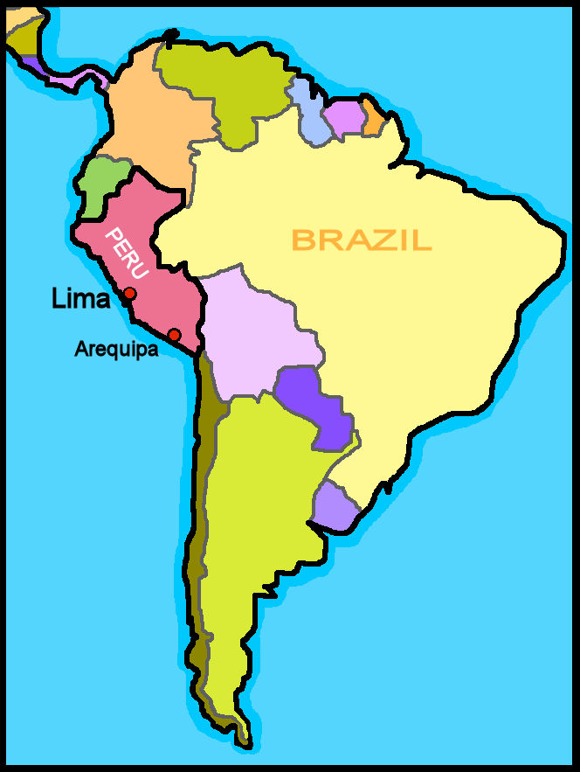
Saying what I and others have
rojo
Postnominal adjective agreement
SSC [z]
Notes:
Artwork by Steve Clarke. All additional pictures selected are available under a Creative Commons license, no attribution required.
The frequency rankings for words that occur in this PowerPoint which have been previously introduced in the resources are given in the SOW (excel document) and in the resources that first introduced and formally re-visited those words.
For any other words that occur incidentally in this PowerPoint, frequency rankings will be provided in the notes field wherever possible.
- Phonics: zapato [1477]
- Vocabulary: familiar [1922] globo [3765] silla [1271] tarta [>5000] regalo [1986] bonito [891] pequeño [202] rojo [534] amarillo [1381]
Revisit 1: tener [19] tengo [19] bolígrafo [>5000] cámara [903] cuaderno [3301] fruta [1925] mochila [>5000] pelota [2270] teléfono [866] un [6] una [6]
Revisit 2: cansado [1818] contento [1949] nervioso [1521] serio [856] tranquilo [1073] ahora [81] ¿cómo? [151]
Frequency of unknown words and cognates: cumpleaños [3372] fiesta [796] primo [1451]
Source: Davies, M. & Davies, K. (2018). A frequency dictionary of Spanish: Core vocabulary for learners (2nd ed.). Routledge: London

Slide 3
[z]
zapato
pronunciar
[Z] always comes before the letters [a] [o] [u]
[z] sounds the same as [c] in front of [e] [i]
Notes:
Timing: 1 minute
Aim: to introduce SSC [z]
Procedure:
Introduce and elicit the pronunciation of the individual SSC [z] and then the source word ‘zapato’ (with gesture, if using).
Click to bring the picture & get pupils to repeat (with gesture, if using).
Suggested gesture: https://www.signbsl.com/sign/shoe
Hold the left hand, palm up, fingers pointing up to create a cupped/cradling shape. Quickly pass the right hand over and through the left, palm down, fingers straight and pointing forwards, to simulate a foot going into a shoe. (Best watched on video on link above, first clip on the left).

Slide 4
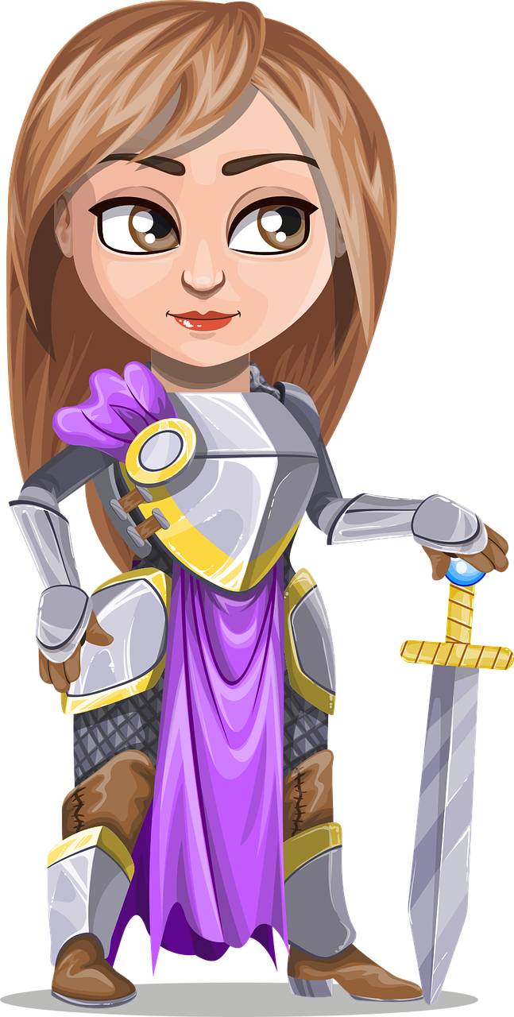
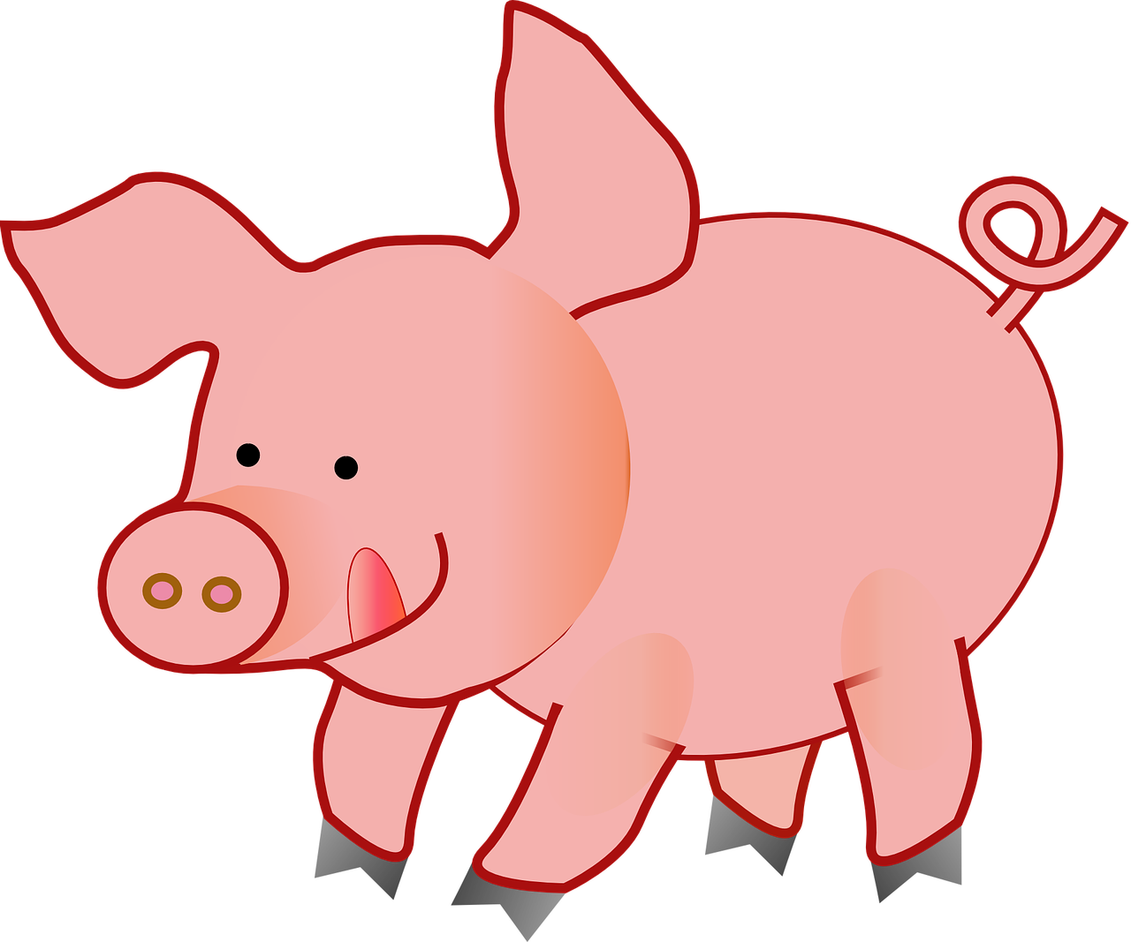
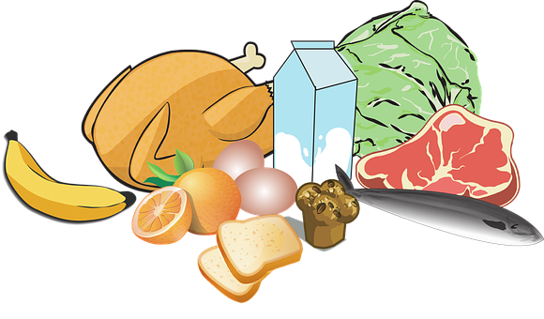
Con tu pareja, pronuncia. Luego, escucha 🔊.
Note! In Latin America [z] and [c] (before e and i)are like [s].
pronunciar
20 segundos
zapato
cerdo
manzana
princesa
cocina
cinco
brazo
azúcar
pareja = partner
luego = then
0
INICIO
Notes:
Timing: 5 minutes
Aim: to apply the spelling rule for SSC [z] (before a, o, u) and [c] (before e, i).
Procedure:
Remind pupils that [z] before a, o, u and [c] before e and i sound the same.
Ask pupils to pronounce the words. Click inicio to start the timer.
Then click on each word to listen and check.

Slide 5
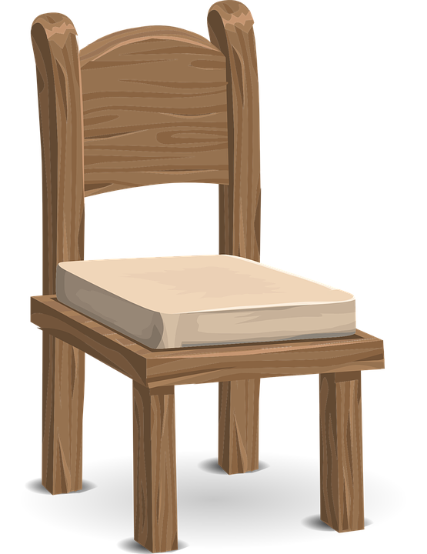
Handout vocabulario
Vocabulario: una fiesta*
¡Hola! Soy Luis, primo* de Sofía y Quique.
a b ñ
vocabulario
vocabulario
vocabulario
vocabulario
vocabulario
amarillo
un regalo
un familiar
una tarta
[a relative]
rojo
un globo
bonito
[pretty]
una silla
pequeño
[small]
fiesta = party
primo = cousin
Notes:
Timing: 4 minutes
Aim: to introduce key vocabulary for the context of the lesson (a birthday party).
Procedure:
Teacher reads the title.
Click to bring the Spanish words for the different items and elicit repetition from pupils.
Note: SSC [ll] hasn’t been introduced yet.
NB. Further practice opportunity in next slide.
Frequency of unknown words and cognates: fiesta [796] primo [1451]
Source: Davies, M. & Davies, K. (2018). A frequency dictionary of Spanish: Core vocabulary for learners (2nd ed.). Routledge: London

Slide 6
hablar
Una fiesta de cumpleaños
Clasifica el vocabulario.
leer
= noun
nombres
adjetivos
una cámara
pequeño
una pelota
feliz
happy
small
elegant
a present
a ball
a balloon
a bicycle
un regalo
pretty
elegante
un globo
bonito
una bici
una cámara
una pelota
elegante
pequeño
feliz
bonito
un globo
un regalo
una bici
fiesta = party
cumpleaños = birthday
Notes:
Timing: 5 minutes
Aim: to recap previously introduced vocabulary by being able to classify the words by their grammatical category.
Procedure:
Teacher reads the title of the activity (also the context of this lesson – A birthday party) and elicits English translation from pupils.
Click to bring Spanish instruction and read out loud. Draw pupils’ attention to the two categories (adjetivos & nombres). The first one is a cognate.
Pupils work in pairs to classify the words in the two categories, saying them aloud.
Elicit answers from pupils. Answers are animated (x2 clicks per word – x1 for exit animation + x1 for entrance) – left to right.
Frequency of unknown words and cognates: fiesta [796] cumpleaños [3372]
Source: Davies, M. & Davies, K. (2018). A frequency dictionary of Spanish: Core vocabulary for learners (2nd ed.). Routledge: London

Slide 7
Adjectives following the noun
In Spanish, many adjectives follow the noun:
Spanish tells you what it is, and then how it is.
un estuche amarillo
una tarta bonita
a yellow pencil case
a pretty cake
un amigo feliz
In English the adjective comes before the noun.
a happy (male) friend
Notes:
Timing: 2 minutes
Aim: to introduce postnominal adjective agreement.
Procedure:
Click through the animations to present the new information.
Elicit English translations for the Spanish examples provided.
NB. There is a separate slide with a reminder on regular agreement.

Slide 8
leer
Sofía plans a party for Ángela.
Remember: In English the adjective comes before the noun.
Lee la lista*. ¿Cómo es?
E
una tarta pequeña
Escribe en inglés . .
1
E
1
2
3
4
5
una silla pequeña
a small cake
a small chair
2
un familiar feliz
a happy relative
3
un regalo bonito
a pretty gift
4
un globo amarillo
a yellow balloon
5
una amiga curiosa
a curious (female) friend
¿ayuda? 🆘
Use the words to help you.
la lista ⬇
a female friend | pretty | comfortable | a relative | a chair | a gift
yellow | curious | a cake | happy | a balloon | small
Notes:
Timing: 5 minutes
Aim: to practise written comprehension vocabulary and processing of the word order change from Spanish to English.
Procedure:
Read the title to set the scene and the instruction in Spanish. Ensure pupils understand the question ‘¿Cómo es?’ (What is it like?).
Explain that this is a list of items for Ángela’s party.
Click to bring up further instruction (‘escribe en inglés’) and read the speech bubble with the reminder re word order in English.
If pupils need further support, click on ‘ayuda’ to bring up the words to help them.
Do [E] with them to model the task. Click through the animations to make obvious to pupils they will have to rephrase their translations to make them sound natural in English.
Note: More able pupils can approach the translation without looking at the words below.

Slide 9
Adjectives following the noun
💡 Remember, adjectives change depending on whether they describe a masculine or feminine noun.
masculine noun
feminine noun
un estuche amarillo
una tarta bonita
a yellow pencil case
a pretty cake
una amiga feliz
When an adjective ends in –e or -z it can describe a masculine OR a feminine noun.
a happy (female) friend
un amigo feliz
a happy (male) friend
Notes:
Timing: 1 minute
Aim: to reintroduce adjective agreement, in combination with position of adjectives (postnominal).
Procedure:
Click through the animations to present the new information.
Elicit English translations for the Spanish examples provided.
Callout 1 reminds pupils about gender agreement of adjectives ending in –e & -z

Slide 10
escuchar
Sofía tiene una fiesta. ¡Ángela tiene una fiesta también!
escuchar
Escucha y rodea el adjetivo.
escuchar
Escribe en inglés . .
descripción | objeto
amarillo / amarilla
pequeño / pequeña
bonito / bonita
rojo / roja
feliz / bonita
curioso / curiosa
E
a present
1
a chair
2
a cake
3
a ball
4
a relative (f/m)
5
a (male) friend
Notes:
Timing: 7 minutes [2 slides]
Aim: to practise both retrieval of vocabulary and processing of the word order change from Spanish to English; to revisit ‘tengo’ & ‘tienes’.
Procedure:
Read the context and click to bring up further instruction.
Pupils write 1-5 in their books
Click to listen to the example. Pupils circle / write the correct form of the adjective & write the object mentioned.
Complete the task with items 1-5 x2.
Click to reveal answers.
Nex slide – Part 2. (listening out for ‘tengo’ & ‘tienes’) with the 2nd set of audio buttons (with full sentences).
Pupils to listen one more time and tick whether it is Sofia talking about her party (Tengo) or asking Ángela about her party (¿tienes…?).
Transcript:
Ej. Tienes un regalo [amarillo].
Tengo una silla [pequeña].
Tienes una tarta [bonita].
Tienes una pelota [roja].
Tengo un familiar [feliz].
Tengo un amigo [curioso].
Listen and check transcript:
Ej. Tienes un regalo amarillo.
Tengo una silla pequeña.
Tienes una tarta bonita.
Tienes una pelota roja.
Tengo un familiar feliz.
Tengo un amigo curioso.

Slide 11
escuchar
Does Sofía talk to Ángela about Angela’s party or about her own?
escuchar
Esucha otra vez* y marca .
escuchar
descripción | objeto
amarillo / amarilla
pequeño / pequeña
bonito / bonita
rojo / roja
feliz / bonita
curioso / curiosa
I have | you have
a present
E
a chair
1
a cake
2
a ball
3
a relative (f/m)
4
a (male) friend
5
otra vez = again
Notes:
Timing: 7 minutes
Aim: to practise both retrieval of vocabulary and processing of the word order change from Spanish to English; to revisit ‘tengo’ & ‘tienes’.
Procedure:
Click to bring up part 2 of the task (listening out for ‘tengo’ & ‘tienes’) with the 2nd set of audio buttons (with full sentences).
Pupils to listen one more time and tick whether it is Sofia talking about her party (Tengo) or asking Ángela about her party (¿tienes…?).
Transcript:
Ej. Tienes un regalo [amarillo].
Tengo una silla [pequeña].
Tienes una tarta [bonita].
Tienes una pelota [roja].
Tengo un familiar [feliz].
Tengo un amigo [curioso].
Listen and check transcript:
Ej. Tienes un regalo amarillo.
Tengo una silla pequeña.
Tienes una tarta bonita.
Tienes una pelota roja.
Tengo un familiar feliz.
Tengo un amigo curioso.

Slide 12
¡adiós!
rojo

