Slide 1


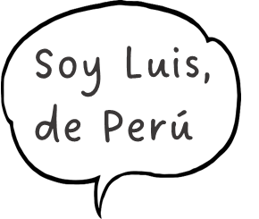
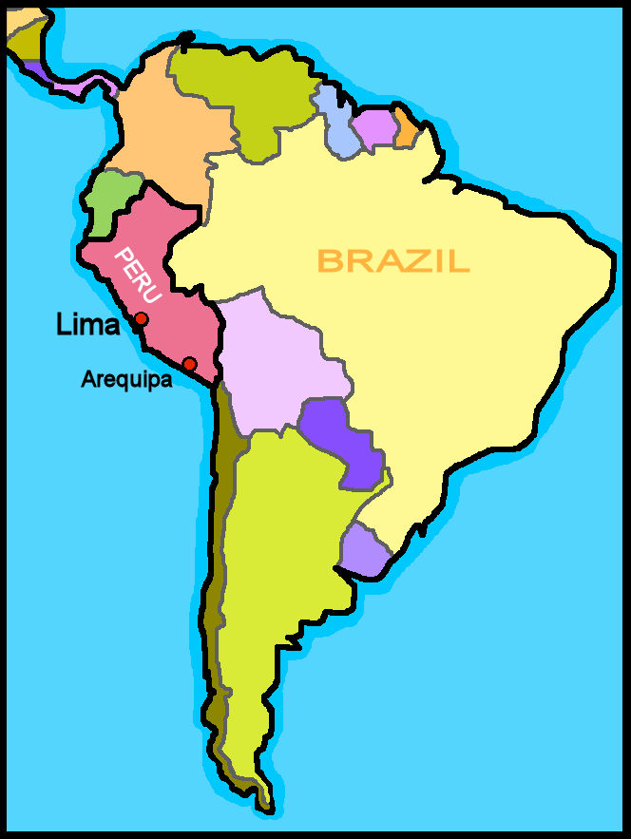
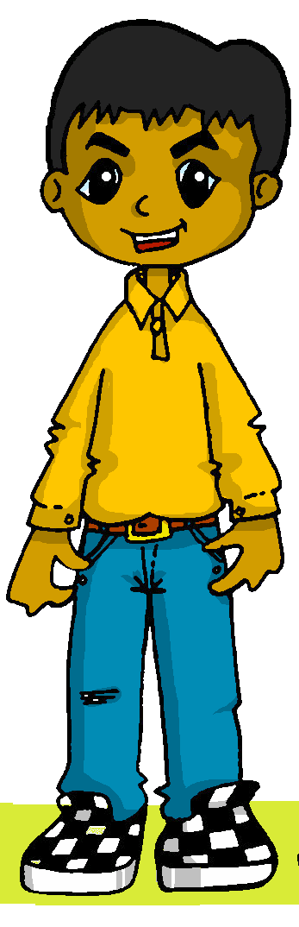




Saying what I and others have
rojo
Follow ups 1-5
Notes:
Artwork by Steve Clarke. All additional pictures selected are available under a Creative Commons license, no attribution required.
The frequency rankings for words that occur in this PowerPoint which have been previously introduced in the resources are given in the SOW (excel document) and in the resources that first introduced and formally re-visited those words.
For any other words that occur incidentally in this PowerPoint, frequency rankings will be provided in the notes field wherever possible.
- Phonics: zapato [1477]
- Vocabulary: familiar [1922] globo [3765] silla [1271] tarta [>5000] regalo [1986] bonito [891] pequeño [202] rojo [534] amarillo [1381]
Revisit 1: tener [19] tengo [19] bolígrafo [>5000] cámara [903] cuaderno [3301] fruta [1925] mochila [>5000] pelota [2270] teléfono [866] un [6] una [6]
Revisit 2: cansado [1818] contento [1949] nervioso [1521] serio [856] tranquilo [1073] ahora [81] ¿cómo? [151]
Frequency of unknown words and cognates:
adivinar [2201] ciudad [178] espalda [942] compañero [551]
Source: Davies, M. & Davies, K. (2018). A frequency dictionary of Spanish: Core vocabulary for learners (2nd ed.). Routledge: London

Slide 2



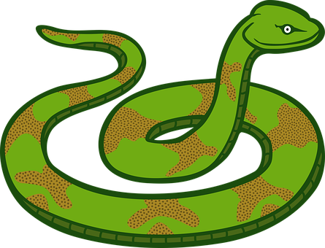



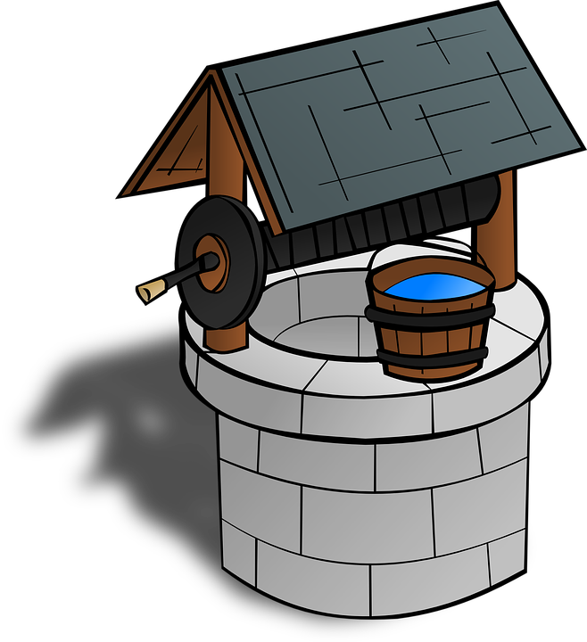
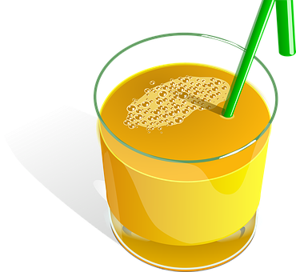
Follow up 1
[z] zapato
[z] sounds the same as [c] in front of [e] [i].
[A]
Escucha y marca .
[B]
pronunciar
Sounds like ‘s’ in snake
Sounds like ‘th’ in ‘Theo’
Escribe 📝en la espalda* una ciudad.
Un compañero/a, adivina.
 | s | z
 |  |  | co _ _
 |  |  | ca _ _
 |  |  | pa _ _
 |  |  | _ _ na
 |  |  | po _ _
 |  |  | _ _ mo
¿Es [____] ?
Is it…?
E
s a
Zamora
1
z a
Cádiz
Ceuta
so
Cáceres
2
Valencia
Salamanca
3
zo
Zaragoza
zo
Plasencia
Zafra
4
Albacete
5
zu
Puzol
compañero = partner
adivina = guess
la espalda = the back
ciudad = city
Notes:
Timing: 5 minutes
Aim: to develop phonological awareness of [z] in contrast with [s]
Procedure:
Read the instruction and clarify meaning.
Click to bring up speech bubble and ensure pupils are confident with the two SSCs.
Do E with them.
Pupils tick and/or write the correct sound [s] [z]
Part B
Click to bring up reminder of [z] [ce] [ci] sound correlation & instructions.
Partner A writes down one city, partner B tries to guess by asking ‘¿es…? + one of the cities on the board.
Teachers circulate to listen to pupils’ pronunciation and praise/correct as necessary.
Transcript
[EJ] cosa
[1] caza
[2] paso
[3] zona
[4] pozo
[5] zumo

Slide 3


Follow up 2:
Vocabulario
a b ñ
¡Excelente! 🤗
vocabulario
vocabulario
un regalo
amarilla
pequeño
tiene
tengo
una
yellow (f)
happy
small (m)
a gift
a cake
comfortable (m)
s/he has
a / an (f)
a book
a relative
do you have
I have
un libro
¿tienes…?
un familiar
feliz
cómodo
una tarta
Notes:
Timing: 5 minutes
Aim: to practise written comprehension and spoken pronunciation of vocabulary for this week and the revisited weeks.
Procedure:
1. Click for English prompt. Pupils need to locate the correct Spanish word and pronounce it, chorally.
2. Click for target word to be highlighted.
3. Repeat for all 12 items.

Slide 4


Follow up 3:
Escribe en el grupo correcto 📝.
leer
The ending changes when the noun is masculine/feminine
The ending is the same for a masculine/feminine noun
serio
feliz
bonito
rápida
elegante
pequeña
triste
-o
- When referring to a singular masculine noun, these adjectives end in _______
- When referring to a singular feminine noun, these adjectives end in ____
- Adjectives ending in ______ or –z have the same ending for a masculine/feminine noun.
-a
-e
Notes:
Timing: 5 minutes
Aim: to revisit the rule for regular gender adjectival agreement.
Procedure:
1. Read the instruction in Spanish.
2. Pupils have to arrange the adjectives in the two different categories (all previously introduced, including Week 12 new items – pequeño / bonito).
3. Once the words are arranged, ask them to complete the rule.

Slide 5



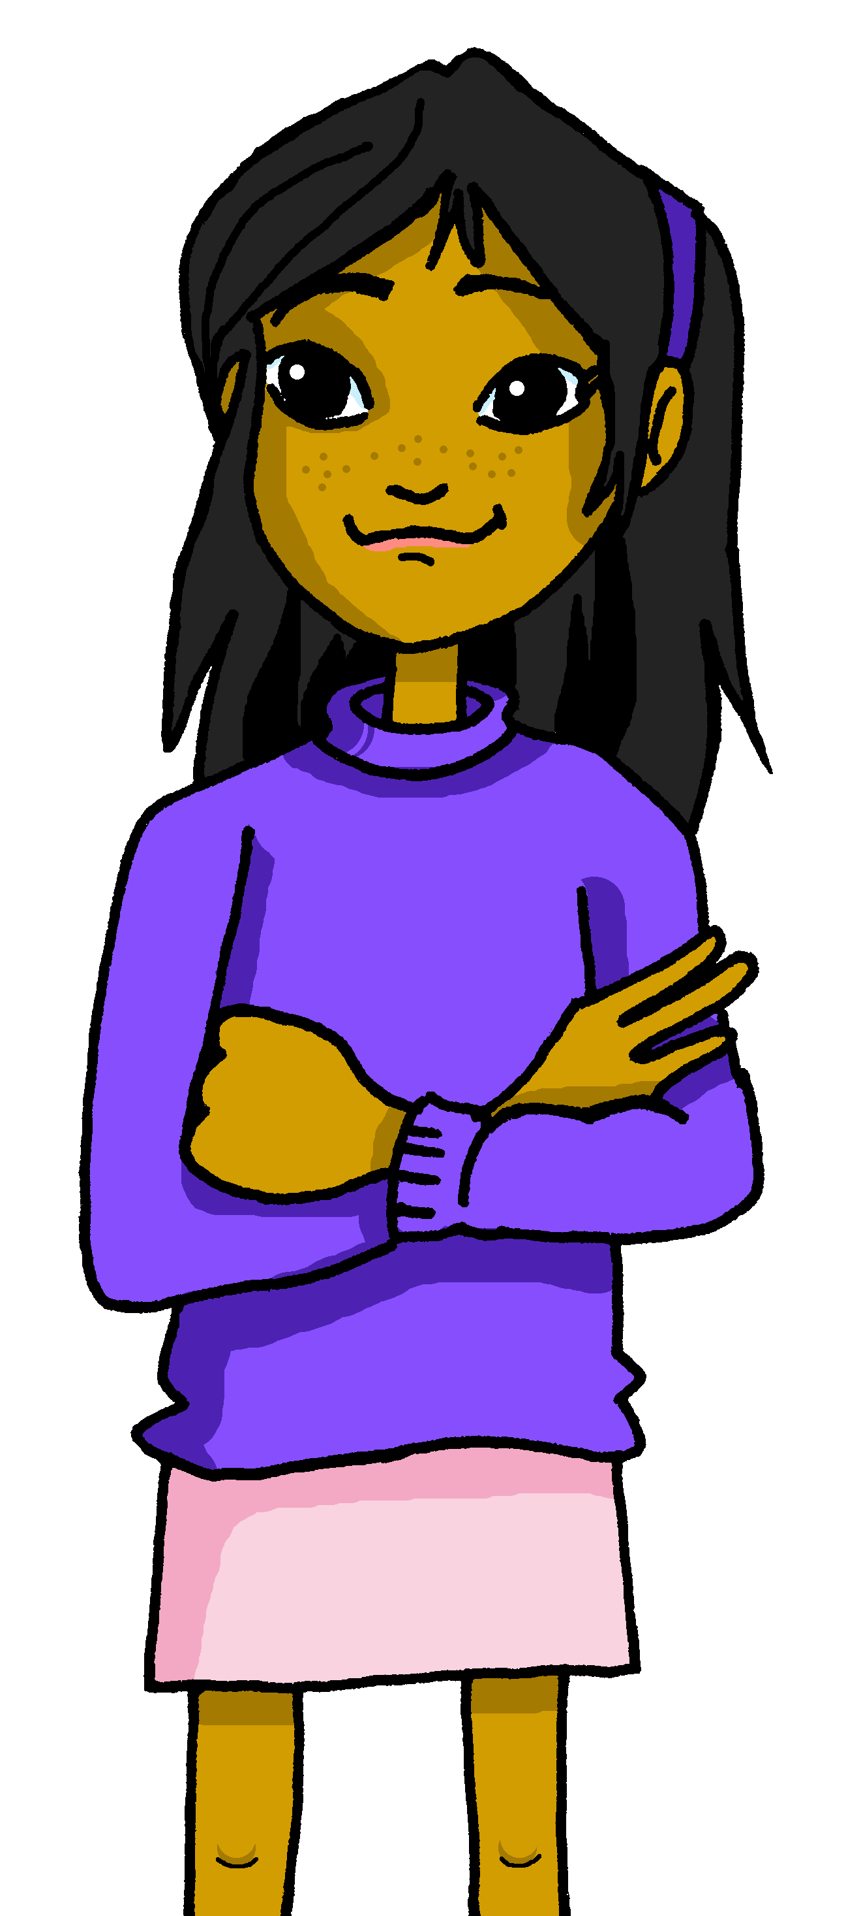

Yes/no questions
Remember! Turn a statement into a yes/no question by making
your voice go up at the end.
Tengo un libro.
I have a book.
¿Tengo un libro?
Do I have a book?
Remember how to say ‘you have’:
Tienes un libro.
You have a book.
Ask someone else ‘do you have?’ using tienes and making your voice go up.
¿Tienes un libro?
Do you have a book?
Notes:
Do this recap slide before Follow up 4.
Timing: 2 minutes
Aim: to recap tengo, tienes and raised intonation questions.
Procedure:
1. Click to bring up each new part of the explanation.
2. Elicit the English for the Spanish examples.

Slide 6

Follow up 4:
¿Qué es en español?
You do not need all of the words!
[1/5]
hablar
Do I have a small cake?
¿Tengo una tarta pequeña?
20 segundos
una
un
tienes
tarta
pequeño
tengo
pequeña
triste
INICIO
Notes:
[1/5]
Time: 6-8 minutes (5 slides)
Aim: to practise oral sentence building. Targeted features: postnominal regular gender agreement | revisit tengo / tienes / tiene | raised intonation questions.
Procedure:
1. Click for English sentence and Spanish prompt words.
2. Click inicio to start the timer.
3. Pupils select from the words given to create and say the sentence out loud before the time elapses.
4. Click for the Spanish sentence to appear.

Slide 7
Follow up 4:
¿Qué es en español?
You do not need all of the words!
[2/5]
hablar
I have a pretty (male) cat.
Tengo un gato bonito.
20 segundos
bonita
gato
un
tiene
tengo
una
bonito
INICIO
Notes:
[2/5]
Time: 6-8 minutes (5 slides)
Aim: to practise oral sentence building. Targeted features: postnominal regular gender agreement | revisit tengo / tienes / tiene | raised intonation questions.
Procedure:
1. Click for English sentence and Spanish prompt words.
2. Click inicio to start the timer.
3. Pupils select from the words given to create and say the sentence out loud before the time elapses.
4. Click for the Spanish sentence to appear.

Slide 8
Follow up 4:
¿Qué es en español?
You do not need all of the words!
[3/5]
hablar
You have a red chair.
Tienes una silla cómoda.
20 segundos
rojo
silla
un
tienes
roja
una
cómodo
INICIO
Notes:
[3/5]
Time: 6-8 minutes (5 slides)
Aim: to practise oral sentence building. Targeted features: postnominal regular gender agreement | revisit tengo / tienes / tiene | raised intonation questions.
Procedure:
1. Click for English sentence and Spanish prompt words.
2. Click inicio to start the timer.
3. Pupils select from the words given to create and say the sentence out loud before the time elapses.
4. Click for the Spanish sentence to appear.

Slide 9
Follow up 4:
¿Qué es en español?
[4/5]
Remember: To ask someone else ‘do you have?’ using tienes, you make your voice go up.
You do not need all of the words!
hablar
Do you have a yellow gift?
¿Tienes un regalo amarillo?
20 segundos
tengo
una
un
amarillo
amarilla
regalo
globo
tienes
INICIO
Notes:
[4/5]
Time: 6-8 minutes (5 slides)
Aim: to practise oral sentence building. Targeted features: postnominal regular gender agreement | revisit tengo / tienes / tiene | raised intonation questions.
Procedure:
1. Click for English sentence and Spanish prompt words.
2. Click inicio to start the timer.
3. Pupils select from the words given to create and say the sentence out loud before the time elapses.
4. Click for the Spanish sentence to appear.

Slide 10
Follow up 4:
¿Qué es en español?
You do not need all of the words!
[5/5]
hablar
Do you have a happy (male) friend?
¿Tienes un amigo feliz?
20 segundos
amigo
amiga
tranquilo
feliz
tiene
una
tienes
un
INICIO
Notes:
[5/5]
Time: 6-8 minutes (5 slides)
Aim: to practise oral sentence building. Targeted features: postnominal regular gender agreement | revisit tengo / tienes / tiene | raised intonation questions.
Procedure:
1. Click for English sentence and Spanish prompt words.
2. Click inicio to start the timer.
3. Pupils select from the words given to create and say the sentence out loud before the time elapses.
4. Click for the Spanish sentence to appear.

Slide 11



Follow up 5a:
Escribe en inglés 📝.
a b ñ
Can you get at least15 points?
vocabulario
 | nerviosa | tranquilo | now
 | cansado | contenta | how?
 | tener | un bolígrafo | un cuaderno
 | un teléfono | a / an (feminine) | una mochila
 | una tarta | bonito | amarillo
 | pequeña | rojo | un regalo
 | un/una familiar | un globo | una silla
nervous (f)
calm (m)
ahora
x3
tired (m)
pleased (f)
¿cómo?
to have, having
a pen
a exercise book
x2
a phone
una
a school bag
a cake
pretty
yellow
small (f)
red
a present, gift
x1
a relative
a balloon
a chair
Notes:
Timing: 6 minutes
Aim: to practise written production of vocabulary for this week and previous weeks.
Procedure:
1. Pupils need to write the Spanish for as many words as possible, aiming to get at least 15 points (but more if possible).
2. Click for Spanish answers.
Note:
The most recently learnt and practised words are pink, words from the previous week are green and those from two weeks ago are blue, thus more points are awarded for them, to recognise that memories fade and more effort (heavy lifting!) is needed to retrieve them.

Slide 12
Follow up 5b:
Escribe en español 📝.
a b ñ
vocabulario
Can you get at least15 points?
 | tired (m) | calm (f) | nervous (m)
 | now | pleased (f) | how?
 | a phone | a school bag | to have / having
 | a pen | a / an (feminine) | a exercise book
 | small (m) | a cake | a present
 | red (m) | yellow (f) | a chair
 | pretty (m) | a balloon | a relative (m/f)
cansado
tranquila
nervioso
ahora
contenta
¿cómo?
x3
un teléfono
una mochila
tener
x2
un bolígrafo
una
un cuaderno
pequeño
una tarta
un regalo
rojo
amarilla
una silla
x1
bonito
un globo
un/una familiar
Notes:
Timing: 6 minutes
Aim: to practise written comprehension of vocabulary from last week and this week.
Procedure:
1. Pupils need to write the Spanish for as many words as possible, aiming to get at least 15 points (but more if possible).
2. Click for Spanish answers.
Note:
The most recently learnt and practised words are pink, words from the previous week are green and those from two weeks ago are blue, thus more points are awarded for them, to recognise that memories fade and more effort (heavy lifting!) is needed to retrieve them.

Slide 13
Handout: Follow up 5a
Follow up 5a:
Escribe en inglés 📝.
a b ñ
Can you get at least15 points?
vocabulario
 | nerviosa | tranquilo | now
 | cansado | contenta | how?
 | tener | un bolígrafo | un cuaderno
 | un teléfono | a / an (feminine) | una mochila
 | una tarta | bonito | amarillo
 | pequeña | rojo | un regalo
 | un/una familiar | un globo | una silla
x3
x2
x1
Notes:
Timing: 6 minutes
Aim: to practise written production of vocabulary for this week and previous weeks.
Procedure:
1. Pupils need to write the Spanish for as many words as possible, aiming to get at least 15 points (but more if possible).
2. Click for Spanish answers.
Note:
The most recently learnt and practised words are pink, words from the previous week are green and those from two weeks ago are blue, thus more points are awarded for them, to recognise that memories fade and more effort (heavy lifting!) is needed to retrieve them.

Slide 14
Handout: Follow up 5b
Follow up 5b:
Escribe en español 📝.
a b ñ
vocabulario
Can you get at least15 points?
 | tired (m) | calm (f) | nervous (m)
 | now | pleased (f) | how?
 | a phone | a school bag | to have / having
 | a pen | a / an (feminine) | a exercise book
 | small (m) | a cake | a present
 | red (m) | yellow (f) | a chair
 | pretty (m) | a balloon | a relative (m/f)
x3
x2
x1
Notes:
Timing: 6 minutes
Aim: to practise written comprehension of vocabulary from last week and this week.
Procedure:
1. Pupils need to write the Spanish for as many words as possible, aiming to get at least 15 points (but more if possible).
2. Click for Spanish answers.
Note:
The most recently learnt and practised words are pink, words from the previous week are green and those from two weeks ago are blue, thus more points are awarded for them, to recognise that memories fade and more effort (heavy lifting!) is needed to retrieve them.

