Slide 1
español, con Sofía

Slide 2
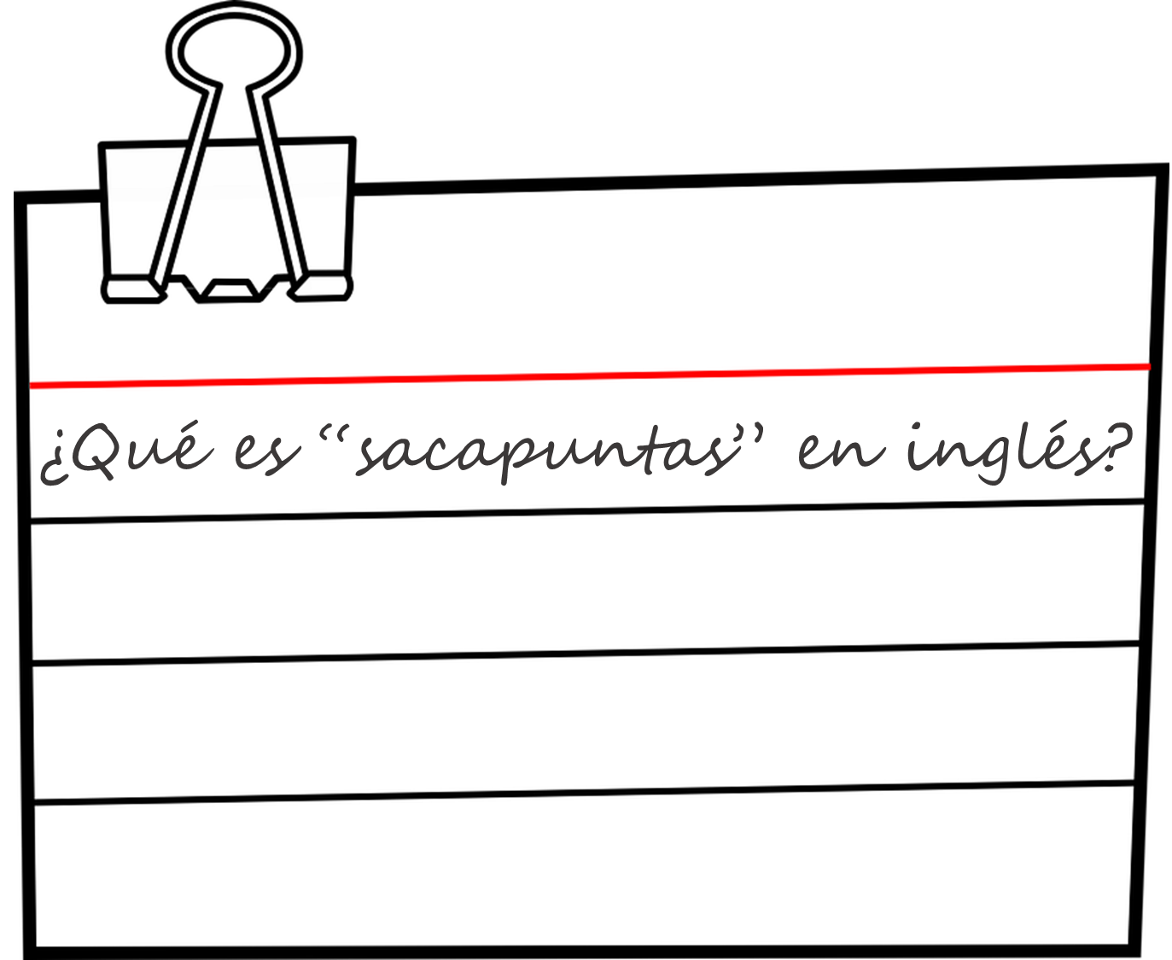
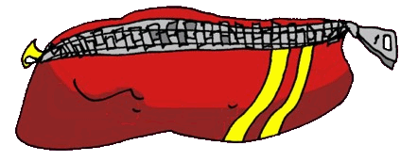
Describing me and others
¿Qué tienes?
rojo
‘tener’: 1st & 3rd person plural
SSC [ce] [ci]
Notes:
Artwork by Steve Clarke. All additional pictures selected are available under a Creative Commons license, no attribution required.
The frequency rankings for words that occur in this PowerPoint which have been previously introduced in the resources are given in the SOW (excel document) and in the resources that first introduced and formally re-visited those words.
For any other words that occur incidentally in this PowerPoint, frequency rankings will be provided in the notes field wherever possible.
Phonics: SSC: decir [32] centro [317] cluster: cerca [1042] celebrar [886] dulce [1861] cero [1731] cocina [1214]
Vocabulary: tienes [19] amigo [210] bolígrafo [>5000] botella [1878] gato [1728] libro [230] pregunta [507] respuesta [488] sacapuntas [>5000] estuche [>5000]
Revisit 1: qué [50] día [65] lunes [1370] martes [3101] miércoles [1816] jueves [1650] viernes [1259] sábado [1179] domingo [693] Revisit 2: estás [21] sí [45] no [11] en1 [5] ¡Buenos días! [103/65] ¡Buenas tardes! [103/392]
Frequency of unknown words and cognates: adivinar [2201] conectar [1973] palabra [192] posible [427] el [1] la [1]
Source: Davies, M. & Davies, K. (2018). A frequency dictionary of Spanish: Core vocabulary for learners (2nd ed.). Routledge: London

Slide 3
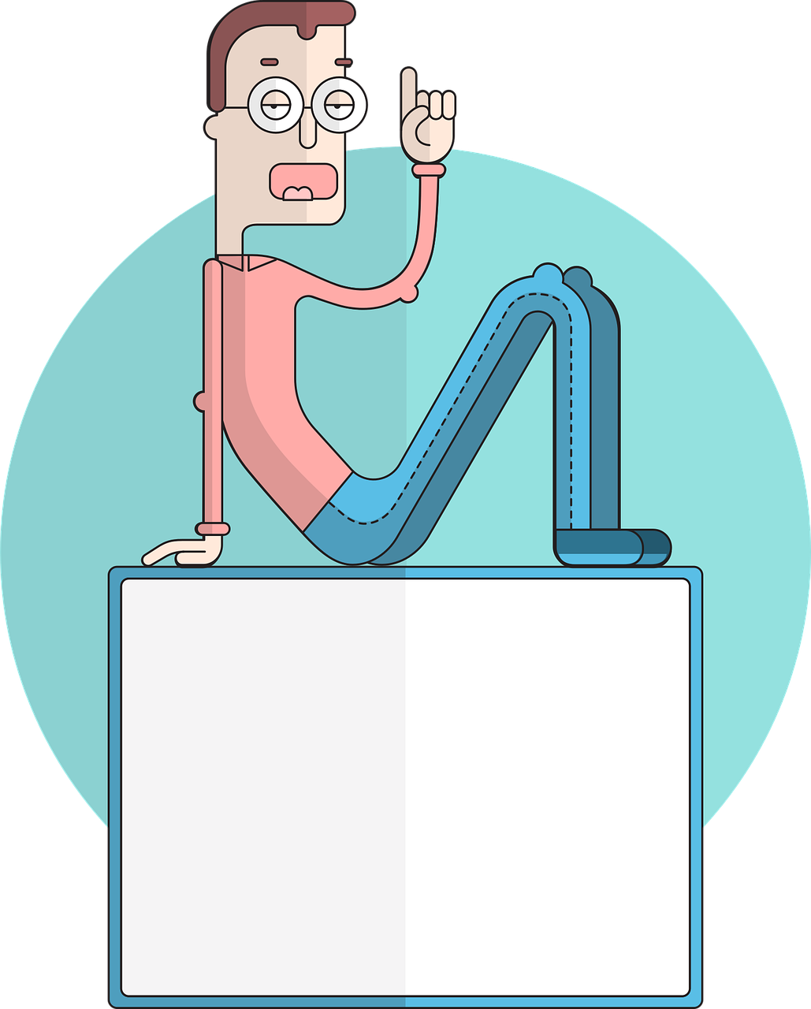
pronunciar
[ci]
decir
[to say, tell]
[ce]
centro
Notes:
Timing: 1 minute
Aim: to revisit SSC [ce] and [ci]
Procedure:
Present and elicit the pronunciation of the individual SSC [ci] and then the source word ‘decir’ (with gesture, if using).
Click to bring up the picture and get pupils to repeat (with gesture, if using).
Present and elicit the pronunciation of the individual SSC [ce] and then the source word ‘centro’ (with gesture, if using).
Click to bring up the picture and get pupils to repeat (with gesture, if using).
Suggested gestures: i) For ‘centre’, pupils can bring their two index fingers together to touch as per the image where arrows converge in a central point.
ii) British sign language for ‘say’ is to lift the right index finger to mouth and then direct it quickly away from the body (as though tracing the trajectory of a string of words coming out of the mouth towards a listener in front). For a video, see here: https://www.signbsl.com/sign/say

Slide 4
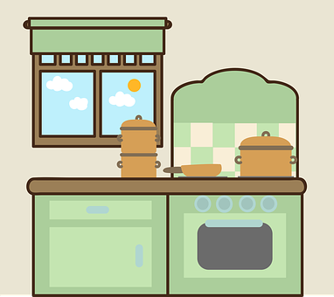
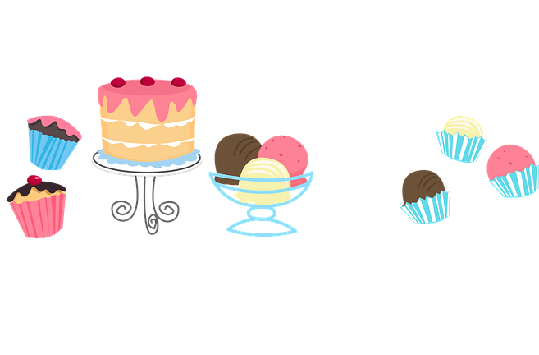
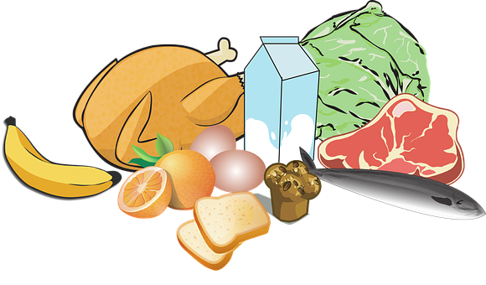
pronunciar
Sofía wants to cross the river.
conecta = connect
palabra = word
Conecta* palabras* con [ce] [ci].
1 minuto
cena
chocolate
cocina
coche
celebrar
0
dulces
cero
comida
100
cera
cien
[wax]
0
INICIO
Notes:
Timing: 2 minutes
Aim: to apply SSC [ce] [ci]
Clarify the context of the task to pupils.
Click to bring up instruction in Spanish and check understanding.
Pupils work in pairs to say out say aloud the words with [ce] [ci] sound in order to help Sofia cross the river.
Elicit answer answers from pupils – click to bring up animations and connect words with [ce] [ci]
NB.. There is more than one correct path:
Dulces – cerca – cien – celebrar – cero – cocina (animated)
Dulces – cena – celebrar – cero – cocina
Dulces – cerca – celebrar –cero – cocina
Frequency of unknown words and cognates: celebrar [886] conectar [1973] cero [1731] cocina [1214] dulce [1861] palabra [192] cerca [1042]
Source: Davies, M. & Davies, K. (2018). A frequency dictionary of Spanish: Core vocabulary for learners (2nd ed.). Routledge: London

Slide 5
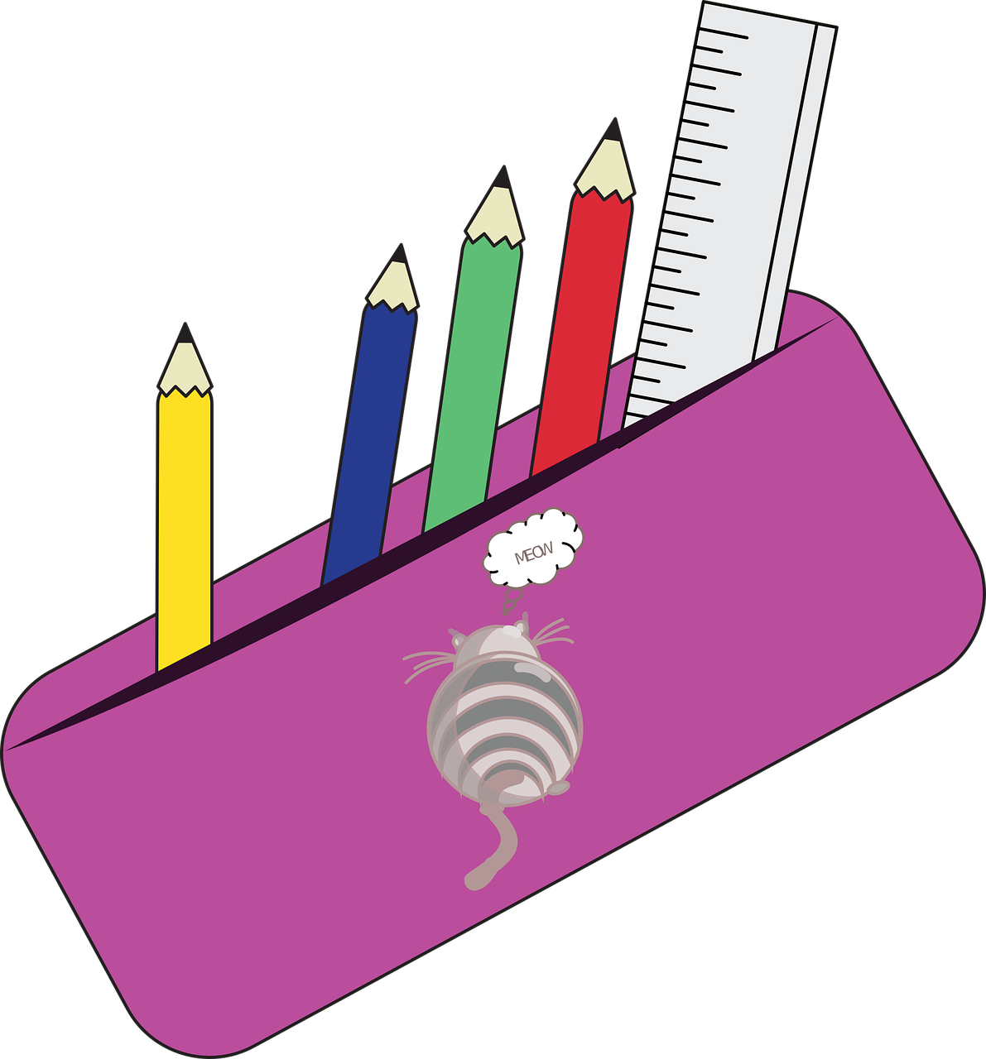
Handout vocabulario
¿Qué es en español?
a b ñ
vocabulario
vocabulario
vocabulario
vocabulario
vocabulario
una pregunta
un libro
una amiga
un gato
un
estuche
un sacapuntas
una respuesta
una botella
a pencil sharpener
a pencil
case
a female friend
a question
a bottle
a book
a cat
an answer
Notes:
Timing: 3 minutes
Aim: to revisit two words from last week’s vocabulary and introduce six new nouns for this week.
Procedure: 1. Click for an English prompt.
2. Elicit the Spanish word from pupils. 3. Continue until all 8 items have been seen and heard.
Note: The new words are also illustrated with a picture (apart from “respuestas” which have been left towards the end so that pupils can use prior knowledge to work out meaning); previously learnt words are not illustrated.

Slide 6
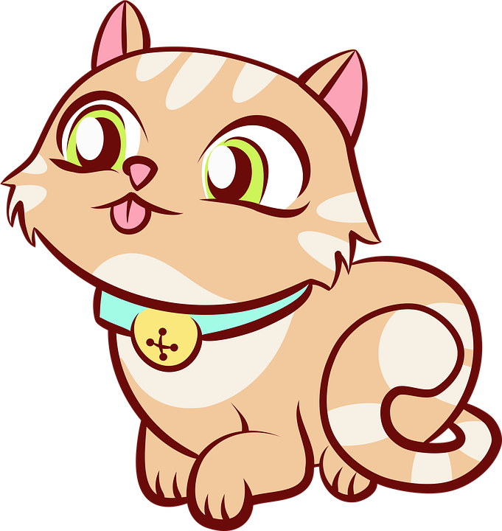
leer
¿Es posible [P] o imposible [I] ?
Escribe 1 – 7 y [P] o [I].
1
Tengo una botella.
Tengo un sacapuntas.
Tengo un libro.
Tengo una amiga.
Tengo un gato.
Tengo una pregunta.
Tengo un boli.
[I]
2
[P]
3
[I]
4
[I]
En mi estuche, …
5
[P]
6
[P]
7
[P]
Notes:
Timing: 5 minutes
Aim: to practise connection of the correct singular indefinite article with the corresponding noun; in addition, to practise written comprehension of the new vocabulary for this week.
Procedure:
Explain that Sofía has written a list of things she has but split her hot chocolate on it. Elicit the full sentences from pupils (chorally), including the missing articles. E.g. Teacher: uno. Pupils: Tengo una botella. Click each time to reveal the correct article, after pupils have spoken.
Click to bring up and title and instructions. Read the title – ‘¿Es posible o imposible?’ Ensure that pupils understand the title. These two words are new for this week.
Explain that this is a list of what Sofía says she has in her pencil case, but is she being sensible or joking? Is what she says possible or impossible?
Do [1] with them to model the task.
Paying attention to the word meaning and comparing it to what they can see would fit into the pencil case, pupils write [I] or [P].
Elicit posible or imposible from pupils. Click to reveal the answers. Where it is posible, a 2nd click moves the item into the pencil case.

Slide 7
Tener: tengo
[to have | having]: you have
We have already seen the verb tener means ‘to have’.
I
you
Tengo un gato
To mean I have, use ‘tengo’.
For ‘you have’, use ‘tienes’.
Tengo un amigo, Rubén.
¡Tienes un gato!
Tengo un amigo.
¡Tienes un gato!
I have a (male) friend.
¡You have a cat!
Notes:
Timing: 2 minutes
Aim: to introduce 2nd person singular of tener: ‘tienes’
Procedure:
Present the information about tener (to have).
Elicit English translations for the Spanish examples provided.

Slide 8
Yes/no questions
Remember! Turn a statement into a yes/no question by making
your voice go up at the end.
Tengo un libro.
I have a book.
¿Tengo un libro?
Do I have a book?
Remember how to say ‘you have’:
Tienes un libro.
You have a book.
Ask someone else ‘do you have?’ using tienes and making your voice go up.
¿Tienes un libro?
Do you have a book?
Notes:
Timing: 2 minutes
Aim: to recap tienes and raised intonation questions.
Procedure:
1. Click to bring up each new part of the explanation.
2. Elicit the English for the Spanish examples after each animated question mark.

Slide 9
escuchar
Escucha a Sofía y marca .
Is she asking herself or Ángela?
escuchar
Do I have…? | Do you have…? | en inglés
E
a book
1
a cat
2
an answer
3
a bottle
4
a bicycle
5
a (piece of) fruit
6
a question
Notes:
Timing: 5 minutes
Aim: to practise aural comprehension of singular and plural nouns and differentiate between tengo and tienes, connecting these with their meanings in yes/no questions.
Procedure:
Pupils write 1-6 in their books and I and you.
Click to listen to the example. Pupils decide whether question means do I have or do you have.
Click to listen again. Pupils write the meaning of the noun in English.
Complete the task with items 1-6, listening once for the verb.
Click to correct.
Listen again to understand the nouns.
Click to reveal noun answers.
Transcript:
Ej. ¿Tengo un libro?
1. ¿Tengo un gato?
2. ¿Tienes una respuesta?
3. ¿Tienes una botella?
4. ¿Tengo una bici?
5. ¿Tienes una fruta?
6. ¿Tienes una pregunta?

Slide 10
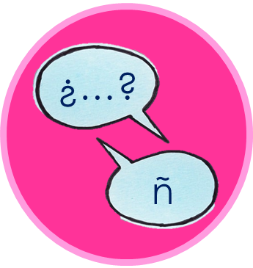
hablar y escuchar
¡A hablar 💬!
una botella
Persona A: Round 1
Persona B: Round 1
1. ___ _____ a bottle.
 | Which verb?
1
I have
Tengo…
Tienes…
Person A says: una botella
Tengo una botella.
Person B hears ‘una botella’ and replies with the full sentence, using either tengo or tienes.
Person A writes the missing sentence beginning in English.
Notes:
Timing: 12 minutes (3 minutes for modelling, 7 minutes for the task, 2 minutes for answers)
Aim: to model the speaking task.
Procedure:
1. Click to model each step and explain it. 2. Then give out the handouts. (two slides at the end of the presentation)

Slide 11
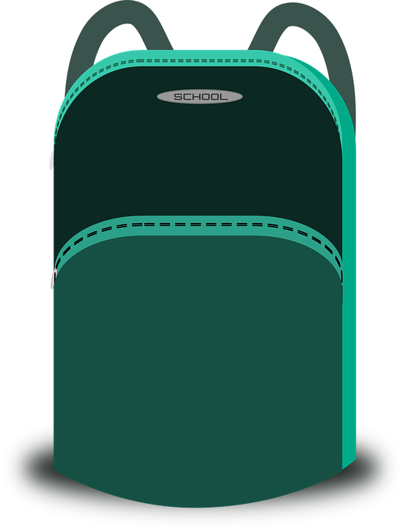
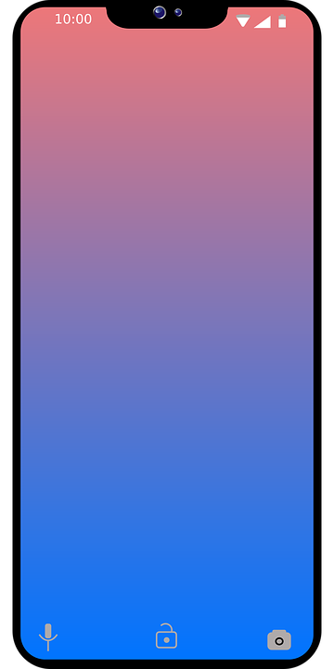
hablar y escuchar
Corrige las respuestas ✅.
Check your answers.
Persona A: Round 1
Persona B: Round 1
1. ___ _______ a book.
2. ___ _______ a question.
3. ___ _______ a sharpener.
4. ___ _______ a pencil case.
5. ___ _______ a phone.
I have
un libro
1
2
3
4
5
Tengo…
Tienes…
una pregunta
Tengo un libro.
I have
?
Tengo una pregunta.
You have
un sacapuntas
Tienes un sacapuntas.
I have
un estuche
Tengo un estuche.
You have
un teléfono
Tienes un teléfono.
Notes:
DO NOT DISPLAY DURING THE TASK Timing: 1 minute
Aim: to give feedback to all pupils on Round 1.
Procedure:
Elicit the half sentence for number 1 from A pupils. Click to reveal.
Elicit the corresponding full sentence for number 1 from B pupils.
Click to confirm the full sentence in Spanish and A’s sentence beginning in English.
Continue for items 2 – 5.
Then go to the next slide to give feedback on Round 2.

Slide 12
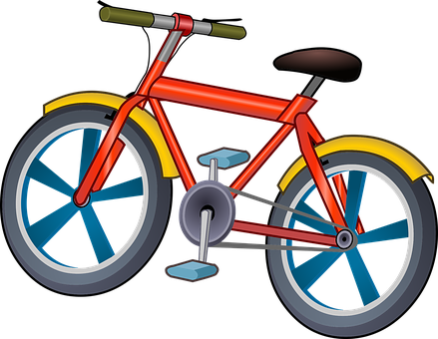
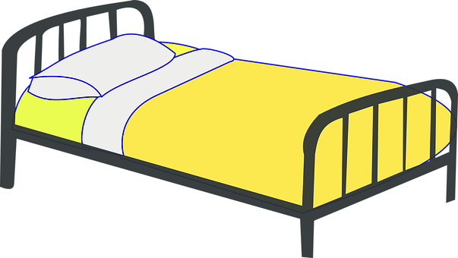
hablar y escuchar
Corrige las respuestas ✅.
Check your answers.
Persona B: Round 2
un estuche
Persona A: Round 2
1. ___ _______ a pencil case.
2. ___ _______ a male friend.
3. ___ _______ a bottle.
4. ___ _______ an answer.
5. ___ _______ a bike.
1
2
3
4
5
You have
Tengo…
Tienes…
Tienes un estuche.
You have
un amigo
Tienes un amigo.
I have
una botella
Tengo una botella.
You have
una respuesta
Tienes una respuesta.
I have
una bici
Tengo una bici.
Notes:
DO NOT DISPLAY DURING THE TASK Timing: 1 minute
Aim: to give feedback to all pupils on Round 2.
Procedure:
Elicit the half sentence for number 1 from A pupils. Click to reveal.
Elicit the corresponding full sentence for number 1 from B pupils.
Click to confirm the full sentence in Spanish and A’s sentence beginning in English.
Continue for items 2 – 5.

Slide 13
¡adiós!
rojo

Slide 14
handout
¡A hablar!
Persona A: Round 1
Persona A: Round 2
1. ___ _______ a book.
2. ___ _______ a question.
3. ___ _______ a sharpener.
4. ___ _______ a pencil case.
5. ___ _______ a phone.
1
2
3
4
5
Tengo…
Tienes…
Notes:
Person A handout

Slide 15
Handout
¡A hablar!
Persona B: Round 1
Persona B: Round 2
1
2
3
4
5
1. ___ _______ a pencil case.
2. ___ _______ a male friend.
3. ___ _______ a bottle.
4. ___ _______ an answer.
5. ___ _______ a bike.
Tengo…
Tienes…
?
Notes:
Person B handout

